Slide 1

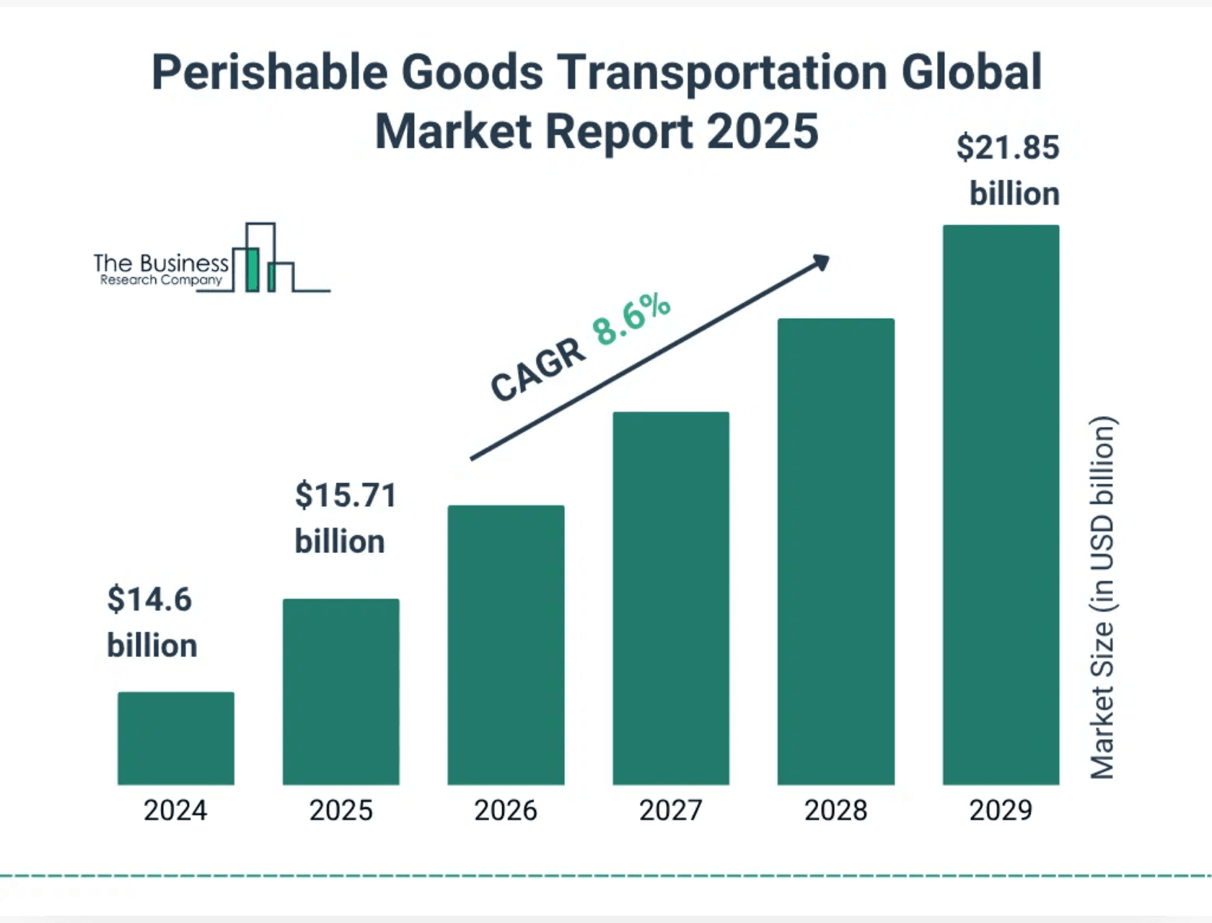
Next-Generation Solution
AI-driven decay analysis and shelf-life prediction for perishable goods
Optimizing Inventory, Reducing Waste, and Maximizing Revenue

Slide 2

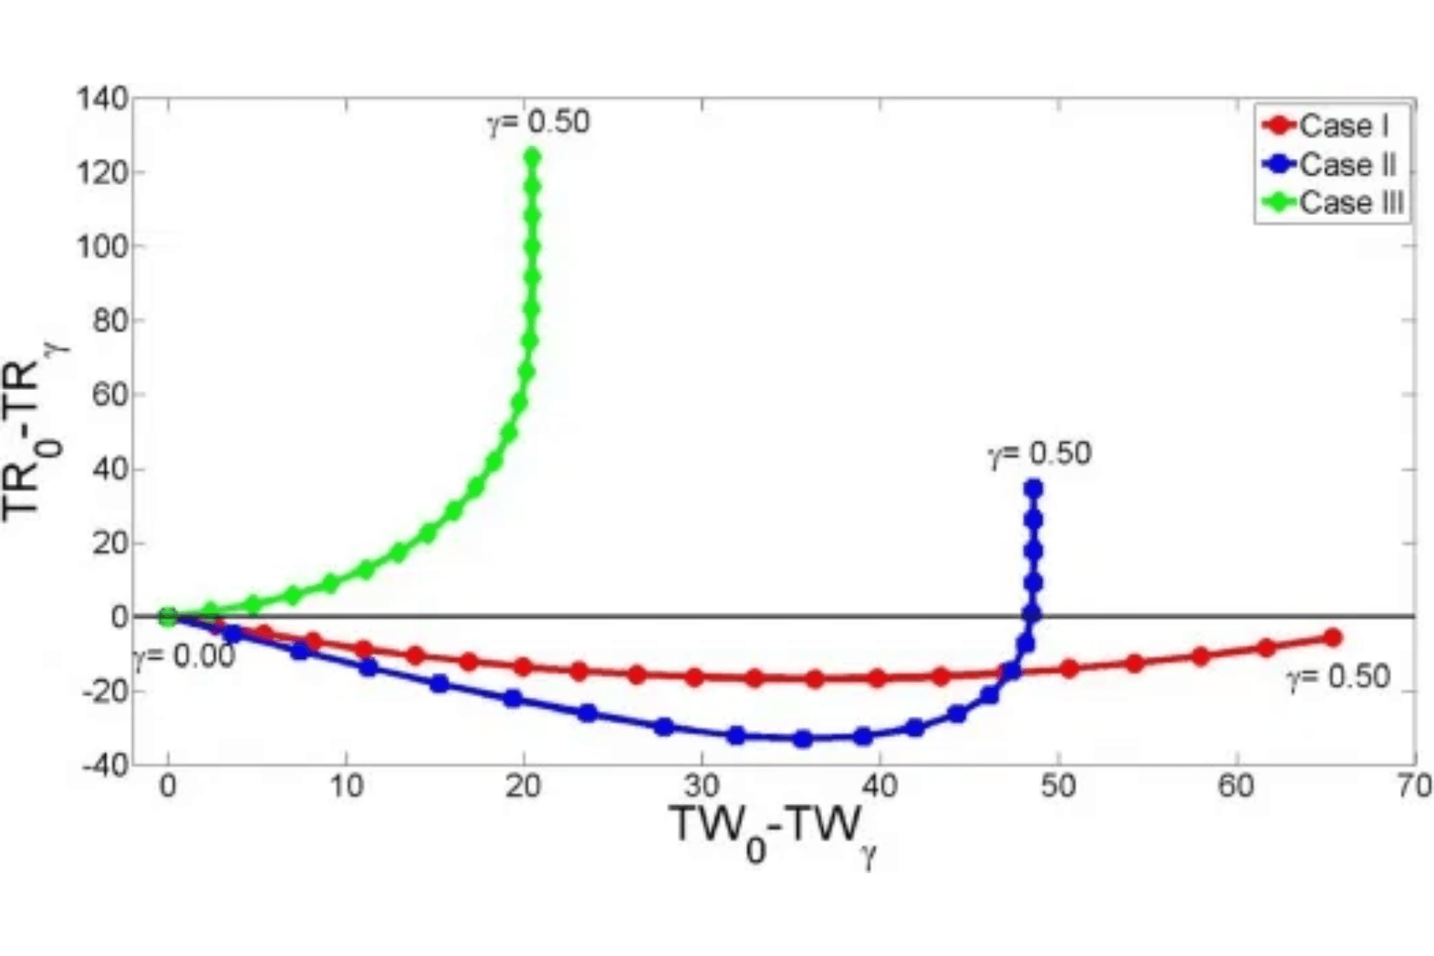
The Problem
Perishable inventory management suffers from reliance on fixed expiry dates, leading to significant financial losses.
1
Unreliable Expiry Dates
Traditional fixed dates fail to account for environmental variability and handling practices.
2
Heterogeneous Decay Rates
Decay rates are heavily influenced by temperature, humidity, and logistics, leading to unpredictable spoilage.
3
Financial Impact
Chronic overstocking, high spoilage rates, and substantial losses for retailers.
4
Operational Challenges
Lack of real-time decay insights prevents optimization of storage costs and markdown strategies.

Slide 3

Our Understanding
The core challenge is the lack of a dynamic prediction mechanism that captures the true state of perishable goods.
1
2
Dynamic Prediction Gap
Data-Driven Necessity
Traditional methods cannot dynamically predict spoilage, hindering proactive inventory management.
A data-driven AI solution is required to move beyond static dates and predict spoilage dynamically.
3
4
Proactive Decision Making
Key Objective
Dynamic prediction enables proactive decisions: re-routing inventory, adjusting storage, and implementing timely markdowns.
Create a system providing real-time decay scores for waste reduction and optimized pricing.

Slide 4
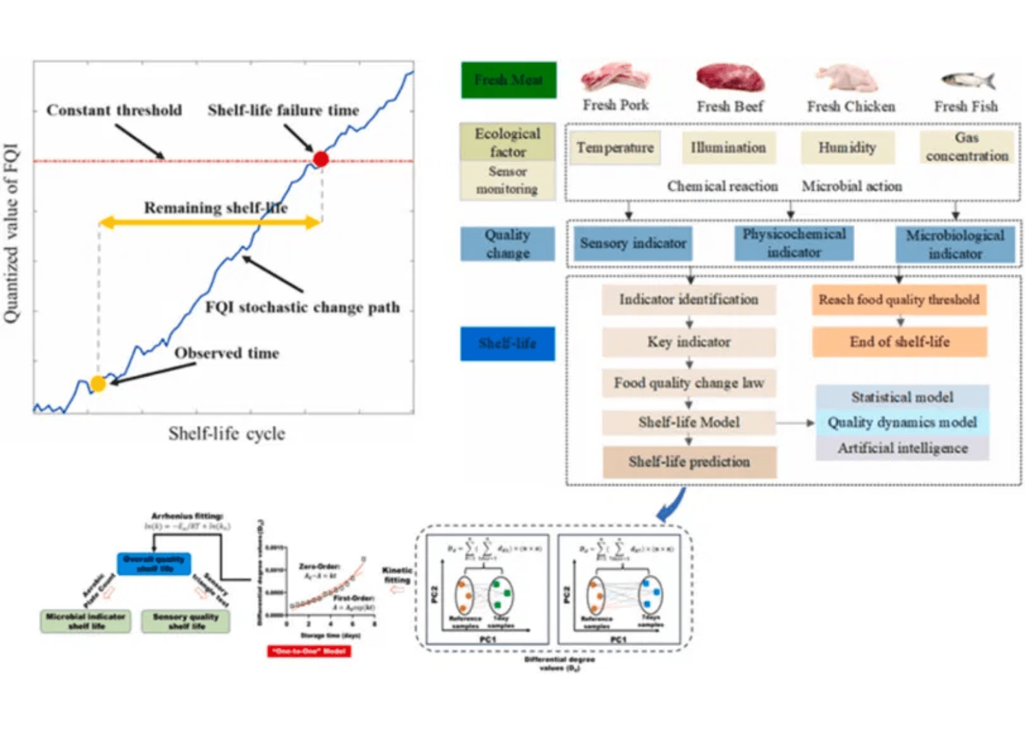
The AI Solution
The platform provides dynamic decay prediction and shelf-life estimation to optimize the supply chain.
1
Decay Prediction Model
Utilizes an ML ensemble (XGBoost/Gradient Boosting) to generate a real-time Decay Prediction Score for every batch.
2
Shelf-Life Estimation
Employs Weibull Survival Analysis to provide estimated remaining shelf life with confidence intervals.
3
Smart Alerts
LLM-enhanced contextual alerts notify staff of at-risk inventory, enabling immediate intervention.
4
Price Optimizer
Dynamically recommends markdown strategies to maximize revenue and minimize waste before spoilage occurs.

Slide 5
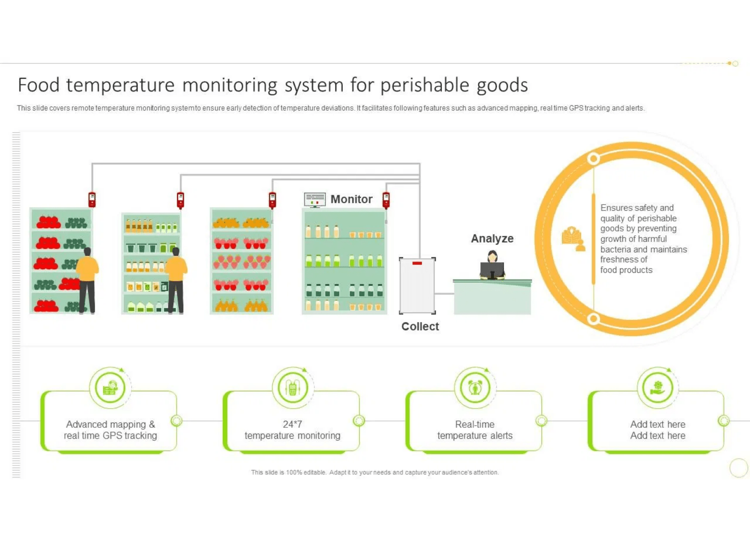
Data & Insights
The solution is powered by a comprehensive, real-time data pipeline from diverse sources.
1
Environmental Data
IoT sensors capture real-time temperature, humidity, light exposure, and air quality during storage and transit.
2
Visual Data
Computer vision analysis of images detects early signs of spoilage (color changes, mold) for continuous monitoring.
3
Product & Logistics Data
Product metadata (type, packaging, initial freshness) and logistics data (transit time, handling frequency) provide critical context.
4
Data Quality & Scale
System designed for real-time ingestion and edge processing, utilizing synthetic datasets for robust model training.

Slide 6
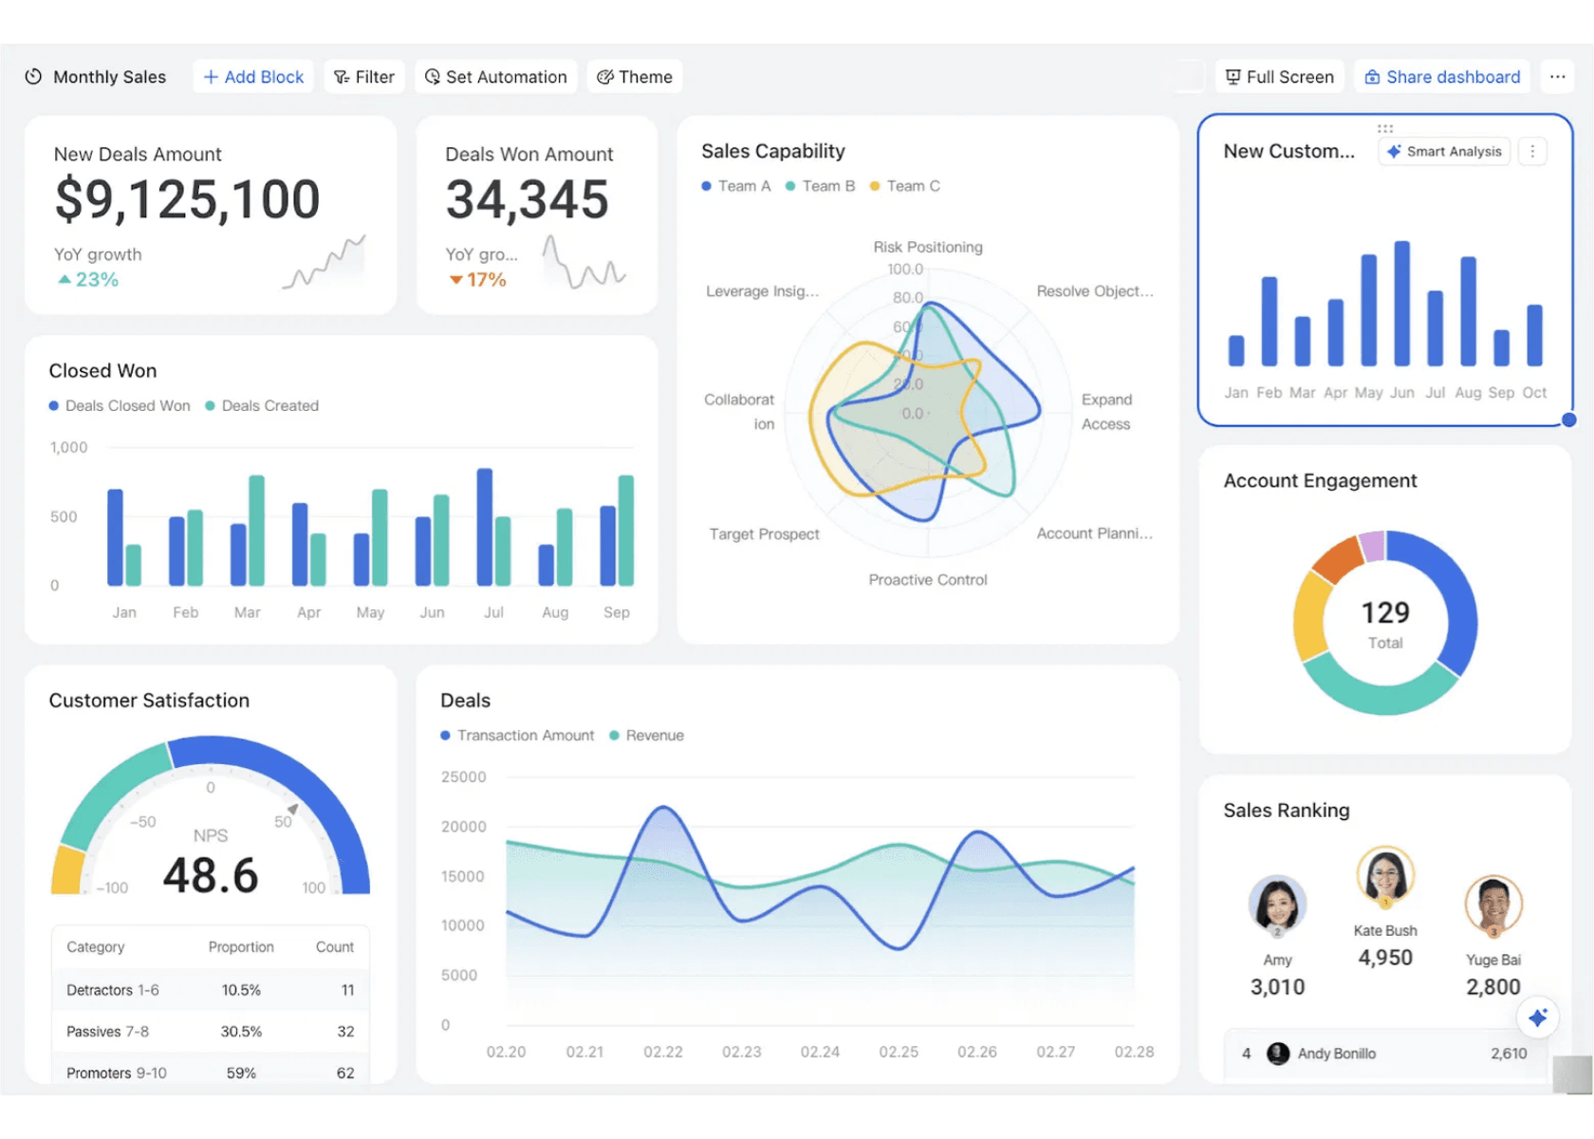
Expected Output
A comprehensive AI platform delivering actionable insights for inventory and pricing management.
1
Core Deliverables
Production-ready platform providing decay prediction scores and estimated shelf life.
2
Dynamic Alerts
Real-time, dynamic alerts for inventory managers to flag high-risk batches immediately.
3
Integrated Dashboards
Visual dashboards for tracking spoilage trends, inventory health, and prediction accuracy.
4
Business Impact
Enables dynamic pricing, waste reduction, and optimized inventory across retail and supply chain.

Slide 7
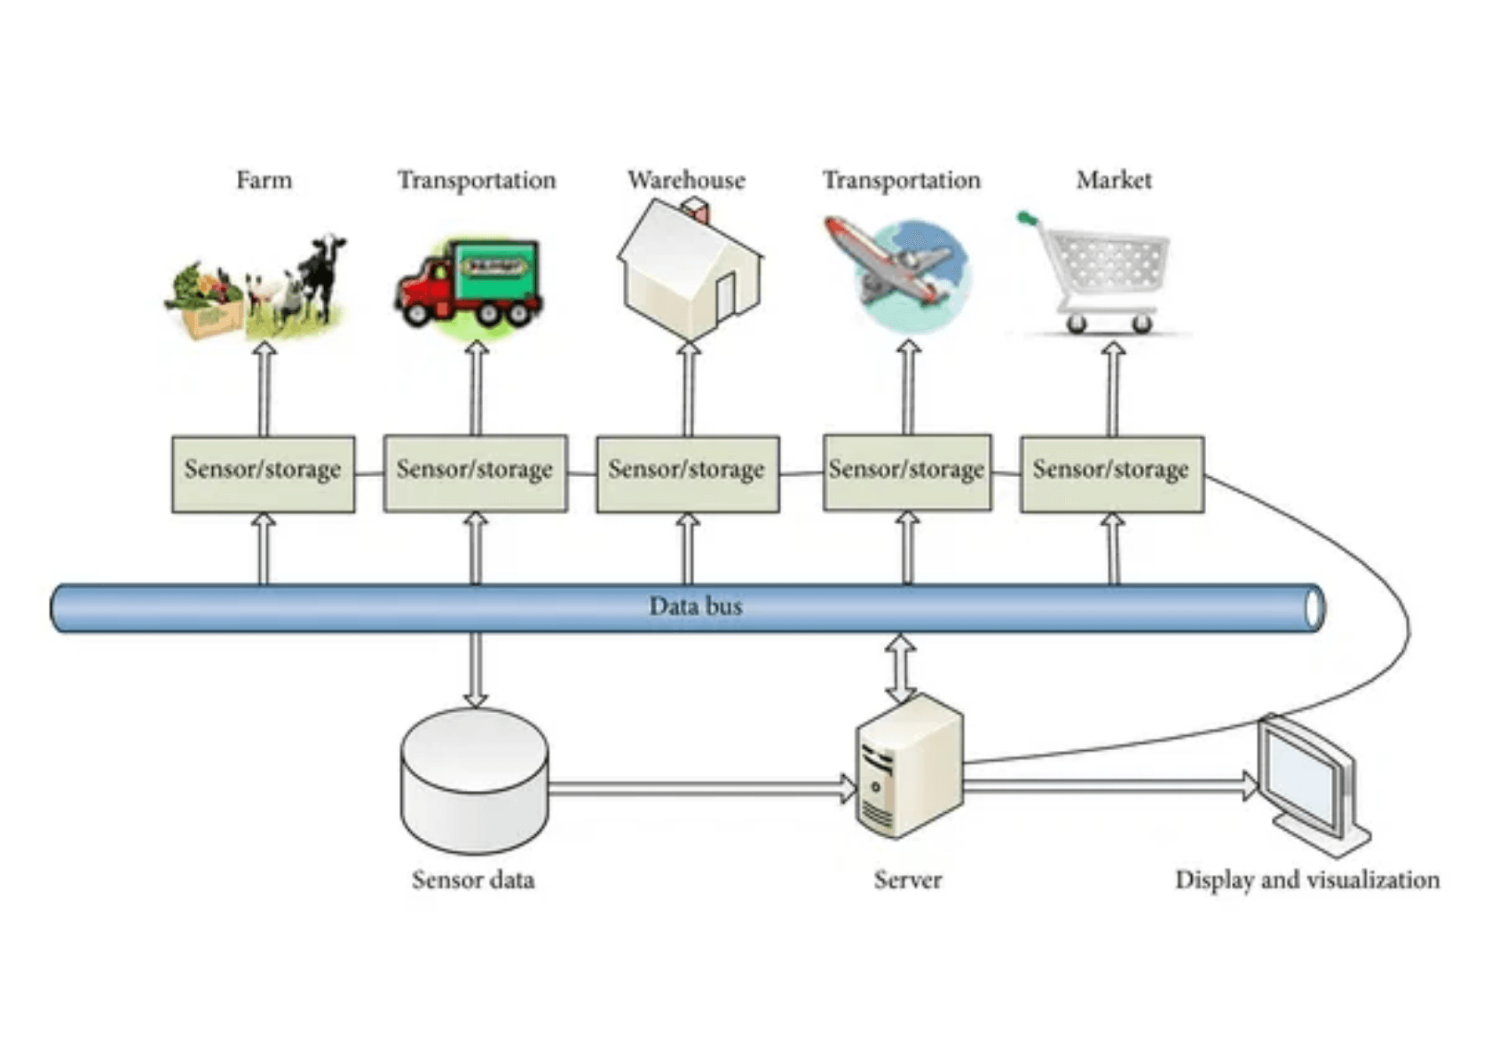
Solution Architecture
Tier 1
Frontend (React)
User-facing interface providing interactive dashboards and management tools.
Dashboard
Inventory
Alerts
Assistant
↓
Tier 2
Backend (FastAPI)
REST API Layer: /predictions, /inventory, /alerts, /analytics, /voice
Services Layer:
DecayPredictor
ShelfLifeEstimator
PriceOptimizer
AlertEngine
VoiceService
LLMService
Data Layer: SQLite Database
Products
Batches
Sensors
Predictions
Alerts
↓
Tier 3
LLM Service (Ollama / API)
Local: qwen2.5:7b | External: Azure/OpenAI Compatible

Slide 8


Thank You
Q&A and Next Steps
Roadmap to Success
1
2
Pilot Deployment
Data Collection
Deploy the platform in a controlled environment with selected retail partners for real-world validation.
Gather IoT sensor data, visual imagery, and historical decay patterns across product categories.
3
4
Model Validation
Scale & Optimize
A/B testing of prediction accuracy and markdown strategies against baseline methods.
Expand deployment across retail and supply chain networks with continuous improvement.
Questions? Let's discuss how AI-driven decay analysis can transform your supply chain.

