Slide 1
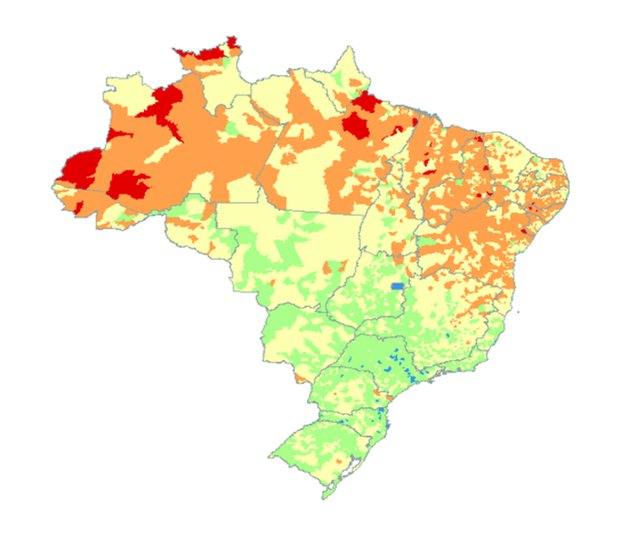
HUMAN DEVELOPMENT INDEX IN BRAZIL: ANALYSIS OF FACTORS INFLUENCING RESULTS
Paulo Bernardocki
2019-01-12

Slide 2
Introduction/Business Problem
This report is intended to different levels of government audiences in Brazil, from municipality to country level. It intends to explore the effect of different demographic and economical data on the Human Development Index (HDI), for each municipality in the country. There are more than 5,000 municipalities in Brazil.
Demographic, Infrastructure and Economic data will be correlated

Slide 3




Data Sources
Business Venues
Human Development Index
Per Capita Index and Population
Cellular Towers

Slide 4
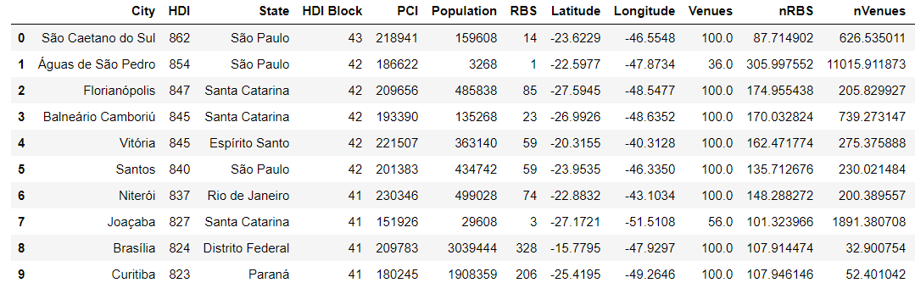
Dataframe

Slide 5
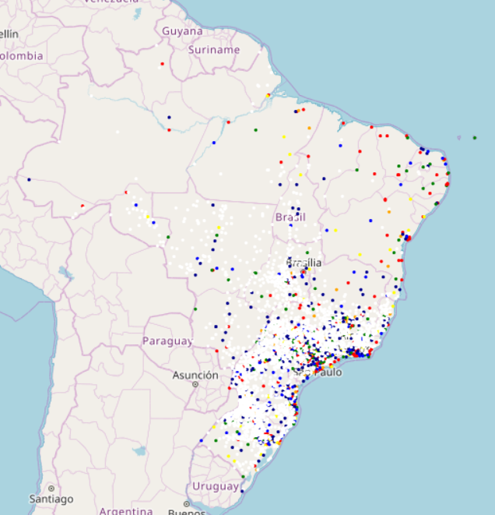
Exploratory Data Analysis (1/3)
Concentration of economic activity towards the southeast of the territory
Also closer to the coast in comparison to the interior

Slide 6
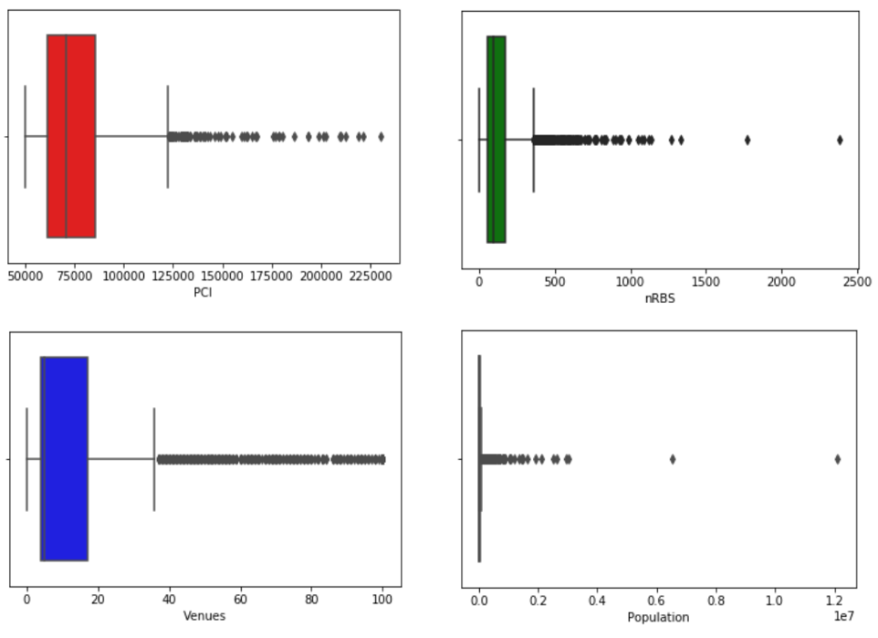
Exploratory Data Analysis (2/3)
Outliers Removal
Venues: removed values above 80
Population: removed values below 1k and above 300k inhabitants
PCI: removed values above 150k

Slide 7
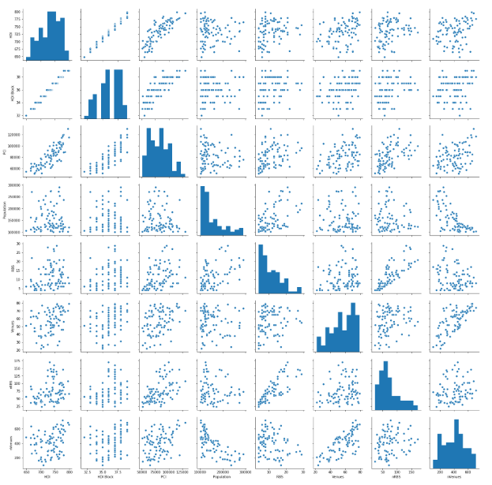
Exploratory Data Analysis (3/3)
With the removal of outliers, the data become more evenly distributed
Healthy variability of the atributes
PCI demonstrates higher correlation

Slide 8
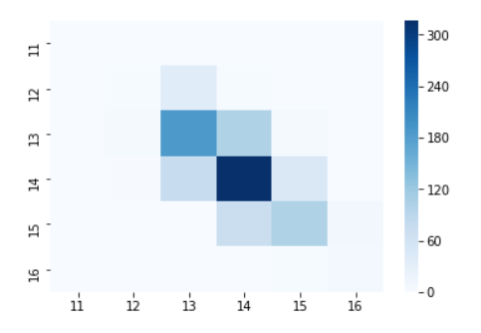
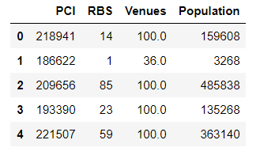
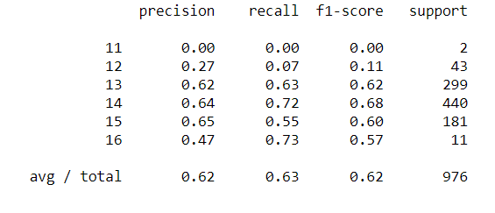
Data Analysis: kNN Classification
The result in the range of 60-65% was considered good,
However in this case it is excpected that a linear regression provides better results

Slide 9
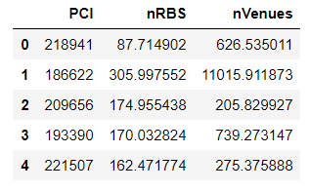
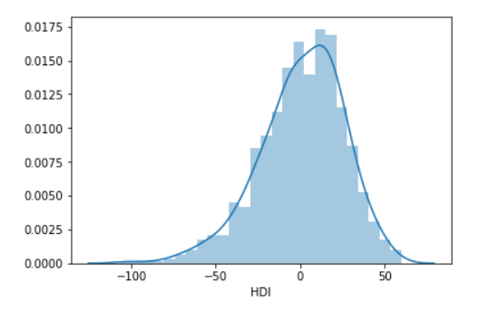


Data Analysis: Linear Regression
Good result: error is low and have a normal distribution.
Parameters in the same range indicates relevance between attributes

Slide 10
Conclusion
The usage of demographic, infrastructure and economic variables successfully predicted the behavior of the Human Capital Index across Brazil.
It was noted that the Per Capita Income has a relevant role in this calculation, balanced with the infrastructure proxy (number of Radio Base Stations for cellular service) as well as the economic proxy (the number of business venues in each city) has also a role in this calculation.

