Slide 1

INVESTOR OVERVIEW
Living microgreens,
grown in Madrid.
Precision hydroponics · Live, made-to-order harvest · Zero food miles
OCTOBER 2026

Slide 2


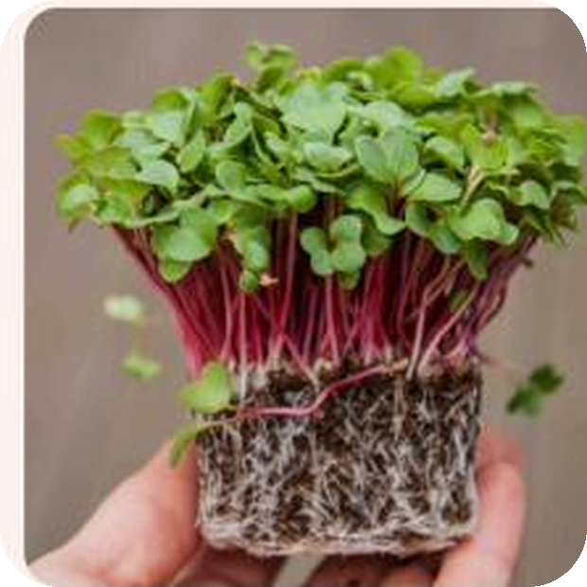
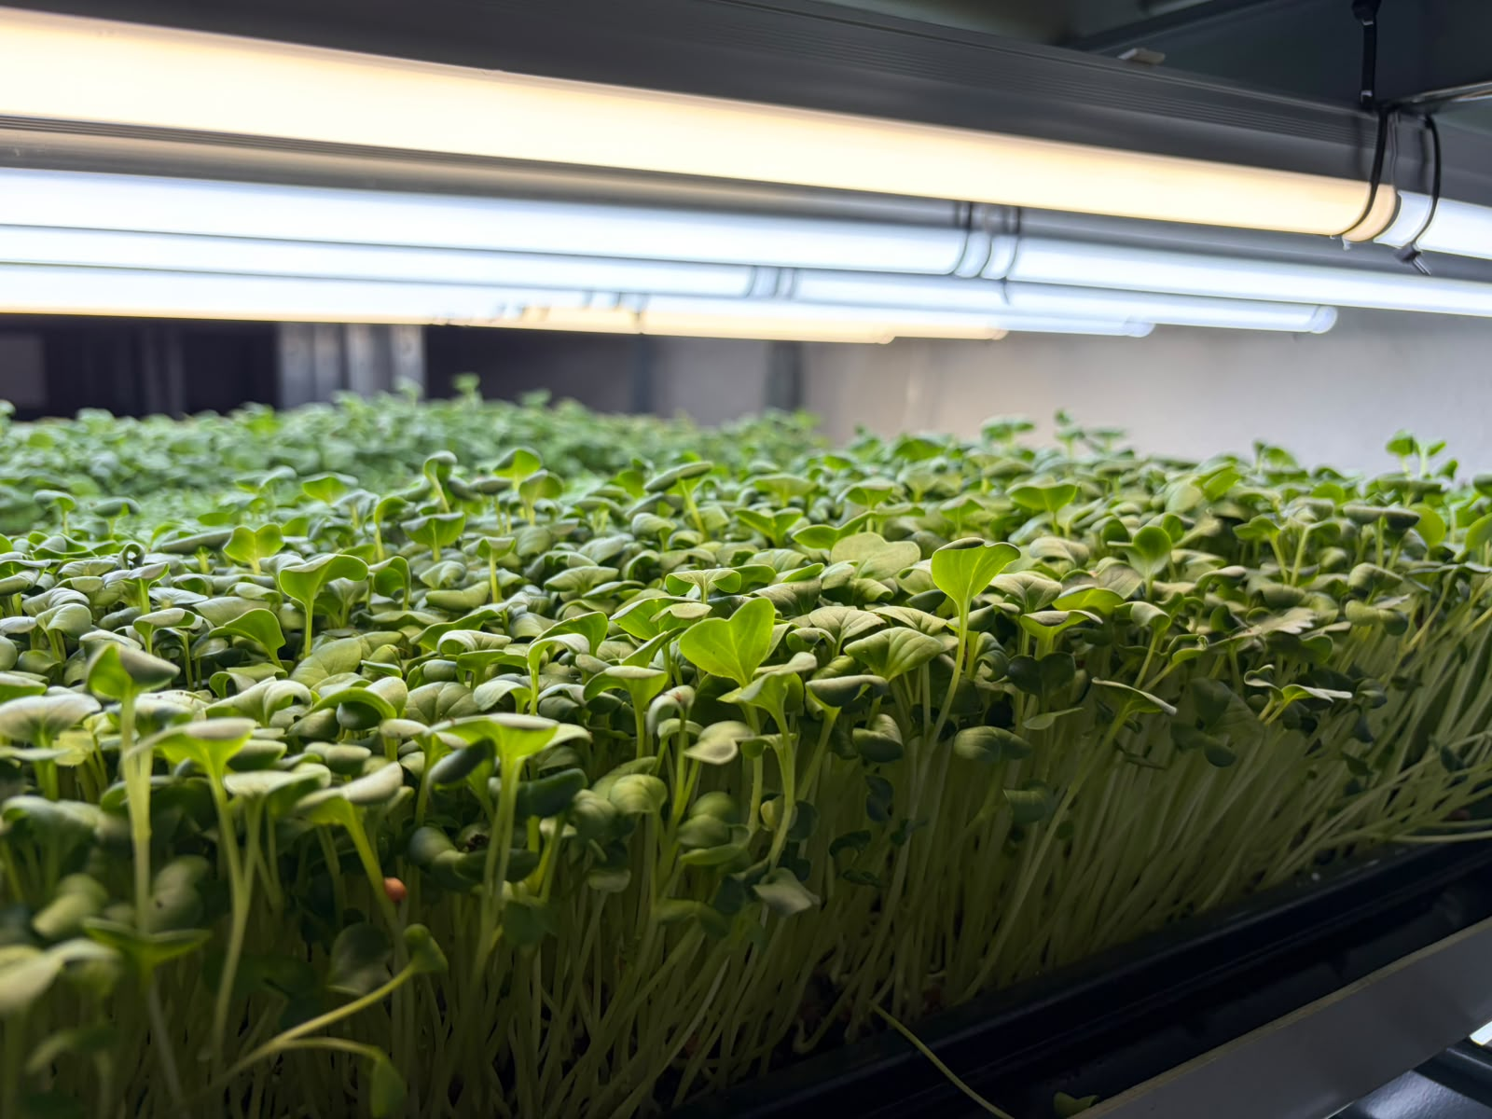
ABOUT US
WHO WE ARE
We grow like artisans.
We operate like a company.
Rootflow Hydroponics was founded in Madrid in 2026 with a simple idea: to bring professional kitchens living microgreens at their peak, hours after harvest.
We grow with precision LED hydroponics and harvest only to order, for distributors, wholesalers, and foodservice. No inventory, no waste, always made to order.
LOCAL
14+
24–48 h
100%
GROWN IN MADRID
VARIETIES IN PRODUCTION
HARVEST TO DELIVERY
CUSTOM TO EACH CLIENT
ROOTFLOW HYDROPONICS · MADRID · rootflow.es
Living, gourmet, locally grown.

Slide 3
MARKET CONTEXT
THE MARKET
A young category growing double digits*.
Microgreens are no longer a fine-dining curiosity: it's a ~$3B global category set to double this decade — and Europe leads the market.
~$3B
GLOBAL MARKET
2025
2×
PROJECTED SIZE
2031
— HEALTH
Microgreens pack up to 40× more nutrients than their mature counterparts.
— PROXIMITY
+11%
ANNUAL GROWTH (CAGR)
~36%
EUROPE'S SHARE
Consumers and chefs reward local, fresh, sustainable produce — the heart of zero food miles.
— TECHNOLOGY
Indoor vertical farming is the fastest-growing format in the category (12.5% per year).
Rootflow sits right where these trends meet: premium microgreens, vertical farming, and zero food miles.
* Sources: Mordor Intelligence, Microgreens Market Report (Jan. 2026) · Grand View Research, Microgreens Market Analysis (2023).
ROOTFLOW HYDROPONICS · MADRID · rootflow.es
Living, gourmet, locally grown.

Slide 4
BENCHMARK CASE
THE SECTOR IS ALREADY FUNDED
Tierra raises €400,000 with ENISA.
Tierra is the closest direct comparable to Rootflow: microgreens and precision agriculture in Madrid, with proprietary crop-control software. It just closed a €400,000 round backed by ENISA, Spain's state innovation lender.
The funds go to expanding capacity, developing two patents, and advancing its software. Their case confirms ENISA funds exactly this profile of company — in our market, right now.
Rootflow competes with its own edges: a custom ERP already in production, a zero-inventory model that's hard to replicate, and direct sales to high-margin foodservice.
€400K
ROUND SIZE
ENISA
PUBLIC BACKING
Madrid
SAME MARKET
+2
OWN PATENTS
Already operating in Spain: Cangarus · Fronda · Groots · Tugas · Massa Greens. The market is active and proven.
ROOTFLOW HYDROPONICS · MADRID · rootflow.es
Proven market, capital available.

Slide 5



THE TEAM
WHO WE ARE
Three founders, three fronts covered.
Pedro Domecq Vergara
Nicolás Bustamante Thams
Domingo de Guzmán Greus
ADMINISTRATION & FINANCE
SALES & HOSPITALITY
PRODUCTION & AGRONOMY
BBA (ICADE)
Background in strategy consulting and M&A. Leads finance, administration, and corporate structure.
BBA (Richmond University)
Background in foodservice business development. Manages restaurant and distributor relationships and market entry.
Agricultural Engineer (UPM)
Trained in AI- and Arduino-based greenhouse automation. Leads cultivation, variety R&D, and production operations.
ROOTFLOW HYDROPONICS · MADRID · rootflow.es
Living, gourmet, locally grown.

Slide 6
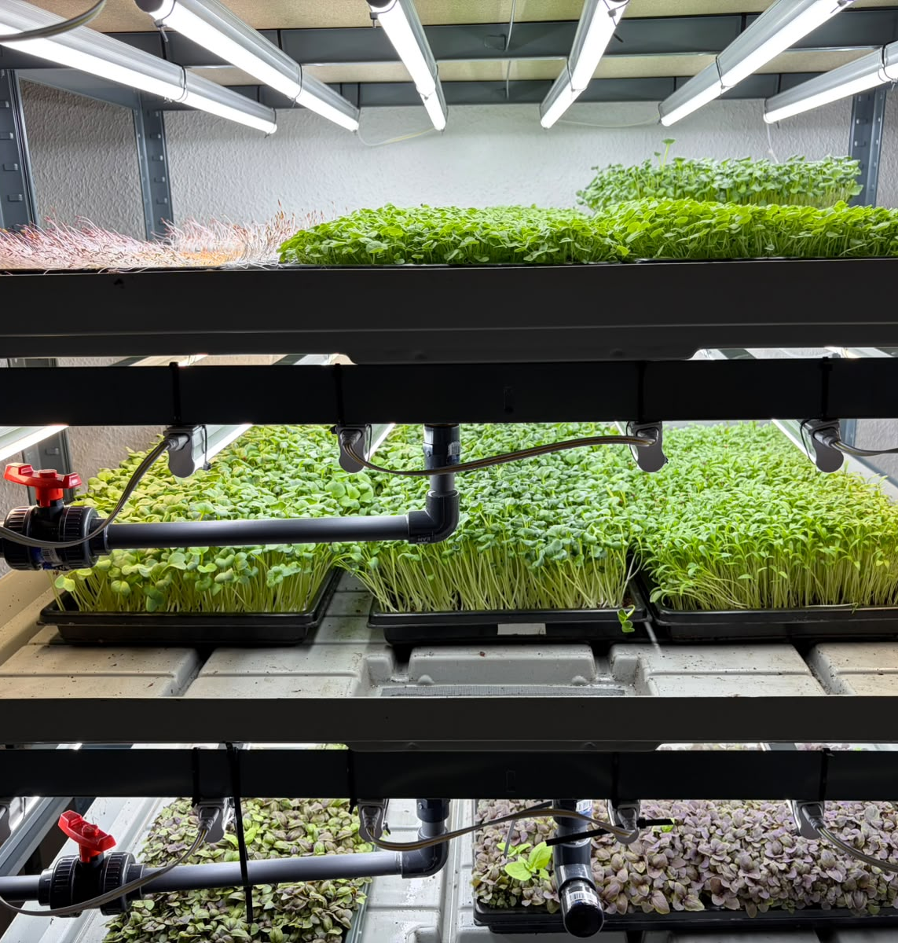
PRODUCT
WHAT WE DO
A few grams.
Huge value.
Ultra-fresh microgreens and edible flowers, harvested at their exact peak of flavor, aroma, and color. Low weight, extremely high value: a few grams transform a dish — and the perception of an entire menu.
14 + 5 varieties in production, with five more in development
5–100 g any portion: live tray, bulk, or single-serve
6–10 days of shelf life by variety, thanks to live harvest
ROOTFLOW HYDROPONICS · MADRID · rootflow.es
Living, gourmet, locally grown.

Slide 7
VALUE PROPOSITION
WHY ROOTFLOW
Gourmet produce, close to home,
no shortcuts.
I — ORIGIN
II — SCALE
True zero-mile
Agile structure
Grown and delivered in Madrid. A freshness imported or long-haul produce simply can't match.
Fast decisions and made-to-order production: the agility of a small, specialized team.
III — PROXIMITY
IV — HARVEST
Direct source
Live harvest
Deal directly with the grower: instant response, transparency, and real control over sourcing.
The product arrives alive and keeps growing. Aroma, color, and texture intact until plating.
ROOTFLOW HYDROPONICS · MADRID · rootflow.es
Living, gourmet, locally grown.

Slide 8
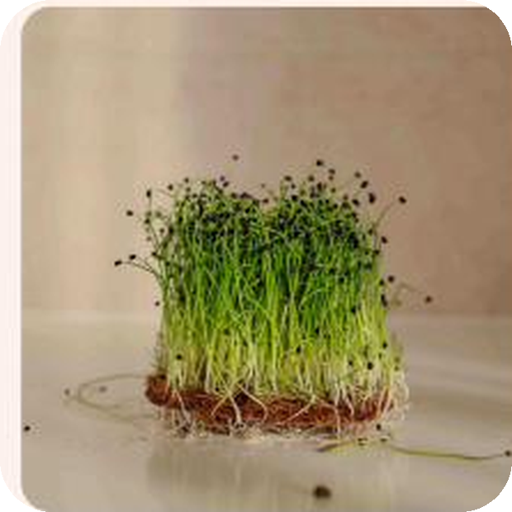
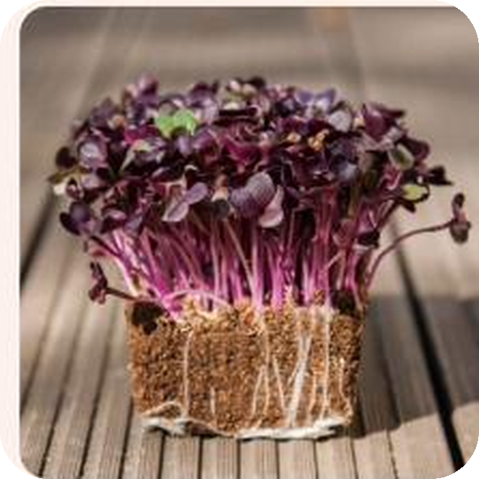
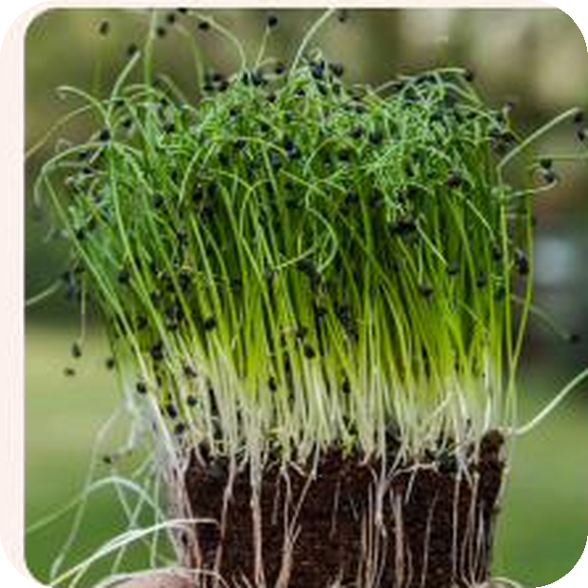
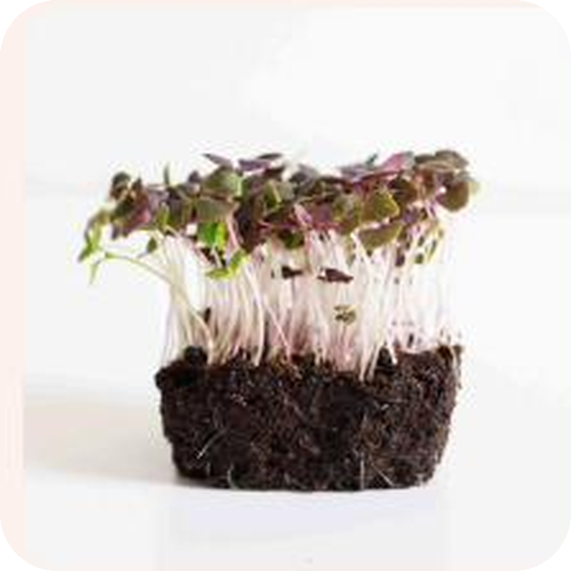
THE RANGE
VARIETIES IN PRODUCTION
14 varieties. And whatever the market wants.
01 Cilantro · Coriandrum sativum
08 Daikon Radish · Raphanus sativus
02 Fennel · Foeniculum vulgare
09 Purple Basil · Ocimum basilicum
03 Red Radish · Raphanus sativus
10 Red Beet · Beta vulgaris
04 Pea · Pisum sativum
11 Barbra Onion · Allium cepa
05 Yellow Beet · Beta vulgaris
12 Red Giant Mustard · Brassica juncea
06 Genovese Basil · Ocimum basilicum
13 Pink Radish · Raphanus sativus
07 Chinese Chives · Allium tuberosum
14 Red Amaranth · Amaranthus tricolor
+5 in development for a co-developed micro-mix · the range grows with every client.
ROOTFLOW HYDROPONICS · MADRID · rootflow.es
Living, gourmet, locally grown.

Slide 9




MODEL
HOW WE DO IT
Live harvest, zero inventory.
Made to order
LED hydroponics
Total flexibility
Private label
We cut when you order. We produce exactly what will be consumed: zero inventory, zero waste, maximum freshness.
Soil-free, pesticide-free cultivation in controlled conditions. Same quality and size, 52 weeks a year.
From 5 to 100 g; live tray, bulk, or single-serve. Format, cut point, and blends tailored to each client.
Your label on our product. The distributor brings the brand; we bring the quality and consistency.
ROOTFLOW HYDROPONICS · MADRID · rootflow.es
Living, gourmet, locally grown.

Slide 10
PROCESS
HOW WE PRODUCE
From order to plate, in six steps.
01 Order
02 Sowing
03 Blackout
The client sets variety, format, and date. We produce against real demand, not forecasts.
Tray by tray, on clean substrate at a density calibrated per variety.
Germination in blackout (3–7 days) for a uniform, vigorous sprout.
04 Light
05 Harvest
06 Delivery
Growth under LED, with controlled irrigation and climate (2–13 days by variety).
Live-cut at the perfect point — or delivered as a living tray, uncut.
Within 24–48 h in Madrid, custom-labeled and traceable by batch.
The entire cycle is logged in our ERP: every tray is traceable from seed to delivery.
ROOTFLOW HYDROPONICS · MADRID · rootflow.es
Living, gourmet, locally grown.

Slide 11
OPERATIONS
PRODUCTION & CAPACITY
We know what we produce, down to the gram.
Every variety has its cycle — blackout germination and growth under light — and a per-tray yield we measure and log. That discipline lets us commit to volumes and dates with full reliability.
VARIETY
CYCLE (BLACKOUT + LIGHT)
ROTATION
YIELD
Radish · short cycle
3 + 3 days
10 cycles/mo
245 g / tray
Cilantro · medium cycle
5 + 10 days
3 cycles/mo
145 g / tray
Basil · long cycle
5 + 13 days
2.3 cycles/mo
90 g / tray
Estimate based on 96 trays under light simultaneously (3 towers, 14.4 m² of growing surface) · planned variety mix · yields measured in production.
Current capacity: ~120 kg/mo with a commercial variety mix · peak of ~240 kg/mo in short-cycle monoculture
ROOTFLOW HYDROPONICS · MADRID · rootflow.es
Living, gourmet, locally grown.

Slide 12

TECHNOLOGY
PROPRIETARY SYSTEM
A custom ERP,
built from scratch.
ROOTFLOW ERP
Orders
OF THE WEEK
Production
BY TRAY
We didn't adapt off-the-shelf software: we built our own ERP. Orders, production, traceability, and invoicing live in a single system designed around how we work. And the next step is already mapped: once the facility adds climate and irrigation sensors, that data will flow straight into the system.
Traceability
BY BATCH
Stock
ESTIMATED
Orders, clients, and invoicing in a single flow
React · Supabase · real-time data. Runs the business today; the crop tomorrow.
Production planning and batch-level traceability
25,000+
LINES OF CODE
Estimated stock and real yield by variety
Ready to connect the facility's sensors
ROOTFLOW HYDROPONICS · MADRID · rootflow.es
Living, gourmet, locally grown.

Slide 13
TRACTION
WHERE WE ARE TODAY
Small, but already earning.
We operate from a 58 m² space in Madrid with three growing towers in continuous production. A compact, efficient base already generating recurring revenue.
ALREADY CO-DEVELOPING
Exclusive micro-mix
58 m²
3
2
An exclusive blend for one of our distributors, adding 5 new varieties to the range.
Co-development isn't a promise: we're already doing it.
CURRENT SPACE
TOWERS RUNNING
PAYING CLIENTS
ACTIVE CLIENTS
Two distributors with recurring weekly orders, one of them with a consignment deal underway at Mercamadrid, Madrid's wholesale market.
ROOTFLOW HYDROPONICS · MADRID · rootflow.es
Living, gourmet, locally grown.

Slide 14
ROADMAP
THE PATH
From idea to group, in six milestones.
WHERE WE COME FROM
WHERE WE ARE
WHERE WE'RE HEADED
00
01
02
03
04
05
Done
Done
In progress
Next
Next
Next
Incorporate
Validate
Finance
Scale
Diversify
Consolidate
Company formed; 58 m² facility live.
MVP validated; 2 recurring distributors.
Break-even, stable book, round closed.
Facility live, 2 big clients, first hire.
New lines and acquisitions, cash stable.
Group or holding with Rootflow as OpCo.
The know-how is already in hand: product, clients, ERP, and operations proven before raising a single dollar.
ROOTFLOW HYDROPONICS · MADRID · rootflow.es
Living, gourmet, locally grown.

Slide 15
ROADMAP · MILESTONE 3
WHERE WE'RE HEADED
The leap: from 58 m² to a 350 m² facility.
In 3–6 months we move production to a 350 m² facility in southern Madrid. Three large-format racks add 2,880 light positions and take growing surface from 14.4 m² to 432 m².
Growing capacity multiplies by 30. At full run-rate, the plan projects ~3,100 kg per month: enough volume to serve distribution at scale and supply restaurants in our hot zones, while keeping the live, made-to-order model.
Growth funded by the round plus a working-capital line; the facility is leased to avoid tying up capital.
350 m²
FACILITY · SOUTH MADRID
432 m²
GROWING SURFACE
30×
CAPACITY VS. TODAY
~3,100 kg
PER MONTH · RUN-RATE
Designed to automate in phases: climate and irrigation sensing and control, with real-time data flowing into our ERP.
ROOTFLOW HYDROPONICS · MADRID · rootflow.es
Orderly growth, financed with discipline.

Slide 16
BUSINESS MODEL
TWO BUSINESS LINES
One facility, two ways to sell.
LINE 1 · DISTRIBUTION
€1.38M
REVENUE · YEAR 5
LINE 2 · RESTAURANTS
€345K
REVENUE · YEAR 5
Volume
Margin
Distributors, retail and Mercamadrid: identified clients and new accounts.
Wholesale price list: €44/kg on average.
Own van in Madrid; Athos for the rest of Spain.
123 restaurants across 8 hot zones in Madrid.
Two orders a week · average ticket of €28.93.
Delivered by 2 riders from a refrigerated microhub.
Restaurant price list: €173/kg on average.
YEAR 5 · BASE CASE
Distribution
Restaurants
× 4.4 margin per kilo
restaurants €120/kg vs €27/kg in distribution, after delivery and acquisition
Kilos sold
95%
5%
Revenue
80%
20%
The lever: the share of the facility sold to restaurants comes out of distribution. Output doesn't grow: it sells better.
ROOTFLOW HYDROPONICS · MADRID · rootflow.es
Volume and margin, from the same facility.

Slide 17
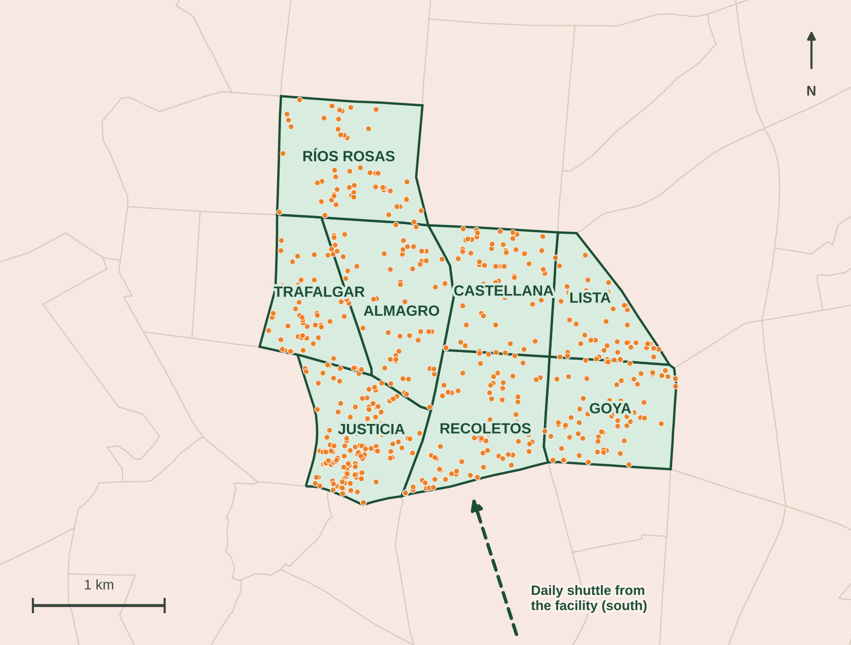
RESTAURANT DELIVERY
HOT ZONES
Eight neighborhoods, one microhub, two riders.
OPEN RESTAURANTS BY NEIGHBORHOOD · CITY CENSUS
Justicia
140
Recoletos
92
Castellana
69
Goya
64
Trafalgar
62
Almagro
57
Ríos Rosas
54
Lista
47
585 restaurants across the 8 zones, plus 714 bar-restaurants we don't count.
Refrigerated microhub inside the zone · two orders a week to every restaurant.
123
TARGET RESTAURANTS
1 IN 5 IN THE ZONE
~40
DELIVERIES A DAY
2 RIDERS · 7 PER HOUR
€4.4
LAST MILE PER ORDER
15% OF THE TICKET
Source: Madrid City Council premises and activities census (datos.madrid.es), open premises under code 561001 Restaurant, Oct. 2026. Target and delivery: financial model V17, base case, year 5.
ROOTFLOW HYDROPONICS · MADRID · rootflow.es
Living, gourmet, locally grown.

Slide 18
THE ROUND
WHAT WE'RE RAISING
We're raising €100,000 to make the leap.
CAPITAL STACK
INVESTOR RETURN · BASE CASE
PRIVATE INVESTOR · equity, 10%
€100,000
51%
5.2×
Year 4
ENISA AGROINNPULSO · loan in process
€100,000
ANNUAL IRR
MOIC
EXIT HORIZON
TERMS · INVESTOR TRANCHE
TOTAL RAISED
€200,000
Equity investment: 10% of the company for €100,000 · exit right agreed from year 4 · 1.5× downside floor on the amount invested · no personal guarantee · founders keep 90% and control.
Covers the plan's €173,048 need · 1.16× coverage
Why equity: ENISA requires equity at least equal to its loan, so the private tranche comes in as equity to meet it. Every investor euro unlocks a matching public euro.
WHERE IT GOES · €173,048
€64,800 Facility, racks and equipment
€65,008 Ramp-up buffer (4 months)
€24,440 Licenses, legal and contingency
€18,800 Automation, microhub and deposits
Safety margin: €30,000 minimum cash, 15.9× minimum DSCR (years 2–7), and working capital on a credit line — not the round.
ROOTFLOW HYDROPONICS · MADRID · rootflow.es
Orderly growth, financed with discipline.

Slide 19
FINANCIALS
FINANCIAL PROJECTION
From ramp-up to full run-rate.
Year 1 runs at a loss (−€30K EBITDA): the facility is filling and the team arrives before the revenue does. From there, revenue climbs client by client — distribution and restaurants — to full run-rate: ~€1.72M and a 42% EBITDA margin.
€1.68M
€1.72M
€1.37M
€900K
REVENUE
€248K
Year 1
Year 2
Year 3
Year 4
Year 5 · run-rate
EBITDA
−€30K
€309K
€553K
€716K
€714K
MARGIN
−12%
34%
40%
43%
42%
Base case from financial model V17 · full run-rate in year 5: facility full, 123 restaurants, team of 9 · figures ex-VAT, subject to year-end close.
Operating leverage: the levers — minutes per tray, pricing, cost and restaurant share — drive run-rate EBITDA margin from 27% (conservative) to 53% (optimistic).
ROOTFLOW HYDROPONICS · MADRID · rootflow.es
Living, gourmet, locally grown.

Slide 20
SCENARIOS
RANGE OF OUTCOMES
From base case to full potential.
One model, three cases.
CONSERVATIVE
BASE
OPTIMISTIC
Base is the business plan. Changing a single lever — minutes per tray, price, automation or restaurant share — recomputes headcount, EBITDA, cash, and the investor's return.
28.2%
50.7%
66.6%
INVESTOR IRR
INVESTOR IRR
INVESTOR IRR
2.70×
€2.70M
5.16×
€5.16M
7.70×
€7.70M
MOIC
EQUITY VALUE · EXIT
MOIC
EQUITY VALUE · EXIT
MOIC
EQUITY VALUE · EXIT
€1.45M
€389K · 27%
€1.72M
€714K · 42%
€1.98M
€1.05M · 53%
REVENUE · RUN-RATE
EBITDA · RUN-RATE
REVENUE · RUN-RATE
EBITDA · RUN-RATE
REVENUE · RUN-RATE
EBITDA · RUN-RATE
WHAT CHANGES IN EACH CASE
Minutes per tray
4
3
2
Selling price (index)
90%
100%
110%
Product cost (index)
105%
100%
90%
Automation CAPEX
€0
€10,000
€35,000
Headcount at run-rate
11 people
9 people
7 people
Downside floor: guarantees the investor at least 1.5× — €150,000 on €100,000 invested — even if the plan falls short. Under the current plan it is not triggered in any of the three cases.
ROOTFLOW HYDROPONICS · MADRID · rootflow.es
Living, gourmet, locally grown.

Slide 21
LEVERS
HOW MARGIN GROWS
Four levers
for growth.
I — COST
II — PRICE
Automation
Pricing
Climate and irrigation sensing and control cut labor cost — the largest line in vertical farming — and raise output per m².
Today we sell at the low end of the market. As the brand and chef relationships mature, there's room to move toward premium pricing.
III — MARGIN
IV — SCALE
Premium mix
New lines
More restaurants, edible flowers and high-value-per-kilo varieties: raises revenue per tray without raising production cost.
Each additional rack scales over a fixed cost base. The same foundation supports new lines and business areas.
ROOTFLOW HYDROPONICS · MADRID · rootflow.es
Living, gourmet, locally grown.

Slide 22
STRUCTURE
WHY EQUITY
We take equity because ENISA requires it.
I — THE REQUIREMENT
II — THE PROTECTION
III — THE LIQUIDITY
IV — THE CONTROL
Equity ≥ loan
1.5× floor
Exit from year 4
Founders keep 90%
ENISA requires the company's equity to be at least equal to the loan. A private loan is debt and doesn't count: to unlock the €100,000 public loan, the private tranche has to be equity.
The investor receives the greater of two amounts: their 10% of the company's value, or 1.5× their investment. They earn a return even in the conservative case.
No dividends until ENISA is repaid. The return comes from an exit right agreed upfront, not from a coupon.
A minority stake with no veto over day-to-day operations; the founding team continues to run the business.
WHAT THE INVESTOR RECEIVES AT EXIT · ON €100,000
Conservative
€270K · 2.7×
Base
€516K · 5.2×
Optimistic
€770K · 7.7×
Instrumentation: a convertible note, converted into equity before ENISA formalizes its loan, as its procedure requires.
ROOTFLOW HYDROPONICS · MADRID · rootflow.es
Living, gourmet, locally grown.

Slide 23
VISION
BEYOND MICROGREENS
Rootflow is the first OpCo. Not the last.
HOLDING · strategy, capital and acquisitions · one OpCo per project
OPCO 1 · TODAY
LEG 2 · GROWERS
LEG 3 · NUTRITION
LEG N · INORGANIC
Rootflow
Seeds and Seed Mats
Microgreen powder
New OpCos
Live microgreens for restaurants and distributors: low capital, skin in the game and recurring cash.
Already in the plan: a microhub in Salamanca, Chamberí and the center, with riders for the last mile.
Specialty seed distribution: a new revenue line and direct buying of our main input cost.
Biodegradable Seed Mats with pre-spaced seed, plus seeding machines, for farms (B2B) and retail kits via e-commerce.
Surplus and trim, dehydrated or freeze-dried into a branded supplement — think AG1, built on microgreens.
Long shelf life, no cold-chain pressure and its own direct-to-consumer channel.
Acquisitions in the legs we already run, or in new ones.
One OpCo per project under the holding: ring-fenced risk and tailored financing.
Synergies: every leg shares growing know-how, ERP, clients and brand. Seed cuts our cost; powder turns trim into margin.
Core first: each new leg opens once there's cash flow, in its own OpCo — without distracting from Rootflow.
ROOTFLOW HYDROPONICS · MADRID · rootflow.es
Living, gourmet, locally grown.

Slide 24

LET'S CONNECT
Let's talk.
We'd love to show you the farm in Madrid and explore how you might join this project.
Pedro Domecq · ROOTFLOW HYDROPONICS SL
+34 638 16 19 90 p.domecq@rootflow.es rootflow.es

