Slide 1
Youtube cookery channels viewers comments in Hinglish

Slide 2
Data Set Description
Source
Youtube cookery channels viewers comments in Hinglish Data Set
https://archive.ics.uci.edu/ml/datasets/Youtube+cookery+channels+viewers+comments+in+Hinglish
Abhishek Kaushik ADAPT Centre, School of Computing, Dublin City University abhishekkshk68 '@' gmail.com

Slide 3
Data Set Description
Abstract
The success of Youtube has attracted a lot of users, which results in an increase of the number of comments present on Youtube channels. By analyzing those comments we could provide insight to the Youtubers that would help them to deliver better quality.
A majority of the population in India speak and write a mixture of two languages known as Hinglish for casual communication on social media.
Our study focuses on the sentiment analysis of Hinglish comments on cookery channels. The unsupervised learning technique DBSCAN was employed in our work to find the different patterns in the comments data. We have modelled and evaluated both parametric and non-parametric learning algorithms.

Slide 4
Data Set Description
Abstract
The datasets are taken from top 2 Indian cooking youtube channel .
The data set is in Hinglish¹ Language.
Nisha Madhulika channel and
Kabita’s Kitchen channel.
Data Set Characteristics: Multivariate, Text
Number of Instances: 9800
Number of Attributes: 3
Date Donated: 2019-07-03
Associated Tasks: Classification
Missing Values?: N/A
Number of Web Hits: 741

Slide 5
Data Set Description
Both the datasets are divided into seven categories
Label 1- Gratitude
Label 2- About the recipe
Label 3- About the video
Label 4- Praising
Label 5- Hybrid
Label 6- Undefined
Label 7- Suggestions and queries
All the labelling has been done manually.

Slide 6
Data Set Information
Nisha Madhulika dataset
Dataset characteristics: Multivariate
Number of instances: 4900
Attribute characteristics: Real
Number of attributes: 3
Date donated: March, 2019
Associate tasks: Classification
Missing values: Null
Number of subscribers: 7,063,604
Kabita Kitchen dataset
Dataset characteristics: Multivariate
Number of instances: 4900
Attribute characteristics: Real
Number of attributes: 3
Date donated: March, 2019
Associate tasks: Classification
Missing values: Null
Number of subscribers: 4,867,502

Slide 7
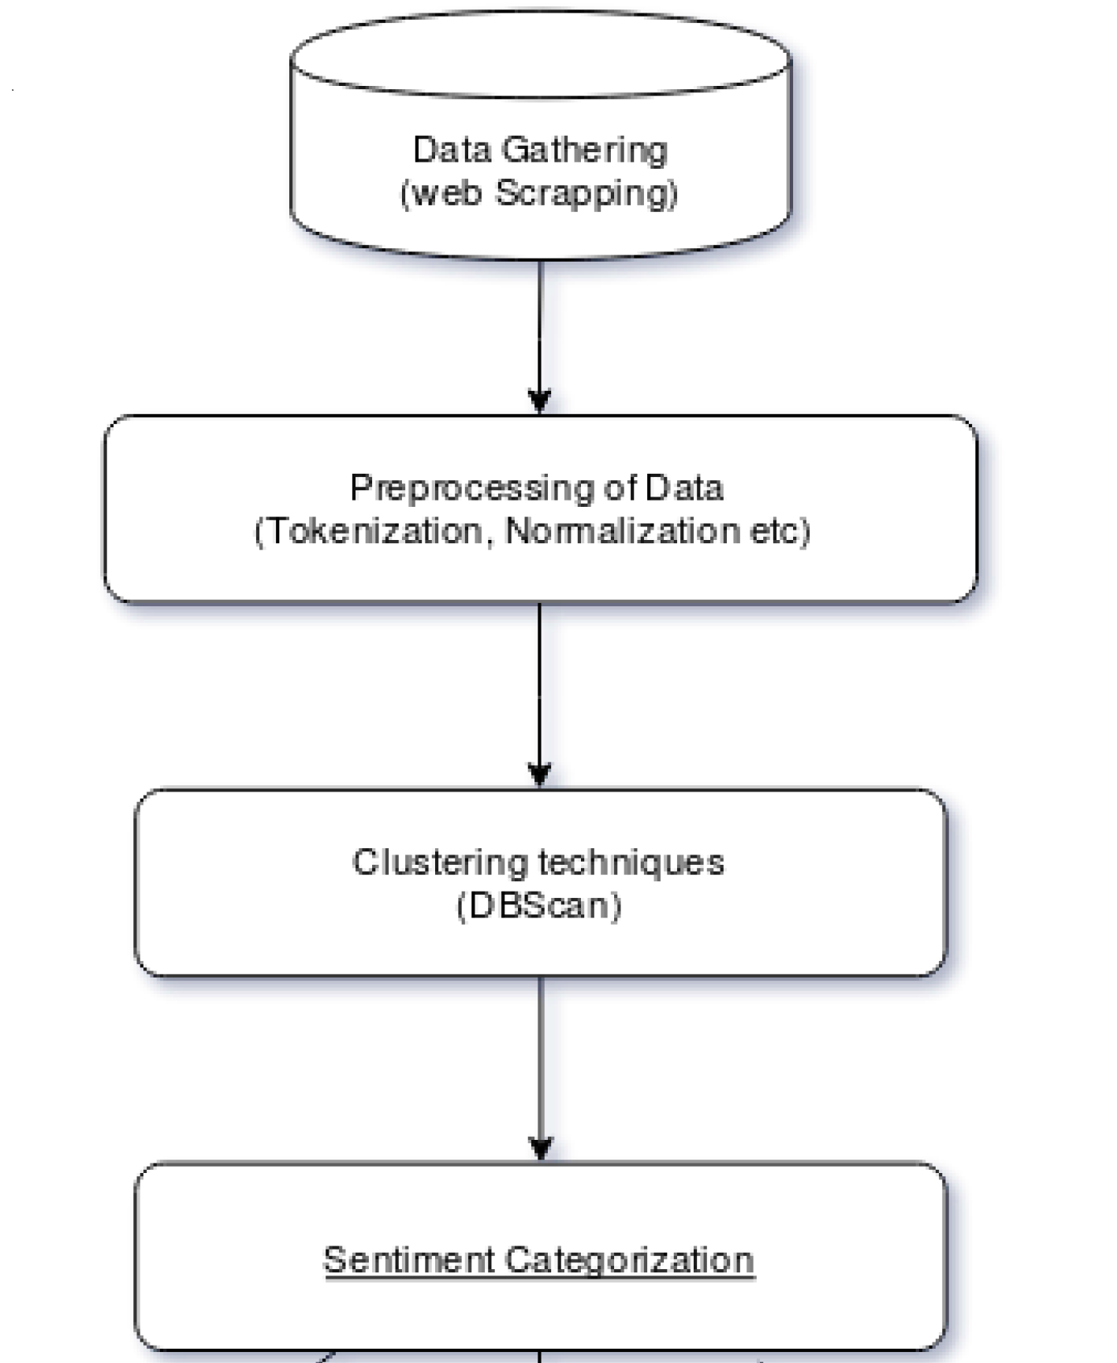
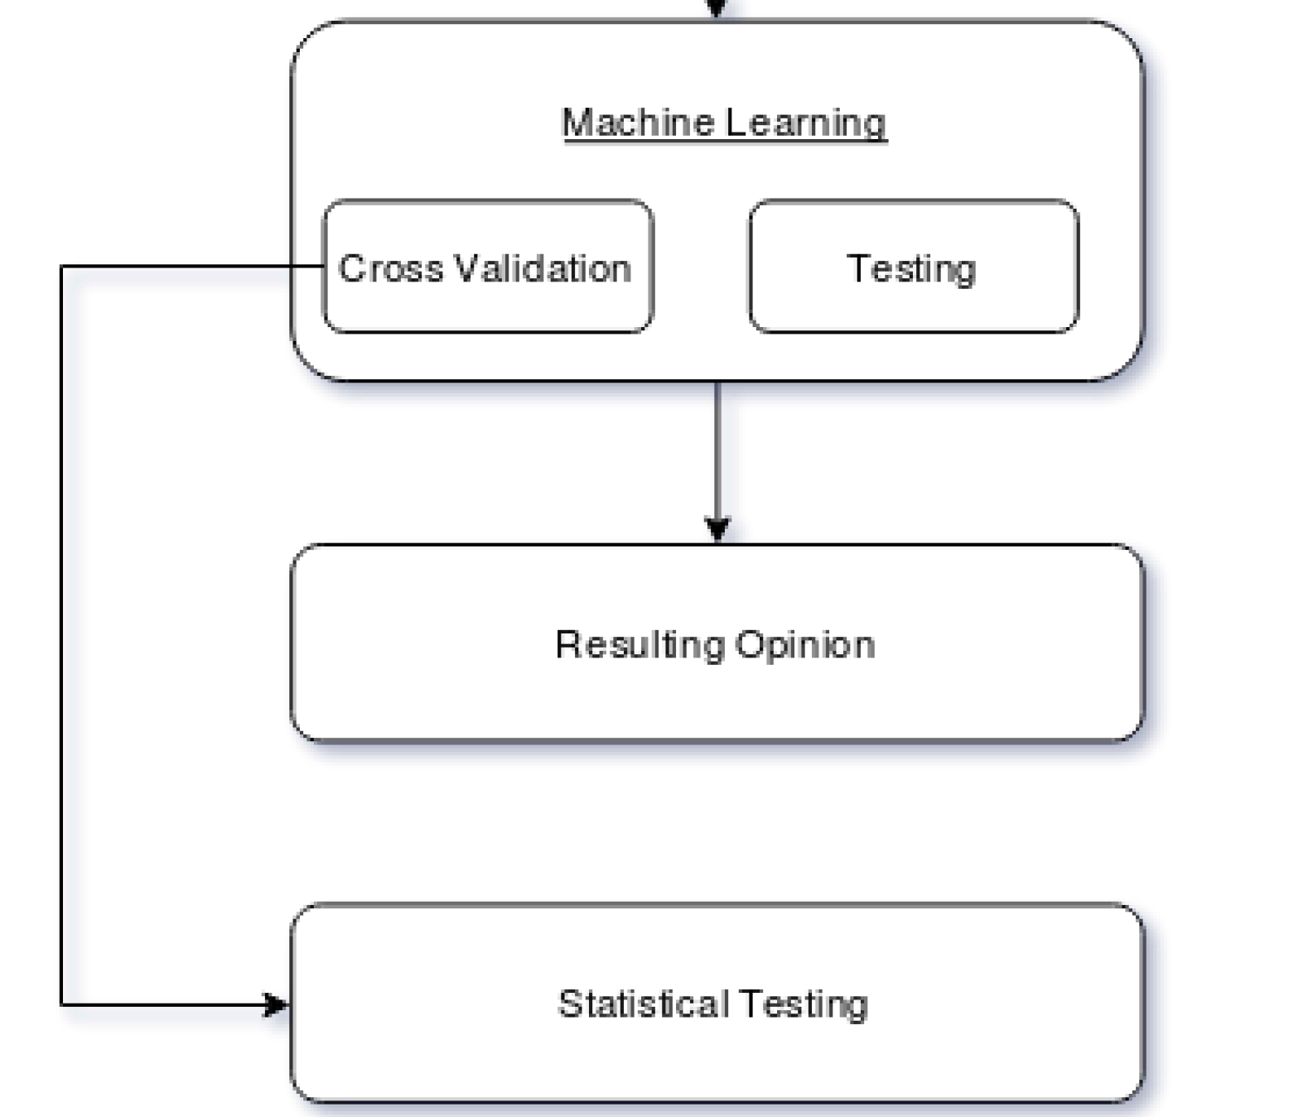
Conceptual diagram - methodology

Slide 8
Bag of Words
Machine learning algorithms do not work with text data. So, there is a need to convert the text into vectors known as feature extractions. A popular method used for feature extraction in text is called bag of words (BoW).
The bag of words model is a way of presenting the textual data while modelling the text with the machine learning algorithms.
BoW is considered to be best for classification.

