Slide 1

Game-to-Market
Exploratory Data Analysis Project
Pedram Doroudchi
10/17/22

Slide 2
Agenda
Executive Summary
Approach
EDA
EDA Summary & Conclusion

Slide 3
Executive Summary
The Business Problem
XYZ is a private firm in the US. Due to remarkable growth in the cab industry during the last few years and multiple key players in the market, it is planning to make an investment in the cab industry.
We have been provided with multiple data sets that contain information on 2 cab companies, Pink Cab and Yellow Cab Company. Each file (data set) provided represents different aspects of the customer profile.
Objective
Provide actionable insights to help XYZ identify the right company to invest in.

Slide 4

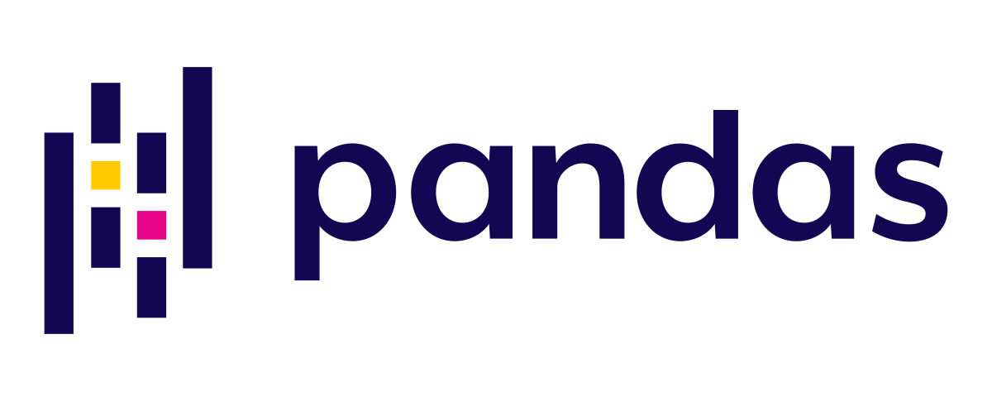
Approach
Imported and merged “Cab_Data.csv,” “Customer_ID.csv,” “Transaction_ID.csv,” and “City.csv” datasets based on shared features into one complete pandas DataFrame (359392 rows x 14 columns)
Changed column names to be more code-friendly
Converted data format from number to datetime type
Data observations range from 01/02/2016 to 12/31/2018
Converted “Income (USD/Month)” column to “annual_income_usd”
Converted “KM Travelled” column to “mi_traveled”
Drafted descriptive statistics for each column in order to perform NA/outlier detection
Found no missing or duplicate values
Outliers are present with respect to the “price_charged” feature
75th percentile value is $600 while 13,582 observations have value greater than $1,000 and 3 observations are greater than $2,000
These observations were not treated as outliers due to sheer number and potential external factors, such as trip duration, not included in the dataset
Created correlation matrix to analyze relationships between variables
Only a few obvious correlations (”price_charged,” “mi_traveled,” and “trip_cost” share strong positive pairwise correlations)

Slide 5
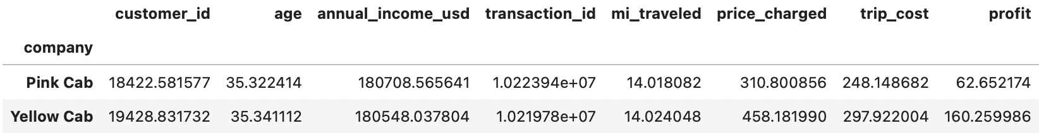
EDA
“Which company appears more profitable on average and what are some attributes of their customers?”
It appears that Yellow Cab is more profitable than Pink Cab by quite some margin; Pink had about 85,000 rides from 2016-2018 while Yellow had about 275,000, over 200% more rides
Both companies had riders with similar average age (~ 35), income (~ 181,000 USD) and distance traveled (~ 14 mi)
Pink’s average profit margin per ride is about 63 USD while Yellow’s is about 160 USD, 150% more
This is despite Yellow having a 20% higher average trip cost which Yellow accounts for by charging prices almost 50% higher than Pink Cab

Slide 6
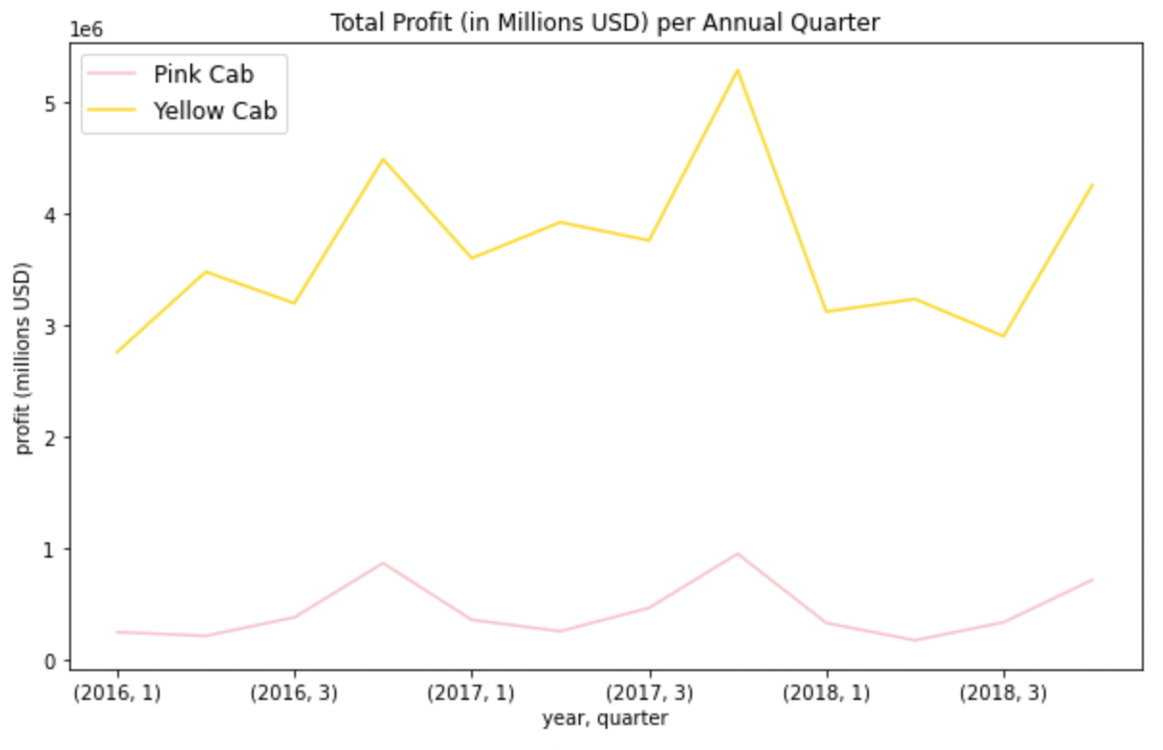
EDA
“What is the annual profit trend of each company?”
The gap in quarterly profits becomes quite evident looking at the graph: Yellow Cab earns at least 3 million USD each quarter (except for Q1 2016 and Q3 2018) while Pink Cab consistently earns less than 1 million USD each quarter
The profit pattern of Yellow Cab displays more variance than that of Pink Cab but both companies display similar seasonal trends with Q1 being weakest and Q4 the strongest financially
Both Yellow and Pink Cab's quarterly profit pattern displays a positive trend from 2016 to 2017 but slightly dips in 2018
Perhaps if Pink Cab showed an aggressively positive profit trend towards the level of Yellow Cab then it would be reasonable to consider its investment potential; however, we see no such trend which only lends more credibility to investing in Yellow Cab

Slide 7
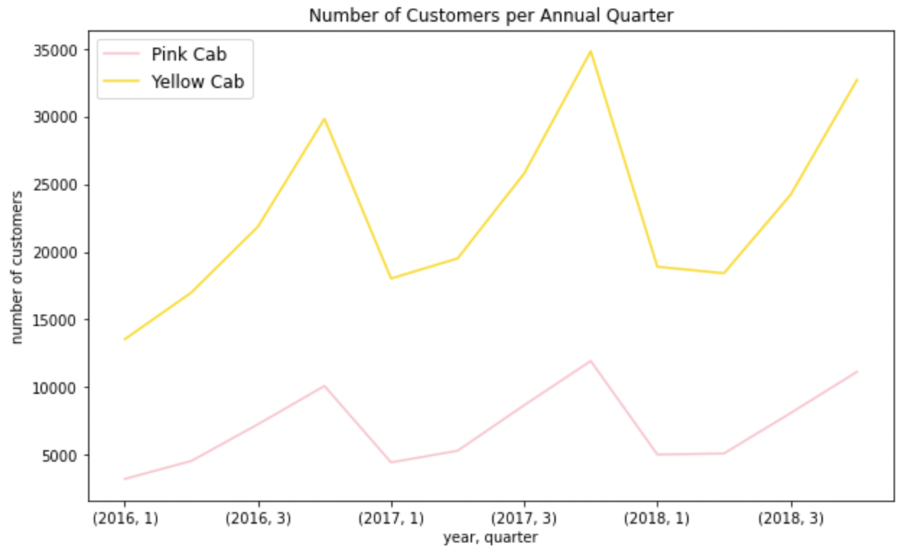
EDA
“Does there appear to be seasonality in the number of customers using each cab service?”
We see a repeating seasonality trend for both Pink and Yellow Cab
The first annual quarter appears to consistently be the weakest quarter for both companies, seeing a significant drop in customer usage from the impressive spike in customers during Q4
Second quarter sees a slight improvement in number of customers (except in 2018 for Yellow Cab where the number of customers decreases from Q1 2017)
The increase in number of customers during third and fourth quarter appears constant for Pink Cab; while both of these quarters show gains in customer usage for Yellow Cab, there is a noticeably sharp gain during the fourth quarter
Both companies display similar seasonal trends and Yellow Cab consistently has more customers than Pink Cab at all times of the year

Slide 8
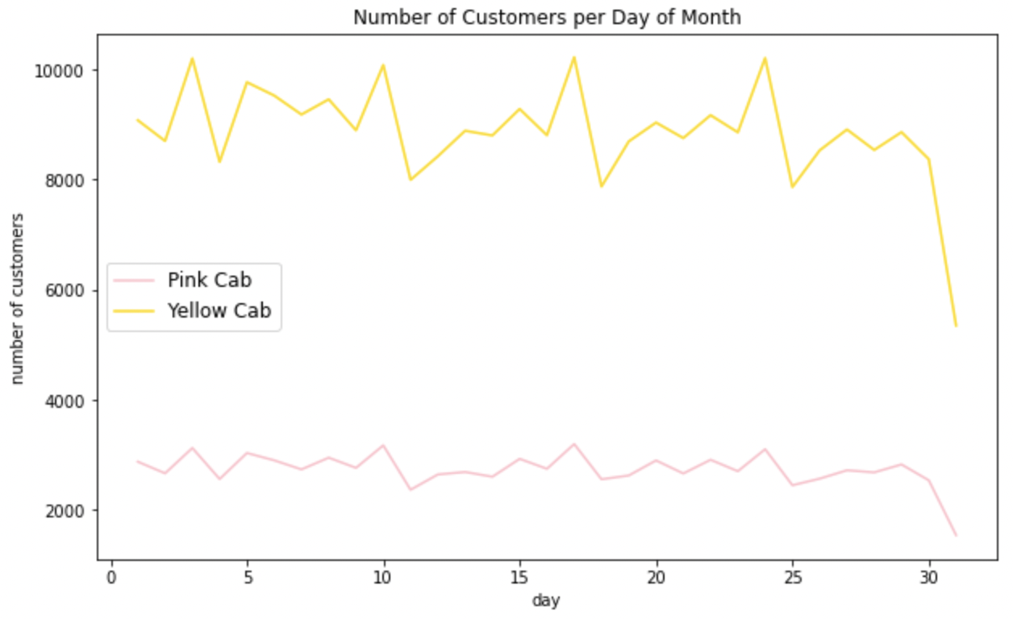
EDA
“Which company has more cab users at a particular time period?”
Comparing daily number of customers between Pink and Yellow Cab, we note further interesting seasonality trends
As expected, Yellow Cab has far more daily customers and a higher variance in number of customers than Pink Cab
Demand for both cab services is highest on the third day of each week and lowest on the following day, the fourth day of each week
Demand plummets for both companies on the last day of each month, but this could be attributed to the fact that only 7 out of 12 months have a 31st day

Slide 9
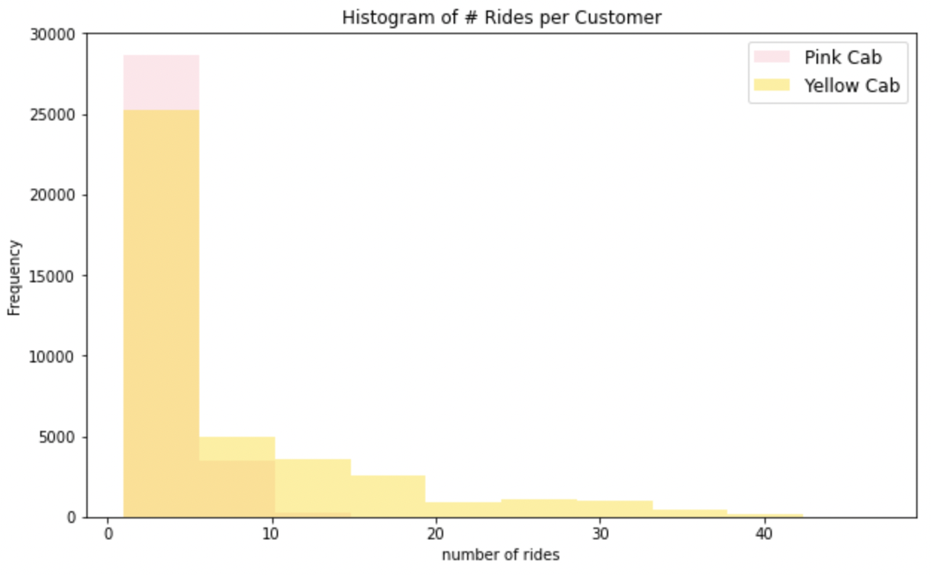
EDA
“How well does each company retain its customers?”
Looking at the overlayed histogram, we note some interesting findings regarding customer retention
Pink Cab has more users who have taken 1-5 rides (~ 29,000 vs 25,000) while Yellow Cab has more customers who have taken 6-10 rides (~ 5,000 vs 4,000) and far more users who have taken more than 10 rides (~ 10,000 vs < 1,000)
In fact, Pink Cab has virtually no customers who have taken more than 15 trips with the company
This shows that Yellow Cab does a far better job retaining its customer base, with some customers taking as many as 50 trips and approximately 25% of customers taking more than 10 rides with the company between 2016 & 2018

Slide 10
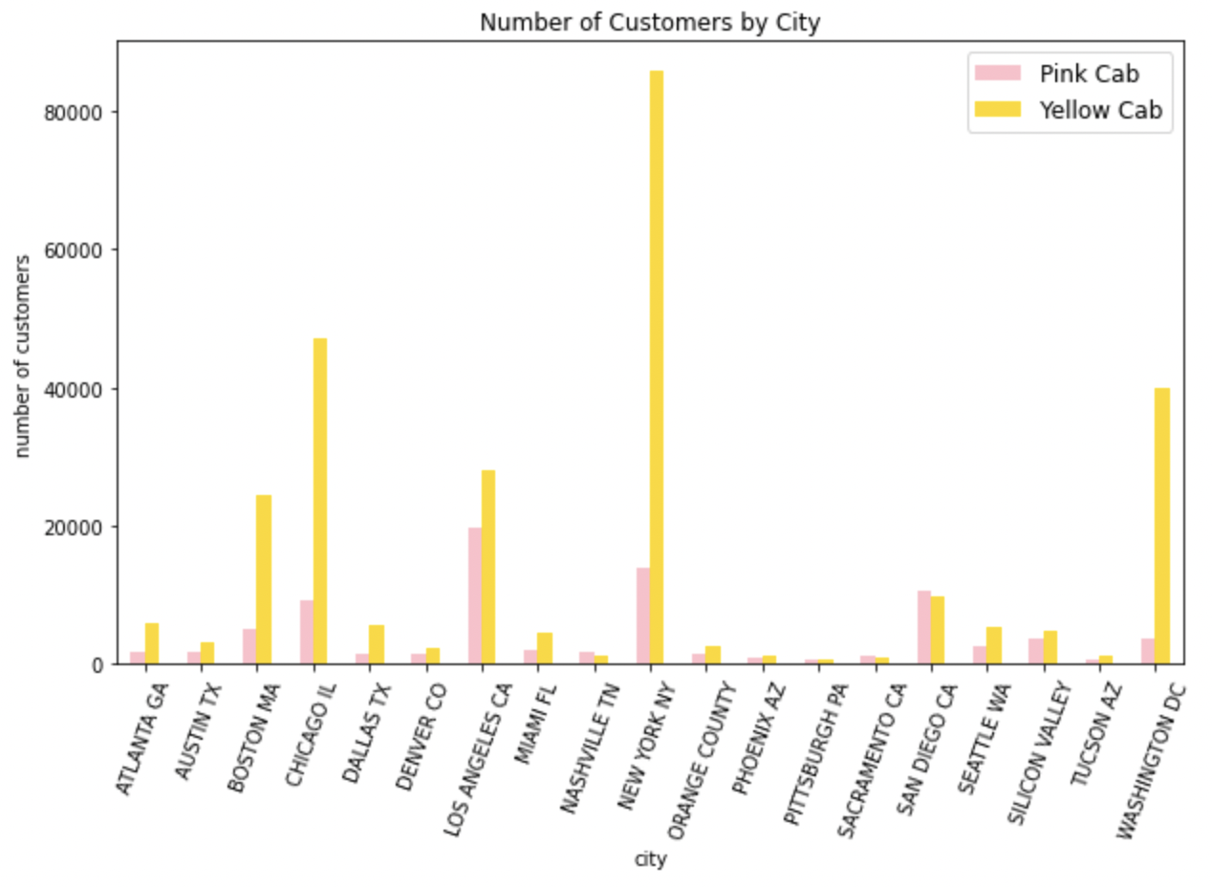
EDA
“How do the cab companies compare city-wise?”
We see above that Yellow Cab has far more customers than Pink Cab in almost every city except for Nashville, TN, Pittsburgh, PA, Sacramento, CA, and San Diego, CA, where Pink Cab has slightly more users
Yellow Cab has far more customers in the major population centers of Chicago, IL (~ 47,000 vs 9,000) and New York, NY (~ 86,000 vs 14,000), which has by far the largest population of the cities above (~ 8.4 million)
Yellow Cab is also notably superior in cities such as Boston, MA, Los Angeles, CA and Washington, DC
Unfortunately for Pink Cab, it appears that Yellow Cab takes the cake for most customers in major American population centers

Slide 11
EDA Summary & Conclusion
Yellow Cab is more profitable than Pink Cab on average yet both companies share similar customer attributes
Perhaps Pink Cab lacks the capital to expand its market share, so XYZ could secure a larger chunk of the company and thus a larger share of future profit; however, this requires further analysis
The profit pattern of Yellow Cab displays more variance than that of Pink Cab but both companies display similar seasonal trends with Q1 being weakest and Q4 the strongest financially
Both companies display similar seasonal trends and Yellow Cab consistently has more customers than Pink Cab at all times of the year
Yellow Cab has far more daily customers and a higher variance in number of customers than Pink Cab
Yellow Cab does a far better job retaining its customer base, with some customers taking as many as 50 trips and approximately 25% of customers taking more than 10 rides with the company between 2016 & 2018; meanwhile, Pink Cab has virtually no customers who have taken more than 15 trips
Yellow Cab takes the cake for most customers in major American population centers
After our thorough analysis, it is safe to say that Yellow Cab dominates Pink Cab in profits, number of customers and customer retention as we have seen above; these are key indicators of a healthy business, and Yellow Cab displays strong performance within each in spades. Thus it is in XYZ's best interest to invest in the future of Yellow Cab Company.

Slide 12
Thank You!

