Slide 1
Cranium
Baian Elmazry
Courtney Thomassen
Joan Henriquez
Kyle Turner
Michael Mosquera
Patrick Dorton

Slide 2
Team
Kyle – Paint GUI, select a card from the deck, video presentation, piece movement.
Joan – Generate example cards and store them in a deck, results traceability matrix, piece movement.
Patrick – Create a timer, track the score, turn order, and game piece for each player. Assisted with card class. Project management.
Courtney – Display the card as it is drawn, PowerPoint development.
Baian – Game board GUI, map the locations of each player’s game piece to the game board, piece movement.
Michael – Dice rolling animation/logic.

Slide 3
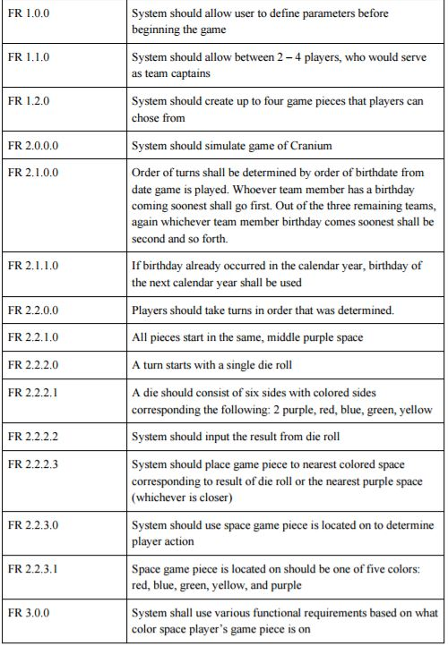
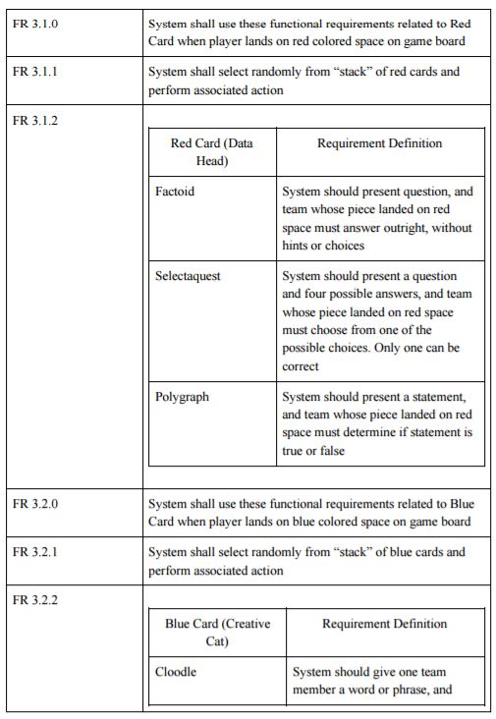
Functional Requirements

Slide 4
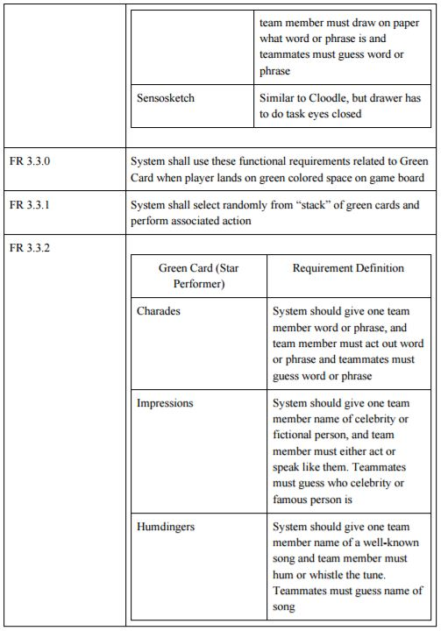
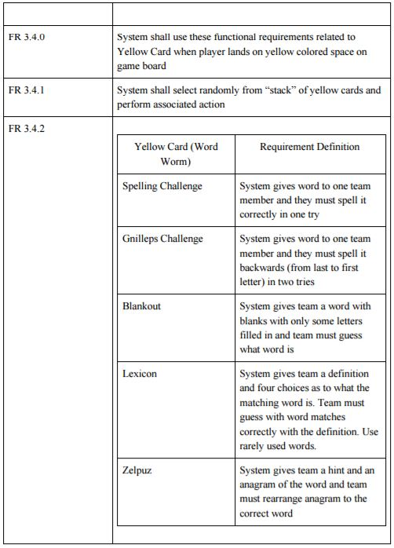

Slide 5
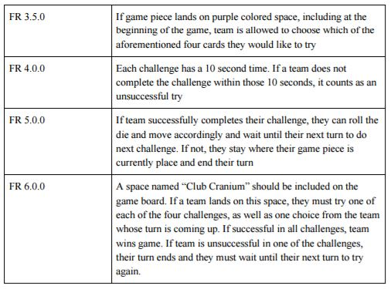

Slide 6
UI Prototype
We implemented the core features for the UI prototype so that all we would have to do in order to expand it into a fully functional game would be to scale up the features we already have.
Functional requirements:
Create a new game
Show the player’s piece on the board
Roll the dice
Set a timer for each turn
Select a card of any color
Track the score of each player
Free draw frame

Slide 7
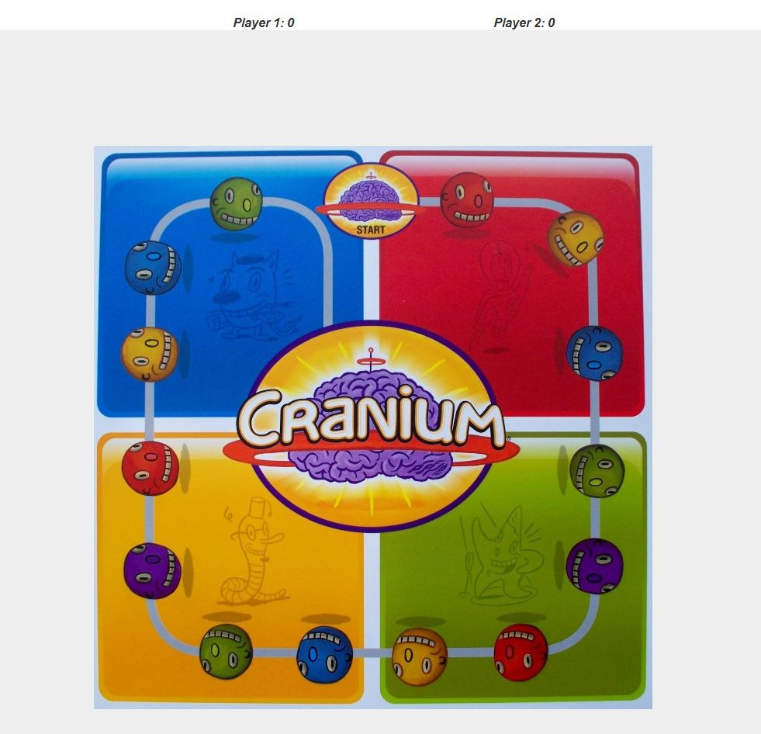

Slide 8
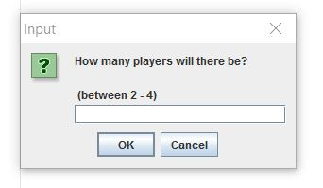
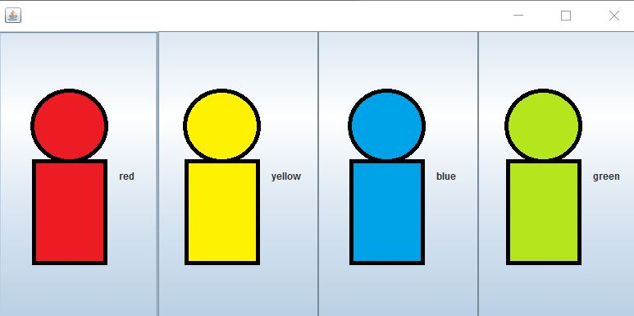

Slide 9
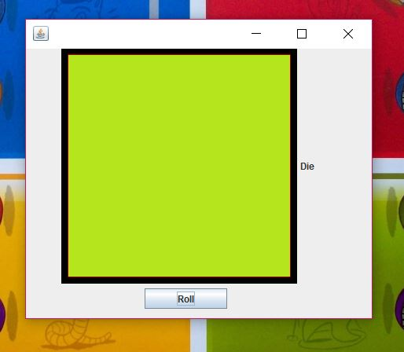

Slide 10
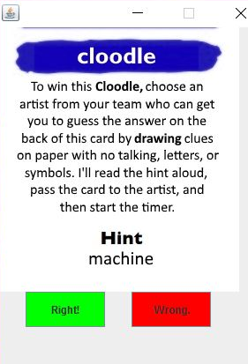
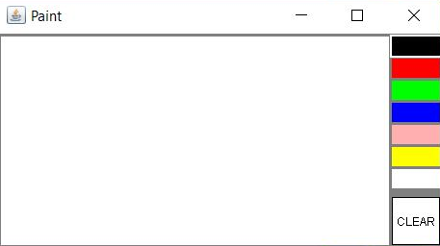

Slide 11
HTI Principles
Consistency
User interface remains constant and all actions are displayed in smaller pop ups so user can always see the familiar interface.
Usability
Most of the program does not require any user interaction. When it does, the user is prompted with clear instructions that reduce the risk of confusion.
Accurate Feedback
Responds to user interaction appropriately.
Efficiency
Application takes up no unnecessary space.
Effective to Use
The game methods work properly and will allow the user to play the game with full functionality.

Slide 12
HTI Principles
Users are only ever prompted to input the number of players and whether a player answered a question correctly, which helps to reduce the possibility of a user error.
All of the buttons are recognizable icons that most users will understand.
The buttons the user must press to indicate whether or not the current player answered the question accurately are colored green for correct and red for incorrect. This will help users identify the buttons and their meaning easily.
There are no unnecessary buttons that could confuse the user.
Players’ scores are always displayed at the top of the UI.

Slide 13
Comparison to Physical Game
The current player should not be able to see the solution to the card they are trying to answer. In the physical game, the answer is located on the card itself. We had to store the answers separately so that all players could look at the screen at all times.
Our timer starts as soon as the card shows up, which does not allow the player to spend any time to be ready. We tried to take this into account and give the players more time than they would get in the physical game to answer.
We were unable to represent the Play-Doh that comes with the physical game digitally, so the cards that require it have been omitted.

Slide 14
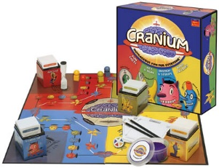

Comparison to Physical Game
Physical Game:
Cards
Timer
Drawing Pad
Player Pieces
Board
Colored Dice
Play-Doh
Digital Game
Cards
Timed card windows
Paint window for drawing
Player Pieces
Board
Colored Dice

