Slide 1

Computational Model
for
Virus Population Dynamics Based On
Stochasticity
Prince Dwivedi [ 0176CS191122 ]
References : MIT OCW [ multiple courses ]

Slide 2

S . T . O . C . H . A . S . T . I . C . S .
What’s Stochastic ?
Why Stochastic ?
Computational Approach based on stochastic model based understanding is something like brute force way of going for all possibilities which in some sense tries to relate the model to the problem under observation a bit more precisely
When determining the next state of a process requires or say has an inbuilt element which depend on randoms that is something we call stochastic behavior
eg : movement of particles at atomic scale

Slide 3

Why we require Simulations for working with problems that involve Stochastics ?
Cosmos Is Stochastic
So we require Probabilities
Complex
Simple
Simulations
Analytic Models
Trials
Estimating Probabilities
and Averaging
Event ( A wave That Decides The Faith )

Slide 4
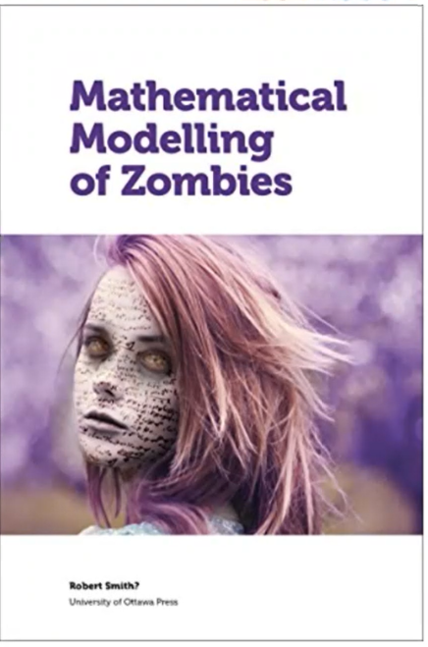
How We Do That ?
____________________________________________________
Start with simple model
Test it against our expectations
eg . Smoke test
Refine the model by adding new elements
Test the model again

Slide 5

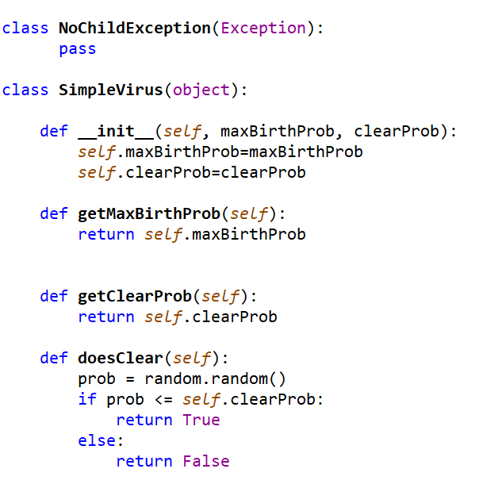
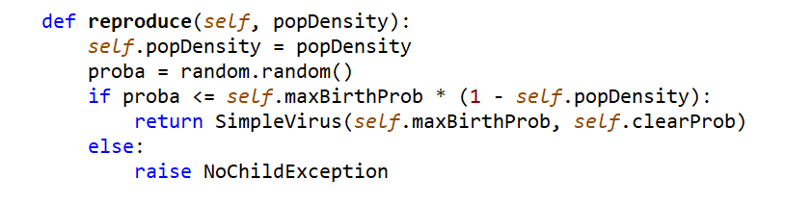
Modelling A Simple Virus
_______________________________________________________________
What’s simple about this Virus ?

Slide 6

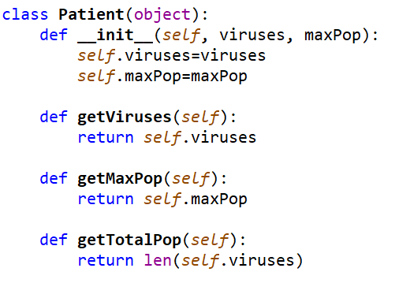
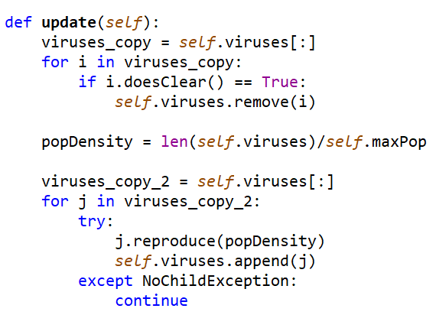
Modelling A Simple Patient
________________________________________________________

Slide 7
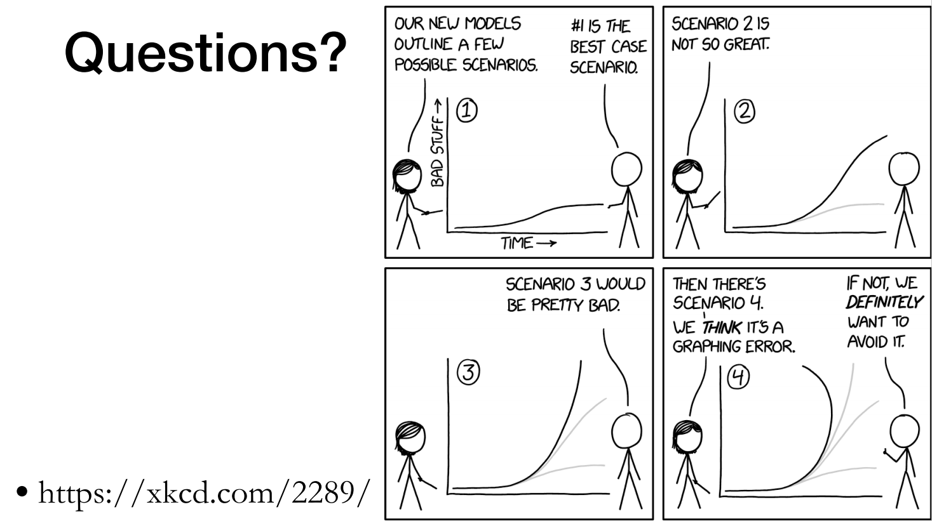

Slide 8

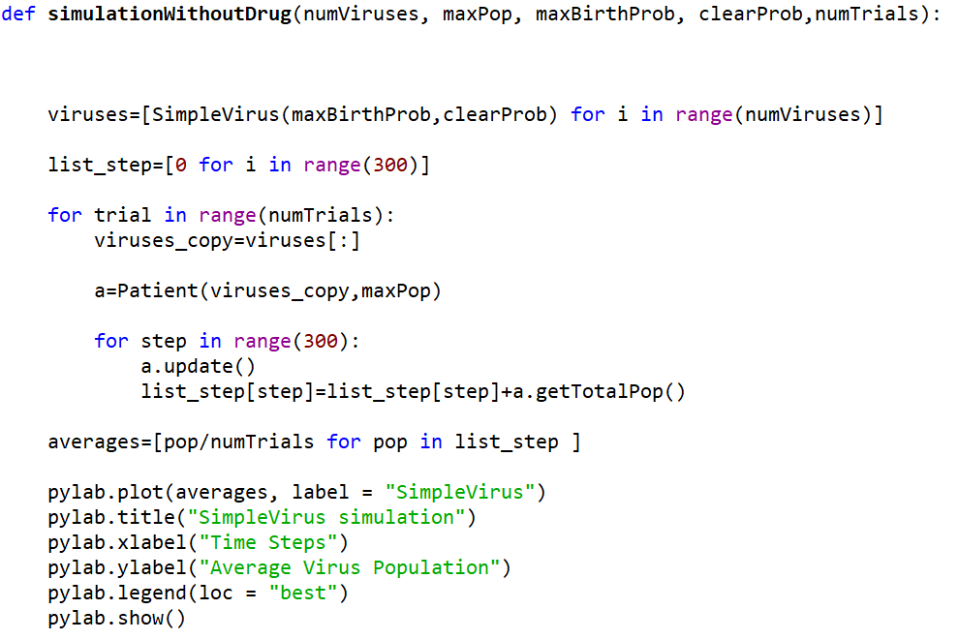
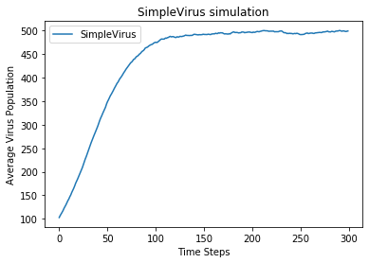
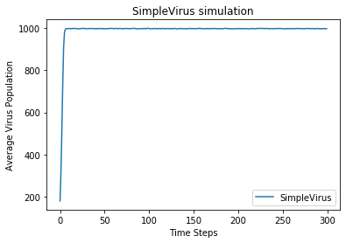
Sanity Check (Smoke Test) With Simulation_1
______________________________________________________________________

Slide 9

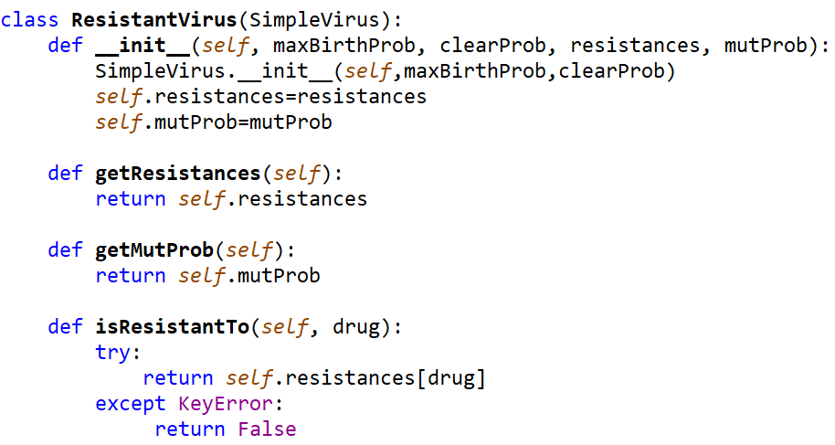
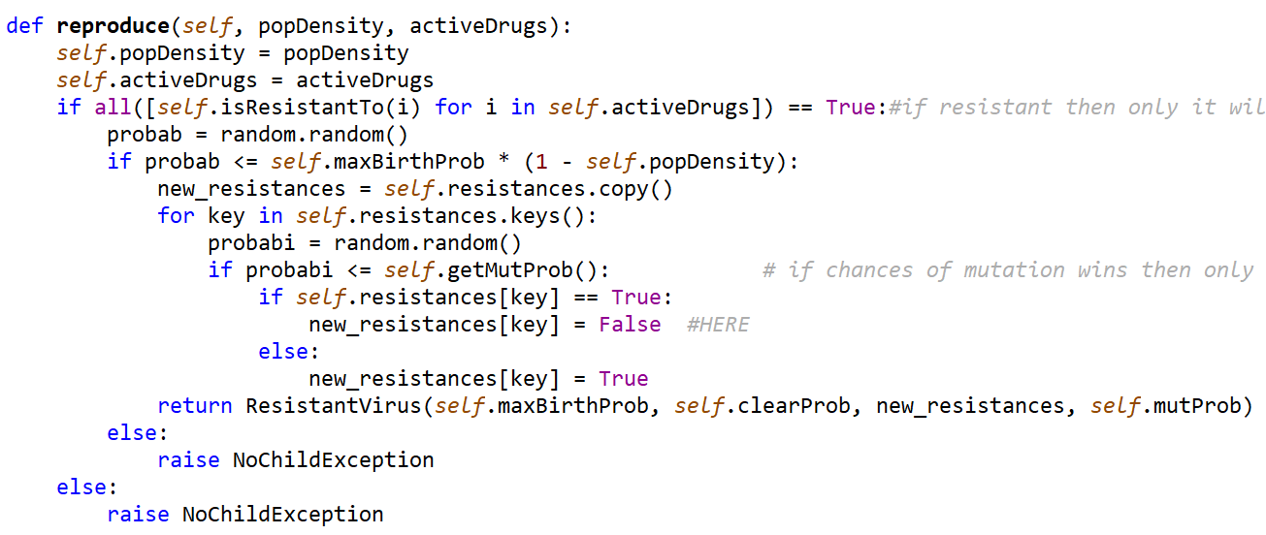
Upgrade to Resistant Virus
__________________________________________________________________________

Slide 10
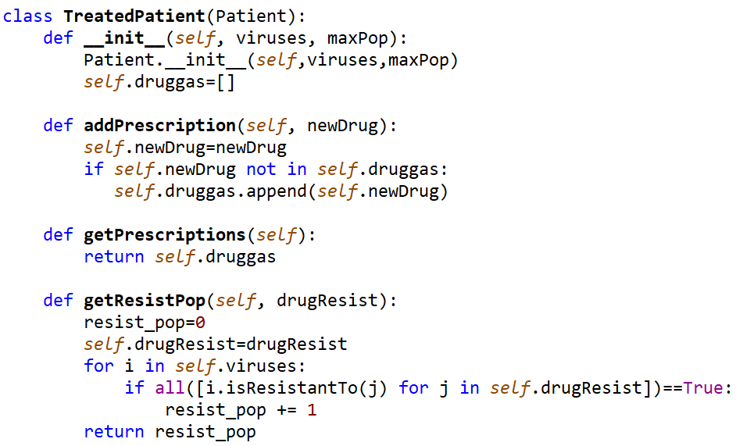
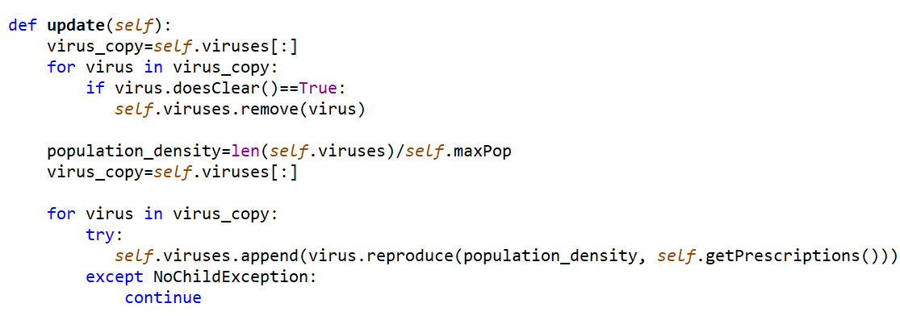
Upgrade to Treated Patient
__________________________________________________________________________

Slide 11
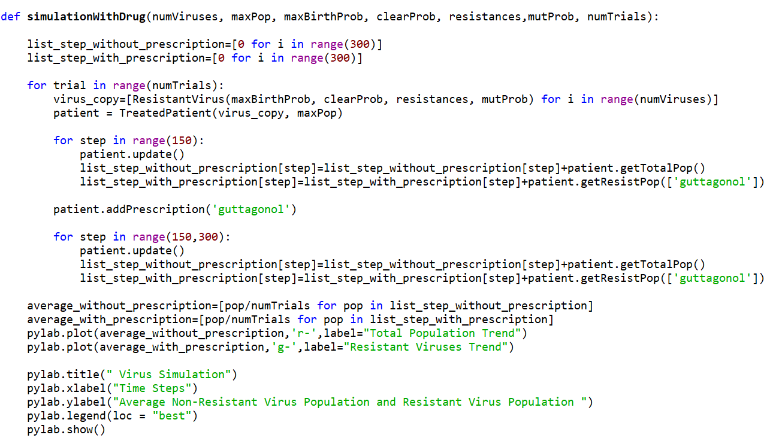
Sanity Check (Smoke Test) With Simulation_2
______________________________________________________________________

Slide 12
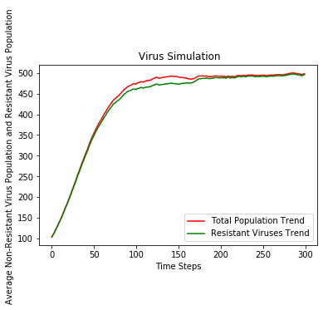
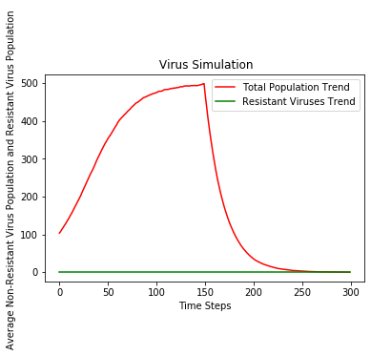
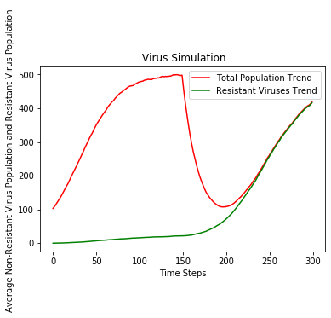
And The Last Step Of Modelling
_______________________________________________________________________________
simulationWithDrug(100, 1000, 0.1, 0.05, {'guttagonol’:True}, , 0.005, 100)
simulationWithDrug(100, 1000, 0.1, 0.05, {}, 0.005, 100)
simulationWithDrug(100, 1000, 0.1, 0.05, {'guttagonol':False}, 0.005, 100)

Slide 13


