Slide 1
2.1.1. Number System
An n-digit number in base b:
x = a_{n-1} a_{n-2} …. a₀
Constraint on a_{i}: a_{i} = 0, 1, 2,…., b-1
Examples (modulo)
base 10 - decimal
base 2 (binary), base 8 (octal), base 16 (hexadecimal)
base 12, base 16

Slide 2
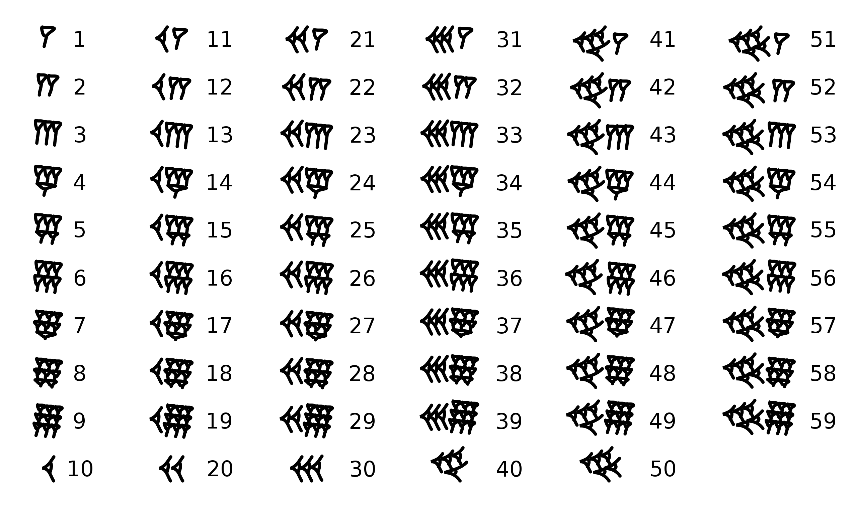
Example
base 60
http://en.wikipedia.org/wiki/Sexagesimal

Slide 3
Digits
Zero
Digits
2023 Superbowl LVII
Arabic | 0 | 1 | 2 | 3 | 4 | 5 | 6 | 7 | 8 | 9
Roman |  | I | II | III | IV | V | VI | VII | VIII | IX
Chinese | 〇 | 一 | 二 | 三 | 四 | 五 | 六 | 七 | 八 | 九
Arabic | 10 | 50 | 100 | 500 | 1000 | 10000
Roman | X | L | C | D | M | X
Chinese | 十 | 五十 | 百 | 五百 | 千 | 万
Arabic | 20 | 30 | 40 | 60 | 70 | 80 | 90
Roman | XX | XXX | XL | LX | LXX | LXXX | XC
Chinese | 二十 | 三十 | 四十 | 六十 | 七十 | 八十 | 九十

Slide 4
Base b to base 10
An n-digit number in base b:
x written as a_{n-1} a_{n-2} …. a₀
Constraint on a_{i}: a_{i} = 0, 1, 2,…., b-1
But what is the VALUE of a number?

Slide 5
Base b to base 10
An n-digit number in base b:
x written as a_{n-1} a_{n-2} …. a₀
Constraint on a_{i}: a_{i} = 0, 1, 2,…., b-1
But what is the VALUE of a number?
by positional weights
e.g. 123 = 1x10² + 2x10¹ + 3x10⁰

Slide 6
Base b to base 10
An n-digit number in base b:
x written as a_{n-1} a_{n-2} …. a₀
Constraint on a_{i}: a_{i} = 0, 1, 2,…., b-1
But what is the VALUE of a number?
Value of a number = Decimal Value
V(x) = a_{n-1} b^{n-1} + a_{n-2} b^{n-2} + …. + a₀ b⁰
^{= x}₁₀

Slide 7
Exercise
1. Among octal numbers listed below, circle all numbers which are NOT written in octal?
107 187 299 777
2. Determine which number in each pair is larger. Subscripts note the base of each number.
a) 21₁₀ 10101₂
b) AB₁₆ 252₈
c) 123₇ 74₉

Slide 8
Base 10 to base b
An n-digit number in base b: a_{n-1} a_{n-2} …. a₀
Constraint on a_{i}: a_{i} = 0, 1, 2,…., b-1
How do you write a number value in base-b?
V(x) = a_{n-1} b^{n-1} + a_{n-2} b^{n-2} + …. + a₀ b⁰

Slide 9
Number System
An n-digit number in base b: a_{n-1} a_{n-2} …. a₀
Constraint on a_{i}: a_{i} = 0, 1, 2,…., b-1
How do you write a number value in base-b?
x = a_{n-1} b^{n-1} + a_{n-2} b^{n-2} + …. + a₀ b⁰
Keep dividing the number by b’s until it runs out:
Each remainder is a character starting from lowest (rightmost) and ending at highest (leftmost)
Quotient is the next number to divide; stop when 0
V(x) = a_{n-1} b^{n-1} + a_{n-2} b^{n-2} + …. + a₀ b⁰

Slide 10
Fractions
Fraction
X.Y = a_{n-1} b^{n-1} + a_{n-2} b^{n-2} + …. + a₀ b⁰ + a₋₁ b⁻¹ + a₋₂ b^{-2 + …}
123.45₁₀ = a₂x8² + a₁x8¹ + a₀x8⁰ + a₋₁x8⁻¹ + a₋₂x8⁻² + …

Slide 11
Fractions
Fraction
X.Y = a_{n-1} b^{n-1} + a_{n-2} b^{n-2} + …. + a₀ b⁰ + a₋₁ b⁻¹ + a₋₂ b^{-2 + …}
123.45₁₀ = a₂x8² + a₁x8¹ + a₀x8⁰ + a₋₁x8⁻¹ + a₋₂x8⁻² + …
Separate whole number & fraction
123 = a₂x8² + a₁x8¹ + a₀x8⁰
0.45 = a₋₁x8⁻¹ + a₋₂x8⁻² + …

Slide 12
Bases 2, 8, 16, etc.
3 binary bits into a single octal
4 binary bits into a single hex
11110 ₂ = 30 ₁₀ = 132₄
36 ₈
1E _{X}
Use characters ‘0’ to ‘9’ and ‘A’ to ‘F’
Write FA1D37B₁₆ in C as 0xFA1D37B
Or 0xfa1d37b
Decimal
Hex
Binary
0
0
0000
1
1
0001
2
2
0010
3
3
0011
4
4
0100
5
5
0101
6
6
0110
7
7
0111
8
8
1000
9
9
1001
A
10
1010
B
11
1011
C
12
1100
D
13
1101
E
14
1110
F
15
1111

Slide 13
Arithmetic in bases
base 10
Addition – carry
Subtraction -- borrow
base 16

