Slide 1
Layers of Abstraction
Architecture (instruction set architecture, ISA)
Highest level of abstraction in computer specification
The parts of a processor design needed to read and write assembly code
Concerned about instruction set specification, registers, etc.
Microarchitecture
Lower-level details about how architecture is implemented
Concerned about cache sizes, core frequency, etc.
May contain optimizations (like pipelining, branch prediction) not talked about by architecture
Processor
Lowest level of abstraction
Implementation of computer in physical hardware
Includes materials, circuitry, geometrical arrangements, etc.

Slide 2
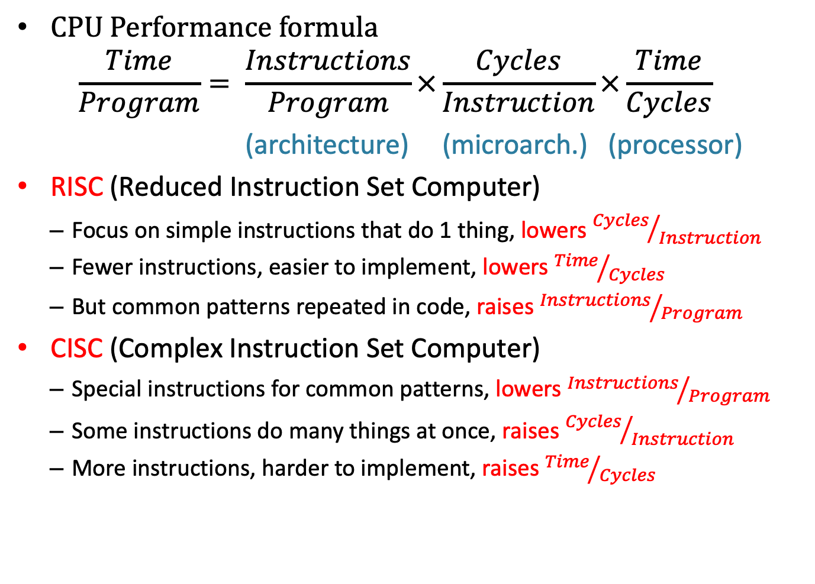
Architecture Design Strategies
CPU Performance formula
$$\frac{Time}{Program}= \frac{Instructions}{Program}×\frac{Cycles}{Instruction}×\frac{Time}{Cycles}$$
(architecture) (microarch.) (processor)
RISC (Reduced Instruction Set Computer)
Focus on simple instructions that do 1 thing, lowers ${Cycles}/{Instruction}$
Fewer instructions, easier to implement, lowers ${Time}/{Cycles}$
But common patterns repeated in code, raises ${Instructions}/{Program}$
CISC (Complex Instruction Set Computer)
Special instructions for common patterns, lowers ${Instructions}/{Program}$
Some instructions do many things at once, raises ${Cycles}/{Instruction}$
More instructions, harder to implement, raises ${Time}/{Cycles}$

Slide 3
IA32/x86 Processors
Evolutionary Design
Started in 1978 with 8086 (based on 8-bit 8008 from 1972)
Layered more features on top as time goes on
Good:
Backwards compatibility, still support ALL old features
Ancient machine code still runs on modern processors
Bad:
Old choices no longer relevant
Obsolete features still wasting space in your computer
Complex Instruction Set Computer (CISC)
Many different instructions with many different formats
Hard to match performance of RISC – ARM, MIPS
But Intel figured out how!

Slide 4
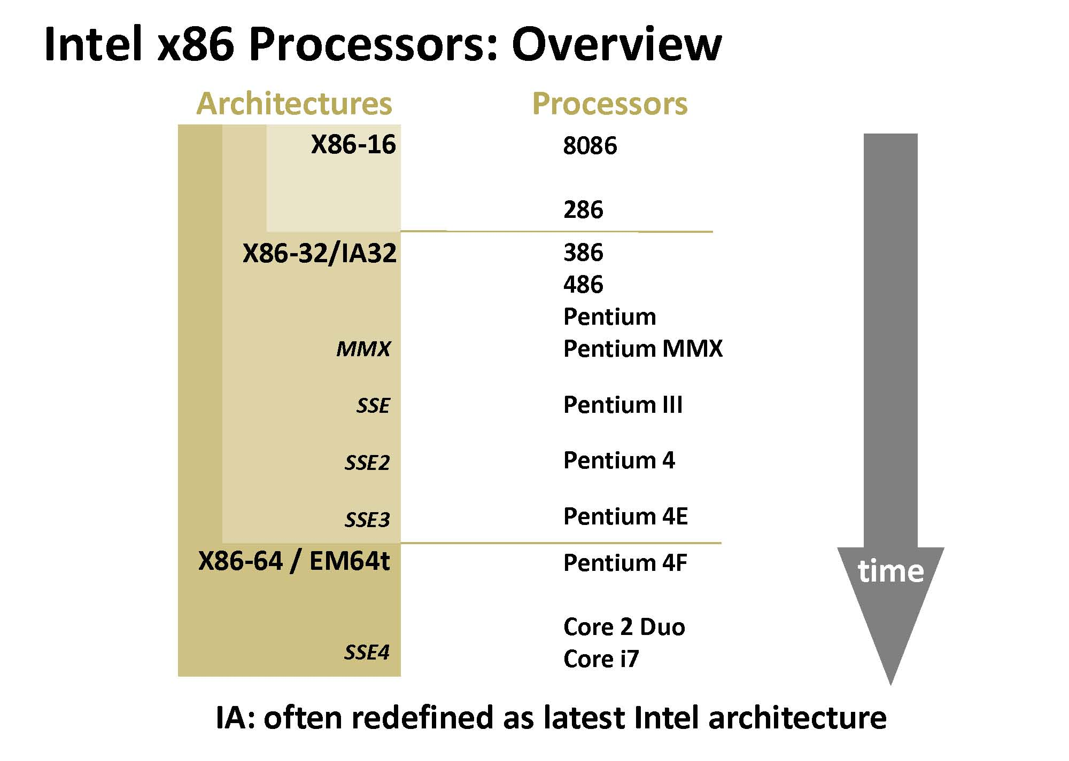

Slide 5
Intel x86 Evolution: Milestones
Name Date Transistors MHz
8086 1978 29K 5-10
First 16-bit Intel processor. Basis for IBM PC & DOS
1MB address space
386 1985 275K 16-33
First 32-bit Intel processor , referred to as IA32
Added “flat addressing”, capable of running Unix
Pentium 4E 2004 125M 2800-3800
First 64-bit Intel x86 processor, referred to as x86-64
Core 2 2006 291M 1060-3500
First multi-core Intel processor
Core i7 2008 731M 1700-3900
Four cores (our shark machines)

Slide 6
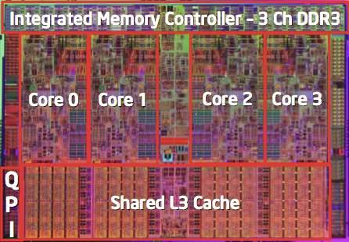
Intel x86 Processors, cont.

Slide 7
Intel’s 64-bit Architecture
Tried a radical shift from IA32 to IA64
Totally different architecture (Itanium)
Executes IA32 code only as legacy
Performance disappointing
AMD stepped in with Evolutionary Solution
x86-64 (now called “AMD64”)
2004: Intel announced EM64T extension
Extended memory 64-bit technology
Almost identical to x86-64!
Still not supported by OS, programmers

Slide 8
Assembly Programmer’s View
CPU
Memory
Addresses
PC
Registers
A
LU
Object Code
Program Data
OS Data
Data
Condition
Codes
Instructions
Stack
Programmer-Visible State
EIP (IA32) or RIP (IA64)
Program Counter (PC)
Address of next instruction
Register File
Heavily used program data
Condition Codes
Store status information about most recent arithmetic operation
Used for conditional branching
Memory
Byte addressable array
Code, user data, (some) OS data
Includes stack used to support procedures

Slide 9
Assembly Characteristics
Minimal Data Types
“Integer” data of 1, 2, or 4 bytes (+ 8 bytes in 64-bit machines)
Data values
Addresses (untyped pointers)
Floating point data of 4, 8, or 10 bytes
No aggregate types such as arrays or structures
Just contiguously allocated bytes in memory
Primitive Operations
Perform arithmetic function on register or memory data
Transfer data between memory and register
Load data from memory into register
Store register data into memory
Transfer control
Unconditional jumps to/from procedures
Conditional branches

Slide 10
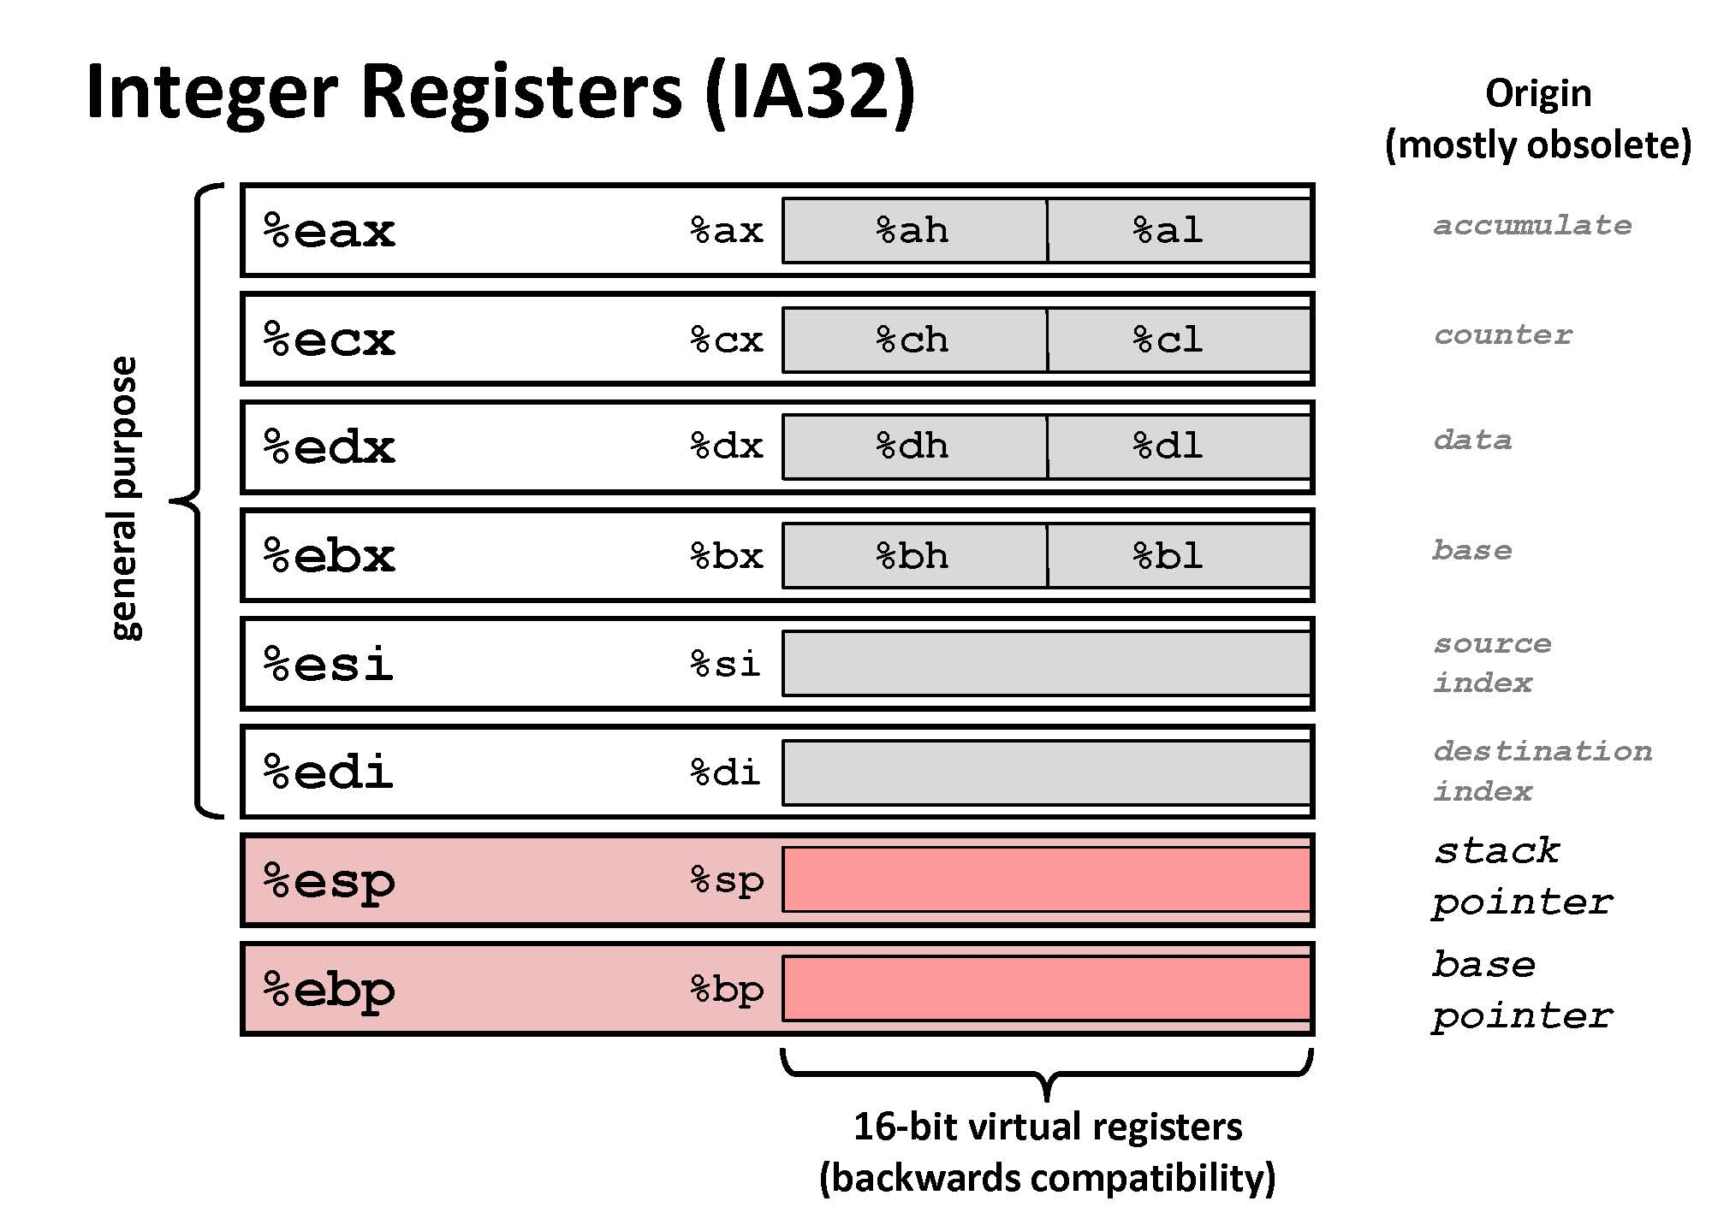
IA32 Machine Basics

Slide 11
x86-64 Integer Registers
%rax
%r8
%eax
%r8d
%rbx
%r9
%ebx
%r9d
%rcx
%r10
%ecx
%r10d
%rdx
%r11
%edx
%r11d
%rsi
%r12
%esi
%r12d
%rdi
%r13
%edi
%r13d
%rsp
%r14
%esp
%r14d
%rbp
%r15
%ebp
%r15d
Can reference low-order 4 bytes (also low-order 1 & 2 bytes)

Slide 12
Data Formats
Word – refers to a 16-bit data type (historically)
32-bit: double word / “long” word
64-bit: quad word
In x86-64
code Suffix size (byte)
char byte b 1
short word w 2
int double l 4
long quad q 8
char * quad q 8
float single prec. s (l) 4
double double prec. l (q) 8

Slide 13
Moving Data
Moving Data
movx Source, Dest:
1st operand => 2nd operand
x refers to the size moved
q = quad word (64 bits) % rax
l = long word (32 bits) % eax
w = word (16 bit) % ax
b = byte (8 bits) % ah, al
%rax
%eax
%rbx
%ebx
%rcx
%ecx
%rdx
%edx
%rsi
%esi
%rdi
%edi
%rsp
%esp
%rbp
%ebp

Slide 14
Moving Data
Operand Types
Immediate: Constant integer data
Like C constant, but prefixed with ‘$’
E.g., $0x400, $-533
Encoded with 1, 2, or 4 bytes
Register: One of 16 integer registers (only 8 in 32-bit x86)
But %rsp and %rbp reserved for special use
Some others have special uses for particular instructions
Memory: 8 consecutive bytes of memory
Various “address modes”

Slide 15
movq Operand Combinations
Source
Dest
Src,Dest
C Analog
li $s0,0x400
Reg
movq $0x4,%rax
temp = 0x4;
Imm
Mem
movq $-147,(%rax)
*p = -147;
move $t0, $s0
Reg
movq %rax,%rdx
temp2 = temp1;
movq
Reg
Mem
movq %rax,(%rdx)
*p = temp;
sw $t0, ($s0)
Mem
Reg
movq (%rax),%rdx
temp = *p;
lw $t0, ($s0)
Cannot do memory-memory transfer with a single instruction

Slide 16
Simple Memory Addressing Modes
Direct D Mem[D]
movq X+8, %rax
Normal (indirect) (R) Mem[Reg[R]]
Register R specifies memory address
Pointer dereferencing in C movq (%rcx),%rax
Displacement (indexed) D(R) Mem[D+Reg[R]]
Register R specifies start of memory region
Constant displacement D specifies offset movq 8(%rbp),%rdx

Slide 17
Indexed Addressing Modes
Most General Form
D(Rb,Ri,S) Mem[D + Reg[Rb] + Reg[Ri]*S]
D: Constant “displacement” 1, 2, or 4 bytes
Rb: Base register: Any of 8 integer registers
Ri: Index register: Any, except for %esp
Unlikely you’d use %ebp, either
S: Scale: 1, 2, 4, or 8
Special Cases
(Rb,Ri) Mem[Reg[Rb] + Reg[Ri]]
D(Rb,Ri) Mem[D + Reg[Rb] + Reg[Ri]]
(,Ri,S) Mem[Reg[Ri]*s]

Slide 18
Address Computation Examples
%edx
0xf000
%ecx
0x100
Expression | Computation | Effective Address
0x8(%edx) | 0x8 + 0xf000 | 0xf008
(%edx,%ecx) | 0xf000 + 0x100 | 0xf100
(%edx,%ecx,4) | 0xf000 + 0x100*4 | 0xf400
0x80(,%edx,2) | 0x80 + 0xf000*2 | 0x1e080

Slide 19
Some Arithmetic Operations
Format Computation
Two Operand Instructions
addq Src,Dest Dest = Dest + Src
subq Src,Dest Dest = Dest – Src MIPS: sub d,r,s (d=r-s)
imulq Src,Dest Dest = Dest * Src
salq Src,Dest Dest = Dest << Src Also called shlq
sarq Src,Dest Dest = Dest >> Src Arithmetic (MIPS: sra)
shrq Src,Dest Dest = Dest >> Src Logical (MIPS: srl)
xorq Src,Dest Dest = Dest ^ Src
andq Src,Dest Dest = Dest & Src
orq Src,Dest Dest = Dest | Src

Slide 20
Some Arithmetic Operations
Format Computation
One Operand Instructions
incq Dest Dest = Dest + 1
decq Dest Dest = Dest - 1
negq Dest Dest = -Dest
notq Dest Dest = ~Dest

Slide 21
Addr Computation Instruction
leaq Src, Dest
Load Effective Address
Src is address mode expression
Set Dest to address denoted by expression
Uses
Computing address without the memory reference
E.g., translation of p = &x[i];
Similar to MIPS ‘la’ instruction
Can also be (ab)used for computing arithmetic expressions of the form x + k*y
k = 1, 2, 4, or 8.

Slide 22
Using leaq for Arithmetic
What is the result (stored in %rdx)?
leaq (%rdx,%rdx,2),%rdx
# %rdx = 3*%rdx
movq (%rdx,%rdx,2),%rdx
# %rdx = Memory[3*rdx]

Slide 23
Arithmetic Expression Example
Carnegie Mellon
arith:
leaq (%rdi,%rsi), %rax # t1
addq %rdx, %rax # t2
leaq (%rsi,%rsi,2), %rdx
salq $4, %rdx # t4
leaq 4(%rdi,%rdx), %rcx # t5
imulq %rcx, %rax # rval
ret
long arith
(long x, long y, long z)
{
long t1 = x + y;
long t2 = z + t1;
long t3 = x + 4;
long t4 = y * 48;
long t5 = t3 + t4;
long rval = t2 * t5;
return rval;
}
Register | Use(s)
%rdi | Argument x
%rsi | Argument y
%rdx | Argument z
%rax | t1, t2, rval
%rdx | t4
%rcx | t5

Slide 24
Arithmetic Expression Example
Carnegie Mellon
long arith
(long x, long y, long z)
{
long t1 = x + y;
long t2 = z + t1;
long t3 = x + 4;
long t4 = y * 48;
long t5 = t3 + t4;
long rval = t2 * t5;
return rval;
}
x = %rdi; y = %rsi; z = %rdx
arith:
leaq (%rdi,%rsi), %rax
addq %rdx, %rax
leaq (%rsi,%rsi,2),%rdx # rdx=3*y
salq $4, %rdx # rdx=16*(3*y)
leaq 4(%rdi,%rdx), %rcx
imulq %rcx, %rax
ret
Interesting Instructions
leaq: address computation
salq: shift
imulq: multiplication (slow!)
But, only used once

Slide 25
Zero/sign extension
Carnegie Mellon
movzSR s,r
Move with zero extension
%dl = AA; movzbq %dl, %rax
%rax = 0000 0000 0000 00AA
movsSR s,r
Move with sign extension
%dl = AA; movsbq %dl, %rax
%rax = FFFF FFFF FFFF FFAA
cltq (Convert Long To Quad)
sign extend %eax to %rax (only for %eax & %rax)

Slide 26
Example of Simple Addressing Modes
void swap
(long *xp, long *yp)
{
long t0 = *xp;
long t1 = *yp;
*xp = t1;
*yp = t0;
}
swap:
movq (%rdi), %rax
movq (%rsi), %rdx
movq %rdx, (%rdi)
movq %rax, (%rsi)
ret

Slide 27
Procedure calls in x86
Arguments
%rdi, %rsi, %rdx, %rcx, %r8, %r9
Return value
%rax
Return Address - Stack-based

Slide 28
Swap()
Memory
void swap
(long *xp, long *yp)
{
long t0 = *xp;
long t1 = *yp;
*xp = t1;
*yp = t0;
}
Registers
%rdi
%rsi
%rax
%rdx
Register Value
%rdi xp
%rsi yp
%rax t0
%rdx t1
swap:
movq (%rdi), %rax # t0 = *xp
movq (%rsi), %rdx # t1 = *yp
movq %rdx, (%rdi) # *xp = t1
movq %rax, (%rsi) # *yp = t0
ret

Slide 29
Swap()
Memory
Registers
Address
123
0x120
%rdi
0x120
0x118
%rsi
0x100
0x110
%rax
0x108
%rdx
456
0x100
swap:
movq (%rdi), %rax # t0 = *xp
movq (%rsi), %rdx # t1 = *yp
movq %rdx, (%rdi) # *xp = t1
movq %rax, (%rsi) # *yp = t0
ret

Slide 30
Swap()
Memory
Registers
Address
123
0x120
%rdi
0x120
0x118
%rsi
0x100
0x110
%rax
123
0x108
%rdx
456
0x100
swap:
movq (%rdi), %rax # t0 = *xp
movq (%rsi), %rdx # t1 = *yp
movq %rdx, (%rdi) # *xp = t1
movq %rax, (%rsi) # *yp = t0
ret

Slide 31
Swap()
Memory
Registers
Address
123
0x120
%rdi
0x120
0x118
%rsi
0x100
0x110
%rax
123
0x108
%rdx
456
456
0x100
swap:
movq (%rdi), %rax # t0 = *xp
movq (%rsi), %rdx # t1 = *yp
movq %rdx, (%rdi) # *xp = t1
movq %rax, (%rsi) # *yp = t0
ret

Slide 32
Swap()
Memory
Registers
Address
456
0x120
%rdi
0x120
0x118
%rsi
0x100
0x110
%rax
123
0x108
%rdx
456
456
0x100
swap:
movq (%rdi), %rax # t0 = *xp
movq (%rsi), %rdx # t1 = *yp
movq %rdx, (%rdi) # *xp = t1
movq %rax, (%rsi) # *yp = t0
ret

Slide 33
Swap()
Memory
Registers
Address
456
0x120
%rdi
0x120
0x118
%rsi
0x100
0x110
%rax
123
0x108
%rdx
456
123
0x100
swap:
movq (%rdi), %rax # t0 = *xp
movq (%rsi), %rdx # t1 = *yp
movq %rdx, (%rdi) # *xp = t1
movq %rax, (%rsi) # *yp = t0
ret

