Slide 1
Sequential Logic
Combinational vs. Sequential
combinational
No memory
Given a set of inputs, unambiguous outputs …
sequential
Memory + combinational
Memory generates different input depending on past memory
Need clock to determine when memory is updated
Memory => state of the system

Slide 2
Storing 1 Bit
Bistable Element
q
Q+
!q
Q–
q = 0 or 1

Slide 3
Storing 1 Bit
q
Q+
Bistable Element
!q
Q–
q = 0 or 1
R-S Latch
R
Q+
Q–
S

Slide 4
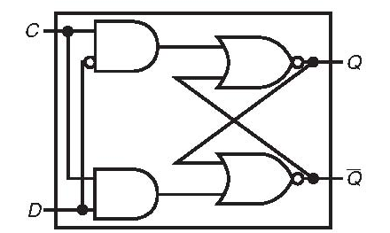
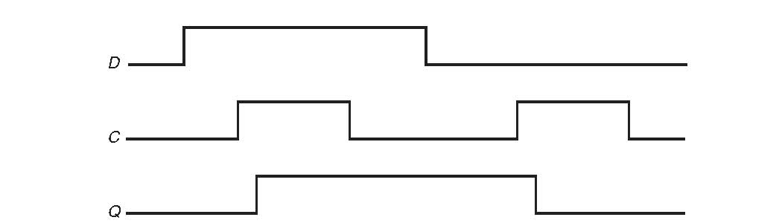
D latch
Clock C is asserted (F/F opened) – D is passed to Q
C is deasserted (closed) – Q is locked on previous value

Slide 5
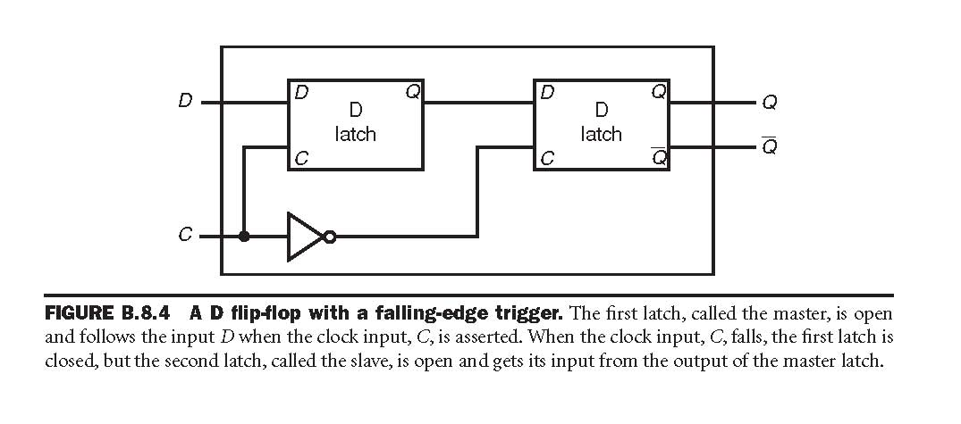
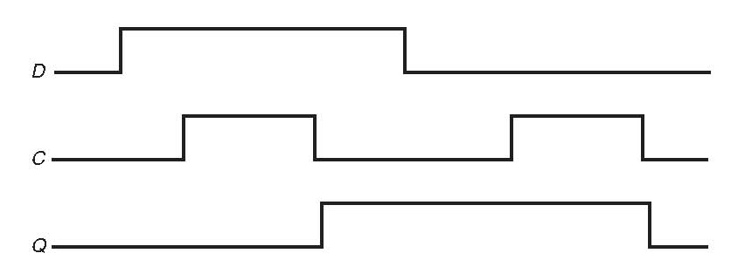
D F/F
1st latch (master) opens as clock is asserted
2nd latch opens at clock falling edge

Slide 6
Registers
Structure
i₇
D
o₇
C
Q+
i₆
D
o₆
I
O
C
Q+
i₅
D
o₅
C
Q+
i₄
D
o₄
C
Q+
Clock
i₃
D
o₃
C
Q+
i₂
D
o₂
C
Q+
i₁
D
o₁
C
Q+
i₀
D
o₀
C
Q+
Clock
Stores word of data
Different from program registers seen in assembly code
Collection of edge-triggered latches
Loads input on rising edge of clock

Slide 7
Register Operation
State = x
State = y
x
Rising
clock
y
Input = y
Output = x


Output = y
Stores data bits
For most of time acts as barrier between input and output
As clock rises, loads input

Slide 8
Registers
Write to a register
d31
d1
d0
write
C
C
D31
D1
D0
Q
Q
Q

Slide 9
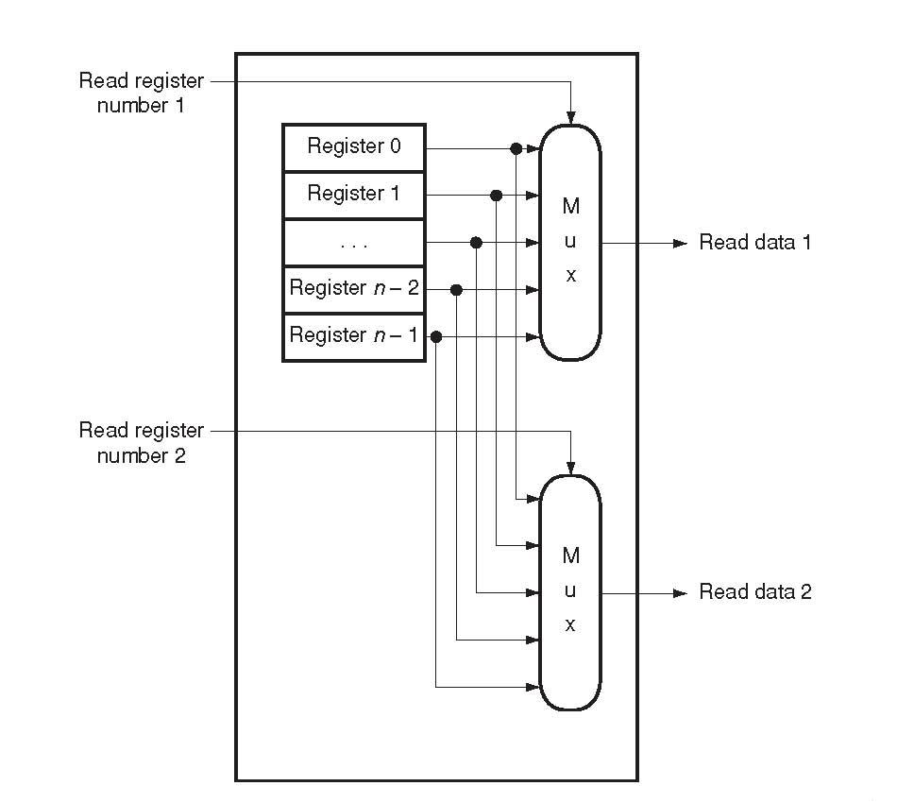
Register File
Register File
Multiple registers
Two read ports

Slide 10
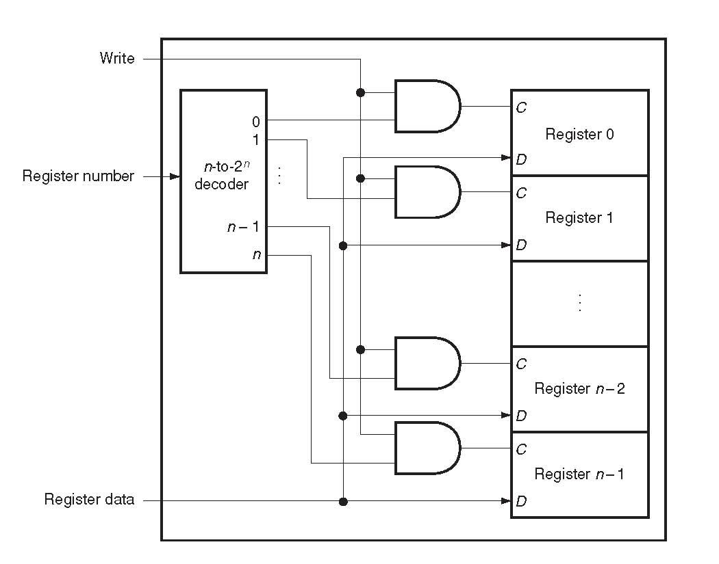
Register File
Write port

Slide 11
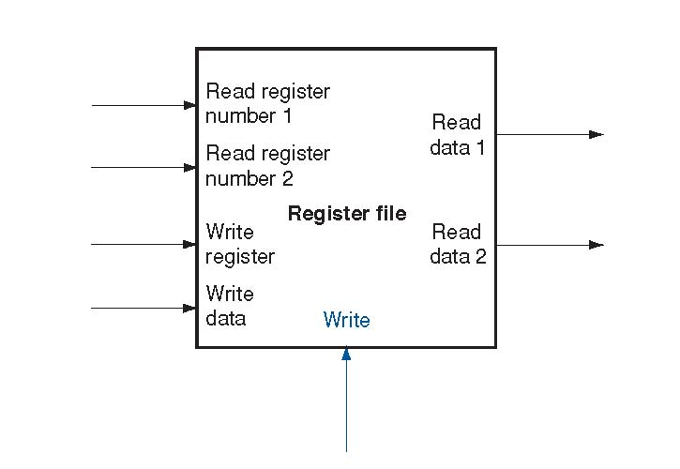
Register File

Slide 12
Main Memory
Main Memory
A huge register file
0x0000 0000
Reserved
0x0040 0000
Text Segment – user code
0x1000 0000
0x1004 0000
Data Segment
Heap
Stack
0x8000 0080
Kernel (Trap Handler)
0x9000 0000
O.S.
0x FFFF 0000
Memory Mapped I/O

Slide 13
Main Memory in ISA 32
Memory
invisible to
user code
0xffffffff
Kernel virtual memory
0xc0000000
User stack
(created at runtime)
Memory mapped region for
shared libraries
printf() function
0x40000000
Run-time heap
(created at runtime by malloc)
Read/write data
Loaded from the
executable file
Read-only code and data
0x08048000
Unused
0

