Slide 1
Machine Org. from Building Blocks
Memory
CPU
Registers
Addresses
Object Code
Program Data
Stack
OS Data/Code
PC
ALU
Data
Condition
Codes
Instructions

Slide 2
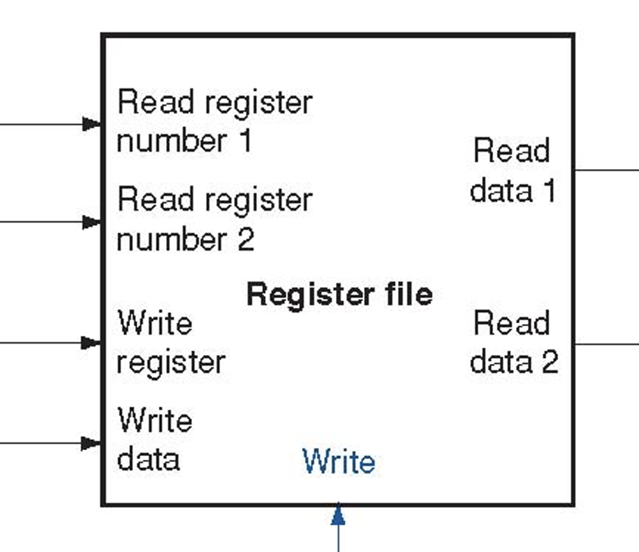
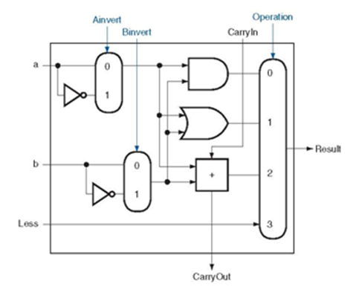
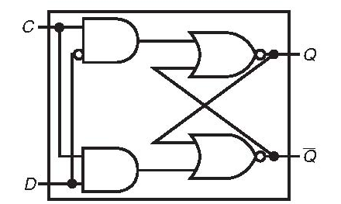
Machine Org. from Building Blocks
Memory
CPU
Registers
Addresses
Object Code
Program Data
Stack
OS Data/Code
PC
ALU
Data
Condition
Codes
Instructions

Slide 3
Machine Org. from Building Blocks
Memory
CPU
Registers
Addresses
Object Code
Program Data
Stack
OS Data/Code
PC
ALU
Data
Condition
Codes
Instructions
Given a program in Memory, how does silicon execute each instruction (machine code) ?

Slide 4
Instruction Decoding
Optional
Optional
5
0
rA
rB
D
icode
ifun
rA
rB
valC
Instruction Format
Instruction byte icode:ifun
Optional register byte rA:rB
Optional constant word valC

Slide 5
Instruction Decoding
Optional
Optional
5
0
rA
rB
D
icode
ifun
rA
rB
valC
Given an instruction (machine code), how does Silicon tell which building blocks to use and HOW?

Slide 6
How to design to handle these instr?
Byte
0
1
2
3
4
5
6
7
8
9
2
0
rrmovq
halt
0
0
2
1
cmovle
2
2
cmovl
2
3
nop
1
0
cmove
2
4
cmovne
2
5
cmovXX rA, rB
2
fn
rA
rB
cmovge
2
6
cmovg
irmovq V, rB
3
0
F
rB
V
rmmovq rA, D(rB)
4
0
rA
rB
D
mrmovq D(rB),rA
5
0
rA
rB
D
OPq rA, rB
6
fn
rA
rB
7
0
jXX Dest
7
fn
Dest
jmp
jle
7
1
call Dest
8
0
Dest
7
2
jl
ret
9
0
addq
7
3
6
0
je
subq
pushq rA
A
0
rA
F
6
1
7
4
jne
6
2
andq
7
5
popq rA
B
0
rA
F
jge
xorq
6
3
7
6
jg

Slide 7
How to design machine ?
cmovXX rA, rB
Create a neutral machine good for any instruction in whichever order
Given a neutral machine
Store program in memory
Bring one instruction at a time, and execute it
Move on to the next instruction (except for jump and call)
Stored Program Computer
Von Neumann, 1945
Computer re-usable for any programs
irmovq V, rB
rmmovq rA, D(rB)
mrmovq D(rB), rA
OPq rA, rB
jXX Dest
call Dest
ret
pushq rA
popq rA

Slide 8
Five steps of instruction execution
Bring a new machine code from memory to IR (instruction register)
Check i-code
Get rA, rB, valC, if used
Compute via ALU
OP
valB+D
%rsp+-8
Get memory data
Store result in register
write data
Update PC
cmovXX rA, rB
irmovq V, rB
rmmovq rA, D(rB)
mrmovq D(rB), rA
OPq rA, rB
jXX Dest
call Dest
ret
pushq rA
popq rA

Slide 9
Five steps of instruction execution
5
0
rA
rB
V
cmovXX rA, rB
Bring a new machine code from memory to IR
iCode, iFun, rA, rB, valC
PC + # -> valP
Check i-code
R[rA] -> valA, R[rB] -> valB
Compute via ALU
{OP, valB+D, %rsp+-8} -> valE
Get memory data
valM
Store result in register
Update PC
{valP, target addr, valM} -> PC
irmovq V, rB
rmmovq rA, D(rB)
mrmovq D(rB), rA
OPq rA, rB
jXX Dest
call Dest
ret
pushq rA
popq rA

Slide 10
Five steps of instruction execution
5
0
rA
rB
V
cmovXX rA, rB
Bring a new machine code from memory to IR
iCode, iFun, rA, rB, valC
PC + # -> valP
Check i-code
R[rA] -> valA, R[rB] -> valB
Compute via ALU
{OP, valB+D, %rsp+-8} -> valE
Get memory data
valM
Store result in register
Update PC
{valP, target addr, valM} -> PC
Fetch
Decode
Execute
Memory
Write Back
irmovq V, rB
rmmovq rA, D(rB)
mrmovq D(rB), rA
OPq rA, rB
jXX Dest
call Dest
ret
pushq rA
popq rA

Slide 11
5-cycle SEQ
Building Blocks
Fetch
Read instruction from instruction memory
Decode
Read registers
Execute (ALU op)
Compute value or address
Memory
Read or write data
Write Back (Reg WB)
Write registers
PC
Update program counter

Slide 12
Multiplexor (Selector)
Select input word A or B depending on control signal s
s
s
b₆₃
B
MUX
out₆₃
Out
a₆₃
A
b₆₂
out₆₂
a₆₂
Out = [s: A; 1: B;];
b₀
out₀
a₀

Slide 13
5-cycle SEQ
PC
newPC
valE
,
valM
Write back
valM
Data
Memory
Data
memory
memory
Addr
, Data
valE
CC
CC
ALU
Execute
Cnd
ALU
aluA
,
aluB
valA
,
valB
Decode
srcA
,
srcB
A
A
B
dstA
,
dstB
B
M
Register
M
Register
Register
Register
file
file
file
file
E
E
icode
rA
,
ifun
valP
,
rB
valC
Instruction
PC
Instruction
PC
Fetch
memory
increment
memory
increment
PC

Slide 14
5-cycle SEQ
PC
newPC
valE
,
valM
Write back
valM
Data
Memory
Data
memory
memory
Addr
, Data
valE
CC
CC
ALU
Execute
Cnd
ALU
aluA
,
aluB
valA
,
valB
Decode
srcA
,
srcB
A
A
B
dstA
,
dstB
B
M
Register
M
Register
Register
Register
file
file
file
file
E
E
icode
rA
,
ifun
valP
,
rB
valC
Instruction
PC
Instruction
PC
Fetch
memory
increment
memory
increment
PC

Slide 15
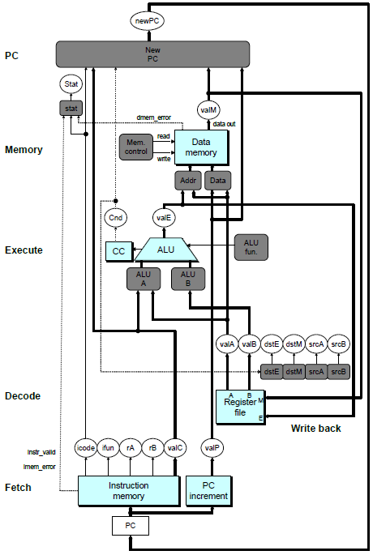
SEQ Hardware
Key
Blue boxes: predesigned hardware blocks
E.g., memories, ALU
Gray boxes: control logic
White ovals: labels for signals
Thick lines: 64-bit word values
Thin lines: 4-8 bit values
Dotted lines: 1-bit values

Slide 16
Computed Values - Variables
Memory
valM Value from memory
Execute
valE ALU result
Cnd Branch/move flag
Decode
srcA Register ID A
srcB Register ID B
dstE Destination Register E
dstM Destination Register M
valA Register value A
valB Register value B
Fetch
icode Instruction code
ifun Instruction function
rA Instr. Register A
rB Instr. Register B
valC Instruction constant
valP Incremented PC

Slide 17
Move Operations
Register ➔ Register
rrmovq rA, rB
2
0
Immediate ➔ Register
irmovq V, rB
3
0
F
rB
V
Register ➔ Memory
rmmovq rA, D(rB)
4
0
rA
rB
D
Memory ➔ Register
mrmovq D(rB), rA
5
0
rA
rB
D

Slide 18
irmovq V, rB
Fetch
valC <- V
via ALU
ALU_A <- valC; ALU_B <- 0; Add; valE
Transfer
dstE <- rB; valE <- valE, write

Slide 19
rmmovq rA, D(rB)
Fetch
valC <- D;
Decode
valA <- R[rA]; valB <- R[rB]
Add
ALU_A <- valC; ALU_B <- valB; add;valE
3. Memory Write
M_addr <- valE; M_data <- valA; M_write

Slide 20
Stage Computation: rmmovq
rmmovq rA, D(rB)
Fetch
icode:ifun ← M₁[PC]
Read instruction byte
rA:rB ← M₁[PC+1]
Read register byte
valC ← M₈[PC+2]
Read displacement D
valP ← PC+10
Compute next PC
Decode
Execute
Memory
Write
back
PC update

Slide 21
Stage Computation: rmmovq
rmmovq rA, D(rB)
Fetch
icode:ifun ← M₁[PC]
Read instruction byte
rA:rB ← M₁[PC+1]
Read register byte
valC ← M₈[PC+2]
Read displacement D
valP ← PC+10
Compute next PC
Decode
valA ← R[rA]
Read operand A
valB ← R[rB]
Read operand B
Execute
Memory
Write
back
PC update

Slide 22
Stage Computation: rmmovq
rmmovq rA, D(rB)
Fetch
icode:ifun ← M₁[PC]
Read instruction byte
rA:rB ← M₁[PC+1]
Read register byte
valC ← M₈[PC+2]
Read displacement D
valP ← PC+10
Compute next PC
Decode
valA ← R[rA]
Read operand A
valB ← R[rB]
Read operand B
Execute
valE ← valB + valC
Compute effective address
Memory
Write
back
PC update
Use ALU for address computation

Slide 23
Stage Computation: rmmovq
rmmovq rA, D(rB)
Fetch
icode:ifun ← M₁[PC]
Read instruction byte
rA:rB ← M₁[PC+1]
Read register byte
valC ← M₈[PC+2]
Read displacement D
valP ← PC+10
Compute next PC
Decode
valA ← R[rA]
Read operand A
valB ← R[rB]
Read operand B
Execute
valE ← valB + valC
Compute effective address
Memory
M₈[valE] ← valA
Write value to memory
Write
back
PC update

Slide 24
Stage Computation: rmmovq
rmmovq rA, D(rB)
Fetch
icode:ifun ← M₁[PC]
Read instruction byte
rA:rB ← M₁[PC+1]
Read register byte
valC ← M₈[PC+2]
Read displacement D
valP ← PC+10
Compute next PC
Decode
valA ← R[rA]
Read operand A
valB ← R[rB]
Read operand B
Execute
valE ← valB + valC
Compute effective address
Memory
M₈[valE] ← valA
Write value to memory
Write
back
PC update
PC <- valP
Update PC

Slide 25
Executing Arith./Logical Operation
OPq rA, rB
6
fn
rA
rB
Fetch
Read 2 bytes
Decode
Read operand registers
Execute
Perform operation
Set condition codes
Memory
Do nothing
Write back
Update register
PC Update
Increment PC by 2

Slide 26
Stage Computation: Arith/Log. Ops
OPq rA, rB
Fetch
icode:ifun ← M₁[PC]
Read instruction byte
rA:rB ← M₁[PC+1]
Read register byte
valP ← PC+2
Compute next PC
Decode
valA ← R[rA]
Read operand A
valB ← R[rB]
Read operand B
Execute
valE ← valB OP valA
Perform ALU operation
Set CC
Set condition code register
Memory
Write
back
R[rB] ← valE
Write back result
PC update
PC ← valP
Update PC
Formulate instruction execution as sequence of simple steps
Use same general form for all instructions

Slide 27
Executing popq
popq rA
b
0
rA
8
Fetch
Read 2 bytes
Decode
Read stack pointer
Execute
Increment stack pointer by 8
Memory
Read from old stack pointer
Write back
Update stack pointer
Write result to register
PC Update
Increment PC by 2

Slide 28
Stage Computation: popq
popq rA
Fetch
icode:ifun ← M₁[PC]
Read instruction byte
rA:rB ← M₁[PC+1]
Read register byte
valP ← PC+2
Compute next PC
Decode
valA ← R[%rsp]
Read stack pointer
valB ← R[%rsp]
Read stack pointer
Execute
valE ← valB + 8
Increment stack pointer
Memory
valM ← M₈[valA]
Read from stack
Write
back
R[%rsp] ← valE
Update stack pointer
R[rA] ← valM
Write back result
PC update
PC ← valP
Update PC
Use ALU to increment stack pointer
Must update two registers
Popped value
New stack pointer

Slide 29
Executing Conditional Moves
cmovXX rA, rB
2
fn
rA
rB
Fetch
Read 2 bytes
Decode
Read operand registers
Execute
If !cnd, then set destination register to 0xF
Memory
Do nothing
Write back
Update register (or not)
PC Update
Increment PC by 2

Slide 30
Stage Computation: Cond. Move
cmovXX rA, rB
Fetch
icode:ifun ← M₁[PC]
Read instruction byte
rA:rB ← M₁[PC+1]
Read register byte
valP ← PC+2
Compute next PC
Decode
valA ← R[rA]
Read operand A
valB ← 0
Execute
valE ← valB + valA
Pass valA through ALU
If ! Cond(CC,ifun) rB ← 0xF
(Disable register update)
Memory
Write
back
R[rB] ← valE
Write back result
PC update
PC ← valP
Update PC
Read register rA and pass through ALU
Cancel move by setting destination register to 0xF
If condition codes & move condition indicate no move

Slide 31
Executing Jumps
jXX Dest
7
fn
Dest
fall thru:
XX
XX
Not taken
target:
XX
XX
Taken
Fetch
Read 9 bytes
Increment PC by 9
Decode
Do nothing
Execute
Determine whether to take branch based on jump condition and condition codes
Memory
Do nothing
Write back
Do nothing
PC Update
Set PC to Dest if branch taken or to incremented PC if not branch

Slide 32
Stage Computation: Jumps
jXX Dest
Fetch
icode:ifun ← M₁[PC]
Read instruction byte
valC ← M₈[PC+1]
Read destination address
valP ← PC+9
Fall through address
Decode
Execute
Cnd ← Cond(CC,ifun)
Take branch?
Memory
Write
back
PC update
PC ← Cnd ? valC : valP
Update PC
Compute both addresses
Choose based on setting of condition codes and branch condition

Slide 33
Executing call
call Dest
8
0
Dest
return:
XX
XX
target:
XX
XX
Fetch
Read 9 bytes
Increment PC by 9
Decode
Read stack pointer
Execute
Decrement stack pointer by 8
Memory
Write incremented PC to new value of stack pointer
Write back
Update stack pointer
PC Update
Set PC to Dest

Slide 34
Stage Computation: call
call Dest
Fetch
icode:ifun ← M₁[PC]
Read instruction byte
valC ← M₈[PC+1]
Read destination address
valP ← PC+9
Compute return point
Decode
valB ← R[%rsp]
Read stack pointer
Execute
valE ← valB + –8
Decrement stack pointer
Memory
M₈[valE] ← valP
Write return value on stack
Write
back
R[%rsp] ← valE
Update stack pointer
PC update
PC ← valC
Set PC to destination
Use ALU to decrement stack pointer
Store incremented PC

Slide 35
Executing ret
ret
9
0
return:
XX
XX
Fetch
Read 1 byte
Decode
Read stack pointer
Execute
Increment stack pointer by 8
Memory
Read return address from old stack pointer
Write back
Update stack pointer
PC Update
Set PC to return address

Slide 36
Stage Computation: ret
ret
Fetch
icode:ifun ← M₁[PC]
Read instruction byte
Decode
valA ← R[%rsp]
Read operand stack pointer
valB ← R[%rsp]
Read operand stack pointer
Execute
valE ← valB + 8
Increment stack pointer
Memory
valM ← M₈[valA]
Read return address
Write
back
R[%rsp] ← valE
Update stack pointer
PC update
PC ← valM
Set PC to return address
Use ALU to increment stack pointer
Read return address from memory

