Slide 1
Integers
Topics
    Numeric Encodings (2.2)
      Unsigned & Two’s complement
      C promotion rules
    Basic operations (2.3)
      Addition, negation, multiplication
      Consequences of overflow
      Using shifts to perform power-of-2 multiply/divide

Slide 2
Decimal Numbers
Digits: 0,1,…9
    49 – 2
      49 + (100 – 2) = 49 + 98 = 147 = 47
    2 – 49
      2 + (100 – 49) = 2 + 51 = 53 = 100-47
Pat. 10’s comp.
0 0
1 1
2 2
3 3
4 4
5 -5
6 -4
7 -3
8 -2
9 -1
Pat. 10’s comp
00 0
01 1
..
49 49
50 -50
51 -49
52 -48
..
98 -2
99 -1

Slide 3
Unsigned & Signed Numeric Values
Given n bits, all a matter of mapping (rule)
X | B2U(X) | B2S(X) | B2O(X) | B2T(X)
000 | 0 | 0 | 0 | 0
001 | 1 | 1 | 1 | 1
010 | 2 | 2 | 2 | 2
011 | 3 | 3 | 3 | 3
100 | 4 | -0 | -3 | -4
101 | 5 | -1 | -2 | -3
110 | 6 | -2 | -1 | -2
111 | 7 | -3 | -0 | -1

Slide 4
Unsigned & Signed Numeric Values
X
B2U(X)
B2T(X)
Equivalence
  Same encodings for nonnegative values
Uniqueness
  Every bit pattern represents unique integer value
  Each representable integer has unique bit encoding
⇒ Can Invert Mappings
  U2B(x) = B2U⁻¹(x)
    Bit pattern for unsigned integer
  T2B(x) = B2T⁻¹(x)
    Bit pattern for two’s comp integer
0000
0
0
0001
1
1
0010
2
2
0011
3
3
0100
4
4
0101
5
5
0110
6
6
0111
7
7
1000
8
–8
1001
9
–7
1010
10
–6
1011
11
–5
1100
12
–4
1101
13
–3
1110
14
–2
1111
15
–1

Slide 5
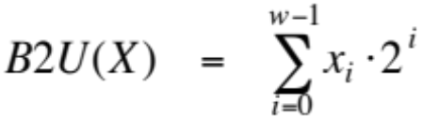
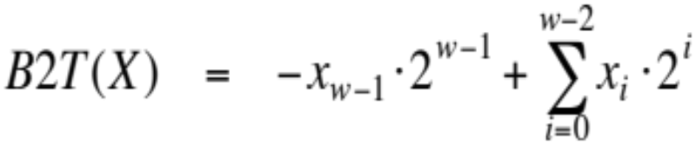
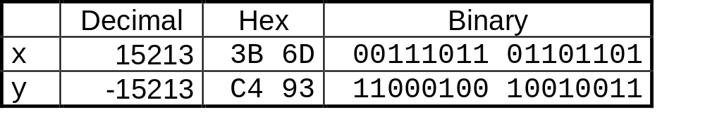
Encoding Integers
Unsigned
Two’s Complement
Sign
Bit
short int x = 15213;
short int y = -15213;
  C short 2 bytes long

Slide 6
Two’s Complement
From x to decimal
  For 2’s complement, most significant bit indicates sign
    0 for nonnegative
    1 for negative

Slide 7
Two’s Complement
From x to –x
  -x = ~x + 1
  6-bit binary
    x = 010101₂ (21)
    -x = 101010 + 1 = 101011 (-32+8+3 = -21)
    x = 101011 (-21)
    -x = 010101 (+21)
    x = 100000 ?
-x = ~x + 1
x+ ~x = 1111..1 = -1

Slide 8
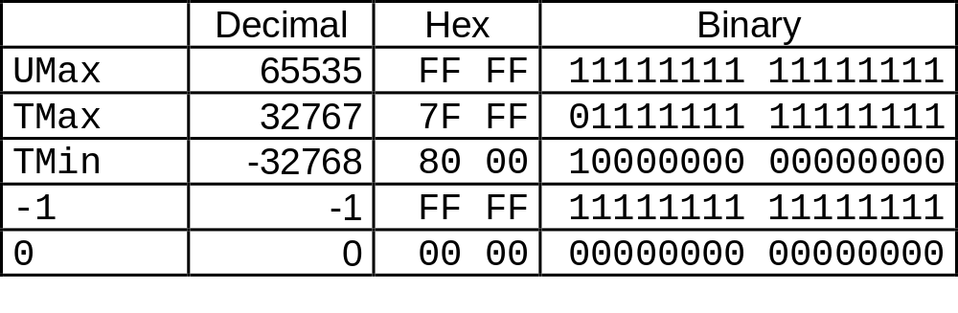
Numeric Ranges
Unsigned Values
  UMin = 0
    000…0
  UMax = 2^{w} – 1
    111…1
Two’s Complement Values
  TMin = –2^{w–1}
    100…0
  TMax = 2^{w–1} – 1
    011…1
Other Values
  Minus 1
    111…1
Values for W = 16

Slide 9
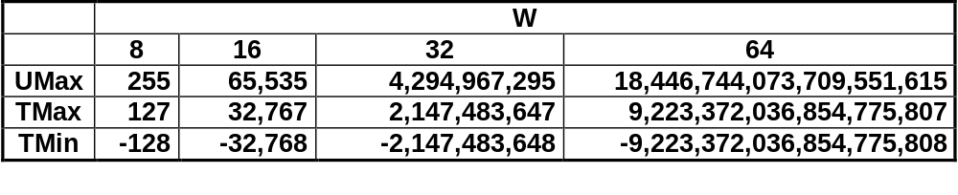
Values for Different Word Sizes
C Programming
  #include <limits.h>
    K&R App. B11
  Declares constants, e.g.,
    ULONG_MAX
    LONG_MAX
    LONG_MIN
  Values platform-specific
Observations
  |TMin | = TMax + 1
  Asymmetric range
    Umax = 2 * TMax + 1
  -Tmin ?

Slide 10
Prob. 2.19
X
T2B₄(X)
-8
-3
-2
-1
0
5

