Slide 1
Integers
Topics
    Numeric Encodings (2.2)
      Unsigned & Two’s complement
      C promotion rules
    Basic operations (2.3)
      Addition, negation, multiplication
      Consequences of overflow
      Using shifts to perform power-of-2 multiply/divide

Slide 2
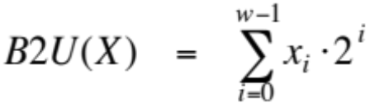
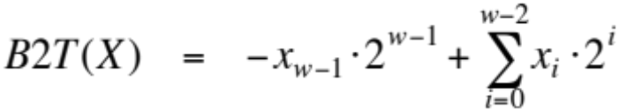
Encoding Integers
Unsigned
Two’s Complement
Sign
Bit

Slide 3
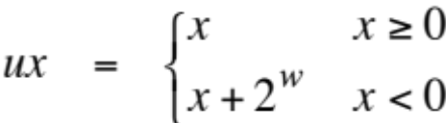
2.2. Casting Signed to Unsigned
C Allows Conversions from Signed to Unsigned
Resulting Value
  No change in bit representation
  Nonnegative values unchanged
    ux = 15213
  Negative values change into (large) positive values
    uy = 50323
short int x = 15213;
unsigned short int ux = (unsigned short) x;
short int y = -15213;
unsigned short int uy = (unsigned short) y;

Slide 4
Signed vs. Unsigned in C
Constants
  By default are considered to be signed integers
  Unsigned if have “U” as suffix
    0U, 4294967259U
Casting
  Explicit casting between signed & unsigned same as U2T and T2U
    int tx, ty;
    unsigned ux, uy;
    tx = (int) ux;
    uy = (unsigned) ty;
  Implicit casting also occurs via assignments and procedure calls
    tx = ux;
    uy = ty;

Slide 5
Casting Surprises
Expression Evaluation
  If mix unsigned and signed in single expression, signed values implicitly cast to unsigned
  Including comparison operations <, >, ==, <=, >=
  Examples for W = 8
Constant₁ Constant₂
0 0U
-1 0
  -1 0U
  127 -128
  127U -128
  (unsigned) -1 -2
  127 128U
  127 (int) 128U

Slide 6
Casting Surprises
Expression Evaluation
  If mix unsigned and signed in single expression, signed values implicitly cast to unsigned
  Including comparison operations <, >, ==, <=, >=
  Examples for W = 8
Constant₁ Constant₂
0 == 0U
-1 < 0
  -1 > 0U
  127 > -128
  127U < -128
  (unsigned) -1 > -2
  127 < 128U
  127 > (int) 128U

Slide 7
Why Casting Surprises ?
2’s Comp. → Unsigned
  Ordering Inversion
  Negative → Big Positive
UMax
UMax – 1
TMax + 1
Unsigned
Range
TMax
TMax
2’s Comp.
Range
0
0
–1
–2
TMin

Slide 8
Sign Extension
Task:
  Given w-bit signed integer x
  Convert it to w+k-bit integer with same value
Rule:
  Make k copies of sign bit:
  X ′ = x_{w–1} ,…, x_{w–1} , x_{w–1} , x_{w–2} ,…, x₀
k copies of MSB
w
X
• • •
• • •
X ′
• • •
• • •
k
w

Slide 9
Sign Extension Example
short int x = 15213;
int ix = (int) x;
short int y = -15213;
int iy = (int) y;
Decimal
Hex
Binary
x
15213
3B 6D
00111011 01101101
ix
15213
00 00 3B 6D
00000000 00000000 00111011 01101101
y
-15213
C4 93
11000100 10010011
iy
-15213
FF FF C4 93
11111111 11111111 11000100 10010011
  Converting from smaller to larger integer data type
  C automatically performs sign extension

Slide 10
Justification For Sign Extension
Prove Correctness by Induction on k
  Induction Step: extending by single bit maintains value
  Key observation: –2^{w–1} = –2^{w} +2^{w–1}
  Look at weight of upper bits:
    X –2^{w–1} x_{w–1}
    X ′ –2^{w} x_{w–1} + 2^{w–1} x_{w–1} = –2^{w–1} x_{w–1}
w
X
-
• • •
X ′
-
+
• • •
w+1

Slide 11
Shift Operations
Left Shift: x << y
  Shift bit-vector x left y positions
    Throw away extra bits on left
    Fill with 0’s on right
Right Shift: x >> y
  Shift bit-vector x right y positions
    Throw away extra bits on right
  Logical shift
    Fill with 0’s on left
  Arithmetic shift
    Replicate most significant bit on right
    Useful with two’s complement integer representation
Argument x
01100010
<< 3
00010000
00010000
00010000
Log. >> 2
00011000
0001100
00011000
Arith. >>2
00011000
0001100
00011000
Argument x
10100010
<< 3
00010000
00010000
00010000
Log. >> 2
00101000
0010100
00101000
Arith. >> 2
11101000
1110100
11101000

Slide 12
Prob. 2.44
int x = foo(); /* arbitrary value */
int y = bar(); /* arbitrary value */
ux = unsigned x; uy = unsigned y;
For any x and y, are the following always true ?
(x>0) || (x-1<0)
(x & 7) !=7 || (x<<29 < 0)
(x*x) >=0
x < 0 || -x <= 0
x > 0 || -x >= 0
x+y == uy+ux
x * ~y + uy * ux == -x

