Slide 1
4.2. Logic Design
Combinational logic
No memory, stateless
A set of inputs uniquely and unambiguously specifies what outputs are
Use Boolean logic (combinations of true and false)

Slide 2
4.2. Logic Design
Combinational logic
No memory, stateless
A set of inputs uniquely and unambiguously specifies what outputs are
Use Boolean logic (combinations of true and false)

Slide 3
Bit Equality
Bit equal
a
eq
eq = (a&&b)||(!a&&!b)
b
Generate 1 if a and b are equal

Slide 4
Bit Equality
Bit equal
a
eq
eq = (a&&b)||(!a&&!b)
b
Generate 1 if a and b are equal
eq = a’&b’ + a&b
a | b | eq
0 | 0 | 1
0 | 1 | 0
1 | 0 | 0
1 | 1 | 1

Slide 5
Word Equality
Word-Level Representation
b₆₃
Bit equal
eq₆₃
B
=
Eq
a₆₃
b₆₂
Bit equal
eq₆₂
A
a₆₂
HCL Representation
Eq
bool Eq = (A == B)
b₁
Bit equal
eq₁
a₁
b₀
Bit equal
eq₀
a₀

Slide 6
Bit-Level Multiplexor
s
Bit MUX
HCL Expression
out = (s&&a)||(!s&&b)
b
out
s
a
Mux
multiplexor (mux), selector
Control signal s
Data signals a and b
Output a when s=1, b when s=0

Slide 7
s
Mux
s | a | b | o
0 | 0 | 0 | 0
0 | 0 | 1 | 0
0 | 1 | 0 | 1
0 | 1 | 1 | 1
1 | 0 | 0 | 0
1 | 0 | 1 | 1
1 | 1 | 0 | 0
1 | 1 | 1 | 1

Slide 8
Word Multiplexor
s
Word-Level Representation
s
B
MUX
b₆₃
Out
out₆₃
A
a₆₃
Out = [
s : A;
1 : B;
];
b₆₂
out₆₂
a₆₂
Select input word A or B depending on control signal s
b₀
out₀
a₀

Slide 9
Decoder
Input a,b enables one of 4 outputs
a,b = 00 -> out0
a,b = 01 -> out1
a,b = 10 -> out2
a,b = 11 -> out3
Out0
a
Out1
b
Out2
Out3

Slide 10
Out0
a
Out1
b
Out2
Out3
a | b | Out0 | Out1 | Out2 | out3
0 | 0 | 1 | 0 | 0 | 0
0 | 1 | 0 | 1 | 0 | 0
1 | 0 | 0 | 0 | 1 | 0
1 | 1 | 0 | 0 | 0 | 1
Out0 = a’b’
Out1= a’b
Out2 = ab’
Out3 = ab

Slide 11
1-bit Adder
1-bit Adder: Properties
Three inputs: a, b, Carry-in
Two outputs: sum, C-out
Carry-in
a
sum
b
Carry-out

Slide 12
1-bit Adder
1-bit Adder: Properties
Three inputs: a, b, Carry-in
Two outputs: sum, C-out
Carry-in
a
sum
b
Carry-out
a b Cin S Cout
0 0 0 0 0
0 0 1 1 0
0 1 0 1 0
0 1 1 0 1
0 0 1 0
1 0 1 0 1
1 1 0 0 1
1 1 1 1 1

Slide 13
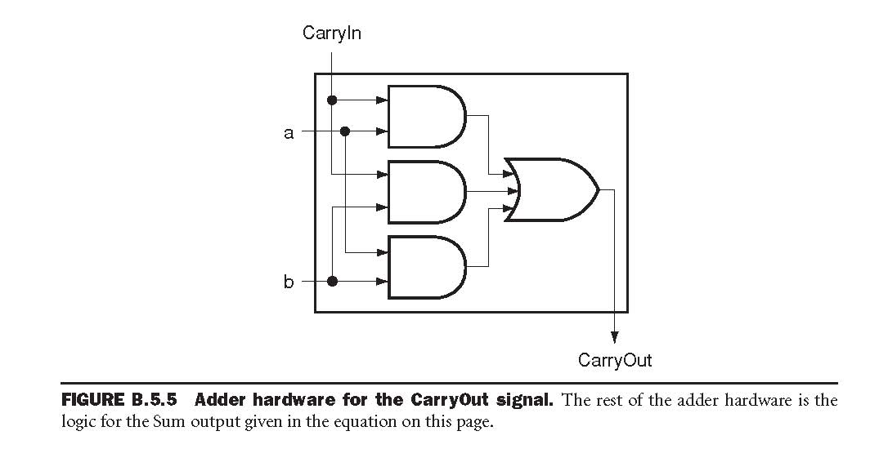
Carry-Out implementation
Cout =(b ⋅ Cin) + (a ⋅ Cin) + (a⋅b)
Similar implementation of Sum

Slide 14
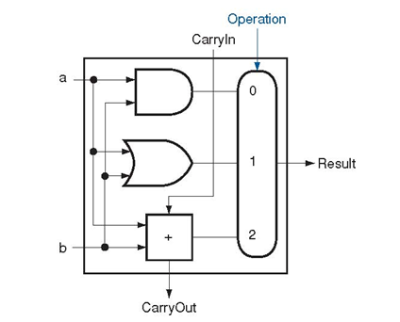
1-bit ALU
1-bit ALU
1-bit adder
Logical unit:
and/or

Slide 15
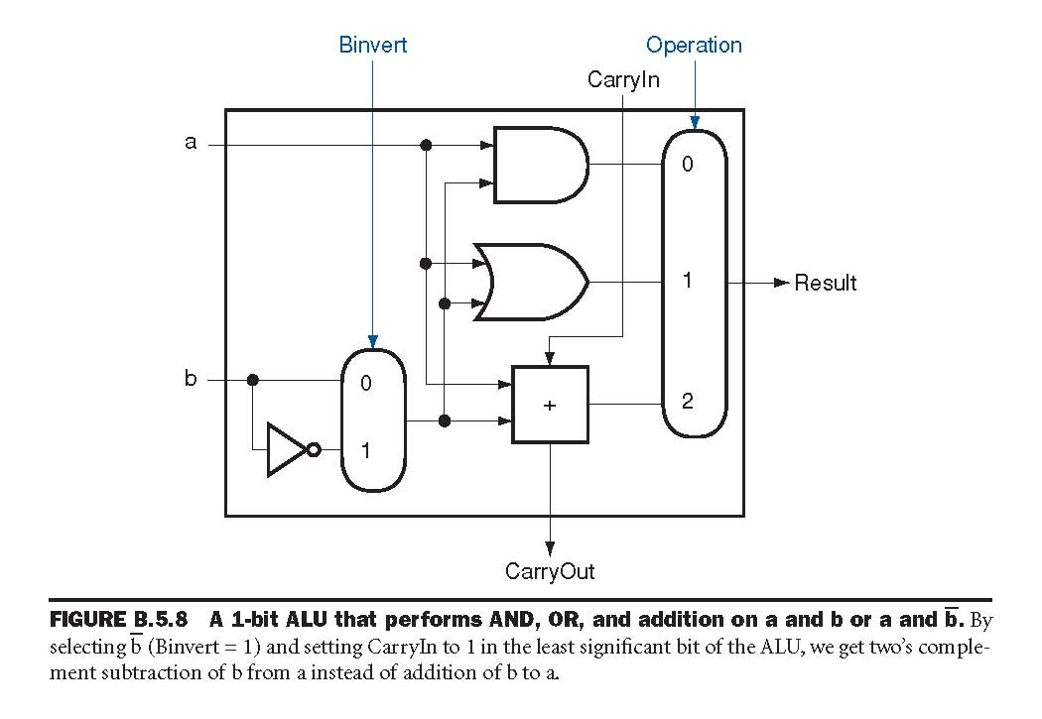
1-bit ALU
Capable of
ADD, AND, and OR
How to add SUB ?
a – b = a + (~b + 1)

Slide 16
1-bit ALU
Capable of
ADD, AND, and OR
How to add SUB ?
a – b = a + (~b + 1)
Add Binvert
How to add 1 ?

Slide 17
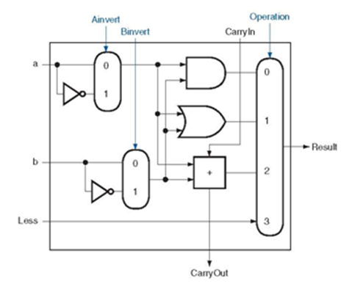
1-bit ALU
ADD, AND, OR, SUB
How to add NOR ?
(A+B)’ = A’B’
(AB)’ = A’ + B’
a-b
-a+b
-a-b = -(a+b)
a+b

Slide 18
32-bit ALU
CarryIn
Operation
From 1-bit ALU to
32-bit ALU
Chain carry-out to carry-in to the next bit
Set CarryIn in the least significant bit to 1 for subtraction
a₀
CarryIn
ALU₀
CarryOut
b₀
Result₀
a₁
CarryIn
ALU₁
CarryOut
b₁
Result₁
a₂
CarryIn
ALU₂
CarryOut
b₂
Result₂
…
…
…
a₃₁
CarryIn
ALU ₃₁
CarryOut
b₃₁
Result₃₁

