Slide 1
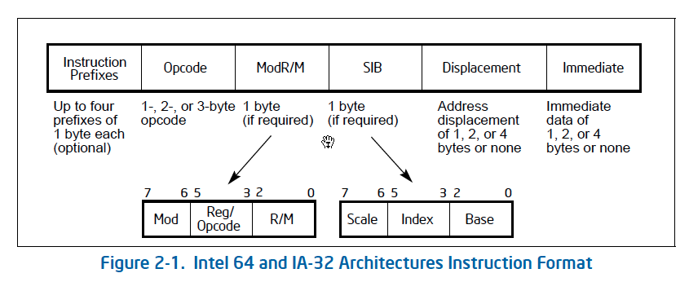
x86 Encoding

Slide 2
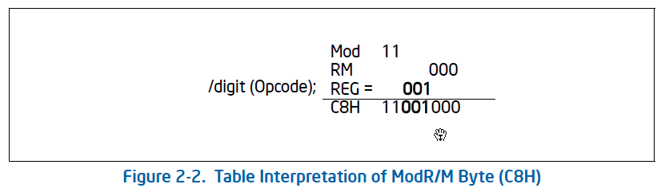
x86 Encoding

Slide 3
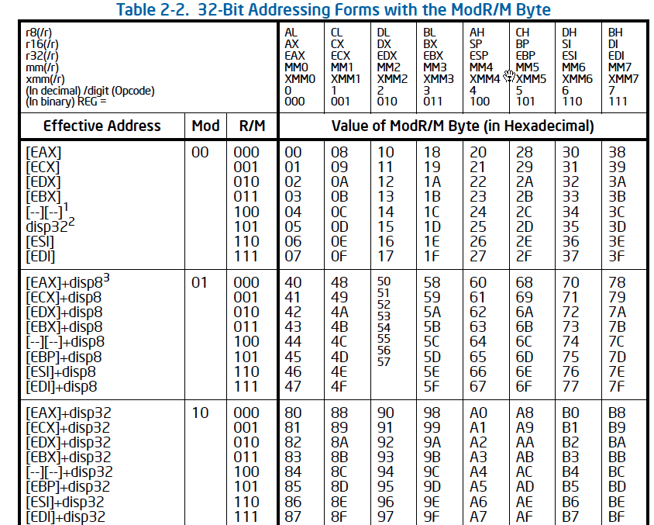
x86 Encoding

Slide 4
Object Code
Setup
Label .L49 becomes address 0x804875c
Label .L57 becomes address 0x8048bc0
08048718 <unparse_symbol>:
8048718: 55 pushl %ebp
8048719: 89 e5 movl %esp,%ebp
804871b: 8b 45 08 movl 0x8(%ebp),%eax
804871e: 83 f8 05 cmpl $0x5,%eax
8048721: 77 39 ja 804875c <unparse_symbol+0x44>
8048723: ff 24 85 c0 8b jmp *0x8048bc0(,%eax,4)

Slide 5
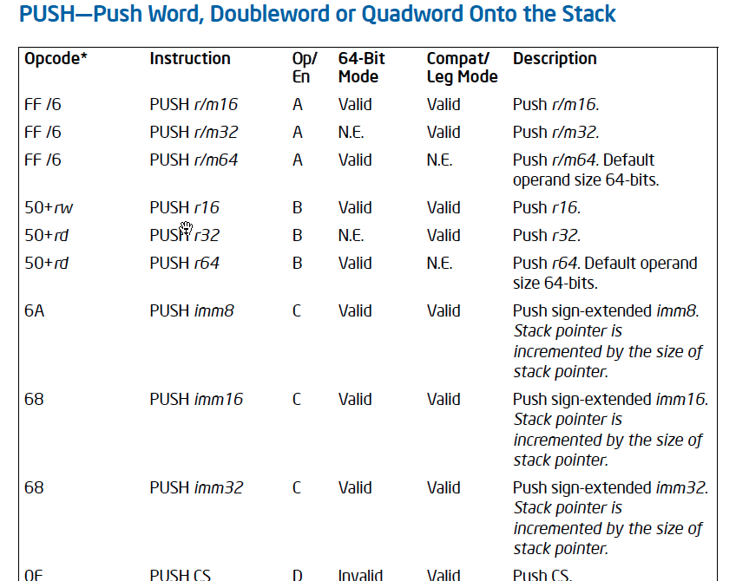

Slide 6
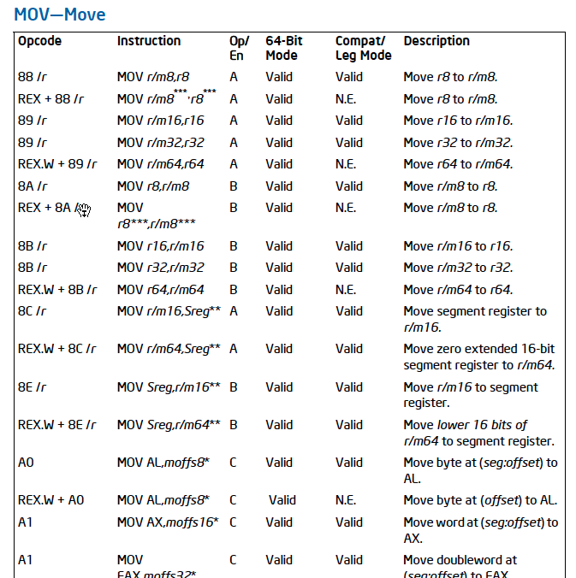

Slide 7
Object Code
89 e5 movl %esp,%ebp
Opcode: 89
modRM (mod R/M reg)
11 100 (esp) 101 (ebp)
08048718 <unparse_symbol>:
8048718: 55 pushl %ebp
8048719: 89 e5 movl %esp,%ebp
804871b: 8b 45 08 movl 0x8(%ebp),%eax
804871e: 83 f8 05 cmpl $0x5,%eax
8048721: 77 39 ja 804875c <unparse_symbol+0x44>
8048723: ff 24 85 c0 8b jmp *0x8048bc0(,%eax,4)

Slide 8
Object Code
8b 45 08 movl 0x8(%ebp),eax
Opcode: 8b
modRM (mod R/M reg)
01 000 (eax) 101 (ebp)
08048718 <unparse_symbol>:
8048718: 55 pushl %ebp
8048719: 89 e5 movl %esp,%ebp
804871b: 8b 45 08 movl 0x8(%ebp),%eax
804871e: 83 f8 05 cmpl $0x5,%eax
8048721: 77 39 ja 804875c <unparse_symbol+0x44>
8048723: ff 24 85 c0 8b jmp *0x8048bc0(,%eax,4)

Slide 9
Y86-64 Instructions
Format
1–10 bytes of information read from memory
Can determine instruction length from first byte
Not as many instruction types, and simpler encoding than x86-64
Each accesses and modifies some part(s) of the program state

Slide 10
Y86-64 Instruction Set #1
Byte
0
1
2
3
4
5
6
7
8
9
halt
0
0
nop
1
0
cmovXX rA, rB
2
fn
rA
rB
irmovq V, rB
3
0
F
rB
V
rmmovq rA, D(rB)
4
0
rA
rB
D
mrmovq D(rB), rA
5
0
rA
rB
D
OPq rA, rB
6
fn
rA
rB
jXX Dest
7
fn
Dest
call Dest
8
0
Dest
ret
9
0
pushq rA
A
0
rA
F
popq rA
B
0
rA
F

Slide 11
Y86-64 Instruction Set #2
rrmovq
2
0
Byte
0
1
2
3
4
5
6
7
8
9
cmovle
2
1
halt
0
0
cmovl
2
2
nop
1
0
cmove
2
3
cmovXX rA, rB
2
fn
rA
rB
cmovne
2
4
irmovq V, rB
3
0
F
rB
V
cmovge
2
5
rmmovq rA, D(rB)
4
0
rA
rB
D
cmovg
2
6
mrmovq D(rB), rA
5
0
rA
rB
D
OPq rA, rB
6
fn
rA
rB
jXX Dest
7
fn
Dest
call Dest
8
0
Dest
ret
9
0
pushq rA
A
0
rA
F
popq rA
B
0
rA
F

Slide 12
Y86-64 Instruction Set #3
Byte
0
1
2
3
4
5
6
7
8
9
halt
0
0
nop
1
0
cmovXX rA, rB
2
fn
rA
rB
irmovq V, rB
3
0
F
rB
V
rmmovq rA, D(rB)
4
0
rA
rB
D
addq
6
0
mrmovq D(rB), rA
5
0
rA
rB
D
subq
6
1
OPq rA, rB
6
fn
rA
rB
andq
6
2
jXX Dest
7
fn
Dest
xorq
6
3
call Dest
8
0
Dest
ret
9
0
pushq rA
A
0
rA
F
popq rA
B
0
rA
F

Slide 13
Y86-64 Instruction Set
Byte
0
1
2
3
4
5
6
7
8
9
2
0
rrmovq
halt
0
0
2
1
cmovle
2
2
cmovl
2
3
nop
1
0
cmove
2
4
cmovne
2
5
cmovXX rA, rB
2
fn
rA
rB
cmovge
2
6
cmovg
irmovq V, rB
3
0
F
rB
V
rmmovq rA, D(rB)
4
0
rA
rB
D
mrmovq D(rB),rA
5
0
rA
rB
D
OPq rA, rB
6
fn
rA
rB
7
0
jXX Dest
7
fn
Dest
jmp
jle
7
1
call Dest
8
0
Dest
7
2
jl
ret
9
0
addq
7
3
6
0
je
subq
pushq rA
A
0
rA
F
6
1
7
4
jne
6
2
andq
7
5
popq rA
B
0
rA
F
jge
xorq
6
3
7
6
jg

Slide 14
Y86-64 Processor State
RF: Program registers
CC: Condition codes
Stat: Program status
%rax
%rsp
%r8
%r12
%rcx
%rbp
%r9
%r13
ZF
SF
OF
DMEM: Memory
%rdx
%rsi
%r10
%r14
PC
%rbx
%rdi
%r11
Program Registers
15 registers (omit %r15). Each 64 bits
Condition Codes
Single-bit flags set by arithmetic or logical instructions
ZF: Zero SF:Negative OF: Overflow
Program Counter
Indicates address of next instruction
Program Status
Indicates either normal operation or some error condition
Memory
Byte-addressable storage array
Words stored in little-endian byte order

Slide 15
Encoding Registers
Each register has 4-bit ID
Same encoding as in x86-64
Register ID 15 (0xF) indicates “no register”
Will use this in our hardware design in multiple places
%rax
0
%r8
8
%rcx
1
%r9
9
%rdx
2
%r10
A
%rbx
3
%r11
B
%rsp
4
%r12
C
%rbp
5
%r13
D
%rsi
6
%r14
E
%rdi
7
No Register
F

Slide 16
Instruction Example
Addition Instruction
Add value in register rA to that in register rB
Store result in register rB
Note that Y86-64 only allows addition to be applied to register data
Set condition codes based on result
e.g., addq %rax,%rsi Encoding: 60 06
Two-byte encoding
First indicates instruction type
Second gives source and destination registers
Generic Form
Encoded Representation
addq rA, rB
6
0
rA
rB

Slide 17
Arithmetic and Logical Operations
Instruction Code
Function Code
Add
Refer to generically as “OPq”
Encodings differ only by “function code”
Low-order 4 bytes in first instruction word
Set condition codes as side effect
addq rA, rB
6
0
rA
rB
Subtract (rA from rB)
subq rA, rB
6
1
rA
rB
And
andq rA, rB
6
2
rA
rB
Exclusive-Or
xorq rA, rB
6
3
rA
rB

Slide 18
Move Operations
Register ➔ Register
rrmovq rA, rB
2
0
rA
rB
Immediate ➔ Register
irmovq V, rB
3
0
F
rB
V
Register ➔ Memory
rmmovq rA, D(rB)
4
0
rA
rB
D
Memory ➔ Register
mrmovq D(rB), rA
5
0
rA
rB
D
Like the x86-64 movq instruction
Simpler format for memory addresses
Give different names to keep them distinct

Slide 19
Move Instruction Examples
X86-64
Y86-64
movq $0xabcd, %rdx
irmovq $0xabcd, %rdx
$0xabcd: 00 00 00 00 00 00 ab cd
Encoding:
30 f2 cd ab 00 00 00 00 00 00
movq %rsp, %rbx
rrmovq %rsp, %rbx
Encoding:
20 43
movq %rsi,0x41c(%rsp)
rmmovq %rsi,0x41c(%rsp)
Encoding:
40 64 1c 04 00 00 00 00 00 00
movq -12(%rbp),%rcx
mrmovq -12(%rbp),%rcx
Encoding:
50 15 f4 ff ff ff ff ff ff ff

Slide 20
Conditional Move Instructions
Move Unconditionally
rrmovq rA, rB
2
0
rA
rB
Refer to generically as “cmovXX”
Encodings differ only by “function code”
Based on values of condition codes
Variants of rrmovq instruction
(Conditionally) copy value from source to destination register
Move When Less or Equal
cmovle rA, rB
2
1
rA
rB
Move When Less
cmovl rA, rB
2
2
rA
rB
Move When Equal
cmove rA, rB
2
3
rA
rB
Move When Not Equal
cmovne rA, rB
2
4
rA
rB
Move When Greater or Equal
cmovge rA, rB
2
5
rA
rB
Move When Greater
cmovg rA, rB
2
6
rA
rB

Slide 21
Jump Instructions
Jump (Conditionally)
jXX Dest
7
fn
Dest
Refer to generically as “jXX”
Encodings differ only by “function code” fn
Based on values of condition codes
Same as x86-64 counterparts
Encode full destination address
Unlike PC-relative addressing seen in x86-64

Slide 22
Jump Instructions
Jump Unconditionally
jmp Dest
7
0
Dest
Jump When Less or Equal
jle Dest
7
1
Dest
Jump When Less
jl Dest
7
2
Dest
Jump When Equal
je Dest
7
3
Dest
Jump When Not Equal
jne Dest
7
4
Dest
Jump When Greater or Equal
jge Dest
7
5
Dest
Jump When Greater
jg Dest
7
6
Dest

Slide 23
Y86-64 Program Stack
Stack “Bottom”
Region of memory holding program data
Used in Y86-64 (and x86-64) for supporting procedure calls
Stack top indicated by %rsp
Address of top stack element
Stack grows toward lower addresses
Top element is at highest address in the stack
When pushing, must first decrement stack pointer
After popping, increment stack pointer
•
•
•
Increasing
Addresses
%rsp
Stack “Top”

Slide 24
Stack Operations
pushq rA
A
0
rA
F
Decrement %rsp by 8
Store word from rA to memory at %rsp
Like x86-64
Read word from memory at %rsp
Save in rA
Increment %rsp by 8
Like x86-64
popq rA
B
0
rA
F

Slide 25
Subroutine Call and Return
call Dest
8
0
Dest
Push address of next instruction onto stack
Start executing instructions at Dest
Like x86-64
Pop value from stack
Use as address for next instruction
Like x86-64
ret
9
0

Slide 26
Miscellaneous Instructions
nop
1
0
Don’t do anything
Stop executing instructions
x86-64 has comparable instruction, but can’t execute it in user mode
We will use it to stop the simulator
Encoding ensures that program hitting memory initialized to zero will halt
halt
0
0

Slide 27
Y86 Code Generation Example
x86 Code
Y86 Code
len2:
pushq %rbp
movq %rsp,%rbp
xorq %rcx,%rcx
movq 8(%rbp),%rdx
movq (%rdx),%rax
jmp .L26
len2:
pushq %rbp # Save %ebp
rrmovq %4sp,%rbp # Set frame
xorq %rcx,%rcx # len = 0
mrmovq 8(%rbp),%rdx # Get a
mrmovq (%rdx),%rax # Get *a
jmp .L26 # Goto entry

Slide 28
Y86 Code Generation Example
x86 Code
Loop + Finish
Y86 Code
Loop + Finish
L24:
movq (%rdx),%rax
incq %rcx
L26:
addq $4,%rdx
testq %rax,%rax
jne L24
movq %rbp,%rsp
movq %rcx,%rax
popq %rbp
ret
L24:
mrmovq (%rdx),%rax # Get *a
irmovq $1,%rsi
addq %rsi,%rcx # len++
L26: # Entry:
irmovq $4,%rsi
addq %rsi,%rdx # a++
andq %rax,%rax # *a == 0?
jne L24 # No--Loop
rrmovq %rbp,%rsp # Pop
rrmovq %rcx,%rax # Rtn len
popq %rbp
ret

