Slide 1
OPq rA, rB
rmmovq rA, D(rB)
jXX Dest
popq rA
Fetch
icode:ifun ← M₁[PC]
icode:ifun ← M₁[PC]
icode:ifun ← M₁[PC]
icode:ifun ← M₁[PC]
rA:rB ← M₁[PC+1]
rA:rB ← M₁[PC+1]
rA:rB ← M₁[PC+1]
valP ← PC+2
valC ← M₈[PC+2]
valC ← M₈[PC+1]
valP ← PC+10
valP ← PC+9
valP ← PC+2
Decode
valA ← R[rA]
valA ← R[rA]
valA ← R[%rsp]
valB ← R[rB]
valB ← R[rB]
valB ← R[%rsp]
Execute
valE ← valB OP valA
valE ← valB + valC
valE ← valB + 8
Set CC
Cnd ← Cond(CC,ifun)
Memory
M₈[valE] ← valA
valM ← M₈[valA]
Write
back
R[rB] ← valE
R[%rsp] ← valE
R[rA] ← valM
PC update
PC ← valP
PC ← valP
PC ← Cnd ? valC : valP
PC ← valP

Slide 2
Fetch Logic
icode
ifun
rA
rB
valC
valP
Control Logic
Instr. Valid: Is this instruction valid?
icode, ifun: Generate no-op if invalid address
Need regids: Does this instruction have a register byte?
Need valC: Does this instruction have a constant word?
Need
valC
PC
increment
Instr
valid
Need
regids
icode
ifun
Split
Align
Byte 0
Bytes 1-9
Instruction
memory
imem_error
PC

Slide 3
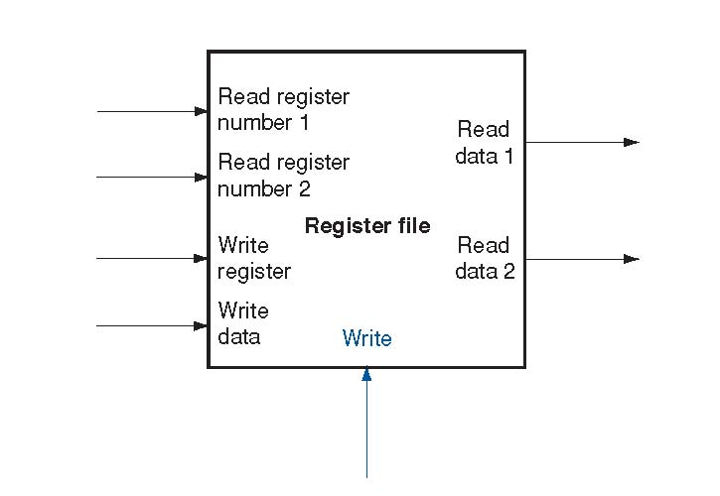
Decode Logic
Register File
Read ports A, B
Write ports E, M
Addresses are register IDs or 15 (0xF) (no access)
Cnd
valA
valB
valM
valE
A
B
Register
file
M
dstE
dstM
srcA
E
srcB
Control Logic
srcA, srcB: read port addresses
dstE, dstM: write port addresses
dstE
dstM
srcA
srcB
Signals
Cnd: Indicate whether or not to perform conditional move
Computed in Execute stage
icode
rA
rB

Slide 4
A Source
OPq rA, rB
Decode
valA ← R[rA]
Read operand A
cmovXX rA, rB
Decode
valA ← R[rA]
Read operand A
int srcA = [
icode in {IOPQ, IRRMOVQ, IRMMOVQ, IPUSHQ}: rA;
icode in {IPOPQ, IRET}: RRSP;
1 : RNONE; # Don't need register
];
rmmovq rA, D(rB)
Decode
valA ← R[rA]
Read operand A
popq rA
Decode
valA ← R[%rsp]
Read stack pointer
jXX Dest
Decode
No operand
call Dest
Decode
No operand
ret
Decode
valA ← R[%rsp]
Read stack pointer

Slide 5
E Destination
OPq rA, rB
Write-back
R[rB] ← valE
Write back result
cmovXX rA, rB
Conditionally write back result
Write-back
R[rB] ← valE
int dstE = [
icode in {IRRMOVQ} && Cnd: rB;
icode in {IIRMOVQ, IOPQ} : rB;
icode in {IPUSHQ, IPOPQ, ICALL, IRET}: RRSP;
1 : RNONE; # Don't write any register
];
rmmovq rA, D(rB)
Write-back
None
popq rA
Write-back
R[%rsp] ← valE
Update stack pointer
jXX Dest
Write-back
None
call Dest
Write-back
R[%rsp] ← valE
Update stack pointer
ret
Write-back
R[%rsp] ← valE
Update stack pointer

Slide 6
Execute Logic
Units
ALU
Implements 4 required functions
Generates condition code values
CC
Register with 3 condition code bits
cond
Computes conditional jump/move flag
Control Logic
Set CC: Should condition code register be loaded?
ALU A: Input A to ALU
ALU B: Input B to ALU
ALU fun: What function should ALU compute?
Cnd
valE
cond
ALU
ALU
fun.
CC
Set
CC
ALU
A
ALU
B
icode
ifun
valC
valA
valB

Slide 7
ALU A Input
OPq rA, rB
Execute
valE ← valB OP valA
Perform ALU operation
int aluA = [
icode in {IRRMOVQ, IOPQ}: valA;
icode in {IIRMOVQ, IRMMOVQ, IMRMOVQ}: valC;
icode in {ICALL, IPUSHQ}: -8;
icode in {IRET, IPOPQ}: 8;
# Other instructions don't need ALU
];
cmovXX rA, rB
Execute
valE ← 0 + valA
Pass valA through ALU
rmmovq rA, D(rB)
Execute
valE ← valB + valC
Compute effective address
popq rA
Execute
valE ← valB + 8
Increment stack pointer
jXX Dest
Execute
No operation
call Dest
Execute
valE ← valB + –8
Decrement stack pointer
ret
Execute
valE ← valB + 8
Increment stack pointer

Slide 8
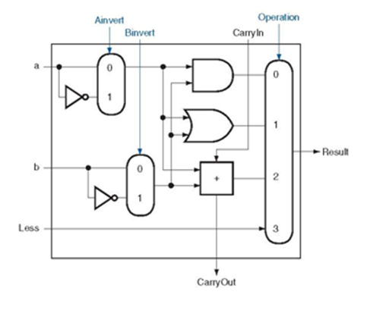
ALU Operation
OPl rA, rB
Execute
valE ← valB OP valA
Perform ALU operation
int alufun = [
icode == IOPQ : ifun;
1 : ALUADD;
];
cmovXX rA, rB
Execute
valE ← 0 + valA
Pass valA through ALU
rmmovl rA, D(rB)
Execute
valE ← valB + valC
Compute effective address
popq rA
Execute
valE ← valB + 8
Increment stack pointer
jXX Dest
Execute
No operation
call Dest
Execute
valE ← valB + –8
Decrement stack pointer
ret
Execute
valE ← valB + 8
Increment stack pointer

Slide 9
Memory Logic
Stat
stat
valM
Memory
Reads or writes memory word
Control Logic
stat: What is instruction status?
Mem. read: should word be read?
Mem. write: should word be written?
Mem. addr.: Select address
Mem. data.: Select data
dmem_error
data out
instr_valid
Mem.
read
read
Data
memory
imem_error
Mem.
write
write
data in
Mem.
addr
Mem.
data
icode
valE
valA
valP

Slide 10
Memory Address
OPq rA, rB
Memory
No operation
rmmovq rA, D(rB)
int mem_addr = [
icode in { IRMMOVQ, IPUSHQ, ICALL, IMRMOVQ } : valE;
icode in { IPOPQ, IRET } : valA;
# Other instructions don't need address
];
Memory
M₈[valE] ← valA
Write value to memory
popq rA
Memory
valM ← M₈[valA]
Read from stack
jXX Dest
Memory
No operation
call Dest
Memory
M₈[valE] ← valP
Write return value on stack
ret
Memory
valM ← M₈[valA]
Read return address

Slide 11
Memory Read
OPq rA, rB
Memory
No operation
bool mem_read = icode in { IMRMOVQ, IPOPQ, IRET };
rmmovq rA, D(rB)
Memory
M₈[valE] ← valA
Write value to memory
popq rA
Memory
valM ← M₈[valA]
Read from stack
jXX Dest
Memory
No operation
call Dest
Memory
M₈[valE] ← valP
Write return value on stack
ret
Memory
valM ← M₈[valA]
Read return address

Slide 12
PC Update Logic
newPC
New PC
Select next value of PC
New
PC
icode
Cnd
valC
valM
valP

Slide 13
PC Update
OPq rA, rB
PC update
PC ← valP
Update PC
rmmovq rA, D(rB)
PC update
PC ← valP
Update PC
popq rA
int new_pc = [
icode == ICALL : valC;
icode == IJXX && Cnd : valC;
icode == IRET : valM;
1 : valP;
];
PC update
PC ← valP
Update PC
jXX Dest
PC update
PC ← Cnd ? valC : valP
Update PC
call Dest
PC update
PC ← valC
Set PC to destination
ret
PC update
PC ← valM
Set PC to return address

Slide 14
SEQ Operation
State
PC register
Cond. Code register
Data memory
Register file
All updated as clock rises
Combinational Logic
ALU
Control logic
Memory reads
Instruction memory
Register file
Data memory
Combinational
logic
Read
Write
Data
memory
CC
100
Read
ports
Write
ports
Register
file
%rbx = 0x100
PC
0x014

Slide 15
SEQ Operation #2
Cycle 1
Cycle 2
Cycle 3
Cycle 4
Clock
j
k
l
m
Cycle 1:
0x000: irmovq $0x100,%rbx # %rbx <-- 0x100
Cycle 2:
0x00a: irmovq $0x200,%rdx # %rdx <-- 0x200
Cycle 3:
0x014: addq %rdx,%rbx # %rbx <-- 0x300 CC <-- 000
Cycle 4:
0x016: je dest # Not taken
Cycle 5:
0x01f: rmmovq %rbx,0(%rdx) # M[0x200] <-- 0x300
Combinational
logic
Read
Write
Data
memory
state set according to second irmovq instruction
combinational logic starting to react to state changes
CC
100
Read
ports
Write
ports
Register
file
%rbx = 0x100
PC
0x014

Slide 16
SEQ Operation #3
Cycle 1
Cycle 2
Cycle 3
Cycle 4
Clock
j
k
l
m
Cycle 1:
0x000: irmovq $0x100,%rbx # %rbx <-- 0x100
Cycle 2:
0x00a: irmovq $0x200,%rdx # %rdx <-- 0x200
Cycle 3:
0x014: addq %rdx,%rbx # %rbx <-- 0x300 CC <-- 000
Cycle 4:
0x016: je dest # Not taken
Cycle 5:
0x01f: rmmovq %rbx,0(%rdx) # M[0x200] <-- 0x300
Combinational
logic
Read
Write
Data
memory
state set according to second irmovq instruction
combinational logic generates results for addq instruction
CC
100
000
Read
ports
Write
ports
Register
file
%rbx = 0x100
%rbx
<--
0x300
0x016
PC
0x014
Combinational
logic
Combinational
logic
Combinational
logic
Read
Write
Combinational
logic
Read
Write
Combinational
logic
Data
memory
Read
Write
Combinational
logic
Data
memory
Read
Write
Combinational
logic
Data
memory
Read
Write
Combinational
logic
Data
memory
Read
Write
Combinational
logic
Data
memory
CC
000
Read
Write
Data
memory
Read
Write
CC
000
Data
memory
CC
000
Read
ports
Read
Write
Write
ports
Data
memory
CC
000
Read
ports
Write
ports
Data
memory
CC
000
Read
ports
Write
ports
Register
file
%rbx = 0x300
CC
000
Read
ports
Write
ports
CC
000
Register
file
%rbx = 0x300
Read
ports
Write
ports
CC
000
Register
file
%rbx = 0x300
Read
ports
Write
ports
Register
file
%rbx = 0x300
CC
000
Read
ports
Write
ports
Register
file
%rbx = 0x300
Read
ports
Write
ports
Register
file
%rbx = 0x300
Read
ports
Write
ports
Register
file
%rbx = 0x300
Register
file
%rbx = 0x300
PC
0x016
Register
file
%rbx = 0x300
PC
0x016
PC
0x016
PC
0x016
PC
0x016
PC
0x016
PC
0x016
PC
0x016
PC
0x016

Slide 17
SEQ Operation #4
Cycle 1
Cycle 2
Cycle 3
Cycle 4
Clock
j
k
l
m
Cycle 1:
0x000: irmovq $0x100,%rbx # %rbx <-- 0x100
Cycle 2:
0x00a: irmovq $0x200,%rdx # %rdx <-- 0x200
Cycle 3:
0x014: addq %rdx,%rbx # %rbx <-- 0x300 CC <-- 000
Cycle 4:
0x016: je dest # Not taken
Cycle 5:
0x01f: rmmovq %rbx,0(%rdx) # M[0x200] <-- 0x300
Combinational
logic
Read
Write
Data
memory
state set according to addq instruction
combinational logic starting to react to state changes
CC
000
Read
ports
Write
ports
Register
file
%rbx = 0x300
PC
0x016
Combinational
logic
Combinational
logic
Combinational
logic
Read
Write
Combinational
logic
Read
Write
Data
memory
Read
Write
Data
memory
Read
Write
Data
memory
Data
memory
CC
000
CC
000
CC
000
Read
ports
Write
ports
CC
000
Read
ports
Write
ports
Read
ports
Write
ports
Register
file
%rbx = 0x300
Read
ports
Write
ports
Register
file
%rbx = 0x300
Register
file
%rbx = 0x300
Register
file
%rbx = 0x300
PC
0x016
PC
0x016
PC
0x016
PC
0x016

Slide 18
SEQ Operation #5
Cycle 1
Cycle 2
Cycle 3
Cycle 4
Clock
j
k
l
m
Cycle 1:
0x000: irmovq $0x100,%rbx # %rbx <-- 0x100
Cycle 2:
0x00a: irmovq $0x200,%rdx # %rdx <-- 0x200
Cycle 3:
0x014: addq %rdx,%rbx # %rbx <-- 0x300 CC <-- 000
Cycle 4:
0x016: je dest # Not taken
Cycle 5:
0x01f: rmmovq %rbx,0(%rdx) # M[0x200] <-- 0x300
Combinational
logic
Read
Write
Data
memory
state set according to addq instruction
combinational logic generates results for je instruction
CC
000
Read
ports
Write
ports
Register
file
%rbx = 0x300
0x01f
PC
0x016
Combinational
logic
Combinational
logic
Combinational
logic
Read
Write
Read
Write
Data
memory
Read
Write
Data
memory
Data
memory
CC
000
CC
000
CC
000
Read
ports
Write
ports
Read
ports
Write
ports
Read
ports
Write
ports
Register
file
%rbx = 0x300
Register
file
%rbx = 0x300
Register
file
%rbx = 0x300
0x01f
PC
0x016
0x01f
PC
0x016
0x01f
PC
0x016

Slide 19
SEQ Summary
Implementation
Express every instruction as series of simple steps
Follow same general flow for each instruction type
Assemble registers, memories, predesigned combinational blocks
Connect with control logic
Limitations
Too slow to be practical
In one cycle, must propagate through instruction memory, register file, ALU, and data memory
Would need to run clock very slowly
Hardware units only active for fraction of clock cycle

