Slide 1
MIPS Resources
MARS MIPS simulator – Download and Install
  http://courses.missouristate.edu/KenVollmar/MARS/
  Dbl click OR run with
  % java -jar Mars4_5.jar
  in command window
MIPS Documentation
  https://pauldownen.com/courses/23F/Assembly/notes/MIPS_Instruction_Set.pdf
  https://inst.eecs.berkeley.edu/~cs61c/resources/MIPS_help.html
MIPS Youtube
  https://www.youtube.com/playlist?list=PL5b07qlmA3P6zUdDf-o97ddfpvPFuNa5A

Slide 2
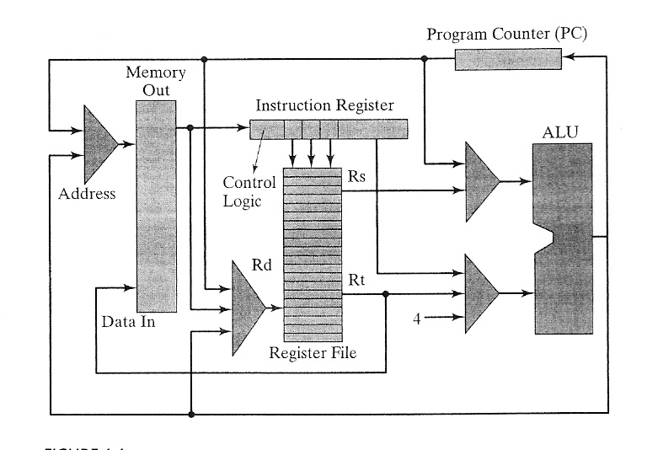
MIPS Architecture
Microprocessor without Interlocked Pipeline Stages
Resources
  CPU
    ALU
    Registers
  Memory
  I/O
      Central Processing Unit
      Arithmetic & Logical Unit
CPU

Slide 3
Hardware Organization
Resources
  CPU (Central Processing Unit)
      ALU (Arithmetic & Logical Unit)
      Register File
      Program Counter (PC)
      Instruction Register (IR)
  Memory
  I/O

Slide 4
Program Execution
Hello program
  Compile
    gcc –o hello hello.c
  ./hello
Von Neumann Architecture (1945) – re-use memory
Code Memory
CPU
Registers
Program Code
Instructions
PC
ALU
Addresses
Data Memory
Data
CC
Program Data

Slide 5
Pre-
processor
(cpp)
Compiler
(cc1)
hello.s
Assembler
(as)
Linker
(ld)
hello
hello.c
Source
program
(text)
Assembly
program
(text)
Executable
object
program
(binary)
??
PC (Program Counter)
IP (Instruction Pointer)
Instruction Format, Syntax

Slide 6
Assembly to Machine Code

Slide 7
Assembler: System Software
Assembly program into Executable Machine Code
Assembler

Slide 8
Assembly Programmer’s View
Code Memory
CPU
Instructions
Registers
Program Code
PC
ALU
Addresses
Data Memory
Condition
Codes
Data
Program Data
Programmer-Visible State
  Program Counter (PC)
    Address of the next instruction
  Register File
    Heavily used program data
  Condition Codes
    Store status information about most recent arithmetic operation
    Used for conditional branching
Memory
  Byte addressable array (organized in words)
  Code, user data, OS data
  Includes stack

Slide 9
How to use Resources ?
Code Memory
CPU
Instructions
Registers
Program Code
PC
ALU
Addresses
Data Memory
Condition
Codes
Data
Program Data
Data transfer
  From memory to register: load
  From register to memory: store
Operator
  Add, sub, mul, etc.
Input/Output

Slide 10
Assembly Characteristics
Minimal Data Types
  “Integer” data of 1, 2, or 4 bytes
    Data values
    Addresses (untyped pointers)
  Floating point data of 4, 8, or 10 bytes
  No aggregate types such as arrays or structures
    Just contiguously allocated bytes in memory
Primitive Operations
  Perform arithmetic function on register or memory data
  Transfer data between memory and register
    Load data from memory into register
    Store register data into memory
  Transfer control
    Unconditional jumps to/from procedures
    Conditional branches

Slide 11
Assembly Instruction
label: instruction operand {,operand} #comments
  label – a place holder: address
  Instruction – operation to perform
  Operand – source or target of the operation
    First operand is a Destination
      Except saving from Register to Memory
    Register: One of 32 integer registers
    Immediate: Constant integer data
      0xff for hex constant
      Otherwise, decimal
    Memory: 4 consecutive bytes of memory
      Various “address modes”

Slide 12
Resources
Memory
  Code and Data memories
  2³² bytes of storage 2¹⁰=1024 (1k)
        2³² = 2³⁰x2² = 4B
2⁶⁴ = 2³²x2³² = 16BxB
ALU – perform 32-bit operation
32 32-bit Registers
  $zero or $0: always 0, and cannot be modified
  $t0 -- $t9 (10): General purpose => temporary
  $a0 -- $a3 (4): General purpose => arguments
  $s0 -- $s7 (8): General purpose => save
  $v0, $v1 (2): General purpose => i/o
  $sp (1): stack pointer
  $ra (1): return address

Slide 13
reg1 = 0
reg9 = 0
rept: reg3 = grades[reg9]
compare(reg3, 0)
branch(LT) to next
add reg1, reg1, reg3
add reg9, 1, reg9
goto rept
next:
compare(reg9,0)
branch(LE) to done
reg3 = reg1/reg9
print reg3
goto Exit
done:
print 'no grades were entered'
Exit:
reg1 = 0
reg9 = 0
rept:
If (grades[reg9]<0) goto next
add reg1, reg1, grades[reg9]
add reg9, 1, reg9
goto rept
next:
if (reg9 <= 0) goto done
average = reg1/reg9
print average
goto Exit
done:
print 'no grades were entered'
Exit:

Slide 14
li $t1, 0
li $t9, 0
rept: mul $t8, $t9, 4
lw $t3, grades($t8)
blt $t3, 0, next
add $t1, $t1, $t3
addi $t9, $t9, 1
b rept
next:
ble $t9, 0, done
blez $t9, done
div $t3, $t1, $t9
print $t3
b Exit
done:
print 'no grades were entered'
Exit:
reg1 = 0
reg9 = 0
rept: reg3 = grades[reg9]
compare(reg3, 0)
branch(LT) to next
add reg1, reg1, reg3
add reg9, 1, reg9
goto rept
next:
compare(reg9,0)
branch(LE) to done
reg3 = reg1/reg9
print reg3
goto Exit
done:
print 'no grades were entered'
Exit:

