Slide 1


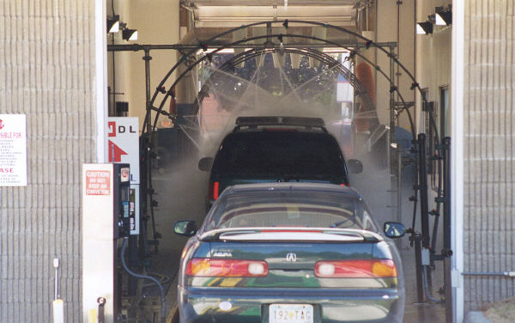
Real-World Pipelines
Sequential
Parallel
Pipelined
Idea
  Divide process into independent stages
  Move objects through stages in sequence
  Multiple objects processed at same time

Slide 2
Pipelining
Microprocessor without Interlocked Pipeline Stages

Slide 3
Computational Example
System
  Computation requires total of 300 picoseconds
  Plus 20 picoseconds to save result in register
  Must have clock cycle of at least 320 ps
300 ps
20 ps
Combinational
logic
R
e
g
Delay = 320 ps
Throughput = 3.12 GOPS
Clock

Slide 4
3-Way Pipelined Version
100 ps
20 ps
100 ps
20 ps
100 ps
20 ps
Comb.
logic
A
R
e
g
Comb.
logic
B
R
e
g
Comb.
logic
C
R
e
g
Delay = 360 ps
Throughput = 8.33 GOPS
Clock
System
  Divide combinational logic into 3 blocks of 100 ps each
  Can begin new operation as soon as previous one passes through stage A.
    Begin new operation every 120 ps
  Overall latency increases
    360 ps from start to finish

Slide 5
Pipeline Diagrams
Unpipelined
  Cannot start new operation until previous one completes
3-Way Pipelined
  Up to 3 operations in process simultaneously
OP1
OP2
OP3
Time
OP1
A
B
C
OP2
A
B
C
OP3
A
B
C
Time

Slide 6
Operating a Pipeline
239
241
300
359
Clock
OP1
A
B
C
OP2
A
B
C
OP3
A
B
C
0
120
240
360
480
640
Time
100 ps
20 ps
100 ps
20 ps
100 ps
20 ps
100 ps
100 ps
100 ps
20 ps
20 ps
20 ps
100 ps
100 ps
100 ps
20 ps
20 ps
20 ps
100 ps
100 ps
100 ps
20 ps
20 ps
20 ps
Comb.
logic
A
R
e
g
Comb.
logic
B
R
e
g
Comb.
logic
C
Comb.
logic
A
R
e
g
Comb.
logic
B
R
e
g
Comb.
logic
C
R
e
g
Comb.
logic
A
Comb.
logic
A
R
e
g
R
e
g
Comb.
logic
B
Comb.
logic
B
R
e
g
R
e
g
Comb.
logic
C
Comb.
logic
C
R
e
g
R
e
g
R
e
g
Clock
Clock
Clock
Clock

Slide 7
Limitations: Nonuniform Delays
50 ps
20 ps
150 ps
20 ps
100 ps
20 ps
Comb.
logic
A
R
e
g
Comb.
logic
B
R
e
g
Comb.
logic
C
R
e
g
Delay = 510 ps
Throughput = 5.88 GOPS
Clock
OP1
A
B
C
OP2
A
B
C
OP3
A
B
C
Time
  Throughput limited by slowest stage
  Other stages sit idle for much of the time
  Challenging to partition system into balanced stages

Slide 8
Limitations: Register Overhead
50 ps
20 ps
50 ps
20 ps
50 ps
20 ps
50 ps
20 ps
50 ps
20 ps
50 ps
20 ps
Comb.
logic
R
e
g
Comb.
logic
R
e
g
Comb.
logic
R
e
g
Comb.
logic
R
e
g
Comb.
logic
R
e
g
Comb.
logic
R
e
g
Clock
Delay = 420 ps, Throughput = 14.29 GOPS
  Deepening pipelines increases overhead of loading registers
  Percentage of clock cycles spent loading registers:
    1-stage pipeline: 6.25%
    3-stage pipeline: 16.67%
    6-stage pipeline: 28.57%
  High speed of modern processor designs obtained through very deep pipelining

Slide 9
Data Dependencies
Combinational
logic
R
e
g
Clock
OP1
OP2
OP3
Time
System
  Each operation depends on result from preceding one

Slide 10
Data Dependencies
1 irmovl $50, %eax
2 addl %eax , %ebx
3 mrmovl 100( %ebx ), %edx
  Result from one instruction used as operand for another
    Read-after-write (RAW) dependency
  Very common in actual programs
  Must make sure our pipeline handles these properly
    Get correct results
    Minimize performance impact

Slide 11
Data Hazards
Comb.
logic
A
R
e
g
Comb.
logic
B
R
e
g
Comb.
logic
C
R
e
g
Clock
OP1
A
B
C
OP2
A
B
C
OP3
A
B
C
OP4
A
B
C
Time
  Result does not feed back around in time for next operation
  Pipelining has changed behavior of system

Slide 12
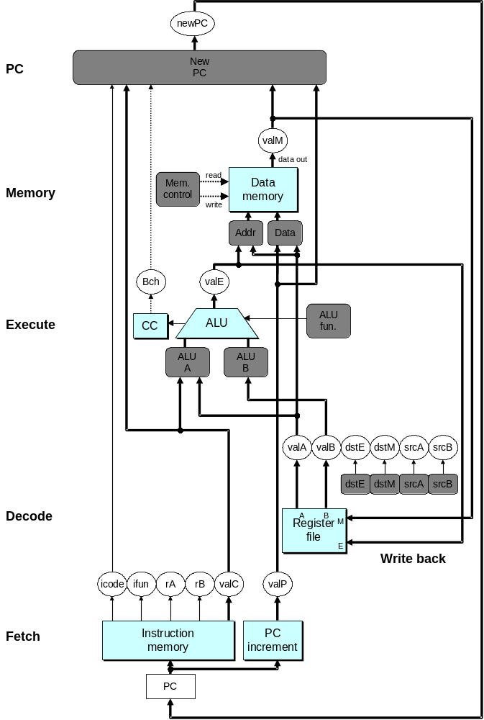
SEQ Hardware
  Stages occur in sequence
  One operation in process at a time

Slide 13
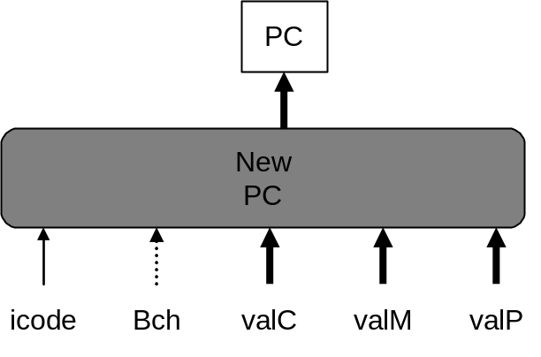
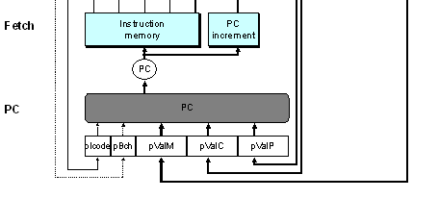
SEQ+ Hardware
  Combine PC update logic to beginning of cycle
  Still sequential implementation
  Reorder PC stage to put at beginning

Slide 14
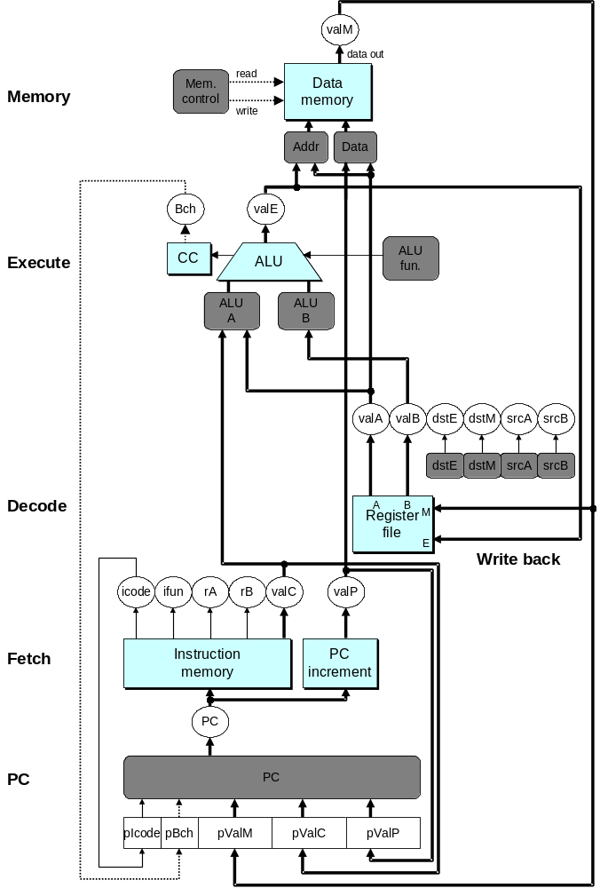
SEQ+ Hardware
PC Stage
  Task is to select PC for current instruction
  Based on results computed by previous instruction
Processor State
  PC is no longer stored in register
  But, can determine PC based on other stored information

Slide 15
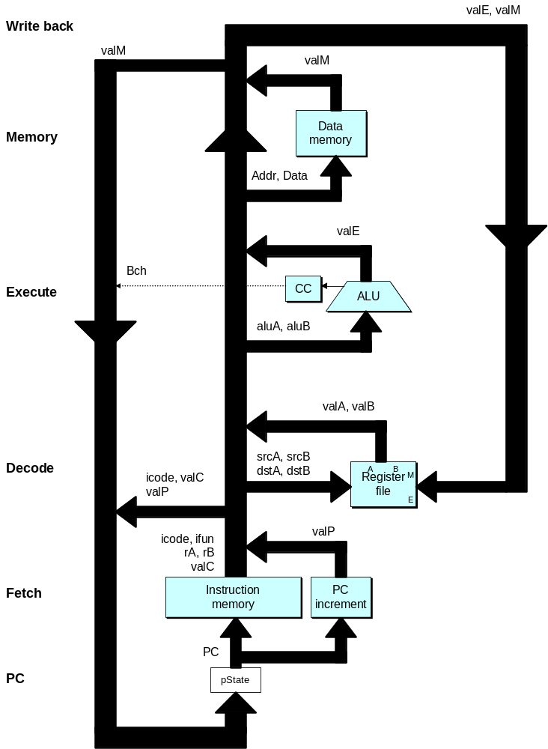
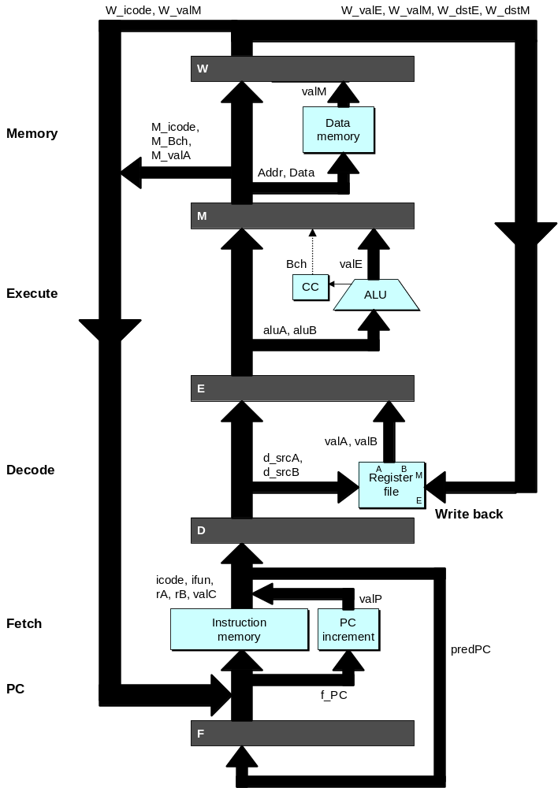
Adding Pipeline Registers

Slide 16
Pipeline Stages
Fetch
  Select current PC
  Read instruction
  Compute incremented PC
Decode
  Read program registers
Execute
  Operate ALU
Memory
  Read or write data memory
Write Back
  Update register file

Slide 17
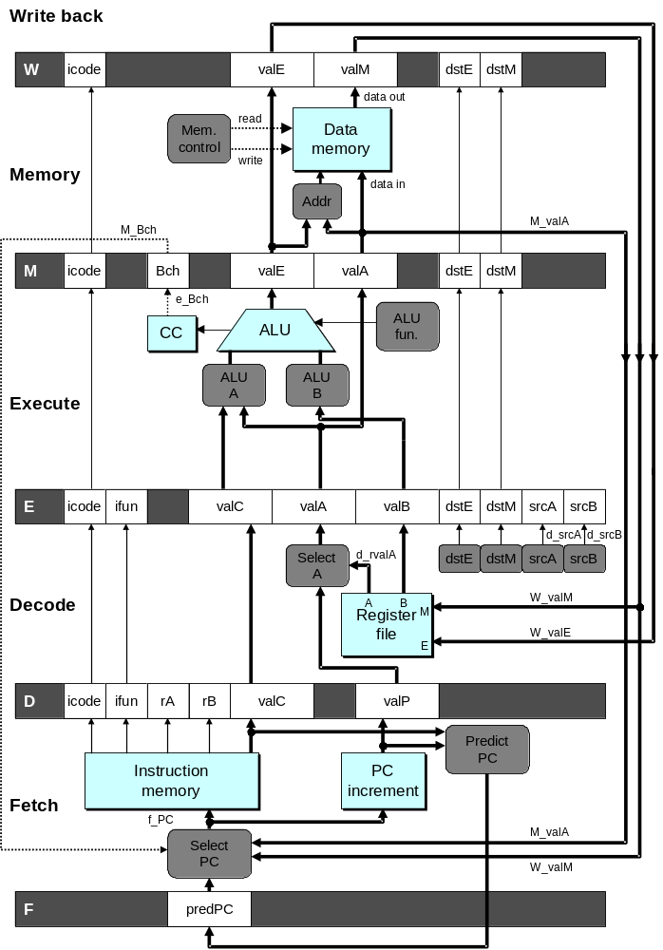
PIPE- Hardware
  Pipeline registers hold intermediate values from instruction execution
Forward (Upward) Paths
  Values passed from one stage to next
  Cannot jump past stages
    e.g., valC passes through decode

Slide 18
SEQ+ vs. PIPE-

Slide 19
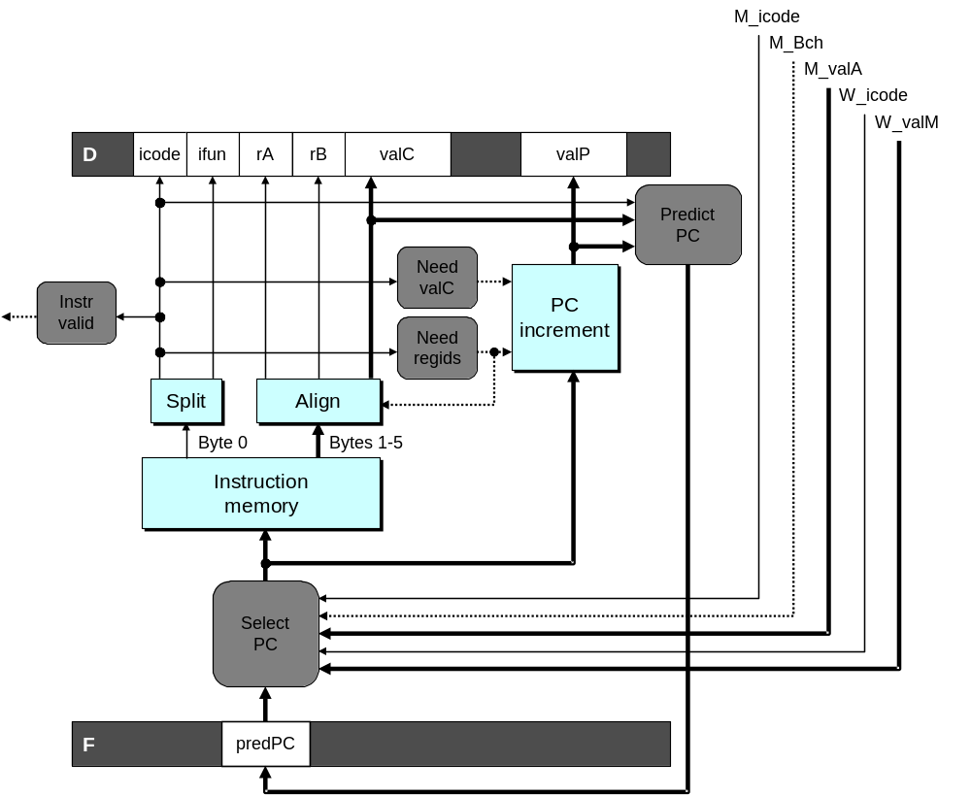
Predicting the PC
  Start fetch of new instruction after current one has completed fetch stage
    Problem with conditional branch (has to wait for execution stage to complete)
    Not enough time to reliably determine next instruction
  Guess which instruction will follow
    Recover if prediction was incorrect

Slide 20
PC Prediction Strategy
Instructions that Don’t Transfer Control
  Predict next PC to be valP
  Always reliable
Call and Unconditional Jumps
  Predict next PC to be valC (destination)
  Always reliable
Conditional Jumps
  Predict next PC to be valC (destination)
  Only correct if branch is taken
    Typically right 60% of time
Return Instruction
  Don’t try to predict

Slide 21
Recovering from PC Misprediction
  Mispredicted Jump
    Will see branch flag once instruction reaches memory stage
    Can get fall-through PC from valA
  Return Instruction
    Will get return PC when ret reaches write-back stage

Slide 22
Feedback Paths
Predicted PC
  Guess value of next PC
Branch information
  Jump taken/not-taken
  Fall-through or target address
Return point
  Read from memory
Register updates
  To register file write ports

Slide 23
Pipeline Hazard
Data Hazards
  Instruction having register R as source follows shortly after instruction having register R as destination
  Common condition, don’t want to slow down pipeline
Control Hazards
  Mispredict conditional branch
    Our design predicts all branches as being taken
    Naïve pipeline executes two extra instructions
  Getting return address for ret instruction
    Naïve pipeline executes three extra instructions
Making Sure It Really Works
  What if multiple special cases happen simultaneously?

Slide 24
Data Dependencies
1 irmovl $50, %eax
2 addl %eax , %ebx
3 mrmovl 100( %ebx ), %edx
  Result from one instruction used as operand for another
    Read-after-write (RAW) dependency
  Very common in actual programs
  Must make sure our pipeline handles these properly
    Get correct results
    Minimize performance impact

Slide 25
Data Dependencies: 3 Nop’s
# prog 1
1
2
3
4
5
6
7
8
9
10
11
F
F
D
D
E
E
M
M
W
0x000:
irmovl
$10,%
edx
W
F
F
D
D
E
E
M
M
W
0x006:
irmovl
$3,%
eax
W
F
F
D
D
E
E
M
M
W
0x00c:
nop
W
F
F
D
D
E
E
M
M
W
0x00d:
nop
W
F
F
D
D
E
E
M
M
W
0x00e:
nop
W
F
F
D
D
E
E
M
M
W
0x00f:
addl
%
edx
,%
eax
W
F
F
D
D
E
E
M
M
W
0x011: halt
W
Cycle 6
W
W

R[

R[
]
]
3
%
3
%
eax
eax
  3 nop’s provide sufficient time to keep registers stable
Cycle 7
D
D

valA

valA
R[
R[
]
]
=
=
10
%
10
%
edx
edx

valB

valB
R[
R[
]
]
=
=
3
%
3
%
eax
eax

Slide 26
Data Dependencies: 2 Nop’s
# prog 2
1
2
3
4
5
6
7
8
9
10
F
F
D
D
E
E
M
M
W
0x000:
irmovl
$10,%
edx
W
F
F
D
D
E
E
M
M
W
0x006:
irmovl
$3,%
eax
W
F
F
D
D
E
E
M
M
W
0x00c:
nop
W
F
F
D
D
E
E
M
M
W
0x00d:
nop
W
F
F
D
D
E
E
M
M
W
0x00e:
addl
%
edx
,%
eax
W
F
F
D
D
E
E
M
M
W
0x010: halt
W
Cycle 6
W
W
W


R[
]

3
R[
R[
]
]
3
%
eax
3
%
%
eax
eax
•
•
•
•
•
•
D
D
D


valA

valA
valA
R[
R[
R[
]
]
]
=
=
=
10
10
%
10
Error
%
%
edx
edx
edx


valB

valB
valB
R[
R[
R[
]
]
]
=
=
=
0
0
%
0
%
%
eax
eax
eax

Slide 27
Data Dependencies: No Nop
# demo-h0.ys
1
2
3
4
5
6
7
8
0x000:
irmovl
$10,%
edx
F
D
E
M
W
0x006:
irmovl
$3,%
eax
F
D
E
M
W
0x00c:
addl
%
edx
,%
eax
F
D
E
M
W
0x00e: halt
F
D
E
M
W
Cycle 4
M
M_
valE
= 10
M_
dstE
=
%
edx
E
e_
valE

0 + 3 = 3
E_
dstE
=
%
eax
D
D
Error

valA

valA
R[
R[
]
]
=
=
0
%
0
%
edx
edx

valB

valB
R[
R[
]
]
=
=
0
%
0
%
eax
eax

Slide 28
Pipeline Summary
Concept
  Break instruction execution into 5 stages
  Run instructions through in pipelined mode
Limitations
  Can’t handle dependencies between instructions when instructions follow too closely
  Data dependencies
    One instruction writes register, later one reads it
  Control dependency
    Instruction sets PC in way that pipeline did not predict correctly
    Incorrect predictions of branch and return
Fixing the Pipeline
  In CS 305

