Slide 1
Turning C into Object Code
Code in files p1.c p2.c
Compile with command: gcc p1.c p2.c -o p
Put resulting binary in file p
text
C program (p1.c p2.c)
Compiler (gcc –Og -S)
text
Asm program (p1.s p2.s)
Assembler (gcc or as)
binary
Object program (p1.o p2.o)
Static libraries (.a)
Linker (gcc or ld)
binary
Executable program (p)

Slide 2
Compiling Into Assembly
C Code (sum.c)
Generated x86-64 Assembly
long plus(long x, long y);
void sumstore(long x, long y,
long *dest)
{
long t = plus(x, y);
*dest = t;
}
sumstore:
pushq %rbx
movq %rdx, %rbx
call plus
movq %rax, (%rbx)
popq %rbx
ret
Obtain with command
gcc –S sum.c
Produces file sum.s

Slide 3
Object Code
Code for sumstore
Assembler
Translates .s into .o
Binary encoding of each instruction
Nearly-complete image of executable code
Missing linkages between code in different files
Linker
Resolves references between files
Combines with static run-time libraries
E.g., code for malloc, printf
Some libraries are dynamically linked
Linking occurs when program begins execution
0x0400595:
0x53
0x48
0x89
0xd3
0xe8
0xf2
0xff
0xff
0xff
0x48
0x89
0x03
0x5b
0xc3
Total of 14 bytes
Each instruction 1, 3, or 5 bytes
Starts at address 0x0400595

Slide 4
Machine Instruction Example
C Code
Store t at address dest
Assembly
Move 8-byte value to memory
Quad words in x86-64 parlance
Operands:
t: Register %rax
dest: Register %rbx
*dest: Memory M[%rbx]
Object Code
3-byte instruction
Stored at address 0x40059e
*dest = t;
movq %rax, (%rbx)
0x40059e: 48 89 03

Slide 5
Disassembling Object Code
Disassembled
0000000000400595 <sumstore>:
400595: 53 push %rbx
400596: 48 89 d3 mov %rdx,%rbx
400599: e8 f2 ff ff ff callq 400590 <plus>
40059e: 48 89 03 mov %rax,(%rbx)
4005a1: 5b pop %rbx
4005a2: c3 retq
Disassembler
objdump –d sum
Useful tool for examining object code
Analyzes bit pattern of instruction series
Produces approximate rendition of assembly code
Can be run on either a.out (complete executable) or .o file

Slide 6
Alternate Disassembly
Disassembled
Object
0x0400595:
0x53
0x48
0x89
0xd3
0xe8
0xf2
0xff
0xff
0xff
0x48
0x89
0x03
0x5b
0xc3
Dump of assembler code for function sumstore:
0x0000000000400595 <+0>: push %rbx
0x0000000000400596 <+1>: mov %rdx,%rbx
0x0000000000400599 <+4>: callq 0x400590 <plus>
0x000000000040059e <+9>: mov %rax,(%rbx)
0x00000000004005a1 <+12>:pop %rbx
0x00000000004005a2 <+13>:retq
Within gdb Debugger
gdb sum
disassemble sumstore
Disassemble procedure
x/14xb sumstore
Examine the 14 bytes starting at sumstore

Slide 7
What Can be Disassembled?
% objdump -d WINWORD.EXE
WINWORD.EXE: file format pei-i386
No symbols in "WINWORD.EXE".
Disassembly of section .text:
30001000 <.text>:
30001000: 55 push %ebp
30001001: 8b ec mov %esp,%ebp
30001003: 6a ff push $0xffffffff
30001005: 68 90 10 00 30 push $0x30001090
3000100a: 68 91 dc 4c 30 push $0x304cdc91
Anything that can be interpreted as executable code
Disassembler examines bytes and reconstructs assembly source

Slide 8
Binary Bomb project
Has six problems (phases)
Phase 1: text comparison
Phase 2: loops
Phase 3: conditionals/switches
Phase 4: recursive calls and the stack discipline
Phase 5: pointers
Phase 6: linked lists/pointers/structs
There is no secret phase
Each phase is autograded to max 70

Slide 9
Binary Bomb project
First, get your own bomb
Download a tar file to your PC
File transfer from PC to mercury
untar in mercury -> executable bomb
Disassembly bomb to x86 source code
Transfer x86 source code to your PC
Off-line, add pseudo-C comments to x86 code
In mercury, solve phases in mercury with gdb

Slide 10
III. Solve phases - gdb
Google search gdb
Tons of tutorials, and command helps
In mercury,
Start gdb
gdb bomb
Set breakpoints
Examine data in memory appropriate for the phase

Slide 11
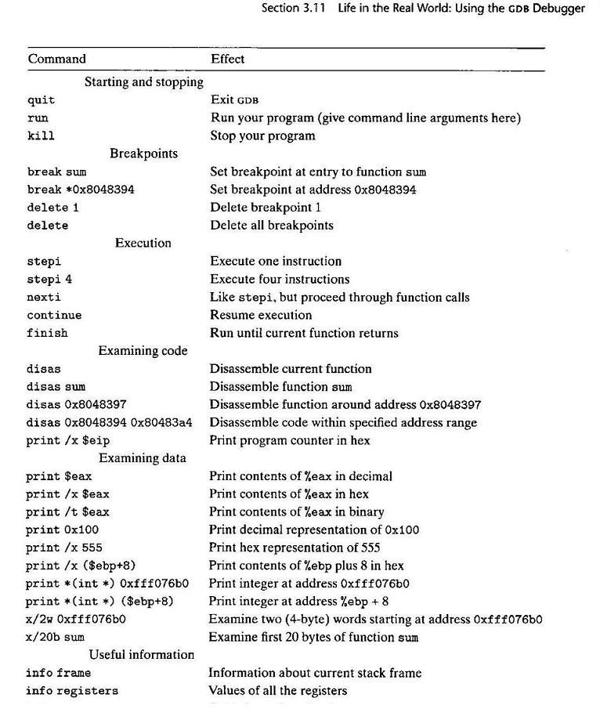

Slide 12
x/20c sum Examine first 20 characters of sum
x/x 0xfff076b0 Print in hex a word at address 0xfff076b0

