Slide 2


Slide 3
Linear Regression with Transients
Linear Regression with Non-Compliant Data
A modelling study of different survey designs
Data with non-centered residuals
Repeated measures sampling
Mapping/census vs sampling

Slide 4
Linear Regression with Non-Linear Data
The Linear Component of Non-Linear Data
A modelling study of different survey designs
Pearson Correlation Coefficient measures the linear correlation between two sets of data
Spearman's Correlation measures the "monocity" between two sets of data (e.g. do they both increase and decrease at the same time?)
Kendall's Tau measures the ordinal association between two sets of data - supposedly Kendall's Tau is similar to the Spearman Correlation, but Kendall's Tau has a more logical confidence intervals.

Slide 5
Prms:
X range
Y stdev
Trend
N
Get uniform x (n=100) add index
Get y values
Graph
(new solid, previous faded)
Video
png
UnifX_NormY( xrange, ystdev, trend_int, trend_slope, N)
Returns data frame i, x, y for i=1,N

Slide 6
Time series simulator
Linear, non-linear (polynomial, exponential, logarithmic), transient
Test linear component detection
Slope significance (OLS)
Spearman’s
Pearson’s
Kendall’s Tau
Linear term of polynomial regression

Slide 7
CVpop : A : Cvsamp (n) : CVmeas
Simulate initial base population (N)
Normal (CV_{pop})
Lognormal
Weibull
Simulate population trend over time (30 occasions)
No trend
Gradient of trend magnitudes
Non-linear
Transient perturbation
4yr: down-neutral-up-neutral
  Amplitude: A
Comprehensive surveys
(census of all units)
Sampling
(estimation from random samples)
Sampling (n)
(repeated measures, longitudinal,
0% sample rotation,
Fixed/repeat sample)
Sampling (n)
(partial sample replacement, 20% sample rotation,
5-yr panel retention)
Sampling (n)
(independent samples, cross-sectional,
100% sample rotation,
New draw sample)
Measurement (CV_{meas})
Measurement
Measurement
Measurement

Slide 8
UnifX_NormY( xLo, xHi, ystdev, trend_int, trend_slope, N)
Returns data frame x, y for i=1,N
initialize data frame simData[x = uniform(xlo,xhi,N),
y = mx + b

Slide 9
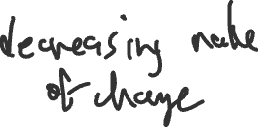







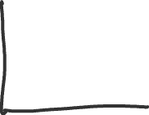
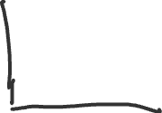
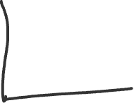

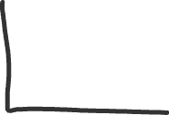
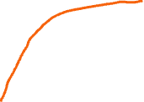

Slide 10
Concepts to present
Treating occurrences of climatic anomalies as random error
Separating what is known and unknown – Gambler’s fallacy
Repeated measures sampling is different than repeated comprehensive survey (census) of the entire population.
Separate legitimacy of linear regression slope significance determination from quantification of linear component.
Results to present
Sample slope distributions (accuracy / bias)
Sample s.e. distributions (precision)
Residual distributions relative to regression line (assess assumption)
Power to detect linear trend; rate of false positives
% variance explained by linear trend

Slide 11
regression model
sampling design
(census, repeated measures, rotation, replace)
significance
(OLS coeff p, permutation, Pearson, Spearman, Kendall’s Tau)
transient
(non-centered residuals)
Gambler’s Fallacy
Don’t treat past known outcomes as probabilistic
Significance
Population Model
initial & over time
trend: linear, polynomial, transient
Sampling Regime
Linear component

Slide 12
Key messages from Gamblers Fallacy
Past events are not probabilistic and, when outcomes are independent, are excluded from current probabilistic considerations of future outcomes
Critically important to distinguish what you know from what is unknown and subject to probabilistic prediction.

Slide 13
Two Methodological Issues with Linear Regression – presence of transients and use of multiple tests
Presence of Transients with Non-Centered Residuals
Testing of Subsets
Linear Trend from Regression - assessment of two use cases:
Data with transients
Testing data subsets

Slide 14



Linear regression with transient present
  Original question – consequences of offset residual distributions (Gray, COSTR)
  The role of picking a model – prerogative and responsibility of the researcher
  The linear regression model
    2 elements: line-fitting procedure and slope significance based on model
    Some sample datasets (with & w/out trend)
    Movie of all possible data over time illustrating error – the model of the data stream
    List the assumptions
    Formal Testing: Regression slope significance vs permutation test
      Confirm Type I error is near alpha for null data (no trend)
      Power under gradient of trends for slope significance & permutation test
      Compare the four sampling regimes (census, 100,20,0% replacement) – repeated measures regression
  COSTR time series – a transient?
    Increasing smoothing
    Isolate transient – plausibility of model relative to linear regression model
    Illustrative diagram with error distributions
  What does a linear regression result mean in data with a transient?
    Treat transient as a random event – with s.d. from data
    Movie of all possible data (greater variation relative to no transient)
    Relationship to Gambler’s Fallacy
    Type I and II error – under null data and gradient of linear trends with superimposed transient
  The linear component
    Importance of linear trend
    Pearson, Spearman correlations & Kendal’s Tau
    R2 – variance explained
    Polynomial regression & linear term
    Explanatory simulation results
Simulations:
measures: slope sig., Pearson, Spearman, Kendall, R2, linear term sig in poly regression
All measures for gradient of linear trends with hi,med,lo levels of error
All measures when transient superimposed

Slide 15
Linear Regression – Visualizations with Simulated Data
Visualizing Linear Regression with Simulated Data
Basics of Linear Regression Visualized with Simulated Data

Slide 16
Testing slope significance of multiple data subsets
  Concept of p-value correction under multiple comparisons
  Benjamini-Hochberg correction method, for instance with p.adjust() in R
  Bonferroni
  Use of entire record and recent subsets. Simulation results.

Slide 17
Stats put on a pedestal.
Binary outcome (significant, not significant)
The statistical test is the authority.
Stats are a tool that will fit to varying degrees to a particular analysis situation.
Significance lies somewhere on a gradient.
The researcher is the authority.

Slide 18
How is treatment of COSTR time series with the linear model (true pattern treated as random error)
Like
The Gambler’s Fallacy
past outcomes treated as probabilistic
incorrect perspective leads to incorrect assessment of current probabilities

Slide 19























number of data points
population trend scenarios
Xmin, Xmax
error stdev
Nsim
get prms
get x values
get y values
regression
save iteration

Slide 20
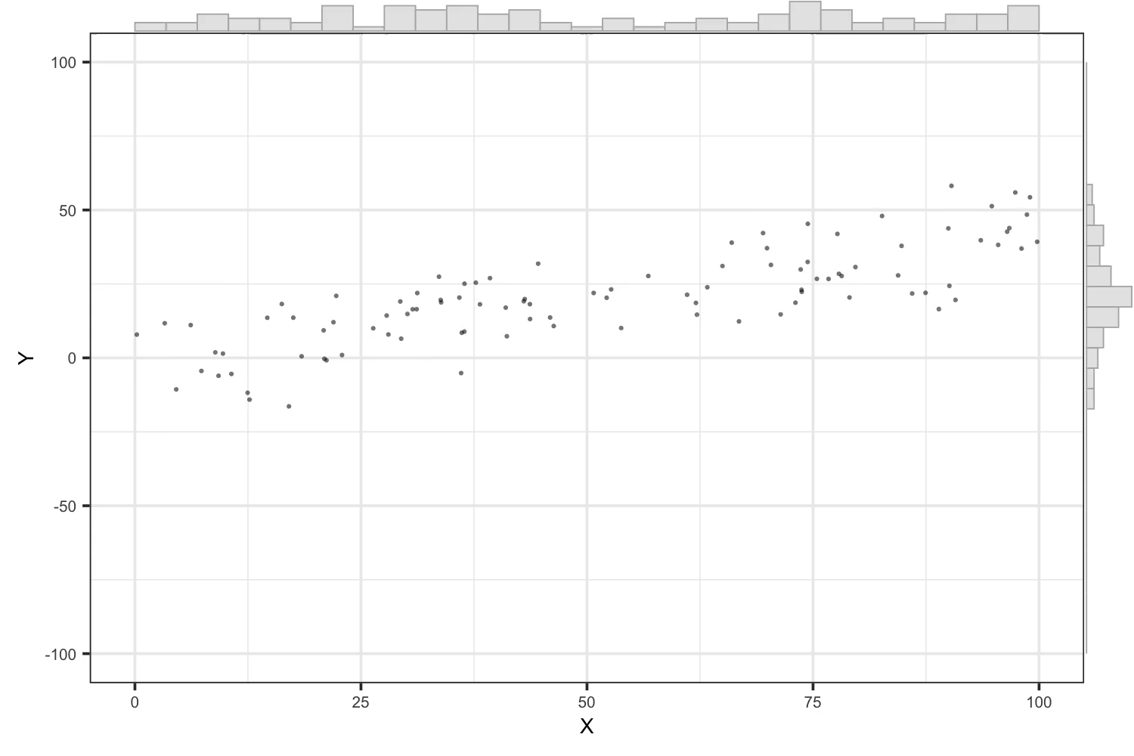
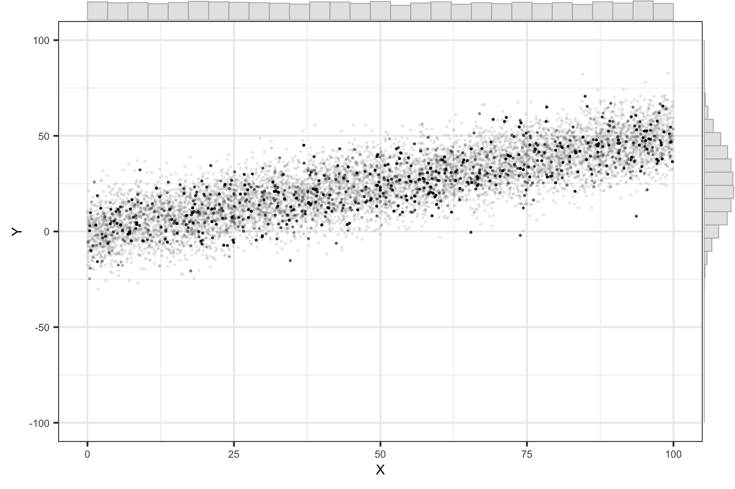

Slide 21
Incorporating Transient
Effects of magnitude/intensity and duration
1-yr spike (1 yr)
pyramid (3 yr)
spike/decay (3 yr)
Linear regression is blind to the pattern of residuals. The transient departure is treated as a random residual and it is added to the pool of residuals to calculate variance.
A temporal feature “known” to have happened with known timing, is treated as a probabilistic error (result of random error in the data point that could have happened at any time in the record).
Link to Gambler’s Fallacy tenuous. Leave out unless clear connection can be simply explained.

Slide 22
Simulating effects of transient on regression
get slope sampling distribution (and variance) with model transients placed systematically within data record (i.e. one fixed transient with Monte Carlo characterization of variability resulting from true random errors).
compare that distribution (will be offset from slope=0 when transient not centered in record) with the distribution from data that complies with regression assumptions and with same variance in residuals (will be centered on slope=0).
That comparison will show effects of treating known departure at known time as a random residual.
Need to extend to effects on Type I error and Power.
That is where the connection to Gambler’s Fallacy lies.
Treating known outcomes as probabilistic (would have been different under repeated measurement).
slope
Type I error
position within data record
no transient, same residual variance
Power
20% slope
10% slope
position within data record
position within data record

Slide 24
Integrating cross-sectional and longitudinal data
‘cross-sectional’ is not really correct with 20% rotation
It’s a matter of integrating longitudinal data with different temporal patterns.
Also, repeat transect sampling is longitudinal at transect scale and at site scale
New transect sampling is cross-sectional at transect scale and longitudinal at site scale.

