Slide 1
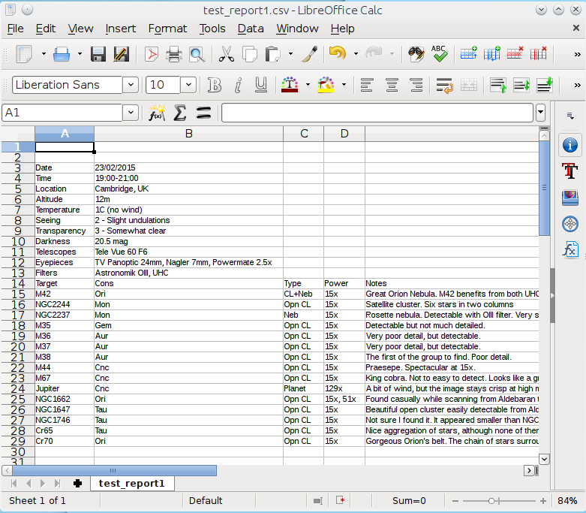
Meta Data
Target Data
Fields
separated
by
TAB

