Slide 2

Introduction & Disclaimer
All techniques outlined in the proposed system are ones I’ve relied on heavily, some extending over decades, in systems that I’ve personally developed to solve machine learning problems in signal and image processing applications (many of these of a mission critical nature, requiring both accuracy and robustness)
Further development would require close cooperation with patients, caregivers, and families with those with XDP [disorders] in order to collect data that would be used to develop a prototype, validate the overall system concept and level of accuracy, and ultimately, it’s utility for optimization of wellbeing of those with XDP [disorders]
If this submission does nothing more than stimulate interest on the part of other system developers to pursue this overall concept, using any competing techniques or system designs, it will have served it’s purpose

Slide 3
Basic Assumptions: Patients and System Design
All patients are unique
They have unique physiological system responses
They are unique in preferences, regimens and psychological responses
The “Wellbeing Quotient” ( WQ ) is a complex function of the above
Issues with a system modeling approach
System models require knowledge of overall structure and module characteristics
Physiological + psychological models of this level of complexity are not available
Inaccurate models will tend to err in extrapolation (prediction)
Ex: high order polynomials modeling physical a process obeying different laws
Choice: use a robust pattern recognition / regression approach
Use physiologically relevant basis functions (time domain response models)
Training (direct mapping): inputs → response functions (patterns) → system output ( WQ )
Input pattern → DP / D(ref patterns) → linear SVR → kernel SVR → WQ
Prediction (interpolated mapping): input pattern → Ensemble(L/K-SV regressions) → L/K-SVR(Ensemble WQ’s) → overall system output ( WQ )

Slide 4
Consistent Origins in System Design Experience
Use of large margin techniques
First published large margin / soft margin perceptron training algorithm
“A Network of Localized Linear Discriminants”, NIPS ‘91 (Now NeurIPS)
Classifier based on support vector hidden units (SVM’s) develeoped for sensor quality inspection:
“A _____”, USPTO …..
Smooth, piecewise (localized) decomposition of problem space
“A Network of Localized Linear Discriminants”, NIPS ‘91 (Now NeurIPS)
Weighted ensemble of sub-classifiers in speech recognition
“A -------”, ICASSP….
Image enhancement
Multi-scale signal analysis
“A -------”, ICASSP….
Patent
Image Enhancement
BPT: multi-temporal analysis windows w/ a multi-bandwidth (constant-Q) filterbank for speech segmentation and pattern matching
Multi-view front ends
Speech therapy / BPT speech rec
Patent
Maternal ECG prediction
Concept drift / distribution shift adaptation

Slide 5
Basic Assumptions: Patients and System Design
We all, consciously or sub-consciously, strive for wellbeing optimization
Especially during times of stress due to illness or injury
We make notes about “what works” vs. “what doesn’t work”
Keeping track of results with behaviour modification is difficult
Keeping track of results with multiple modifications in parallel is even harder
We tend not to be able to keep track of inputs and outputs in an “analog” fashion
Calibration of analog scales is more difficult from a standpoint of perception
We tend to think more in “binary” terms
A system which can automatically learn these interactions
Could be beneficial in helping anyone to optimize their sense of wellbeing
Would be potentially beneficial to caregivers and/or patients with XDP defects ←
Machine learning techniques are capable of learning the relationships between large numbers of simultaneous / overlapping inputs with respect to optimization of outputs
“Inputs” = [sleep, diet, activities, exercises, therapies, games, music, social…]
“Output” = Wellbeing Quotient ( WQ , ex: a Likert scale)

Slide 6
Basic Assumptions: Patients and System Design
Interactions beteween inputs affecting WQ are limited in temporal extent
We’re focused on shorter term, incremental improvements
A “gradient descent” paradigm where incremental improvements lead to more significant results over time
Positive feedback, even if only psychological, can have powerful effects
A cautious approach to wellbeing optimization
System suggestions will be limited to non-medication based inputs / activities
We’re all “creatures of habit”
This limits, in practice, the combinatorial explosion of possible input patterns
Modifications of habits / habitual patterns are best done slowly and incrementally
The system will learn the impacts on WQ with small modifications of inputs
Amplitudes (amount, duration) and timing modifications
The system will also learn the effects of adding new input types
All additions will be done gradually (e.g., a new type of exercise, therapy or activity)

Slide 7
Basic Assumptions: Patients and System Design
Adaptation to concept drift / datashift distribution is critical
The goal is gradual improvement in wellbeing
Any changes (i.e., improvements) indicate system response changes
The system should be updating it’s time domain modeling continuous to track changes
This is actually a significant, well known problem in ML currently
The ongoing caregiver or patient logging of WQ over time provides the moving target
The system is designed to continuously, but gradually, update it’s sets of coefficients
Earlier “templates” of physiological response to inputs are retained for some time, allowing for “regression” and “restart” on the path to wellbeing
We’re all “creatures of habit”
All additions will be done gradually (e.g., a new type of exercise, therapy or activity)

Slide 8
System Design Perspectives
Make extensive use of CPU time and memory
Patient’s physiological & psychological responses to inputs will change relatively slowly (relative to CPU clock frequency) over time
WQ changes relatively slowly
WQ is expected to be updated by caregiver(s) at relatively longer intervals
Modern CPU’s (either laptops or smartphones) run in the gigaherz cycle times, with huge amounts of inexpensive memory available
Use this disparity to implement a system based on continuous learning
System will be updating continuously throughout the course of the day
System has, effectively, an almost infinite amount of memory available for the pattern recognition based components
Maximize use of a limited amount of data
Allow complete flexibility for caregiver inputs to system
The system will utilize smooth interpolation functions to “fill in the gaps” in logged WQ’s
No restrictions on times (or intervals) to log inputs and WQ’s
Any number of input types, and levels of detail for each input type, will be allowed
The system automatically weights each input type, at each level of detail, based on learned importance in prediction of WQ

Slide 9
System Design Elements
Physiologically relevant impulse response functions for response modeling
Instead of modeling the system, we model the response functions in the time domain
WQ changes relatively slowly
WQ is expected to be updated by caregiver(s) at relatively longer intervals
A “library” of time domain functions is used prior to feature selection and weighting
Acting as basis functions, they represent basic physiological response types to inputs
Decaying exponentials (first order smoothing / response functions)
Damped sinusoids (models second order effects over a range of harmonics)
Gaussians (to model delays, integration, and smoothing)
Wavelets (the basic multi-scale approach to response function decomposition)
Wavelet types can also represent physiological functions in a meaningful way
Dealing with the combinatorial explosion of input patterns
Collect as many combinations of patterns of overlapping inputs (“templates”) as memory will allow
Use a weighted k nearest neighbor approach for interpolation in between templates
Human beings tend to be “creatures of habit” (constraining input pattern proiiferation)

Slide 10
System Design Elements
Regression for prediction of WQ’s in response to inputs
Instead of modeling the system, we model the response functions in the time domain
Multi-scale decomposition and processing
Wavelet signal analysis is heavily used in biomedical signal processing
Biomedical signals (like speech) have multi-scale components
Physiological functions in the time domain also have multi-scale components
ECG’s: QRS morphology to RR intervals
Provides a platform for meaningful interpolation over time scales
Both in the time domain and the “detail” domain

Slide 11
System Design Elements
Regression for prediction of WQ’s in response to inputs
Use a combination of linear and non-linear regression
Input factors should be at least, partially, independent with respect to their effect on WQ
Non-linear interactions will then be refined by using a non-linear regression
Multi-dimensional linear regression (WQ = LSVR(X*A)) will capture the linear correlations of inputs (X) with WQ as components of WQ
X = array of inputs over time ( dimensionality: [n inputs, t samples] )
A = array of coefficients (dimensionality: [n inputs])
WQ = wellbeing quotient over time (dimensionality: [t samples])
Multi-dimensional non-linear regression (WQ = KSVR(X’*A)) will capture the non-linear correlations of inputs (X’) with WQ as components of WQ

Slide 12
System Design Elements
Physiologically relevant impulse response functions for response modeling
Instead of modeling the system, we model the response functions in the time domain
WQ changes relatively slowly
WQ is expected to be updated by caregiver(s) at relatively longer intervals
A “library” of time domain functions is used prior to feature selection and weighting
Acting as basis functions, they represent basic physiological response types to inputs
Decaying exponentials (first order smoothing / response functions)
Damped sinusoids (models second order effects over a range of harmonics)
Gaussians (to model delays, integration, and smoothing)
Wavelets (the basic multi-scale approach to response function decomposition)
Wavelet types can also represent physiological functions in a meaningful way
Dealing with the combinatorial explosion of input patterns
Collect as many combinations of patterns of overlapping inputs (“templates”) as memory will allow
Use a weighted k nearest neighbor approach for interpolation in between templates

Slide 13


Basic Assumptions and System Characteristics
All patients are unique
They have unique physiological system responses
They are unique in regimens and psychological responses
The “Wellbeing Quotient” ( WQ ) is a complex function of the above
A pattern recognition approach (vs. a modeling approach)
System models require knowledge of overall structure and module characteristics
Physiological + psychological models of this level of complexity are not available
Inaccurate models will tend to err in extrapolation (prediction)
Ex: high order polynomials modeling physical process obeying different laws
In the “detail” domain (coarse & fine input types)
Ensemble techniques for interpolation & robustness
Concept drift / datashift adaptation
Feature selection for complexity minimization & accuracy
Linear and nonlinear regression for prediction of WQ

Slide 14
Basic Techniques Employed
Large margin algorithms
Support vector based
Robustness & generalization
Multi-scale approaches
Wavelet based simulation of physiological systems
Multi-scale problem decomposition
In the time domain
In the “detail” domain (coarse & fine input types)
Ensemble techniques for interpolation & robustness
Concept drift / datashift adaptation
Feature selection for complexity minimization & accuracy
Linear and nonlinear regression for prediction of WQ

Slide 15
Basic Techniques Employed
Large margin algorithms
Support vector based
Robustness & generalization
Multi-scale approaches
Wavelet based simulation of physiological systems
Multi-scale problem decomposition
In the time domain
In the “detail” domain (coarse & fine input types)
Ensemble techniques for interpolation & robustness
Concept drift / datashift adaptation
Feature selection for complexity minimization & accuracy
Linear and nonlinear regression for prediction of WQ

Slide 16
Basic Design Concepts
Physiological system response prototypes to inputs
Use families of wavelets appropriate for modeling
Feature selection determines best wavelet types per input type
Learned in conjunction w/ support vector regression (SVR)
Model transport delays w/ phase shift per scale, and over scale
Transport delay roughly correlates with scale (long → coarse)
Represent response(s) of specific organ(s)
Represent overall system response (driving WQ )
Represent temporal overlap with responses based on other inputs:
Allow modeling system output (WQ ) independently
Allows modeling temporal interaction w/ other input types

Slide 17

Basic Design Concepts
Generalization Performance
Constrain the solution space
Physiologically relevant basis functions
Multi-scale decomposition:
Input & response functions (time domain)
“Detail domain” hierarchy
Specific use of interpolation for generalization properties
Linear regression (linear SVR’s)
Smoothly interpolated due to wavelet like basis functions
Also sets feature weighting in SVR kernel space
Nonlinear regression (nonlinear / kernel SVR’s)
Smoothly interpolated in kernel feature space
Can generate nonlinear functions of selected, weighted basis functions

Slide 18
Basic Design Concepts
Generalization Performance
Specific use of interpolation for generalization properties
Linear regression (linear SVR’s)
Smoothly interpolated due to wavelet like basis functions
Also sets feature weighting in SVR kernel space
Nonlinear regression (nonlinear / kernel SVR’s)
Smoothly interpolated in kernel feature space
Can generate nonlinear functions of selected, weighted basis functions

Slide 19
Notes
Gaussians for overlapped windowed convex combination
Use L/K SVR to combine over time domain scales
Gaussians go to zero towards edge of longest time window, for L/K SVR feature selection / opt
Correlation coefficient or SVR error term as “distance measure” for template matching
Maintain full templates
Use feature selection / feature weighting / kernel SVR for xcor or SVR error term
Update full templates w/ xcor or error term weighting
Choose K nearest templates to update
Meaningful, controllable extrapolation
Tends toward decaying extrapolation in the absence of new inputs
Circadian rhythm “automatic” inputs based on one day ahead prediction from previous sets
Use of “modeling” in the basis function domain (as opposed to system modeling) allows for composition of more complex responses through weighted combination of basis functions (more flexibility in modeling)
Why not just CWT decomposition?
SVR can vary C, in search for sparseness (important for UI & generalization!)
Intent to have time windows corresponding to center freq (not a single window)
SVR is also robust to small variations, with an L1 error measure (also may allow for sparseness)

Slide 20
Notes
Negative events:
Specifically of interest as discussed by Dr. Sharma
Both examples given by Dr. Sharma (falls and swallowing / choking incidents):
Linked to external components:
Food (type, amount)
Flooring (traction of flooring material,discontinuities (e.g., sidewalks with cement plates, brick), curbs, etc.)
Timing is partially random based on external influences
Use (primarily) negative going components
Prevent SVR’s from generating positive coefficients for negative inputs
(Effectively reversing basic sense of positive & negative inputs)
Negative coefficients still allowable for “positive” inputs, as they can effectively have a negative impact:
Food – too much, the wrong type at the wrong time (I.e, reducing sleep quality)
Social interactions if a patient winds up feeling embarassed, for example
Aid in patient self-monitoring
Develops a comprehensive log for doctors and caregiver’s, if so desired by patient
Physiological relevant “atoms”
Overall response = sum of physiologically relevant functions
Could be decomposed into basis functions (wavelets or Fourier), but not readily interpretable by patient
Even a less accurate decomposition into “atoms” could be more useful to patient, through interpretability

Slide 21
Overall System Concept
Library of Template Matrices
& Associated Trained SVR’s
Transform impulse sequence to a
smooth estimate of wellbeing over
time at each sample point
(ex: cubic spline curve fit)
D(SVR templates,
new window matrix)
Choose nearest neighbor
(NN) SVR templates,
evaluate and then
update NN SVR’s
learned mappings
Library of Template Matrices
& Associated Trained SVR’s
Transform impulse sequence to a
smooth estimate of wellbeing over
time at each sample point
(ex: cubic spline curve fit)
Library of Template Matrices
& Associated Trained SVR’s
Transform impulse sequence to a
smooth estimate of wellbeing over
time at each sample point
(ex: cubic spline curve fit)
Library of Template Matrices
& Associated Trained SVR’s
Transform impulse sequence to a
smooth estimate of wellbeing over
time at each sample point
(ex: cubic spline curve fit)
Library of Template Matrices
& Associated Trained SVR’s
Each linear SVR has an associated
feature vector matrix
Wellbeing estimates
Recorded observations or
reported estimates of
child’s wellbeing (discrete,
Asynchronous, subjective scale)
Discrete to continuous
Wellbeing function
Transform impulse sequence to a
smooth estimate of wellbeing over
time at each sample point
(ex: cubic spline curve fit)
Selected
SVR’s
SVR
Target
Linear Support
Vector Regression (SVR)
Learn linear mapping from feature
vectors to wellbeing target function
Linear Support
Vector Regression (SVR)
Learn linear mapping from feature
vectors to wellbeing target function
Linear Support
Vector Regression (SVR)
Learned linear mapping from feature
vectors to wellbeing target function
Feature
Vector Matrix
Windowed Response
Of Hypothesized
Impulse Response
Functions
Feature Vector:
N samples (time domain) x
D features (response functions)
Sliding window generates a
template matrix (NxD) for each
new sample (synchronous)
Input types
Ex: nutrition, activities,
Medications, sleep…
Specify time and
amplitude of inputs
Hypothesized Alternative
Physiological Responses
Families of impulse response
functions over scale and
time delay (transit time)
Selected SVR’s
Selected & scaled
feature vectors
Non-linear Support
Vector Regression (SVR)
Learn non-linear mapping from
feature vectors to wellbeing
target function using selected,
scaled feature vectors
Non-linear Support
Vector Regression (SVR)
Learn non-linear mapping from
feature vectors to wellbeing
target function using selected,
scaled feature vectors
Non-linear Support
Vector Regression (SVR)
Learned non-linear mapping from
feature vectors to wellbeing
target function using selected,
scaled feature vectors
Queries
Specify time and amplitude of
proposed inputs to observe predicted
course of wellbeing over time
Visualization of Contributions
by Input Type
Composites of selected, weighted response
functions to assess likely contributions from
each input type
Wellbeing trajectory prediction

Slide 22
Overall System Concept
Wellbeing estimates
(asynchronous)
Curve fit to logged
wellbeing estimates
(ex: cubic spline fit)
Families of
Impulse Response
Functions
Windowed Response
Of Hypothesized
Impulse Response
Functions
Feature Vector:
N samples
(time domain) x
D features
(response functions)
Input type: Nutrition
(carbohydrates, fats,
protein, water, juice...)
Families of
Impulse Response
Functions
Input type: Nutrition
(carbohydrates, fats,
protein, water, juice...)
SVR
Target
Feature
Vectors
Linear Support
Vector Regression (SVR)
Selected from SVR
library by distance measure
Input type: Activities
(recreation, exercise,
therapy, school,
social...)
Families of
Impulse Response
Functions
.
.
.
.
.
.
.
.
.
SVR
Target
Selected & scaled
Feature vectors
Non-linear Support
Vector Regression (SVR)
(Selected by association
with chosen linear SVR)
Input type: Medication
(prescription,
non-prescription,
nutraceuticals...)
Families of
Impulse Response
Functions
Weighted composites
of selected response
features by input type
Input type: Sleep
Families of
Impulse Response
Functions
Wellbeing trajectory
prediction

Slide 23

The Sense Of Wellbeing: How Do We Strive To Optimize It?
Subconcious,
conscious, or
explicit logging of
“inputs” to the
mind / body
system over time
Subconcious,
conscious, or
explicit logging of
sense of wellbeing
at salient moments
*
* Logbook: virtual (mental) or physical (notebook – paper or electronic). Subconscious or conscious attempt to understand causes, correlations, and effects on the sense of wellbeing.
* Logbook: virtual (mental) or physical (notebook – paper or electronic). Subconscious or conscious attempt to understand causes, correlations, and effects on the sense of wellbeing.
Image courtesy of openclipart.org, released under the
Creative Commons Zero 1.0 Public Domain License

Slide 24
Example: Mind / Body System Inputs & Wellbeing Observations
(Phase 1: Recording Inputs and Wellbeing Quotients)
“Woke up feeling good, and better after breakfast. Took a bit of a nosedive late afternoon, but felt better after rehab, and then even better after that call with Paula.”
Logged:
° Sleep duration
° Breakfast
° Fall (walking)
° Lunch
° Rehab w/ therapist
° Dinner
° Call w/ best friend
*
* Logbook: mental, physical,
spreadsheet, specialized software, or statistical / machine learning based correlation of inputs with wellbeing “quotient” over time

Slide 25
The Sense Of Wellbeing: System “Inputs” And Salient Moments
Subconcious,
conscious, or
explicit logging of
sense of wellbeing
at salient moments
Subconcious,
conscious, or
explicit logging of
“inputs” to the
system over time
*
* Logbook: mental, physical,
spreadsheet, specialized software, or statistical / machine learning based correlation of inputs with wellbeing “quotient” over time

Slide 26
A Sense Of Wellbeing: How Do We Strive To Optimize It?

Slide 28
Basic Design Concepts
Physiological system response prototypes to inputs:
Use families of wavelets appropriate for modeling
Feature selection determines best wavelet types per input type
Learned in conjunction w/ support vector regression (SVR)
Model transport delays w/ phase shift per scale, and over scale
Represent response(s) of specific organ(s)
Represent overall system response (driving WQ )
Represent temporal overlap with responses based on other inputs:
Allow modeling system output (WQ ) independently
Allows modeling temporal interaction w/ other input types

Slide 29
Basic Design Concepts
Physiological system response prototypes to inputs:
Use families of wavelets appropriate for modeling
Feature selection determines best wavelet types per input type
Learned in conjunction w/ support vector regression (SVR)
Model transport delays w/ phase shift per scale, and over scale
Represent response(s) of specific organ(s)
Represent overall system response (driving WQ )
Represent temporal overlap with responses based on other inputs:
Allow modeling system output (WQ ) independently
Allows modeling temporal interaction w/ other input types

Slide 30
Basic Design Concepts
Generalization
Wavelet based simulation of physiological systems
Multi-scale problem decomposit

Slide 31
Introduction & Disclaimer
Potential Benefits:
Interpretability
Feature selection
Sensitivity analysis for joint feature effectiveness

Slide 32
Features
Flexible customization:
User definable input types (groups)
User definable levels of detail within each group
Ex: food group sub-types, exercise group sub-types…
Continously variable times for notation of wellbeing quotients
(Not tied to any fixed intervals for notation)
Wellbeing quotient is interpolated between input notations

Slide 33
Introduction & Disclaimer
A “sticky note” in the space of ideas that might help to optimize the wellbeing of children with RASopathies
A hint of a trace of a concept for a category of application that would help to predict the time course of wellbeing, based on discrete inputs and estimates of wellbeing over time
Based on machine learning techniques to elucidate the correlations and interactions between physiological system impulse response functions and wellbeing outcomes
Submitted as a solo project (not eligible for awards), in the spirit of brainstorming and community.

Slide 34
Introduction & Disclaimer
Due an unexpected event related to a chronic, but unpredictably acute medical condition, coinciding with the Hack4Rare timeline, this submission is purely conceptual due to the resultant time constraints.
All techniques employed in the proposed system are techniques previously employed in systems I’ve personally developed to solve machine learning problems in signal and image processing applications
Further development would require close cooperation with families with children with RASopathies in order to collect data that would be used to develop a prototype, validate the overall system concept and level of accuracy, and ultimately, it’s utility for optimization of wellbeing of children (and potentially adults) with RASopathies

Slide 35
Introduction & Disclaimer
Techniques employed in this system include:
Multi-scale methods
Large margin based optimization
Coordinated use of linear and non-linear support vector kernels
Clustering
Online training / adaptation
Ensembles
Feature selection and adaptive scaling
Curve fitting
Confidence measures
Interactive visualization

Slide 36
Motivation
Highly individual characterisitics of symptoms and response to those symptoms for each child and family
During the RASopathies conference, it bacame clear that parents were trying to make sense of patterns of “inputs” and responses in order to do the best for their child
Keeping logs
Spreadsheets
Plots
Experimentation with medication dosage, timing, etc.

Slide 37
Objective
A system which provides are more comprehensive set of analyses of factors that play into wellbeing, with the ability to make predictions of wellbeing trajectories in response to inputs
While parent’s intuition and the ability of human intelligence to perceive patterns are significant, assessing the impacts of all possible inputs, individually and in concert, along with hypothesized internal states, in order to make predictions of wellbeing outcomes is a challenging task
Allow for personalized definition of inputs which have known impacts on wellbeing outcomes
Allow for flexible logging of wellbeing at any set of points over time
Provide a visualization of the physiological response to inputs over time which are correlated with wellbeing trajectories over time
Allow for “queries” about input types, amplitudes, and timing to assess likely best possible next steps to take, using the predicted wellbeing trajectories to each hypothesized input, or set of inputs at a given time
Eventually: allow system to make recommendations, based on exhaustive analysis of all possible next sets of inputs, using learned prediction functions and current state

Slide 38
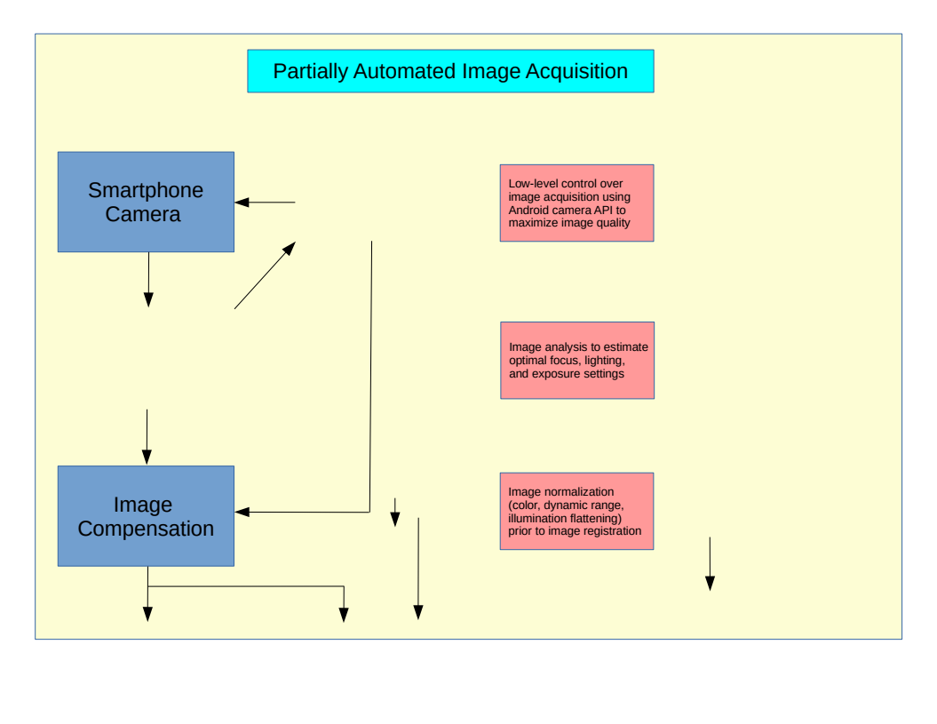
BASIC SYSTEM CONCEPTS
Con

Slide 39
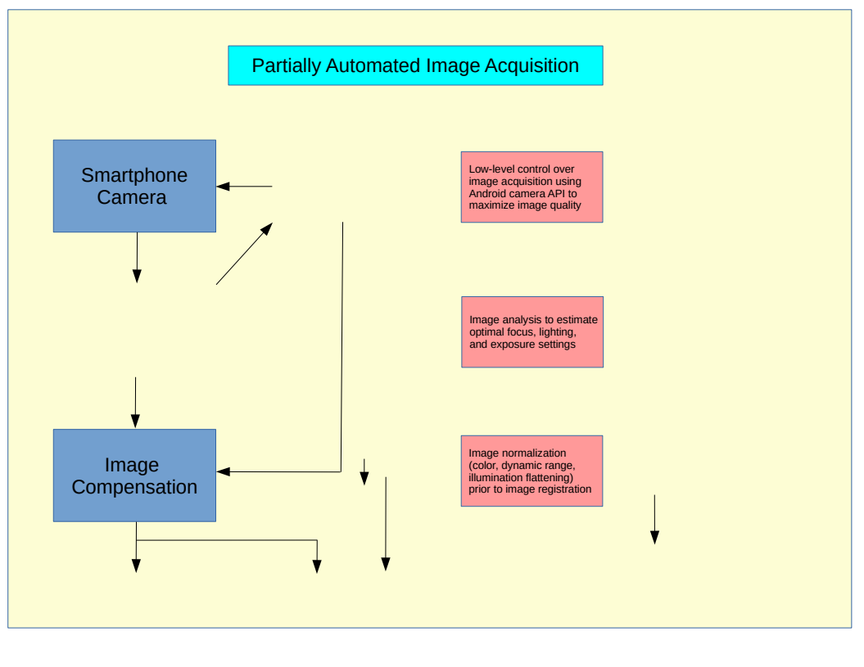

Slide 41
Representation of Internal State Dynamics In Response To New Inputs
Hypothesized internal responses to inputs are represented by families of plausible functions representing the “impulse response” of physiological sub-systems
Families of wavelet kernels over scale and time delay
Exponential decay functions over scale
To be defined: physiological functions representing the temporal dynamics of physiological sub-systems not well represented by either wavelet kernel types or exponential decays
Functions are dynamically selected using support

Slide 42
Representation of Internal State Dynamics In Response To New Inputs
Hypothesized internal responses to inputs are represented by families of plausible functions representing the “impulse response” of physiological sub-systems
Families of wavelet kernels over scale and time delay
Exponential decay functions over scale
To be defined: physiological functions representing the temporal dynamics of physiological sub-systems not well represented by either wavelet kernel types or exponential decays
Functions are dynamically selected using support vector regression in conjunction with recursive feature elimination in minimization of the target function (wellbeing trajectory) prediction error

Slide 43
Utilization Of Dynamically Selected Impulse Response Functions For Visualization
SVR (support vector regression) using a linear kernel generates a weighted “influence function” based on selected and scaled impulse response functions within each input type
The composite “influence function” for each input type is used for visualization, so as to allow parents a more distilled picture of the internal factors that are hypothesized (through the use of the SVR’s) to affect outcomes
The selected impulse response functions across all input types are then scaled and used with a non-linear (RBF or polynomial kernel) SVR to generate the overall wellbeing prediction function, which his the primary system output

Slide 44
Objective

Slide 45
Objective

Slide 47


Slide 48
Please accept my apologies for what is somewhat of an outlier in the set of final projects for Hack4Rare. This project is offered partly as appreciation for being invited to join Hack4Rare, and the opportunity to interact with some of the mentors, which has been extremely helpful in identifying a long term project (outside the scope of this proposal).
Due to an unexpected fork in the road in my quest to find a
solution to an urgent personal medical condition, overlapping
With the Hack4Rare timeframe, I was unable to commit to
Any group projects. I’m offering, for consideration, an idea that
Came to me during this period, inspired by earlier work on the
Problem of fetal ECG detection during labor. The transformation
Of that system prototype to a system for prediction and
optimization of the “wellbeing quotient’ of a child in the Rasopathies
Community is presented as purely conceptual, at this point,
Due to personal limitations on time, and lack of relevant data
With which to do a simulation. If this concept elicits any interest,
I would be available to pursue this to the level of an interative
system for exploratory use and possible validation of this concept.
It should also be noted that this conceptual design is also deeply
Based on career long work with with large margin techniques, feature
Selection, clustering, along with more recent work utilizing
Regression techniques for both interpolation and prediction.

