Slide 1




Drew Fustini
drew@beagleboard.org
Twitter: @pdp7
Slides: https://github.com/pdp7/talks/blob/master/rv-elc.pdf
Linux on RISC-V
with open source hardware and open source FPGA tools
Embedded Linux Conference 2020

Slide 2
Open Source Hardware designer at OSH Park
(PCB manufacturing service in the USA)
drew@oshpark.com / Twitter: @oshpark
Board of Directors, BeagleBoard.org Foundation
drew@beagleboard.org
Board of Directors, Open Source Hardware Assoc.
Certification Program: https://certification.oshwa.org/
RISC-V Ambassador for RISC-V International
https://riscv.org/

Slide 3
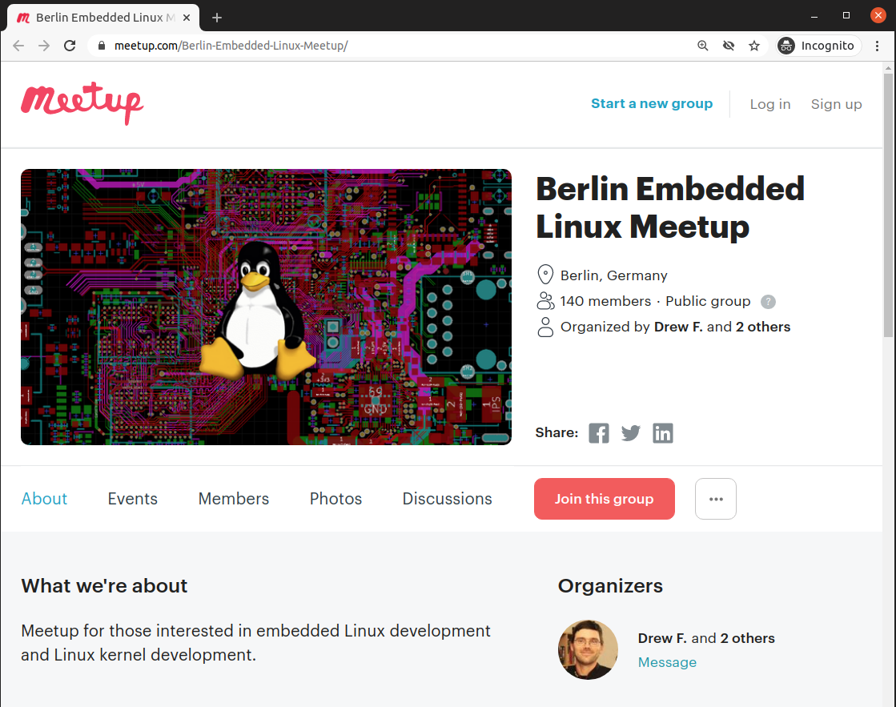

Slide 4
RISC-V at ELC
Join #2-track-riscv on the OSS+ELC slack!
RISC-V: Instruction Sets Want to be Free
  Krste Asanovic (UC Berkeley)
  Wednesday, 10:35am: https://sched.co/c4PV
State of RISC-V Software Development Tools
  Khem Raj (Comcast)
  Wednesday 12:15pm: https://sched.co/c3Yn
Ask the Expert Session with Calista Redmond
  CEO of RISC-V International
  Thursday 11:45am: https://sched.co/cosw

Slide 5


Find many more at: https://riscv.org/local/

Slide 6

Statement of Principles:
Hardware whose design is made publicly available so that anyone can study, modify, distribute, make, and sell the design or hardware based on that design

Slide 7



Documentation required for electronics:
Schematics Board Layout
Editable source files for CAD software such as KiCad or EAGLE
Bill of Materials (BoM)
Not strict requirement, but best practice is for all components available from distributors in low quantity

Slide 8

36c3 talk: Linux on Open Source Hardware with Open Source chip design

Slide 9
Section:
RISC-V the instruction set for everything?
Slides: https://github.com/pdp7/talks/blob/master/rv-elc.pdf

Slide 10
When you write a C or C++ program, it is compiled into instructions for the microprocessor (CPU) to execute.
How does the compiler know what instructions the CPU understands?
  defined by the Instruction Set Architecture
  The ISA is a standard, a set of rules that define the tasks the processor can perform.
  Examples: x86 (Intel/AMD) and ARM
    Both are proprietary and need commercial licensing

Slide 11

RISC-V: Free & Open RISC Instruction Set Arch
  “new instruction set architecture (ISA) that was originally designed to support computer architecture research and education and is now set to become a standard open architecture for industry”
  The 5th RISC instruction to come out out UC Berkeley
  RISC = Reduced Instruction Set Computer

Slide 12
RISC-V: Free & Open RISC Instruction Set Arch
    Instruction Sets Want To Be Free: A Case for RISC-V
      David Patterson, UC Berekely – co-creator of the original RISC!
      https://www.youtube.com/watch?v=mD-njD2QKN0
    RISC-V Summit 2019: State of the Union
      Krste Asanovic, UC Berkeley
      https://www.youtube.com/watch?v=jdkFi9_Hw-c
    Watch the Krste’s KEYNOTE tomorrow!
      “RISC-V: Instruction Sets Want to be Free”
      Wednesday, July 1 • 10:35am – 10:55am
      https://sched.co/c4PV

Slide 13

RISC-V Summit 2019: State of the Union https://youtu.be/jdkFi9_Hw-c

Slide 14

RISC-V Summit 2019: State of the Union https://youtu.be/jdkFi9_Hw-c

Slide 15
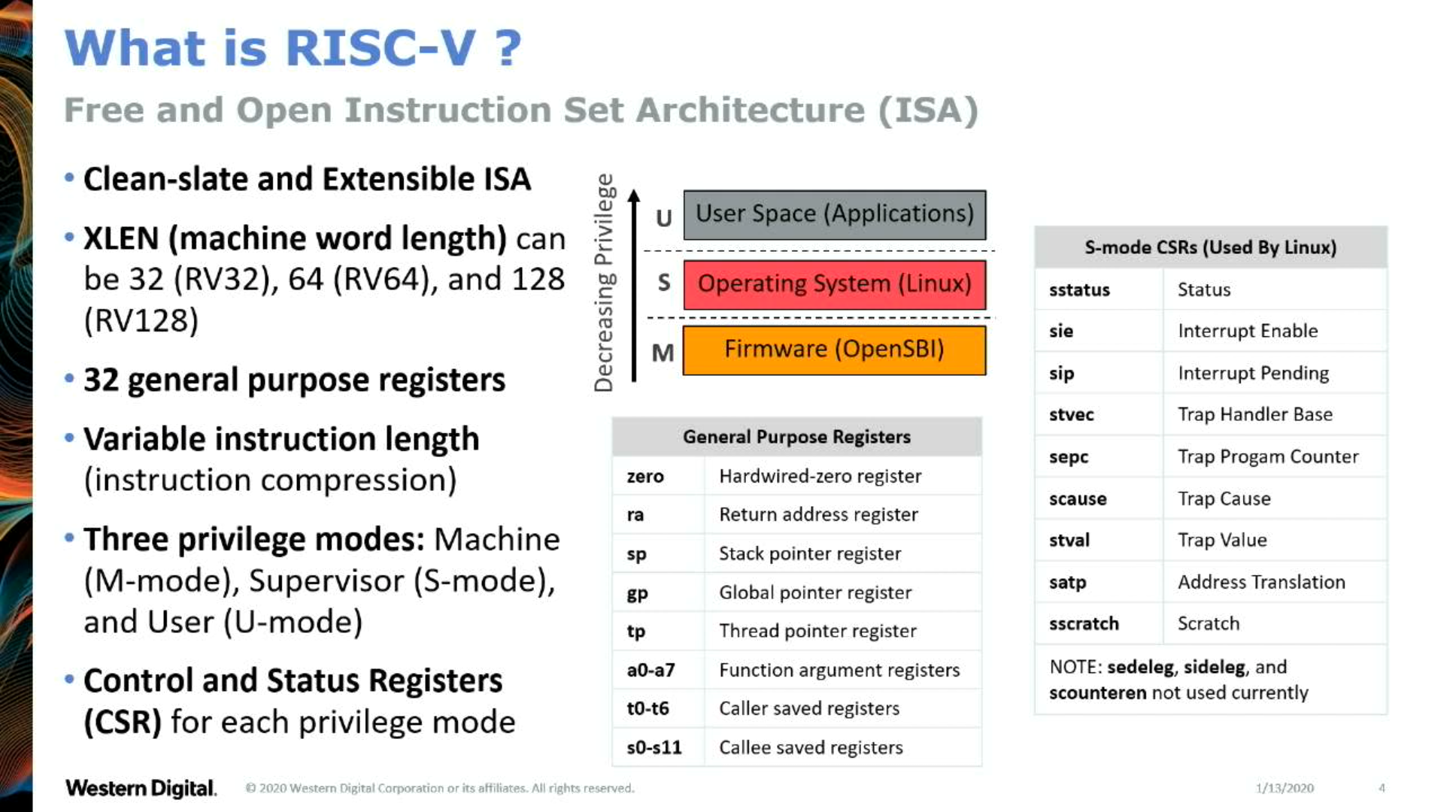
      “Co-developing RISC-V Hypervisor Support”, Anup Patel
      https://youtu.be/4GoikHB5Qcw

Slide 16
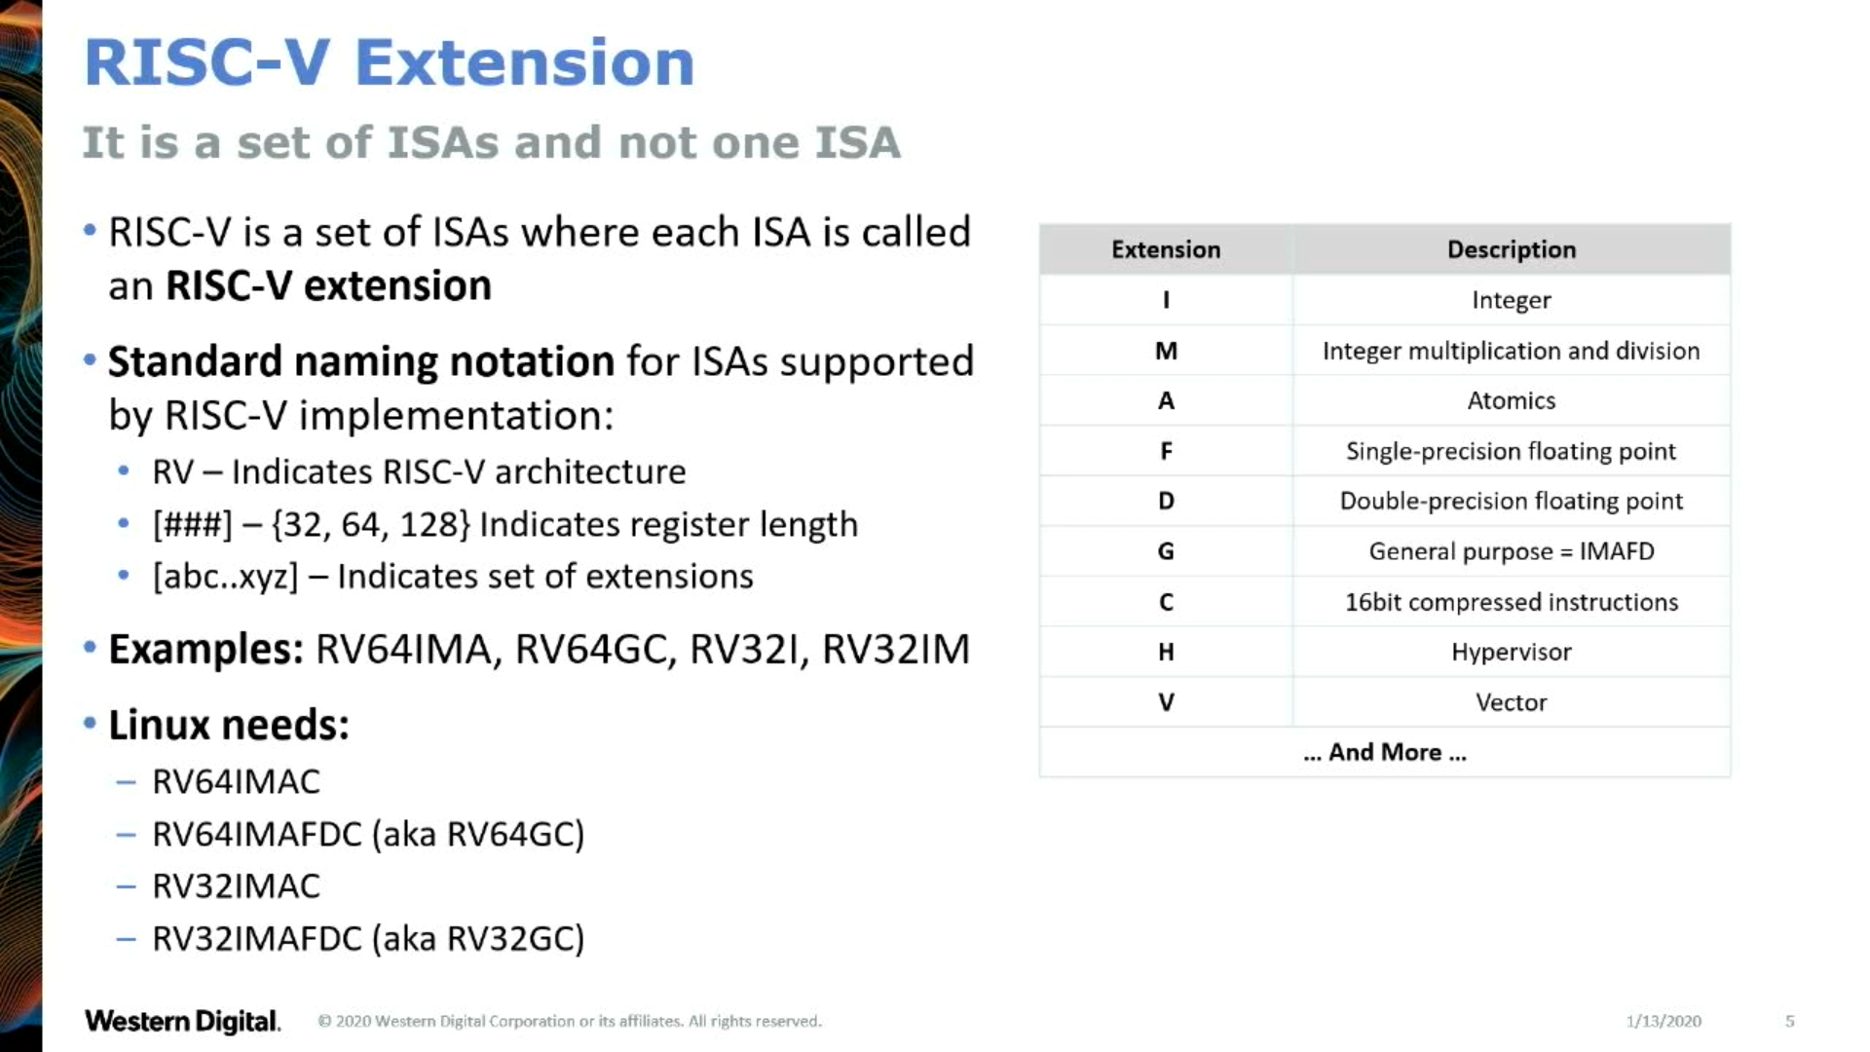
      "Co-developing RISC-V Hypervisor Support" - Anup Patel
      https://youtu.be/4GoikHB5Qcw

Slide 17

Get up-to-speed quick with the RISC-V Reader
riscvbook.com

Slide 18
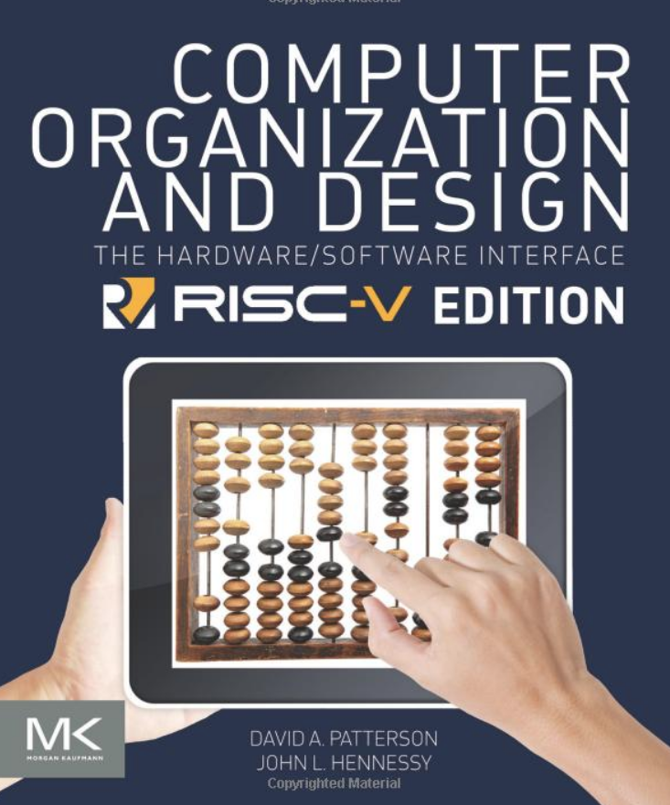
Deep dive withupdated classic!

Slide 19
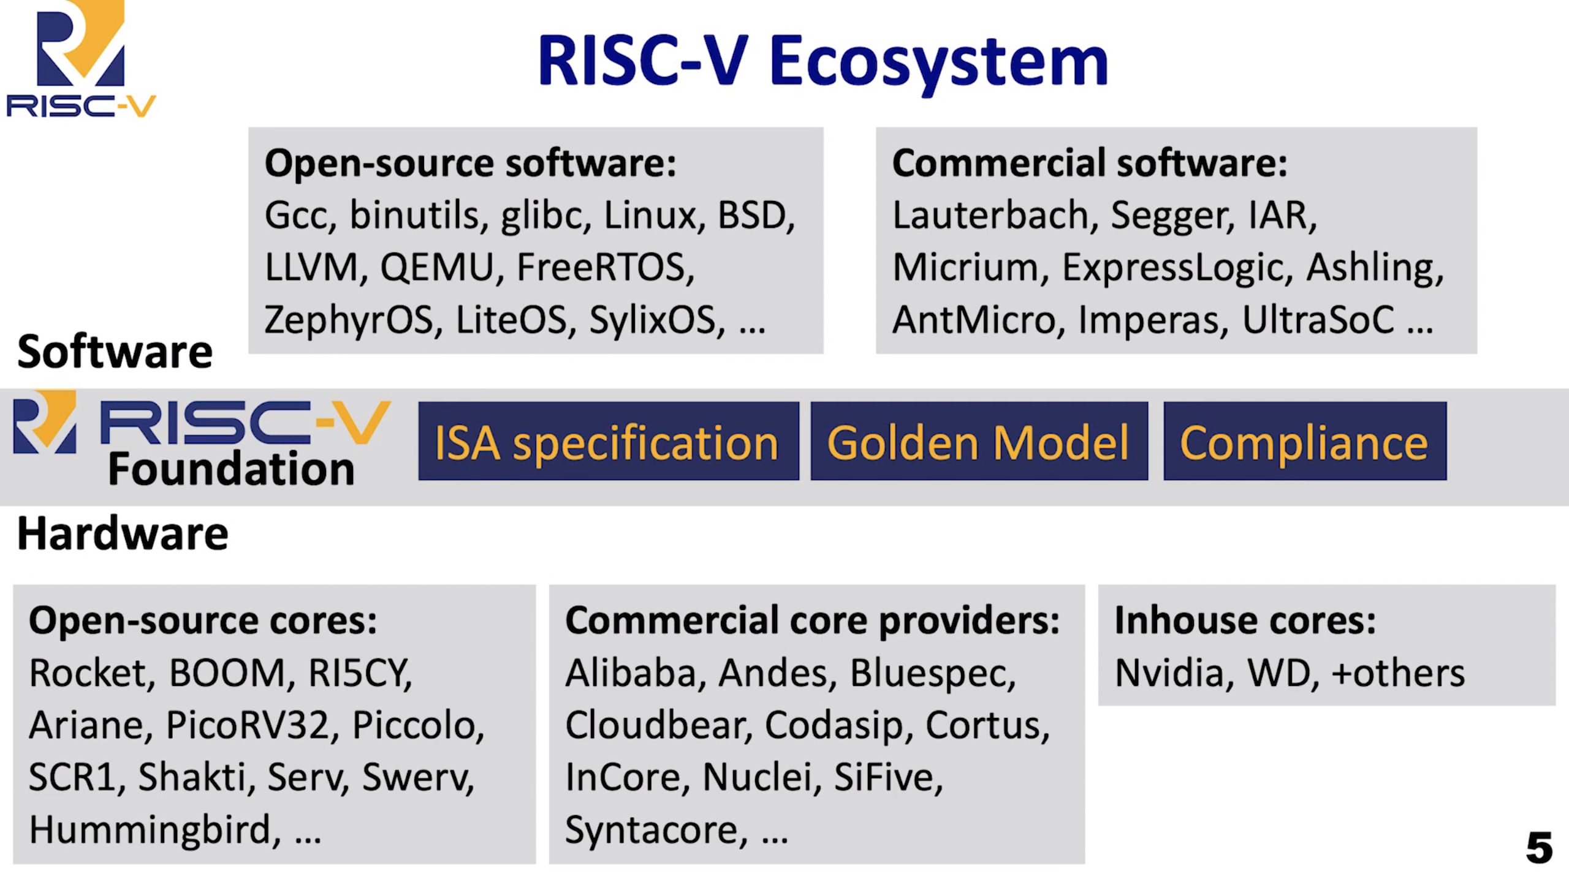
RISC-V Summit 2019: State of the Union https://youtu.be/jdkFi9_Hw-c

Slide 20
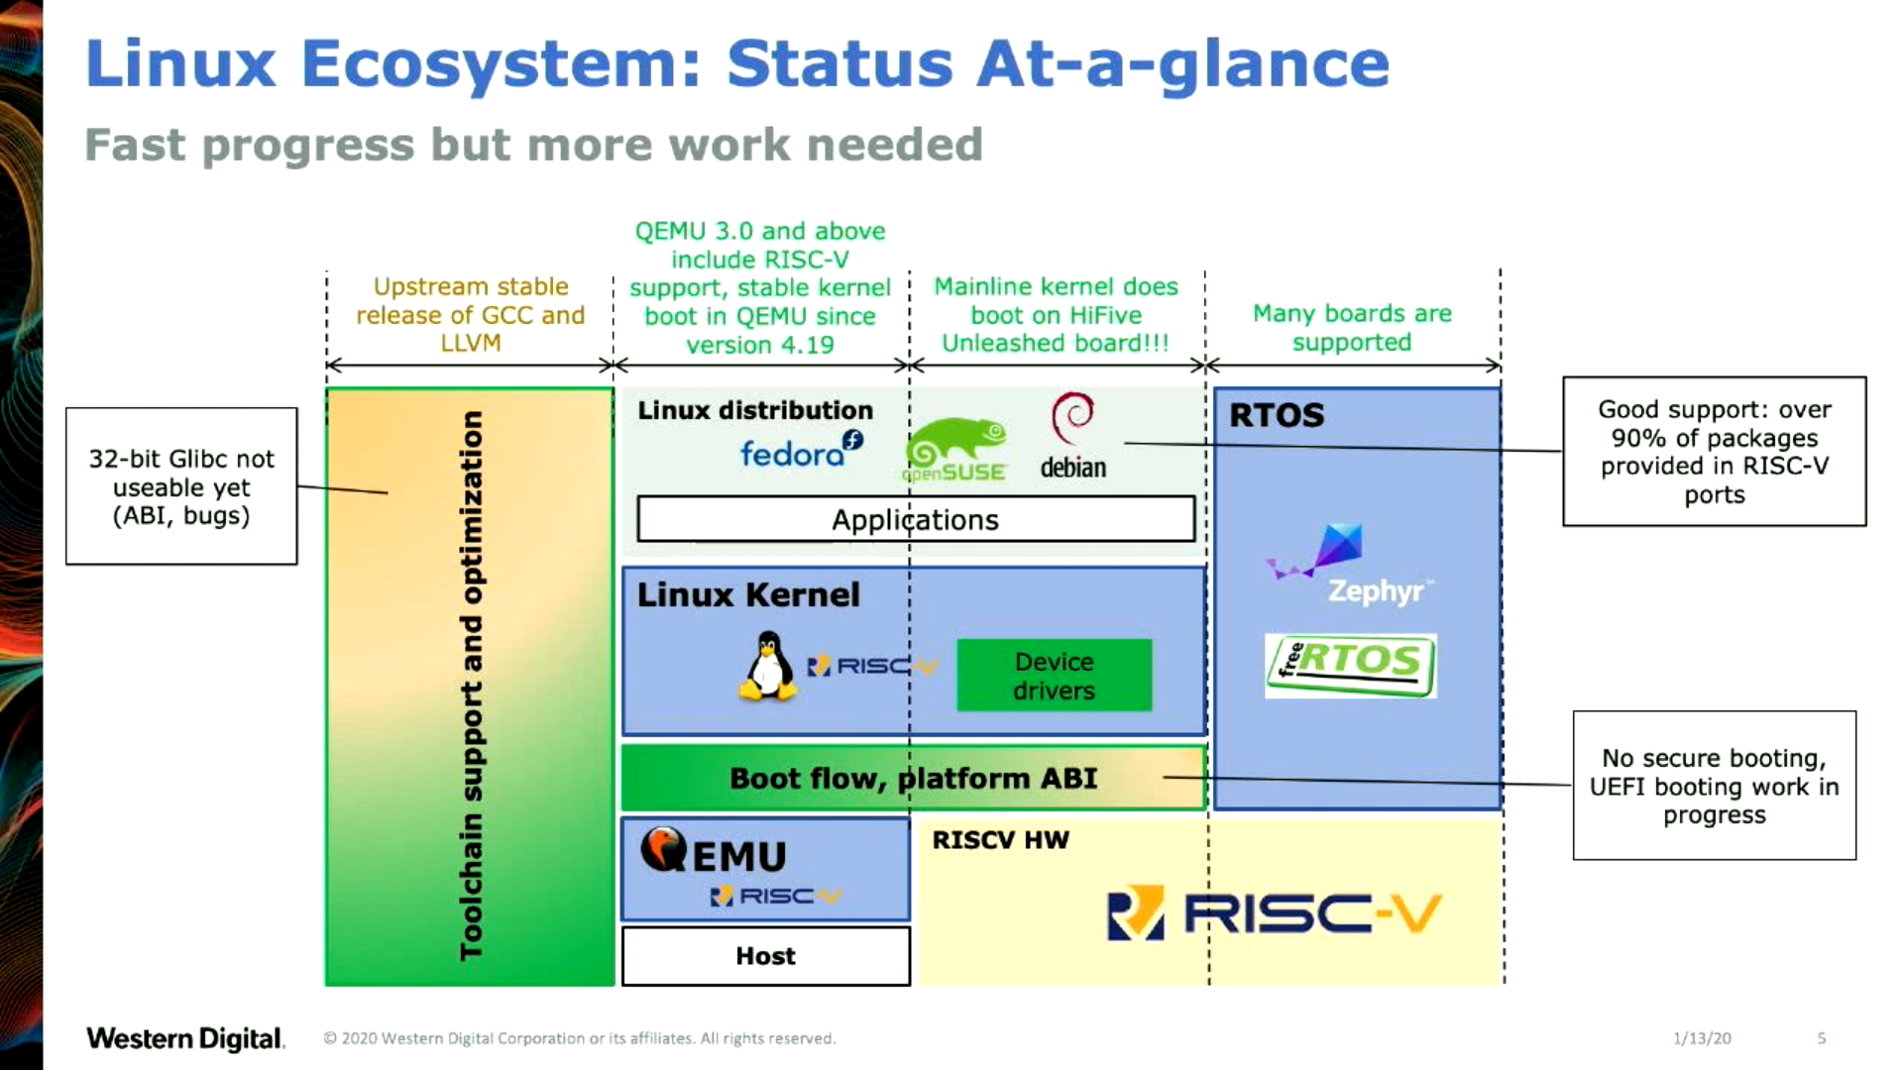
      "RISC-V software ecosystem in 2020" - Atish Patra (LCA 2020)
      https://youtu.be/qwkab2Z44pk

Slide 21
RISC-V at ELC
Go RISC-V Go:
State of Software Development Tools for RISC-V
  Khem Raj (Comcast)
  TOMORROW Wednesday 12:15pm
  https://sched.co/c3Yn
      “Clang/LLVM has newly added backends for RISC-V. In addition, there is now a golang port, which is still out of tree but headed towards upstream acceptance. Additionally, GCC is working towards the GCC-10 release, with several new enhancements to its RISC-V backend. The LLVM backend also means Rust can now cross-compile to the RISC-V architecture. The MUSL C library also has a new RISCV 64-bit port. Additionally, we will discuss the state of tools on the RV32 ecosystem, progress on the glibc port for RV32, and Yocto Project support for RV32 in its core, where QEMU RV32 port is usable for doing application port.”

Slide 22
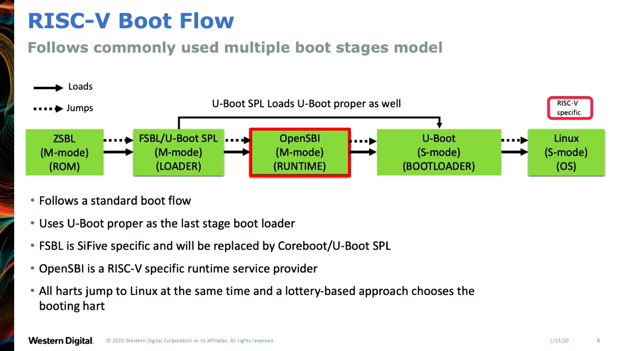
    "RISC-V software ecosystem in 2020" - Atish Patra (LCA 2020)
      https://youtu.be/qwkab2Z44pk

Slide 23
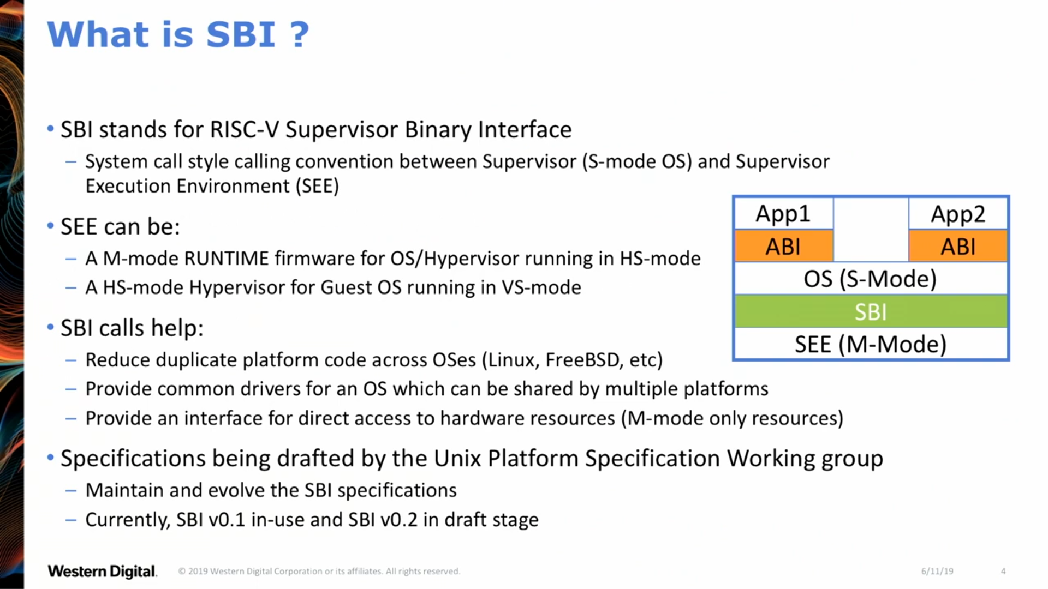
    "OpenSBI Deep Dive" - Anup Patel (RV Workshop 2019)
      https://youtu.be/jstwB-o9ll0

Slide 24
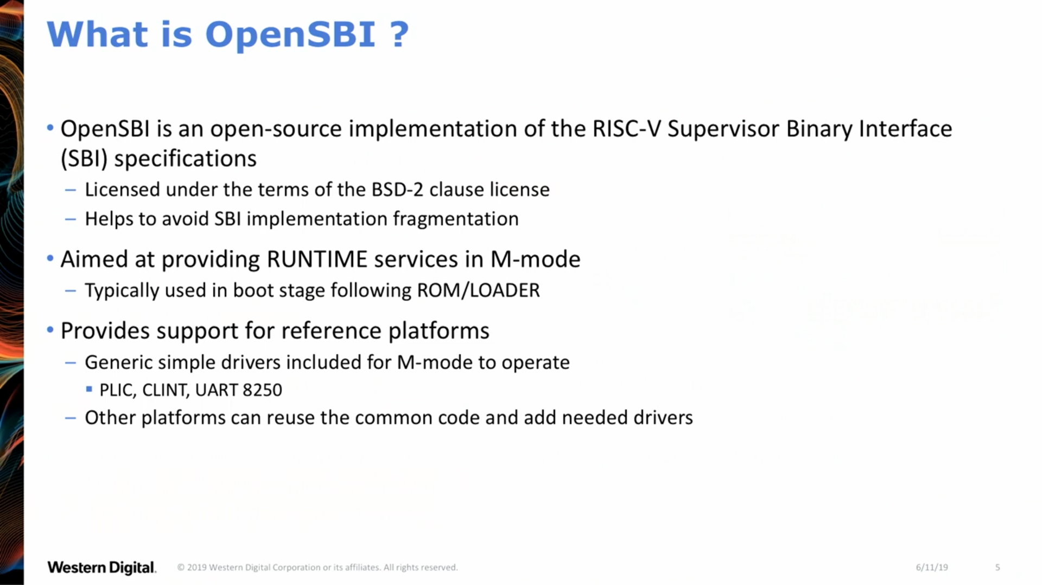
    "OpenSBI Deep Dive" - Anup Patel (RV Workshop 2019)
      https://youtu.be/jstwB-o9ll0

Slide 25
UEFI Support
[RFC PATCH 00/11] Add UEFI support for RISC-V
  Atish Patra (June 25, 2019)
  “This series adds UEFI support for RISC-V”
    Linux kernel: 5.8-rc2
    U-Boot: master
    OpenSBI: master

Slide 26
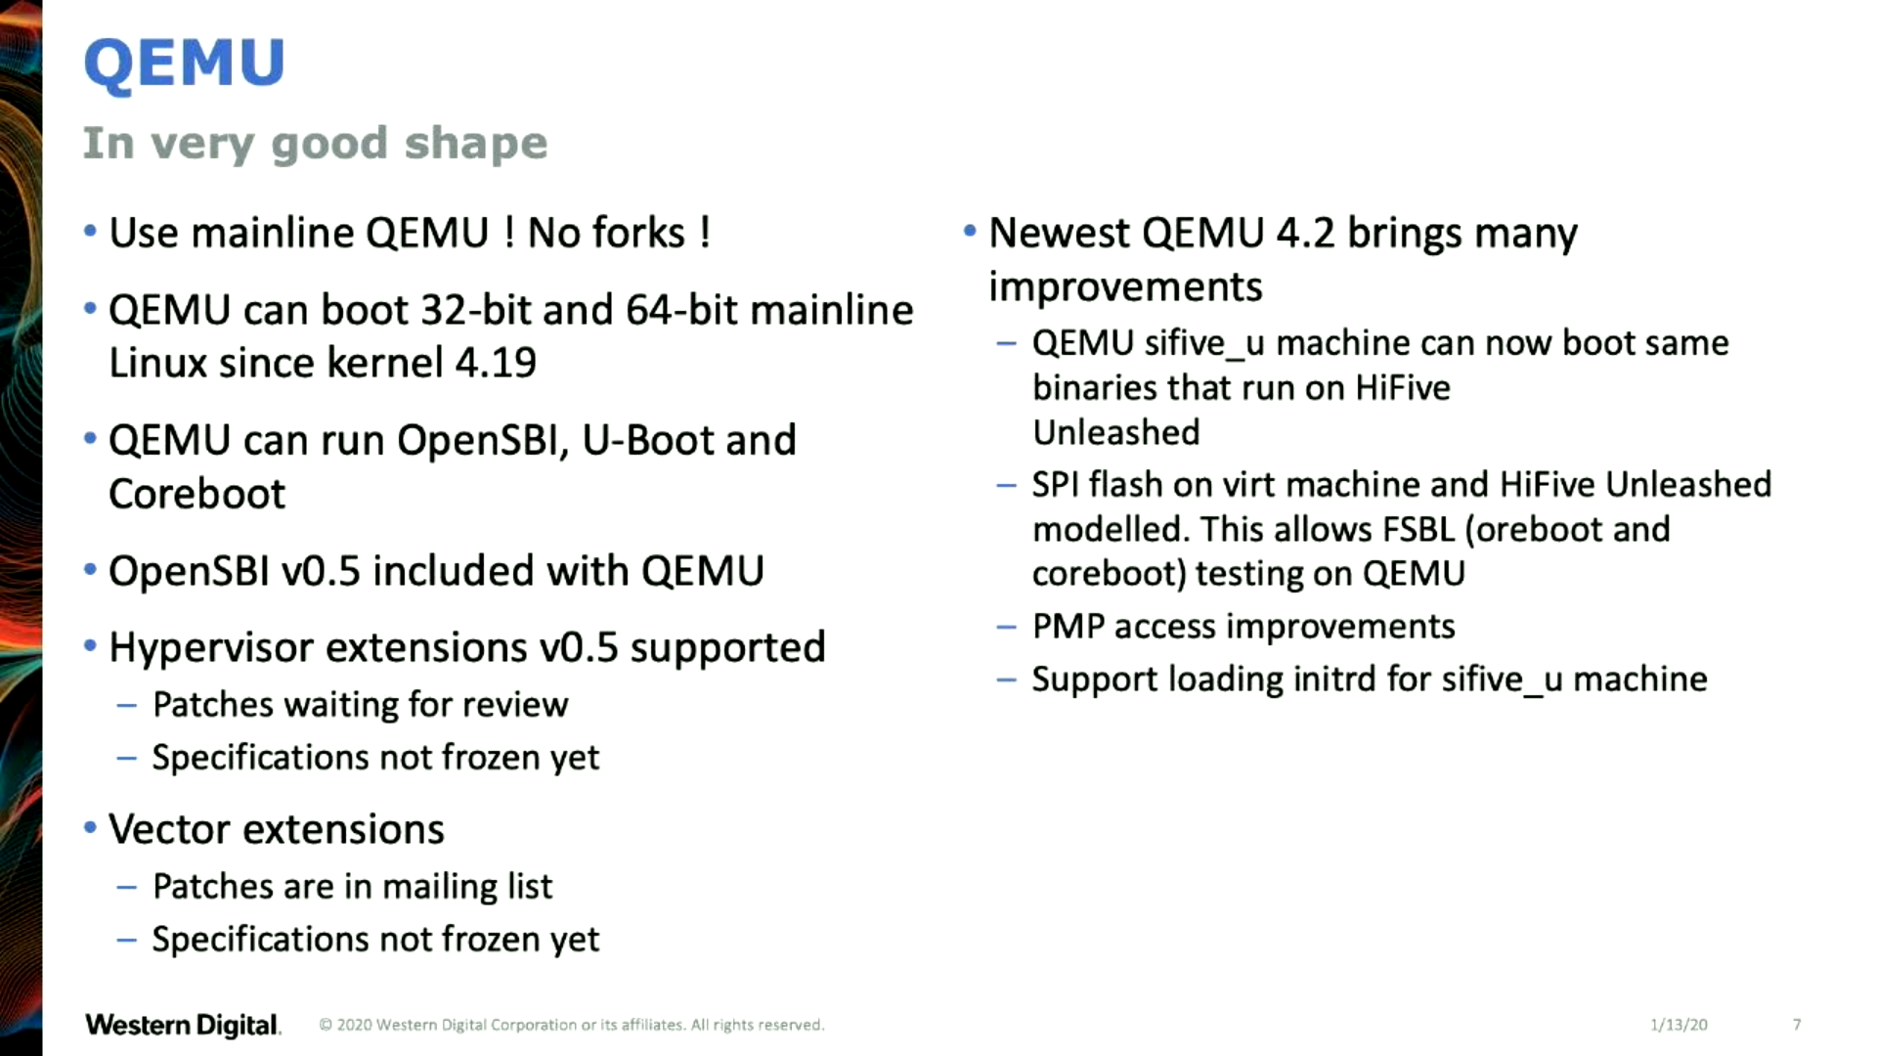
      "OpenSBI Deep Dive" - Anup Patel (RV Workshop 2019)
      https://youtu.be/jstwB-o9ll0

Slide 27
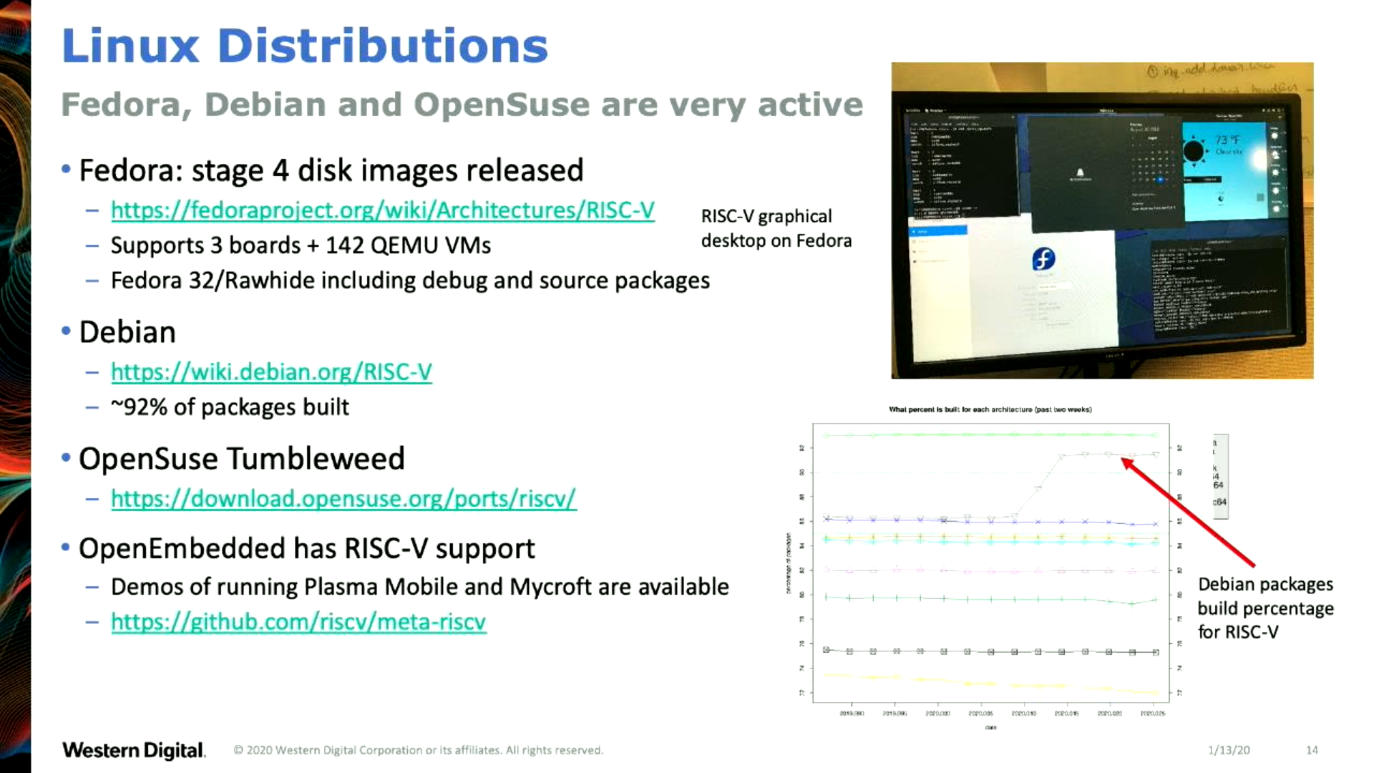
      "OpenSBI Deep Dive" - Anup Patel (RV Workshop 2019)
      https://youtu.be/jstwB-o9ll0

Slide 28
RISC-V and Industry
Designed to be extensible: microcontroller to supercomputer!
RISC-V International now controls standard: riscv.org
  Over 400 members: companies, universities and more
  Transitioning from RISC-V Foundation to Swiss-based RISC-V International
  YouTube channel has hundreds of talks!
Companies like Nvidia and Western Digital will ship millions of devices
Avoid ISA licensing fees
Freedom to choose micro-architecture implementation
  only a few companies like Apple and Qualcomm has licenses to do with ARM
Freedom to leverage existing open source implementations
  Berkeley’s Rocket and BOOM, ETH Zurich’s PULP cores, Western Digital SweRV

Slide 29

lowRISC is a not-for-profit organization whose goal is to produce a fully open source System-on-Chip (SoC) in volume
  “We will produce a SoC design to populate a low-cost community development board and to act as an ideal starting point for derivative open-source and commercial designs”
OpenTitan project with Google
  Announcing OpenTitan, the First Transparent Silicon Root of Trust

Slide 30

SiFive
“founded by the creators of the free and open RISC-V architecture as a reaction to the end of conventional transistor scaling and escalating chip design costs”

Slide 31

SiFive FE310 microcontroller
HiFive1: Arduino-Compatible RISC-V Dev Kit

Slide 32
Section:
Linux-capable RISC-V chips
Slides: https://github.com/pdp7/talks/blob/master/rv-elc.pdf

Slide 33

SiFive Freedom FU540 SoC
  FOSDEM 2018 talk: “Igniting the Open Hardware Ecosystem with RISC-V”

Slide 34

SiFive Freedom FU540 SoC
  HiFive Unleashed board:
    powerful but expensive ($1,000) and very limited quantity

Slide 35

          “Fedora on RISC-V”, Wei Fu (RV Summit 2019)https://www.youtube.com/watch?v=WC6e3g8uWdk

Slide 36
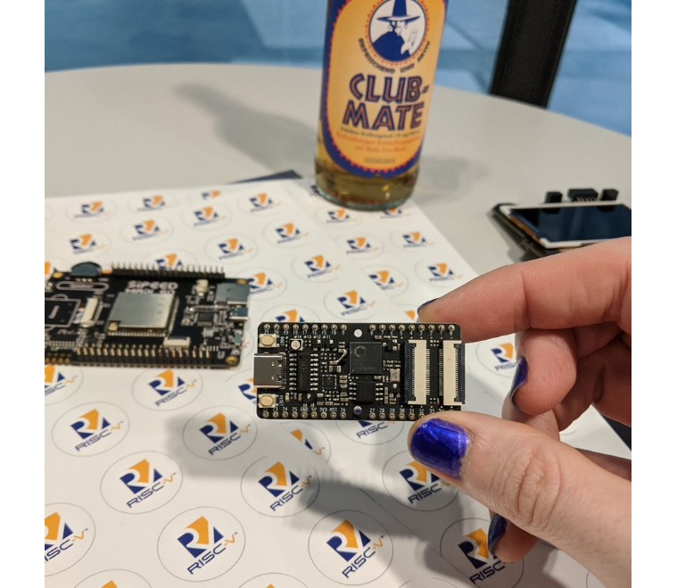

Slide 37
Kendryte K210
  dual core 64-bit RISC-V at 400MHz with 8MB SRAM
  Sipeed MAix BiT for RISC-V is only $13!
  Damien Le Moal at Linux Plumbers 2019
    RISC-V NOMMU and M-mode Linux
  Full support coming in Linux 5.8
  Buildroot with busybox (https://git.io/JJflC)
  need NOMMU/FDPIC support for better userspace
    https://youtu.be/GydyykyNjxs (Maciej W. Rozycki)
    8MB runs out very quick!
  there is a MMU but the wrong spec :(
  u-boot patch series
    [PATCH v14 00/20] riscv: Add Sipeed Maix support
    Sean Anderson (June 24th)

Slide 38


Slide 39
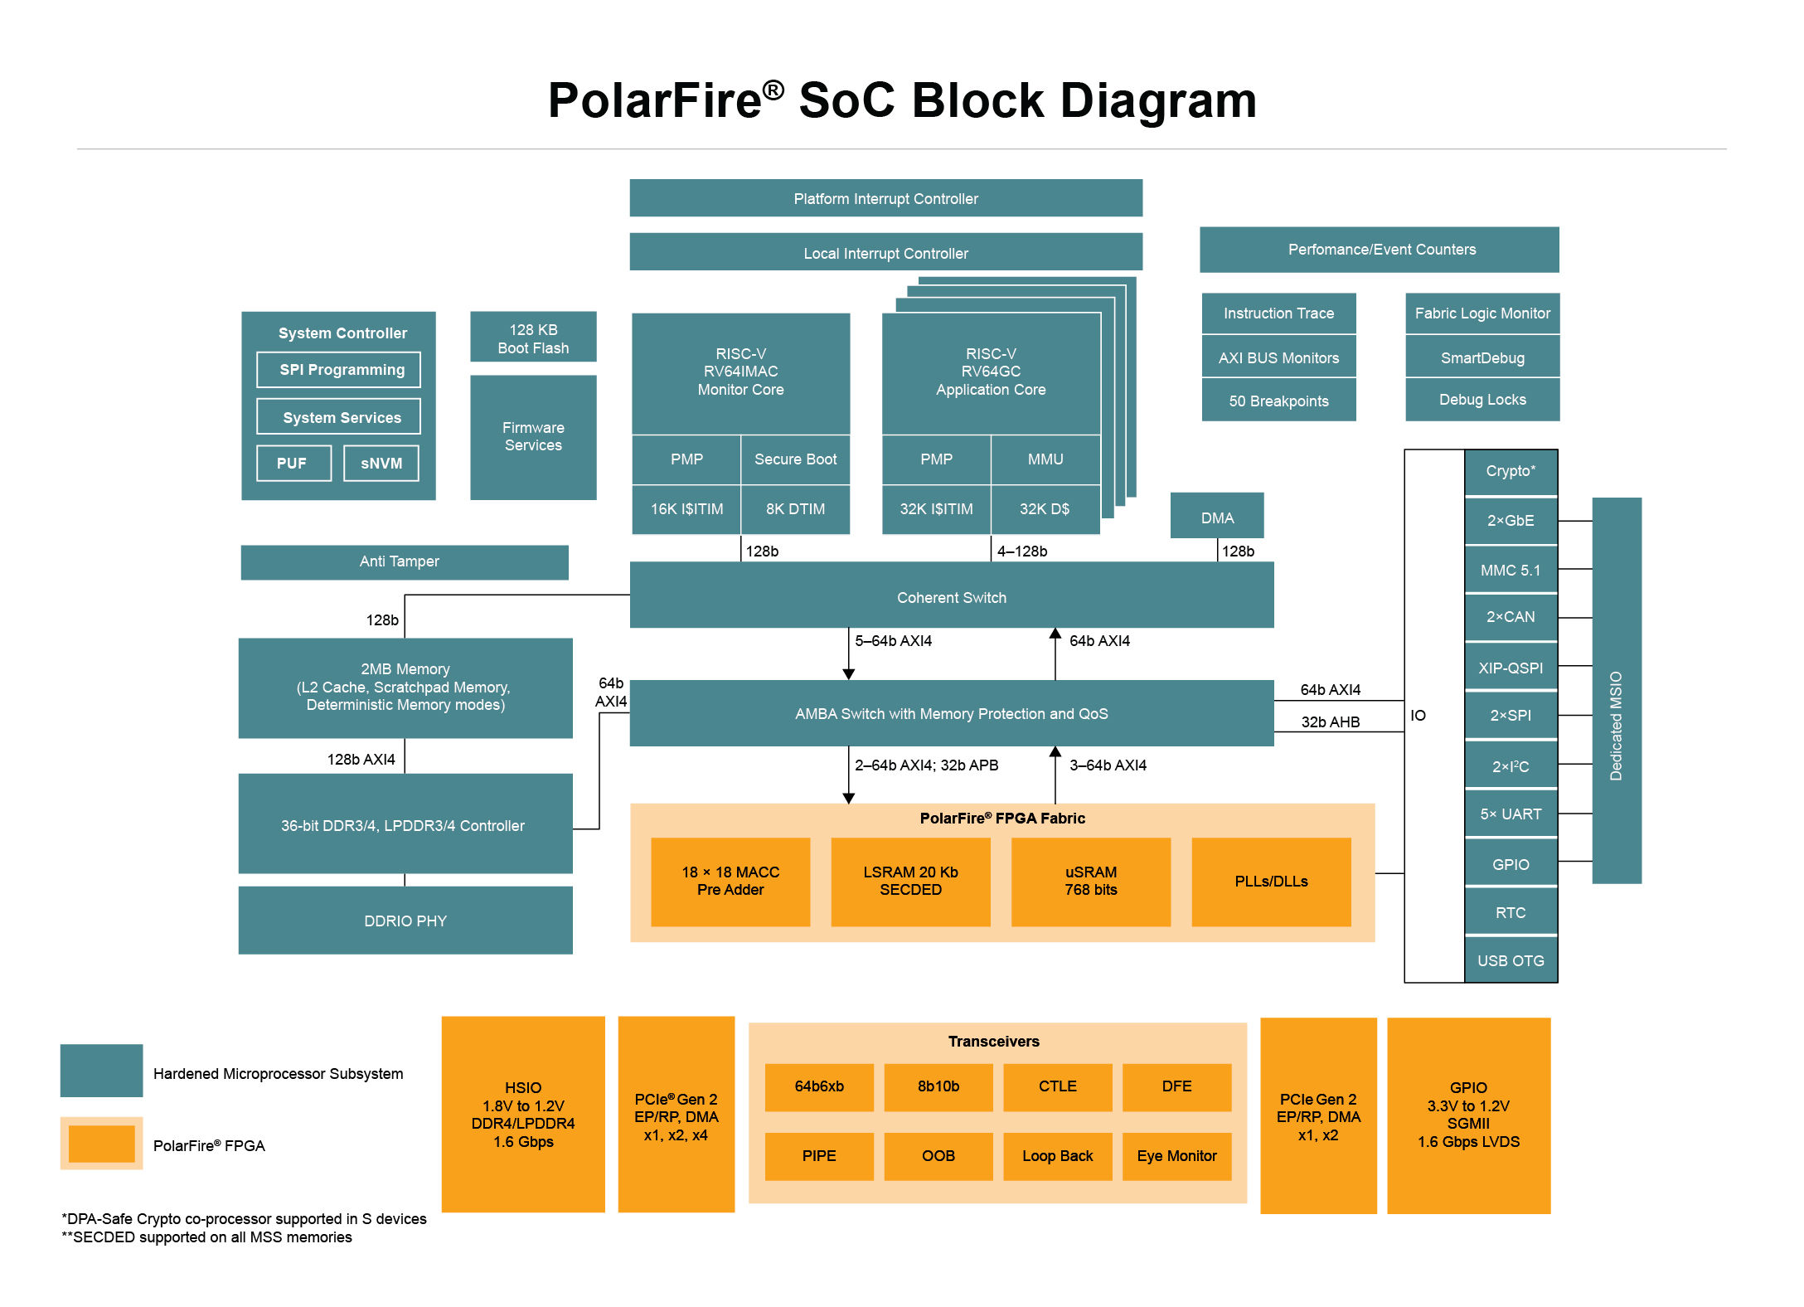
  Microchip PolarFire SoC FPGA
    Hard RISC-V cores with FPGA fabric, similar to Xilinx Zync for ARM. Coming 2nd half 2020.

Slide 40


Slide 41
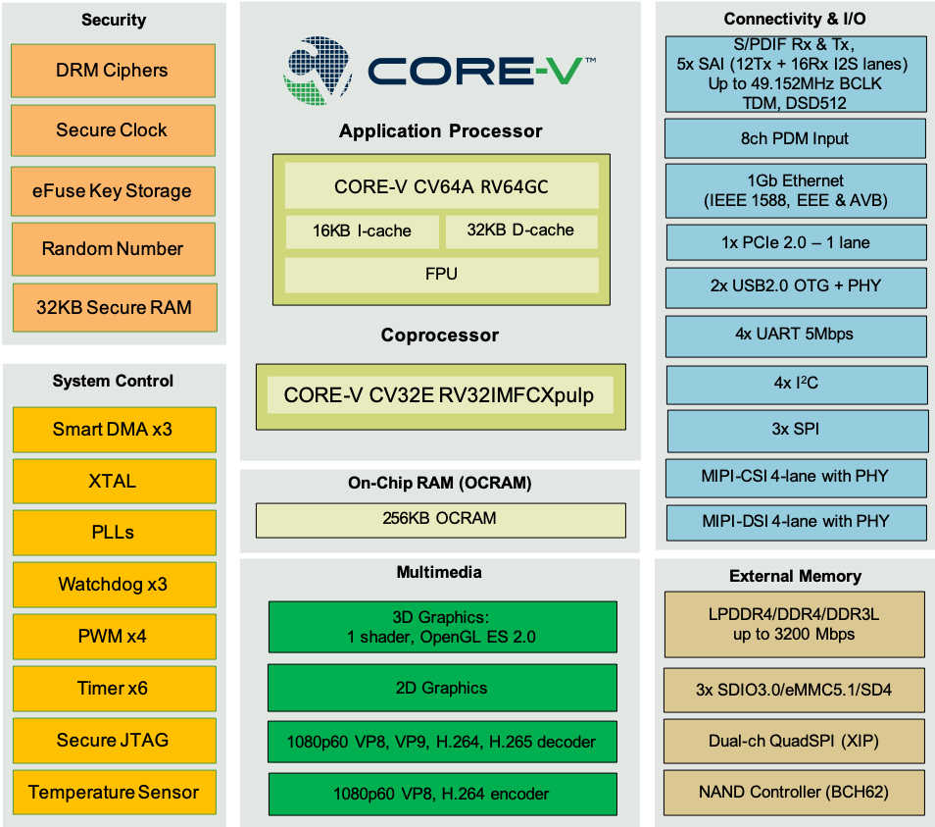
  OpenHW Group: Core-V Chassis SoC
    similar to NXP iMX but with RISC-V cores
    tape-out 2nd half of 2020

Slide 42
Section:
Open Source FPGA tools

Slide 43

Keynote at Hackday Supercon 2019 by
Dr. Megan Wachs of SiFive
“RISC-V and FPGAs: Open Source Hardware Hacking”
  https://www.youtube.com/watch?v=vCG5_nxm2G4

Slide 44


Slide 45

Open Source toolchains for FPGAs
Project IceStorm for Lattice iCE40
    “A Free and Open Source Verilog-to-Bitstream Flow for iCE40 FPGAs” by Claire Wolf (oe1cxw) at 32c3

Slide 46

Open Source toolchains for FPGAs
Project Trellis for Lattice ECP5
  “Project Trellis and nextpnr FOSS FPGA flow for the Lattice ECP5” - David Shah (@fpga_dave)
    youtube.com/watch?v=0se7kNes3EU

Slide 47

Open Source toolchains for FPGAs
Project X-Ray & SymbiFlow for Xilinix Series 7
  Timothy ‘mithro’ Ansell: “Xilinx Series 7 FPGAs Now Have a Fully Open Source Toolchain!” (almost)
    youtube.com/watch?v=EHePto95qoE

Slide 48


Open Source and FPGAs
Hackspace Magazine column about how about open source FPGA tools developed by Claire Wolf (oe1cxw), David Shah and others have made FPGAs more accessible than ever before to makers and hackers:
  hackspace.raspberrypi.org/issues/26/

Slide 49
Section:
Linux on the Hackaday Badge
Slides: https://github.com/pdp7/talks/blob/master/rv-elc.pdf

Slide 50

Hackaday 2019 Supercon badge
RISC-V “soft” core on ECP5 FPGA
Gigantic FPGA In A Game Boy Form Factor

Slide 51

“Team Linux on Badge”

Slide 52
“Team Linux on Badge”
Blog post: Hackaday Supercon badge boots Linux using SDRAM cartridge
Michael Welling (@QwertyEmedded), Tim Ansell (@mithro), Sean Cross (@xobs), Jacob Creedon (@jacobcreedon)
First attempt: use the built-in 16MB SRAM…
no luck :(

Slide 53

“Team Linux on Badge”
Second attempt:
  Jacob Creedon designed an a cartridge board that adds 32MB of SDRAM to the Hackaday Supercon badge… before the event!

Slide 54

“Team Linux on Badge”
Second attempt:
  Jacob Creedon designed an a cartridge board that adds 32MB of SDRAM to the Hackaday Supercon badge… before the event!

Slide 55


Slide 56
Designing Hardware in Python?
Yes!
“Using Python for creating hardware to record FOSS conferences!”
Tim “mithro” Ansell
youtube.com/watch?v=MkVX_mh5dOU

Slide 57
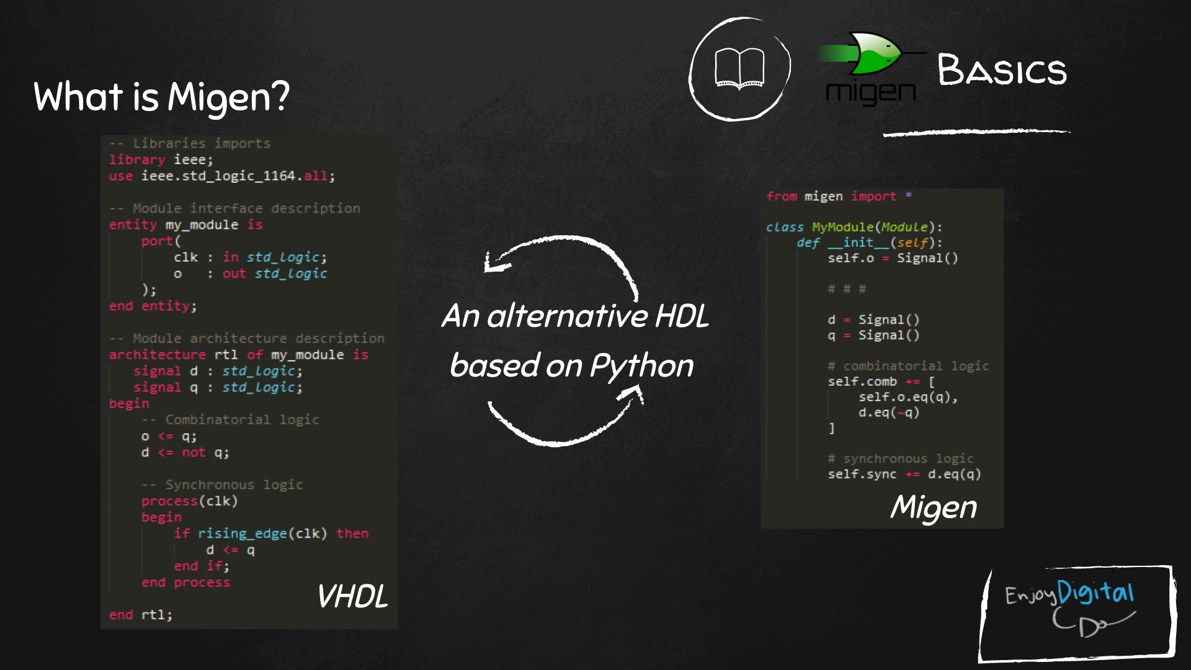
Slides: https://github.com/litex-hub/fpga_101

Slide 58

LiteX used to build cores, create SoCs and full FPGA designs.
LiteX is based on Migen
Migen lets you do FPGA design in Python!
https://github.com/enjoy-digital/litex

Slide 59
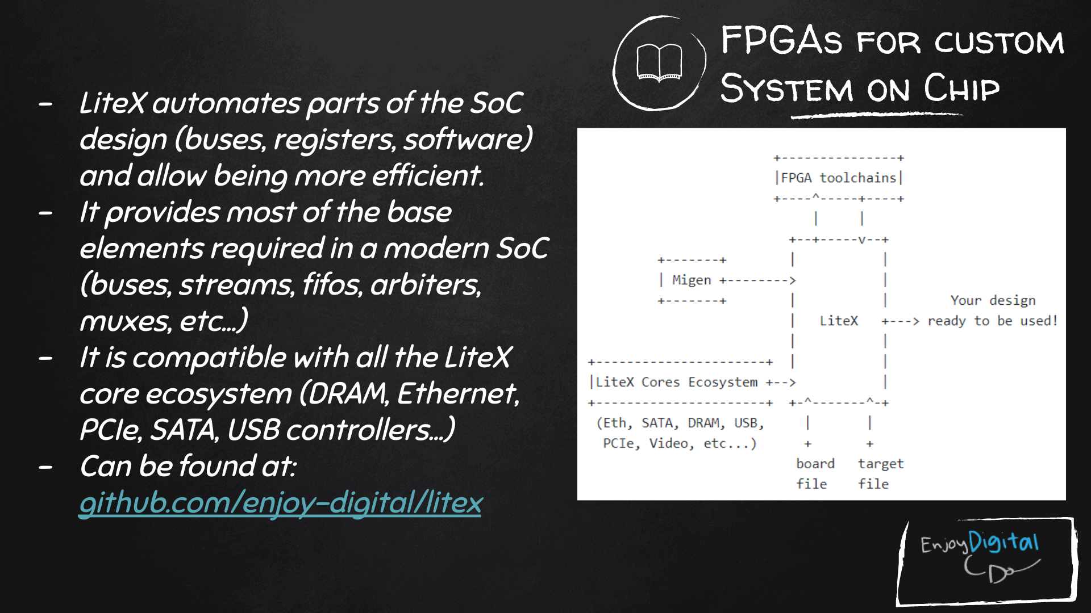
Slides: https://github.com/litex-hub/fpga_101
https://github.com/litex-hub/fpga_101

Slide 60

Linux on LiteX-VexRiscv
VexRiscv: 32-bit Linux Capable RISC-V CPU
SoC built using VexRiscv core and LiteX moduels like LiteDRAM, LiteEth, LiteSDCard, ...
  github.com/litex-hub/linux-on-litex-vexriscv

Slide 61


Slide 62

upstream support for Hackaday Supercon badge:
  https://github.com/litex-hub/litex-boards/pull/31

Slide 63

upstream support for Hackaday Supercon badge:
  https://github.com/litex-hub/litex-boards/pull/31

Slide 64

upstream support for Hackaday Supercon badge:
  https://github.com/litex-hub/litex-boards/pull/31

Slide 65


Slide 66


Slide 67


Slide 68


Slide 69


Slide 70


Slide 71

Greg Davill got the screen working with LiteVideo!
  twitter.com/GregDavill/status/1231082623633543168

Slide 72
Open Source boards with
ECP5 FPGA
(can run Linux)
Slides: https://github.com/pdp7/talks/blob/master/rv-elc.pdf

Slide 73
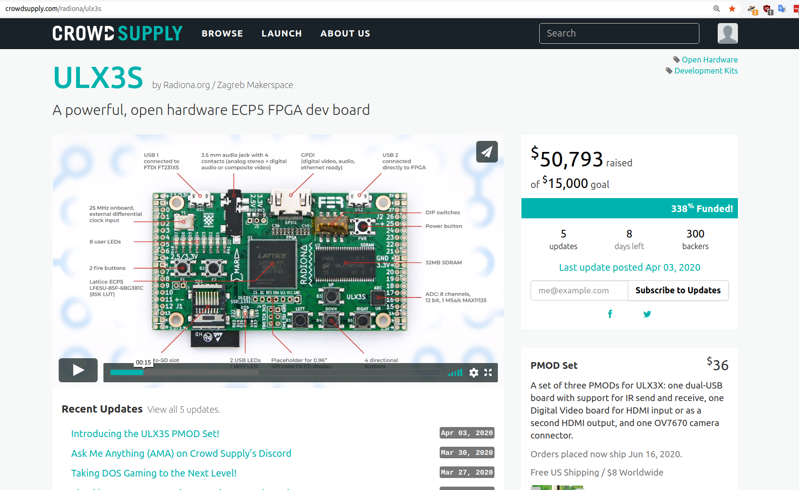
Open Source ECP5 boards
Radiona.org ULX3S
    https://www.crowdsupply.com/radiona/ulx3s

Slide 74

Open Source ECP5 boards
Lattice ECP5 FPGA in Adafruit Feather form factor and 128MB DDR RAM:
  Orange Crab by Greg Davill
    https://github.com/gregdavill/OrangeCrab
    https://groupgets.com/campaigns/710-orangecrab

Slide 75


Slide 76
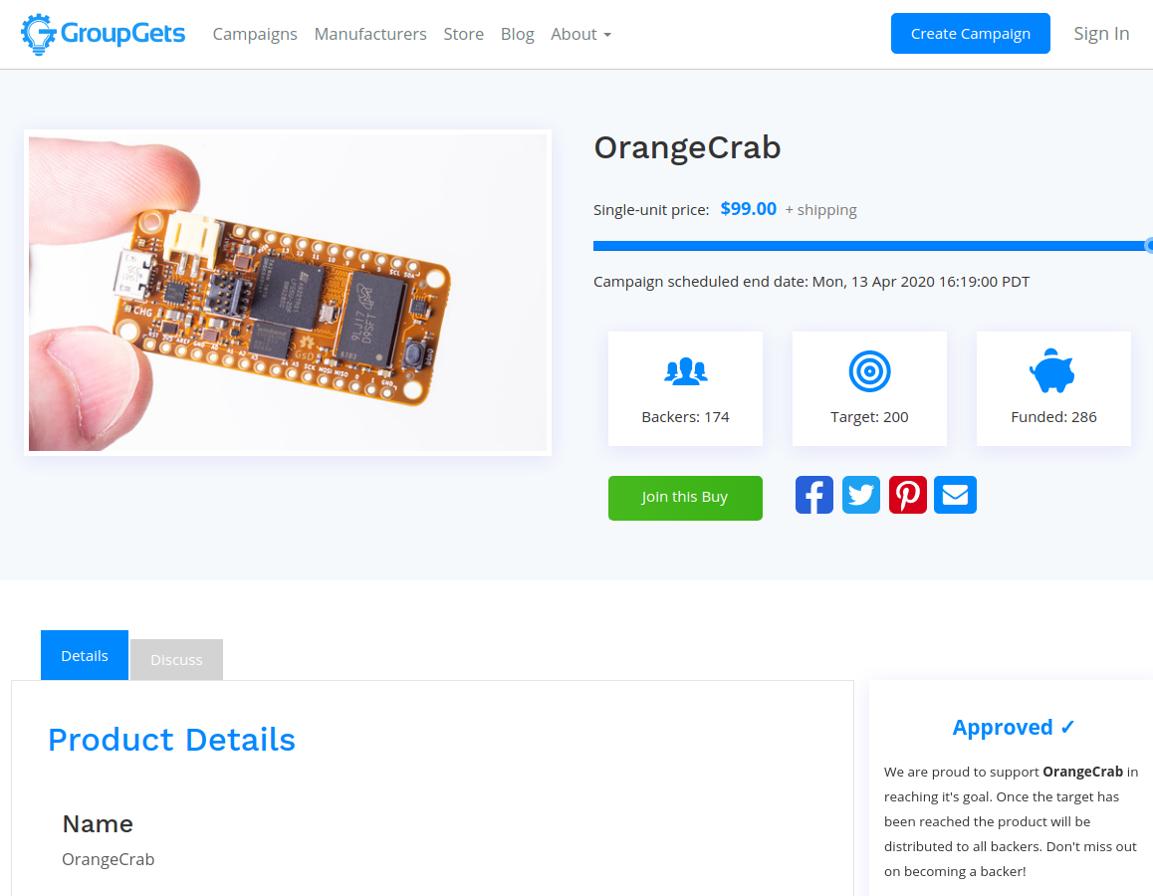
Open Source ECP5 boards
Orange Crab by Greg Davill
    https://groupgets.com/campaigns/710-orangecrab

Slide 77

Want to learn FPGAs? Try Fomu!
workshop.fomu.im
crowdsupply.com/sutajio-kosagi/fomu
Fits in USB port
RGB LED
Learn:
  MicroPython
  Verilog
  LiteX

Slide 78

No hardware? Try Renode!
https://renode.io/

Slide 79
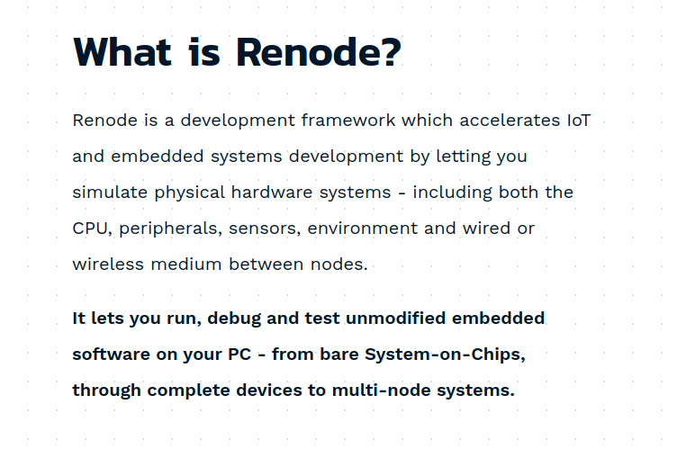
No hardware? Try Renode!
https://renode.io/

Slide 80
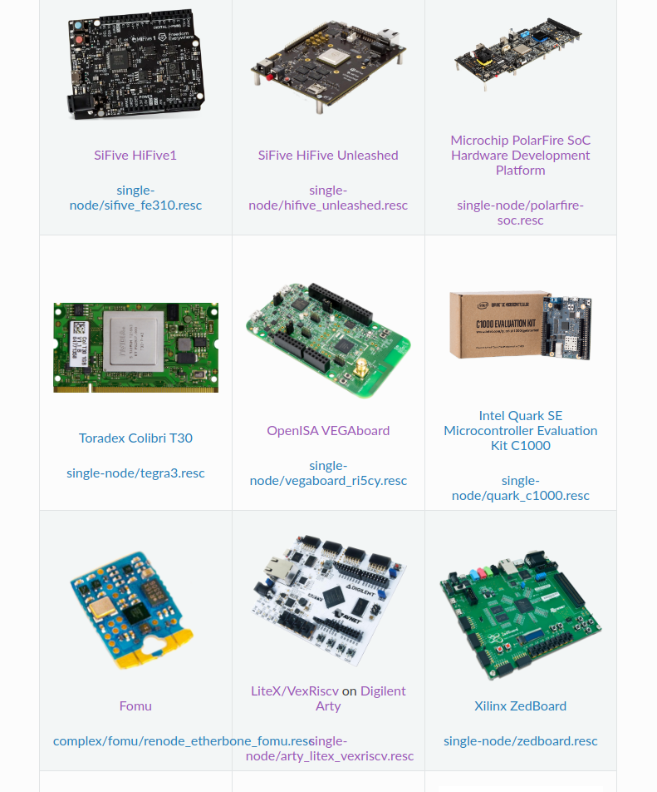

Slide 81
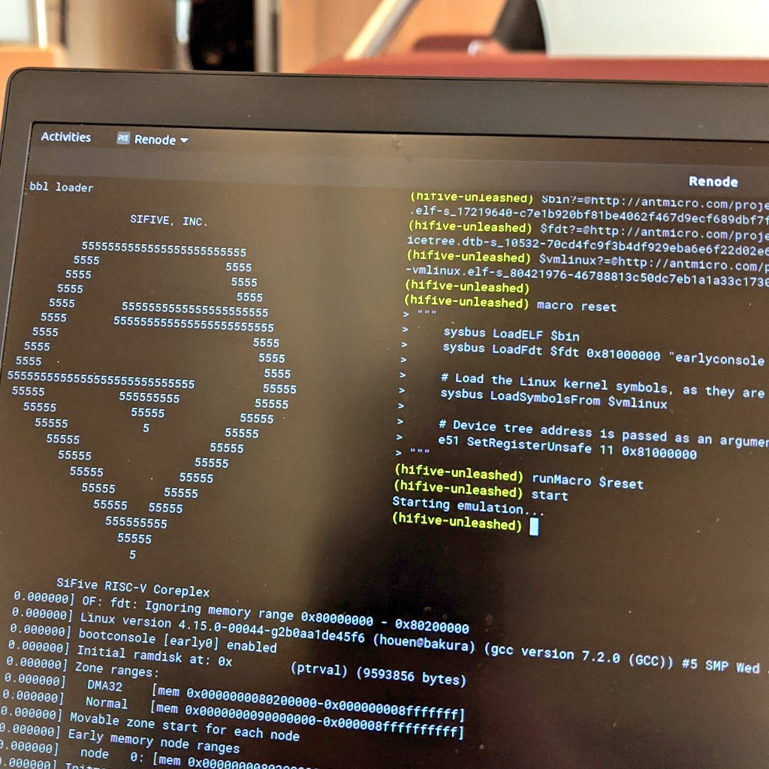

Slide 82

Björn Töpel for RISC-V Munich meetup last week

Slide 83
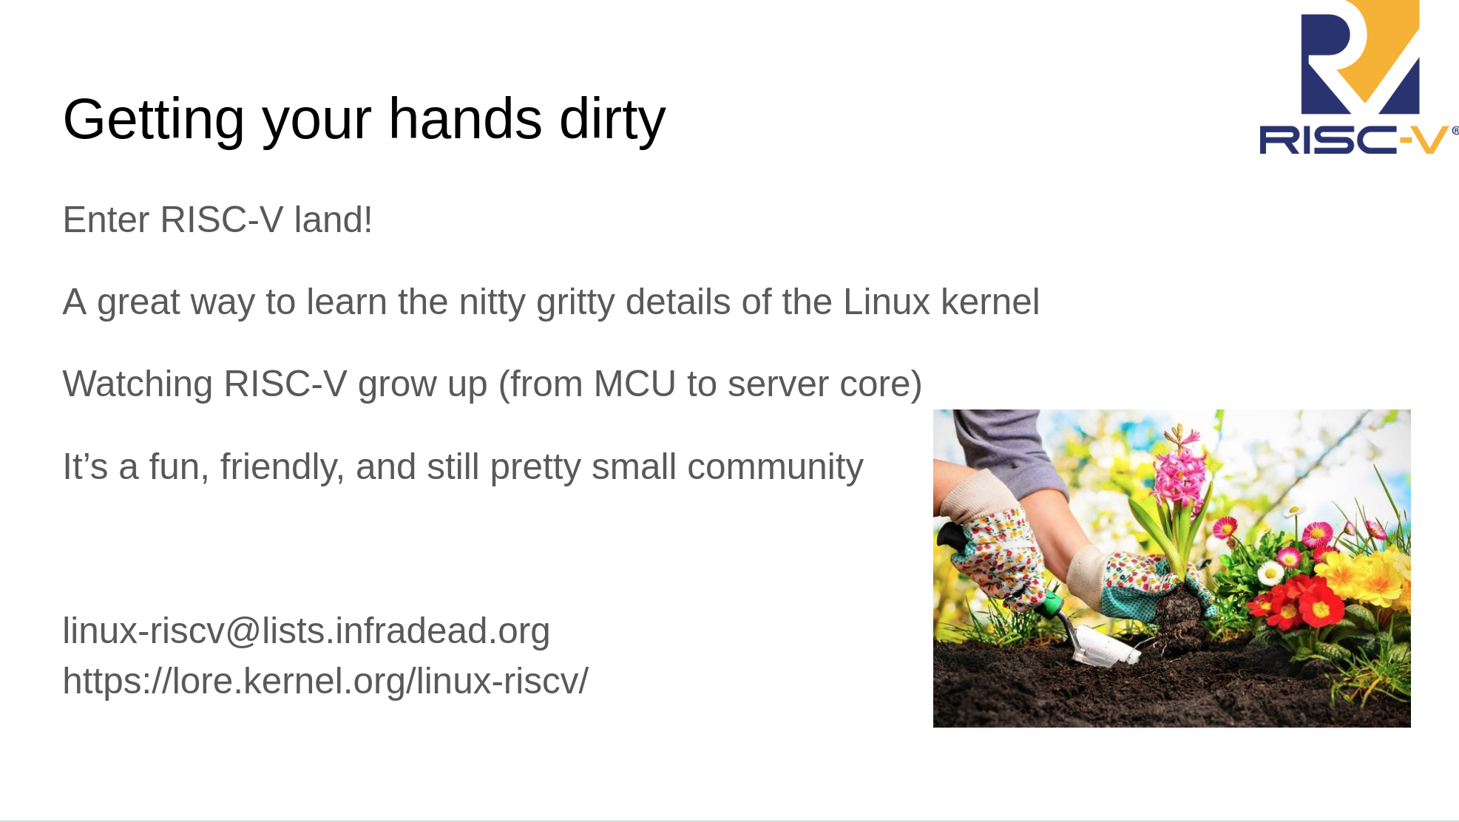

Slide 84
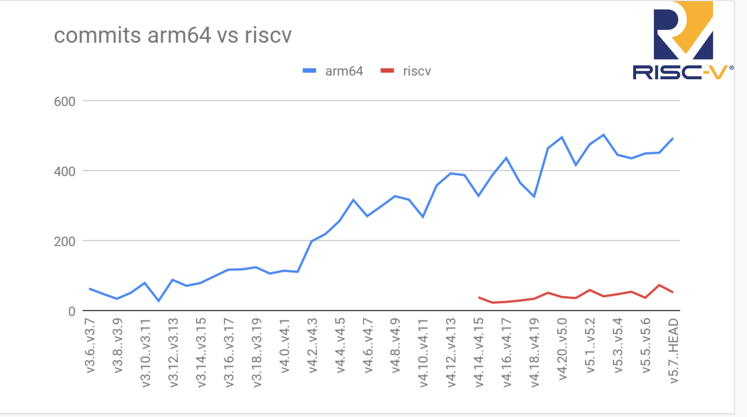

Slide 85
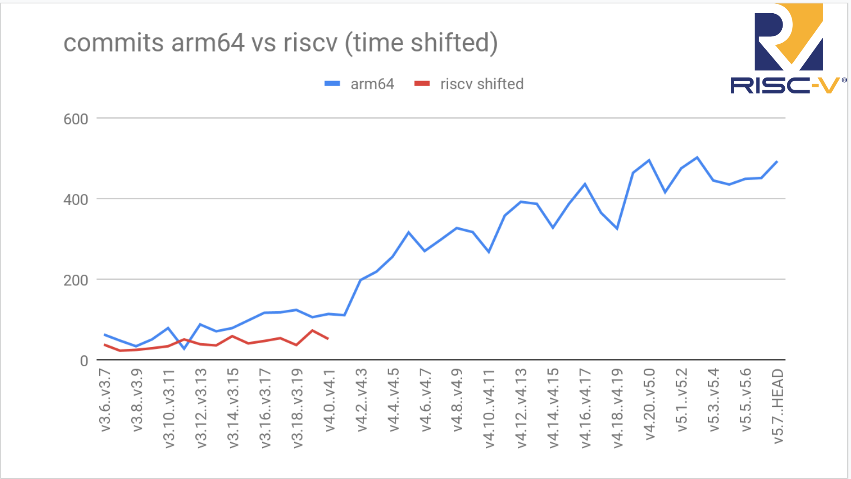

Slide 86
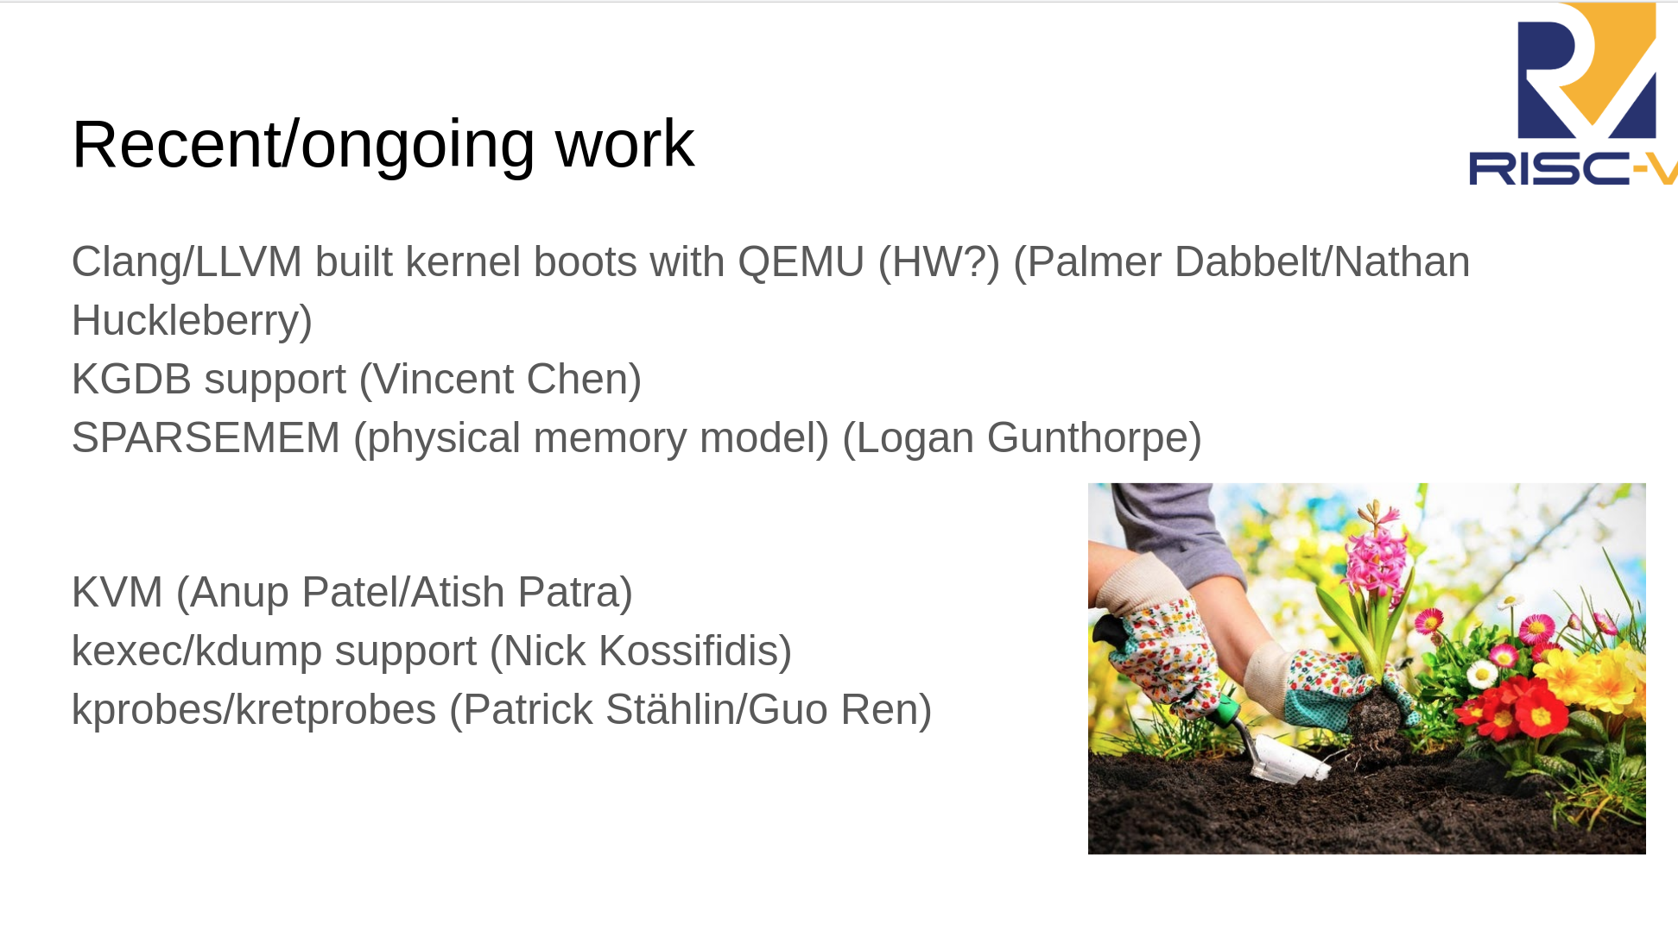

Slide 87
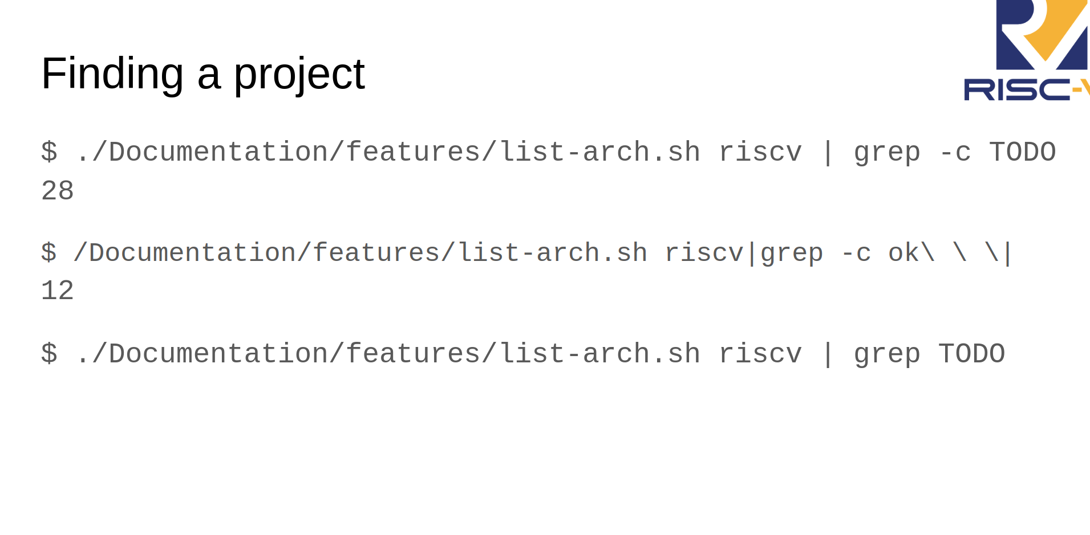

Slide 88

Become a
Slides:
github.com/pdp7/talks/blob/master/rv-elc.pdf
Contact: @pdp7 || drew@beagleboard.org
36c3 talk

Slide 89
RISC-V at ELC
Join #2-track-riscv on the OSS+ELC slack!
RISC-V: Instruction Sets Want to be Free
  Krste Asanovic (UC Berkeley)
  Wednesday, 10:35am: https://sched.co/c4PV
State of RISC-V Software Development Tools
  Khem Raj (Comcast)
  Wednesday 12:15pm: https://sched.co/c3Yn
Ask the Expert Session with Calista Redmond
  CEO of RISC-V International
  Thursday 11:45am: https://sched.co/cosw

