Slide 1




Open Source Hardware and Libre Silicon
Slides: https://github.com/pdp7/talks/
blob/master/penguicon17-oshw-fustini.pdf
Drew Fustini
OSH Park
drew@oshpark.com
@oshpark / @pdp7

Slide 2

Slides: https://github.com/pdp7/talks/blob/master/penguicon17-oshw-fustini.pdf
Statement of Principles:
Hardware whose design is made publicly available so that anyone can study, modify, distribute, make, and sell the design or hardware based on that design

Slide 3



Slides: https://github.com/pdp7/talks/blob/master/penguicon17-oshw-fustini.pdf
Documentation required for electronics:
Schematics Board Layout
Editable source files for CAD software such as KiCad or EAGLE
Bill of Materials (BoM)
Best practice: all components available from distributors in low quantity

Slide 4

Example: Arduino achieved critical mass by sharing their hardware designs and source code
Arduino: The Documentary describes the team’s motivation

Slide 5

Example: Arduino Uno schematic and PCB layout design files for EAGLE CAD can be downloaded from Arduino.cc

Slide 6

What is Open Source?
The term "open source" refers to something people can modify and share because its design is publicly accessible
Open Source software is software with source code that anyone can:
inspect, modify, and enhance

Slide 7
What is Open Source?
Open Source Initiative founded in 1998 and hosts the Open Source Definition:
  “allow distribution in source code as well as compiled form”
  “must not restrict anyone from making use of the program in a specific field of endeavor”
  “may not restrict the program from being used in a business”
compatible Open Source licenses include
Apache, BSD, GPL, MIT and many more

Slide 8


What is Free Software?
A program is free software if the users have four essential freedoms:
1) run the program as you wish, for any purpose
2) study how the program works, and change it so it does your computing as you wish
3) redistribute copies so you can help your
neighbor
4) distribute copies of your modified versions

Slide 9
FLOSS is a term to describe software that is Free, Libre, or Open Source Software
I consider these hardware terms equivalent:
    Free Hardware
    Libre Hardware
    Open Hardware
    Open Source Hardware

Slide 10
Publish documentation with an
Open Source license:
Creative Commons Share-Alike: CC-BY-SA
    Non-Commercial (NC) clause is NOT acceptable
Copyleft: GPLv2, GPLv3
Permissive: Apache, BSD, MIT
OSHW inspired: CERN OHL, TAPR, SolderPad

Slide 11

CERN Open Hardware Licence
Originally written for CERN designs hosted in the Open Hardware Repository
Can be used by any designer wishing to share design information using a license compliant with the OSHW definition criteria.
CERN OHL version 1.2
Contains the license itself and a guide to its usage

Slide 12
CERN Open Hardware Licence
Myriam Ayass, legal adviser at CERN and author of the CERN OHL:
  OHL is to hardware what GPL is to software
  Similar principles to Free or Open Source software
  Anyone should be able to:
  see the source*, study it, modify it and share it
  *the design documentation in case of hardware

Slide 13

CERN Open Hardware Licence
Video interview with Javier Serrano
physicist and electronics engineer at CERN
co-author of the CERN Open Hardware License
creator of the Open Hardware Repository

Slide 14
Licenses, Copyright and Patents
can get confusing!
Review of Popular OSHW Licenses
Video of Ari Douglas at OHS 2014

Slide 15
What is the spirit of Open Source?
Publish everything that will:
enable collaborative development
Goal is NOT to check a box on a marketing brochure or add keywords to a crowdfunding campaign

Slide 16

US-based 501(c)3 non-profit organization
Hosts the Open Source Hardware definition
“aims to be the voice of the open hardware community, ensuring that technological knowledge is accessible to everyone, and encouraging the collaborative development of technology”

Slide 17
OSHW Best Practices
Quick Reference Guide
OSHW "May and Must" (PDF)
OSHW Checklist (PDF)

Slide 18
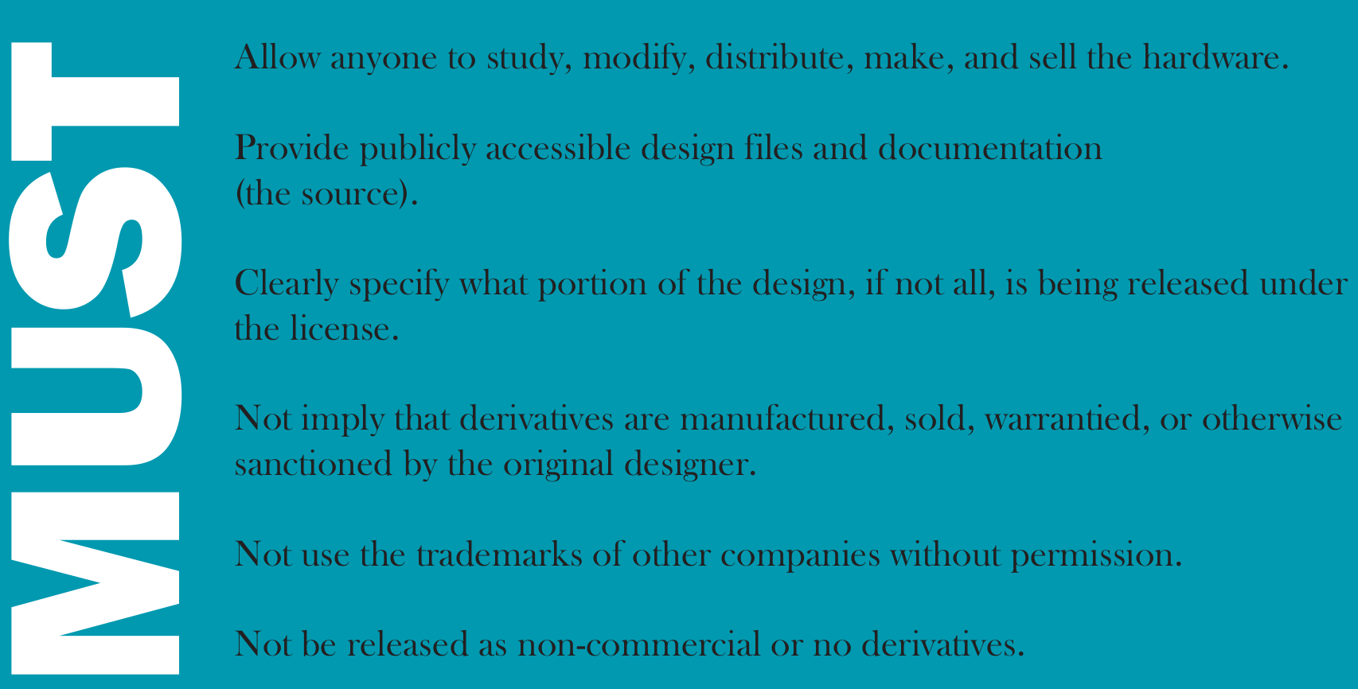

Slide 19
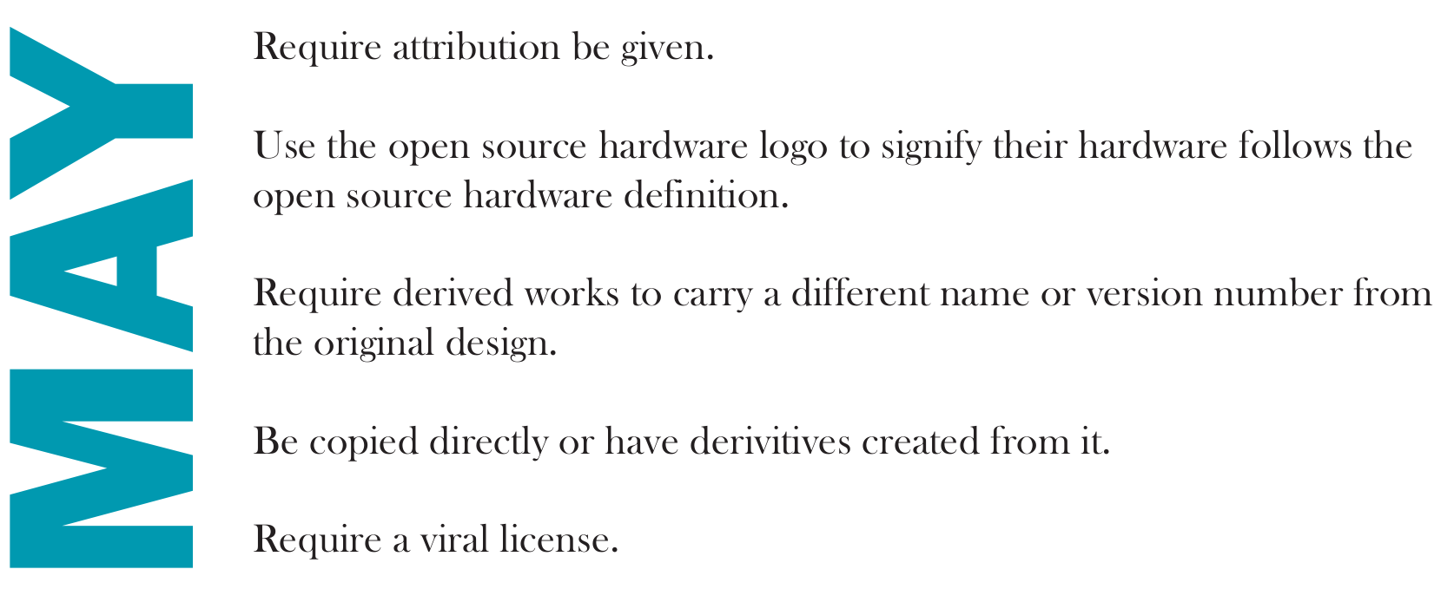

Slide 20


Open Hardware Summit (OHS)
OHS 2017: Denver, Colorado, October 5th
7 prior summits:
  2010, 2011: New York Hall of Science
  2012: Eyebeam (NYC)
  2013: MIT (Boston area)
  2014: Roma, Italia!
  2015: Philadelphia
  2016: Portland, Oregon

Slide 21
Open Hardware Summit (OHS)
OHS 2017: Denver, Colorado, October 5th
Speaker Submissions are open
  Deadline is Monday, May 1st!
Ada Lovelace Fellowship aims to increase diversity by offering a $500 travel stipend each for 10 people (deadline was April 5th)

Slide 22
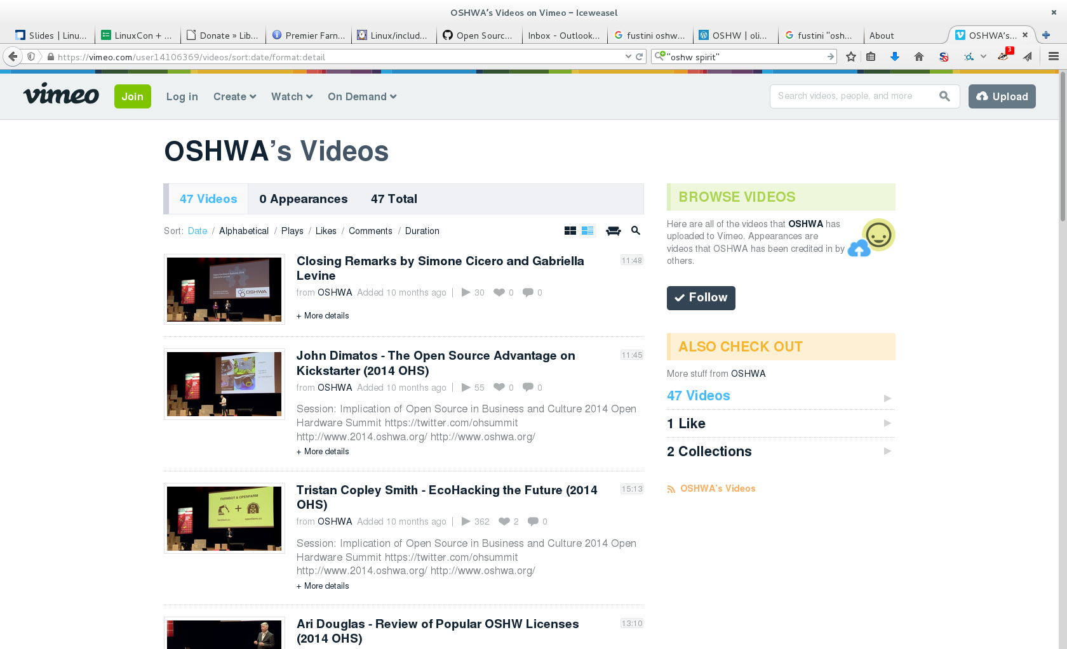
2014 videos:
Open Hardware Summit (OHS)

Slide 23
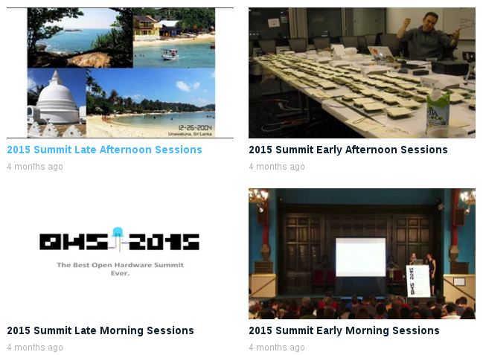
Open Hardware Summit (OHS)
2015 videos:

Slide 24
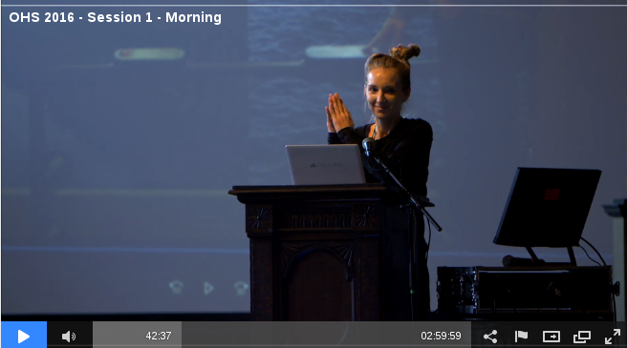
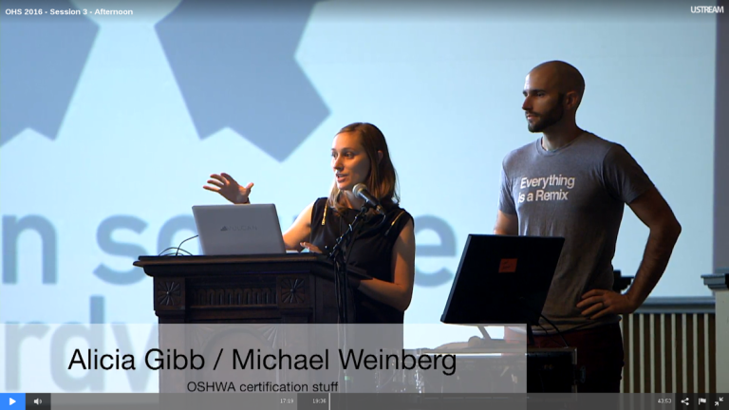
Open Hardware Summit (OHS)
OHS 2016 morning sessions
OHS 2016 afternoon sessions

Slide 25

Open Source Hardware Certification Program
Announced by OSHWA at Open Hardware Summit in Portland back in October 2016
Blog post:Announcing the OSHWA Open Source Hardware Certification Program

Slide 26
Open Source Hardware Certification Program
Allows hardware that complies with the community definition of Open Source Hardware to display a certified OSHW logo
Make it easier for users of OSHW to track down documentation and information
More information: certificate.oshwa.org

Slide 27
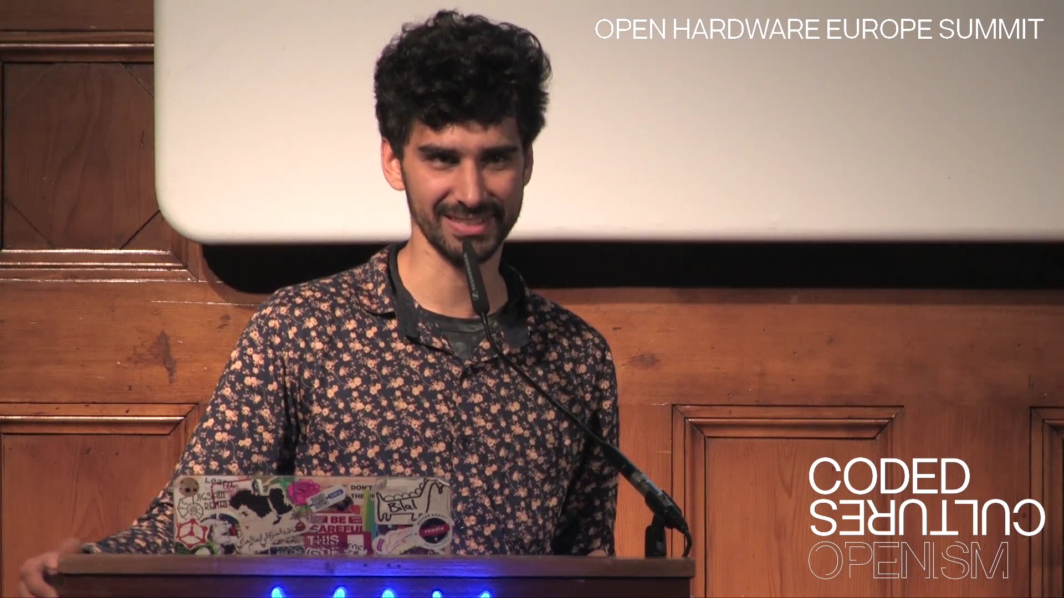
Open Hardware Europe Summit 2016
Video playlist on YouTube
Open Hardware Europe Summit & The DIY 2.0 revolution
  “The global open hardware community met in Vienna, Austria to give talks about new aspects, new methods and lessons learned for the open hardware movement.”

Slide 28

Resources
Join OSHWA
Subscribe to the mailing list
Post in the OSHWA Forum
Follow on Twitter:
  @OHSummit
  @oshwassociation
Building Open Source Hardware
by Alicia Gibb (executive director of OSHWA)

Slide 29
Section:
OSHW PRODUCTS
Slides:
https://github.com/pdp7/talks/blob/master/penguicon17-oshw-fustini.pdf

Slide 30

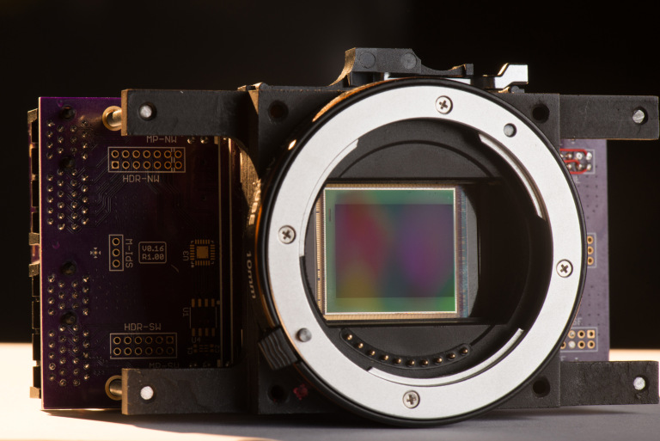
“The goal of the global community-driven apertus° project is to create a variety of powerful, affordable, free (in terms of liberty), sustainable and open digital cinema tools that we as filmmakers love to use”

Slide 31
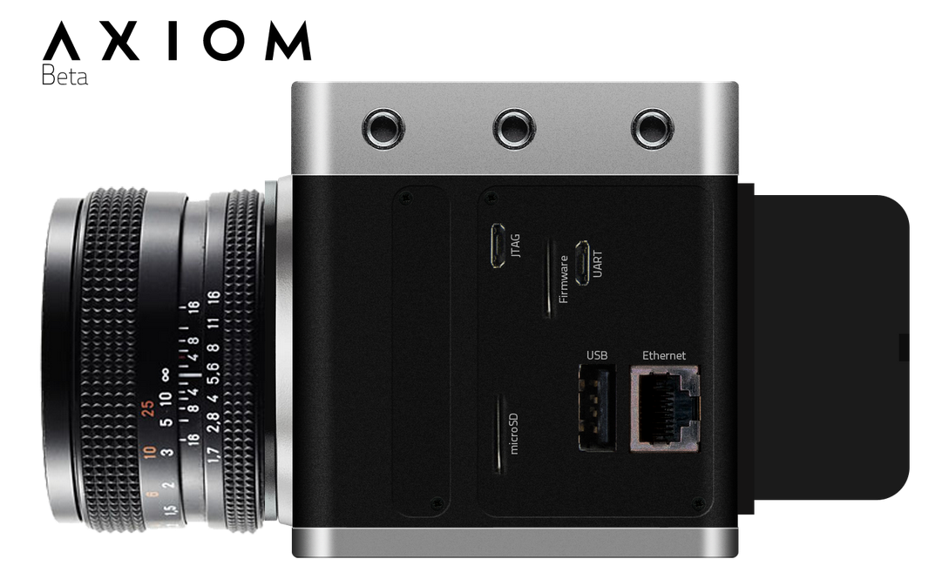
“AXIOM product line is the result of this ongoing endeavor and after successful crowd funding and receiving an EU Innovation grant is well on track to redefine the industry well beyond the DIY garages and hobbyist labs”

Slide 32


Lulzbot 3-D Printers
100% Open Source
Hardware & Software
FSF Respects Your Freedom certified!

Slide 33

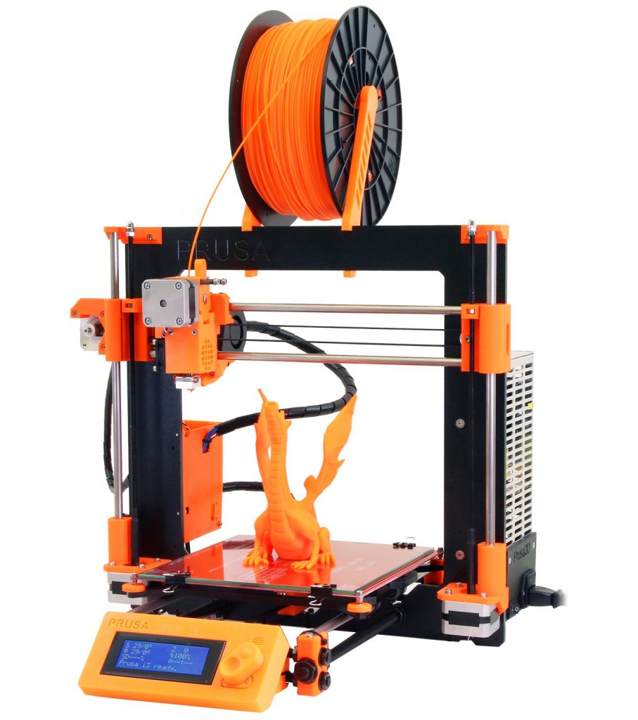
RepRap 3-D Printers
RepRap started as an academic initiative to develop a low-cost 3D printer that can print most of its own components
Giving Manufacturing a New Life
by Adrian Bowyer
Prusa i3 M2 RepRap namedMake:'s Best 3D Printer for 2017

Slide 34

Novena laptop
Created by Bunnie Huang & Sean Cross (xobs)
  Chumby, “Hacking the Xbox”, amazing reverse engineers
100% Open Source Hardware laptop
Quad-core 1.2GHz ARM, 4GB RAM, SSD, WiFi
Xilinx FPGA for custom hardware design
Software Defined Radio (SDR) module

Slide 35
Section:
LINUX on OSHW
Slides:
https://github.com/pdp7/talks/blob/master/penguicon17-oshw-fustini.pdf

Slide 36


Open Source Hardware computing for Makers, Educators & Professionals
Developed by BeagleBoard.org Foundation and BeagleBoard.org Community
Manufacturers: element14, GHI, Seeed

Slide 37

BeagleBoard.org released the first BeagleBoard, an affordable, open hardware ARM computer in 2008

Slide 38


Maker focused, Altoids tin sized BeagleBone introduced in 2011

Slide 39


More affordable, more powerful BeagleBone Black in 2013

Slide 40

Open Source HardwareBeagleBone derivatives

Slide 41

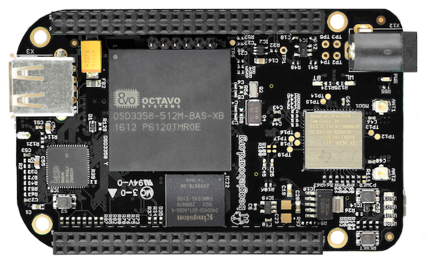
BeagleBone Black Wireless
1 GHz ARM processor, 512 MB RAM
2x 32-bit PRU microcontroller for hard real-time
4GB eMMC with Debian GNU/Linux installed
WiFi, Bluetooth+BLE, HDMI, USB 2.0, 65 GPIO, 8 PWM, 7 analog inputs, 4 UART, 2 I²C, 2 SPI

Slide 42

BeagleBone Black Wireless
CadSoft EAGLE design files hosted on GitHub
Bill of Materials: every part available in qty 1
Octavo System-in-Package (SiP) packages several ICs (CPU, RAM, etc) into one large-pitch BGA chip to simplify PCB layout and assembly

Slide 43

BeagleBone Blue: complete Linux robotics controller. 4 layer PCB designed in EAGLE.

Slide 44
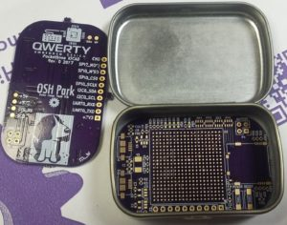
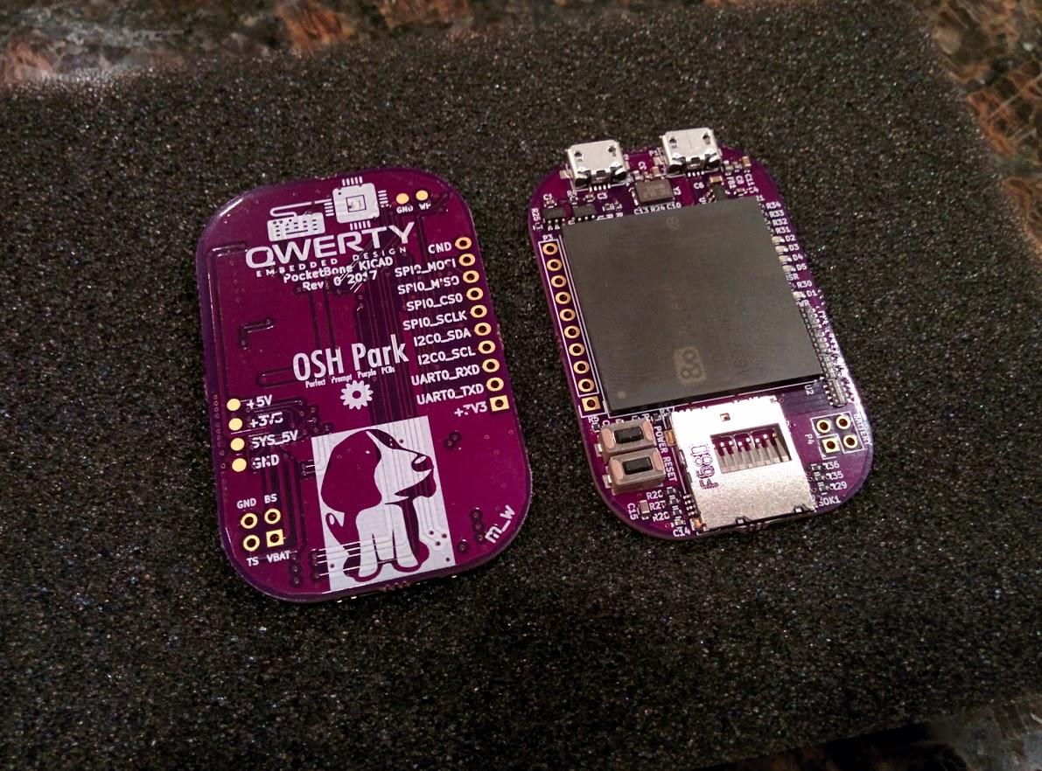
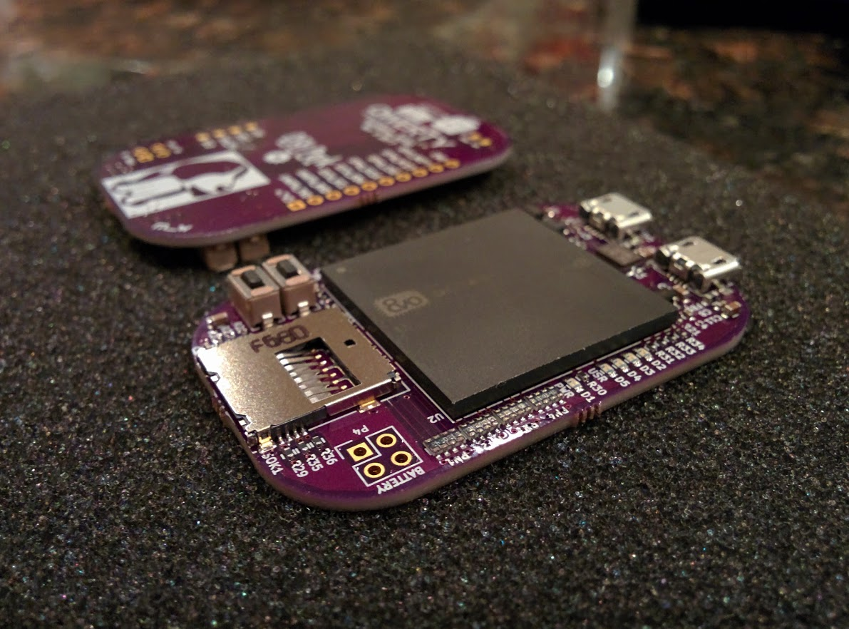
PocketBone
Michael Welling designed this BeagleBone derivative with Octavo SiP that fits in the mini Altoids tin!
4 layer PCB design in KiCad can be manually assembled

Slide 45


MinnowBoard
64-bit Intel Atom “Bay Trail”
MinnowBoard Turbot
  $135: E3826 (dual-core, 1.46 GHz)
USB 3.0, SATA, PCIe, Gigabit Ethernet, HDMI
Integrated Intel HD Graphics
  Open Source Mainline Linux drivers!

Slide 46
MinnowBoard
Manufactured by ADI
Released under Creative Commons CC-BY-SA
Download design files:
  Schematic (Orcad DSN & PDF)
  Board Layout (Allegro BRD & Gerbers)
  Bill of Materials

Slide 47

OLinuXino
Low cost OSHW Linux computers
Designed and manufactured by Olimex in Bulgaria
Great blog post:
Open Source Hardware, why it matters and what is pseudo OSHW

Slide 48

A64-OlinuXino
Allwinner A64: Quad Core 64-bit ARM
Designed with Open Source KiCad
1GB RAM, 4GB eMMC, WiFi+BLE4.0

Slide 49

Slides / Video

Slide 50

KiCad is an Open Source EDA suite including Schematic Capture and PCB Layout
Cross platform: Windows, Mac OS and Linux
CERN has contributed professional CAD features for high-speed digital design
Learn to design your own PCB in KiCad with: Getting to Blinky

Slide 51

TERES I Laptop
“DIY Open Source Hardware Software Hacker's friendly Modular Laptop”
Developing an Open Source Laptop talk by Olimex founder Tsvetan Usunov at Hackaday Belgrade
Design files on GitHub:
“everyone can download & learn, study, edit, modify”

Slide 52
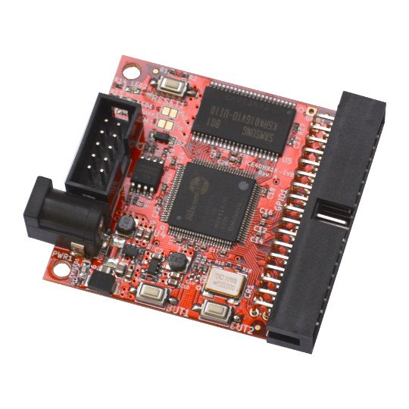
iCE40 FPGA Board
Low cost development board for iCE40 FPGA family from Lattice Semiconductor.
“Interesting part about this family of FPGAs is that there is a completely free & open source development tool available”

Slide 53
Project IceStorm
Clifford Wolf has been “reverse engineering and documenting the bitstream format of Lattice iCE40 FPGAs and providing simple tools for analyzing & creating bitstream files”
Yosys (Yosys Open Synthesis Suite) by Clifford Wolf is an Open Source Verilog synthesis and verification tool

Slide 54
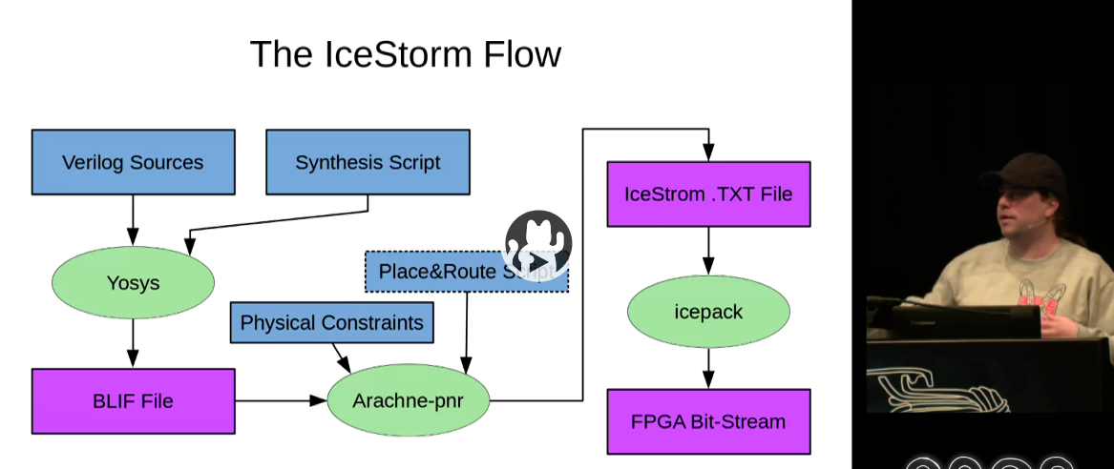
Project IceStorm
Video of talk at 32C3:
“A Free and Open Source Verilog-to-Bitstream Flow for iCE40 FPGAs”

Slide 55


getchip.com
Next Thing Co. in Oakland
Kickstarter in 2015:
    39,560 backers
    $2,071,927 pledged

Slide 56
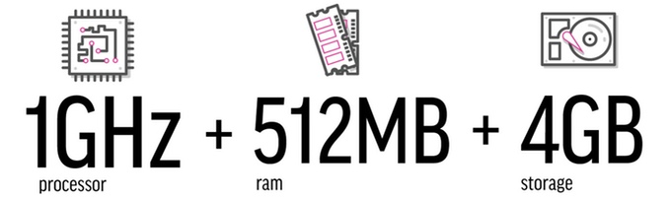
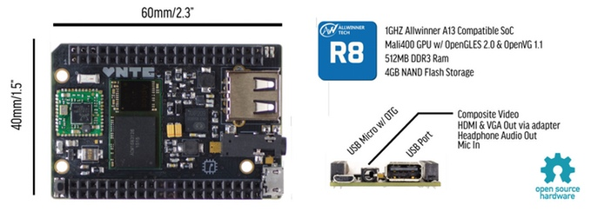
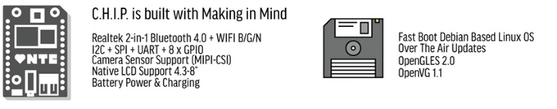



Slide 57

C.H.I.P. is OSHW
GitHub: NextThingCo/CHIP-Hardware
  Schematics
  PCB Layout
  Bill of Materials (BoM)
License:
  Creative Commons Attribution-ShareAlike
  (CC-BY-SA)

Slide 58
Section:
OSHW in Science
Suggestions from the OSHWA mailing list
Slides:
https://github.com/pdp7/talks/blob/master/penguicon17-oshw-fustini.pdf

Slide 59

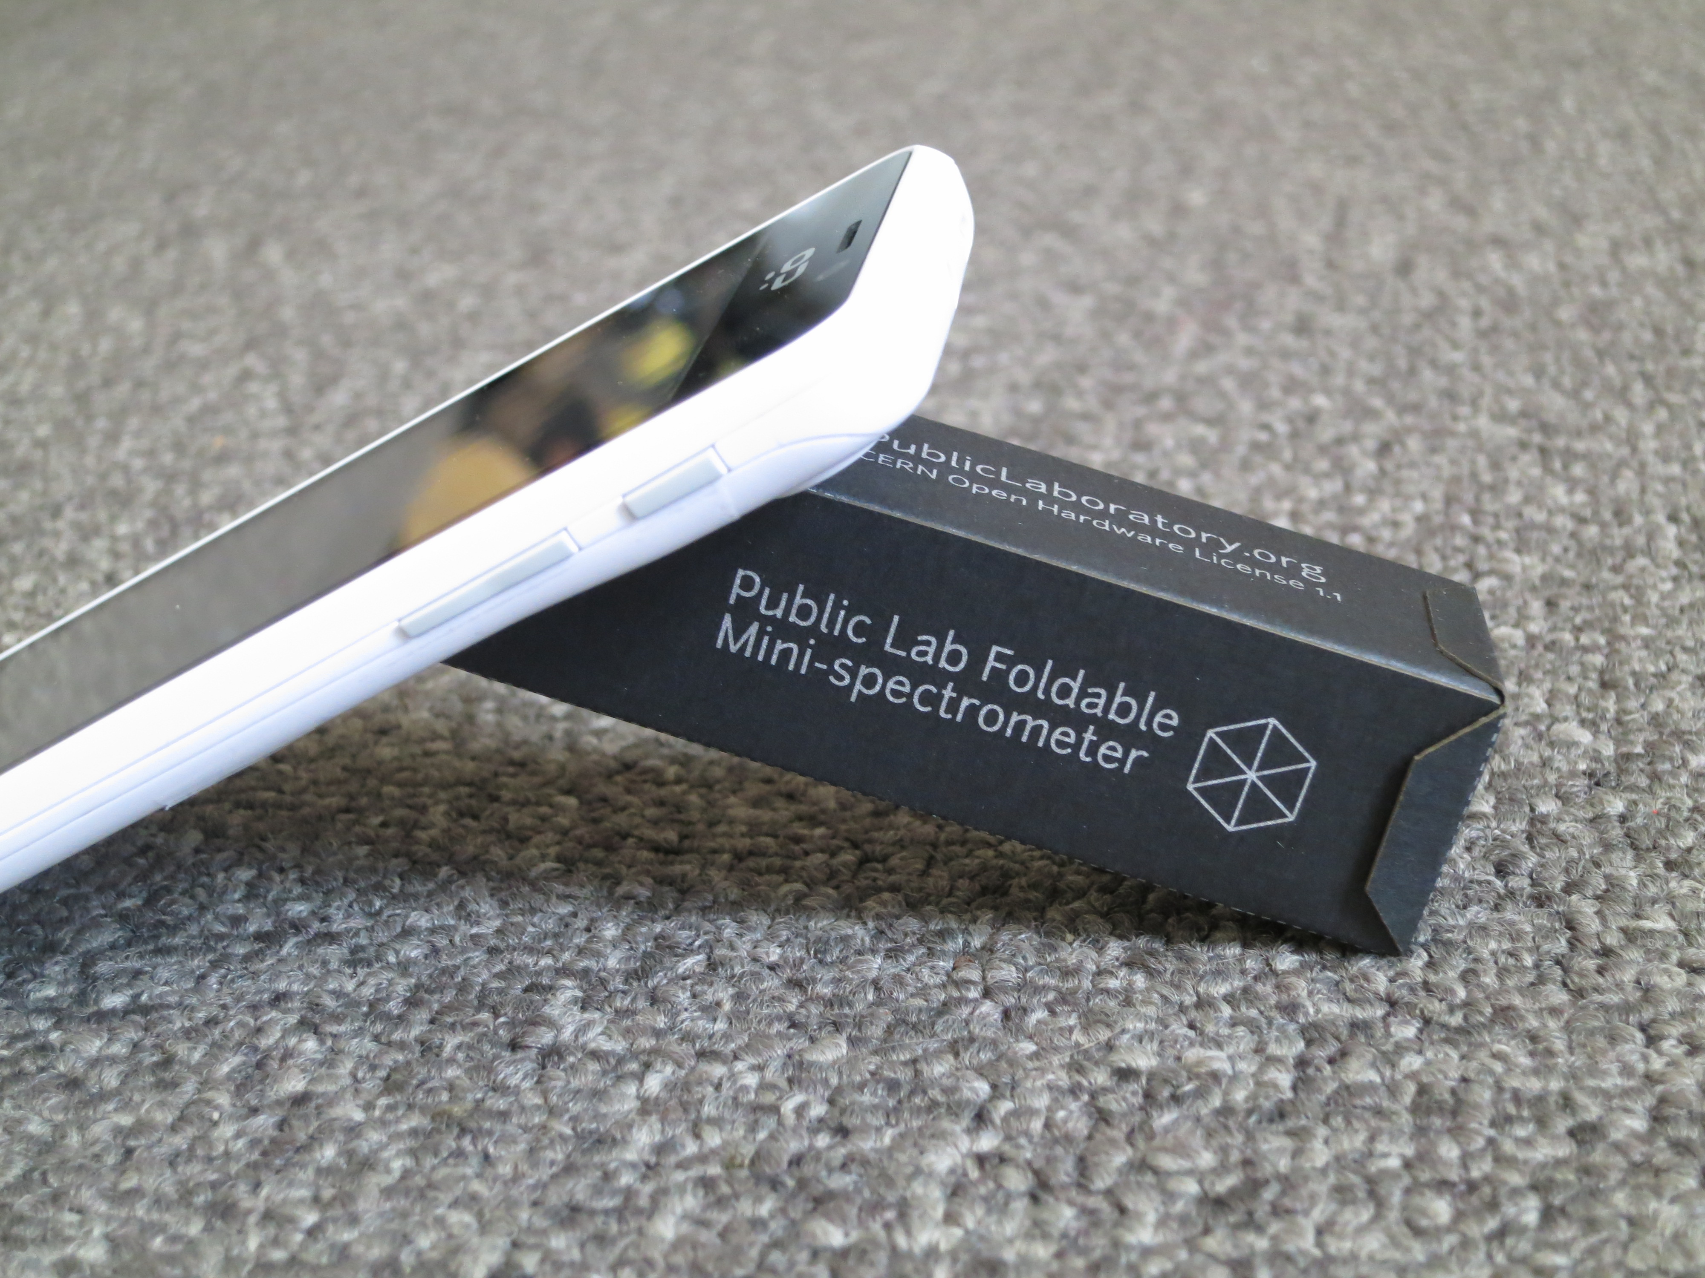
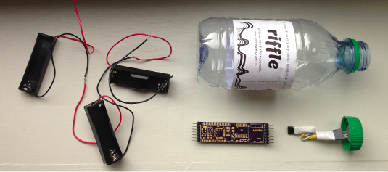
Public Lab
“Using inexpensive DIY techniques, we seek to change how people see the world in environmental, social, and political terms.”
Riffle: Open Source Water Monitoring
Desktop Spectrometry
Balloon Mapping Kit

Slide 60
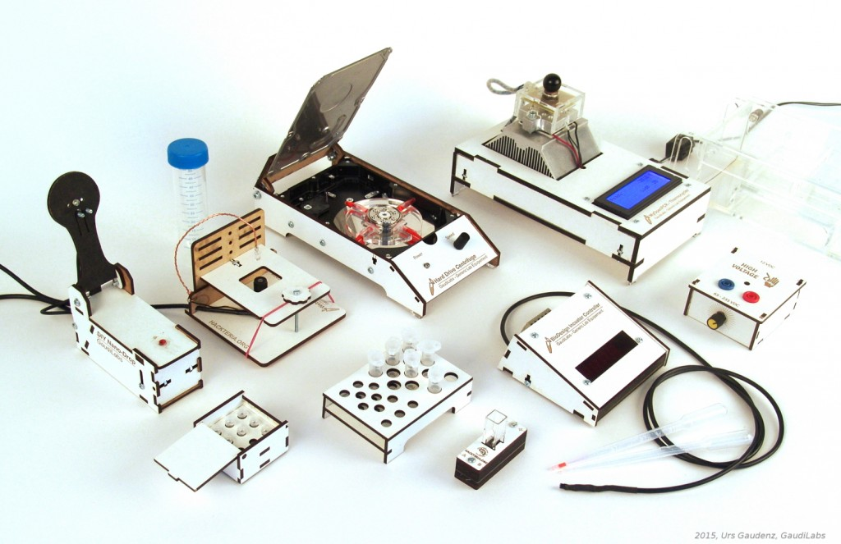
Generic Lab Equipement
GaudiLabs in Switzerland has designed: WebCam Microscope, Hard Drive Centrifuge, Incubator Controller, Gel Box and HV Supply, Turbidity Meter, Microvolume Spectrometer, and Tube Racks

Slide 61
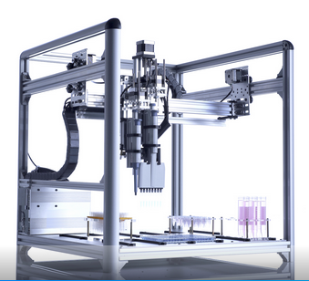
OpenTrons
Robots for Biologists
“We think biologists should have robots to do pipetting for them.”
“They should be able to spend their time designing experiments and analyzing data.”

Slide 62

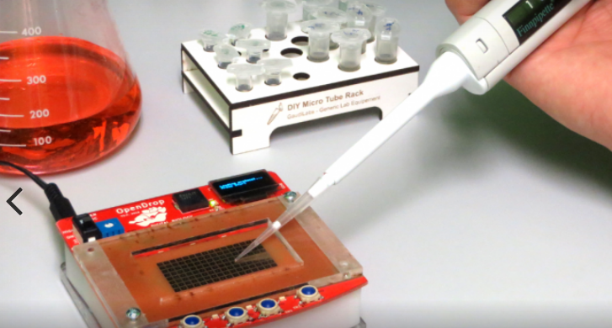
OpenDrop
“Desktop Digital Biology Laboratory”
digital microfludics platform for research
aim of making personal lab-automation accessible to more people

Slide 63
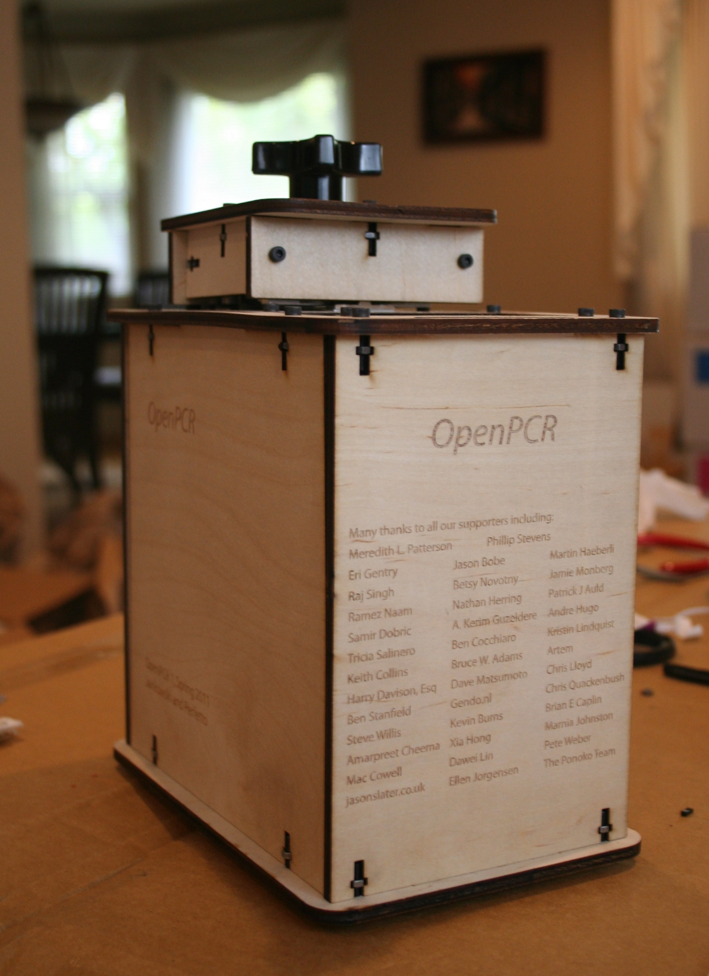
OpenPCR
PCR is a method of copying DNA molecules.
OpenPCR is a project to develop open source hardware, software, and protocols to perform PCR and Real-Time PCR reactions

Slide 64

Open Source Imaging Initiative
“development of medical imaging devices, aiming to make health-care benefits of modern instruments accessible to many more”
“pool the knowledge and experience of many experts in open-source designs for MRI”
Opencore NMR is an open-source toolkit for implementing an NMR spectrometer

Slide 65
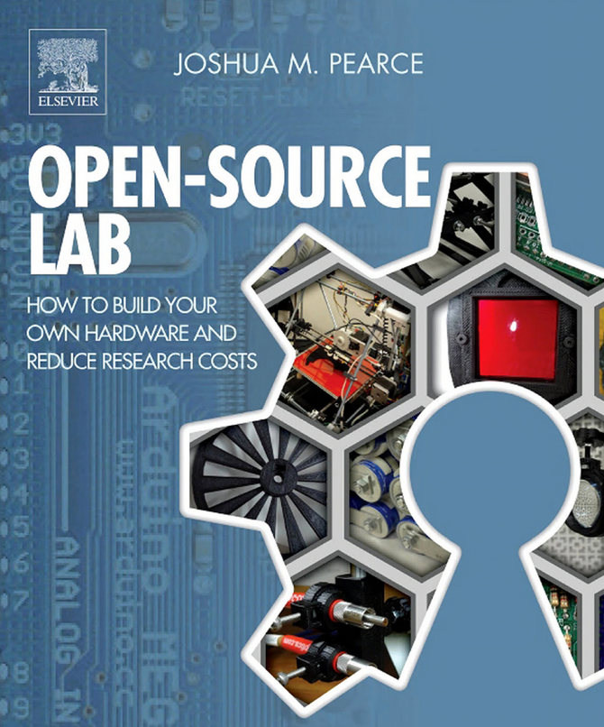
Open-Source Lab
“open-source 3D printing and microcontrollers running on free software enables scientists, engineers, and lab personnel in every discipline to develop powerful research tools at unprecedented low costs”
Author Joshua Pearce runs the MOST research group which is exploring the way solar photovoltaic technology can sustainably power our society

Slide 66

Gathering for Open Science Hardware
“GOSH is a diverse, global community working to enhance the sharing of open, scientific technologies”
Video of GOSH 2016 at CERN
GOSH 2016 in the Journal of Open Hardware
GOSH 2017: Santigo, Chile (March 22-25)

Slide 67
Gathering for Open Science Hardware
“GOSH is a diverse, global community working to enhance the sharing of open, scientific technologies”
Video of GOSH 2016 at CERN
GOSH 2016 in the Journal of Open Hardware
GOSH 2017: Santigo, Chile (March 22-25)

Slide 68
Open Source Imaging Initiative
“development of medical imaging devices, aiming to make health-care benefits of modern instruments accessible to many more”
“pool the knowledge and experience of many experts in open-source designs for MRI”
Opencore NMR is an open-source toolkit for implementing an NMR spectrometer

Slide 69

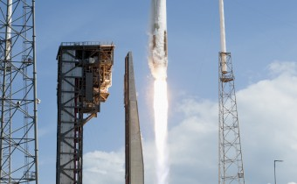
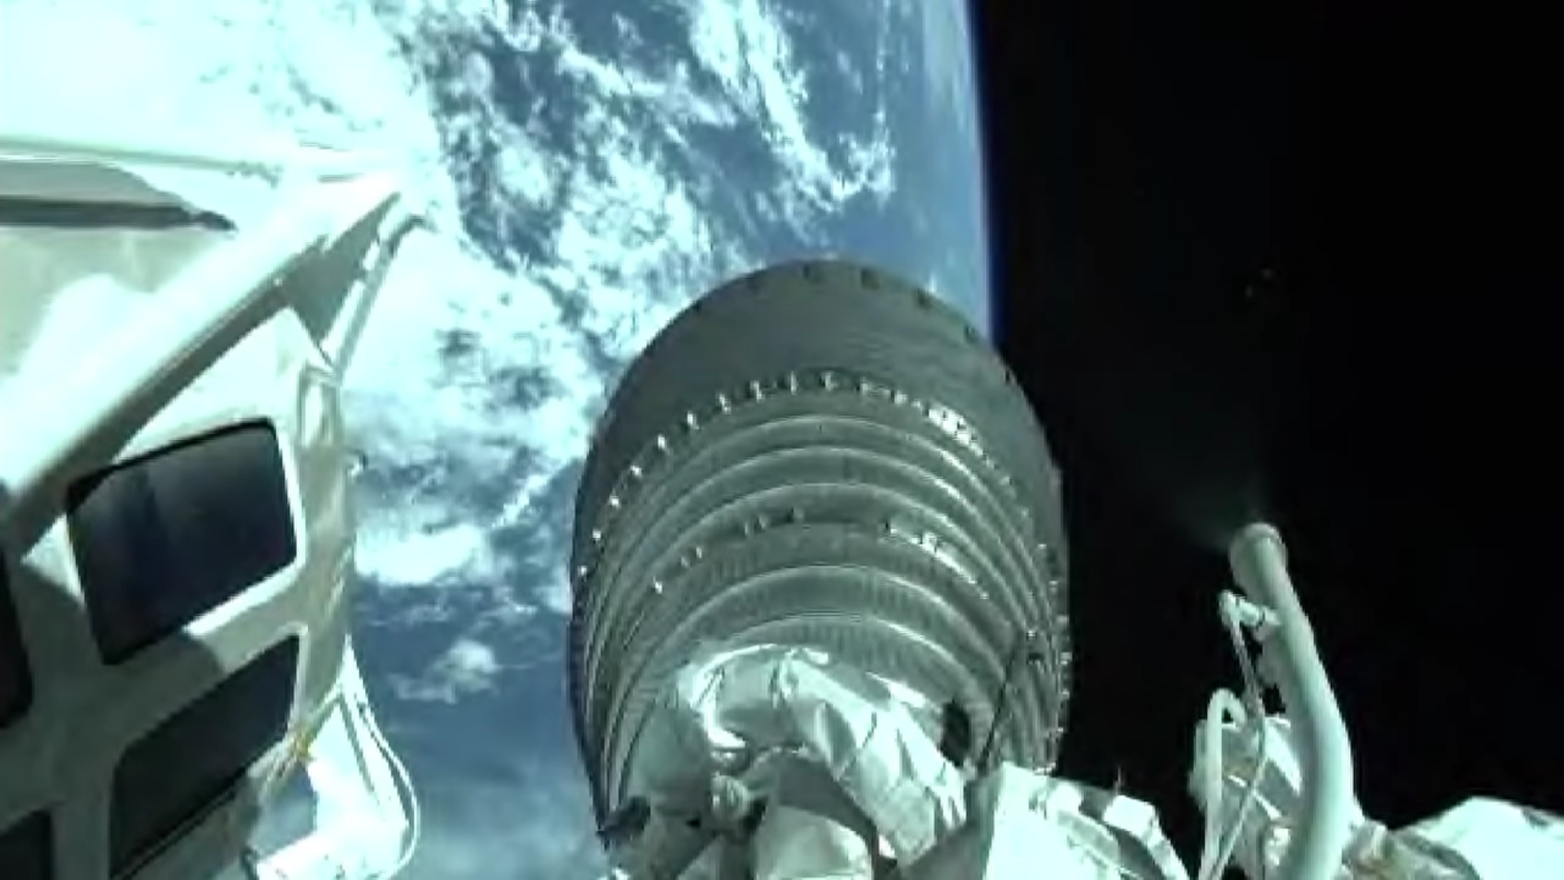

Non-profit for Open Source HW & SW in Space
SatNOGS: global network of satellite ground stations designed as an open source participatory project
UPSat: 1st open source hardware & software satellite
  Launched on April 18th! Waiting for deployment from ISS
  "Flying The First Open Source Satellite"

Slide 70
Section:
Open Source and Libre Silicon
Source: https://github.com/pdp7/talks/blob/master/penguicon17-oshw-fustini.pdf

Slide 71

What about silicon?
RISC-V: Free and Open RISC Instruction Set Arch
  “new instruction set architecture (ISA) that was originally designed to support computer architecture research and education and is now set to become a standard open architecture for industry”
  Video: Instruction Sets Want To Be Free: A Case for RISC-V
  Video: Krste Asanovic presents at RISC-V and Open Source Silicon Event in Munich on March 23, 2017

Slide 72


What about silicon?
OnChip Open-V
“completely free (as in freedom) and open source 32-bit microcontroller based on the RISC-V architecture”

Slide 73

What about silicon?

Slide 74

What about silicon?
Crowd Supply update: A Taste of Chip Design
Video: YoPuzzle: mRISC V development platform
Video: RISC-V Community needs Peripheral Cores

Slide 75

What about silicon?
SiFive
“founded by the creators of the free and open RISC-V architecture as a reaction to the end of conventional transistor scaling and escalating chip design costs”

Slide 76

What about silicon?
HiFive1: Arduino-Compatible RISC-V Dev Kit

Slide 77
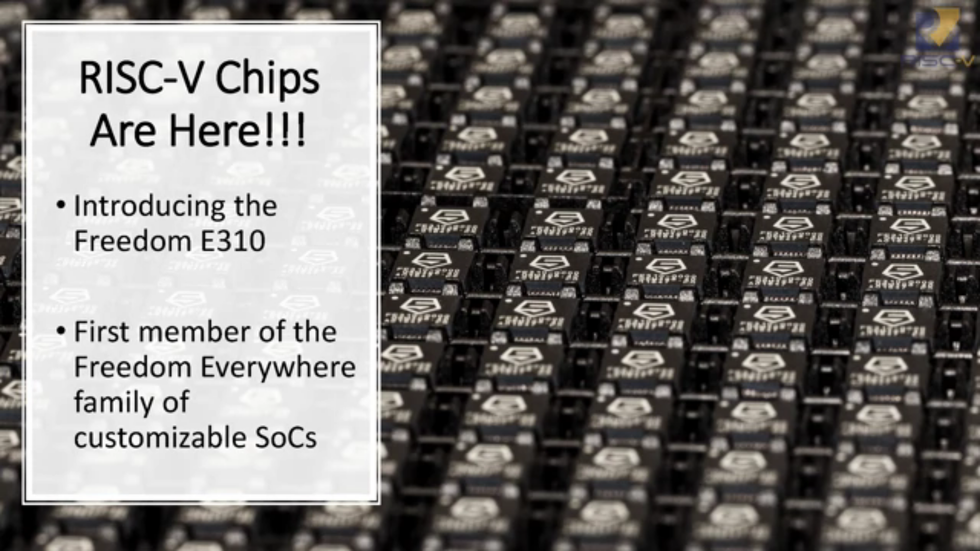
What about silicon?
SiFive FE300 & low cost HiFive Dev Board
  Video of talk by Jack Kang of SiFive (Dec 22, 2016)

Slide 78

What about silicon?
lowRISC:
“creating a fully open-sourced, Linux-capable, RISC-V-based SoC, that can be used either directly or as the basis for a custom design”
Video: Rob Mullins talking about lowRISC
(RISC-V & Open Source Silicon Event in Munich on March 23, 2017)

Slide 79

What about silicon?
FOSSi Foundation
  The Free and Open Source Silicon Foundation
  “non-profit foundation with the mission to promote and assist free and open digital hardware designs”
  “FOSSi Foundation operates as an open, inclusive, vendor-independent group.”

Slide 80

What about silicon?
Open Source Silicon Design Ecosystem
  Talk by FOSSi co-founder Julius Baxter

Slide 81

What about silicon?
LibreCores
  Project of the FOSSi Foundation
  “gateway to free and open source digital designs and other components that you can use and re-use in your digital designs”
  “advances the idea of OpenCores.org”

Slide 82
Thanks
Suggestions from the OSHWA mailing list:
  Abram Connelly
  Andrew Plumb
  Andrew Quitmeyer
  Eleftherios Kosmas
  Marcin Jakubowski

Slide 83
These slides are available at:
https://github.com/pdp7/talks/
blob/master/penguicon17-oshw-fustini.pdf
Drew Fustini
drew@oshpark.com
@OSHPark / @pdp7
OSH Park Blog
This work is licensed under a Creative Commons Attribution-ShareAlike 4.0 International License.

