Slide 1

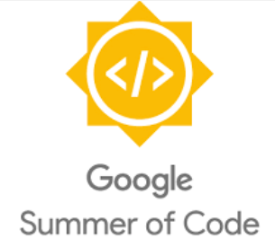
Embedded Linux Conference 2017:
Google Summer of Code and BeagleBoard.org
Drew Fustini
<drew@beagleboard.org>
twitter: @pdp7 / @beagleboardorg

Slide 2

What is Google Summer of Code?
"Google Summer of Code is a global program that offers students stipends to write code for open source projects"

Slide 3
What is Google Summer of Code?
12 years
104 countries
567 open source projects
12,000+ students
Over 30 million lines of code

Slide 4
Google Summer of Code 2016
178 open source projects
1,206 university students
67 countries
1,032 students (85.6%) completed
$5,500 to each successful student

Slide 5
2016 GSoC Timeline
Feb: organizations apply, recruit mentos
March: students propose projects
April: students accepted
Community Bonding Period for students and mentors
May: students begin coding
June: mid-term evaluations
August: final evaluations and project submissions
October: Mentor Summit at Google

Slide 6
Open Source Hardware computing
for
Makers, Educators & Professionals

Slide 7
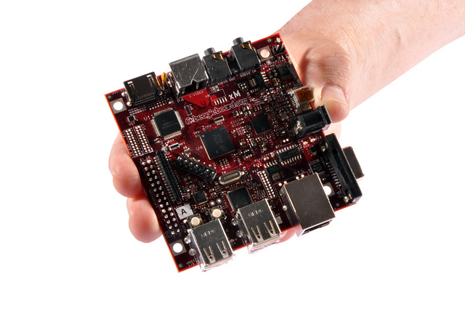
BeagleBoard.org released the first BeagleBoard, an affordable, open hardware computer in 2008

Slide 8
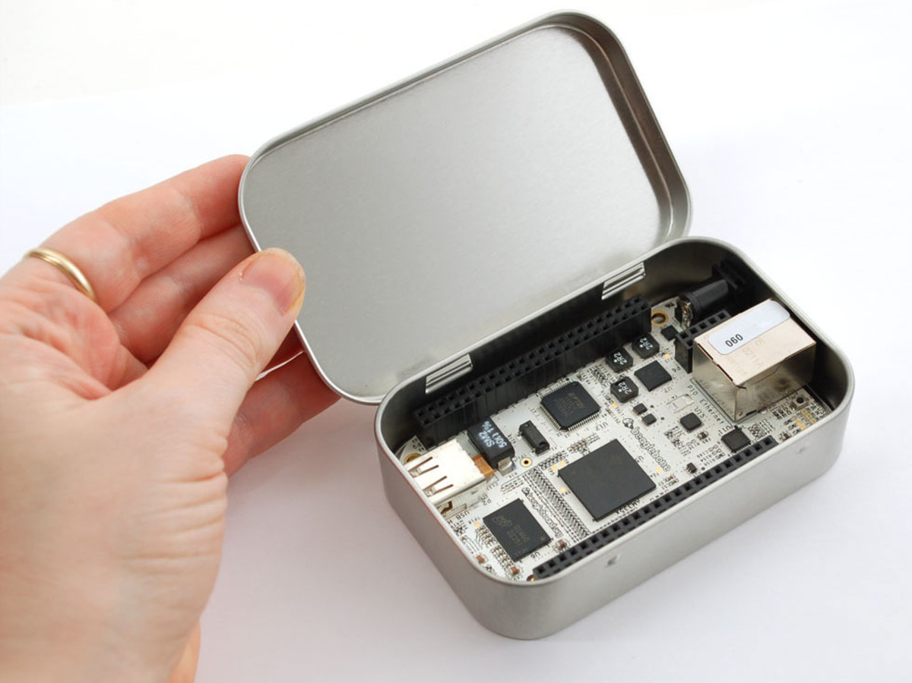

Maker focused, Altoids tin sized BeagleBone introduced in 2011

Slide 9
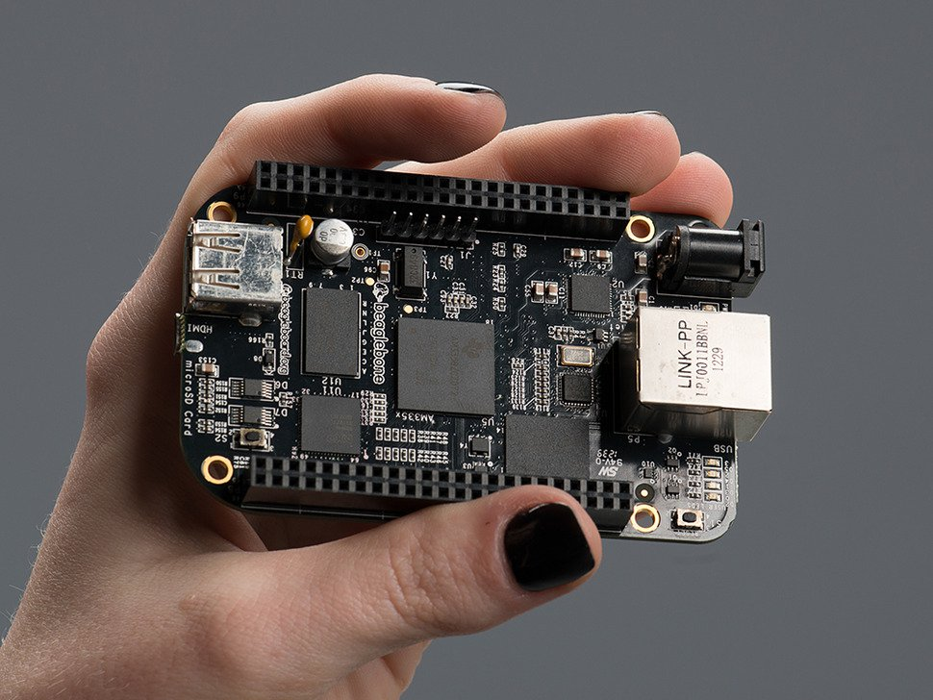

More affordable, more powerful BeagleBone Black in 2013

Slide 10
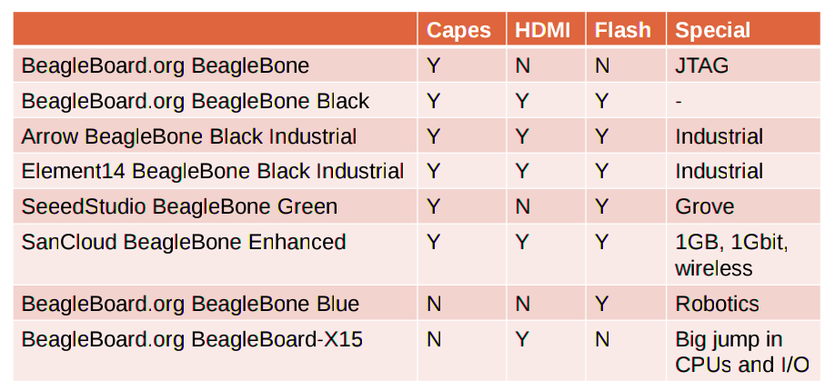
Open Source HardwareBeagleBone derivatives

Slide 11
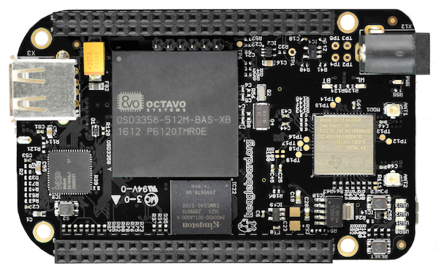
Newest board:
BeagleBone Black Wireless
WiFi (802.11 b/g/n)
Bluetooth 4.1 with Bluetooth Low-energy

Slide 12
BeagleBoard.org Foundation is a US-based 501(c) non-profit corporation
Provides education around the design and use of Open Source Software and Open Source Hardware
Fosters communication between individuals interested in Open Source

Slide 13


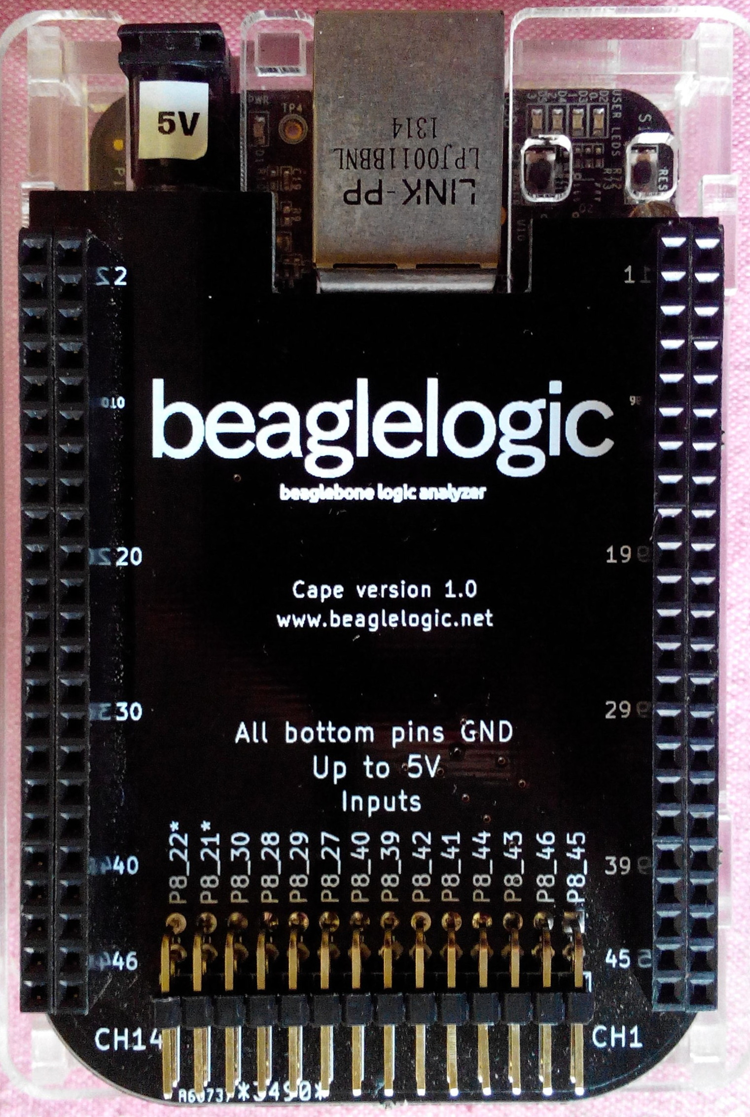
Kumar Abhishek created BeagleLogic for GSoC 2014
BeagleLogic turns BeagleBone into Logic Analyzer
14-channel, 100Msps
Web browser user interface
Video of final presentation

Slide 14
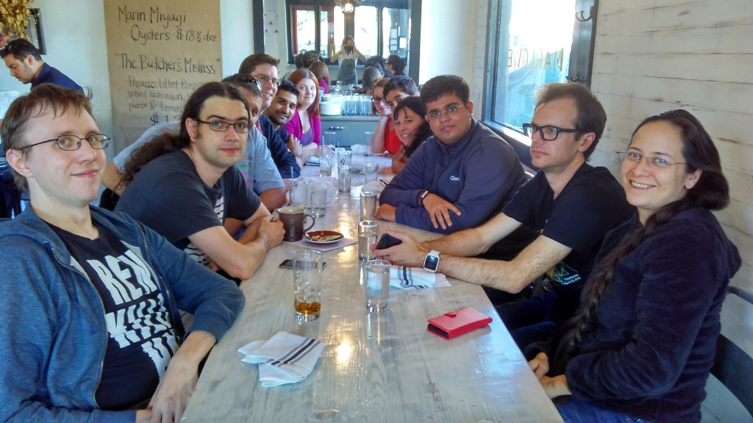
Best Product finalist in 2015 Hackaday Prize
Traveled to Google Summer of Code Mentor Summit and Hackaday SuperCon in California
Blog post about his journey: A day with Hackaday

Slide 15
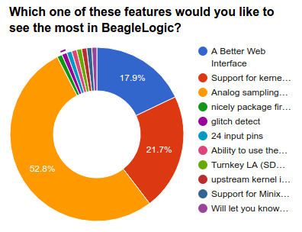
Summer 2016: Kumar is intern at Google HQ
July 2016: BeagleLogic: now also analog
“Majority of prospective users wanted to be able to do analog sampling with BeagleLogic”

Slide 16
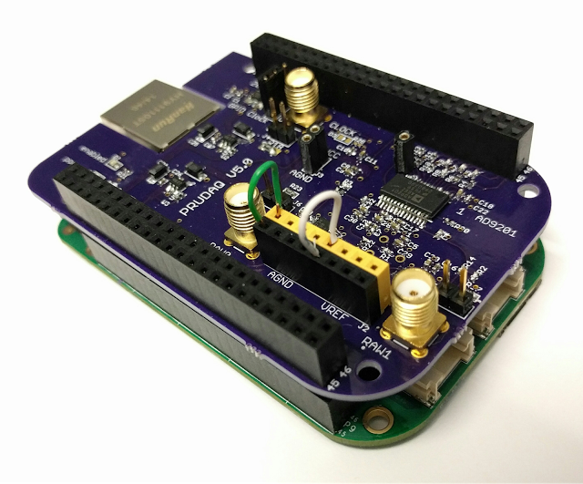
July 2016 - Google Research blog announced PRUDAQ, an ADC cape for BeagleBone:
Announcing an Open Source ADC board for BeagleBone

Slide 17

BeaglePilot
Víctor Mayoral Vilches in Italy for GSoC 2014
Linux-based autopilot for flying robots based on BeagleBone
Introduction video
BeaglePilot on GitHub
The Tale of BeaglePilot

Slide 18

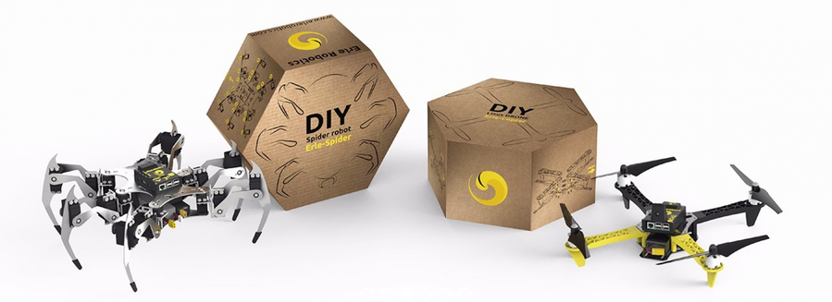
BeaglePilot
Victor co-founded Erle Robotics to develop commercial products based on BeaglePilot
Erle-Brain: “An artificial brain for making robots and drones”

Slide 19
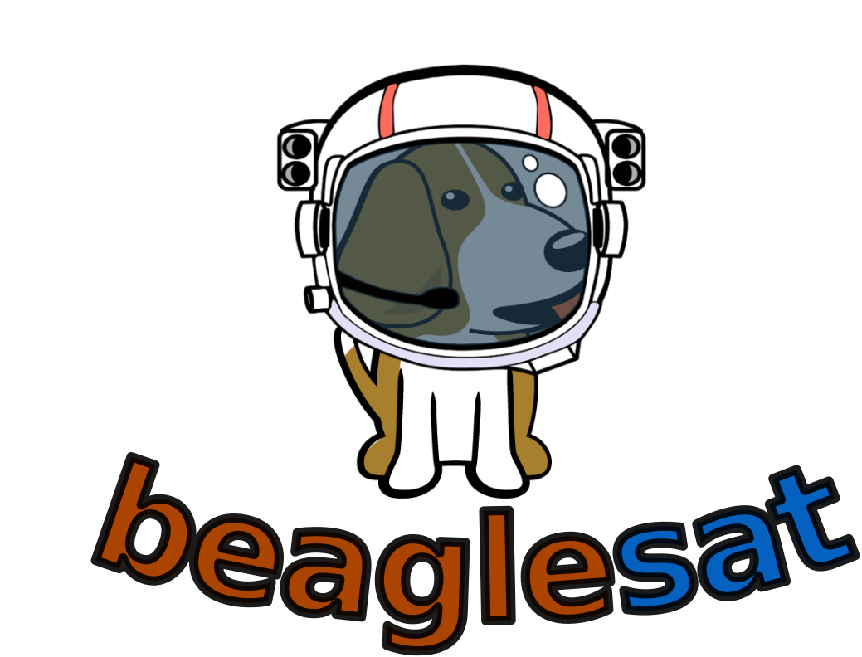
BeagleSat
Niko Visnjic for GSoC 2015
BeagleSat is an open source nano satellite platform based on BeagleBone
Framework & tool set for designing your very own CubeSat from ground up
Project video

Slide 20
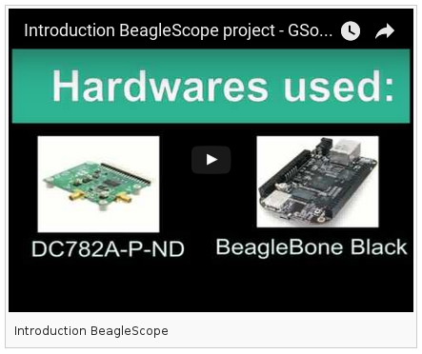
GSoC 2016 projects
BeagleScope
Student: Zubeen Tolani
Mentors: SJLC, Abhishek Kumar, Michael Welling, Hunyue Yau

Slide 21
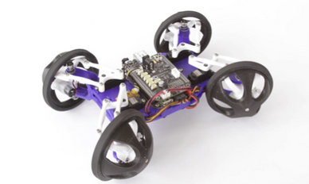
GSoC 2016 projects
API support for Beaglebone Blue
Student: Kiran Kumar Lekkala
Mentors: Alex Hiam, Micheal Welling, Kumar Abhishek, Deepak Karki
Website / Source Code / Wiki / Documentation

Slide 22
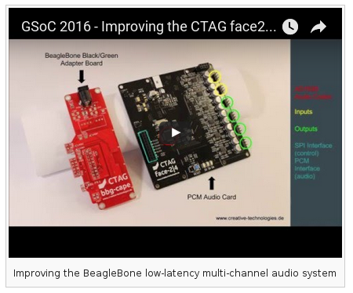
GSoC 2016 projects
BeagleBoard X15 multichannel sound driver
Student: Henrik Langer
Mentors: Robert Manzke, Vladimir Pantelic
Wiki for libdsp-x15
Slides from project presentation

Slide 23
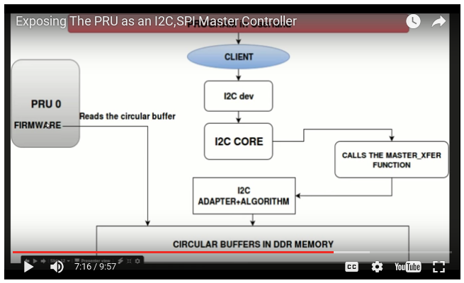
GSoC 2016 projects
Exposing the PRU as I2C & SPI master
Student: Vaibhav Choudhary
Mentors: Andrew Bradford, Matt Porter

Slide 24
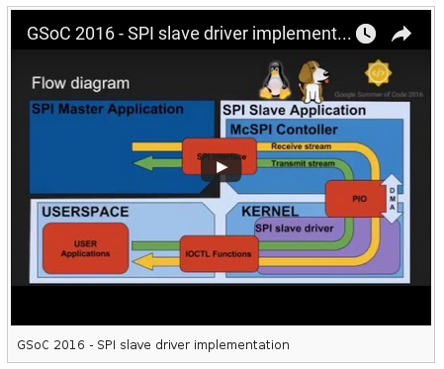
GSoC 2016 projects
SPI slave driver implementation
Student: Patryk Mężydło
Mentors: Michael Welling, Andrew Bradford, Matt Porter

Slide 25
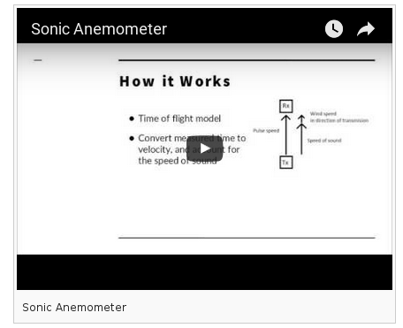
GSoC 2016 projects
Sonic Anemometer for Weather Stations
Student: Visaoni
Mentors: Steve Arnold, Alex Hiam

Slide 26
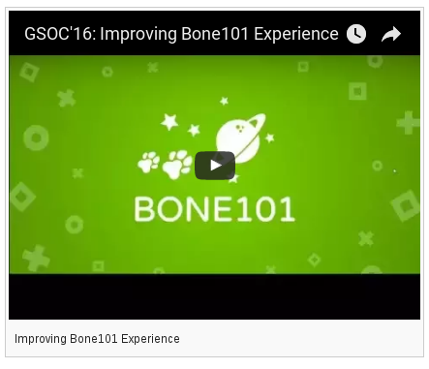
GSoC 2016 projects
Improving Bone101 Experience
Student: Amr Ragaey
Mentors: Jason Kridner, Alex Hiam

Slide 27
Apply in 2017!
e-mail: drew@beagleboard.org
twitter: @pdp7 / @beagleboardorg

