Slide 1
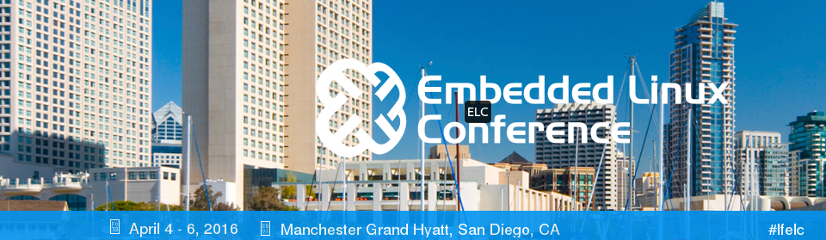
Embedded Linux Conf 2016
Drew Fustini (@pdp7)
drew@beagleboard.org

Slide 2
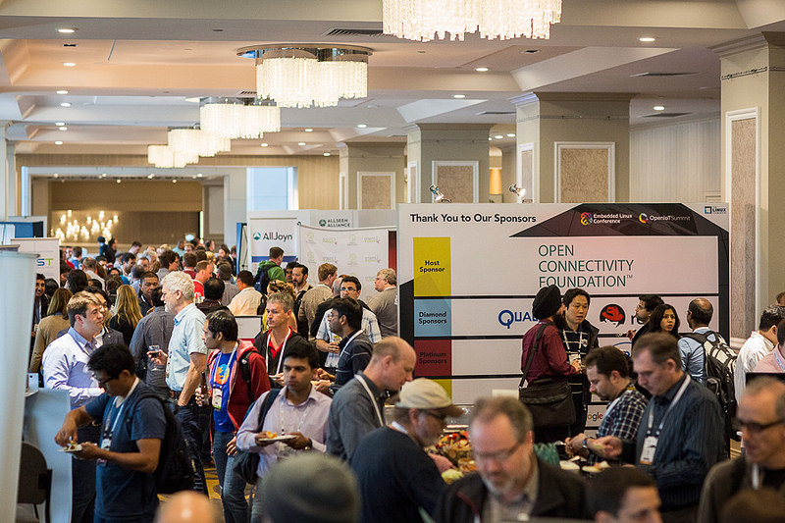
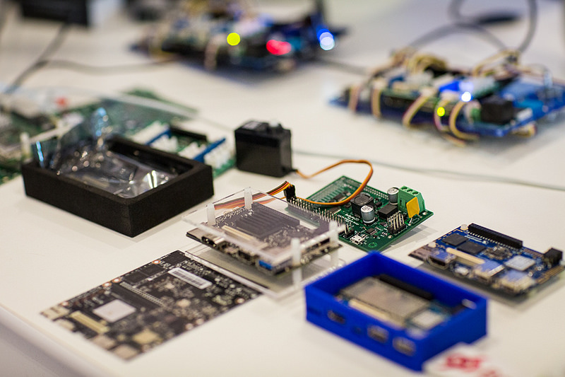
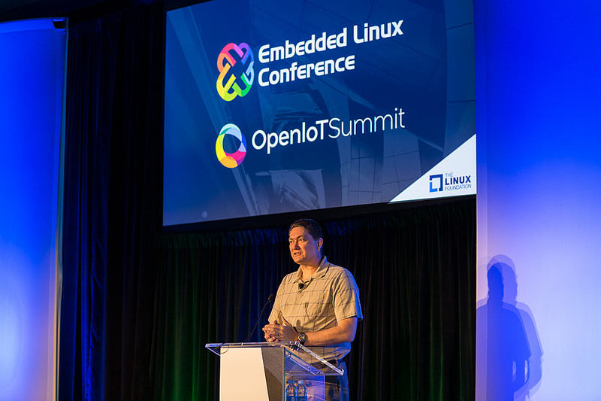
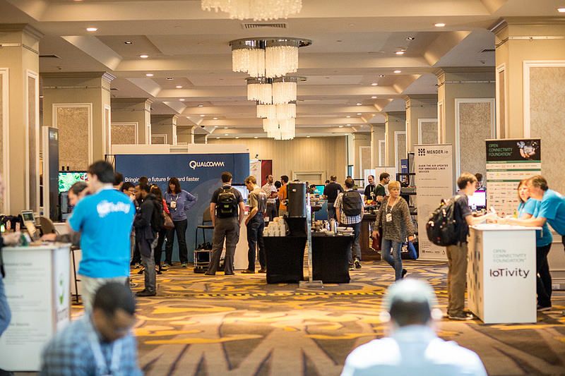
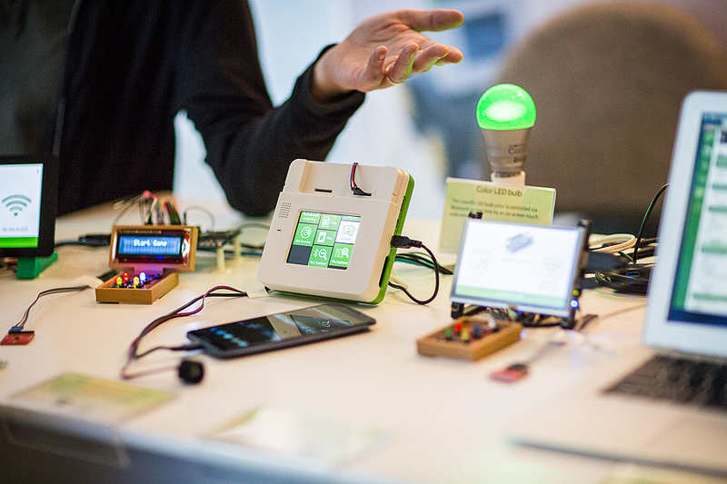
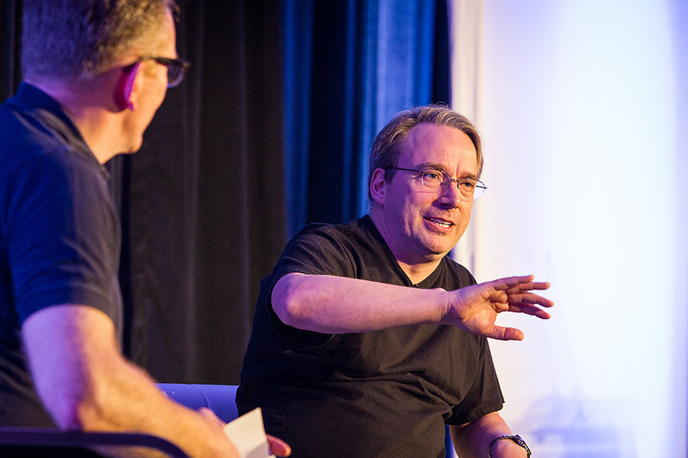
http://events.linuxfoundation.org/events/embedded-linux-conference

Slide 3
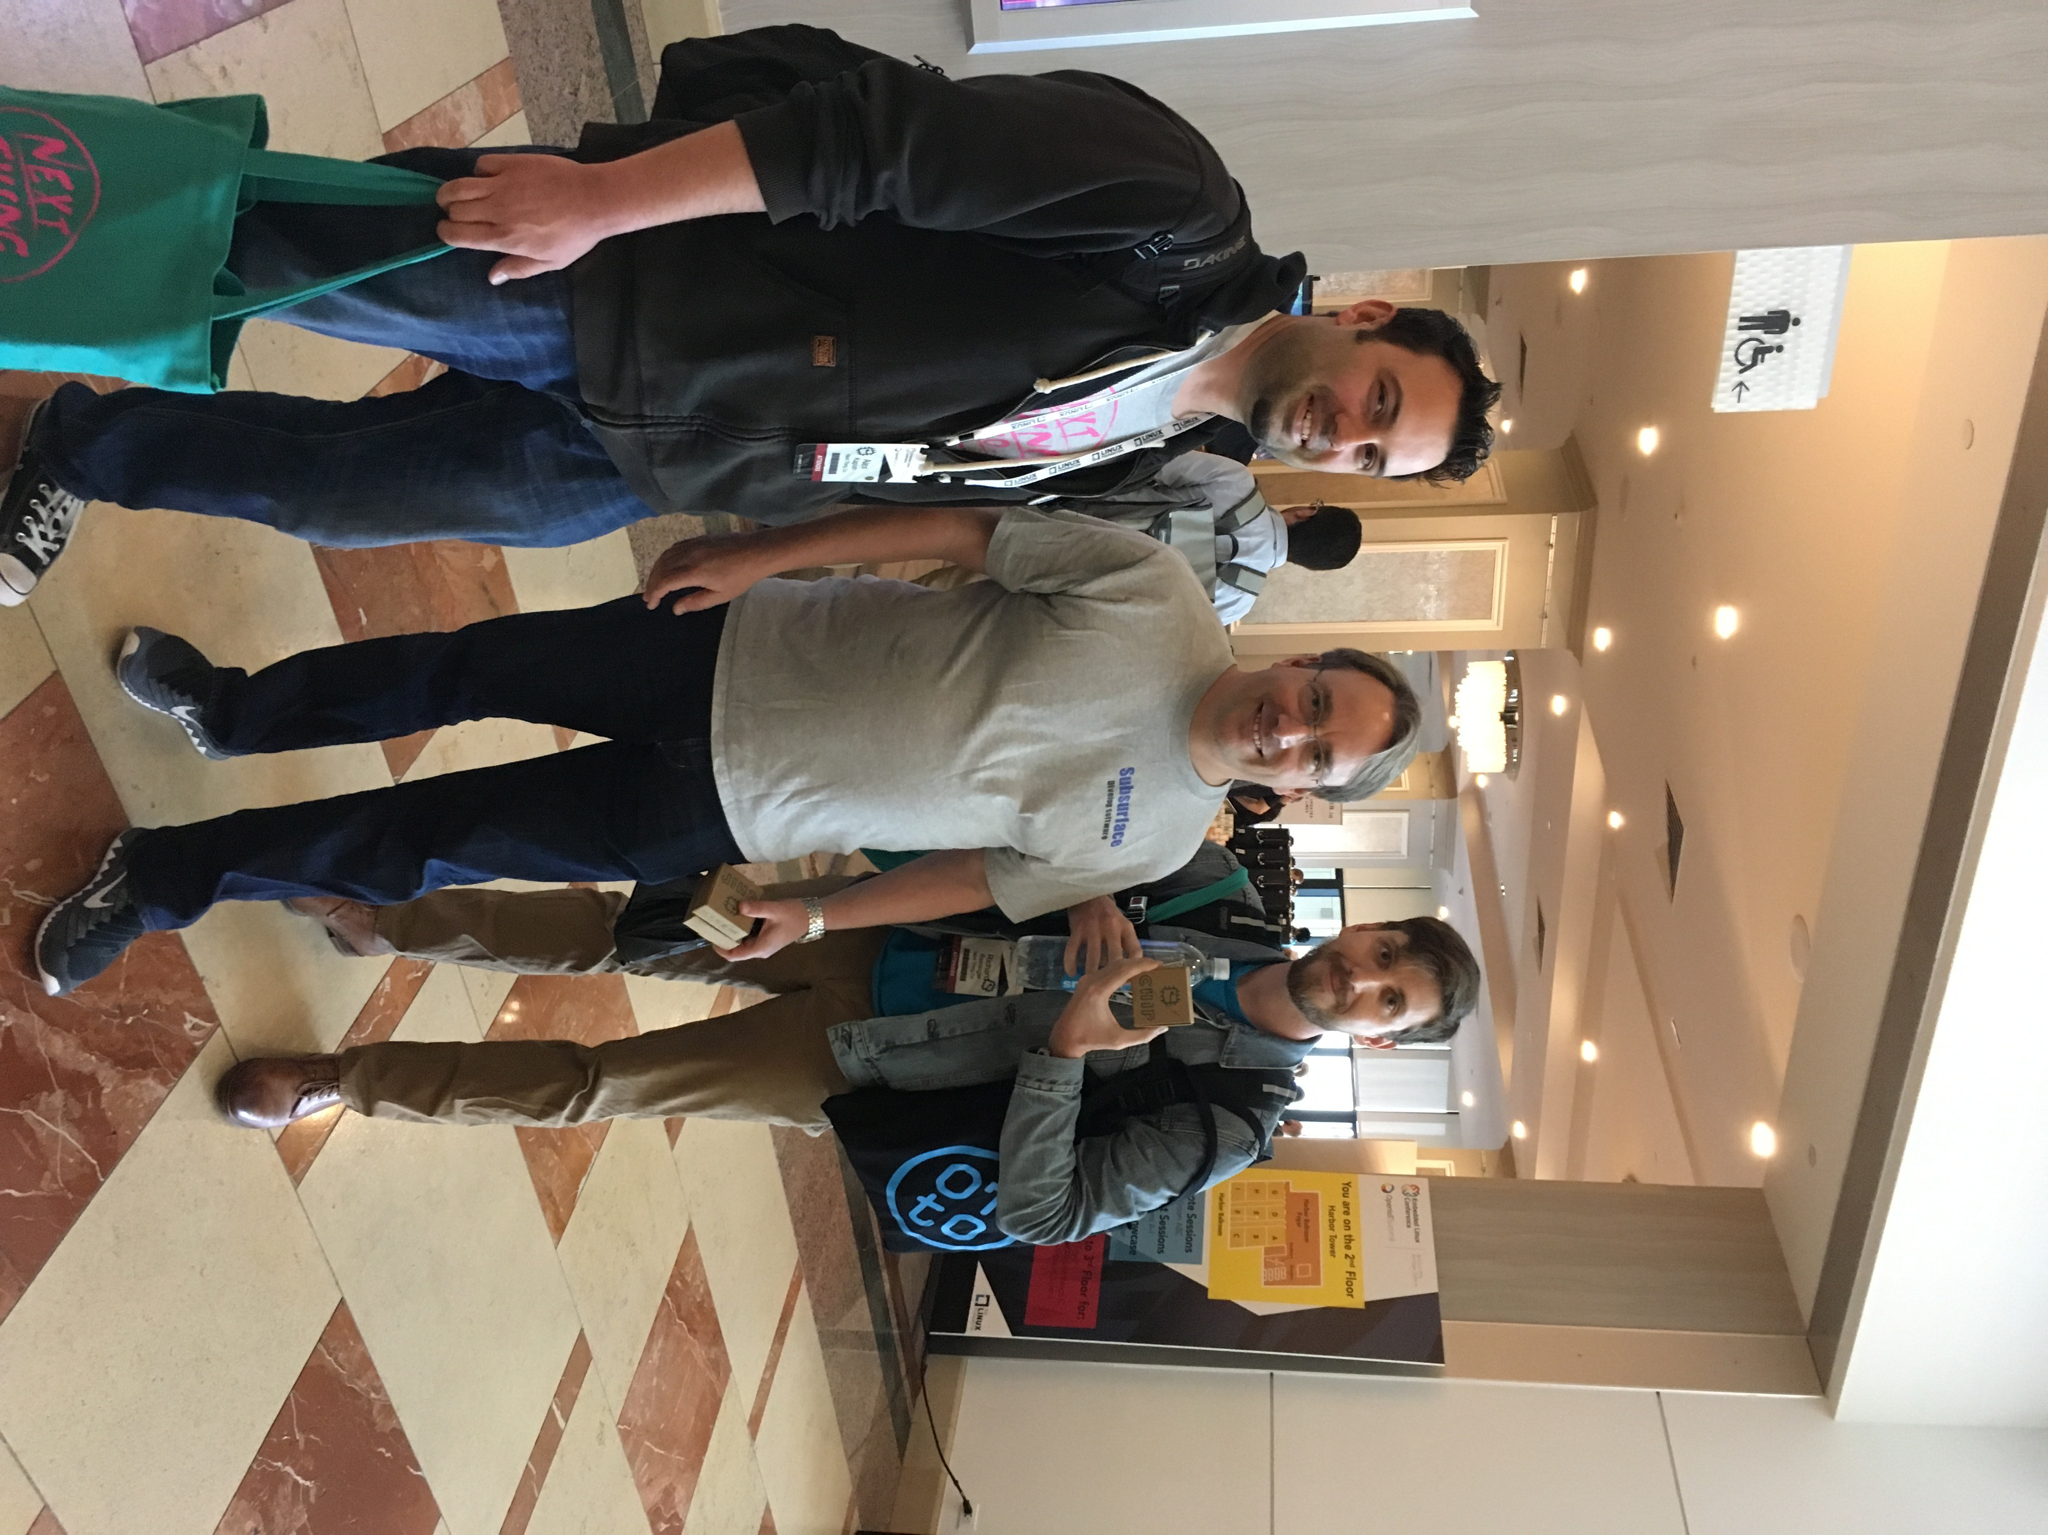

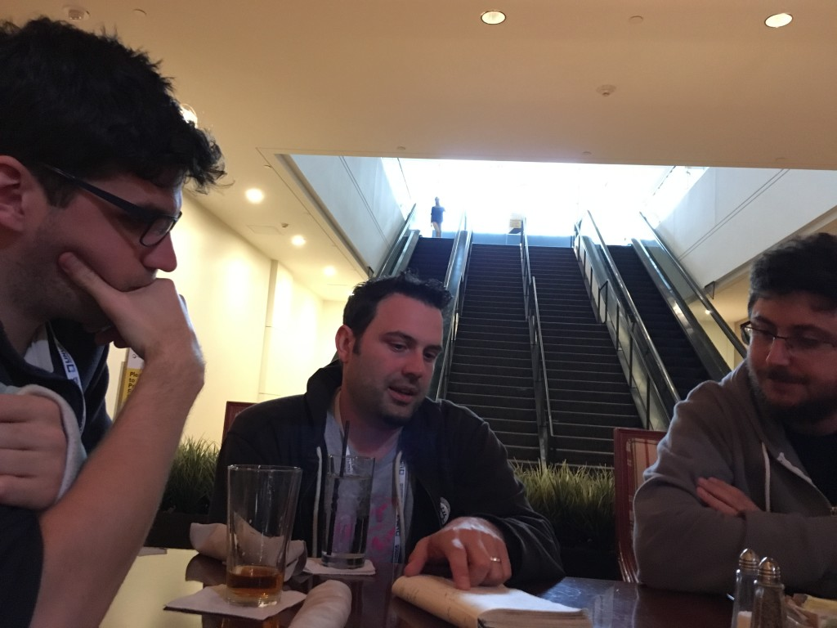
Free Electrons and C.H.I.P.
C.H.I.P. Does Embedded Linux Conference Things with the Free Electrons Team

Slide 4
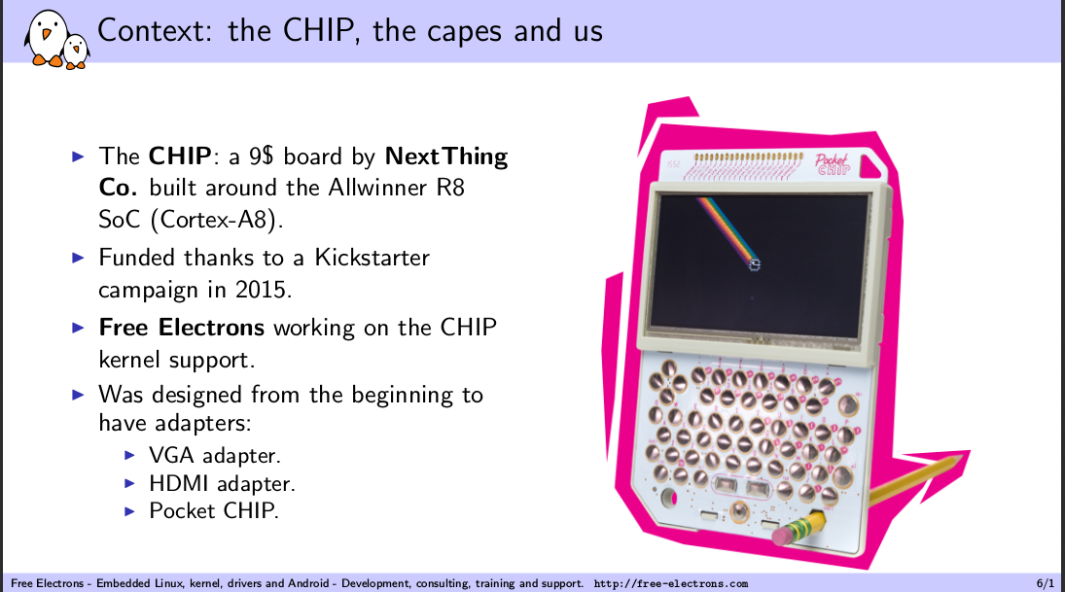
Free Electrons and C.H.I.P.

Slide 5
Free Electrons and C.H.I.P.
Using DT Overlays to Support the C.H.I.P.'s Capes - Antoine Tenart, Free Electrons
  PDF of Slides
  how Device Tree overlays work and how they are generated, walk through the design of the cape manager used on the C.H.I.P and detail how a cape is detected and the Device Tree overlays applied at run-time.
  CHIP Capes also called “Dips”, e.g. “Chips and Dip”

Slide 6
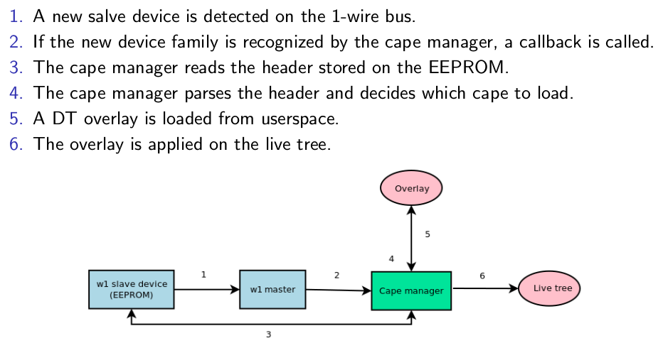
Using DT overlays to support the C.H.I.P.'s capes:

Slide 7
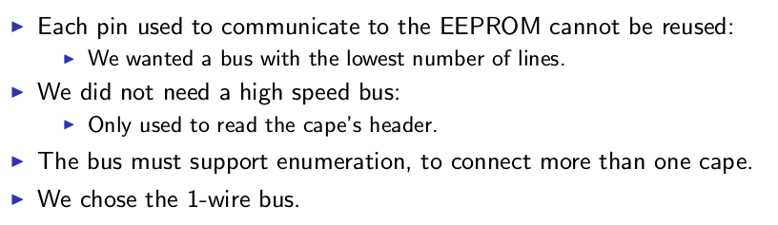
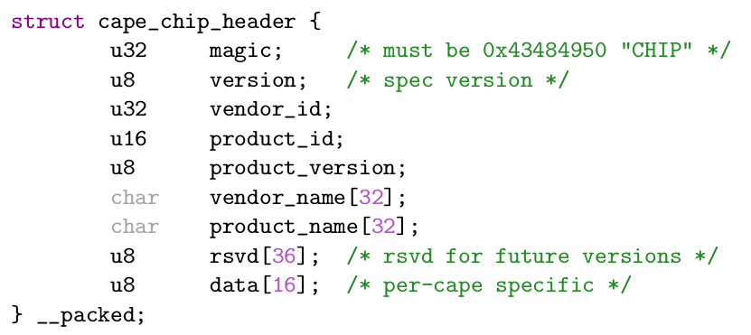
Using DT overlays to support the C.H.I.P.'s capes:
EEPROM header

Slide 8
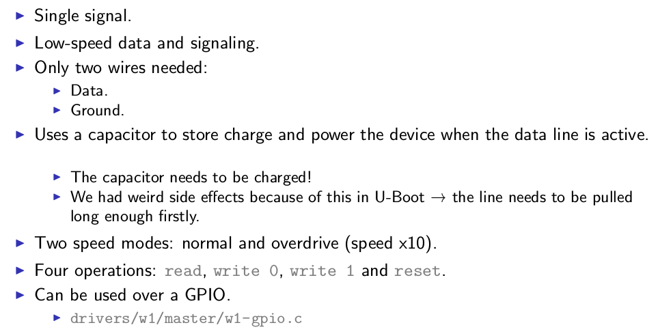
Using DT overlays to support the C.H.I.P.'s capes:
1 Wire Bus

Slide 9
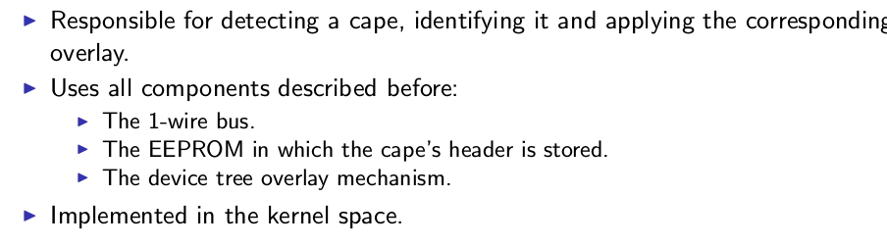
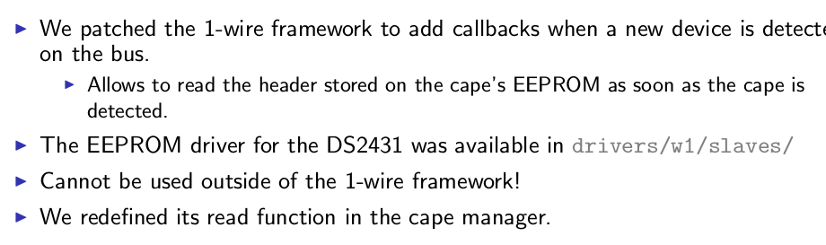
Using DT overlays to support the C.H.I.P.'s capes:
1 Wire Bus & Cape Manager

Slide 10
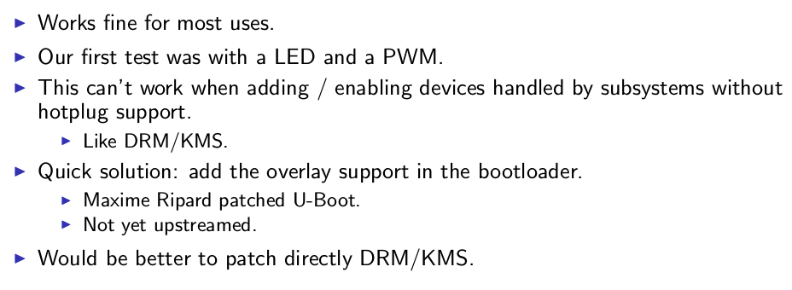
Using DT overlays to support the C.H.I.P.'s capes:
Status

Slide 11
Free Electrons and C.H.I.P.
Bringing Display and 3D to the C.H.I.P Computer - Maxime Ripard, Free Electrons
  PDF of Slides
  walk through the DRM stack, the architecture of a DRM/KMS driver and the interaction between the display and GPU drivers. The presentation is based on the work we have done to develop a DRM driver for the Allwinner SoCs display controller, as part of enabling the C.H.I.P platform with the upstream Linux kernel. The work done to make the ARM Mali OpenGL driver work on top of a mainline DRM/KMS driver will also be detailed.

Slide 12
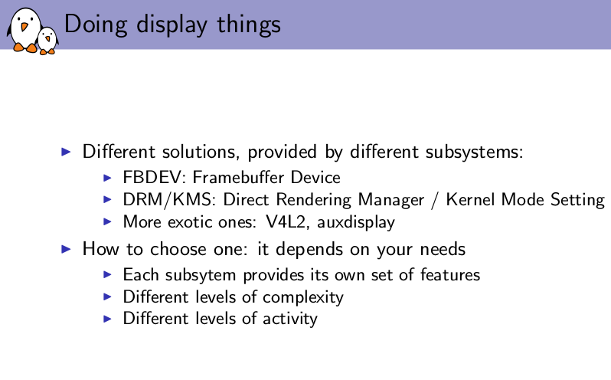
Bringing display and 3D to the C.H.I.P computer

Slide 13
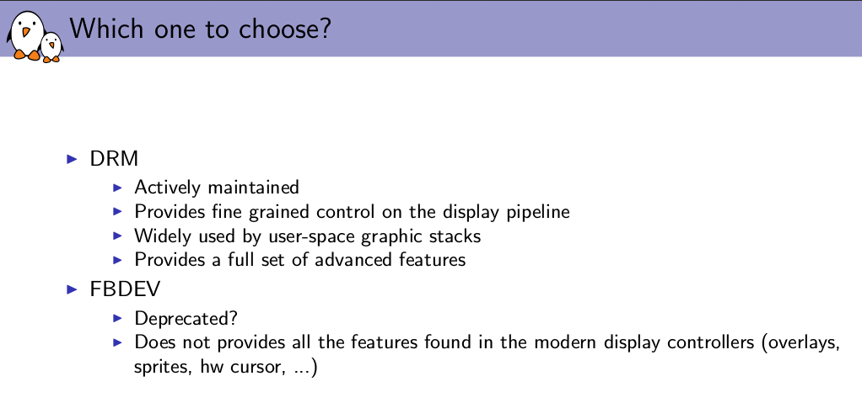
Bringing display and 3D to the C.H.I.P computer

Slide 14
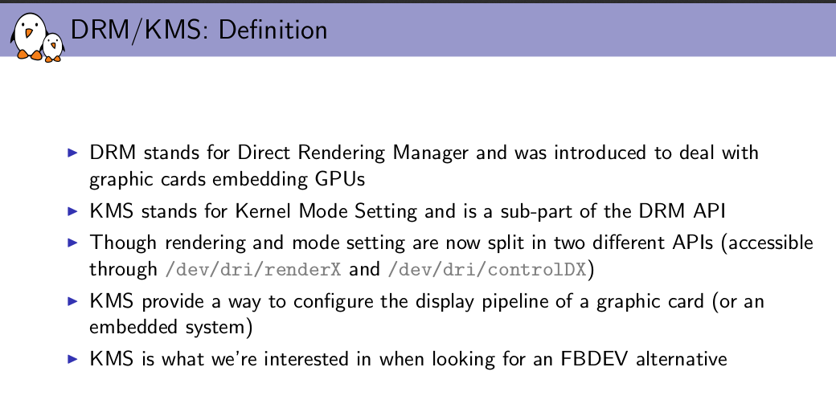
Bringing display and 3D to the C.H.I.P computer

Slide 15
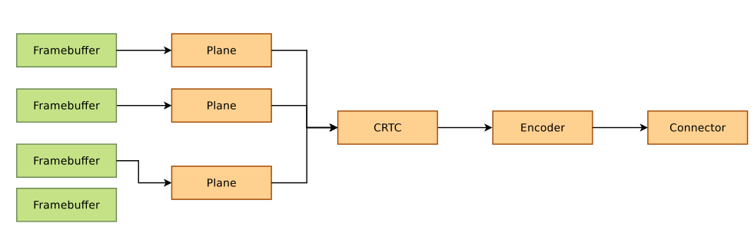
Bringing display and 3D to the C.H.I.P computer

Slide 16
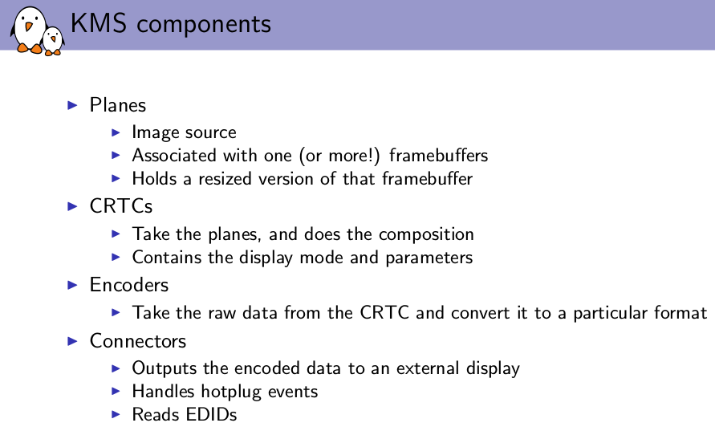
Bringing display and 3D to the C.H.I.P computer

Slide 17
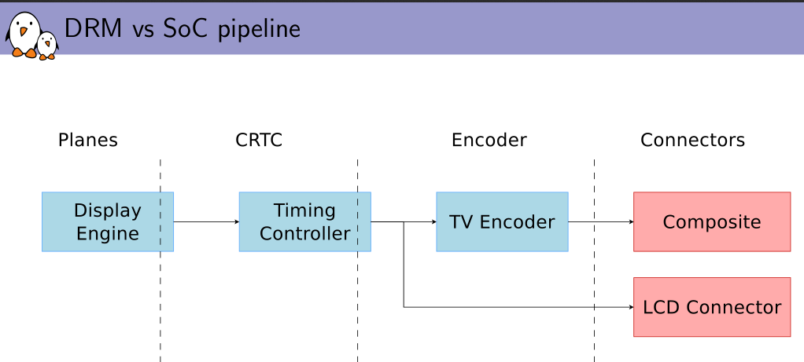
Bringing display and 3D to the C.H.I.P computer

Slide 18
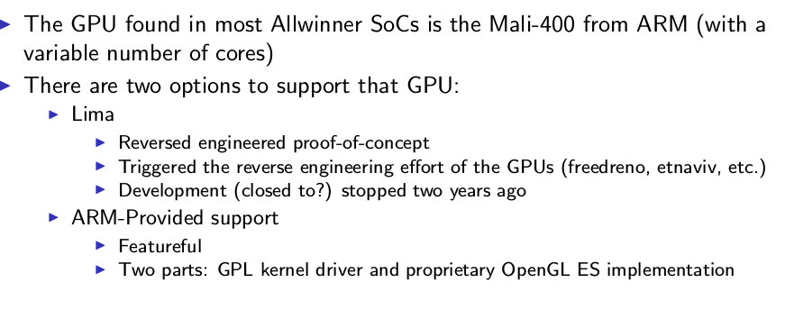
Bringing display and 3D to the C.H.I.P computer

Slide 19
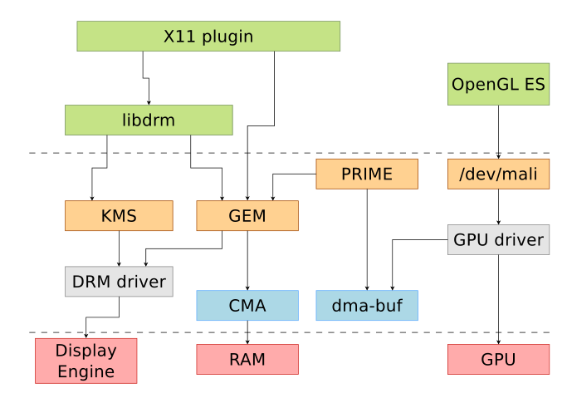
Bringing display and 3D to the C.H.I.P computer

Slide 20
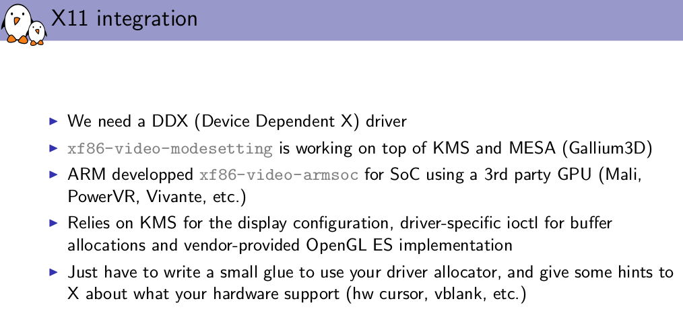
Bringing display and 3D to the C.H.I.P computer

Slide 21
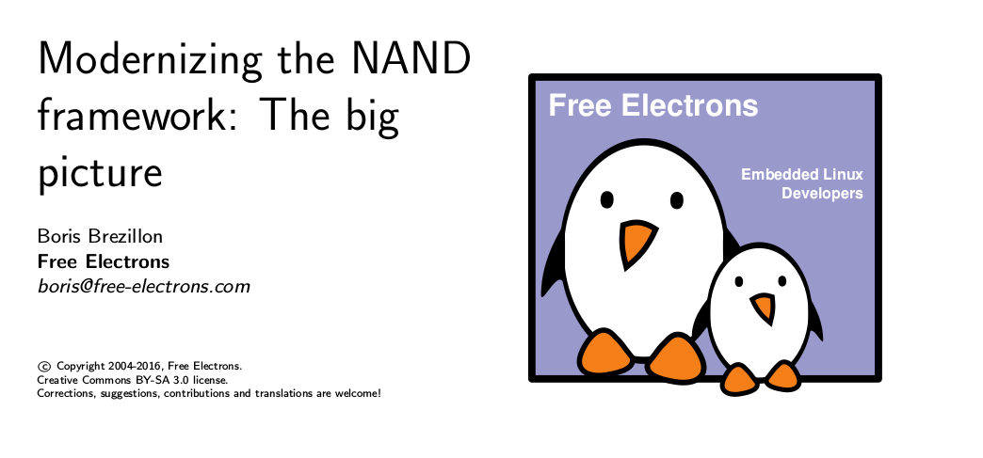
https://events.linuxfoundation.org/sites/events/files/slides/brezillon-nand-framework_0.pdf

Slide 22
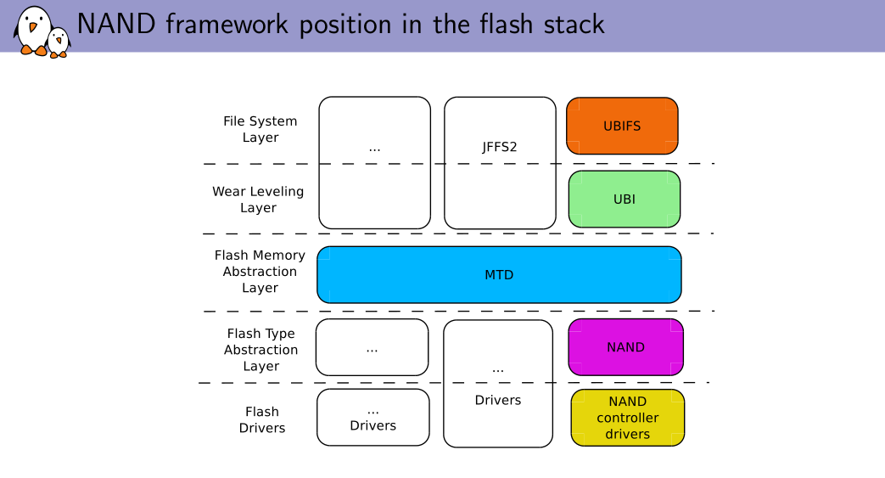
https://events.linuxfoundation.org/sites/events/files/slides/brezillon-nand-framework_0.pdf

Slide 23
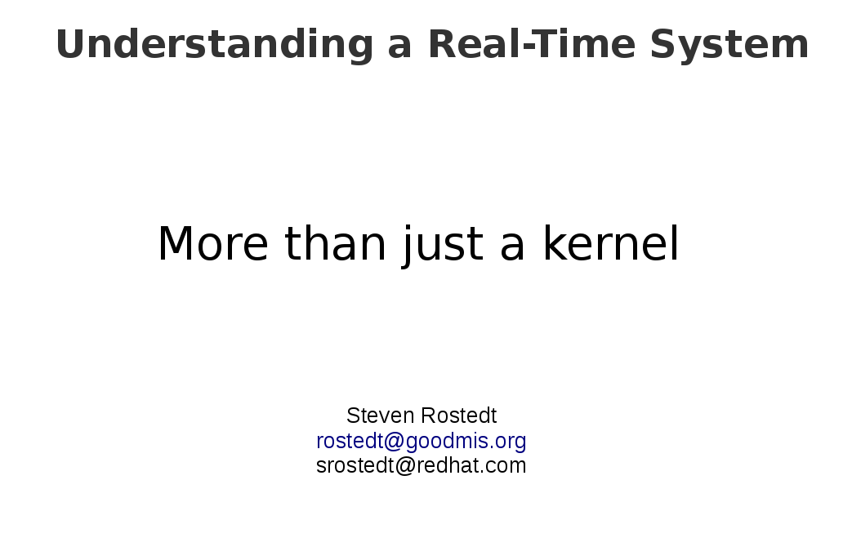
https://events.linuxfoundation.org/sites/events/files/slides/elc-understanding-rt-system-2016.pdf

Slide 24
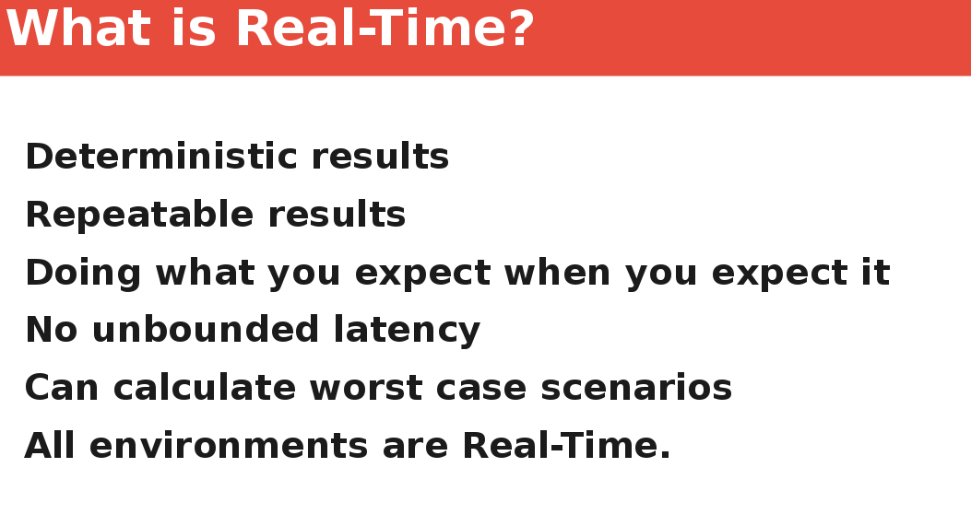
https://events.linuxfoundation.org/sites/events/files/slides/elc-understanding-rt-system-2016.pdf

Slide 25
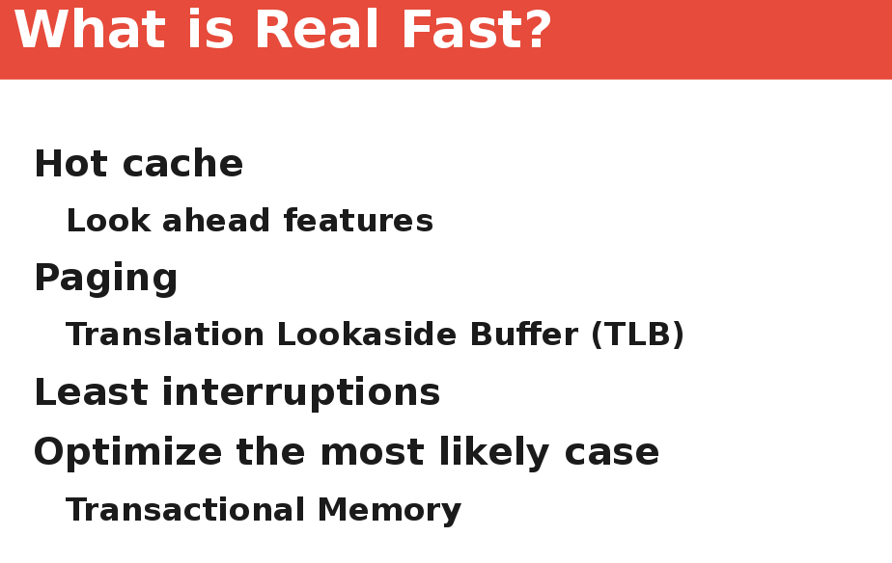
https://events.linuxfoundation.org/sites/events/files/slides/elc-understanding-rt-system-2016.pdf

Slide 26
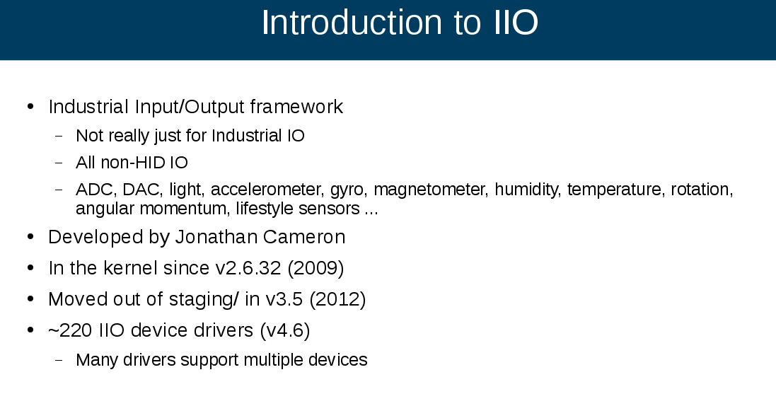
https://events.linuxfoundation.org/sites/events/files/slides/libiio_0.pdf

Slide 27

https://events.linuxfoundation.org/sites/events/files/slides/elc_2016_mem.pdf

Slide 28
J-Core Open Source Processor
PDF: http://j-core.org/ELC-2016.pdf
Google Drive: https://drive.google.com/open?id=0B_NI2VDamOOfc0RaNWJHQWNsOFk
Website: http://j-core.org/
This page describes the j-core processor, a clean-room open source processor and SOC design using the SuperH instruction set, implemented in VHDL and available royalty and patent free under a BSD license.

Slide 29
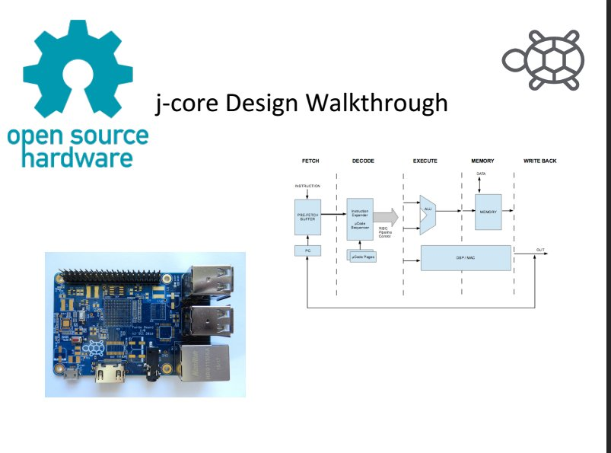
J-Core Open Source Processor

Slide 30
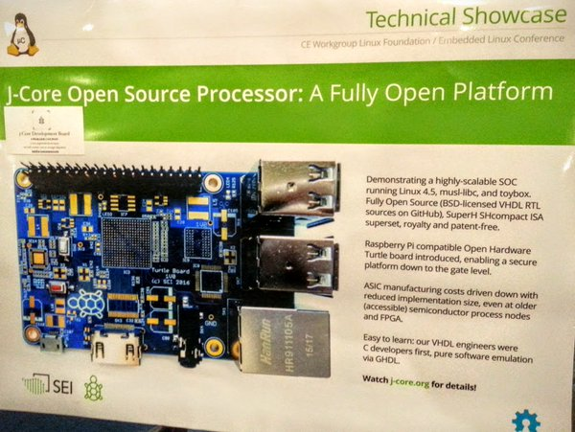
J-Core Open Source Processor

Slide 31
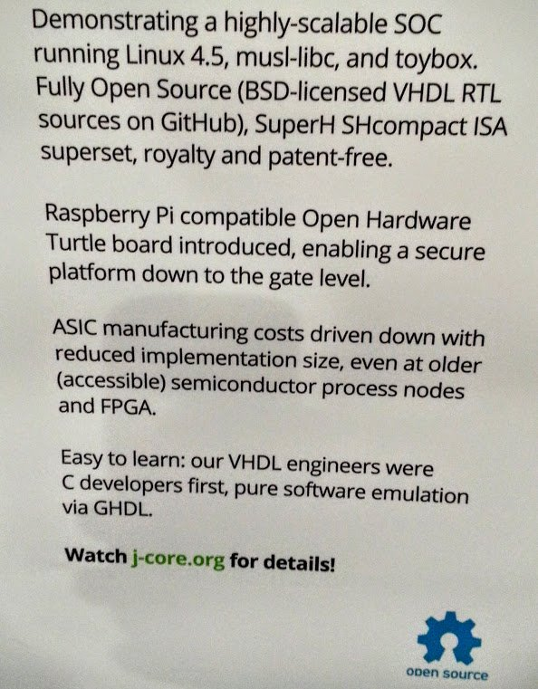

Slide 32
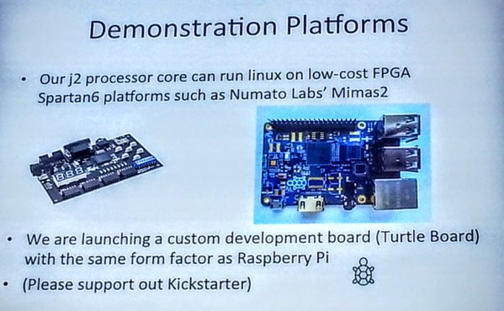
J-Core Open Source Processor

Slide 33
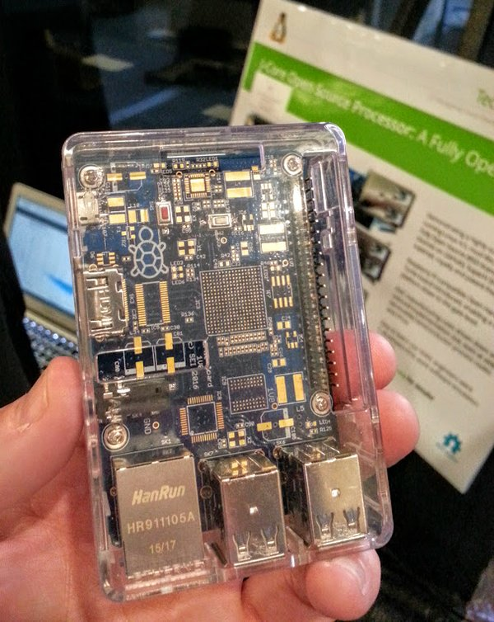

Slide 34
Video?
Coming soon (~2 weeks): https://www.youtube.com/user/TheLinuxFoundation/videos

