Slide 1




Linux on Open Source Hardware
Linux at Fermilab Quarterly meeting
Feb 24, 2016
Drew Fustini
@pdp7 | drew@pdp7.com
Embedded Systems Engineer, OSH Park
“Perfect Purple PCBs”

Slide 2

Design is made
publicly available
so that anyone can
study,
modify,
distribute,
make
or sell
designs or
hardware based on that design

Slide 3



Documentation required for electronics:
Schematics Board Layout
Editable source files for CAD software (KiCad, EAGLE, Altium, etc)
Bill of Materials (BOM)
Best practice: all components available in low quantity distribution

Slide 4
Publish documentation with an
Open Source license:
Creative Commons Share-Alike: CC-BY-SA
    Non-Commercial (NC) clause is NOT acceptable
    http://www.oshwa.org/2014/05/21/cc-oshw/
Copyleft: GPLv2, GPLv3
Permissive: Apache, BSD, MIT
OSHW inspired: CERN OHL, TAPR, SolderPad

Slide 5

CERN Open Hardware Licence http://www.ohwr.org/projects/cernohl/wiki
Originally written for CERN designs hosted in the Open Hardware Repository
Can used by any designer wishing to share design information using a license compliant with the OSHW definition criteria.
CERN OHL version 1.2:
http://www.ohwr.org/documents/294
Contains the license itself and a guide to its usage

Slide 6
CERN Open Hardware Licence http://www.ohwr.org/projects/cernohl/wiki
Myriam Ayass, legal adviser at CERN and author of the CERN OHL:
  OHL is to hardware what GPL is to software
  Same principles as Free or Open Source software
  Anyone should be able to see the source (the design documentation in case of hardware), study it, modify it and share it.

Slide 7
Open Hardware Repository http://www.ohwr.org/
  Collaborate on Open Hardware designs
  Peer review for small teams or solo designers
  Origins in experimental physics laboratories
  Enable teams to work together to solve problems
  More fun than isolation & results in better hardware

Slide 8
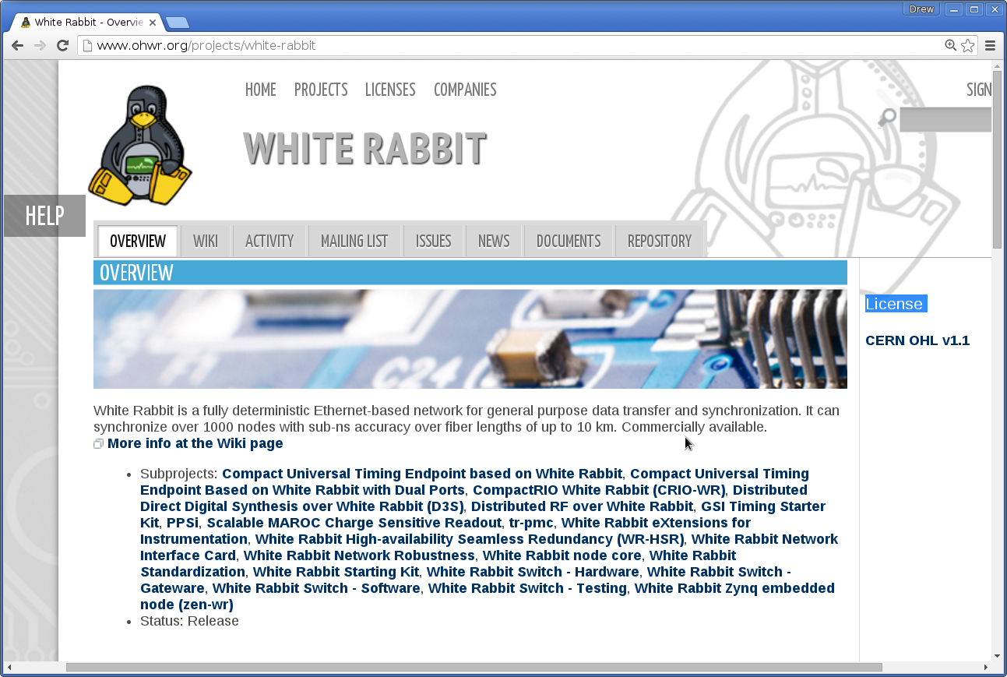
Example: White Rabbit http://www.ohwr.org/projects/white-rabbit

Slide 9

Javier Serrano, Open Hardware at CERN
https://vimeo.com/127579456
Physicist and Electronics Engineer at CERN
co-author of the CERN Open Hardware License
creator of the Open Hardware Repository

Slide 10
Licenses, Copyright and Patents
can get confusing!
Review of Popular OSHW Licenses
https://vimeo.com/110682815
Talk by Ari Douglas at OHS 2014

Slide 11
What is the spirit of Open Source?
Publish everything that will:
enable collaborative development
The goal is NOT to just check a box on a marketing flyer or add keywords to a Kickstarter campaign

Slide 12

Open Source Hardware Association http://www.oshwa.org
US Federal 501(c) non-profit
Hosts the OSHW definition: http://www.oshwa.org/definition/
“aims to be the voice of the open hardware community, ensuring that technological knowledge is accessible to everyone, and encouraging the collaborative development of technology”

Slide 13
May and Must attributes
  PDF poster: http://www.oshwa.org/wp-content/uploads/2014/08/OSHW-May-and-Must.pdf
Quick Reference Guide:
  http://www.oshwa.org/open-source-quick-reference-guide/
Best Practices:
  http://www.oshwa.org/sharing-best-practices/

Slide 14

Open Hardware Summit (OHS)
OHS 2016: http://2016.oshwa.org/
  October 7th in Portland, Oregon
6 prior summits:
  2010, 2011: New York Hall of Science
  2012: Eyebeam (NYC)
  2013: MIT (~Boston)
  2014: Roma, Italia!
  2015: Philadelphia

Slide 15

Open Hardware Summit (OHS)
2015 videos: http://2015.oshwa.org/

Slide 16
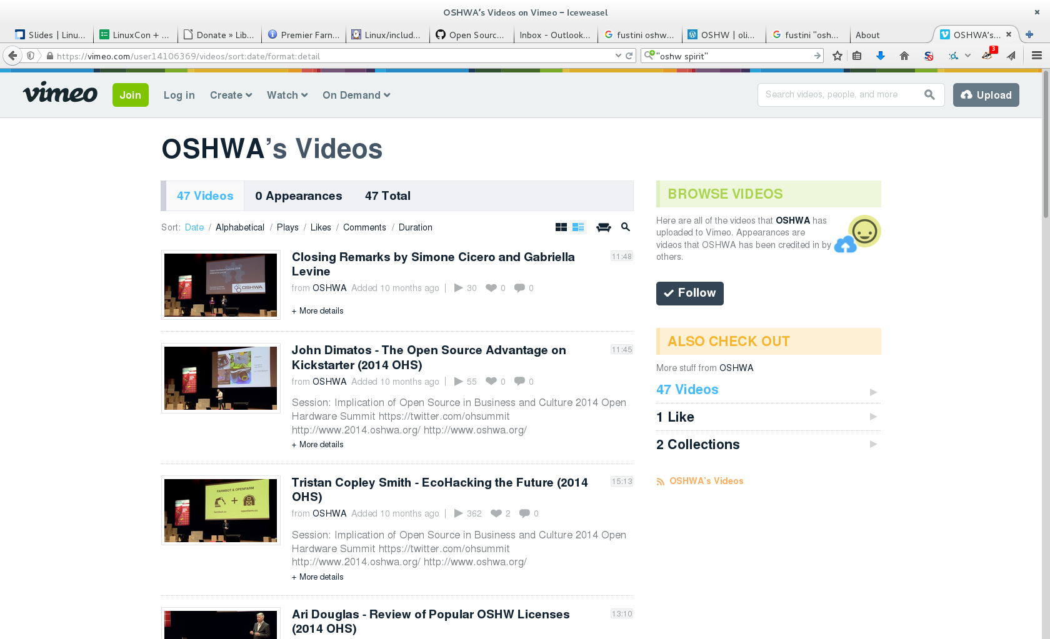
2014 videos: https://vimeo.com/user14106369/videos
Open Hardware Summit (OHS)

Slide 17

Achieved Critical Mass by Sharing:
Arduino
http://arduino.cc/
How did it come to be?
Arduino: The Documentary
https://vimeo.com/18539129

Slide 18
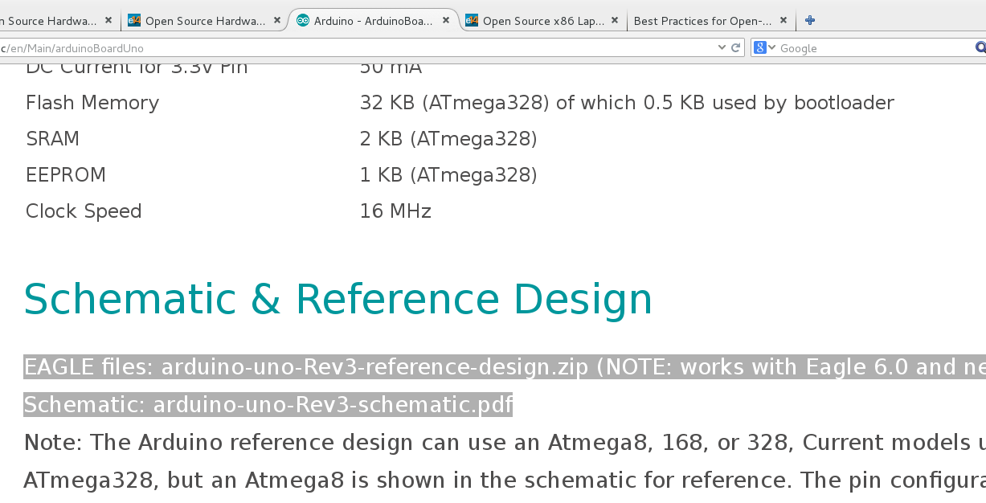
Example: Arduino UNO Design Files
https://www.arduino.cc/en/Main/ArduinoBoardUno

Slide 19




Open Source Hardware ARM Linux boards
Developed by BeagleBoard.org Foundation and BeagleBoard.org Community
Founded by Texas Instruments engineers Jason Kridner and Gerald Coley
Mascot is Boris the Beagle!
Manufacturers: CircuitCo, element14 & Seeed

Slide 20
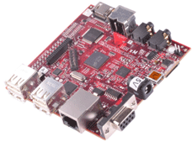
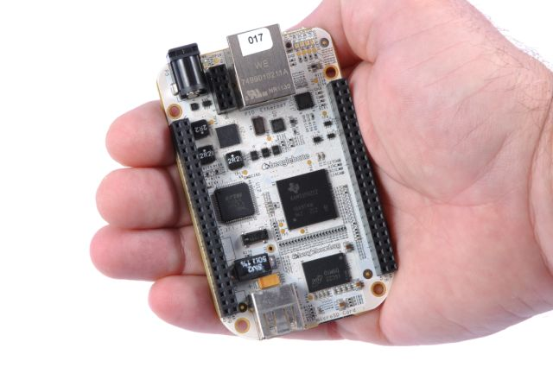
Previous Beagles
BeagleBoard:
  2008
  first affordable ($150) ARM single board computer (SBC)
  Open Source Hardware!
BeagleBone:
  2011
  $89
  256MB RAM
  720MHz, ARM Cortex A8
  fits in an Altoids-tin!

Slide 21

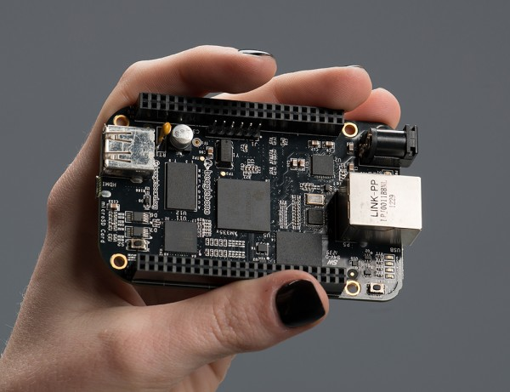
BeagleBone Black (~$50) http://beagleboard.org/black
Flexible open hardware and software development platform
http://elinux.org/Beagleboard:BeagleBoneBlack#Hardware_Files
Fast and flexible
  1-GHz Sitara ARM
  2x 200-MHz PRUs
  512 MB DDR3
  On-board HDMI & Ethernet
  USB 2.0 Host
  GPIO: 65 digital I/O, 7 analog inputs, UART, I2C, SPI

Slide 22
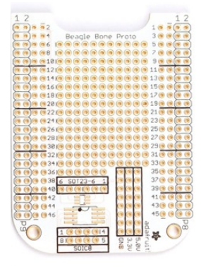
BeagleBone Black http://beagleboard.org/black
Ready to use out of the box:
  USB provides power and client network
  Built-in “bone101” tutorials in Bonescript
  Browser-based IDE (Cloud9)
  4GB eMMC flashed with Debian
BeagleBone Capes:
  http://elinux.org/Beagleboard:BeagleBone_Capes
  Just another word for daughter board
  up to 4 stacked depending on resources used

Slide 23
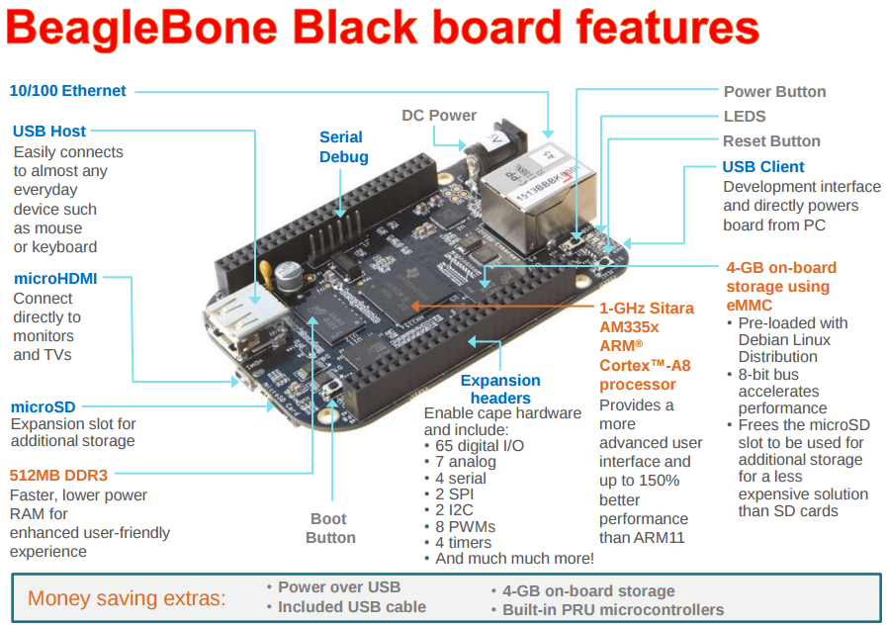

Slide 24
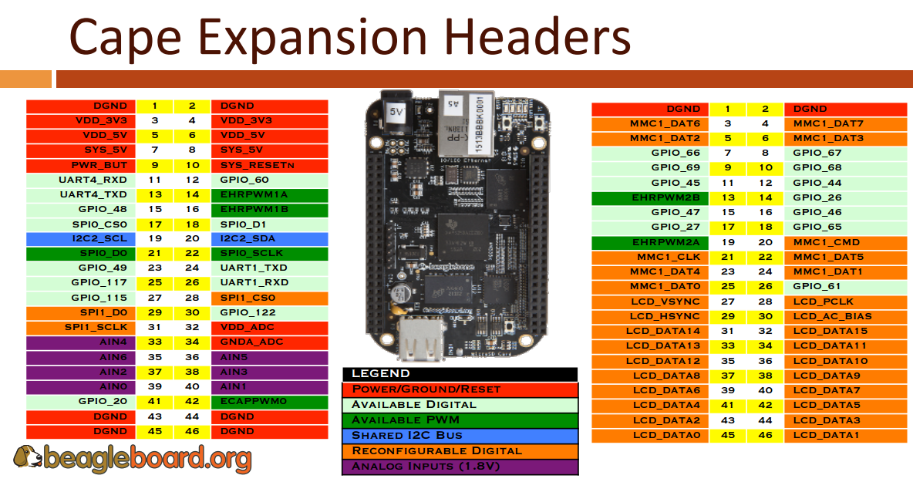

Slide 25
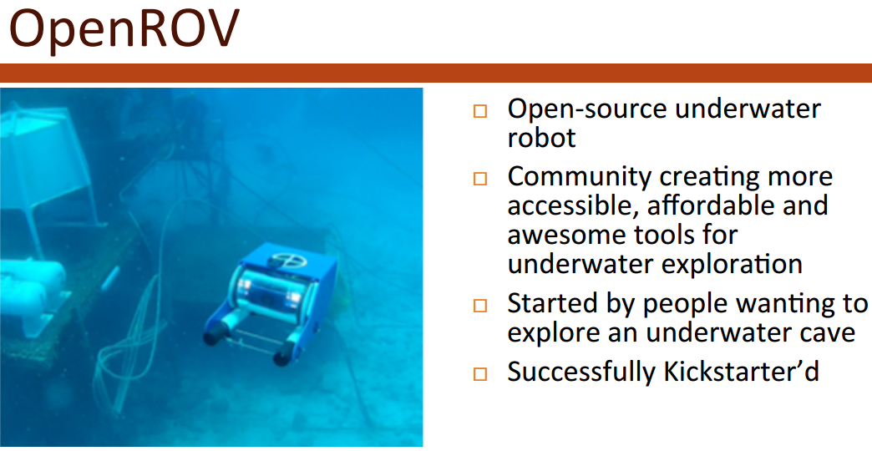
http://www.openrov.com/

Slide 26
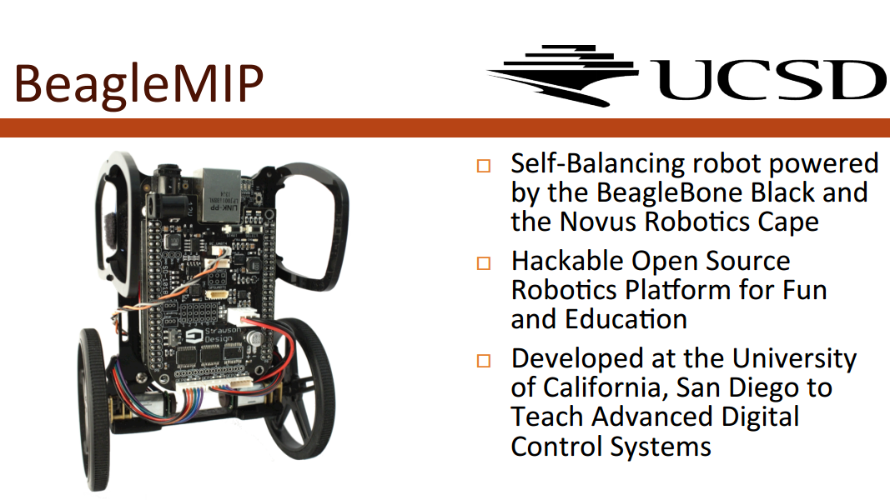
http://www.openrov.com/

Slide 27
BeagleBone Black http://beagleboard.org/black
What are PRUs?
  “Programmable Real-Time Units”
  32-bit RISC processors at 200MHz with single-cycle pin access for hard real-time
  Optimized for packet processing/switching and software implementation of peripherals
Why use PRUs?
  Dedicated function, free from the running OS
  Real-time because it can't be interrupted
  Low latency from input to output
  You can't interface external MCU to DDR memory!

Slide 28
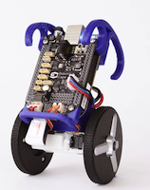
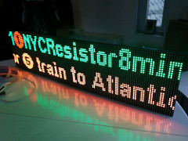
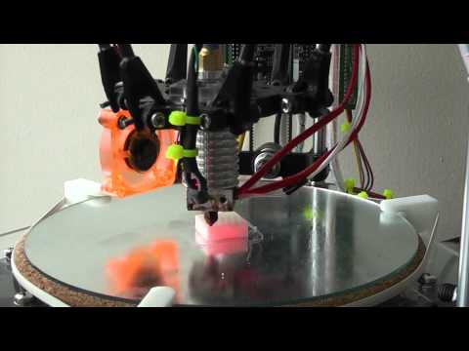
BeagleBone Black http://beagleboard.org/black
Example PRU usage:
  Tight control loops driving mobile robot,
  CNC machine or 3D printer
  Custom Protocols: WS28x LED strips, DMX512, EtherCAT, ProfiBUS, ProfiNET
Popular projects:
  LEDscape: https://trmm.net/Category:LEDscape
  MachineKit (fork of LinuxCNC): http://www.machinekit.io/

Slide 29
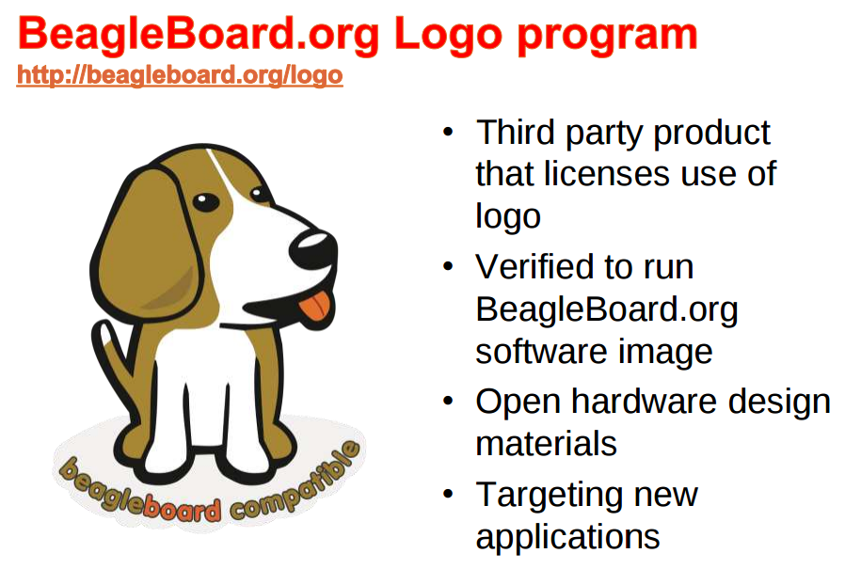

Slide 30
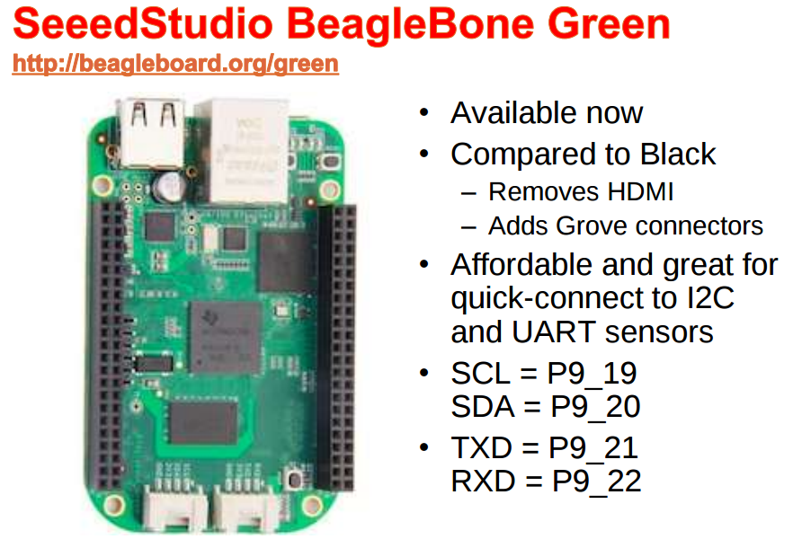
$40

Slide 31
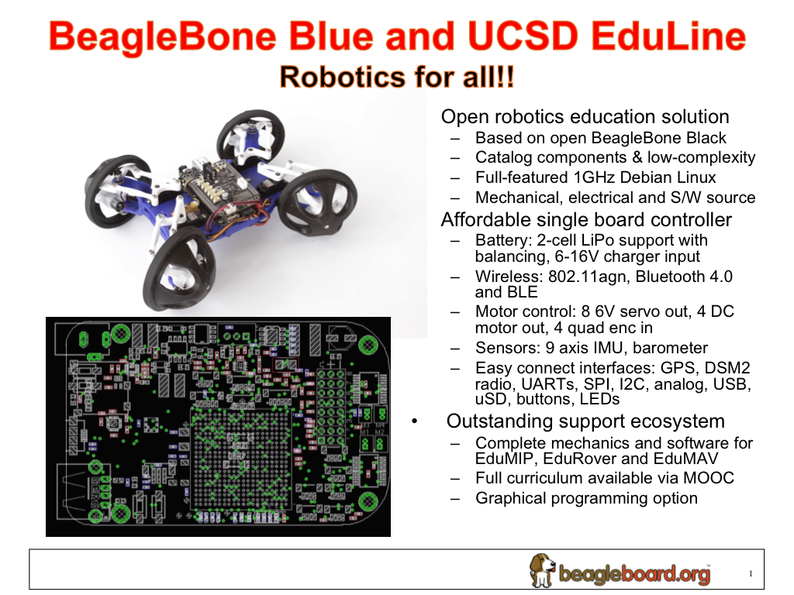

Slide 32
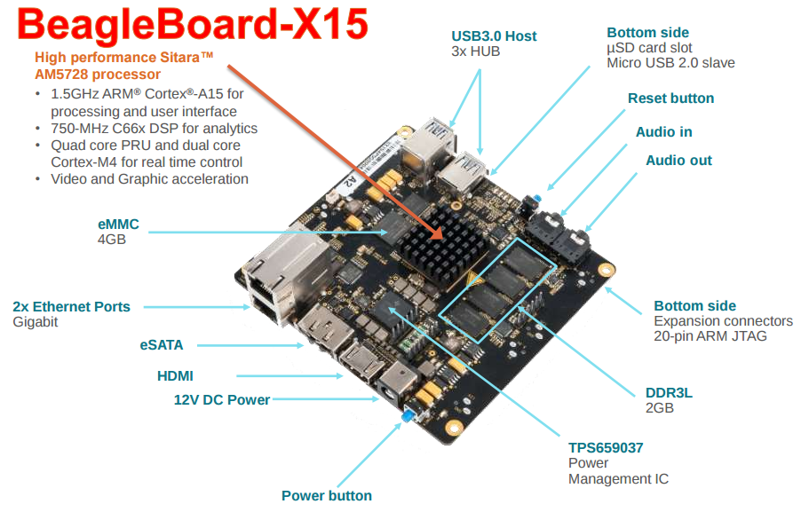

Slide 33


MinnowBard http://www.minnowboard.org/
64-bit Intel Atom “Bay Trail”
MinnowBoard MAX:
  $139 MSRP: E3825 (dual-core, 1.33 GHz)
MinnowBoard Turbot
  $139 MSRP: E3826 (dual-core, 1.46 GHz)
USB 3.0, SATA, PCIe, Gigabit Ethernet, HDMI
Integrated Intel HD Graphics
  Open Source Mainline Linux drivers!

Slide 34
OSHW Design Files
Manufactured by CircuitCo (MAX) & ADI (Turbot)
Released under Creative Commons CC-BY-SA
Download: http://www.elinux.org/Minnowboard:MinnowMax#Design_Files
  [x] Schematic (Orcad DSN & PDF)
  [x] Board Layout (Allegro BRD & Gerbers)
  [x] Bill of Materials

Slide 35
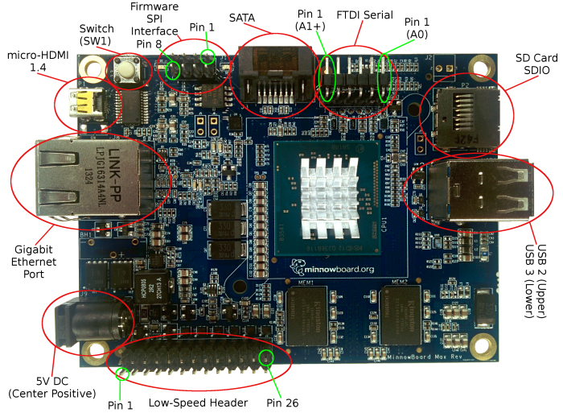
MinnowBoard I/O (MAX & Turbot)

Slide 36
Expansion Port Details
Low-Speed Expansion port:
  2×13 (26-pin) male 0.1″ pin header.
  SPI, I2C, I2S Audio, 2x UARTs, 8x GPIO, 2x PWM
High-Speed Expansion port:
  60-pin, high-density connector.
  1x PCIe Gen 2.0 Lane, 1x SATA2 3Gb/sec, USB 2.0 host, I2C, GPIO, JTAG

Slide 37
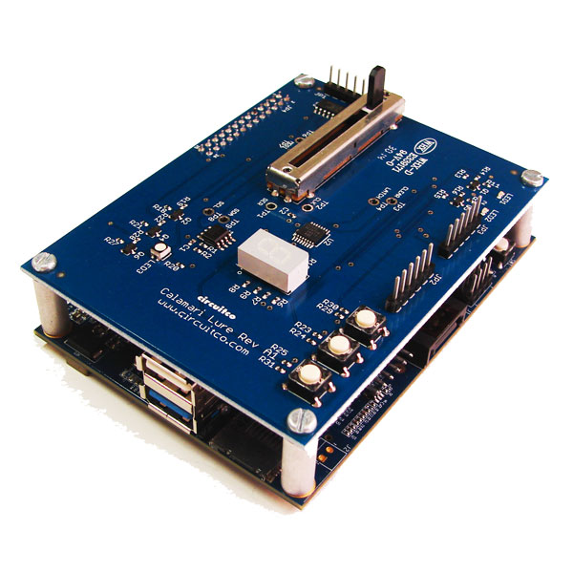
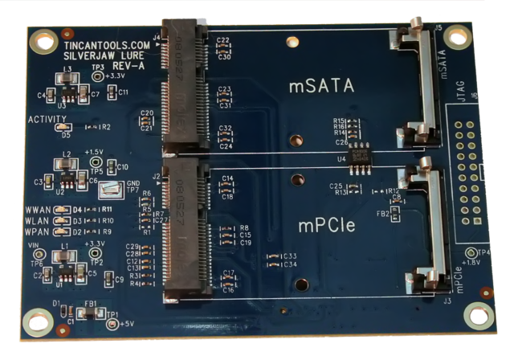
Lures: expansion boards
Calamari Lure: $30
  http://elinux.org/Calamari_Lure
  SPI Based ADC, 10K Slider POT, RGB LED, 2 PWM LEDS, 2 TTL UART Headers, 7-Segment Display with 595 shift register, I2C, EEPROM, 3 Buttons
Silverjaw Lure: $50
  http://wiki.minnowboard.org/Silverjaw_Lure
  dual break-out board providing both an mPCIe and mSATA slot

Slide 38
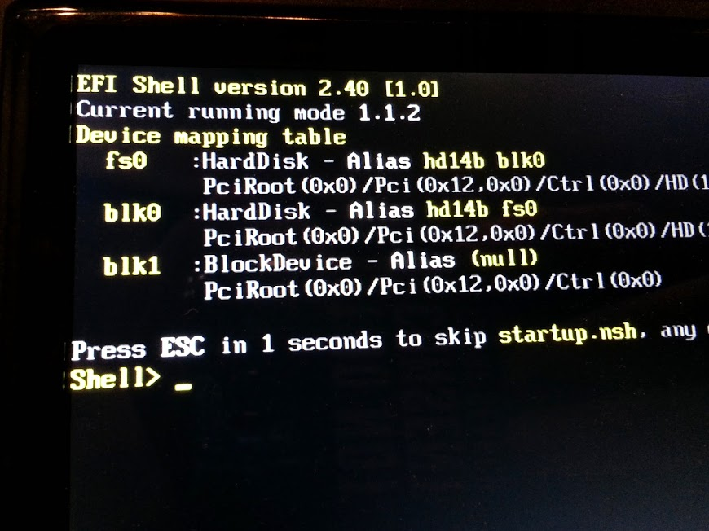
EFI (Firmware)
MinnowBoard uses a UEFI system level firmware, and provides both the UEFI shell, and a typical BIOS style menu interface.
Intel EFI Firmware update for MAX: https://uefidk.com/content/minnowboard-max
eLinux Wiki page on BIOS: http://www.elinux.org/Minnowboard:MaxBios

Slide 39

OlinuXino
https://www.olimex.com/Products/OLinuXino/open-source-hardware
Open Source Hardware low cost Linux computers
Designed & manufactured by Olimex in Bulgaria
Originally Freescale i.MX233
Newer models have Allwinner: A10, A13, A20, H3
Agreement with Allwinner for longevity support and sell individual chips to customers
“Open Source Hardware (OSHW), why it matters and what is pseudo OSHW”https://olimex.wordpress.com/2016/01/13/open-source-hardware-oshw-why-it-matters-and-what-is-pseudo-oshw/

Slide 40

A64-OlinuXino:
https://olimex.wordpress.com/tag/a64/
Allwinner A64: Quad Core 64-bit ARM Cortex-A53
Designed completely with KiCAD
1GB RAM (2GB is possible), 4GB fast SLC eMMC Flash, WiFi+BLE4.0 module

Slide 41

http://www.slideshare.net/olimexbulgaria/designing-with-kicad-of-64bit-arm-board

Slide 42


http://getchip.com/
Next Thing Co. in Oakland
Kickstarter in 2015:
    39,560 backers
    $2,071,927 pledged

Slide 43

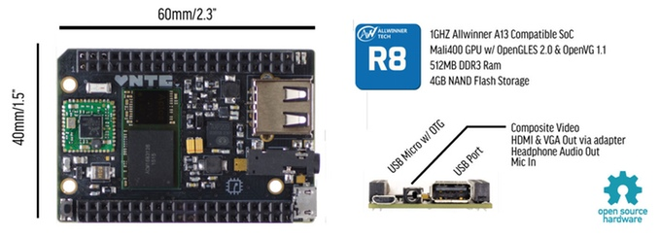
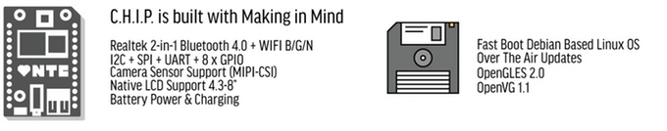



Slide 44
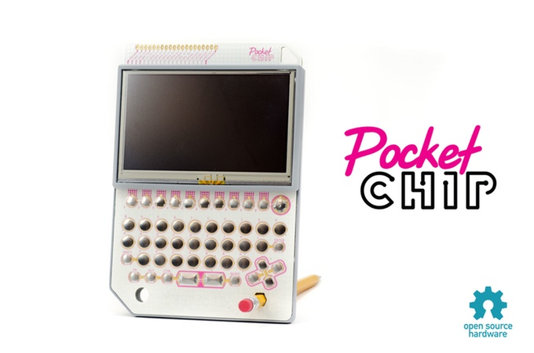
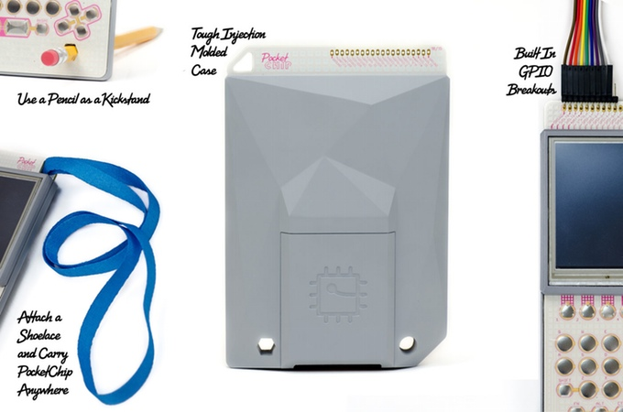
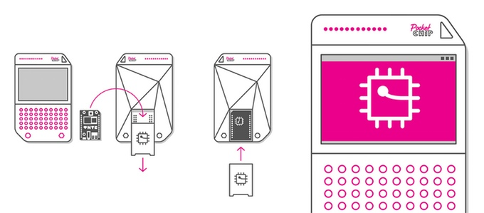
PocketC.H.I.P. makes C.H.I.P. portable!
https://www.kickstarter.com/projects/1598272670/chip-the-worlds-first-9-computer/posts/1245278
3,000 mAH battery (5 hours)
4.3" 470px x 272px screen w/ resistive touch
Full Super-Clicky QWERTY keyboard
Rugged Injection Molded Shell
Fully open source
GPIO breakouts
C.H.I.P. is removable via hatch

Slide 45

CHIP Hardware repo
https://github.com/NextThingCo/CHIP-Hardware
Schematics
PCB Layout
Bill of Materials (BOM)
Datasheets for BOM:
https://github.com/NextThingCo/CHIP-Hardware/tree/master/CHIPv0_21-BOM-Datasheets

Slide 46
Mainline C.H.I.P. Kernel Changes
Kickstarter post: “All about Open Source”
https://www.kickstarter.com/projects/1598272670/chip-the-worlds-first-9-computer/posts/1247188
Run official & current version of Linux kernel
Merge changes into Linus Torvald's tree in a process called "Mainlining"
Linux-Sun-Xi community has already made great progress on for Allwinner SoCs: https://linux-sunxi.org

Slide 47

Contracted by Next Thing Co to support the CHIP in mainline Linux kernel:
  “Free Electrons working on the $9 C.H.I.P. computer”
  http://free-electrons.com/blog/free-electrons-chip-nextthing/
Free Electrons has been supporting Allwinner processors in the mainline Linux kernel for several years
Free Electrons engineer Maxime Ripard is the maintainer of the Allwinner SoC support

Slide 48

Resources
Join OSHWA!
  http://www.oshwa.org/membership/
Subscribe to the mailing list:
  http://lists.oshwa.org/listinfo/discuss
Follow on Twitter:
  @OHSummit
  @oshwassociation
Building Open Source Hardware
  http://www.amazon.com/Building-Open-Source-Hardware-Manufacturing/dp/0321906047/

Slide 49
BONUS SLIDES

Slide 50

What about silicon?
LowRISC!
  http://www.lowrisc.org/
  “lowRISC is producing fully open hardware systems. From the processor core to the development board, our goal is to create a completely open computing eco-system”

Slide 51

Novena laptop https://www.crowdsupply.com/sutajio-kosagi/novena
Created by Bunnie & xobs!
  Chumby! Hacking the X-Box! Amazing reverse engineers:
    The Exploration and Exploitation of an SD Memory Card
      https://www.youtube.com/watch?v=CPEzLNh5YIo
100% Open Source Hardware laptop
Quad-core 1.2GHz Freescale ARM CPU
FPGA! 4GB RAM, WiFi, 2x Ethernet, SSD

Slide 52


Lulzbot 3-D Printers https://www.lulzbot.com
100% Open Source
Hardware & Software
FSF Respects Your Freedom certified
https://www.fsf.org/resources/hw/endorsement/respects-your-freedom

Slide 53

Respects Your Freedom
Hardware product certification by
the Free Software Foundation (FSF)
Certified products: “respect your freedom and your privacy, and will ensure that you have control over your device.”
Hardware design can be proprietary, but all software & firmware must be Free/Libre

Slide 54
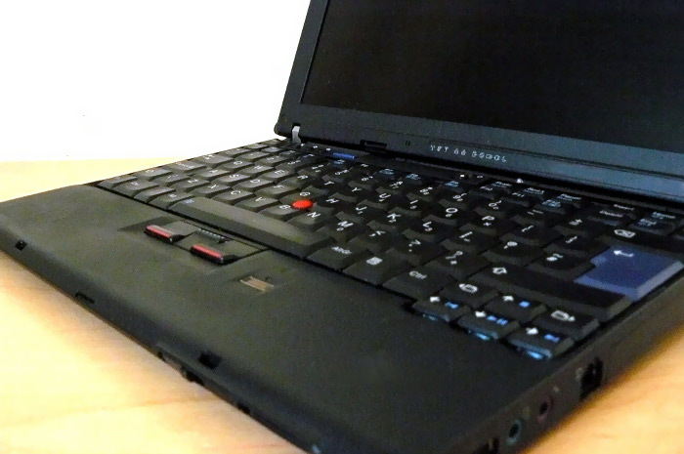
Respects Your Freedom
Libreboot X200 laptop
  http://minifree.org/product/libreboot-x200/
  reconditioned ThinkPad X200
  libreboot firmware (free BIOS/UEFI replacement)
  Trisquel GNU/Linux-libre 7.0 LTS
    Linux-libre is the Linux kernel with all non-free modules and firmware removed

Slide 55
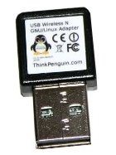
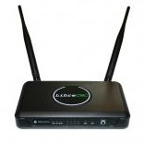

Respects Your Freedom
ThinkPenguin WiFi with Free Software Firmware!
  https://www.fsf.org/resources/hw/endorsement/thinkpenguin
TPE-NWIFIROUTER Wireless N Broadband Router
  pre-installed with libreCMC, an FSF-endorsed embedded GNU/Linux distribution
TPE-N150USB & TPE-N150USB USB Adapters
  Free Software firmware for Atheros AR9271
  Linux-libre ath9k-htc kernel module

