Slide 1



Open Source Hardware
Portland Science Hack Day
October 7, 2016
Drew Fustini
OSH Park
drew@oshpark.com
@oshpark / @pdp7

Slide 2

Design is made
publicly available
so that anyone can
study,
modify,
distribute,
make
or sell
designs or
hardware based on that design

Slide 3



Documentation required for electronics:
Schematics Board Layout
Editable source files for CAD software (KiCad, EAGLE, Altium, etc)
Bill of Materials (BOM)
Best practice: all components available in low quantity distribution

Slide 4
Publish documentation with an
Open Source license:
Creative Commons Share-Alike: CC-BY-SA
    Non-Commercial (NC) clause is NOT acceptable
Copyleft: GPLv2, GPLv3
Permissive: Apache, BSD, MIT
OSHW inspired: CERN OHL, TAPR, SolderPad

Slide 5

CERN Open Hardware Licence
Originally written for CERN designs hosted in the Open Hardware Repository
Can used by any designer wishing to share design information using a license compliant with the OSHW definition criteria.
CERN OHL version 1.2
Contains the license itself and a guide to its usage

Slide 6
CERN Open Hardware Licence
Myriam Ayass, legal adviser at CERN and author of the CERN OHL:
  OHL is to hardware what GPL is to software
  Similar principles to Free or Open Source software
  Anyone should be able to:
  see the source*, study it, modify it and share it
  *the design documentation in case of hardware

Slide 7
Open Hardware Repository
  Collaborate on Open Hardware designs
  Peer review for small teams or solo designers
  Origins in experimental physics laboratories
  Enable teams to work together to solve problems
  More fun than isolation & results in better hardware

Slide 8
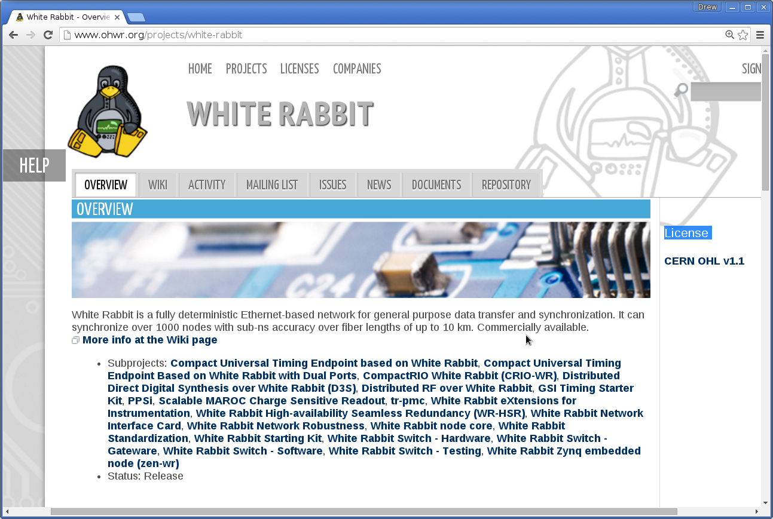
Example: White Rabbit

Slide 9

Javier Serrano, Open Hardware at CERN
Physicist and Electronics Engineer at CERN
co-author of the CERN Open Hardware License
creator of the Open Hardware Repository

Slide 10
Licenses, Copyright and Patents
can get confusing!
Review of Popular OSHW Licenses
Talk by Ari Douglas at OHS 2014

Slide 11
What is the spirit of Open Source?
Publish everything that will:
enable collaborative development
The goal is NOT to just check a box on a marketing flyer or add keywords to a Kickstarter campaign

Slide 12

Open Source Hardware Association
US Federal 501(c) non-profit
Hosts the OSHW definition
“aims to be the voice of the open hardware community, ensuring that technological knowledge is accessible to everyone, and encouraging the collaborative development of technology”

Slide 13
Best Practices
Quick Reference Guide
May and Must attributes (PDF)

Slide 14

Open Hardware Summit (OHS)
OHS 2016: Portland, Oregon
6 prior summits:
  2010, 2011: New York Hall of Science
  2012: Eyebeam (NYC)
  2013: MIT (~Boston)
  2014: Roma, Italia!
  2015: Philadelphia

Slide 15
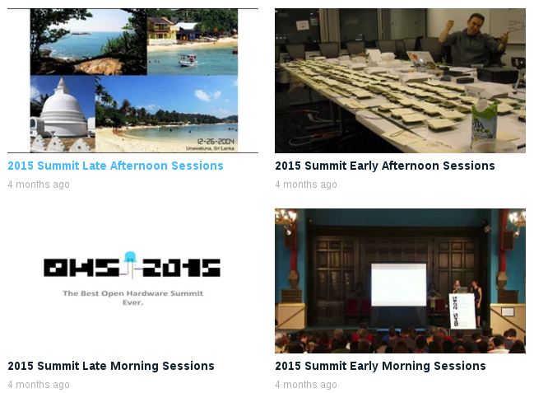
Open Hardware Summit (OHS)
2015 videos:

Slide 16
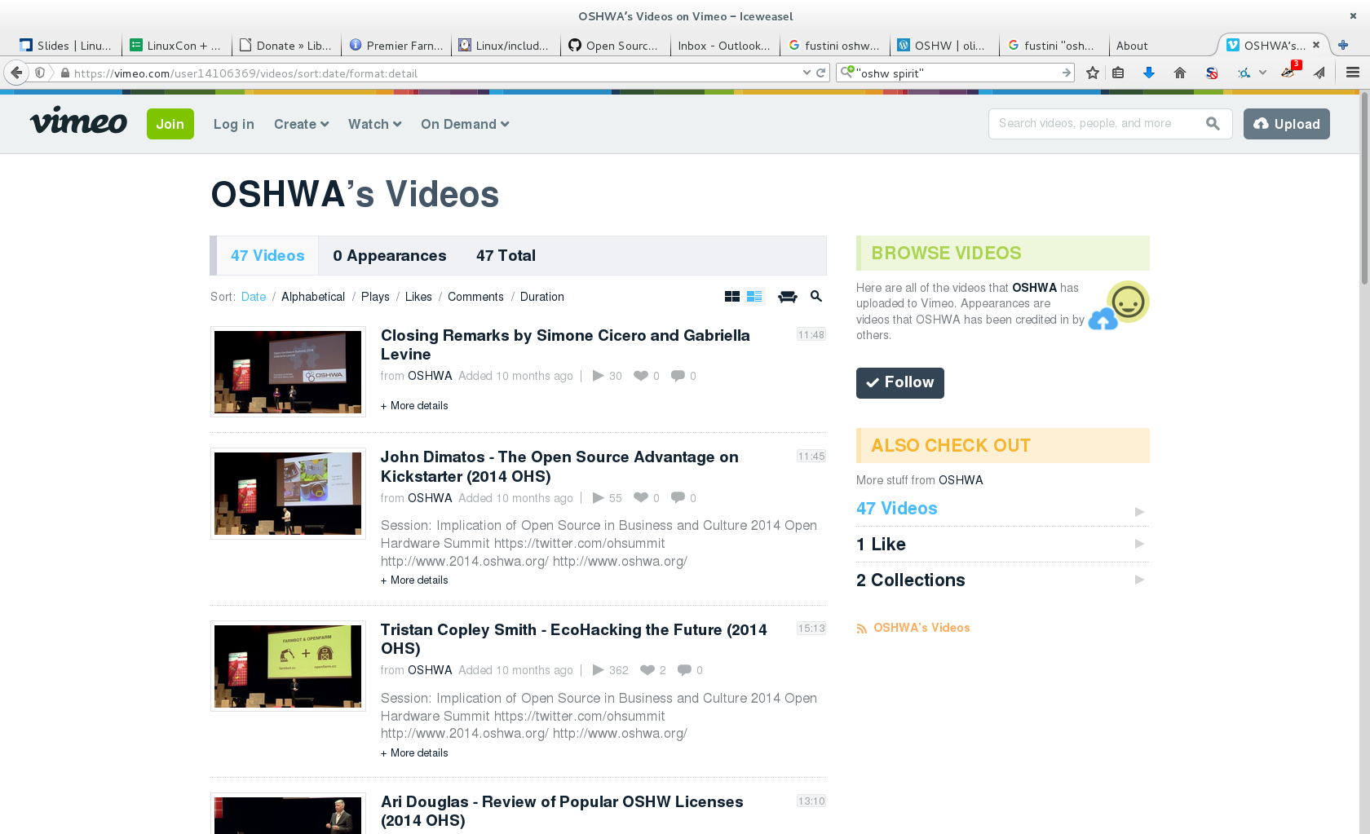
2014 videos:
Open Hardware Summit (OHS)

Slide 17

Achieved Critical Mass by Sharing:
Arduino
How did it come to be?
Arduino: The Documentary

Slide 18
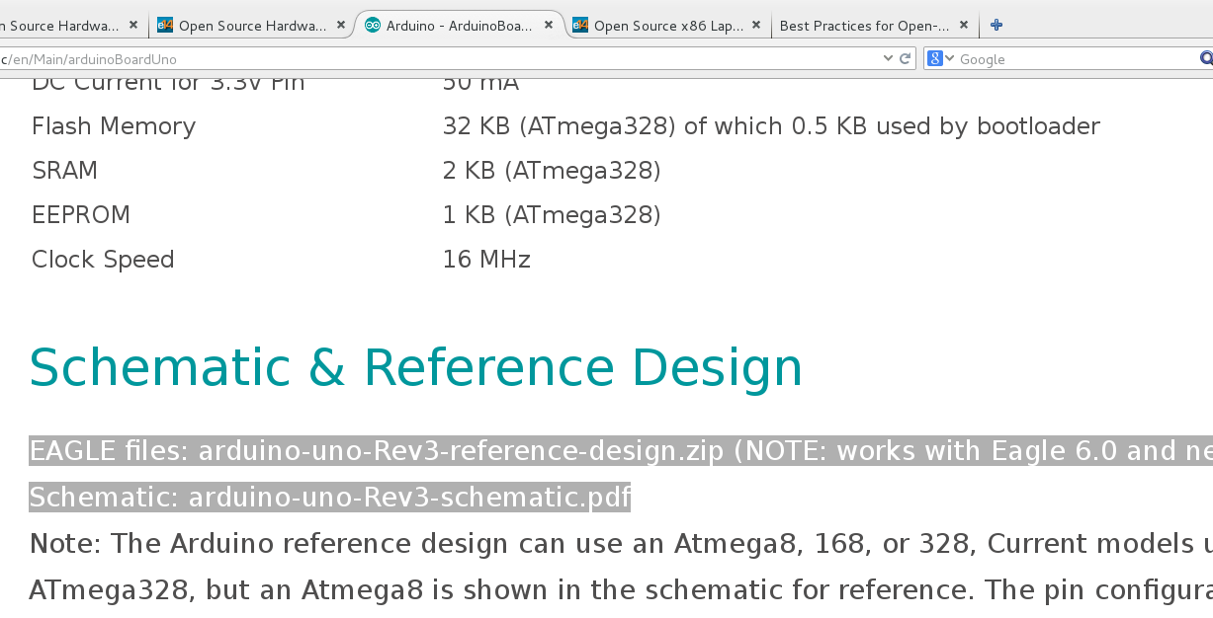
Example: Arduino UNO Design Files

Slide 19

OSHW Resources
Join OSHWA
Subscribe to the mailing list
Follow on Twitter:
  @OHSummit
  @oshwassociation
Building Open Source Hardware
by Alicia Gibb

Slide 20
Section:
LINUX on OSHW

Slide 21


ARM Linux on Open Source Hardware
Developed by BeagleBoard.org Foundation and BeagleBoard.org Community
Manufacturers: element14, GHI, Seeed

Slide 22

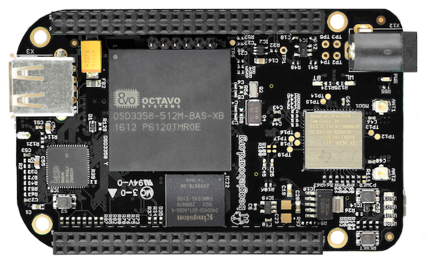
BeagleBone Black Wireless
1 GHz ARM processor, 512 MB RAM
2x 32-bit PRU microcontroller for hard real-time
4GB eMMC with Debian GNU/Linux installed
WiFi 802.11 b/g/n, Bluetooth 4.1 with BLE
HDMI / USB / 65 GPIO pins / 8 PWM outputs
7 analog inputs / 4x UART / 2x I²C / 2x SPI

Slide 23

BeagleBone Black Wireless
(ships Novermber 2016)
CadSoft EAGLE design files hosted on GitHub
Bill of Materials: every part available in qty 1
Octavo System-in-Package (SiP) large pitch BGA simplifies PCB layout and assembly

Slide 24


MinnowBoard
64-bit Intel Atom “Bay Trail”
MinnowBoard Turbot
  $135: E3826 (dual-core, 1.46 GHz)
USB 3.0, SATA, PCIe, Gigabit Ethernet, HDMI
Integrated Intel HD Graphics
  Open Source Mainline Linux drivers!

Slide 25
MinnowBoard
Manufactured by ADI and CircuitCo
Released under Creative Commons CC-BY-SA
Download:
  [x] Schematic (Orcad DSN & PDF)
  [x] Board Layout (Allegro BRD & Gerbers)
  [x] Bill of Materials

Slide 26

OLinuXino
Low cost OSHW Linux computers
Designed and manufactured by Olimex in Bulgaria
Blog post:
“Open Source Hardware, why it matters and what is pseudo OSHW”

Slide 27

A64-OlinuXino
Allwinner A64: Quad Core 64-bit ARM
Designed with Open Source KiCad
1GB RAM, 4GB eMMC, WiFi+BLE4.0

Slide 28

http://www.slideshare.net/olimexbulgaria/designing-with-kicad-of-64bit-arm-board

Slide 29


getchip.com
Next Thing Co. in Oakland
Kickstarter in 2015:
    39,560 backers
    $2,071,927 pledged

Slide 30

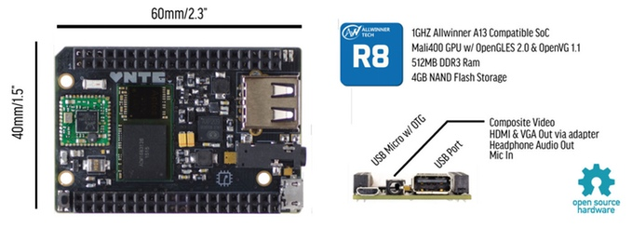
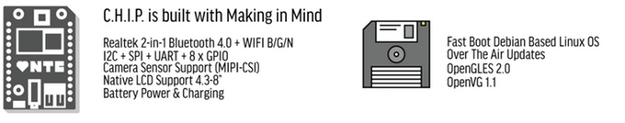



Slide 31

C.H.I.P. is OSHW
GitHub: NextThingCo/CHIP-Hardware
  Schematics
  PCB Layout
  Bill of Materials (BoM)
License:
  Creative Commons Attribution-ShareAlike
  (CC-BY-SA)

Slide 32
Section:
OSHW in Science
Suggestions from the OSHWA mailing list

Slide 33

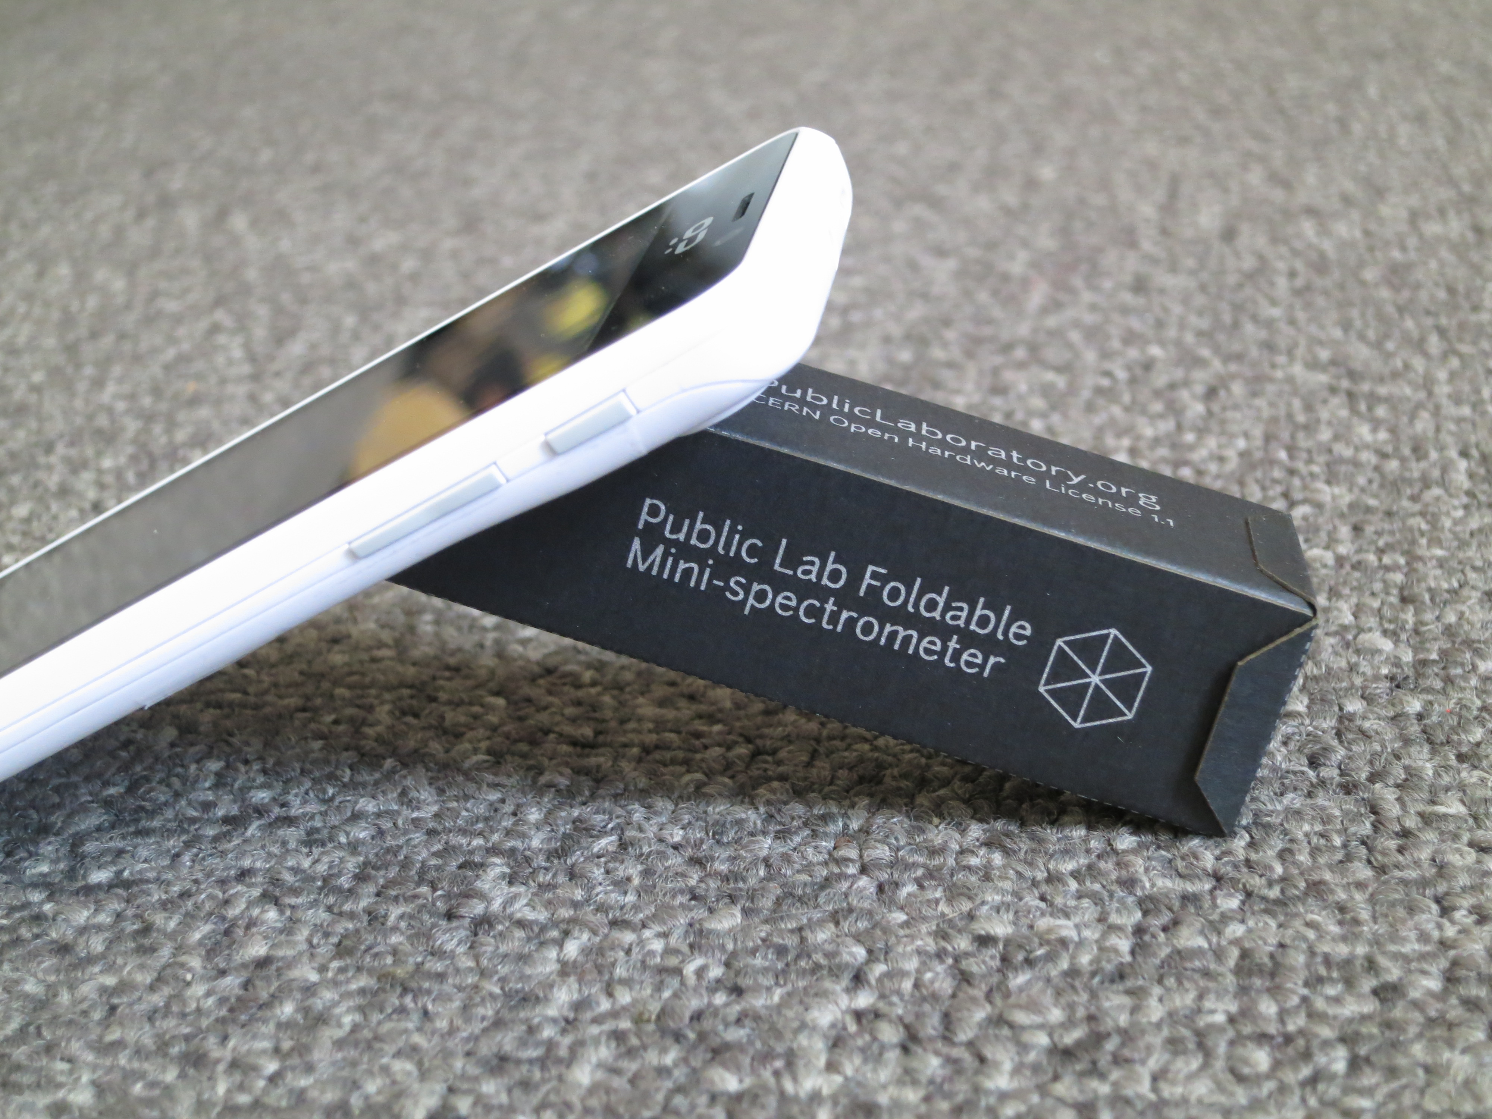
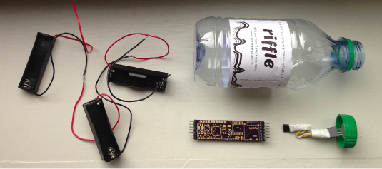
Public Lab
“Using inexpensive DIY techniques, we seek to change how people see the world in environmental, social, and political terms.”
Office in Portland!
Riffle: Open Source Water Monitoring
Desktop Spectrometry
Balloon Mapping Kit

Slide 34
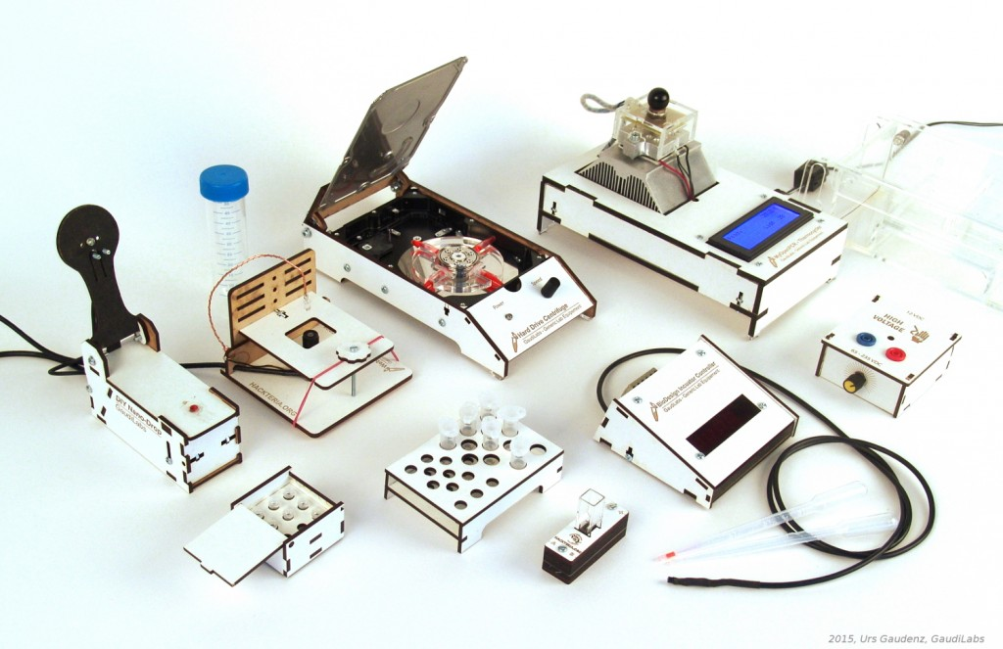
Generic Lab Equipement
GaudiLabs in Lucern, Switzerland
  part of the hackteria.org open source biology art network

Slide 35
Generic Lab Equipement
WebCam Microscope
Hard Drive Centrifuge
Incubator Controller
Gel Box and High Voltage Supply
Turbidity Meter Kit
DIY Microvolume Spectrometer
My Open PCR
Tube Racks

Slide 36

GOSH 2017
Gathering for Open Science Hardware
Santigo, Chile. March 22-25, 2017.
“growing number of people around world are developing and using Open Science Hardware, and we want to help build self-organising community to drive change in open science”

Slide 37

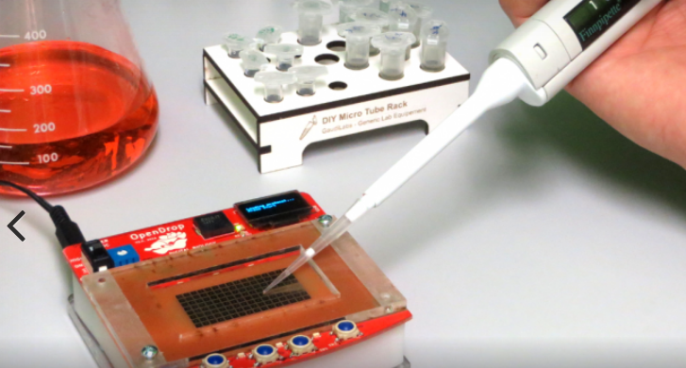
OpenDrop
“Desktop Digital Biology Laboratory”
digital microfludics platform for research
part of a bigger ecosystem around digital biology with the aim of making personal lab-automation accessible to more people

Slide 38
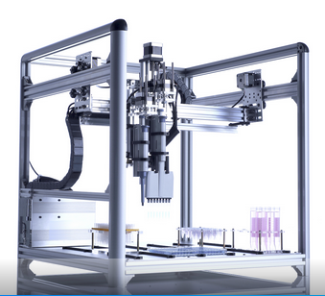
OpenTrons
Robots for Biologists
“We think biologists should have robots to do pipetting for them.”
“They should be able to spend their time designing experiments and analyzing data.”

Slide 39
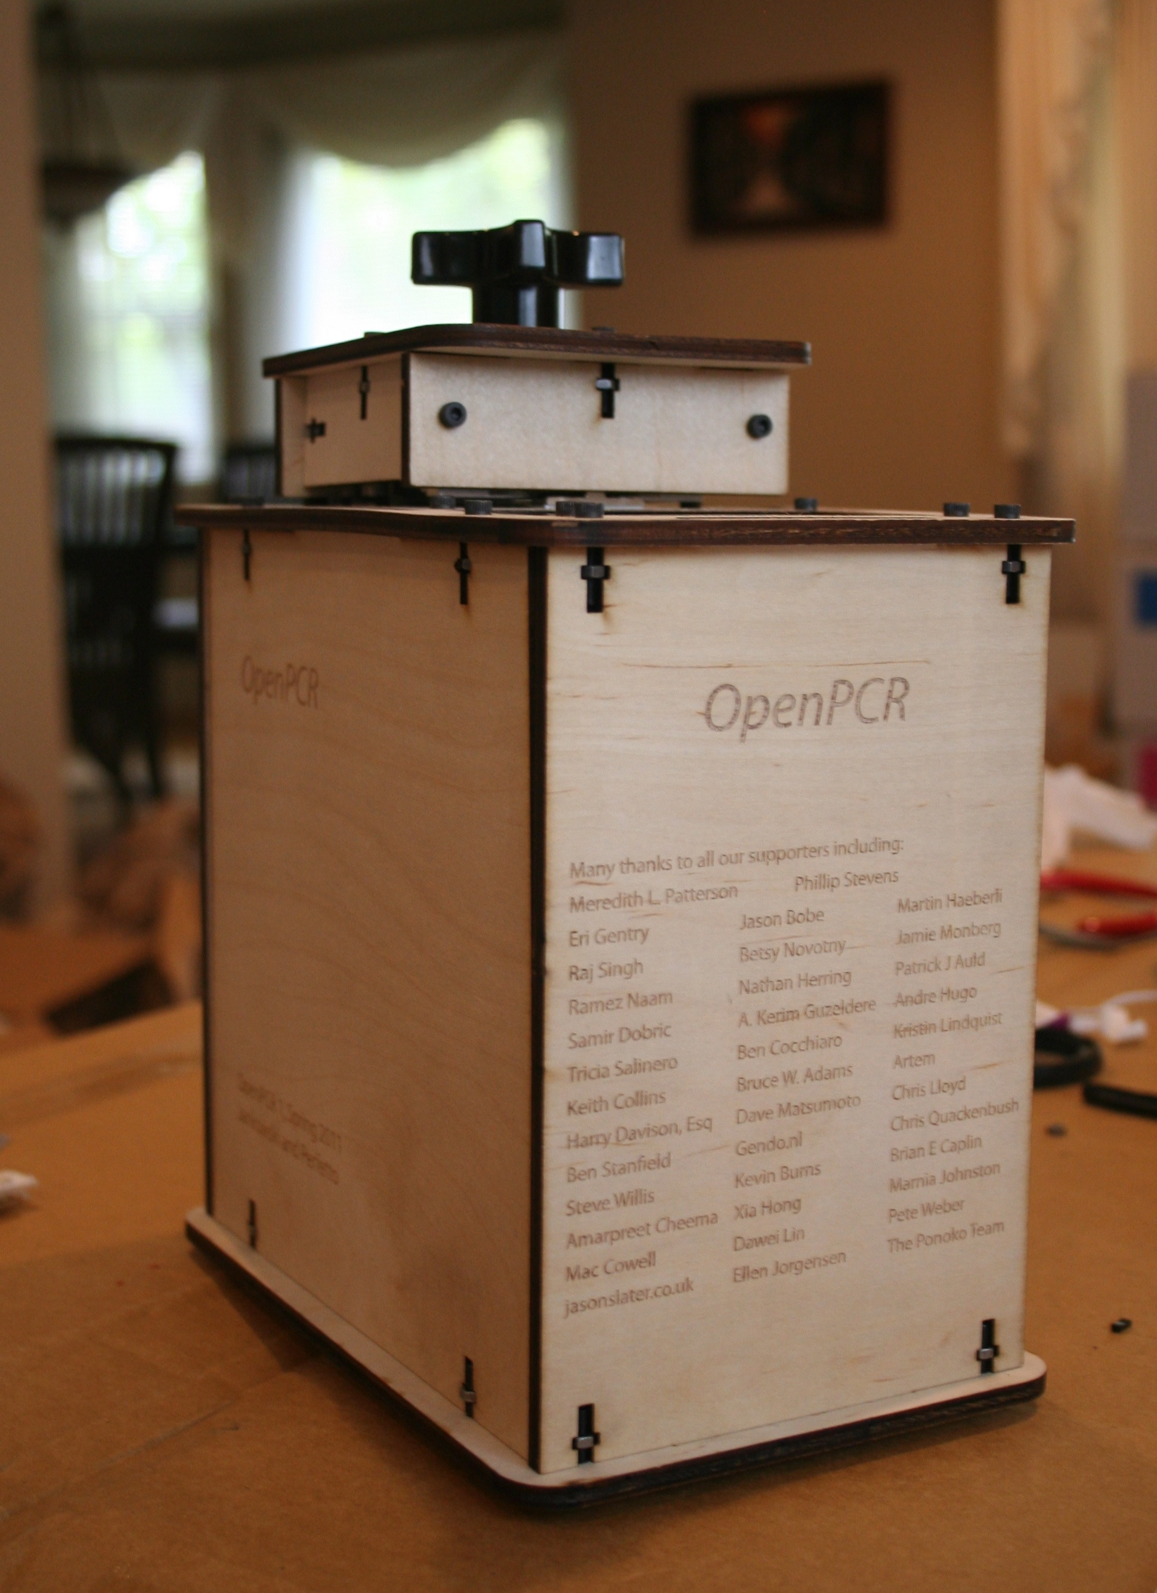
OpenPCR
PCR is a method of copying DNA molecules.
OpenPCR is a project to develop open source hardware, software, and protocols to perform PCR and Real-Time PCR reactions
community dedicated to openness in science and applying the fundamental technologies of PCR to global problems

Slide 40

Open Source Imaging (MRI)
Open Source Magnetic Resonance Imaging
Opencore NMR is an open-source toolkit for implementing an NMR spectrometer
LukasW log: “COSI Magnet: Single ring results look fantastic! Less than 2% difference to simulation”

Slide 41

Hackteria.org
Collection of DIY Biology, Open Source Art Projects that use Biology, LifeSciences, Biotechnology.

Slide 42

Digital Naturalism
Investigates the role that Digital Media can play for Biological Field Work
Uphold the naturalistic values of wilderness exploration, while investigating the new abilities offered by digital technology
Theory and Guidelines by Andrew Quitmeyer

Slide 43
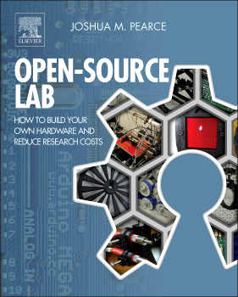
MOST research group
Joshua Pearce Research Group at Michigan Tech in Open Sustainability Technology (MOST) focuses on open and applied sustainability
Exploring the way solar photovoltaic technology can sustainably power our society

Slide 44

Libre Space Foundation
Non-profit for Open Source HW & SW in Space
UPSat: first open hardware satellite bound to be launched to the International Space Station in late December
SatNOGS: open source hardware satellite ground-station network

Slide 45
Section:
BONUS SLIDES

Slide 46

What about silicon?
LowRISC:
“lowRISC is producing fully open hardware systems. From the processor core to the development board, our goal is to create a completely open computing eco-system”

Slide 47

Novena laptop
Created by Bunnie & xobs!
  Chumby! Hacking the X-Box! Amazing reverse engineers
  The Exploration and Exploitation of an SD Memory Card
100% Open Source Hardware laptop
Quad-core 1.2GHz Freescale ARM CPU
FPGA! 4GB RAM, WiFi, 2x Ethernet, SSD

Slide 48


Lulzbot 3-D Printers
100% Open Source
Hardware & Software
FSF Respects Your Freedom certified

Slide 49
Thanks
Suggestions from the OSHWA mailing list:
  Abram Connelly
  Andrew Plumb
  Andrew Quitmeyer
  Eleftherios Kosmas
  Marcin Jakubowski
Jeena Lee for first telling me of Portland Science Hack Day
Max Ogden for asking me to speak

Slide 50
Contact info
email: Drew Fustini <drew@oshpark.com>
SMS: +1-773-710-7131
twitter: @OSHPark / @pdp7
OSH Park Blog

