Slide 1




Drew Fustini
drew@beagleboard.org
Twitter: @pdp7
Slides: https://github.com/pdp7/talks/blob/master/rv-munich.pdf
Linux on RISC-V
with open source hardware and open source FPGA tools
Munich RISC-V Meetup (April 29th, 2020)

Slide 2

Statement of Principles:
Hardware whose design is made publicly available so that anyone can study, modify, distribute, make, and sell the design or hardware based on that design

Slide 3



Documentation required for electronics:
Schematics Board Layout
Editable source files for CAD software such as KiCad or EAGLE
Bill of Materials (BoM)
Not strict requirement, but best practice is for all components available from distributors in low quantity

Slide 4

36c3 talk: Linux on Open Source Hardware with Open Source chip design

Slide 5
Section:
Linux-capable RISC-V chips

Slide 6

SiFive: Linux on RISC-V
FOSDEM 2018 talk
  YouTube: “Igniting the Open Hardware Ecosystem with RISC-V: SiFive's Freedom U500 is the World's First Linux-capable Open Source SoC Platform”
  Interview with Palmer Dabbelt of SiFive

Slide 7

SiFive: Linux on RISC-V
HiFive Unleashed on Crowd Supply

Slide 8

  RISC-V Summit 2019: Linux on RISC V Fedora and Firmware Status Update
    https://www.youtube.com/watch?v=WC6e3g8uWdk
    Wei Fu – Software Engineer, Red Hat

Slide 9


Slide 10


Slide 11


Slide 12
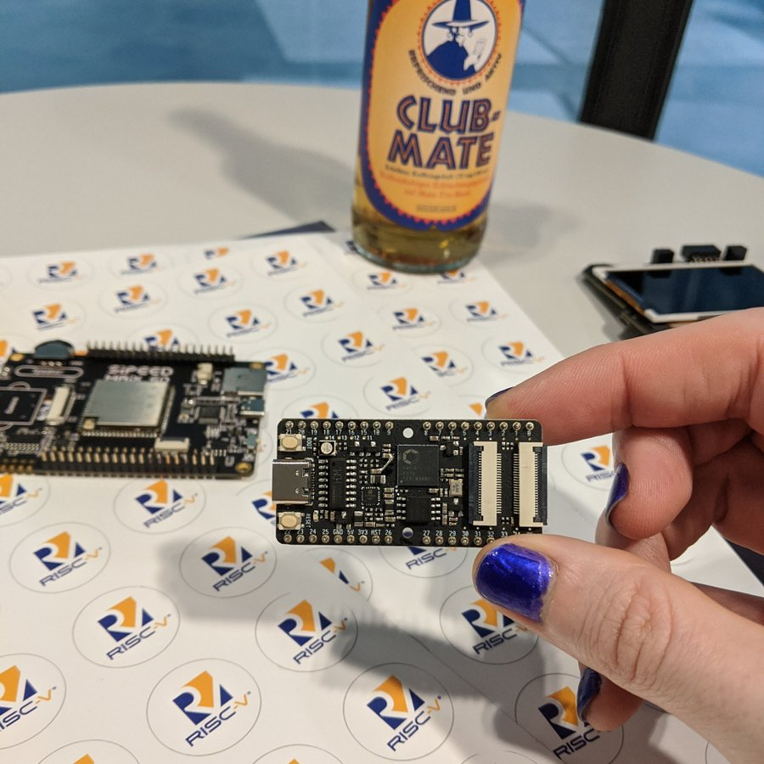

Slide 13


Slide 14
Linux now runs the low cost Kendryte K210 RISC-V processor
  dual core 64-bit RISC-V at 400MHz with 8MB SRAM
  Sipeed MAix BiT for RISC-V is only $13!
  Damien Le Moal at Linux Plumbers Conf: RISC-V NOMMU and M-mode Linux
    youtube.com/watch?v=ycG592N9EMA&t=10394
    jump to 2h 53m
  Many RISC-V Improvements Ready For Linux 5.5: M-Mode, SECCOMP, Other Features
  How to Build & Run Linux on Kendryte K210 RISC-V NOMMU Processor

Slide 15


Slide 16
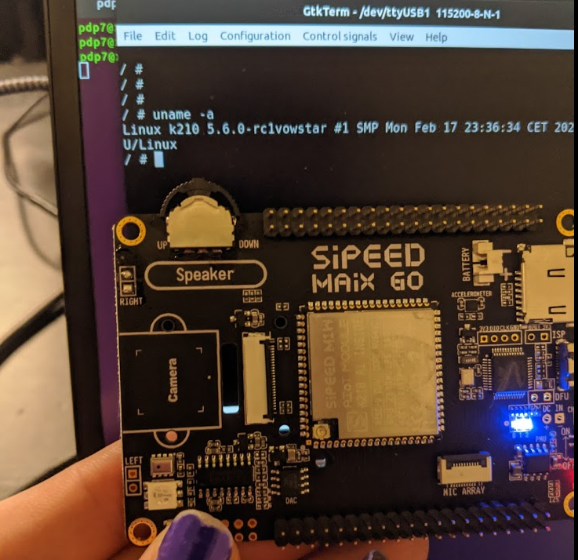

Slide 17
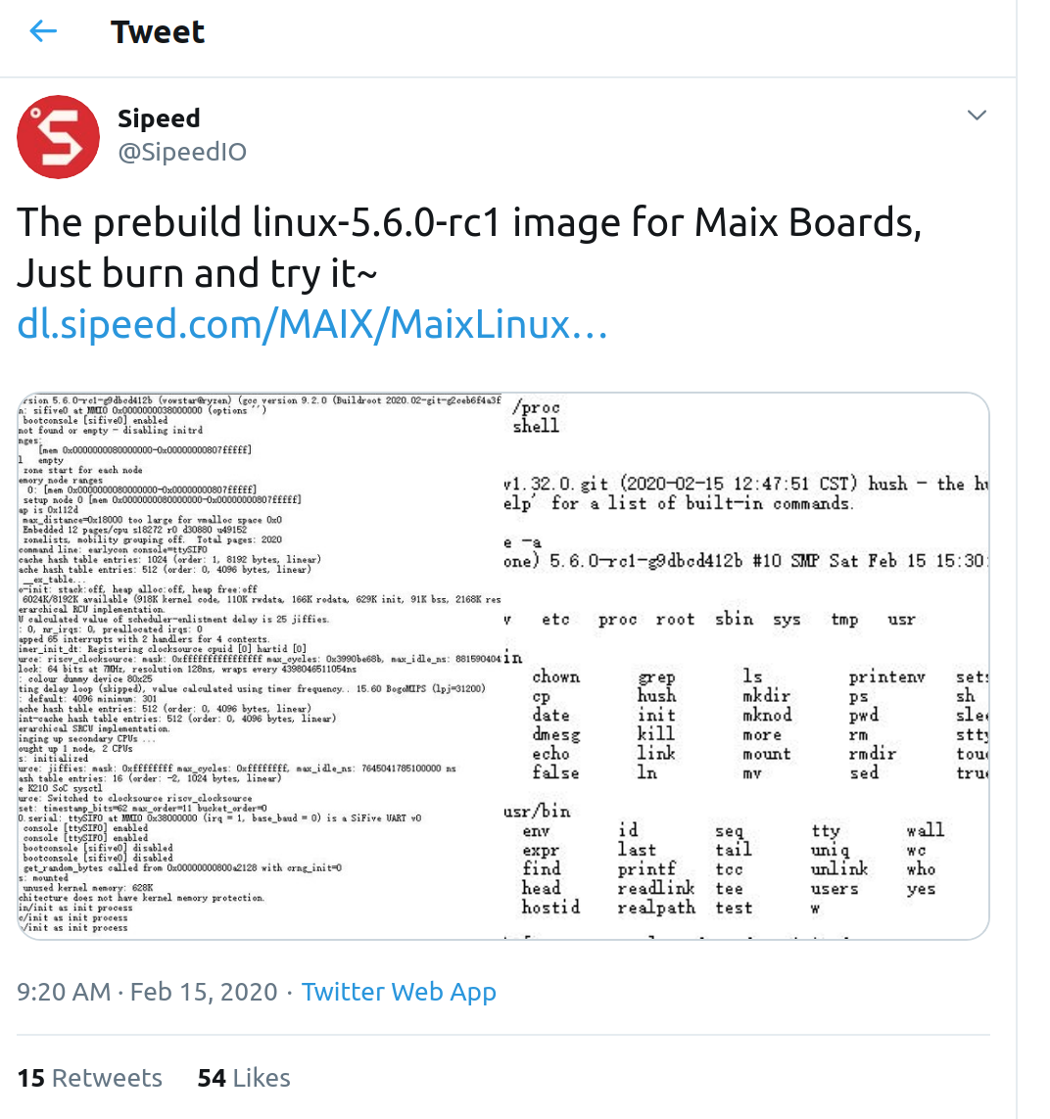
Sipeed now has prebuilt Linux 5.6
  https://twitter.com/SipeedIO/status/1228594799675990016/

Slide 18
Coming in 2020
Microchip PolarFire SoC FPGA
  Hard RISC-V with FPGA fabric… like the Xilinx Zync for ARM
OpenHW Core-V SoC which is similar to NXP iMX with RISC-V instead of ARM!
  “OpenHW Group Unveils CORE-V Chassis SoC Project, Building on PULP Project IP”

Slide 19

Coming in 2020?

Slide 20
Section:
Open Source FPGA tools
Slides: https://github.com/pdp7/talks/blob/master/rv-munich.pdf

Slide 21

Keynote at Hackday Supercon 2019 by
Dr. Megan Wachs of SiFive
“RISC-V and FPGAs: Open Source Hardware Hacking”
  https://www.youtube.com/watch?v=vCG5_nxm2G4

Slide 22


Slide 23

Open Source toolchains for FPGAs
Project IceStorm for Lattice iCE40
    “A Free and Open Source Verilog-to-Bitstream Flow for iCE40 FPGAs” by Claire Wolf (oe1cxw) at 32c3

Slide 24

Open Source toolchains for FPGAs
Project Trellis for Lattice ECP5
  “Project Trellis and nextpnr FOSS FPGA flow for the Lattice ECP5” - David Shah (@fpga_dave)
    youtube.com/watch?v=0se7kNes3EU

Slide 25

Open Source toolchains for FPGAs
Project X-Ray & SymbiFlow for Xilinix Series 7
  Timothy ‘mithro’ Ansell: “Xilinx Series 7 FPGAs Now Have a Fully Open Source Toolchain!” (almost)
    youtube.com/watch?v=EHePto95qoE

Slide 26


Open Source and FPGAs
Hackspace Magazine column about how about open source FPGA tools developed by Claire Wolf (oe1cxw), David Shah and others have made FPGAs more accessible than ever before to makers and hackers:
  hackspace.raspberrypi.org/issues/26/

Slide 27
Section:
Linux on the Hackaday Badge
Slides: https://github.com/pdp7/talks/blob/master/rv-munich.pdf

Slide 28

Hackaday 2019 Supercon badge
RISC-V “soft” core on ECP5 FPGA
Gigantic FPGA In A Game Boy Form Factor

Slide 29

“Team Linux on Badge”

Slide 30
“Team Linux on Badge”
Blog post: Hackaday Supercon badge boots Linux using SDRAM cartridge
  https://blog.oshpark.com/2019/12/20/boot-linux-on-this-hackaday-supercon-badge-with-this-sdram-cartridge/
Michael Welling (@QwertyEmedded), Tim Ansell (@mithro), Sean Cross (@xobs), Jacob Creedon (@jacobcreedon)
First attempt: use the built-in 16MB SRAM…
no luck :(
  (though xobs now might have a way to do it)

Slide 31

“Team Linux on Badge”
Second attempt:
  Jacob Creedon designed an a cartridge board that adds 32MB of SDRAM to the Hackaday Supercon badge… before the event!

Slide 32

“Team Linux on Badge”
Second attempt:
  Jacob Creedon designed an a cartridge board that adds 32MB of SDRAM to the Hackaday Supercon badge… before the event!

Slide 33


Slide 34
Designing Hardware in Python?
Yes!
“Using Python for creating hardware to record FOSS conferences!”
Tim “mithro” Ansell
youtube.com/watch?v=MkVX_mh5dOU

Slide 35


Slide 36


Slide 37


Slide 38
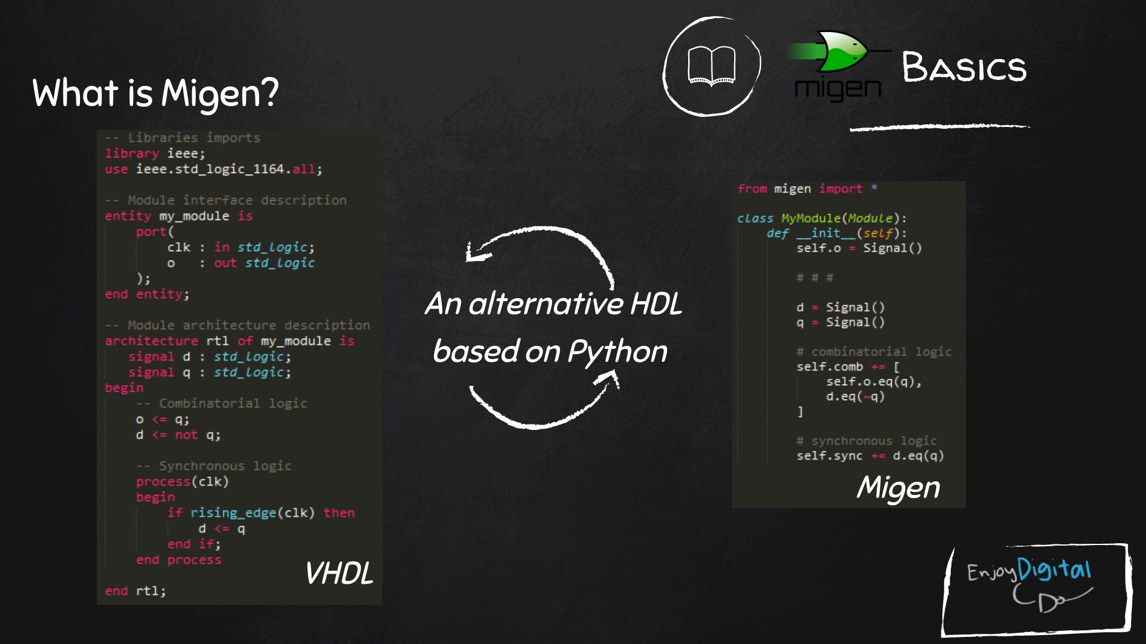
Slides: https://github.com/litex-hub/fpga_101

Slide 39
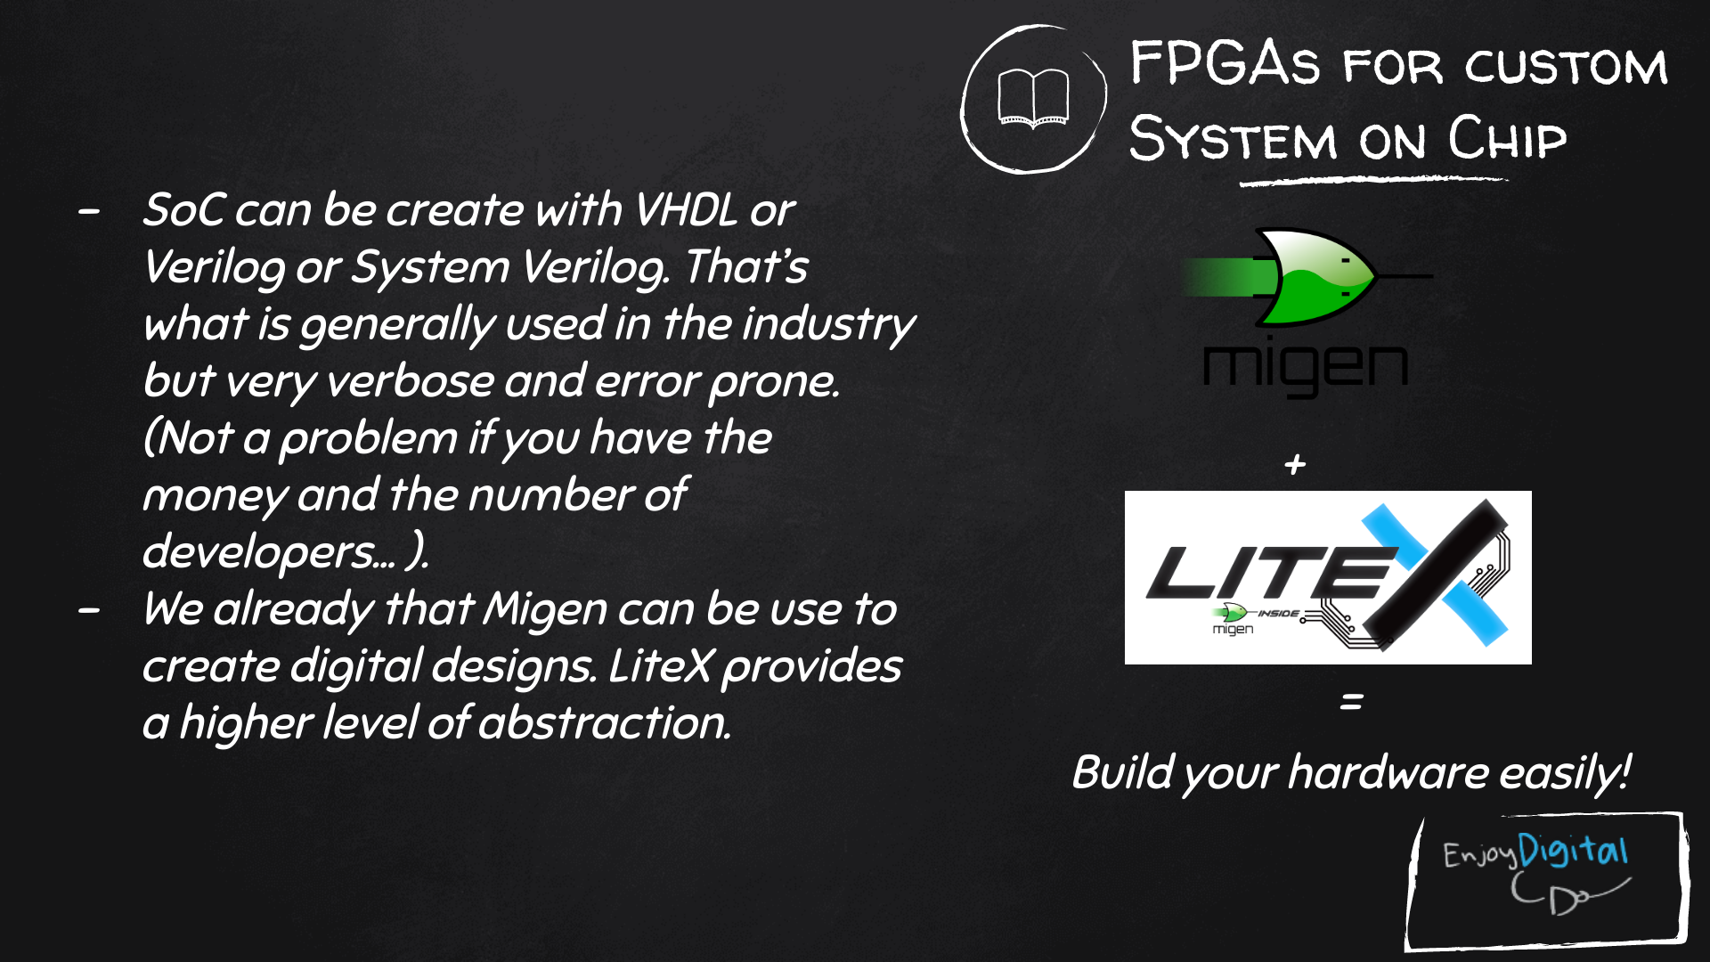
Slides: https://github.com/litex-hub/fpga_101

Slide 40

LiteX used to build cores, create SoCs and full FPGA designs.
LiteX is based on Migen
Migen lets you do FPGA design in Python!
https://github.com/enjoy-digital/litex

Slide 41
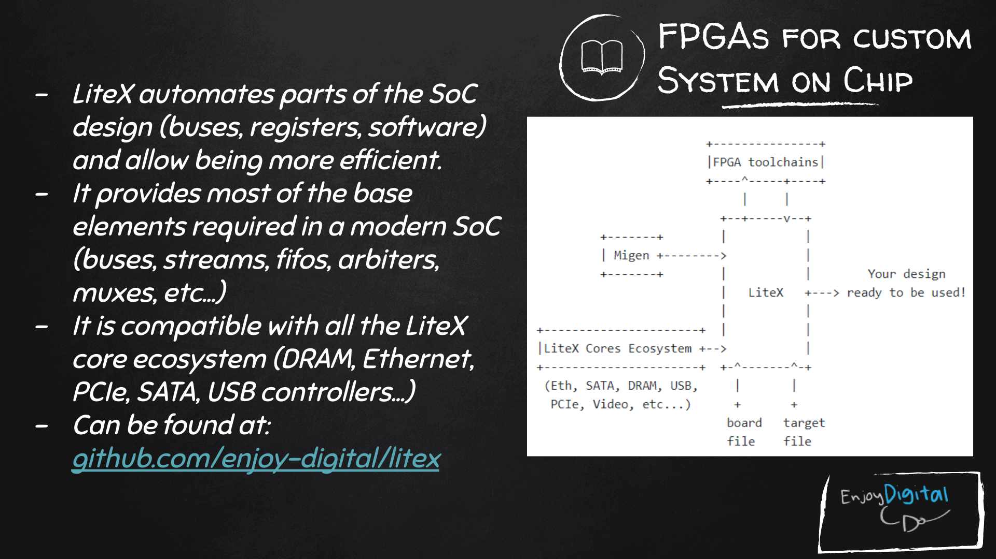
Slides: https://github.com/litex-hub/fpga_101
https://github.com/litex-hub/fpga_101

Slide 42


Slide 43

Linux on LiteX-VexRiscv
VexRiscv: 32-bit Linux Capable RISC-V CPU
SoC built using VexRiscv core and LiteX moduels like LiteDRAM, LiteEth, LiteSDCard, ...
  github.com/litex-hub/linux-on-litex-vexriscv

Slide 44


Slide 45

upstream support for Hackaday Supercon badge:
  https://github.com/litex-hub/litex-boards/pull/31

Slide 46

upstream support for Hackaday Supercon badge:
  https://github.com/litex-hub/litex-boards/pull/31

Slide 47

upstream support for Hackaday Supercon badge:
  https://github.com/litex-hub/litex-boards/pull/31

Slide 48


Slide 49


Slide 50


Slide 51


Slide 52
Opened GitHub issue:
  optimize performance on Hackaday Badge #35
    https://github.com/litex-hub/litex-boards/issues/35
Now 10x faster!
  https://asciinema.org/a/Pcm3vd1BEdEKY9srYX6MsNfCE
  Thanks to enjoy-digital

Slide 53


Slide 54


Slide 55


Slide 56


Slide 57

Greg Davill got the screen working with LiteVideo!
  twitter.com/GregDavill/status/1231082623633543168

Slide 58
Open Source boards with
ECP5 FPGA
(can run Linux)
Slides: https://github.com/pdp7/talks/blob/master/rv-munich.pdf

Slide 59

Open Source Hardware board with Lattice ECP5 FPGA with open RISC-V “soft” CPU:
  David Shah's Trellis board (Ultimate ECP5 Board)
  https://github.com/daveshah1/TrellisBoard

Slide 60
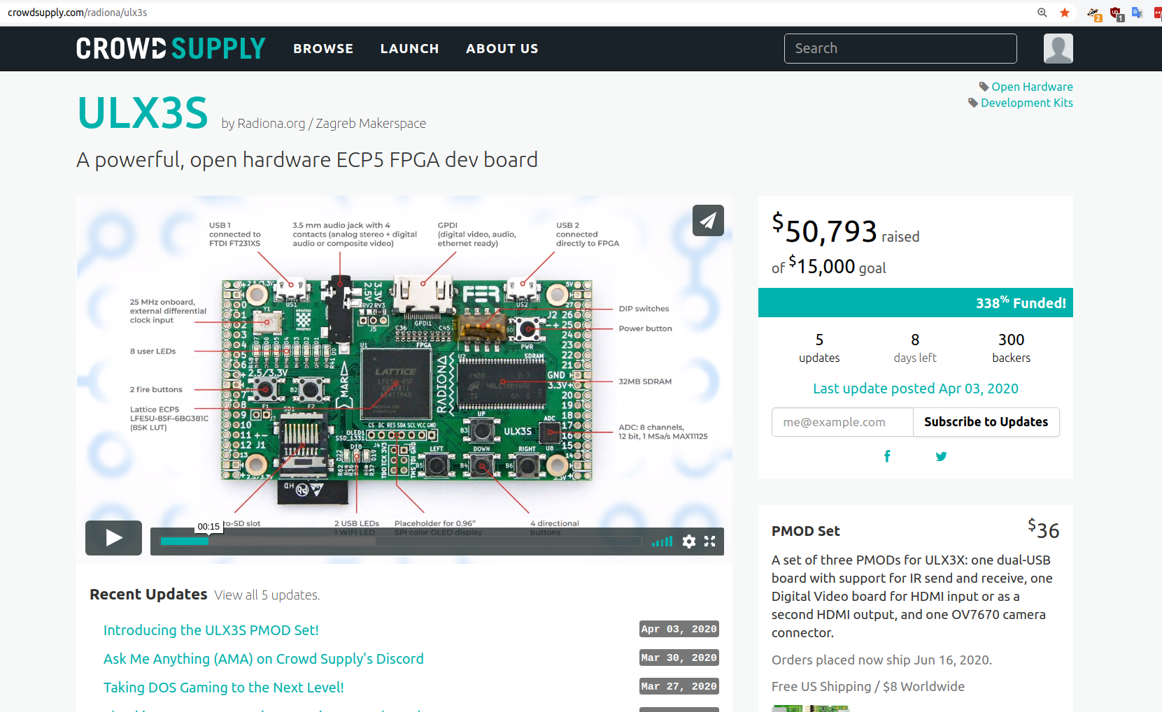
Open Source ECP5 boards
Radiona.org ULX3S
    https://www.crowdsupply.com/radiona/ulx3s

Slide 61

Open Source ECP5 boards
Lattice ECP5 FPGA in Adafruit Feather form factor and 128MB DDR RAM:
  Orange Crab by Greg Davill
    https://github.com/gregdavill/OrangeCrab
    https://groupgets.com/campaigns/710-orangecrab

Slide 62


Slide 63
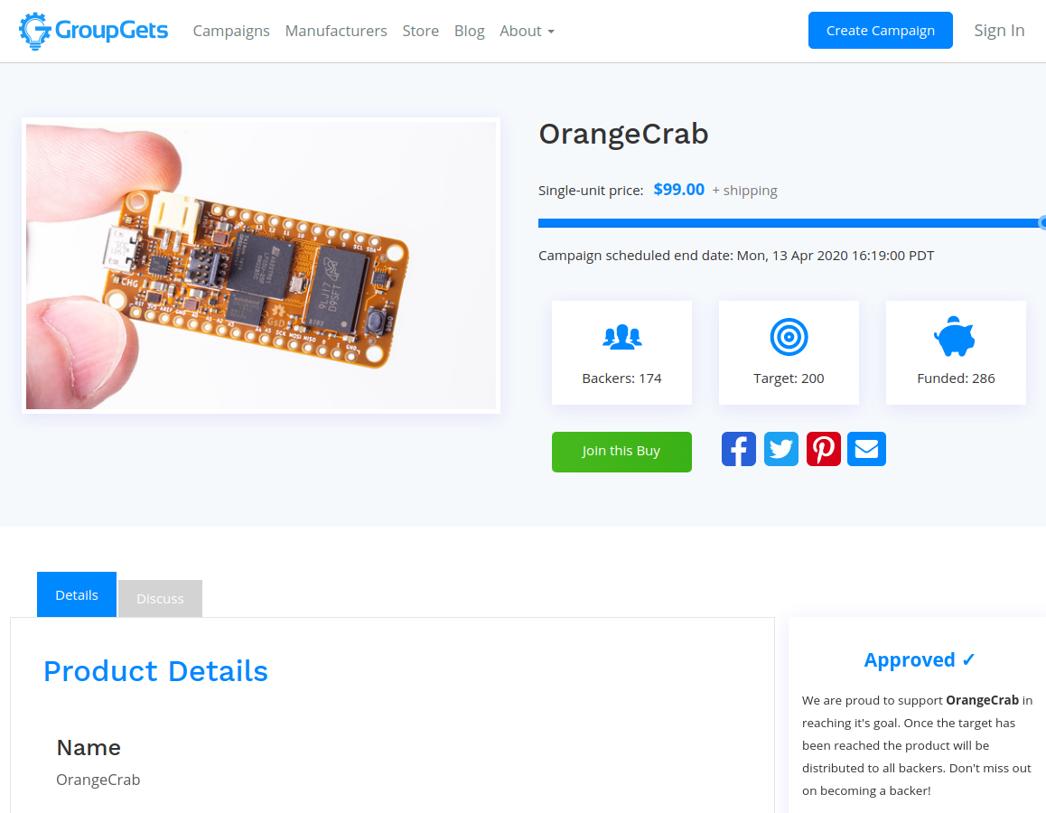
Open Source ECP5 boards
Orange Crab by Greg Davill
    https://groupgets.com/campaigns/710-orangecrab

Slide 64

Want to learn FPGAs? Try Fomu!
workshop.fomu.im
crowdsupply.com/sutajio-kosagi/fomu
Fits in USB port
RGB LED
Learn:
  MicroPython
  Verilog
  LiteX

Slide 65

No hardware? Try Renode!
https://renode.io/

Slide 66
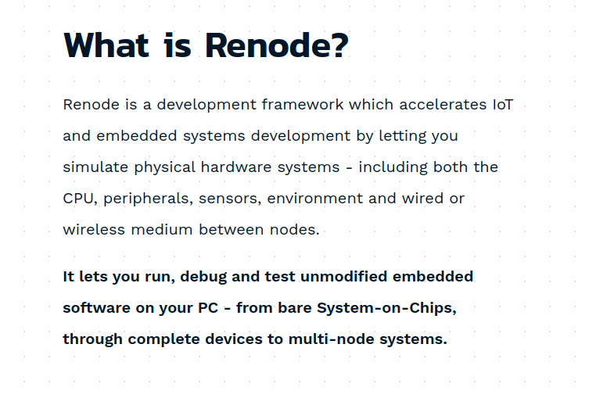
No hardware? Try Renode!
https://renode.io/

Slide 67
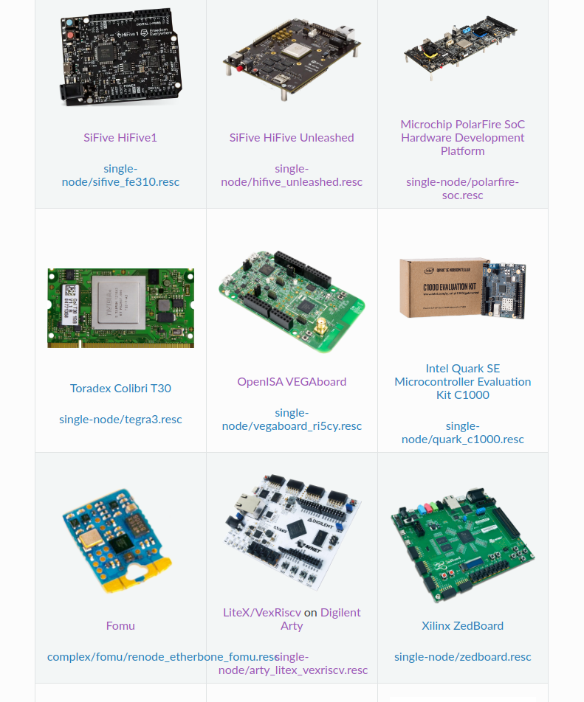

Slide 68
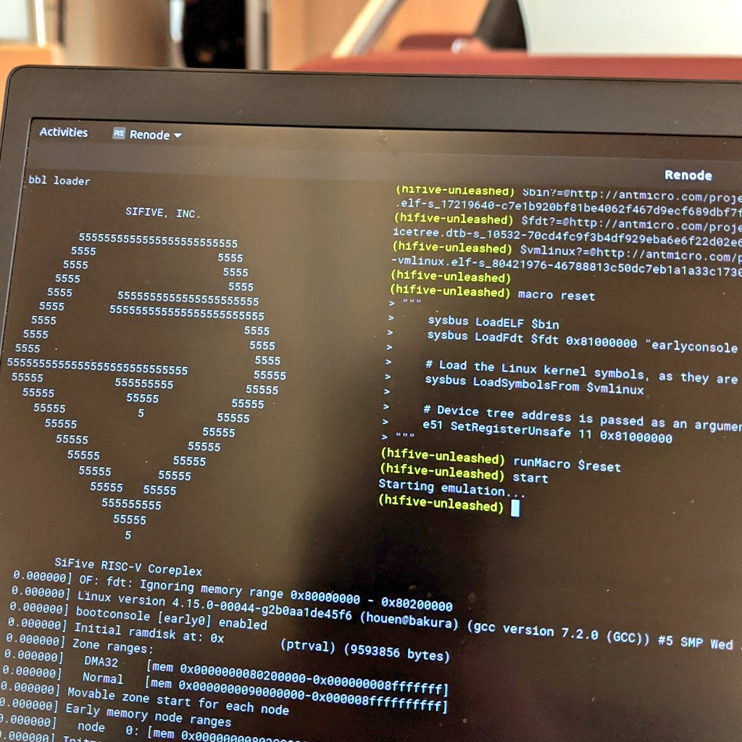

Slide 69

Become a
Slides:
github.com/pdp7/talks/blob/master/rv-munich.pdf
Contact: @pdp7 || drew@oshpark.com
36c3 talk

