Slide 1




Drew Fustini
BeagleBoard.org Foundation
drew@beagleboard.org
Twitter: @pdp7
Slides: https://github.com/pdp7/talks/blob/master/rt-summit-2019.pdf
Real-time usage in the
BeagleBoard.org community
Real Time Summit 2019 (Lyon)

Slide 2
  Open Source Hardware designer at OSH Park
    PCB manufacturing service in the USA
    drew@oshpark.com / Twitter: @oshpark
  Member of Board of Directors of BeagleBoard.org Foundation
      drew@beagleboard.org
  Vice President of the Open Source Hardware Association (OSHWA)
      serving as Vice President
      drew@pdp7.com

Slide 3


Open Source Hardware computing for Makers, Educators & Professionals
Developed by BeagleBoard.org Foundation and BeagleBoard.org Community
Manufacturers: element14, GHI, Seeed

Slide 4

BeagleBoard.org released the first BeagleBoard, an affordable, open hardware ARM computer in 2008

Slide 5


Maker focused, Altoids tin sized BeagleBone introduced in 2011

Slide 6


More affordable, more powerful BeagleBone Black in 2013

Slide 7
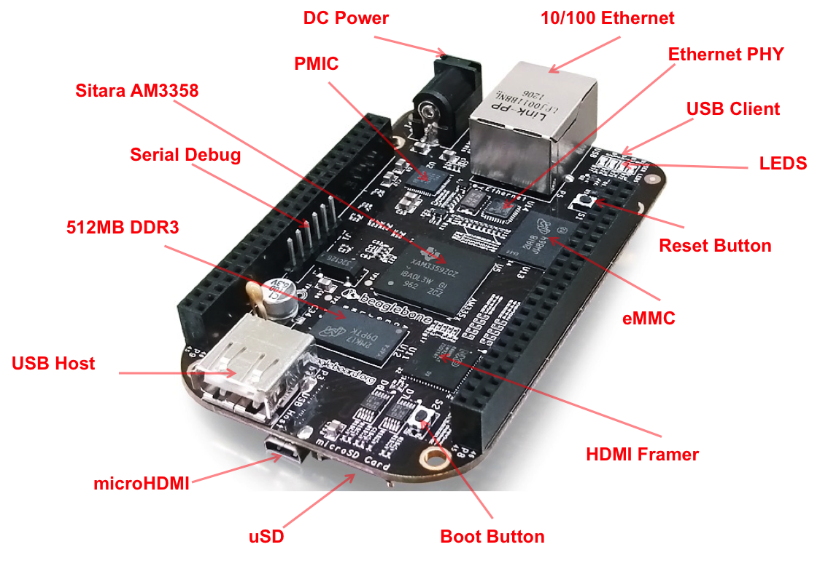
BeagleBone Black

Slide 8

Open Source HardwareBeagleBone derivatives

Slide 9

BeagleBone Blue: complete Linux robotics controller. 4 layer PCB designed in EAGLE.

Slide 10

BeagleBoard.org PocketBeagle

Slide 11
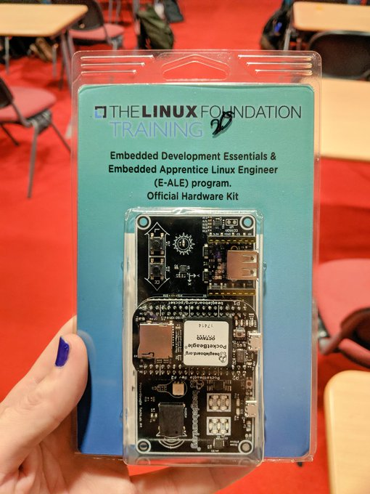
Linux Foundation training
PocketBeagle and TechLab board

Slide 12
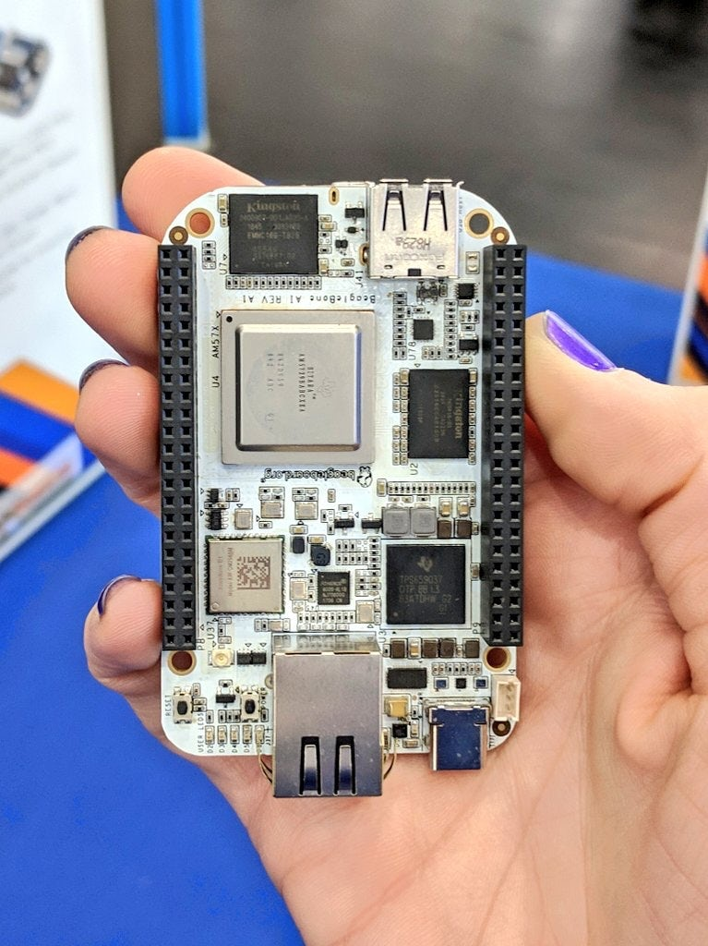
BeagleBone AI: The Fast Track for Embedded Machine Learning

Slide 13
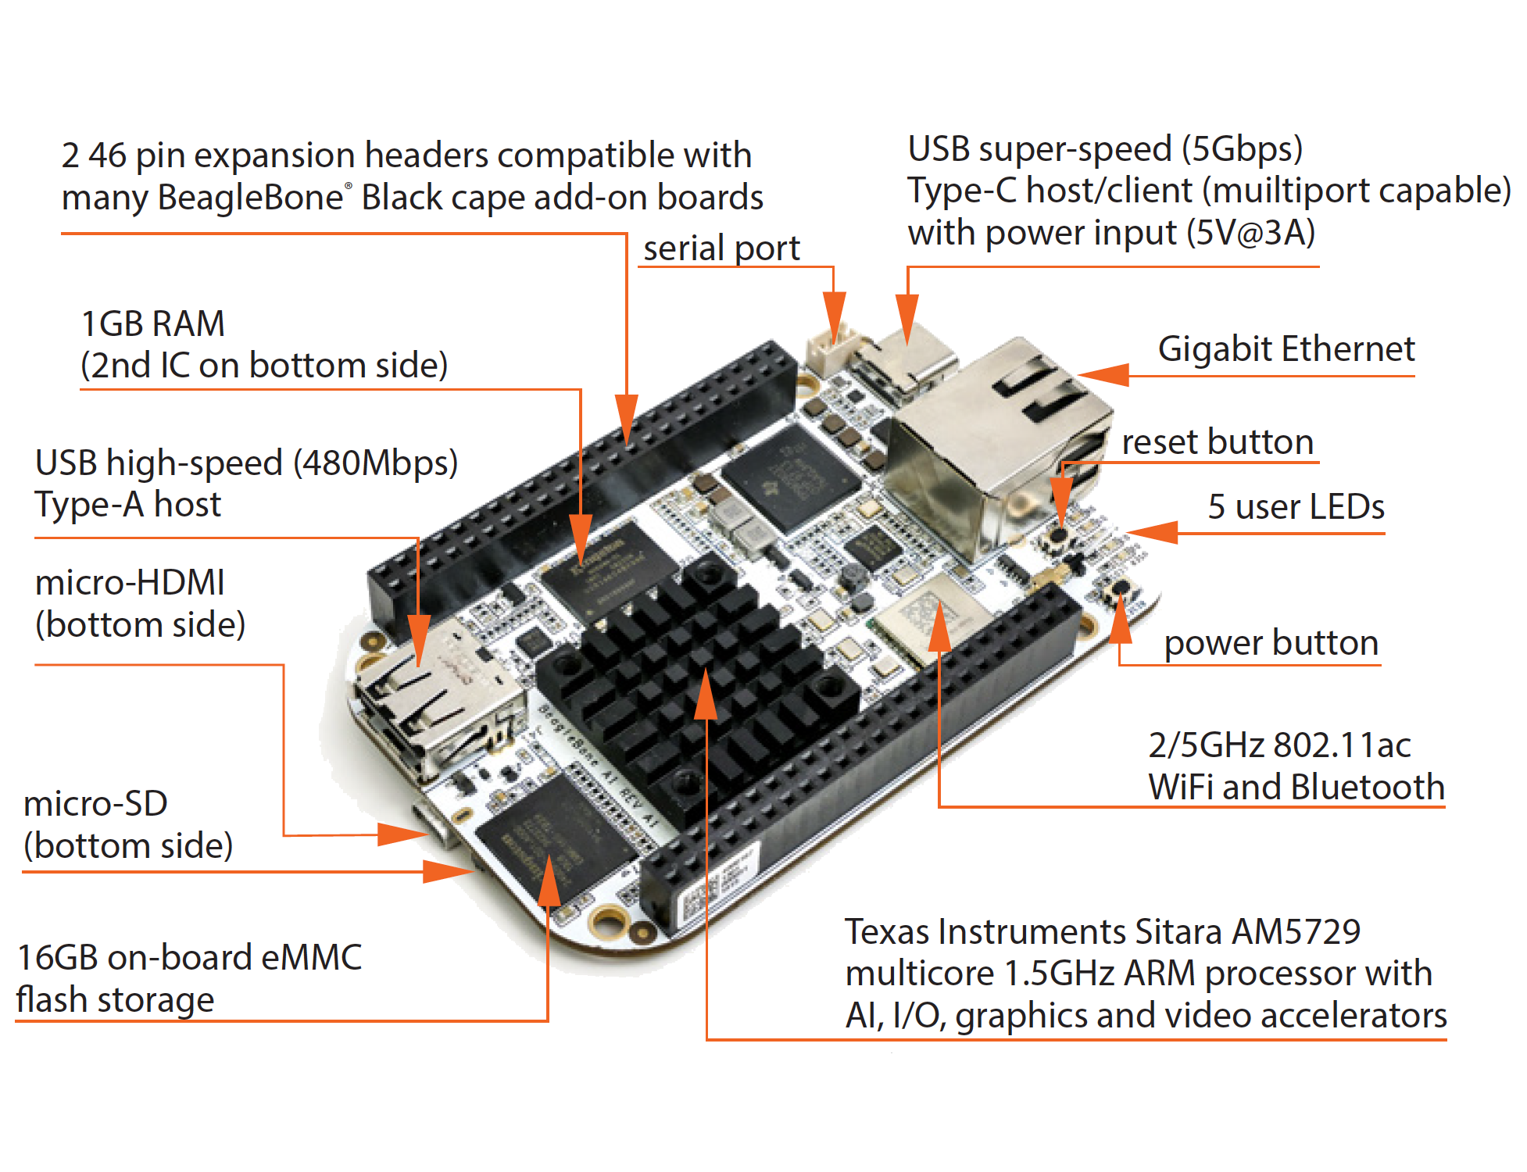
BeagleBone AI: The Fast Track for Embedded Machine Learning

Slide 14
BeagleBone AI
“TI C66x digital-signal-processor (DSP) cores and embedded-vision-engine (EVE) cores supported through an optimized TIDL machine learning OpenCL API with pre-installed tools. Focused on everyday automation in industrial, commercial and home applications.”
Feature highlights:
- BeagleBone Black mechanical and header compatibility
- TI AM5729 SoC: 2x A15 CPU, 2x C66 DSP, 4x M4 MCU, 4x PRU and 4x EVE
- 1GB RAM and 16GB on-board eMMC flash with high-speed interface
- USB type-C for power and superspeed dual-role controller; and USB type-A host
- Gigabit Ethernet, 2.4/5GHz WiFi, and Bluetooth
- microHDMI
- Zero-download out-of-box software experience

Slide 15
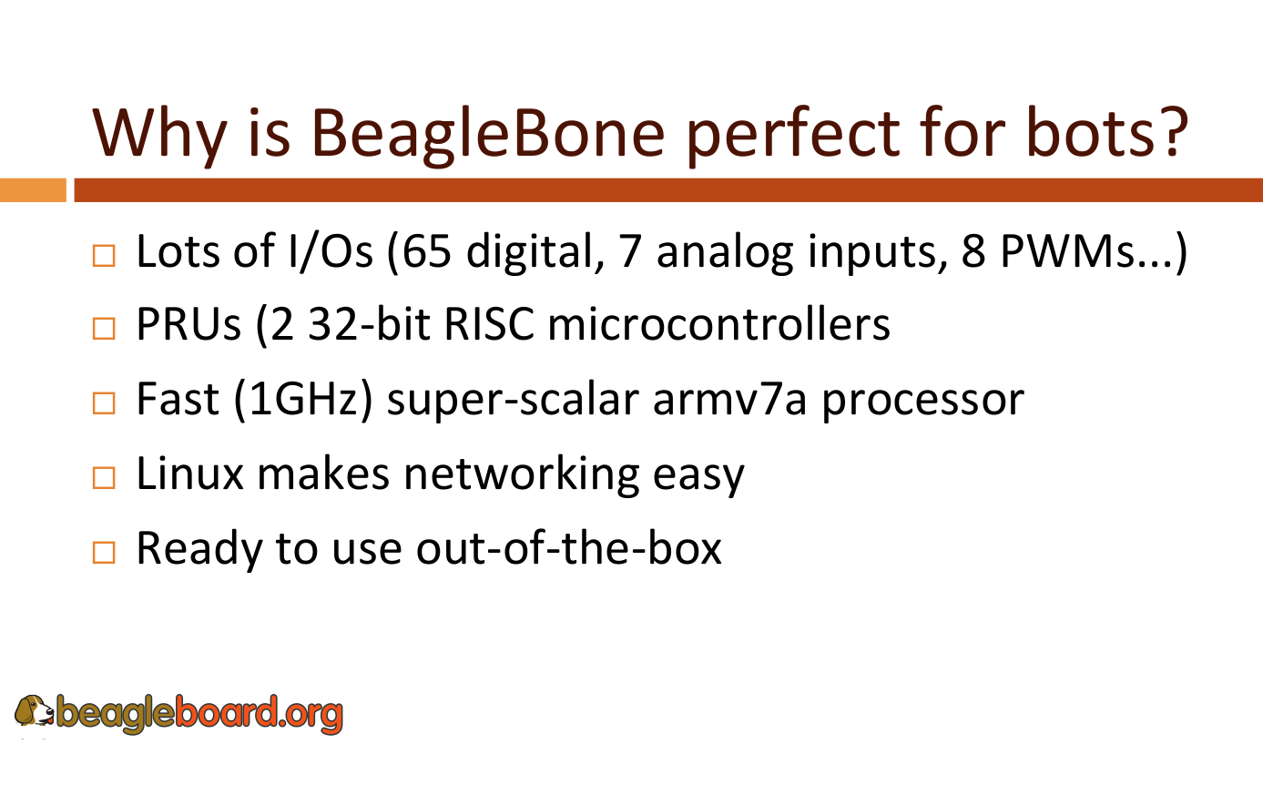

Slide 16
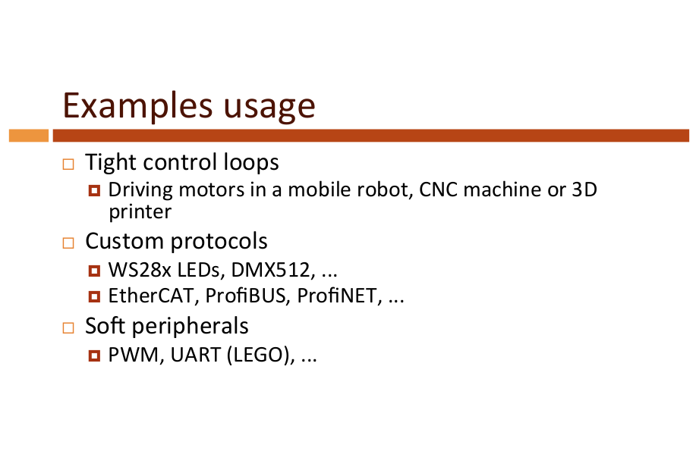

Slide 17
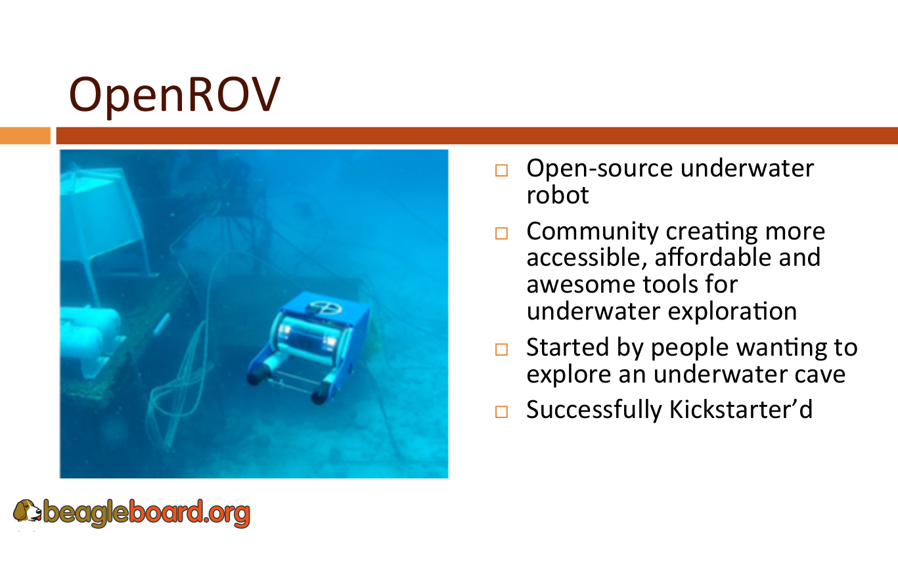

Slide 18
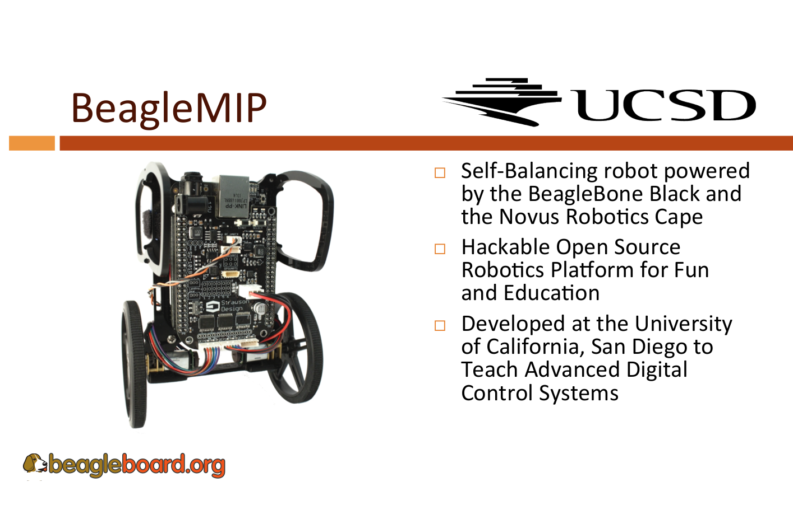

Slide 19


Slide 20
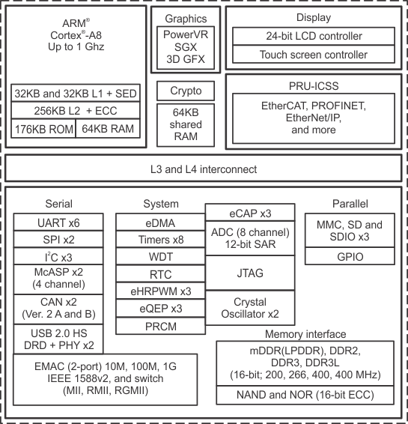
TI Sitara AM3358
(BeagleBone White/Green/Blue, PocketBeagle)

Slide 21
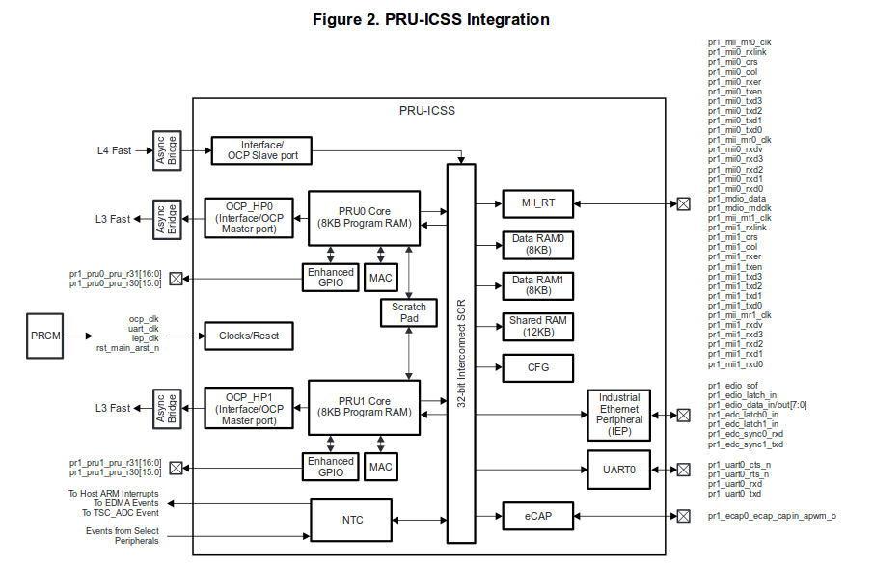

Slide 22
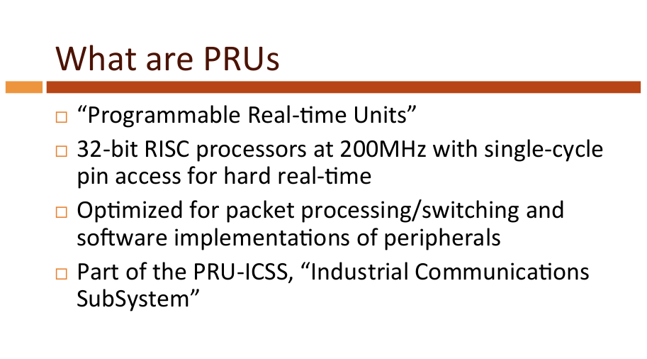

Slide 23
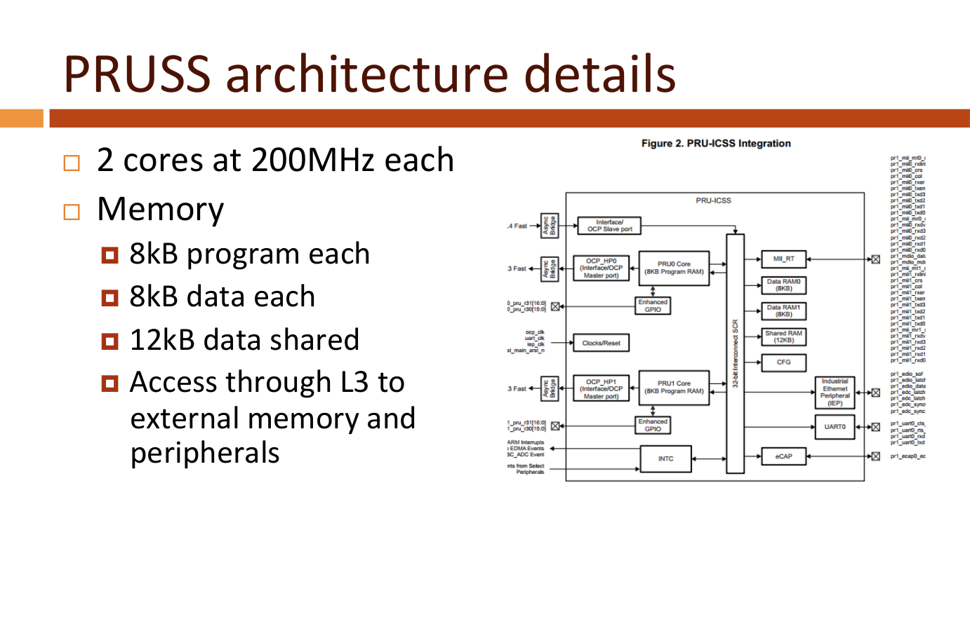

Slide 24
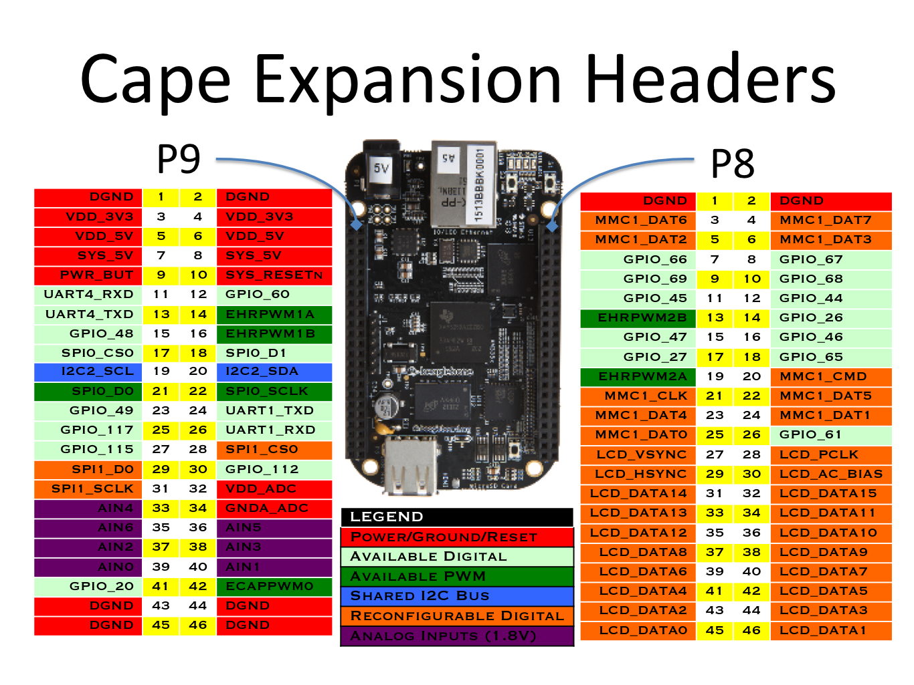

Slide 25
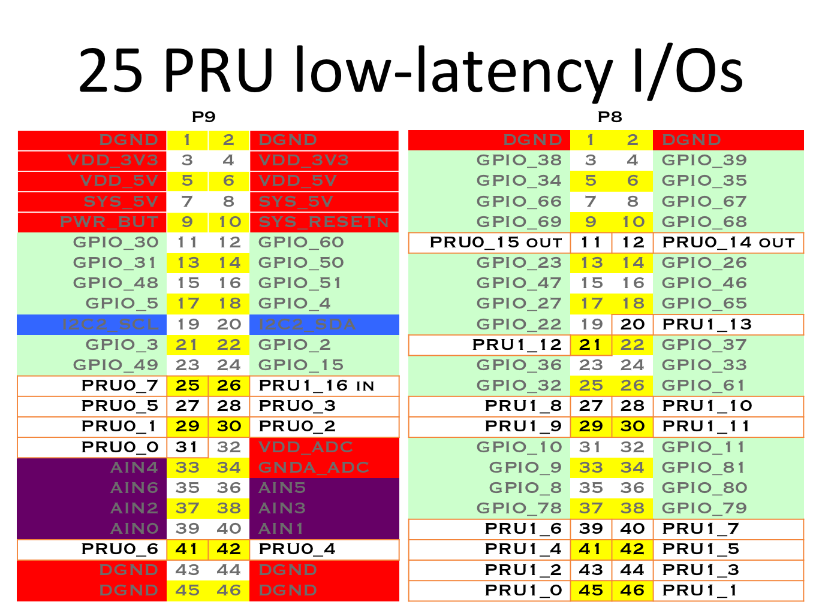

Slide 26
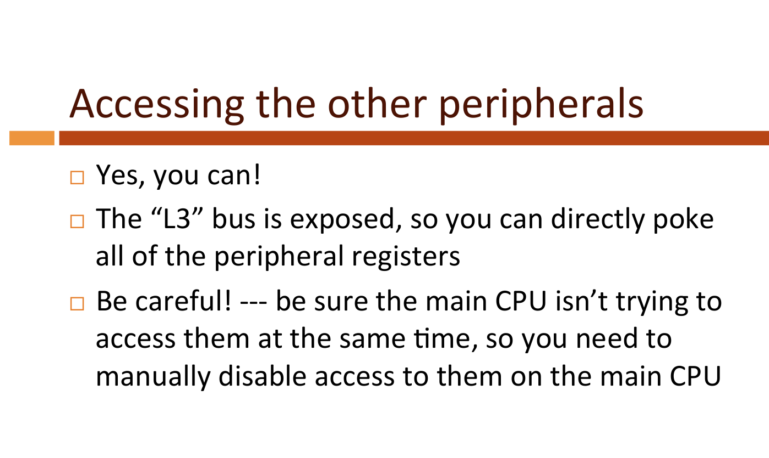

Slide 27
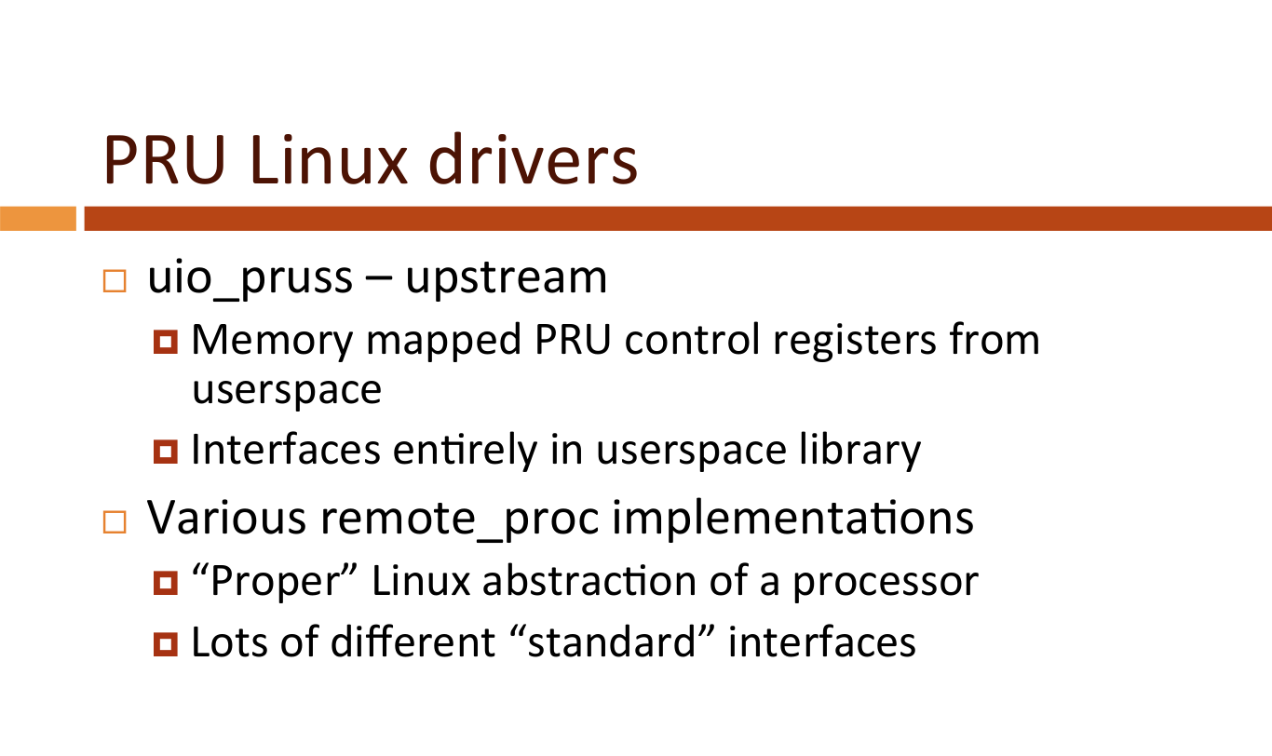

Slide 28



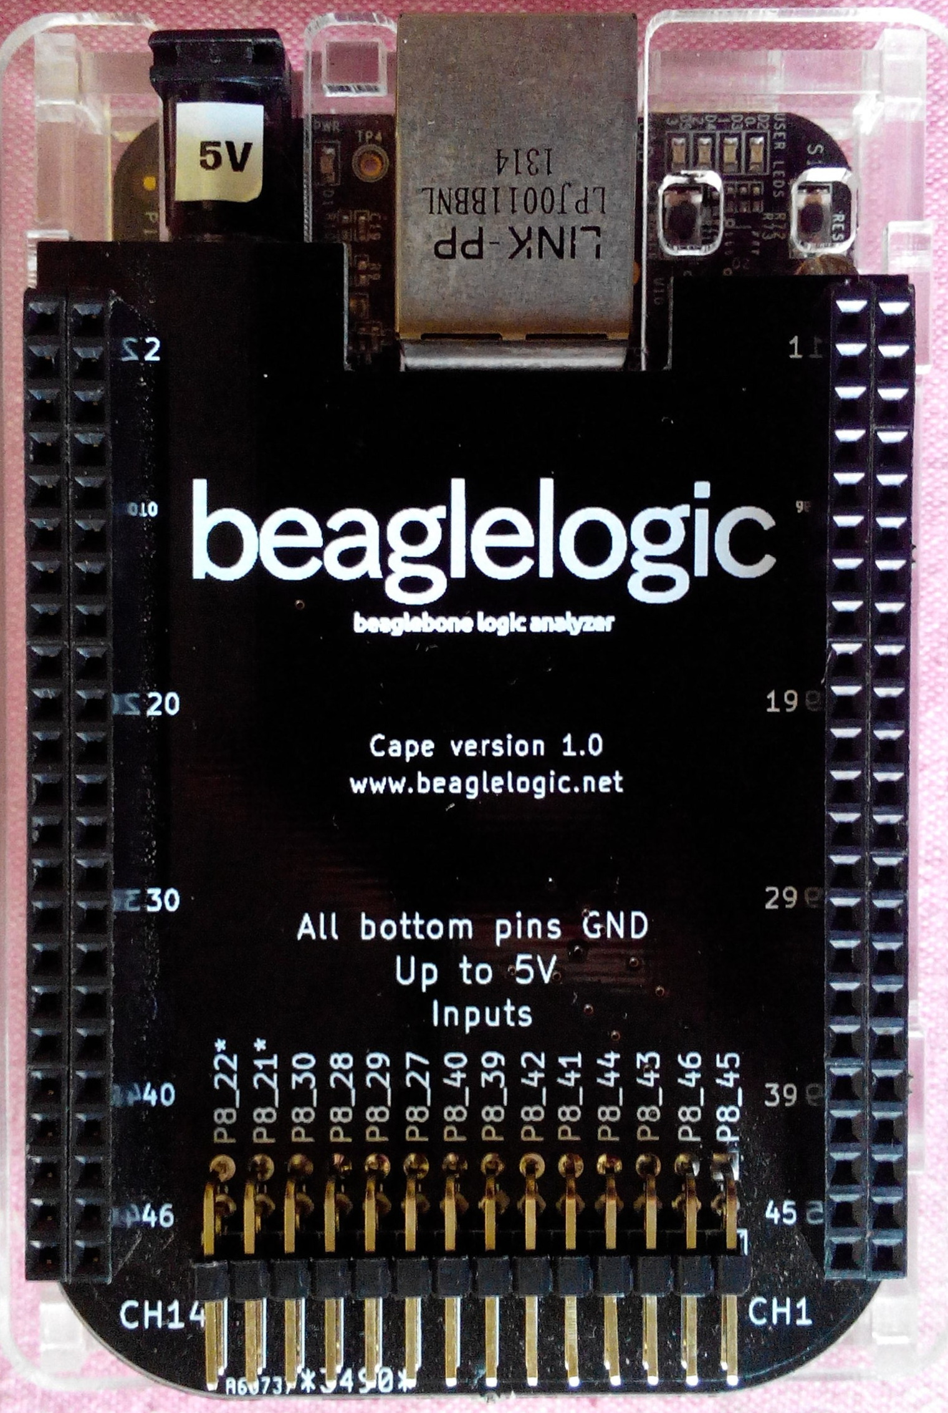
Kumar Abhishek created BeagleLogic for GSoC 2014
BeagleLogic turns BeagleBone into Logic Analyzer
14-channel, 100Msps
Web browser user interface
Video of final presentation

Slide 29
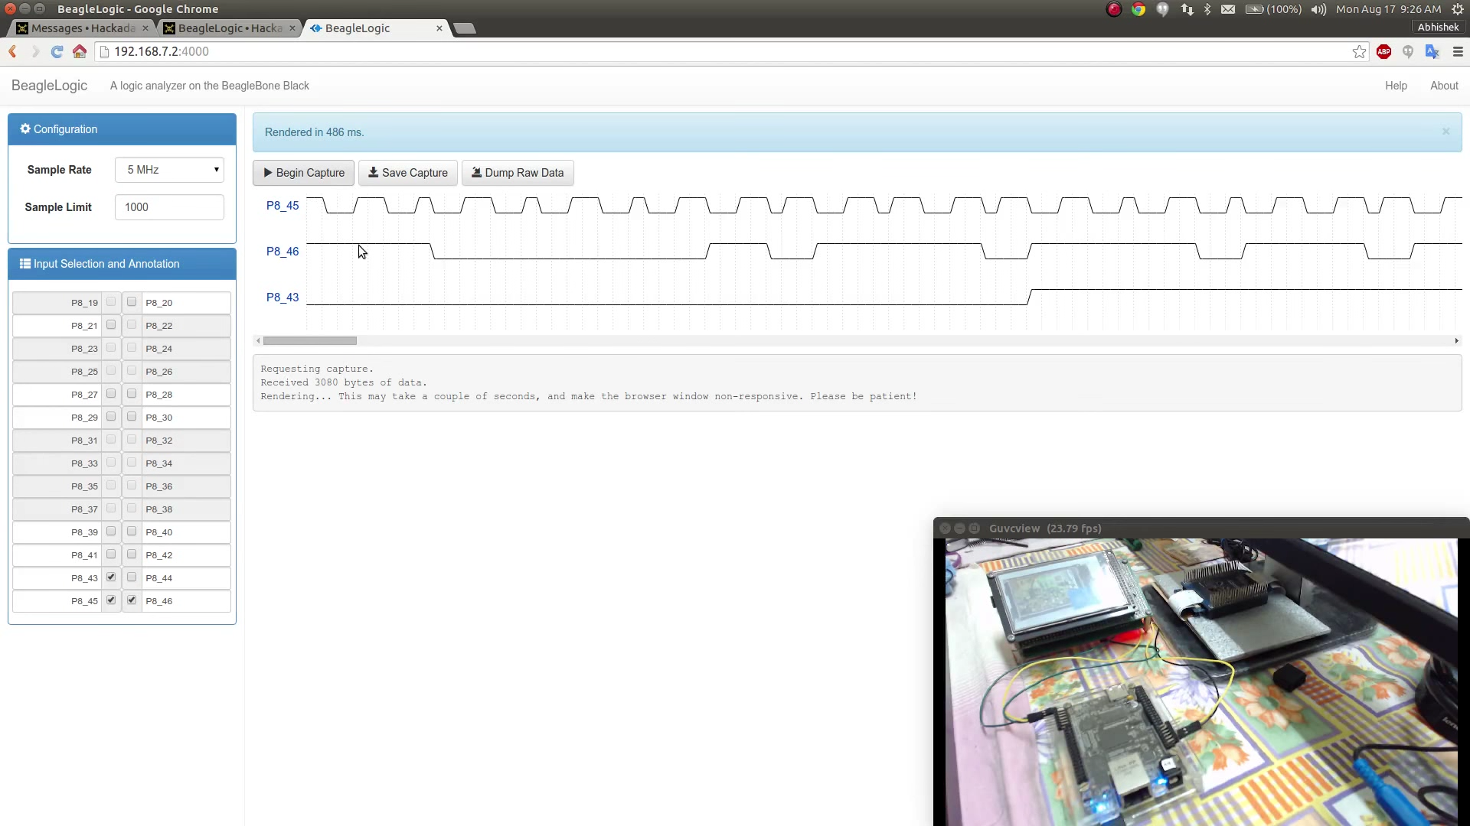
BeagleLogic - Logic Zero to One in 2 minutes

Slide 30
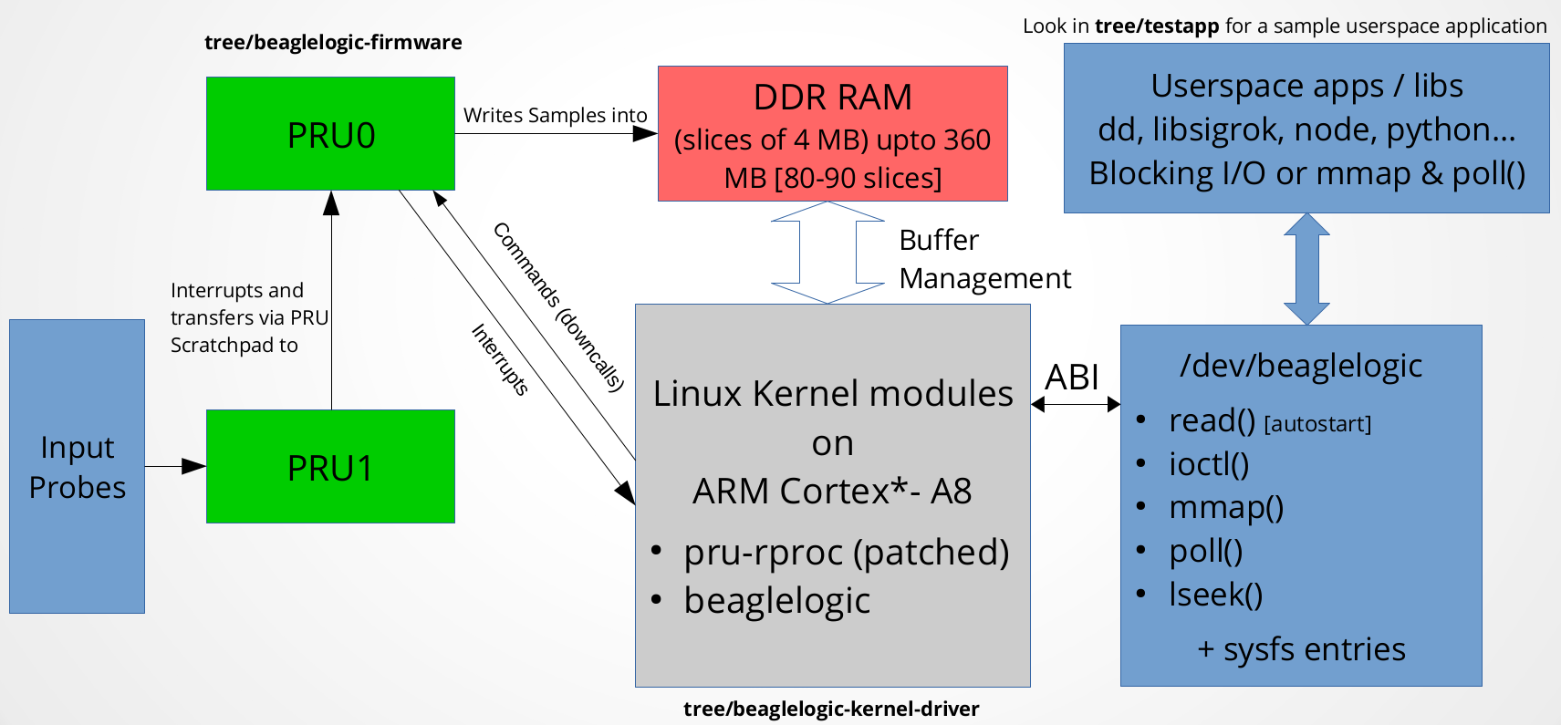
Source: https://hackaday.io/project/4395-beaglelogic

Slide 31
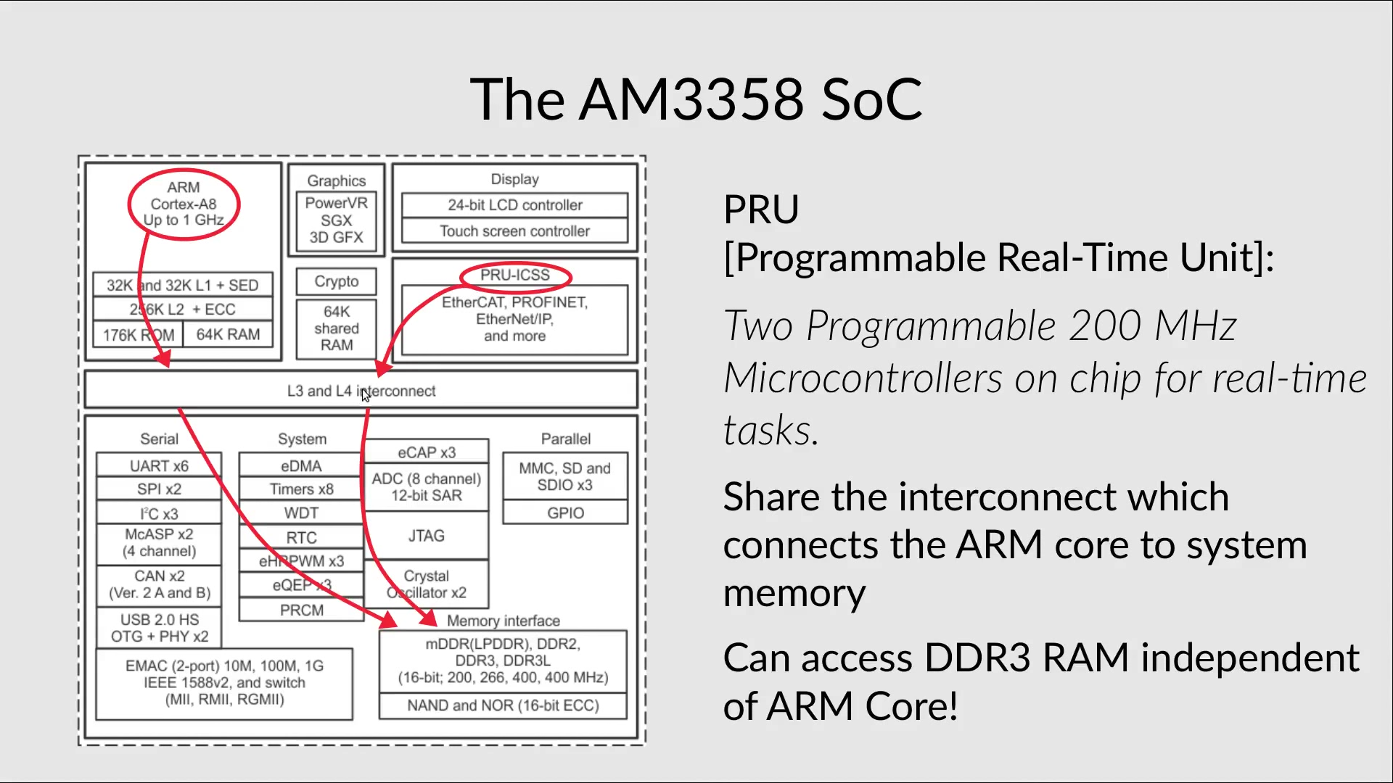
`

Slide 32
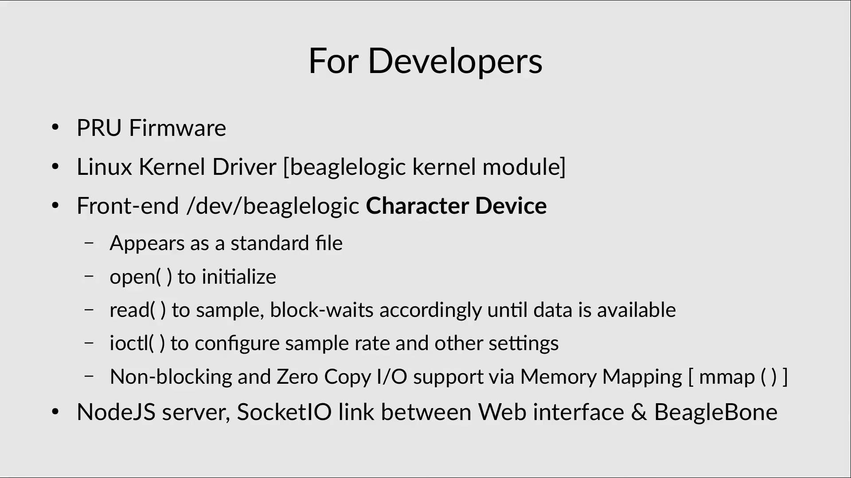

Slide 33

BeaglePilot
Víctor Mayoral Vilches for GSoC 2014
Linux-based autopilot for flying robots based on BeagleBone
Ported ArduPilot to Linux
ROS integration
Videos: Introduction & Final report
GitHub: BeaglePilot

Slide 34
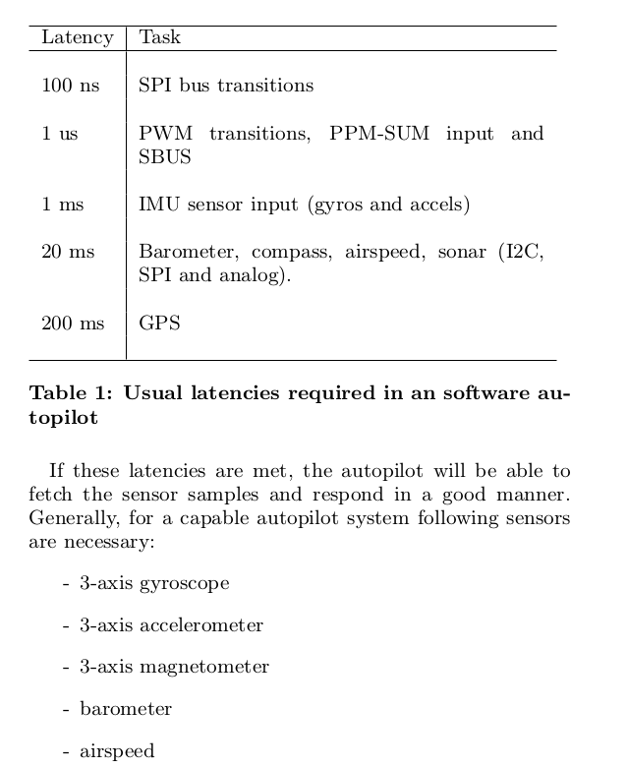

BeaglePilot

Slide 35
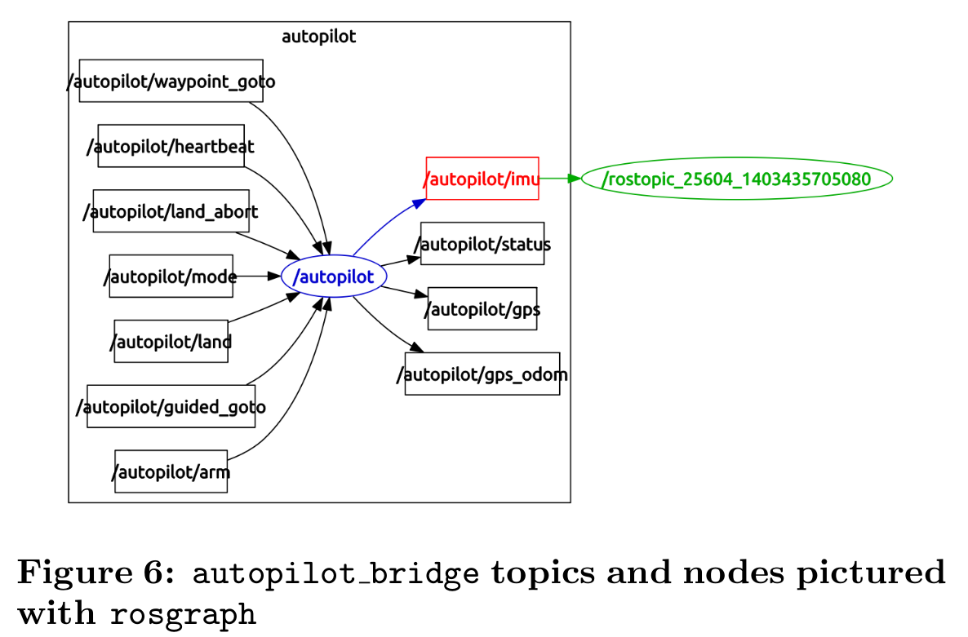
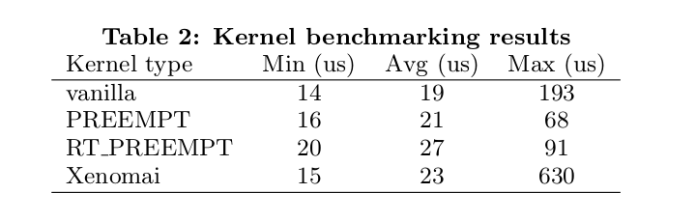
BeaglePilot
Towards an Open Source Linux autopilot for drones
  “Linux can perfectly be used to meet the real-time requirements needed by an autopilot requiring only about 25% of the processor in BeagleBone Black.”

Slide 36
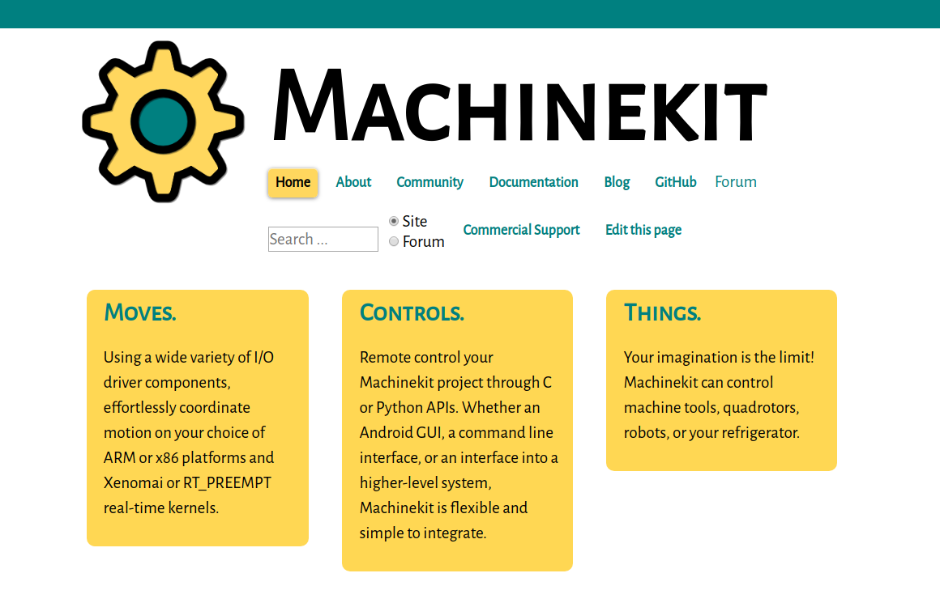
MachineKit.io (fork of LinuxCNC)

Slide 37
MachineKit
Machinekit will run on either Xenomai or PREEMPT_RT
Current image for BeagleBone has kernel 4.19.72-bone-rt-r39
“And the winner is: RT-PREEMPT”*
  http://blog.machinekit.io/2015/11/and-winner-is-rt-preempt.html

Slide 38
MachineKit
Charles Steinkuehler implemented the LinuxCNC/MachineKit HAL on the BeagleBone
The servo thread (motion planning) typically runs at 1 KHz (1 ms) on the ARM cores
"Bit twiddling" (eg: step pulse generation) typically runs much faster, with a 3-5 uS thread period on the PRU cores

Slide 39
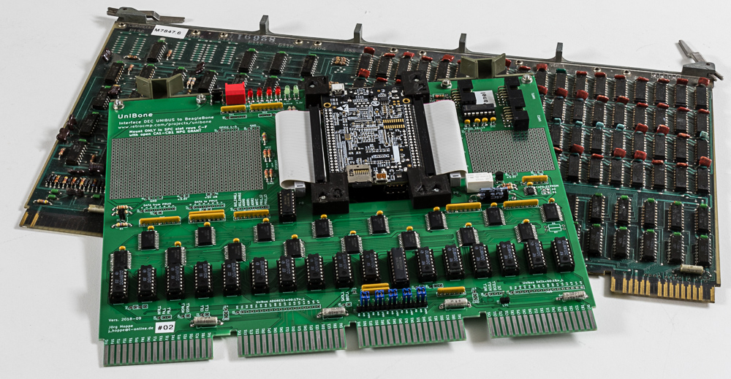
UniBone: PDP-11 card emulator
Jorge Hoppe
http://retrocmp.com/projects/unibone

Slide 40
UniBone: PDP-11 card emulator
Emulate PDP-11 disk controllers and disk
Devices in separate pthreads. To verify these devices I let the PDP-11 CPU exercise them with DECs "XXDP" diagnostics.
The emulator-threads must have realtime priority (SCHED_FIFO), else some diagnostics complain about violated timing constraints (obviously when other threads get preempted)
When the PDP-11 CPU does an register access via UNIBUS to PRU to my devices, best case a delay of about 50 microseconds until the Linux threads get activated (via PRU interrupt)
If not SCHED_FIFO, that delay can be 10-20 milliseconds.

Slide 41
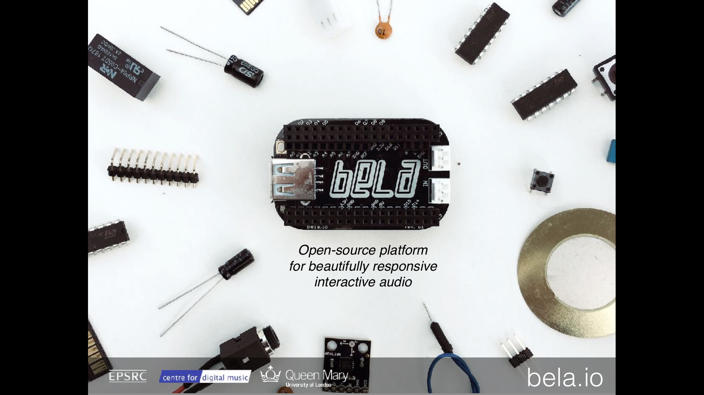

Slide 42
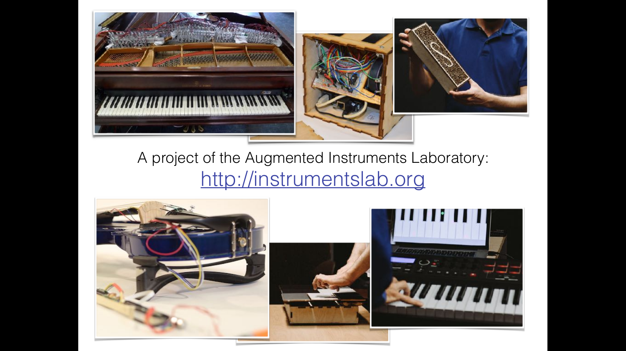

Slide 43
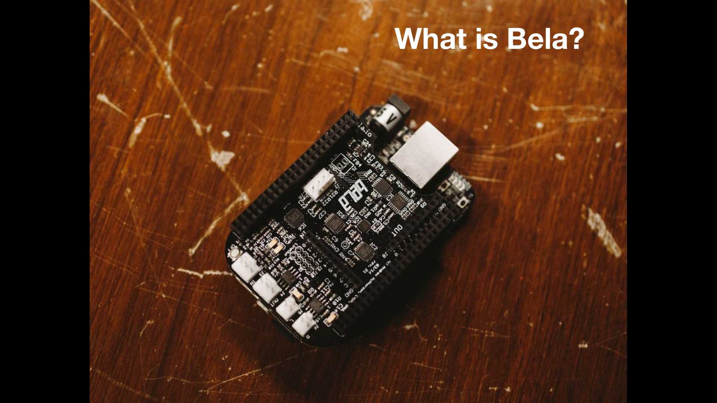

Slide 44
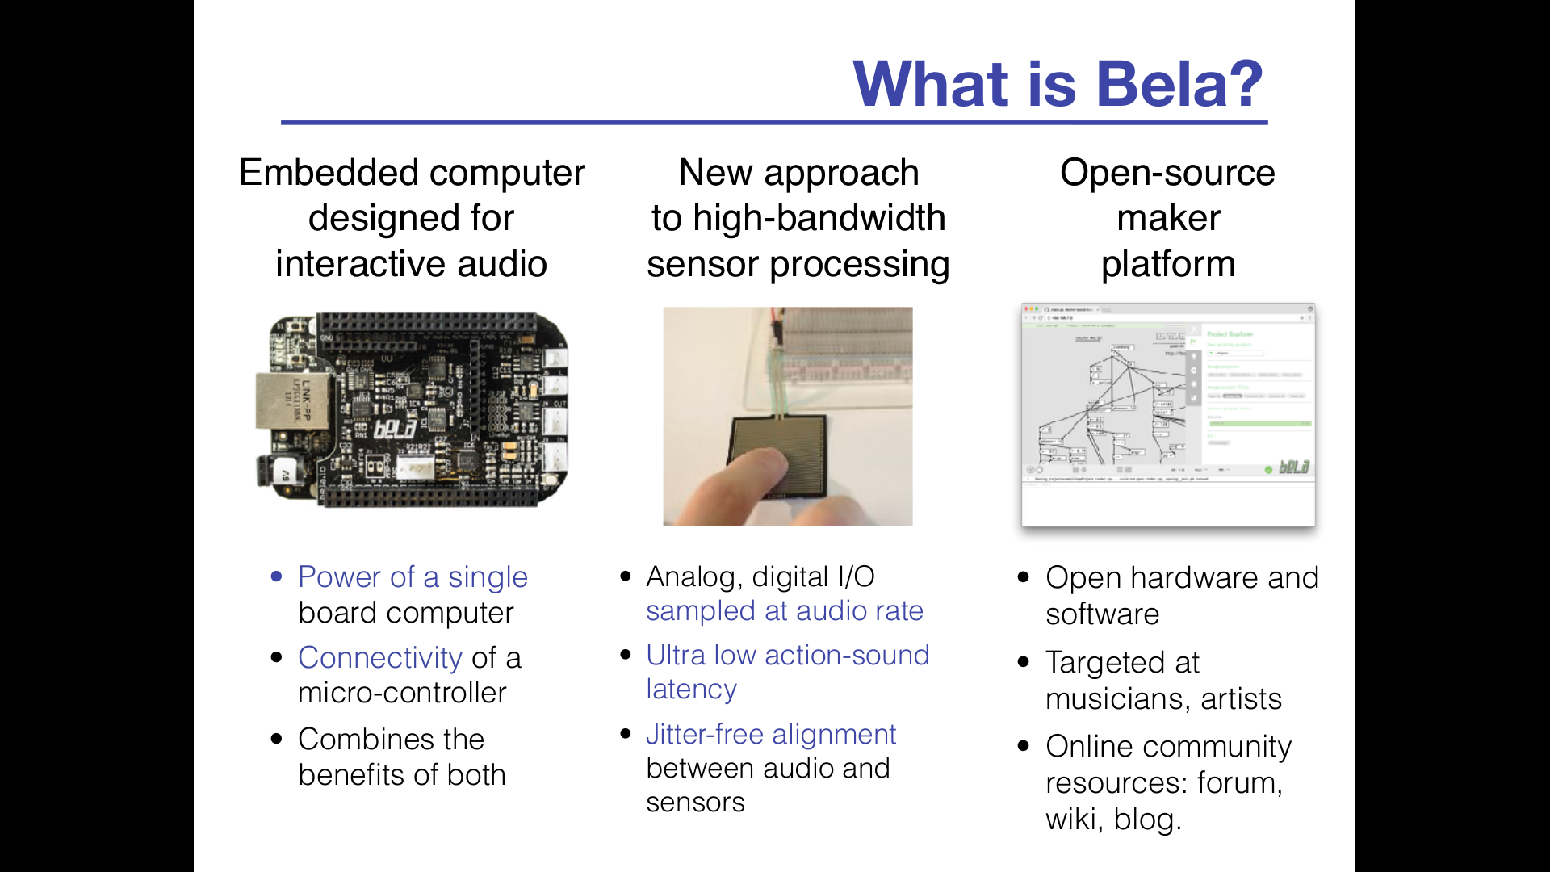

Slide 45
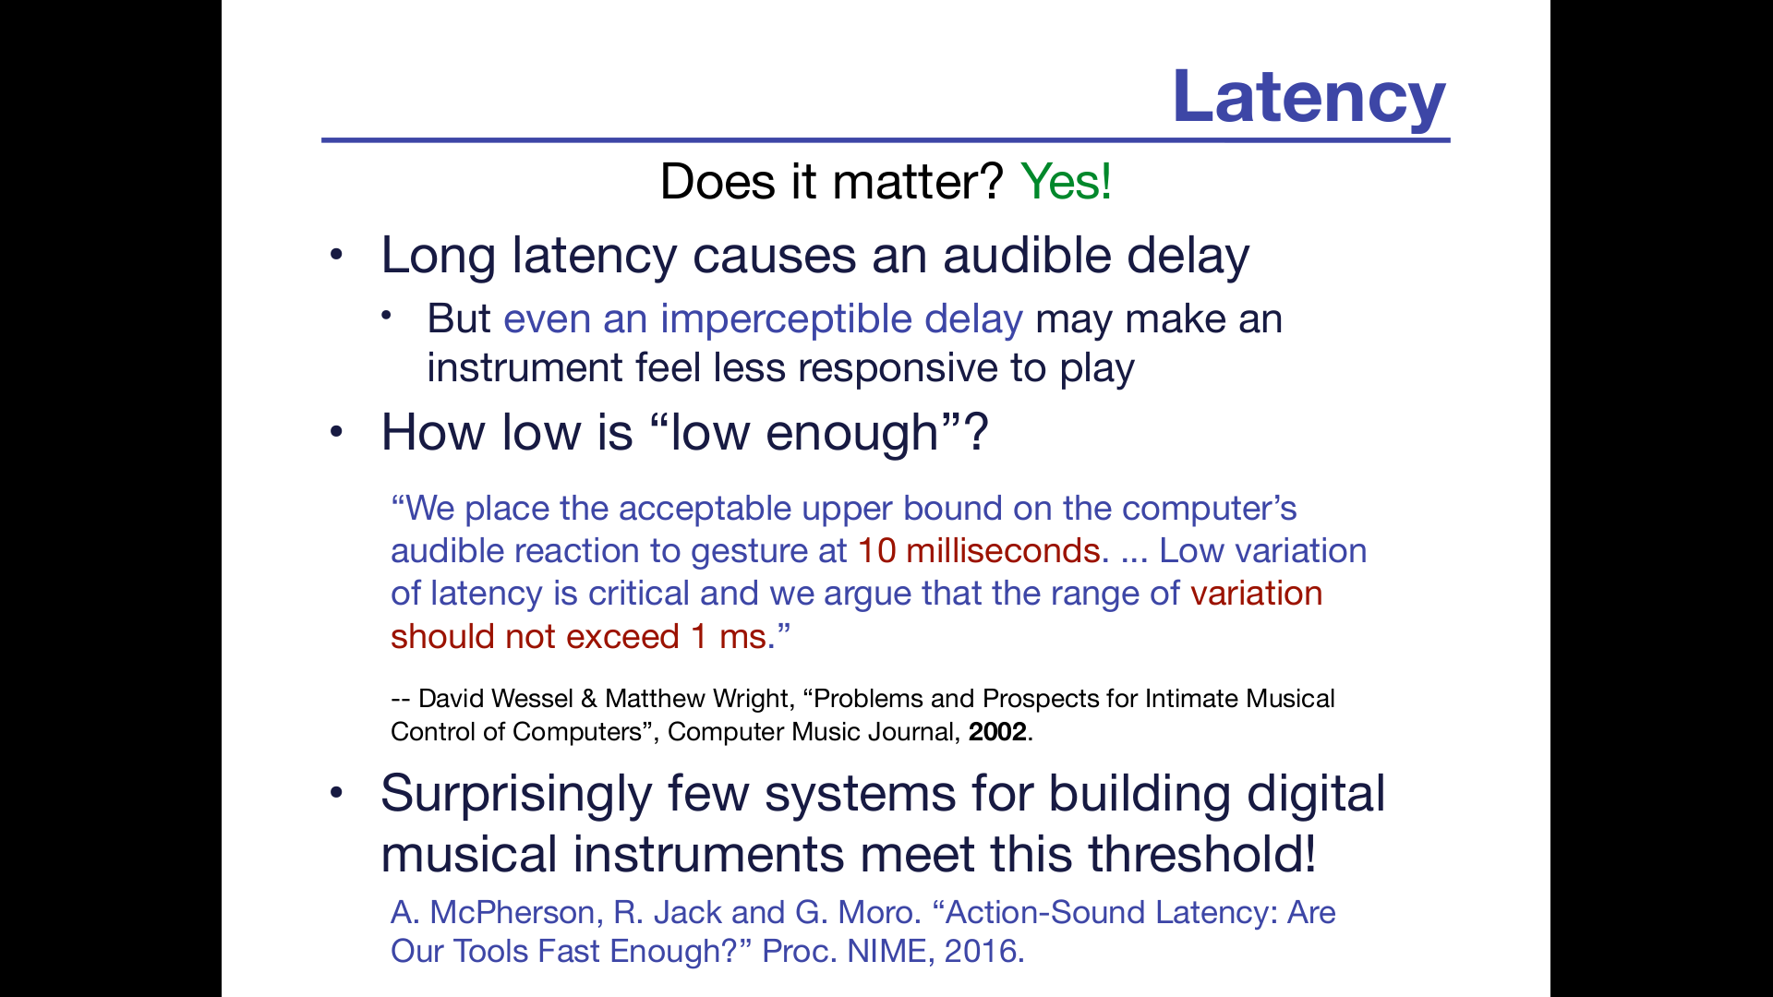

Slide 46
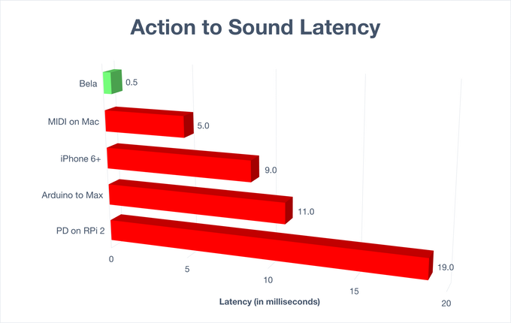

Slide 47
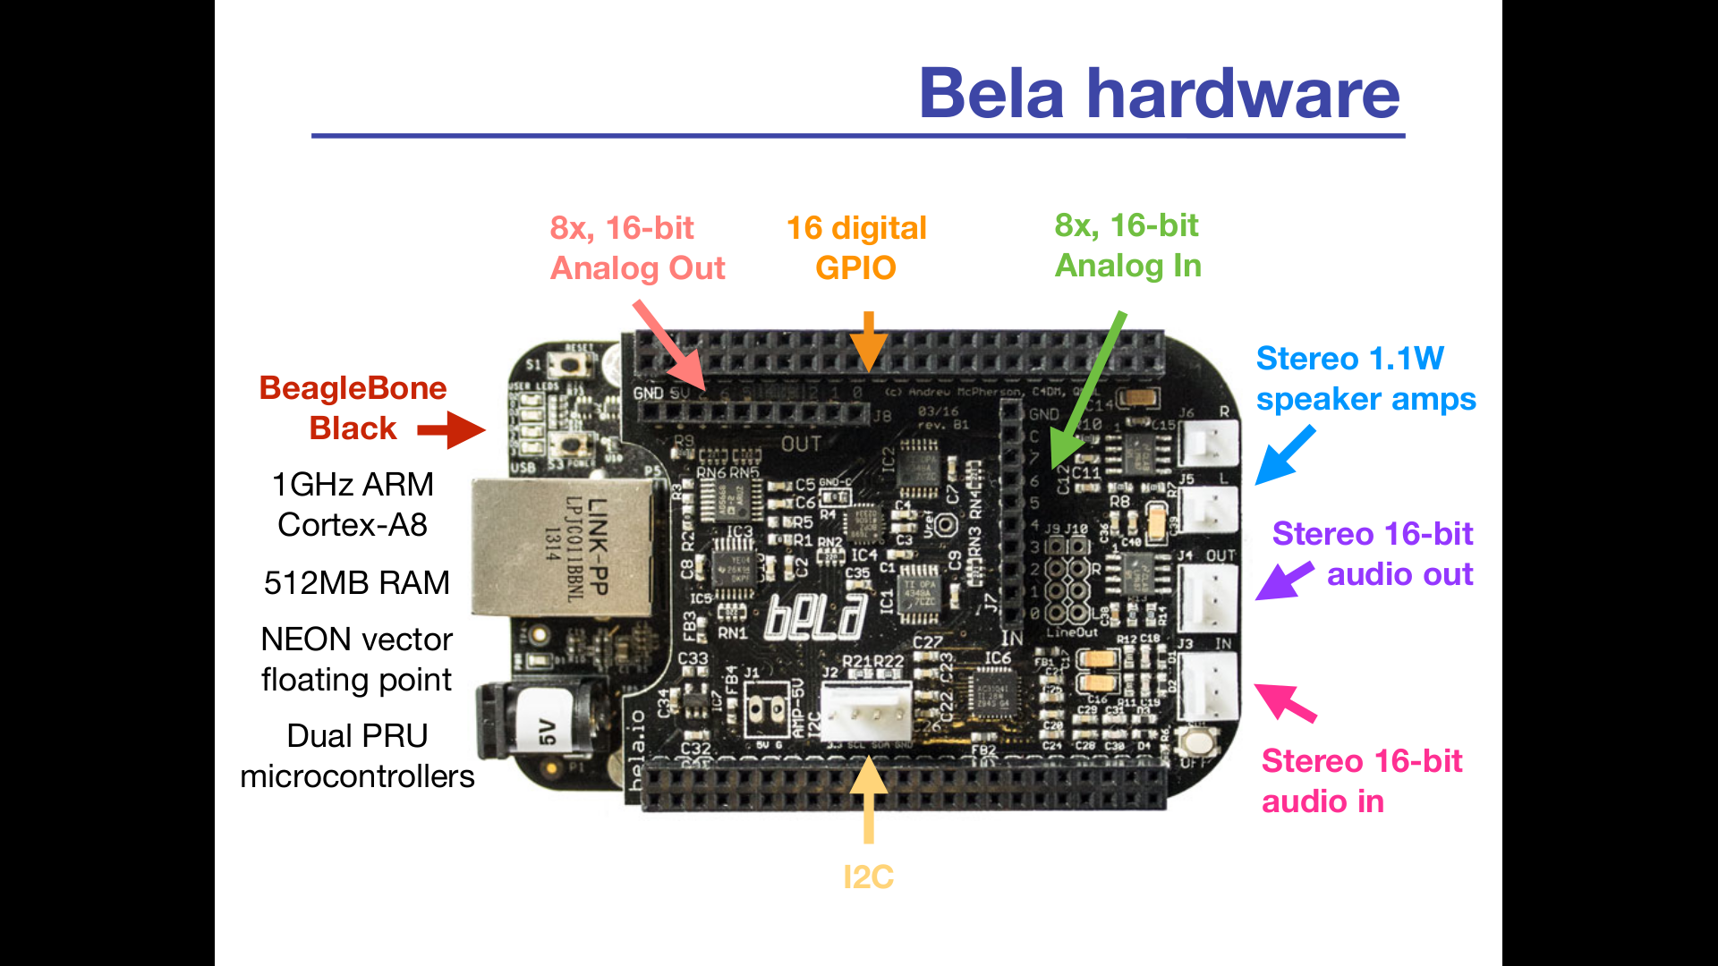

Slide 48
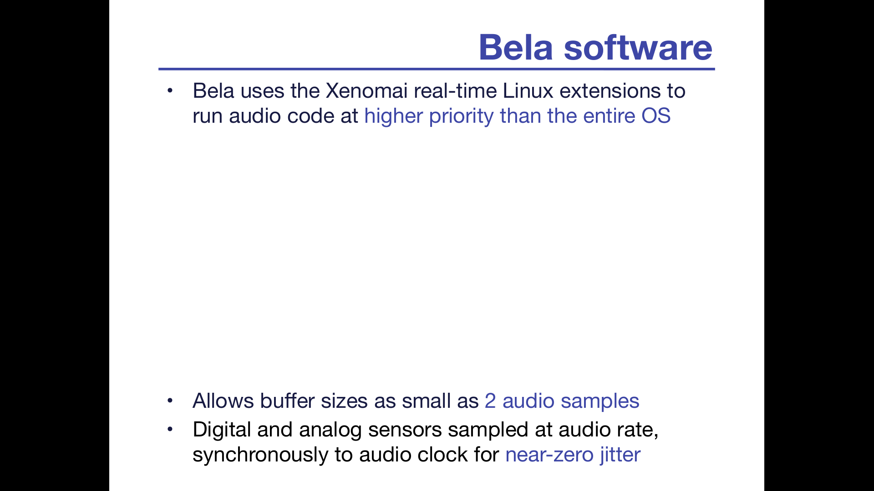
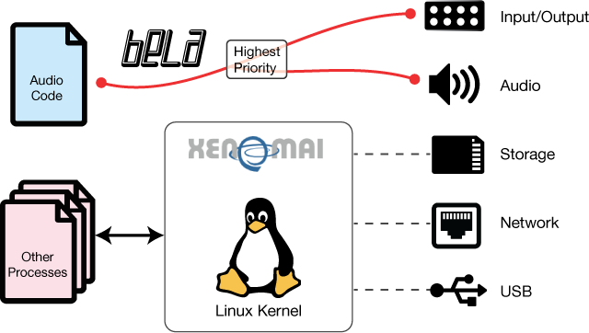

Slide 49
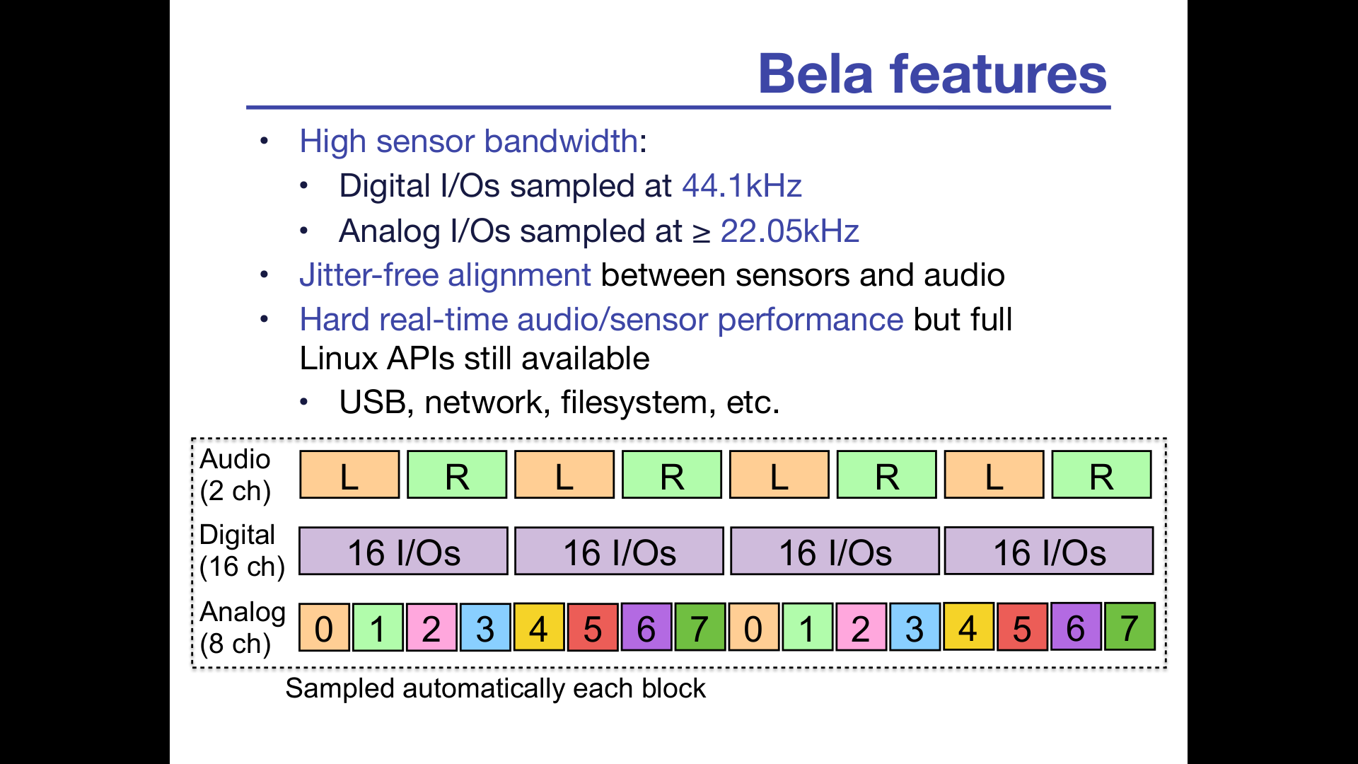

Slide 50
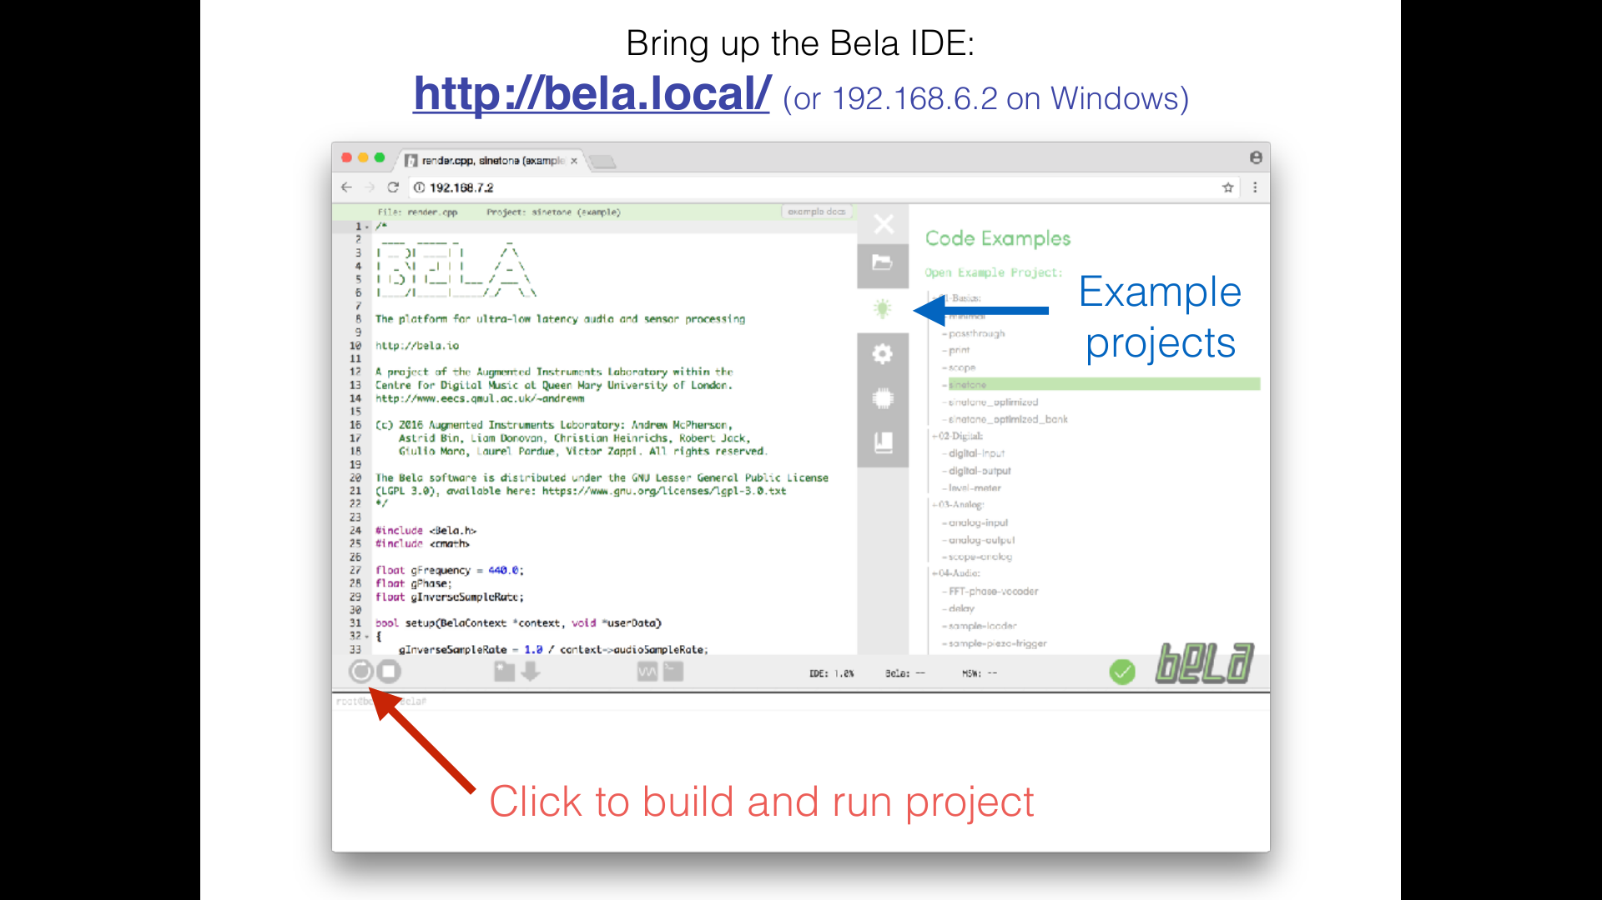

Slide 51
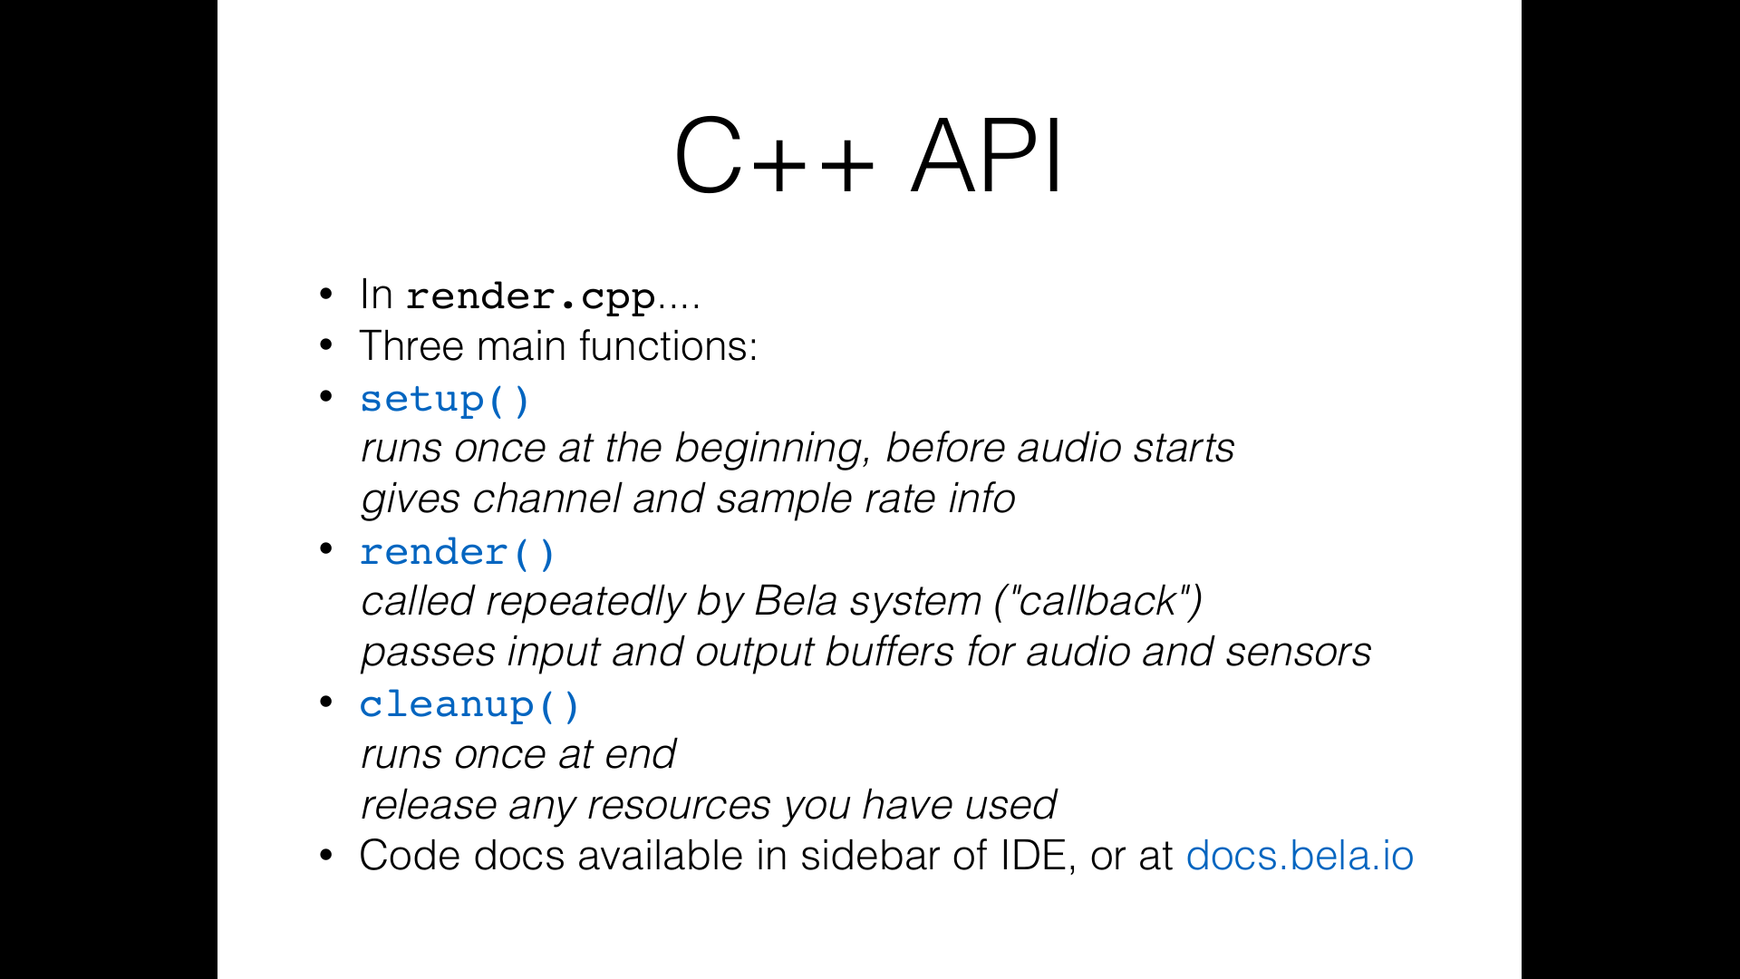

Slide 52
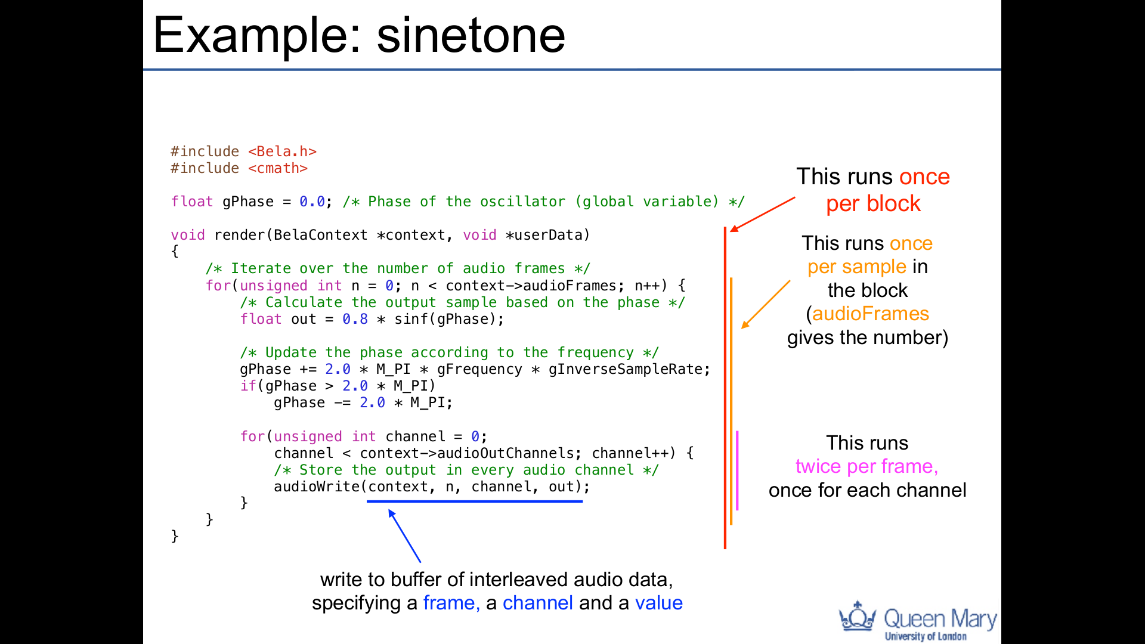

Slide 53
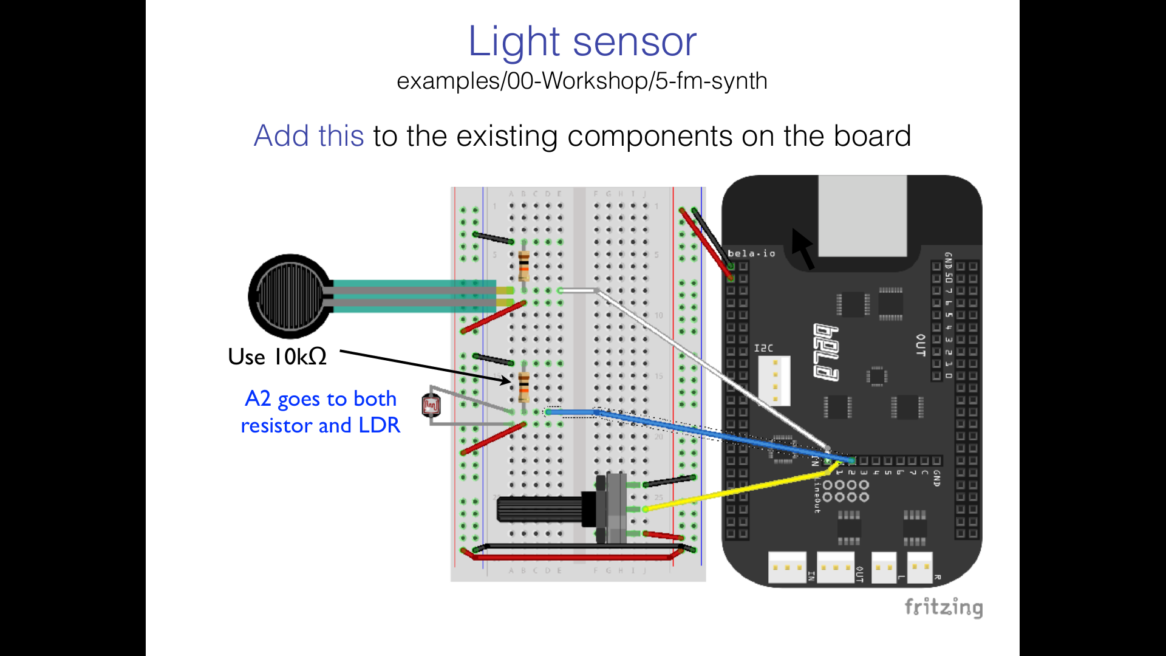

Slide 54
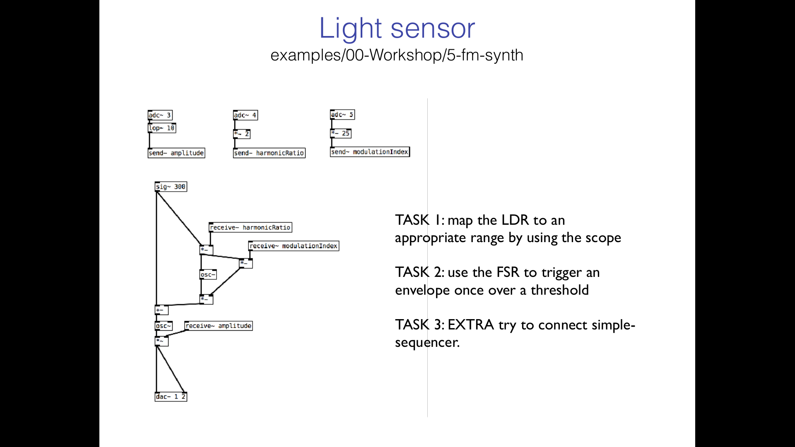

Slide 55
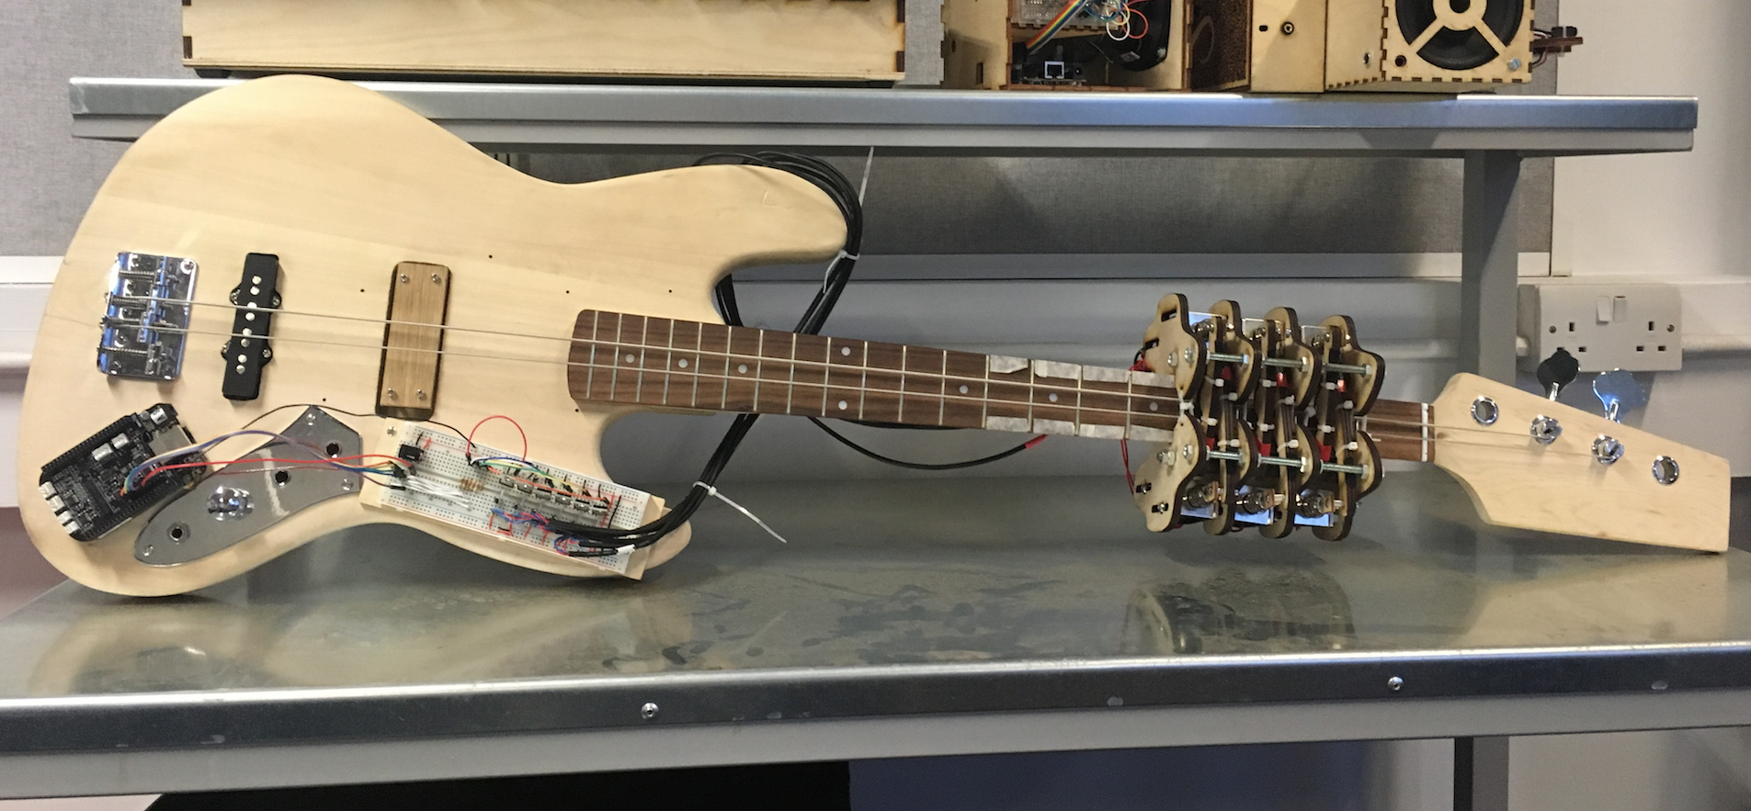
Bela one-handed bass

Slide 56
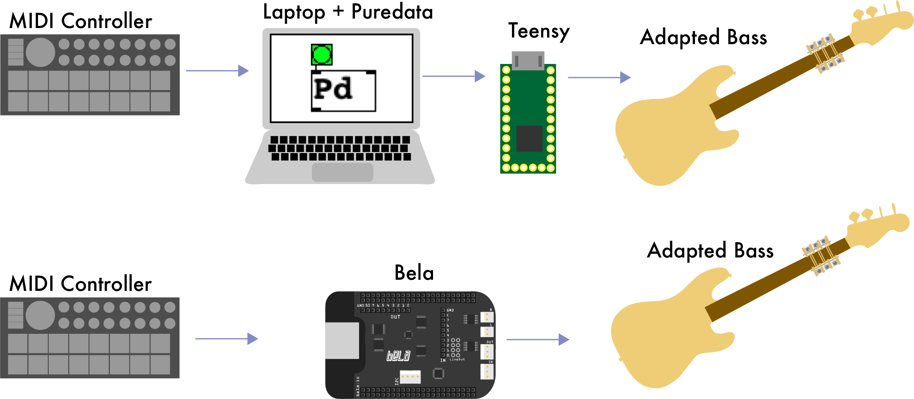
Bela one-handed bass

Slide 57
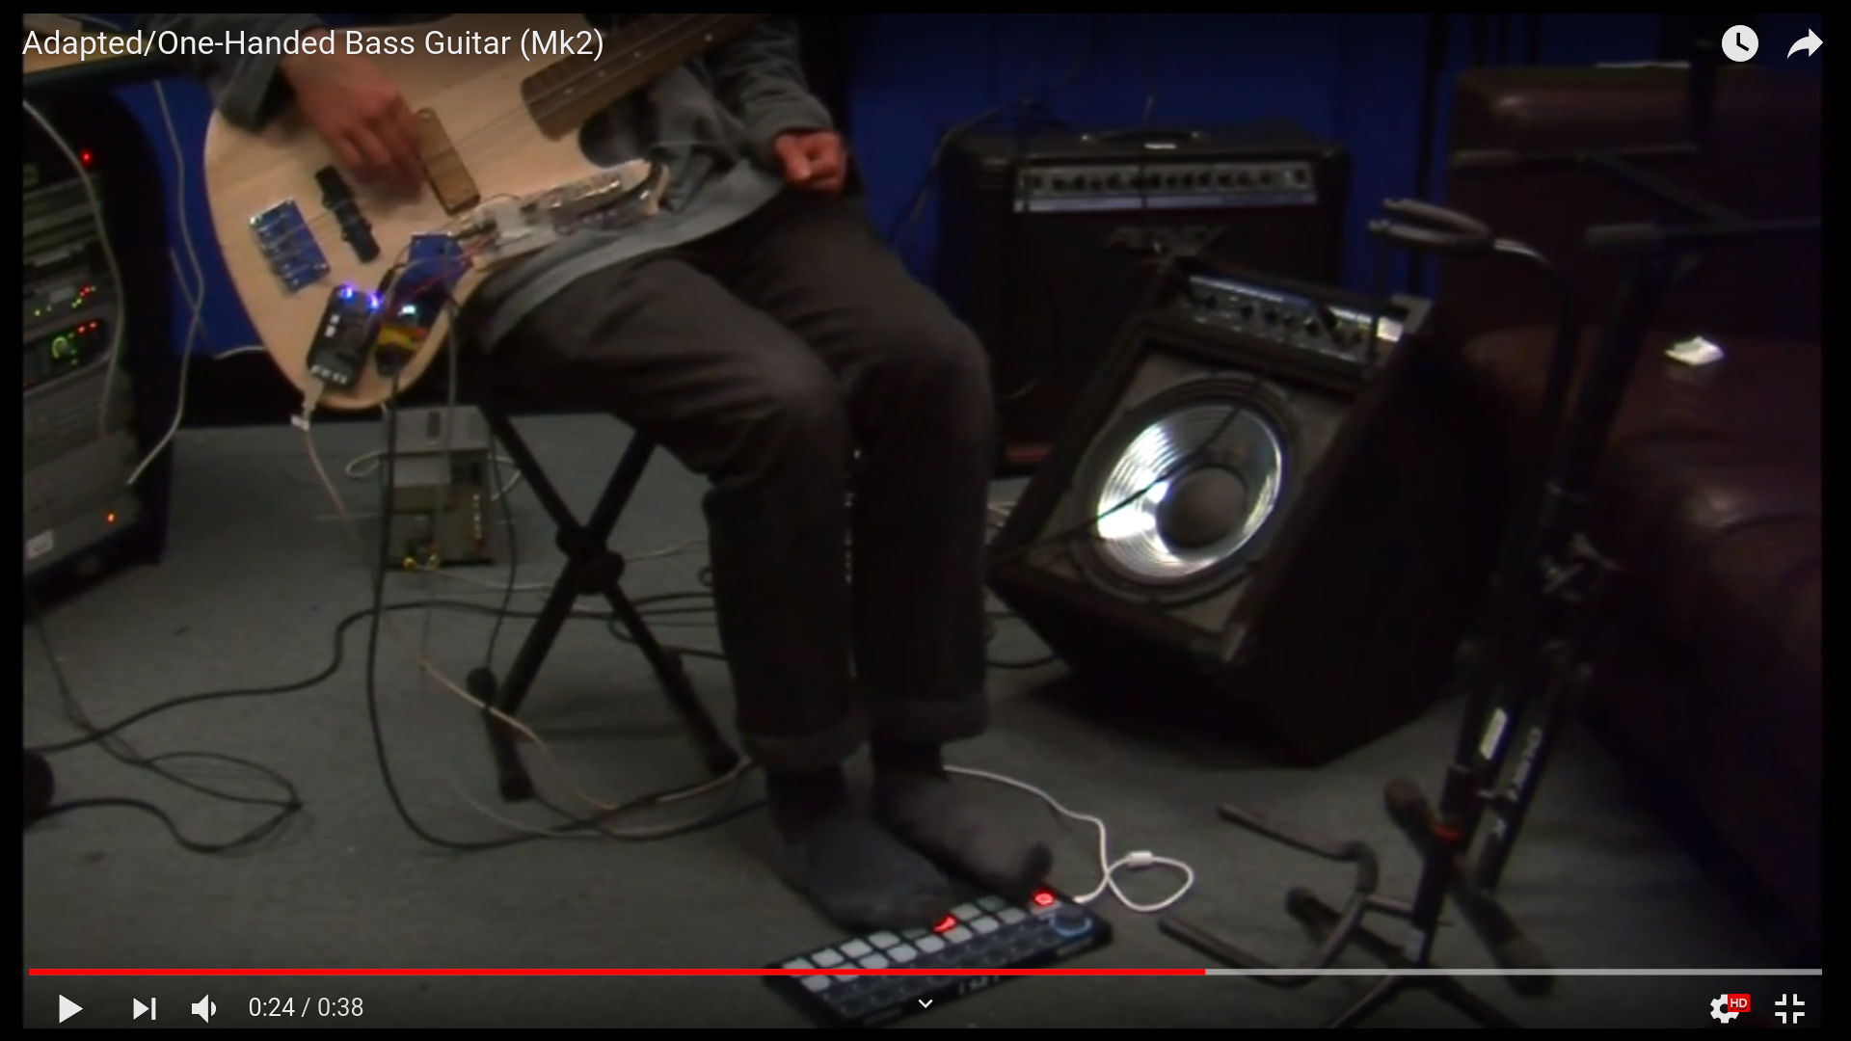

Slide 58
Bela: real-time deadlines
Xenomai 3.0.7 with 3.1 in current testing
Kernel 4.4.113-ti-xenomai-r149, current testing 4.14.108-ti-xenomai-r122 (i-pipe bug just fixed)
2 or 4 samples per block. Sampling rate is 44100 Hz.
The audio callback is called every 2 or 4 samples
Periodic task that needs to wake up every 45us or 90us.
If the thread wakeup latency is larger than that value, then the thread will not wake up on time to even run when it's meant
If the thread takes a significant amount of that time to wake up then it will have very little CPU time to actually perform the computation it has to perform

Slide 59
Bela: Xenomai vs. PREEMPT_RT
Giulio Moro from the Bela team has done some specific latency measurements
  This was with 4.4 PREEMPT_RT versus 4.4 Xenomai co-kernel (i-pipe)
  Xenomai i-pipe bug in 4.14 prevented moving to newer, fix found last week
  Bela will soon be able to compare between 4.14 PREEMPT_RT and 4.14 Xenomai (i-pipe)
“the thread wakeup latency is smaller on average and worst case for xenomai vs preempt rt, which means fewer time spent waiting for the audio thread to start executing and more time spent processing audio.”
“average latency is as low or lower on RT, but that the ceiling is lower on Xenomai and therefore that is more dependable for real-time audio applications”
“doubt RT would work reliably at 2 or 4 samples. That would mean having a repeatable thread wakeup latency below 45 and 90us respectively. While I think RT can achieve the latter fairly often, I don't think it can hit the former not even half of the time.”

Slide 60
Questions for PREEMPT_RT:
What are the expectations could developers have for latency deadlines?
  100 uS? 50 uS? 10 uS?
  Thread wakeup latency?
  What are best practices for measuring their use case?
Reasons to switch from Xenomai to straight RT?
What PREEMPT_RT is new enough to see improvements?
  4.14? 4.19? 5.x?
1GHz Cortex A8 versus dual 1.5GHz Cortext A15 (BeagleBone AI)?

