Slide 1



Drew Fustini
BeagleBoard.org Foundation
drew@beagleboard.org
Twitter: @pdp7
Slides: https://github.com/pdp7/talks/blob/master/er2019.pdf
Linux on Open Source Hardware
and Libre Silicon
Embedded Recipes 2019

Slide 2
  Open Source Hardware designer at OSH Park
    PCB manufacturing service in the USA known for purple soldermask!
    drew@oshpark.com / Twitter: @oshpark
  Volunteer Member of Board of Directors of BeagleBoard.org Foundation
      drew@beagleboard.org
  Volunteer Member of the Board of Directors of the Open Source Hardware Association (OSHWA)
      serving as Vice President
      drew@pdp7.com

Slide 3






What is Open Source?
Examples of popular Open Source projects

Slide 4
What is Open Source?
The term "open source" refers to something people can modify and share because its design is publicly accessible
Open Source software is software with source code that anyone can:
inspect, modify, and enhance

Slide 5


What is Free Software?
A program is free software if the users have four essential freedoms:
1) run the program as you wish, for any purpose
2) study how the program works, and change it so it does your computing as you wish
3) redistribute copies so you can help your
neighbor
4) distribute copies of your modified versions

Slide 6

FLOSS is a term to describe software that is Free, Libre, or Open Source Software
In the context of hardware projects, I consider these terms equivalent:
    Free Hardware
    Libre Hardware
    Open Hardware
    Open Source Hardware

Slide 7
Slides: https://github.com/pdp7/talks/blob/master/er2019.pdf
Statement of Principles:
Hardware whose design is made publicly available so that anyone can study, modify, distribute, make, and sell the design or hardware based on that design

Slide 8



Slides: https://github.com/pdp7/talks/blob/master/er2019.pdf
Documentation required for electronics:
Schematics Board Layout
Editable source files for CAD software such as KiCad or EAGLE
Bill of Materials (BoM)
Best practice: all components available from distributors in low quantity

Slide 9

Example: Arduino achieved critical mass by sharing their hardware designs and source code
Arduino: The Documentary describes the team’s motivation

Slide 10

Example: Arduino Uno schematic and PCB layout design files for EAGLE CAD can be downloaded from Arduino.cc

Slide 11
Publish documentation with an
Open Source license:
Creative Commons Share-Alike: CC-BY-SA
    Non-Commercial (NC) clause is NOT acceptable
Copyleft: GPLv2, GPLv3
Permissive: Apache, BSD, MIT
OSHW inspired: CERN OHL, TAPR, SolderPad

Slide 12

CERN Open Hardware Licence
Originally written for CERN designs hosted in the Open Hardware Repository
Can be used by any designer wishing to share design information using a license compliant with the OSHW definition criteria.
CERN OHL version 1.2
Contains the license itself and a guide to its usage

Slide 13
CERN Open Hardware Licence
Myriam Ayass, legal adviser at CERN and author of the CERN OHL:
  OHL is to hardware what GPL is to software
  Similar principles to Free or Open Source software
  Anyone should be able to:
  see the source*, study it, modify it and share it
  *the design documentation in case of hardware

Slide 14

CERN Open Hardware Licence
Video interview with Javier Serrano
physicist and electronics engineer at CERN
co-author of the CERN Open Hardware License
creator of the Open Hardware Repository

Slide 15
Licenses, Copyright and Patents
can get confusing!
Review of Popular OSHW Licenses
Video of Ari Douglas at OHS 2014

Slide 16
What is the spirit of Open Source?
Publish everything that will:
enable collaborative development
Goal is NOT to check a box on a marketing brochure or add keywords to a crowdfunding campaign

Slide 17

US-based 501(c)3 non-profit organization
Hosts the Open Source Hardware definition
“aims to be the voice of the open hardware community, ensuring that technological knowledge is accessible to everyone, and encouraging the collaborative development of technology”

Slide 18
OSHW Best Practices
Quick Reference Guide
OSHW "May and Must" (PDF)
OSHW Checklist (PDF)

Slide 19
Open Hardware Summit (OHS)
OHS 2020: March 13 in NYC (USA)
  http://2020.oshwa.org/
8 prior summits:
  2010, 2011: New York Hall of Science
  2012: Eyebeam (NYC)
  2013: MIT (Boston area)
  2014: Roma, Italia!
  2015: Philadelphia, USA
  2016: Portland, Oregon, USA
  2017: Denver, USA
  2018: MIT (Cambridge, MA, USA)

Slide 20

October is Open Hardware Month!
OSHWA wants to encourage locally organized events around the world
Sign up to host a meetup or workshop in your city! http://ohm.oshwa.org/

Slide 21

Open Hardware Summit (OHS)
The Open Hardware Summit 2018 talks are now available as individual videos on YouTube

Slide 22
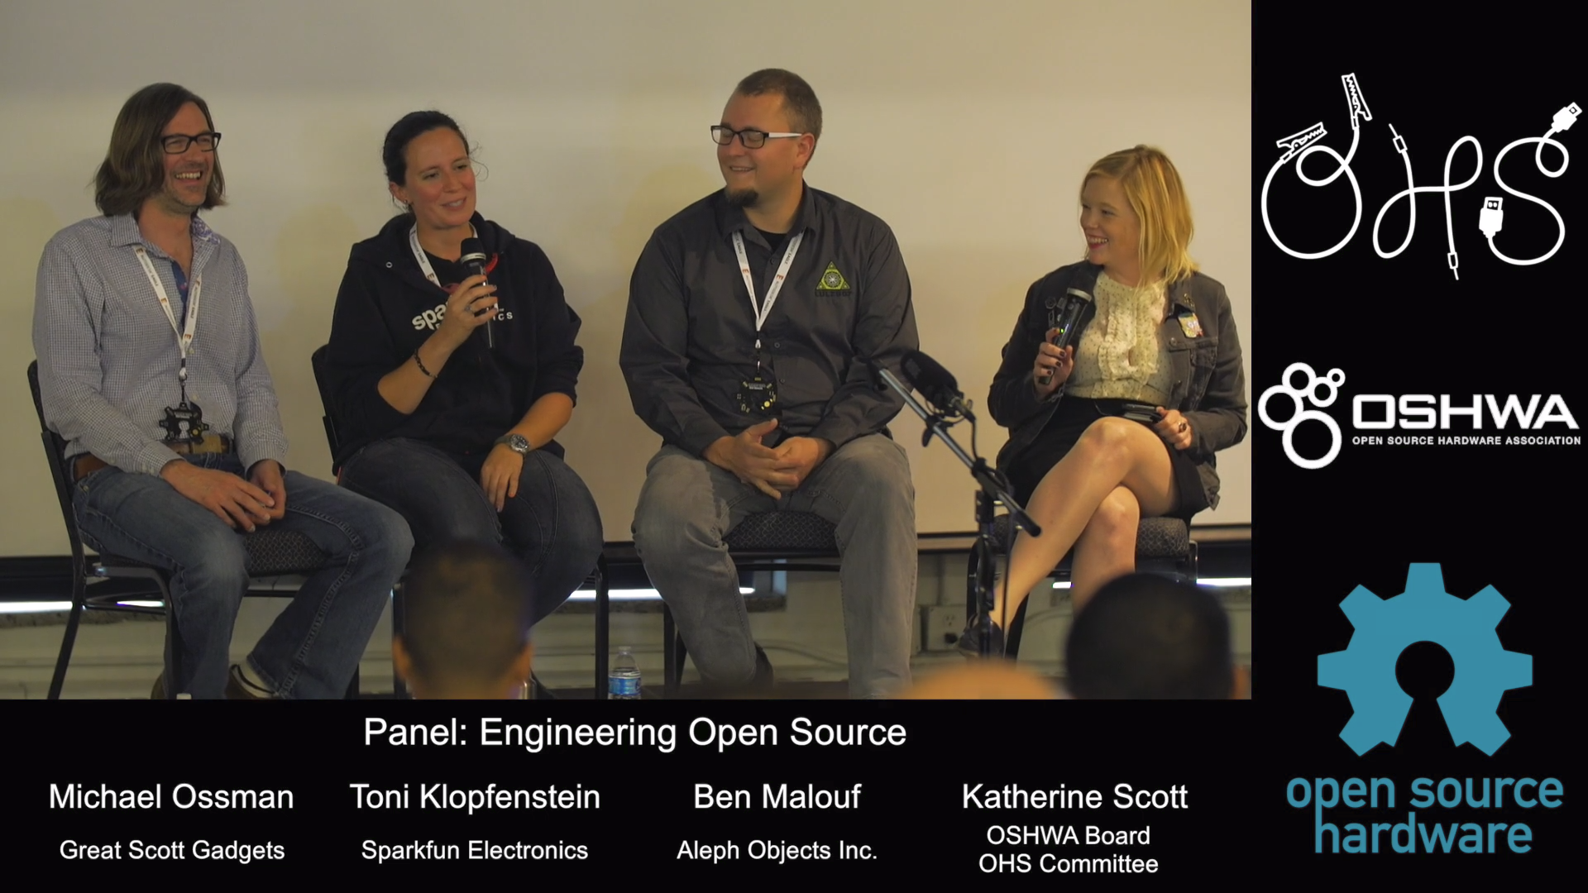
Open Hardware Summit (OHS)
OHS 2017: Engineering Open Source Hardware

Slide 23
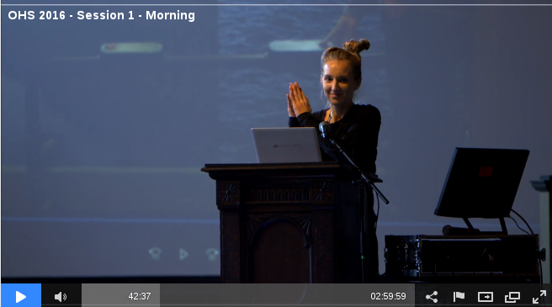
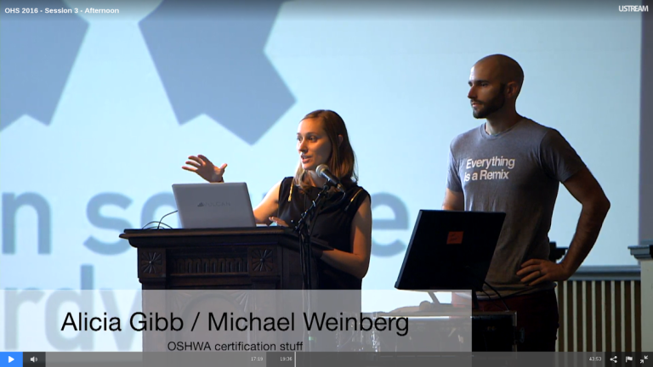
Open Hardware Summit (OHS)
OHS 2016 morning sessions
OHS 2016 afternoon sessions

Slide 24

Open Source Hardware Certification Program
Allows hardware that complies with the community definition of Open Source Hardware to display a certified OSHW logo
Make it easier for users of OSHW to track down documentation and information
More information: certificate.oshwa.org

Slide 25
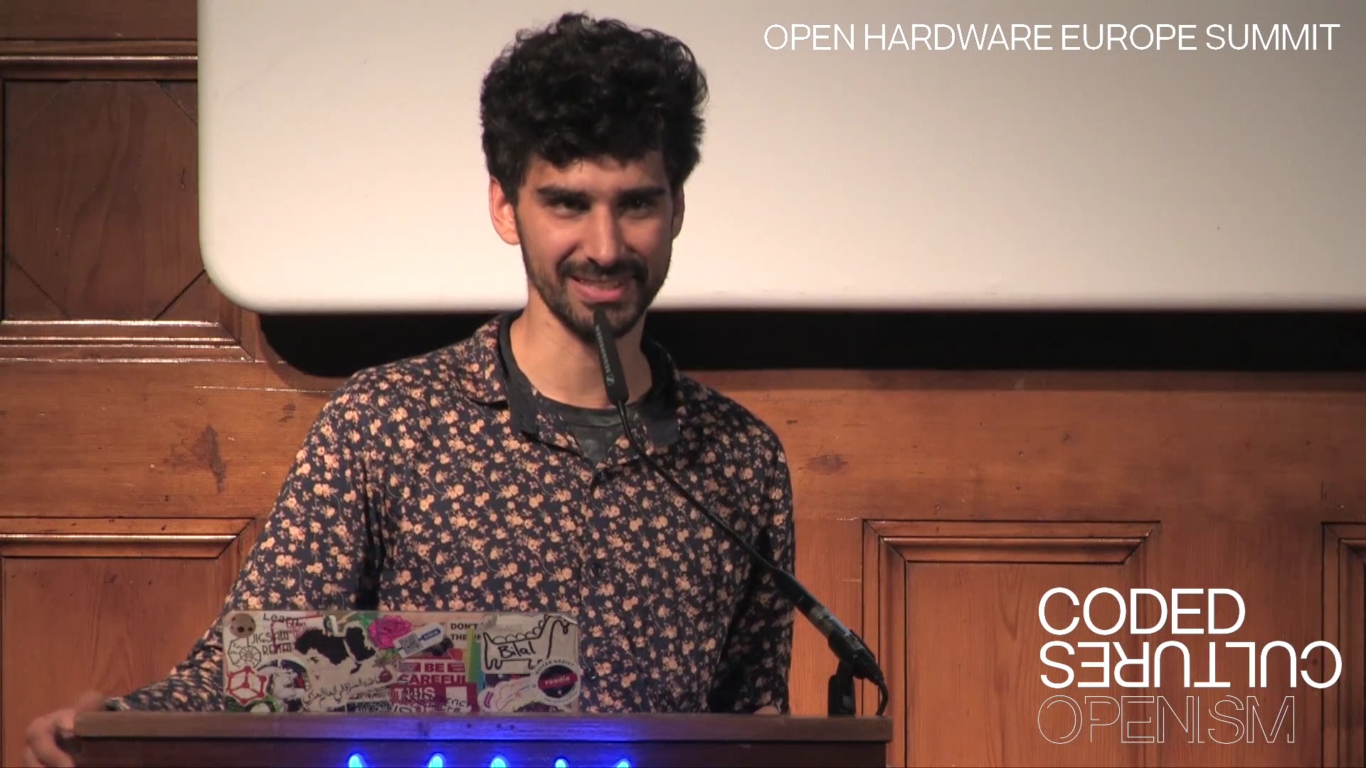
Open Hardware Europe Summit 2016
Video playlist on YouTube
Open Hardware Europe Summit
  “The global open hardware community met in Vienna, Austria to give talks about new aspects, new methods and lessons learned for the open hardware movement.”
  Note: I talked to some people at CCCamp2019 interested in 2020. Email drew@pdp7.com to get connected

Slide 26

Resources
Join OSHWA
Subscribe to the mailing list
Post in the OSHWA Forum
Follow on Twitter:
  @OHSummit
  @oshwassociation
Building Open Source Hardware
by Alicia Gibb (executive director of OSHWA)

Slide 27
Section:
LINUX on OSHW
(my two favorite things!)

Slide 28

Novena laptop
Created by Bunnie Huang & Sean Cross (xobs)
  Chumby, “Hacking the Xbox”, amazing reverse engineers
100% Open Source Hardware laptop
Quad-core 1.2GHz ARM, 4GB RAM, SSD, WiFi
Xilinx FPGA for custom hardware design
Software Defined Radio (SDR) module

Slide 29


Open Source Hardware computing for Makers, Educators & Professionals
Developed by BeagleBoard.org Foundation and BeagleBoard.org Community
Manufacturers: element14, GHI, Seeed

Slide 30

BeagleBoard.org released the first BeagleBoard, an affordable, open hardware ARM computer in 2008

Slide 31


Maker focused, Altoids tin sized BeagleBone introduced in 2011

Slide 32


More affordable, more powerful BeagleBone Black in 2013

Slide 33

Open Source HardwareBeagleBone derivatives

Slide 34


BeagleBone Black Wireless
CadSoft EAGLE design files hosted on GitHub
Bill of Materials: every part available in qty 1
Octavo System-in-Package (SiP) packages several ICs (CPU, RAM, etc) into one large-pitch BGA chip to simplify PCB layout and assembly

Slide 35

BeagleBone Blue: complete Linux robotics controller. 4 layer PCB designed in EAGLE.

Slide 36

BeagleBoard.org PocketBeagle
Michael Welling designed the “PocketBone” using the Octavo SiP and shared on Hackaday.io
In response to online demand, BeagleBoard.org worked with GHI in Michigan to design and manufacture a new product: the PocketBeagle

Slide 37

BeagleBoard.org PocketBeagle
PocketBeagle design makes it feasible for individuals to create their own derivatives
4 layer PCB published for EAGLE and KiCad
Low cost assembly is possible with solder paste stencil and toaster oven

Slide 38

BeagleLogic
Kumar Abhishek created a derivative board intended to be used a logic analyzer
Finalist in the Best Product round of the Hackaday Prize
k

Slide 39
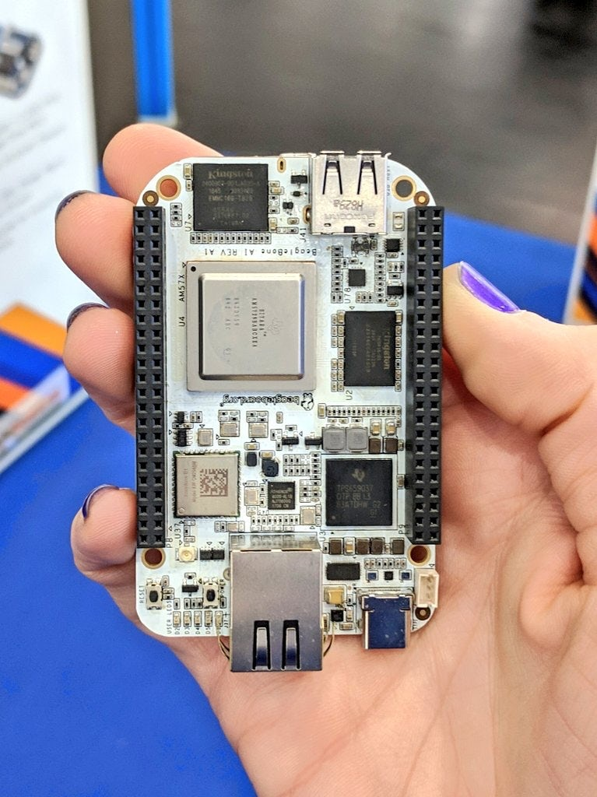
BeagleBone AI: The Fast Track for Embedded Machine Learning

Slide 40
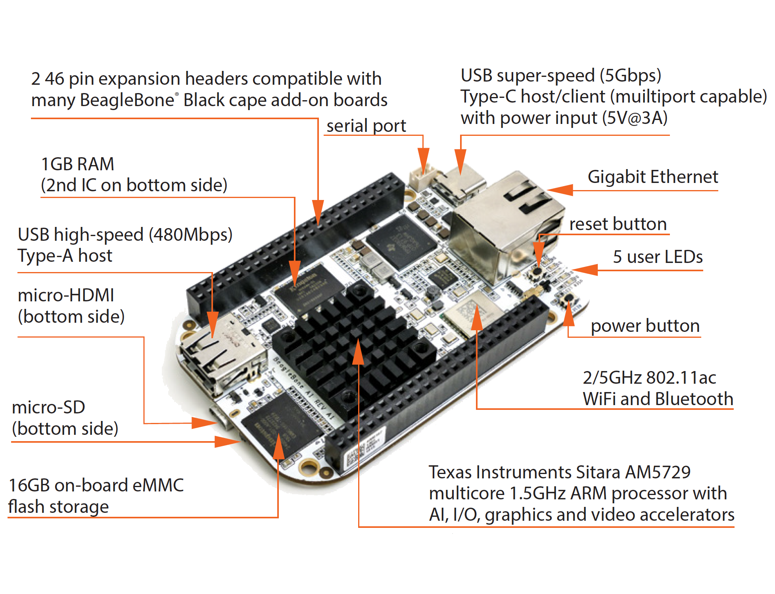
BeagleBone AI: The Fast Track for Embedded Machine Learning

Slide 41
BeagleBone AI
“TI C66x digital-signal-processor (DSP) cores and embedded-vision-engine (EVE) cores supported through an optimized TIDL machine learning OpenCL API with pre-installed tools. Focused on everyday automation in industrial, commercial and home applications.”
Feature highlights:
- BeagleBone Black mechanical and header compatibility
- TI AM5729 SoC: 2x A15 CPU, 2x C66 DSP, 4x M4 MCU, 4x PRU and 4x EVE
- 1GB RAM and 16GB on-board eMMC flash with high-speed interface
- USB type-C for power and superspeed dual-role controller; and USB type-A host
- Gigabit Ethernet, 2.4/5GHz WiFi, and Bluetooth
- microHDMI
- Zero-download out-of-box software experience

Slide 42
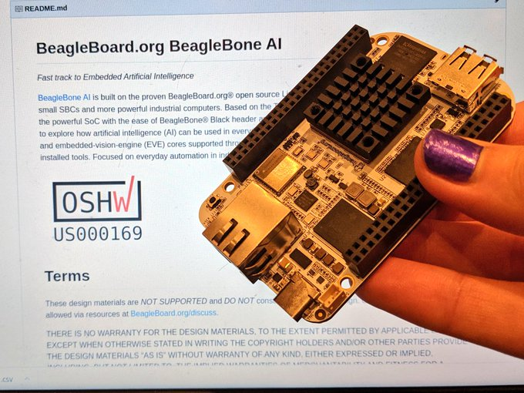
BeagleBone AI design files

Slide 43
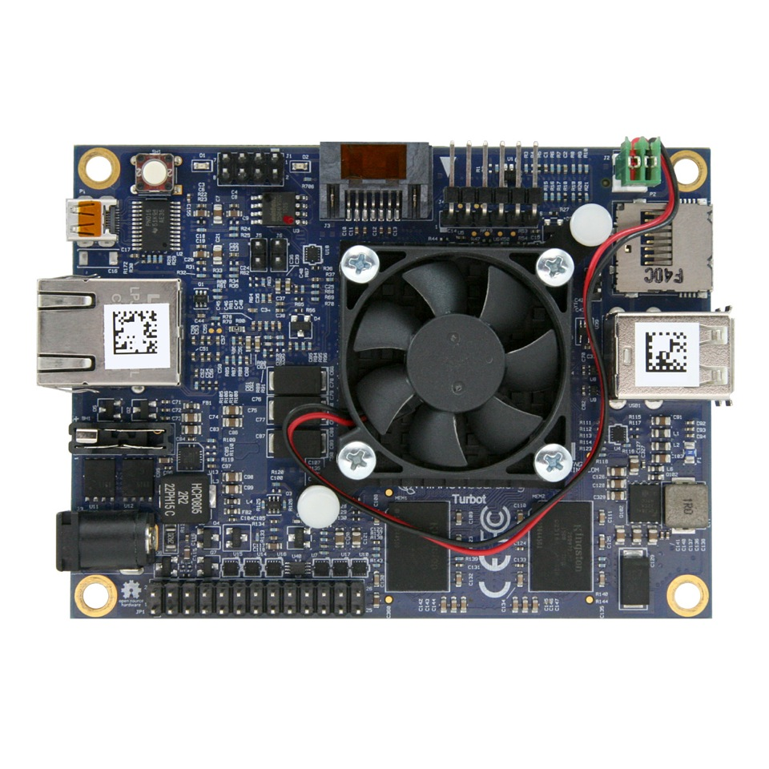

MinnowBoard
64-bit Intel Atom (dual or quad core)
MinnowBoard Turbot
USB 3.0, SATA, PCIe, Gigabit Ethernet, HDMI
Integrated Intel HD Graphics
  Open Source Mainline Linux drivers!

Slide 44

MinnowBoard
Started by Intel, manufactured by ADI, still sold by Netgate… but I believe no future boards planned
Released under Creative Commons CC-BY-SA
Download design files:
  Schematic
  Board Layout
  Bill of Materials

Slide 45

OLinuXino
Low cost OSHW Linux computers
Designed and manufactured by Olimex in Bulgaria
Great blog post:
Open Source Hardware, why it matters and what is pseudo OSHW

Slide 46

A64-OlinuXino
Allwinner A64: Quad Core 64-bit ARM
Designed with Open Source KiCad
1GB RAM, 4GB eMMC, WiFi+BLE4.0

Slide 47

Slides / Video

Slide 48

KiCad is an Open Source EDA suite including Schematic Capture and PCB Layout
Cross platform: Windows, Mac OS and Linux
CERN has contributed professional CAD features for high-speed digital design
Learn to design your own PCB in KiCad with: Getting to Blinky

Slide 49

TERES I Laptop
“DIY Open Source Hardware Software Hacker's friendly Modular Laptop”
Developing an Open Source Laptop talk by Olimex founder Tsvetan Usunov at Hackaday Belgrade
Design files on GitHub:
“everyone can download &
learn, study, edit, modify”

Slide 50


getchip.com
Next Thing Co. in Oakland
Kickstarter in 2015
Company ended in 2018

Slide 51

C.H.I.P. is OSHW
GitHub: NextThingCo/CHIP-Hardware
  Schematics
  PCB Layout
  Bill of Materials (BoM)
License:
  Creative Commons Attribution-ShareAlike
  (CC-BY-SA)

Slide 52


Nebula One created by Groguard to be compat
PocketChip with Nebula One running DOOM!

Slide 53

Giant Board by groguard
A single-board computer in the Adafruit Feather form factor
Funded on Crowd Supply

Slide 54
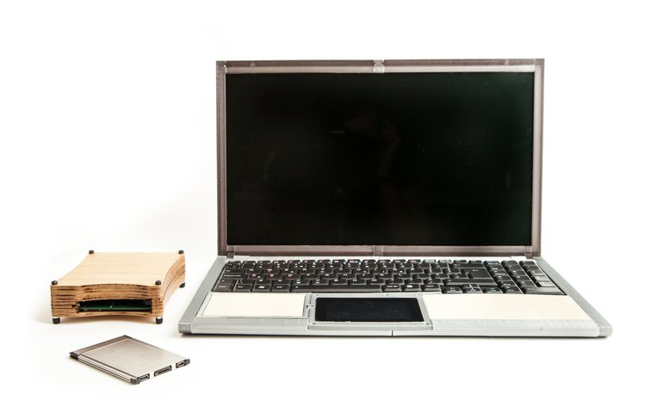
EOMA68 Computing Devices
Embedded Open Modular Architecture
“responsible about both the ecological and the financial resources required to design, manufacture, acquire and maintain our personal computing devices.”
“This campaign therefore introduces the world’s first devices built around the EOMA68 standard, a freely-accessible royalty-free, unencumbered hardware standard”

Slide 55
Are there other OSHW boards that run Linux?
Please let me know! drew@pdp7.com Twitter: @pdp7
Create a list on eLinux wiki?

Slide 56
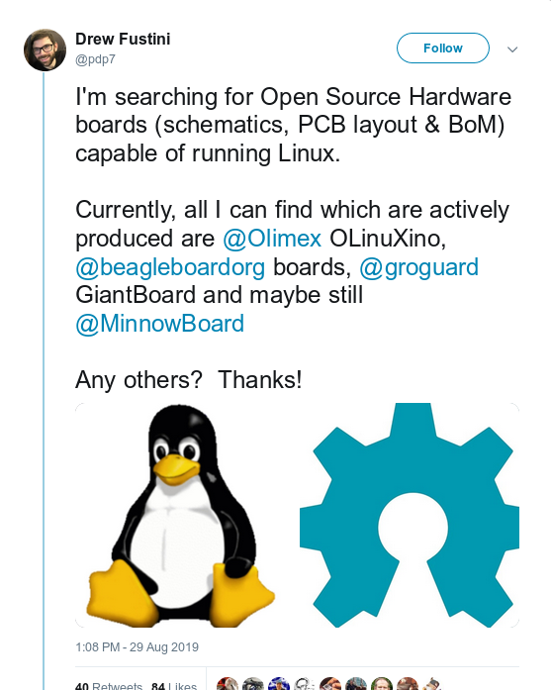
Are there other OSHW boards that run Linux?
k

Slide 57
Thanks Twitter!
HiFive Freedom Unleashed with 64-bit RISC-V
  PCB design files are available
  (thanks to Palmer Dabblet for the link)
VoCore2: “The Coin-sized Linux Computer”
OSHW FPGA boards ECP5 FPGA running RISC-V!
  Orange Crab by Greg Davill
  Radiona.org ULX3S
  David Shah's Trellis board (Ultimate ECP5 Board)
    Fork Sand has built this board
  MyStorm with ECP5 by Alan (who is here!)
  More?

Slide 58
Are there other OSHW boards that run Linux?

Slide 59
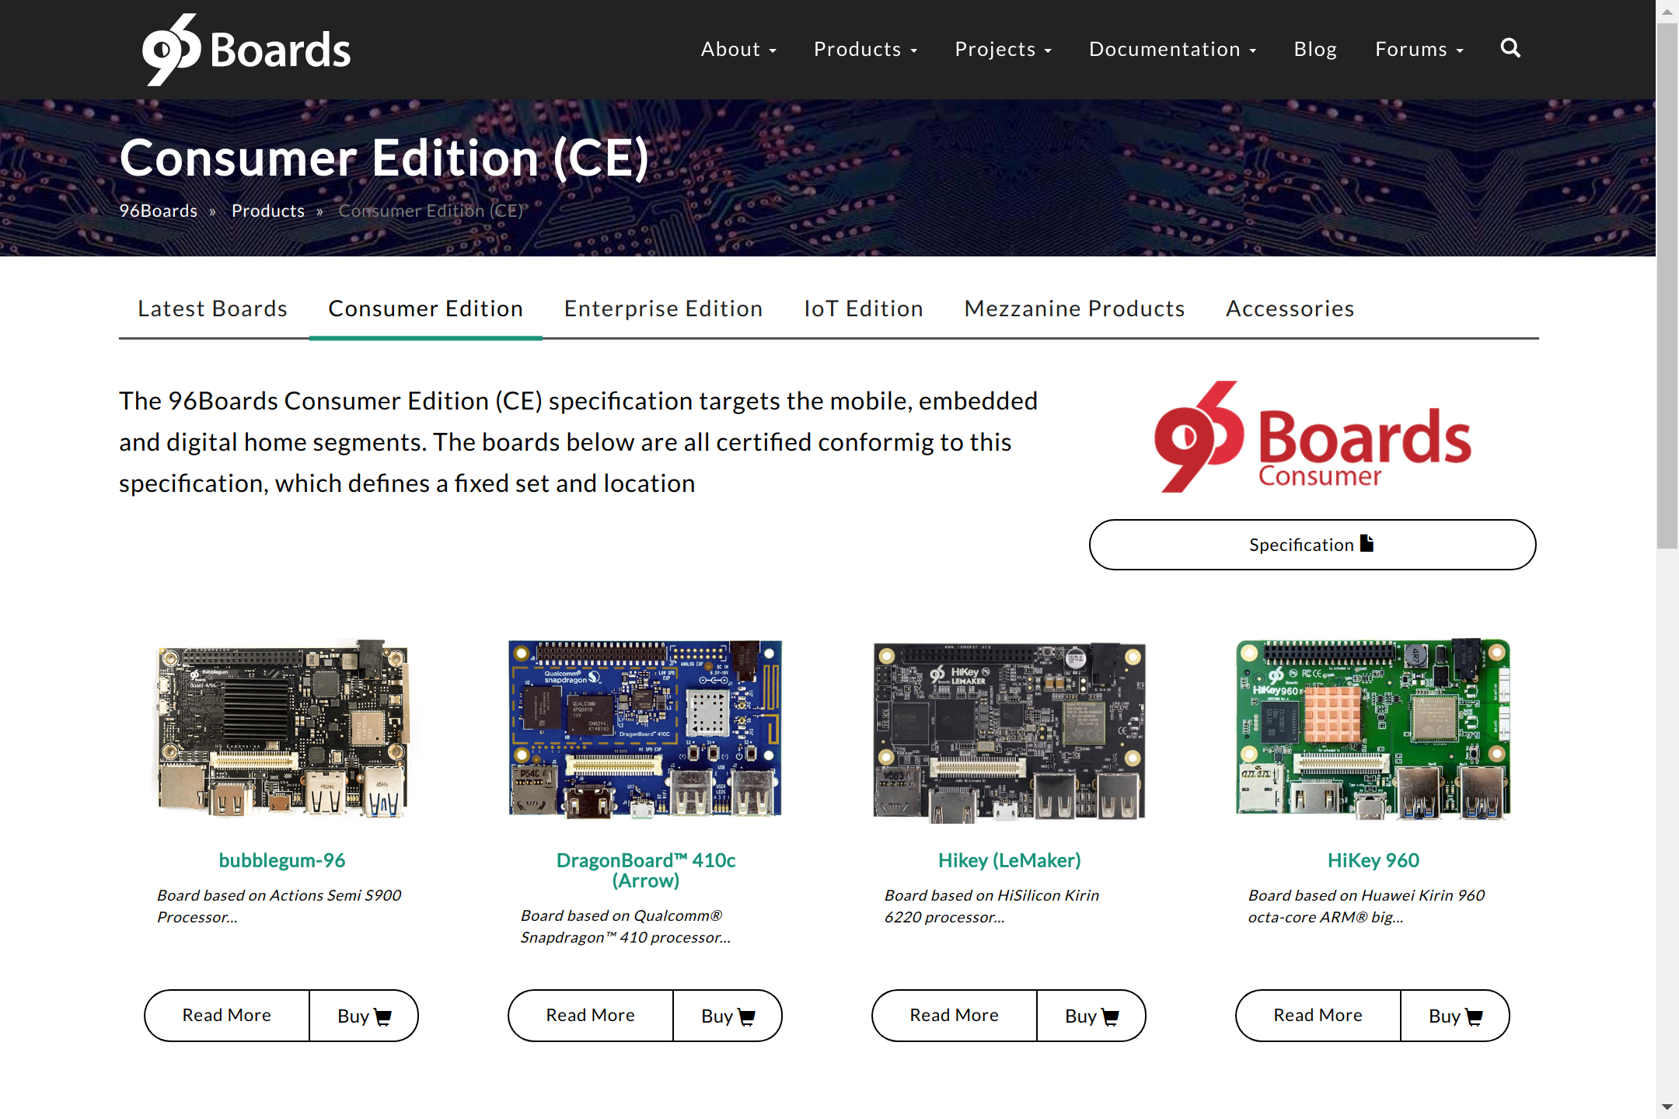
Any OSHW on 96boards.org?

Slide 60
Any OSHW on 96boards.org?
96Boards and Open Source Hardware
“Linaro is a software company, and the goal of 96Boards is to provide an option for standardization of SoC boards for software developers, the maker community and embedded product manufacturers.”
“There is a considerable investment in tools and specialist engineering effort required in designing with a modern high speed SoC which can have over 600 pins in a 0.4mm pitch BGA package - board design and layout costs can easily exceed $25K even before an initial prototype can be built. Furthermore, designs for new SoCs often require the direct involvement of the SoC vendor’s engineers to ensure that design rules for the SoC and PMIC have been fully met.”

Slide 61
Any OSHW on 96boards.org?
Mezzanine Community:
The 96Boards Mezzanine Community was formed by a group of individuals who shared the passion of Open-Source hardware & software.
This community aims to create an ecosystem of Open-Hardware platforms based around the 96Boards CE Mezzanine Specification and also provide a unified platform to host mezzanine designs.

Slide 62
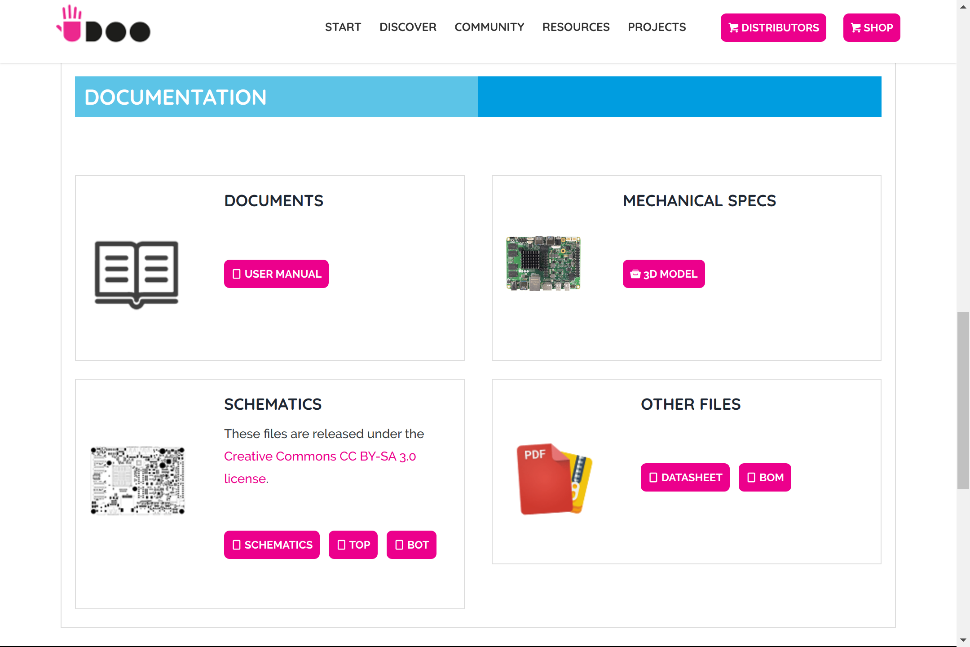
Udoo: no PCB design files?

Slide 63
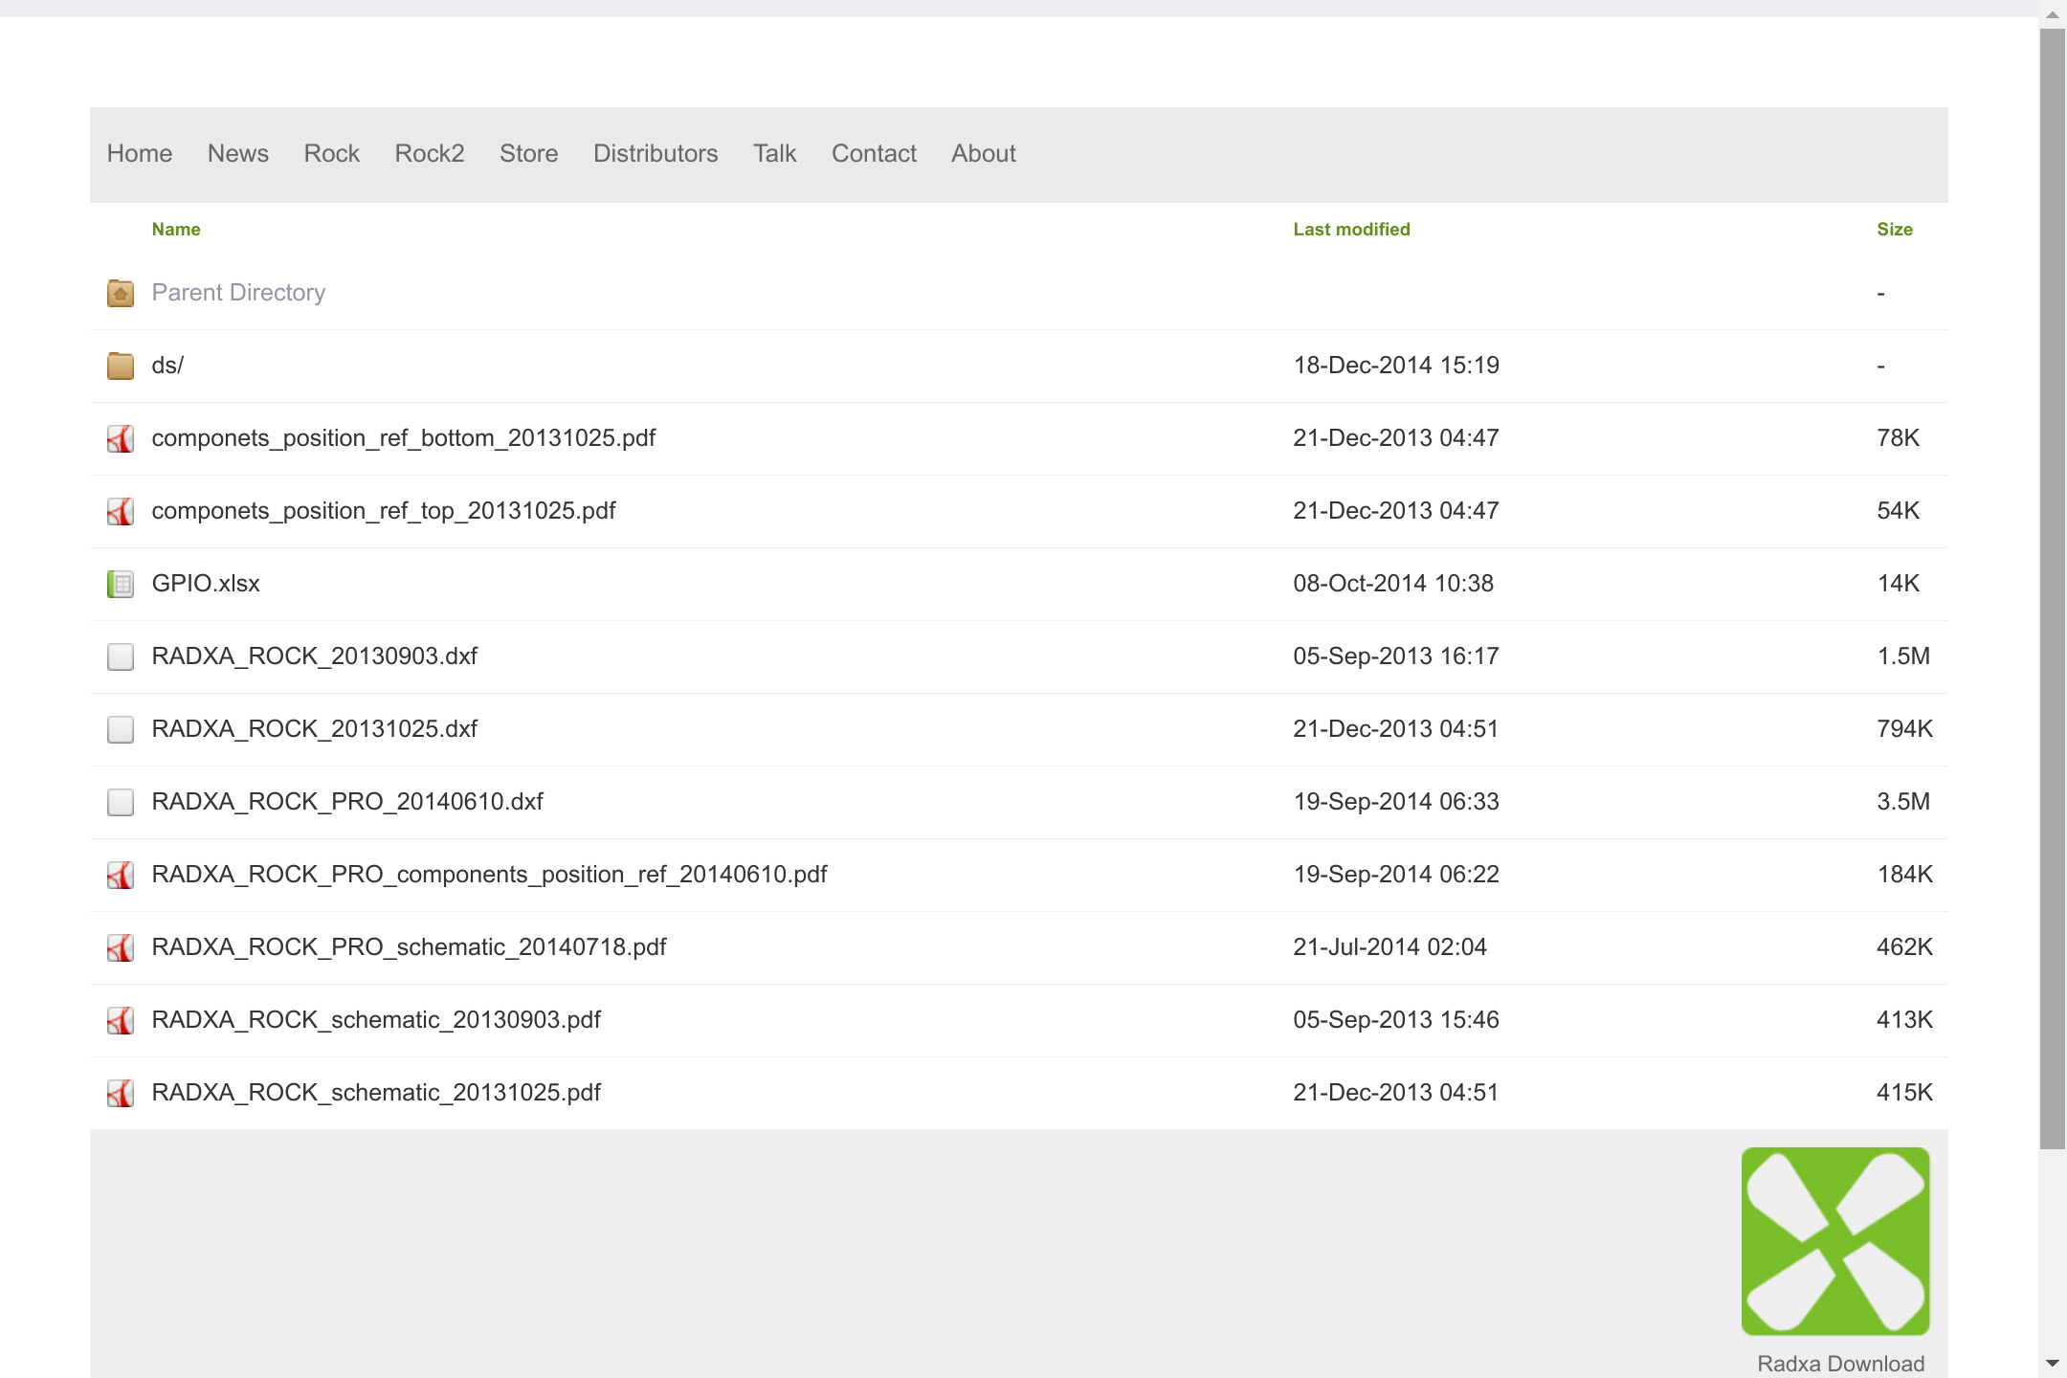
Radxa: no PCB design files?

Slide 64
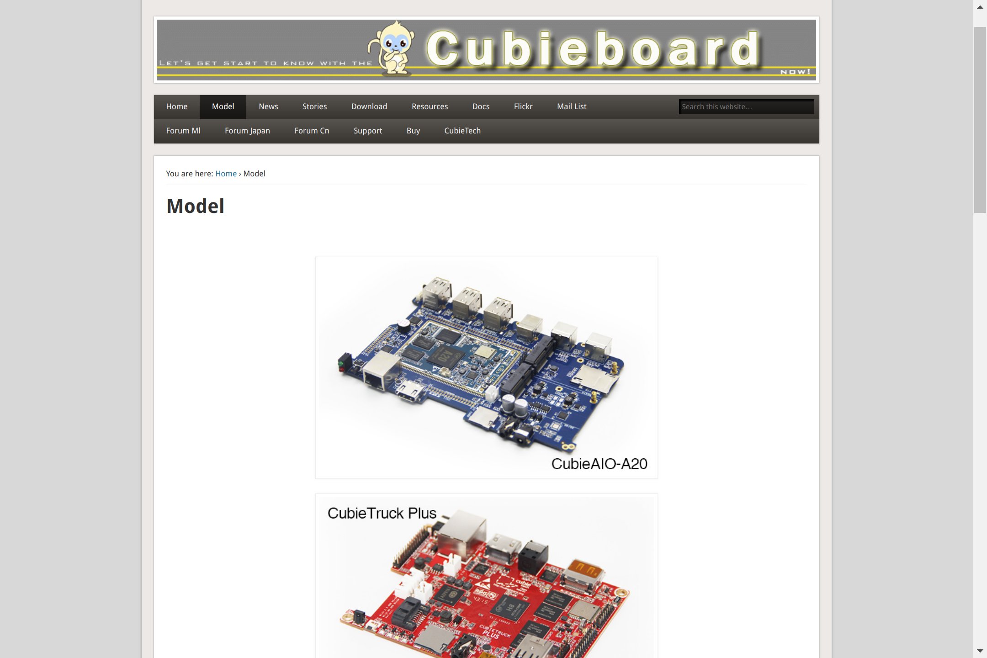
CubieBoard: no PCB design files?

Slide 65
Section:
Open Source and Libre Silicon
Slides: https://github.com/pdp7/talks/blob/master/er2019.pdf

Slide 66

What about silicon?
RISC-V: Free and Open RISC Instruction Set Arch
  “new instruction set architecture (ISA) that was originally designed to support computer architecture research and education and is now set to become a standard open architecture for industry”
  Video: Instruction Sets Want To Be Free: A Case for RISC-V
  Video: Krste Asanovic presents at RISC-V and Open Source Silicon Event in Munich on March 23, 2017

Slide 67


What about silicon?
OnChip Open-V
“completely free (as in freedom) and open source 32-bit microcontroller based on the RISC-V architecture”

Slide 68

What about silicon?

Slide 69

What about silicon?
Crowd Supply update: A Taste of Chip Design
Video: YoPuzzle: mRISC V development platform
Video: RISC-V Community needs Peripheral Cores

Slide 70

What about silicon?
lowRISC:
“creating a fully open-sourced, Linux-capable, RISC-V-based SoC, that can be used either directly or as the basis for a custom design”
Video: Rob Mullins talking about lowRISC
(RISC-V & Open Source Silicon Event in Munich on March 23, 2017)
Laura James from lowRISC is here!

Slide 71

What about silicon?
FOSSi Foundation
  The Free and Open Source Silicon Foundation
  “non-profit foundation with the mission to promote and assist free and open digital hardware designs”
  “FOSSi Foundation operates as an open, inclusive, vendor-independent group.”

Slide 72

What about silicon?
Open Source Silicon Design Ecosystem
  Talk by FOSSi co-founder Julius Baxter

Slide 73

What about silicon?
LibreCores
  Project of the FOSSi Foundation
  “gateway to free and open source digital designs and other components that you can use and re-use in your digital designs”
  “advances the idea of OpenCores.org”

Slide 74

Latch-Up Conf 2019 videos

Slide 75
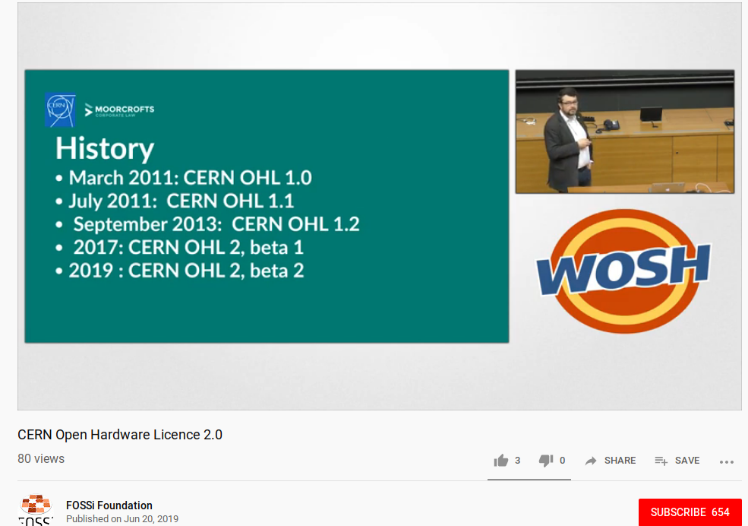
Week of Open Source Hardware

Slide 76

What about silicon?
SiFive
“founded by the creators of the free and open RISC-V architecture as a reaction to the end of conventional transistor scaling and escalating chip design costs”

Slide 77

RISC-V ecosystem
RISC-V Keynote at Embedded Linux Conf
  March 12th, 2018
  Yunsup Lee, Co-Founder and CTO, SiFive
  Designing the Next Billion Chips: How RISC-V is Revolutionizing Hardware

Slide 78

SiFive FE310 microcontroller
HiFive1: Arduino-Compatible RISC-V Dev Kit

Slide 79

SiFive FE310 microcontroller
LoFive designed by Michael Welling (QWERTY Embedded Design)
Lower cost eval board for SiFive FE310.
Open Source Hardware design files
Sold as group buy on GroupGets

Slide 80

SiFive: Linux on RISC-V
FOSDEM 2018 talk
  YouTube: “Igniting the Open Hardware Ecosystem with RISC-V: SiFive's Freedom U500 is the World's First Linux-capable Open Source SoC Platform”
  Interview with Palmer Dabbelt of SiFive

Slide 81

SiFive: Linux on RISC-V
HiFive Unleashed on Crowd Supply

Slide 82
OSHW RISC-V Linux board for less than $100?
Goal: Sub-$100 Open Source Hardware board that can run Linux on RISC-V
Possible by ELC 2019?
Interested in working together?
  drew@oshpark.com / Twitter: @pdp7
  create a mailing list?

Slide 83
Thanks
Suggestions from the OSHWA mailing list:
  Abram Connelly
  Andrew Plumb
  Andrew Quitmeyer
  Eleftherios Kosmas
  Marcin Jakubowski

Slide 84
OSHW boards that run Linux?
Please let me know! drew@pdp7.com Twitter: @pdp7
Create a list on eLinux wiki?

Slide 85
These slides are available at:
https://github.com/pdp7/talks/blob/master/er2019.pdf
Drew Fustini
drew@beagleboard.org
@BeagleBoardOrg / @pdp7
https://beagleboard.org/blog/
This work is licensed under a Creative Commons Attribution-ShareAlike 4.0 International License.

