Slide 1




Drew Fustini
drew@oshpark.com
Twitter: @pdp7
Slides: https://github.com/pdp7/talks/blob/master/fosdem20.pdf
How to run Linux on RISC-V
with open hardware and open source FPGA tools
FOSDEM (2020-02-02)

Slide 2
  Open Source Hardware designer at OSH Park
    PCB manufacturing service in the USA
    drew@oshpark.com / Twitter: @oshpark
  Volunteer Member of Board of Directors of BeagleBoard.org Foundation
      small open source Linux boards
      drew@beagleboard.org
  Volunteer Member of the Board of Directors of the Open Source Hardware Association (OSHWA)
      Open Source Hardware Certification Program: https://certification.oshwa.org/

Slide 3
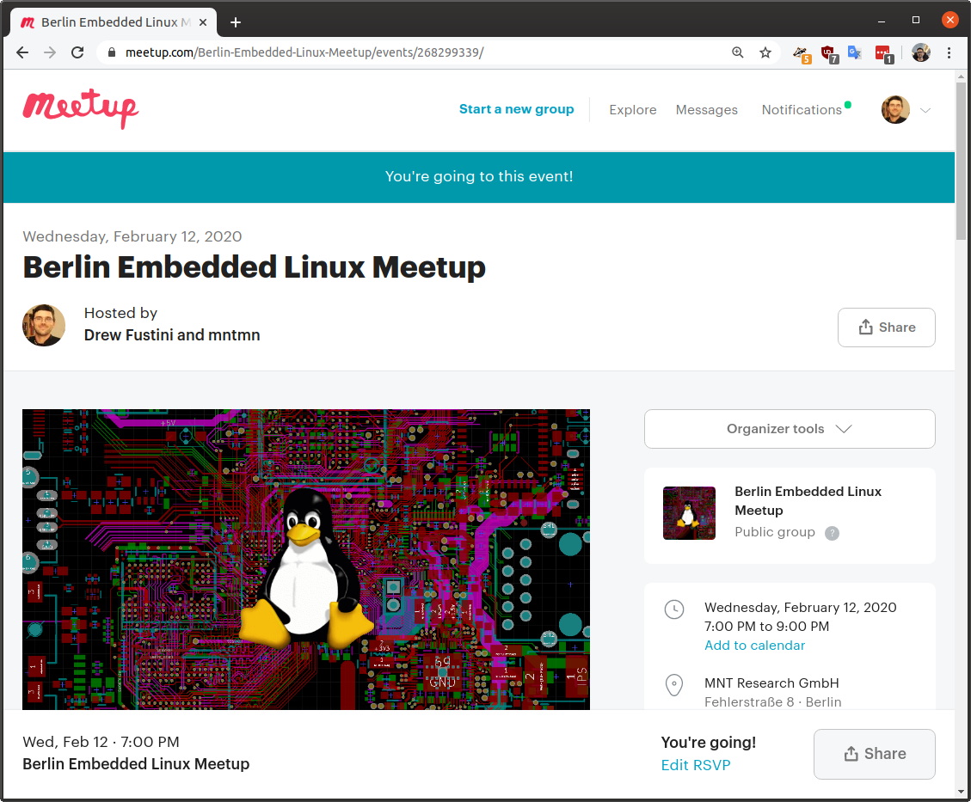

Slide 4

  Open Hardware Summit 2020 in NYC (USA) on March 13th (Friday)
  https://2020.oshwa.org/

Slide 5

Statement of Principles:
Hardware whose design is made publicly available so that anyone can study, modify, distribute, make, and sell the design or hardware based on that design

Slide 6



Documentation required for electronics:
Schematics Board Layout
Editable source files for CAD software such as KiCad or EAGLE
Bill of Materials (BoM)
Not strict requirement, but best practice is for all components available from distributors in low quantity

Slide 7

36c3 talk: Linux on Open Source Hardware with Open Source chip design

Slide 8
Section:
RISC-V the instruction set for everything?
Slides: https://github.com/pdp7/talks/blob/master/fosdem20.pdf

Slide 9
When you write a program in the Arduino IDE, it is compiled into instructions for the microcontroller to execute.
How does the compiler know what instructions the chip understands?
  defined by the Instruction Set Architecture
  The ISA is a standard, a set of rules that define the tasks the processor can perform.
  Examples: x86 (Intel/AMD) and ARM
    Both are proprietary and need commercial licensing

Slide 10

RISC-V: Free and Open RISC Instruction Set Arch
  “new instruction set architecture (ISA) that was originally designed to support computer architecture research and education and is now set to become a standard open architecture for industry”

Slide 11
RISC-V: Free and Open RISC Instruction Set Arch
    Instruction Sets Want To Be Free: A Case for RISC-V
      David Patterson, UC Berekely – co-creator of the original RISC!
      https://www.youtube.com/watch?v=mD-njD2QKN0
    RISC-V Summit 2019: State of the Union
      Krste Asanovic, UC Berkeley
      https://www.youtube.com/watch?v=jdkFi9_Hw-c

Slide 12
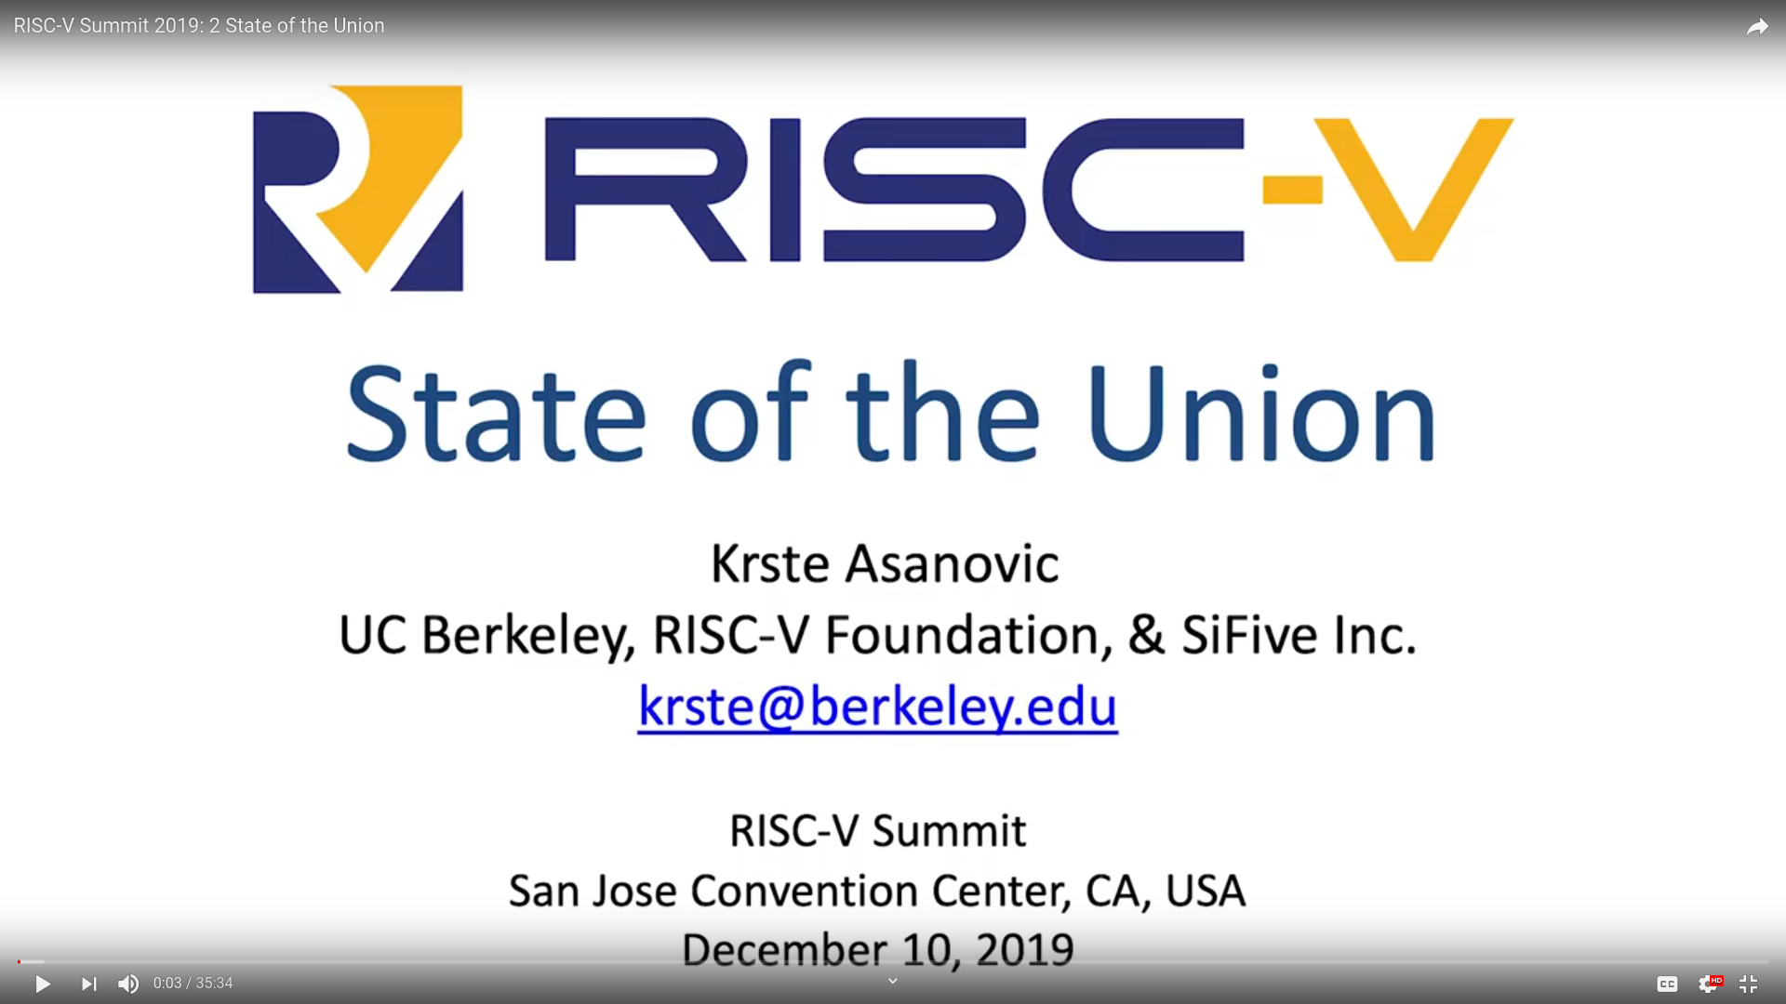

Slide 13


Slide 14


Slide 15


Slide 16
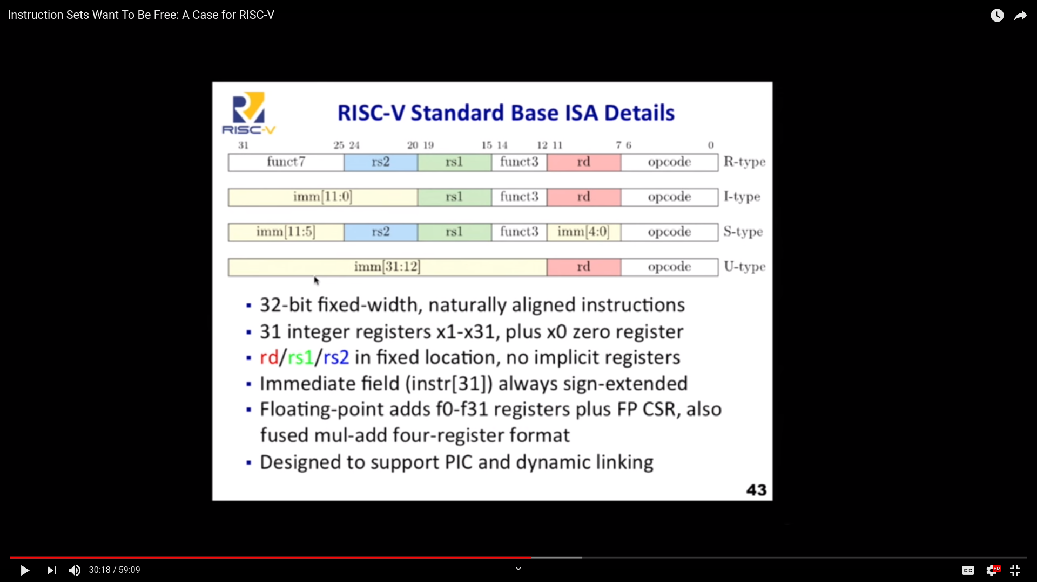

Slide 17
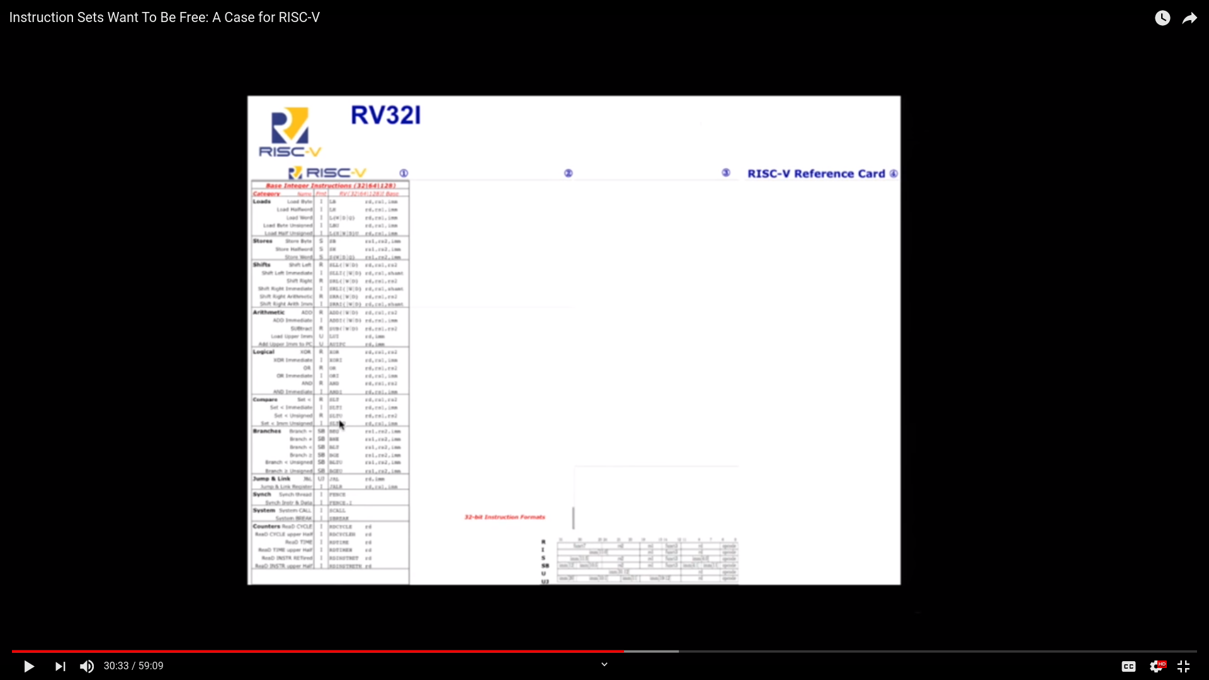

Slide 18
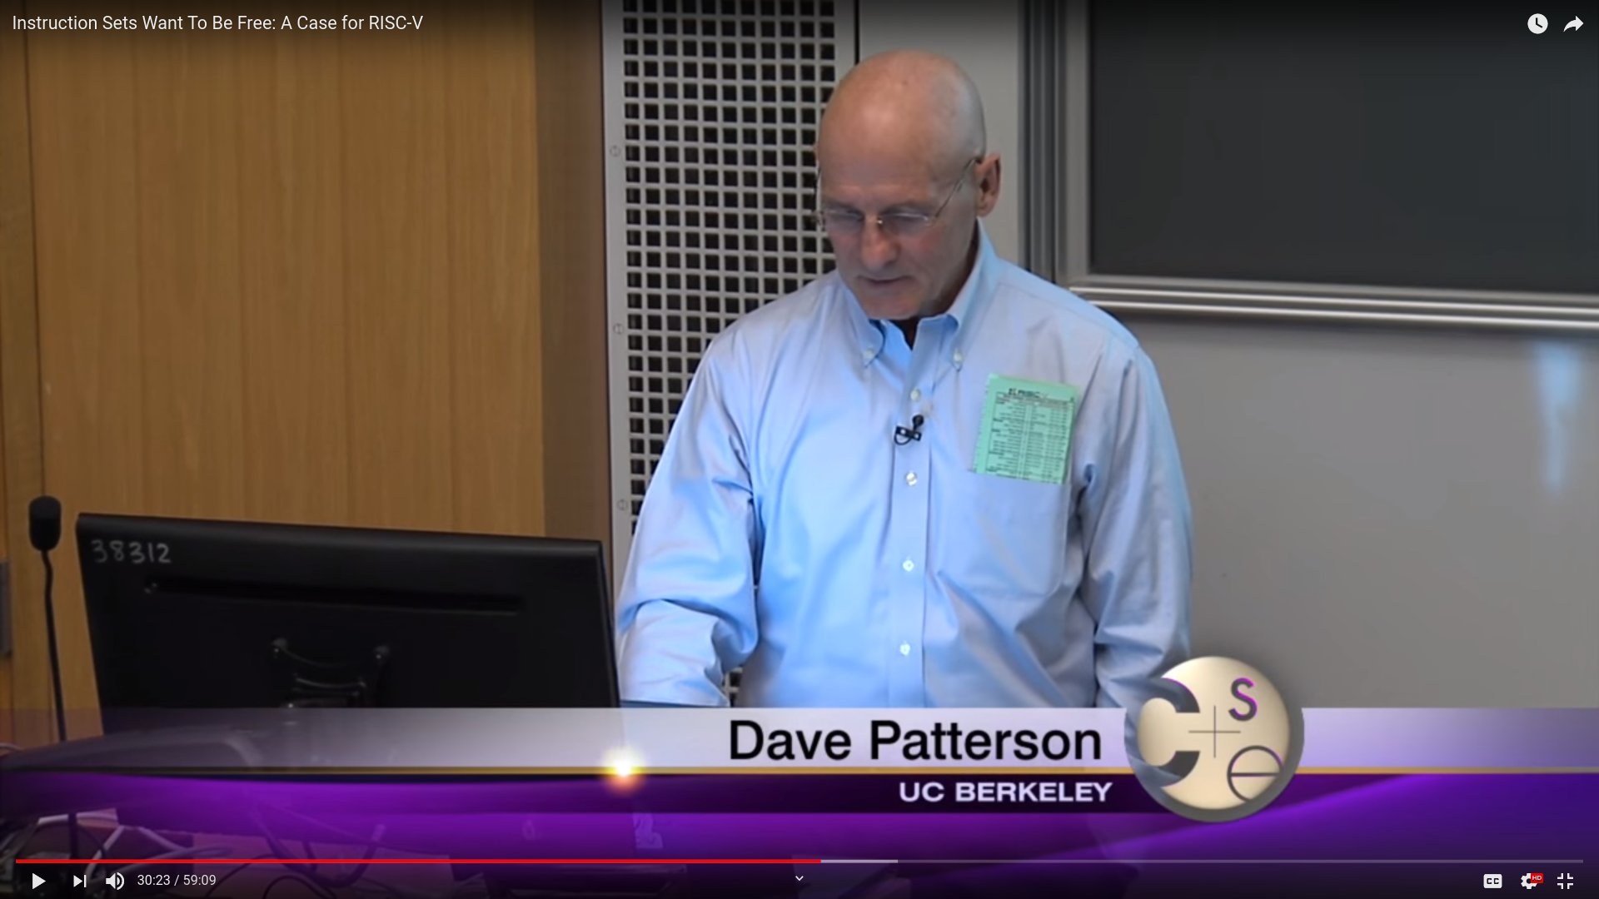

Slide 19
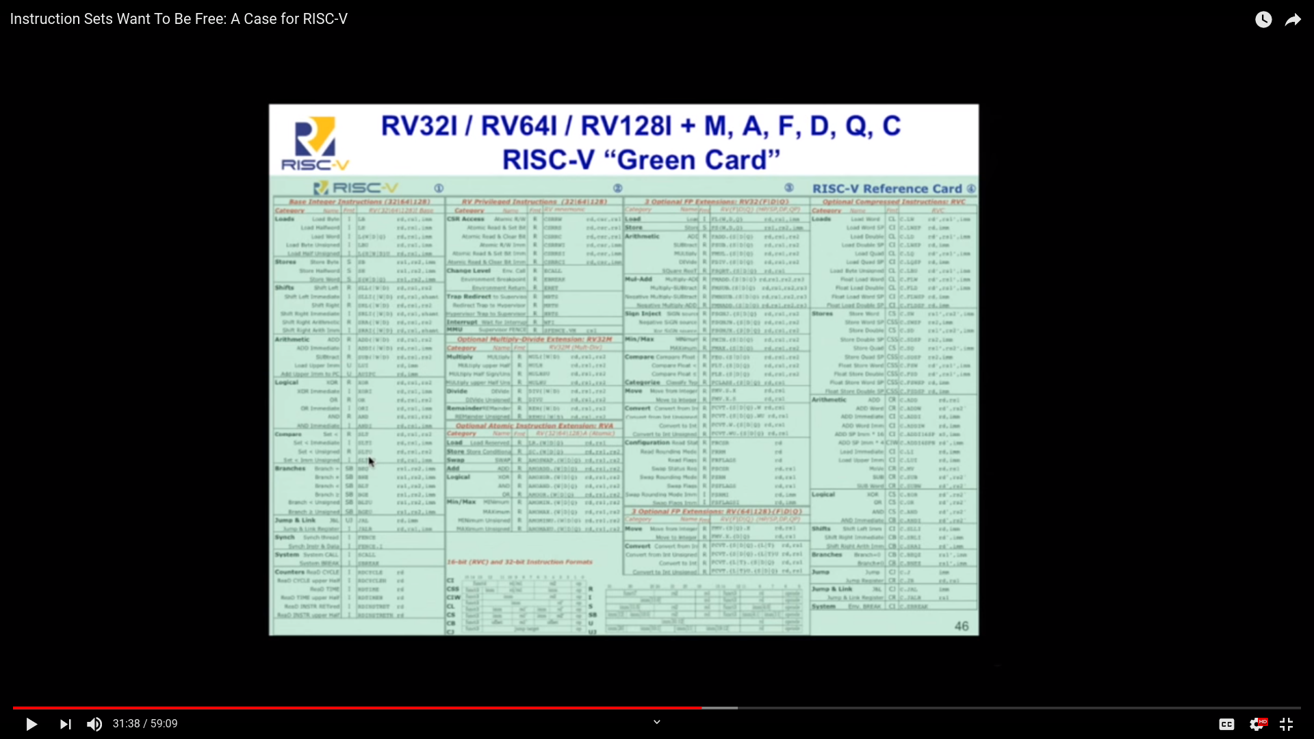

Slide 20
RISC-V and Industry
Created at UC Berkeley but useful beyond academia
Designed to be extensible
  Microcontroller to supercomputer
RISC-V Foundation now controls standard: riscv.org
  Over 400 members: companies, universities and more
  YouTube channel has hundreds of talks!
    https://www.youtube.com/channel/UC5gLmcFuvdGbajs4VL-WU3g
Nvidia and Western Digital will ship millions of devices with RISC-V
  freedom to leverage open source implementations
    BOOM, Rocket, PULP, SweRV, and many more
  avoiding ARM licensing fees

Slide 21
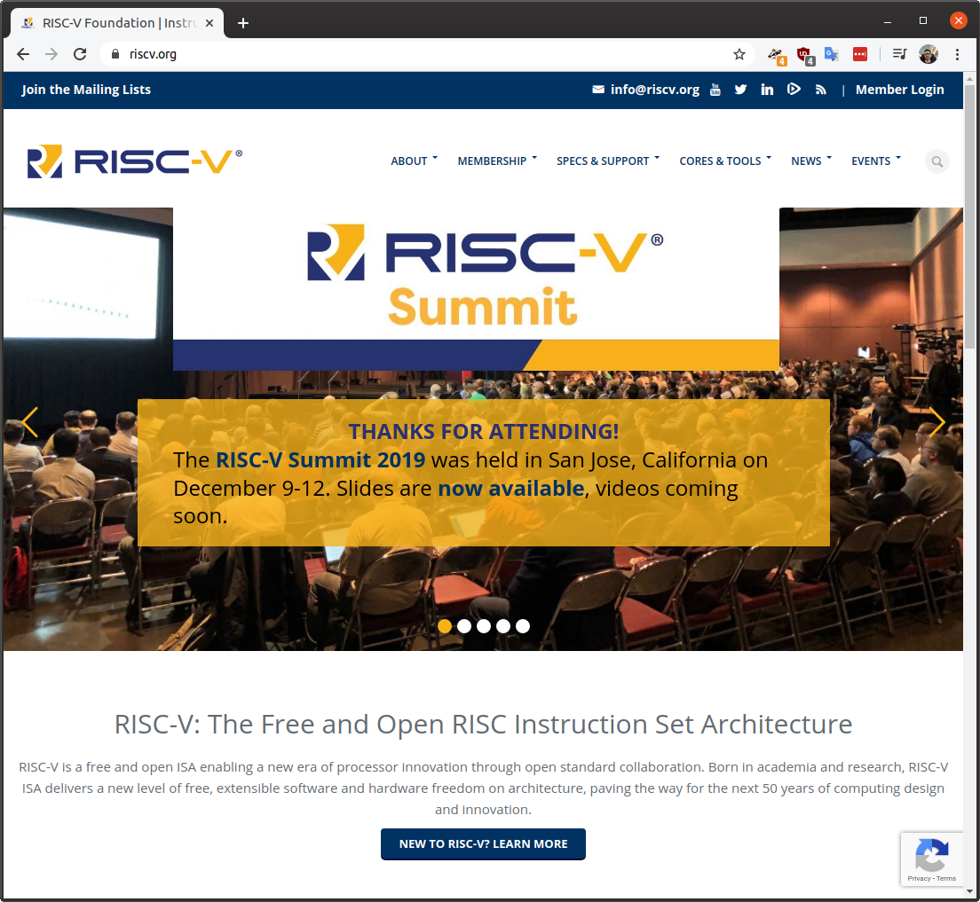

Slide 22
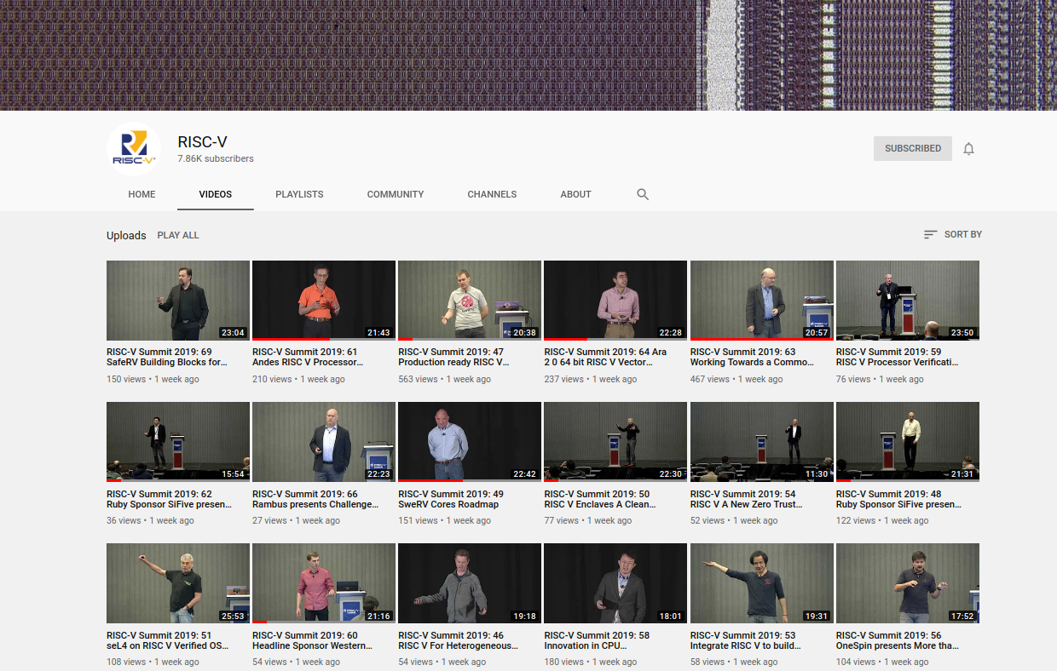

Slide 23
RISC-V and the world
RISC-V Foundation moving from US to Switzerland
Nations such as India have RISC-V initiatives
  Desire for sovereign technology and avoid backdoors from other nations
Strong interest from chipmakers in China
  U.S. companies have been banned from doing business with Huawei… who’s next?
  ARM deemed UK-origin tech so ok to do business with Huawei, but what will brexit-govt bring?

Slide 24

My column in the latest Hackspace Magazine is an introduction to RISC-V and how it is enabling open source chip design:
  hackspace.raspberrypi.org/issues/27/

Slide 25


OnChip Open-V
“completely free (as in freedom) and open source 32-bit microcontroller based on the RISC-V architecture”

Slide 26

OnChip Open-V

Slide 27

lowRISC is a not-for-profit organisation whose goal is to produce a fully open source System-on-Chip (SoC) in volume
  “We will produce a SoC design to populate a low-cost community development board and to act as an ideal starting point for derivative open-source and commercial designs”
OpenTitan project with Google
  Announcing OpenTitan, the First Transparent Silicon Root of Trust

Slide 28

The Future of Operating Systems on RISC-V
  Alex Bradbury gives an overview of the status and development of RISC-V as it relates to modern operating systems, highlighting major research strands, controversies, and opportunities to get involved.
  https://www.youtube.com/watch?v=emnN9p4vhzk

Slide 29
Tutorial for the v0.7 lowRISC release
    By Jonathan Kimmitt (lead developer), and Alex Bradbury (lead reviewer)
    https://www.cl.cam.ac.uk/~jrrk2/docs/ariane-v0.7/tutorial/
    Digilent Nexys A7-100T: $265
    This tutorial adds further functionality towards the final SoC design:
      Graphical Colour Console with X-windows support incorporating mouse and keyboard events.
      Choice of SD-Card, Quad-SPI or Ethernet TFTP boot-loader with DHCP support.
      Linux 5.3.8 RISCV kernel and updated Debian userland with advanced package tool.
      Choice of RV64-GC Rocket (Chisel) or Ariane (SystemVerilog) CPU

Slide 30

FOSSi Foundation
  The Free and Open Source Silicon Foundation
  “non-profit foundation with the mission to promote and assist free and open digital hardware designs”
  Events: ORConf, Latch-up, Week of OSHW
  Open Source Silicon Design Ecosystem
    Talk by FOSSi co-founder Julius Baxter

Slide 31

LibreCores
  Project of the FOSSi Foundation
  “gateway to free and open source digital designs and other components that you can use and re-use in your digital designs”
  “advances the idea of OpenCores.org”

Slide 32

SiFive
“founded by the creators of the free and open RISC-V architecture as a reaction to the end of conventional transistor scaling and escalating chip design costs”

Slide 33

SiFive FE310 microcontroller
HiFive1: Arduino-Compatible RISC-V Dev Kit

Slide 34

SiFive: Linux on RISC-V
FOSDEM 2018 talk
  YouTube: “Igniting the Open Hardware Ecosystem with RISC-V: SiFive's Freedom U500 is the World's First Linux-capable Open Source SoC Platform”
  Interview with Palmer Dabbelt of SiFive

Slide 35

SiFive: Linux on RISC-V
HiFive Unleashed on Crowd Supply

Slide 36

  RISC-V Summit 2019: Linux on RISC V Fedora and Firmware Status Update
    https://www.youtube.com/watch?v=WC6e3g8uWdk
    Wei Fu – Software Engineer, Red Hat

Slide 37


Slide 38


Slide 39
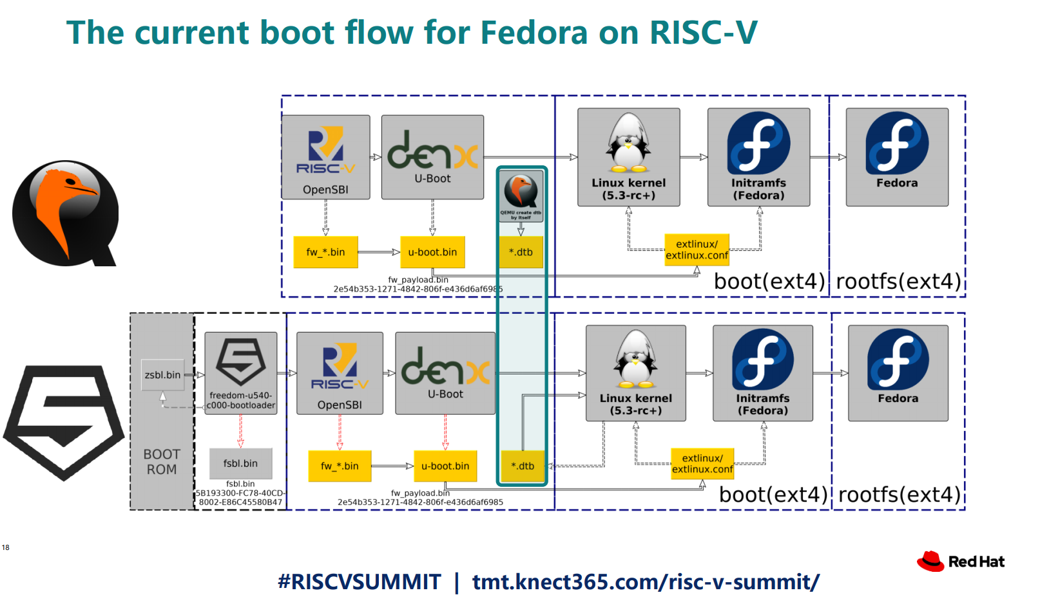

Slide 40


Slide 41
Experiment to get Linux on the low cost Kendryte K210 RISC-V microcontroller
  dual core 64-bit RISC-V at 400MHz with 8MB SRAM
  Sipeed MAix BiT for RISC-V $13
  PDF: RISC-V NOMMU and M-mode Linux
  youtube.com/watch?v=ycG592N9EMA&t=10394
  jump to 2h 53m
Many RISC-V Improvements Ready For Linux 5.5: M-Mode, SECCOMP, Other Features

Slide 42
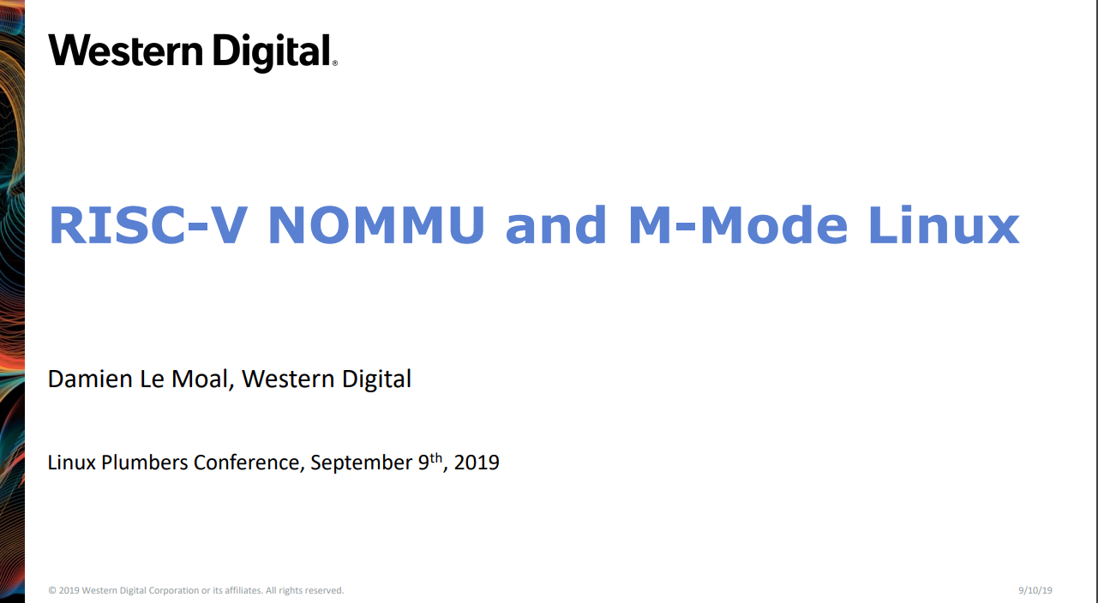

Slide 43


Slide 44
Coming in 2020?
Andes 27-series CPU
  “32-bit A27 and 64-bit AX27 and NX27V cores, which will enter production in Q1 2020.”
  Andes’ RISC-V SoC debuts with AI-ready VPU as Microchip opens access to its PolarFire SoC
Microchip PolarFire SoC FPGA
  Hard RISC-V with FPGA fabric… like the Xilinx Zync for ARM
NXP iMX with RISC-V instead of ARM!
  “OpenHW Group Unveils CORE-V Chassis SoC Project, Building on PULP Project IP”

Slide 45
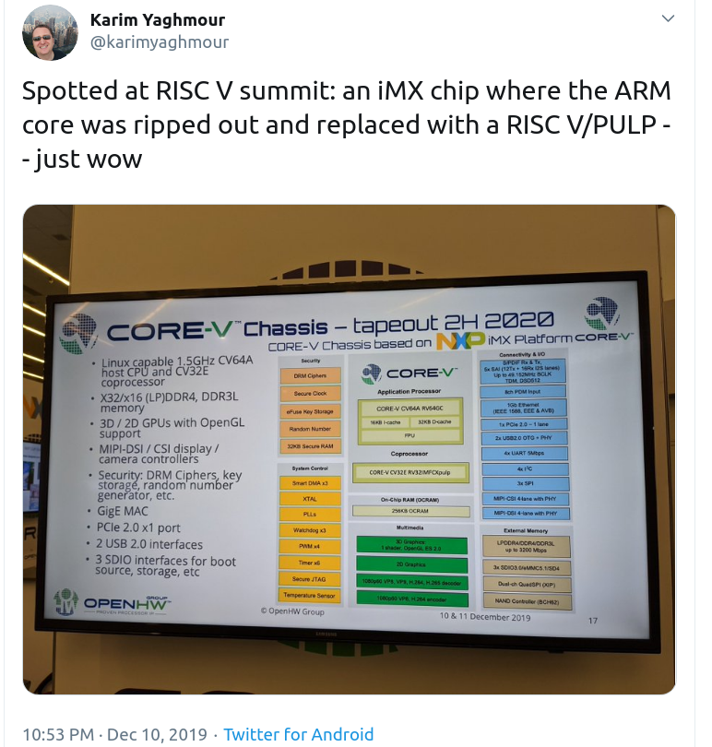

Slide 46

Coming in 2020?

Slide 47
OSHW RISC-V Linux board for less than $100?
Goal: Sub-$100 Open Source Hardware board that can run Linux on RISC-V
Possible by FOSDEM 2021?
Interested in working together?
  drew@oshpark.com / Twitter: @pdp7
  create a mailing list?

Slide 48
Section:
Open Source FPGA tools
Slides: https://github.com/pdp7/talks/blob/master/fosdem20.pdf

Slide 49


Open Source and FPGAs
Hackspace Magazine column about how about open source FPGA tools developed by Claire Wolf (oe1cxw), David Shah and others have made FPGAs more accessible than ever before to makers and hackers:
  hackspace.raspberrypi.org/issues/26/

Slide 50

Keynote at Hackday Supercon 2019 by
Dr. Megan Wachs of SiFive
“RISC-V and FPGAs: Open Source Hardware Hacking”
  https://www.youtube.com/watch?v=vCG5_nxm2G4

Slide 51


Slide 52

Open Source and FPGAs
Open Source toolchains for FPGAs!
  Project IceStorm for Lattice iCE40
    “A Free and Open Source Verilog-to-Bitstream Flow for iCE40 FPGAs” by Claire Wolf (oe1cxw) at 32c3

Slide 53

Open Source and FPGAs
Open Source toolchains for FPGAs!
  Project Trellis for Lattice ECP5
  “Project Trellis and nextpnr FOSS FPGA flow for the Lattice ECP5” - David Shah (@fpga_dave)
    youtube.com/watch?v=0se7kNes3EU

Slide 54

Open Source and FPGAs
Open Source toolchains for FPGAs!
  Project X-Ray and SymbiFlow for Xilinix Series 7
  Timothy ‘mithro’ Ansell: “Xilinx Series 7 FPGAs Now Have a Fully Open Source Toolchain!” (almost)
    youtube.com/watch?v=EHePto95qoE

Slide 55

Open Source and FPGAs
Open Source Hardware boards with Lattice ECP5 FPGA with open RISC-V “soft” CPU:
  Orange Crab by Greg Davill
    https://github.com/gregdavill/OrangeCrab

Slide 56


Slide 57

Open Source and FPGAs
Radiona.org ULX3S
    https://www.crowdsupply.com/radiona/ulx3s

Slide 58

Open Source and FPGAs
Open Source Hardware boards with Lattice ECP5 FPGA with open RISC-V “soft” CPU:
  David Shah's Trellis board (Ultimate ECP5 Board)
  https://github.com/daveshah1/TrellisBoard

Slide 59


Slide 60
Section:
Linux on the Hackaday Badge
Slides: https://github.com/pdp7/talks/blob/master/fosdem20.pdf

Slide 61

Hackaday 2019 Supercon badge
RISC-V “soft” core on ECP5 FPGA
Gigantic FPGA In A Game Boy Form Factor

Slide 62

“Team Linux on Badge”

Slide 63
“Team Linux on Badge”
Blog post: Hackaday Supercon badge boots Linux using SDRAM cartridge
  https://blog.oshpark.com/2019/12/20/boot-linux-on-this-hackaday-supercon-badge-with-this-sdram-cartridge/
Michael Welling (@QwertyEmedded), Tim Ansell (@mithro), Sean Cross (@xobs), Jacob Creedon (@jacobcreedon)
First attempt: use the built-in 16MB SRAM…
no luck :(
  (though xobs now might have a way to do it)

Slide 64

“Team Linux on Badge”
Second attempt:
  Jacob Creedon designed an a cartridge board that adds 32MB of SDRAM to the Hackaday Supercon badge… before the event!

Slide 65

“Team Linux on Badge”
Second attempt:
  Jacob Creedon designed an a cartridge board that adds 32MB of SDRAM to the Hackaday Supercon badge… before the event!

Slide 66

LiteX used to build cores, create SoCs and full FPGA designs.
LiteX is based on Migen
Migen lets you do FPGA design in Python!
https://github.com/enjoy-digital/litex

Slide 67


Slide 68

Linux on LiteX-VexRiscv
VexRiscv: 32-bit Linux Capable RISC-V CPU
SoC built using VexRiscv core and LiteX moduels like LiteDRAM, LiteEth, LiteSDCard, ...
  github.com/litex-hub/linux-on-litex-vexriscv

Slide 69


Slide 70

upstream support for Hackaday Supercon badge:
  https://github.com/litex-hub/litex-boards/pull/31

Slide 71

upstream support for Hackaday Supercon badge:
  https://github.com/litex-hub/litex-boards/pull/31

Slide 72

upstream support for Hackaday Supercon badge:
  https://github.com/litex-hub/litex-boards/pull/31

Slide 73


Slide 74


Slide 75


Slide 76


Slide 77
Opened GitHub issue:
  optimize performance on Hackaday Badge #35
    https://github.com/litex-hub/litex-boards/issues/35
Now 10x faster!
  https://asciinema.org/a/Pcm3vd1BEdEKY9srYX6MsNfCE
  Thanks to enjoy-digital

Slide 78


Slide 79


Slide 80


Slide 81


Slide 82
Slides:
github.com/pdp7/talks/blob/master/fosdem20.pdf
Drew Fustini
drew@oshpark.com
@pdp7
This work is licensed under a Creative Commons Attribution-ShareAlike 4.0 International License.

