Slide 1

Embedded Linux Conference 2017:
Beagle BoF
Jason Kridner
Drew Fustini
Robert C. Nelson
Twitter: @beagleboardorg

Slide 2

Beagle BoF outline
ELC tomorrow: talks and showcase
BeagleBone OSHW ecosystem
New: BB Wireless, BB Blue, BB X15
Debian images
Debian 9 (“Stretch”) planning
U-Boot Overlays
Development resources

Slide 3
ELC 2017: tomorrow!
ELC Technical Showcase
  BeagleBoard X15 & BeagleBone Blue
  Wednesday, February 22, 5:10 pm - 7:00 pm
Educational Robotics Critical for the Future of Linux
  Jason Kridner, Texas Instruments
  Wednesday, February 22 • 10:30am - 11:20am
Google Summer of Code and BeagleBoard.org
  Drew Fustini, BeagleBoard.org Foundation
  Wednesday, February 22 • 11:30am - 12:20pm

Slide 4
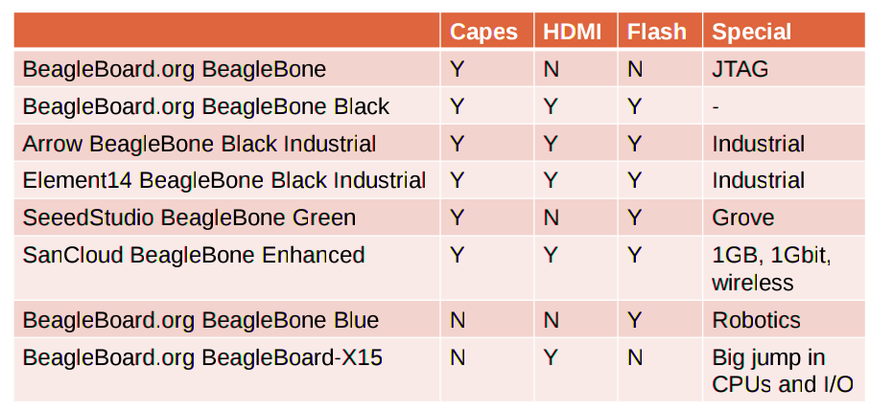
Open Source HardwareBeagleBone derivatives

Slide 5
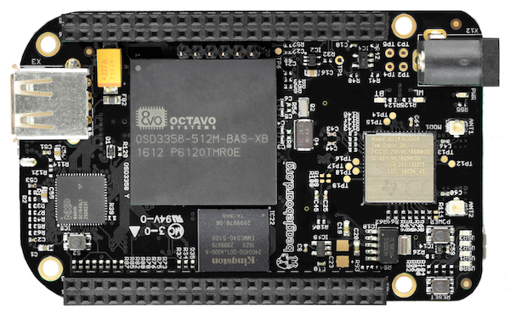
BeagleBone Black Wireless
WiFi 802.11b/g/n and Bluetooth 4.1 with BLE
1st Beagle with Octavo System-in-Package (SiP)
Designed in EAGLE (BBB was OrCad/Allegro)

Slide 6
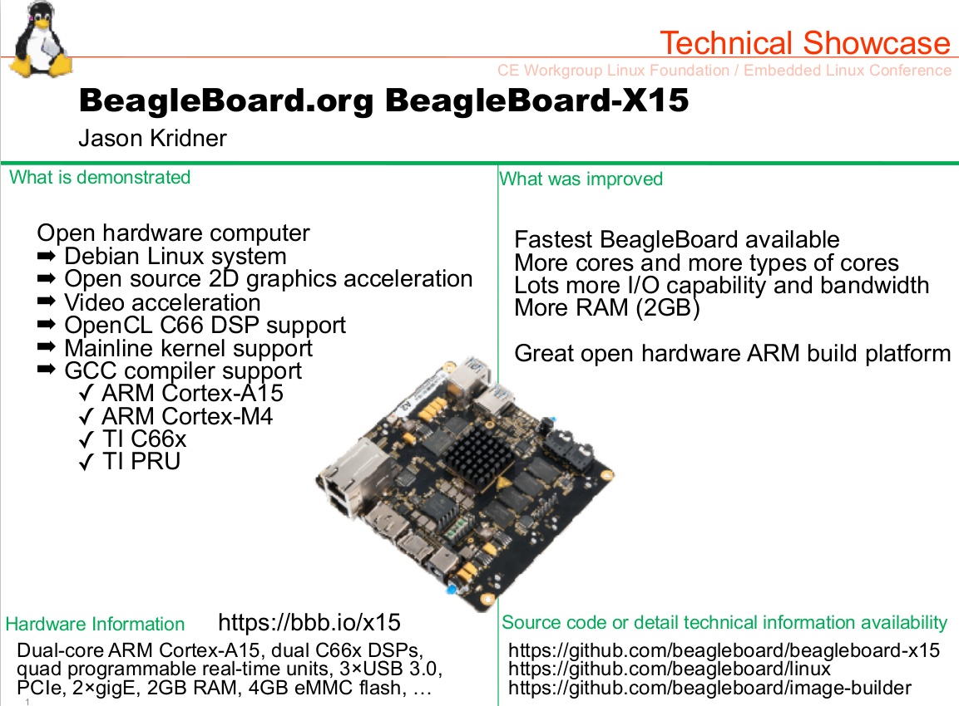

Slide 7
Debian images
BeagleBoard.org Latest Firmware Images
  2016-11-06: Debian 8.6 (“Jessie”)
Debian Image Testing Snapshots
  2017-02-12
    Machinekit
    Jessie Snapshot LXQT (full desktop)
    Jessie Snapshot IoT (smaller size)
    Jessie Snapshot console (minimum size)
    Stretch testing (the future!)

Slide 8
Debian 9 (“Stretch”)
root: password <blank> -> password "root"
root: ssh access -> ssh access disabled
debian: sudo doesn't ask for password -> sudo asks
Device-tree-compiler: our v1.4.2-fork -> dtc git mainline
Kernel: v4.4.x-ti/v4.9.x-ti
U-boot: v2017.03+ with device tree overlays.
U-Boot overlays by default with cape-universal overlay applied

Slide 9
U-Boot Overlays
U-Boot now has Device Tree Overlay support
  debian testing: 2017-01-03 (U-Boot Cape Manager edition)
U-Boot Overlays is currently under development, while the items below may work on "last weeks" version
Please report bugs to: beagleboard/bb.org-overlays/issues
  Always double check the version you are using for comparison.

Slide 10
U-Boot Overlays
Migration Guide: U-Boot Overlays
U-Boot /boot/uEnv.txt configuration
  enable_uboot_overlays=1
U-Boot Disable onboard devices
  Disable eMMC: disable_uboot_overlay_emmc=1
  Disable HDMI VIDEO & AUDIO: disable_uboot_overlay_video=1
  Disable HDMI AUDIO: disable_uboot_overlay_audio=1
  Disable WL1835: disable_uboot_overlay_wireless=1

Slide 11
U-Boot Overlays
U-Boot Override external capes
  Cape device tree overlays: beagleboard/bb.org-overlays
  uboot_overlay_addr0=/lib/firmware/<file0>.dtbo
  uboot_overlay_addr1=/lib/firmware/<file1>.dtbo
  uboot_overlay_addr2=/lib/firmware/<file2>.dtbo
  uboot_overlay_addr3=/lib/firmware/<file3>.dtbo
  Plus one custom cape: dtb_overlay=/lib/firmware/<file4>.dtbo
U-Boot Cape Universal
  Utilize beaglebone-universal-io config-pin
  Enable in /boot/uEnv.txt: enable_uboot_cape_universal=1

Slide 12
U-Boot Overlays
U-Boot overlay white list will continue to grow
  0002-U-Boot-BeagleBone-Cape-Manager.patch
If you have a cape, please test, and let's make sure everyone has a good out of box experience!

Slide 13
Development resources
Mailing lists: bbb.io/discuss
IRC: bbb.io/chat
Kernel build:
  RobertCNelson/ti-linux-kernel-dev
Kernel repo:
  beagleboard/linux
DTB Rebuilder
  RobertCNelson/dtb-rebuilder
Device Tree Overlays for bb.org boards
  beagleboard/bb.org-overlays

