Slide 1




Stephano Cetola <scetola@linuxfoundation.org>
Drew Fustini <drew@beagleboard.org>
Slides: https://github.com/pdp7/talks/blob/master/rv-bof-elc.pdf
RISC-V and Open Hardware BoF
Embedded Linux Conference 2020

Slide 2
RISC-V at ELC
Linux on Open Source Hardware with RISC-V (Drew Fustini)
  Tuesday, June 30 • 12:25pm - 1:15pm
  https://sched.co/c3Pn
RISC-V: Instruction Sets Want to be Free (Krste Asanovic)
  Wednesday, July 1 • 10:35am – 10:55am
  https://sched.co/c3Yq
Go RISC-V Go: The State of Software Development Tools for RISC-V (Khem Raj)
  Wednesday, July 1 • 12:15pm - 1:05pm
  https://sched.co/c3Yn
Ask the Expert Session with Calista Redmond, CEO of RISC-V International
  Thursday, July 2 • 11:45am - 12:15pm
  https://sched.co/cosw

Slide 3


Many RISC-V meetups around the world!
https://riscv.org/local/

Slide 4

RISC-V: Free & Open RISC Instruction Set Arch
  “new instruction set architecture (ISA) that was originally designed to support computer architecture research and education and is now set to become a standard open architecture for industry”
  The 5th RISC instruction to come out out UC Berkeley

Slide 5
RISC-V: Free & Open RISC Instruction Set Arch
    Instruction Sets Want To Be Free: A Case for RISC-V
      David Patterson, UC Berekely – co-creator of the original RISC!
      https://www.youtube.com/watch?v=mD-njD2QKN0
    RISC-V Summit 2019: State of the Union
      Krste Asanovic, UC Berkeley
      https://www.youtube.com/watch?v=jdkFi9_Hw-c
      Or watch the KEYNOTE THIS WEDNESDAY!

Slide 6
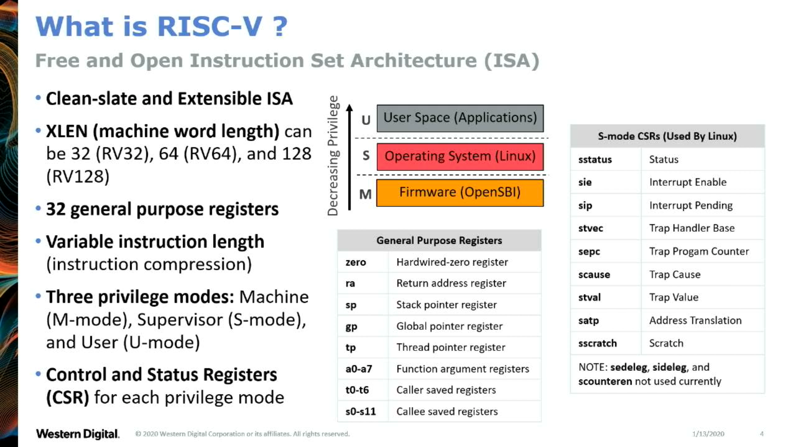
    "Co-developing RISC-V Hypervisor Support" - Anup Patel
      https://youtu.be/4GoikHB5Qcw

Slide 7
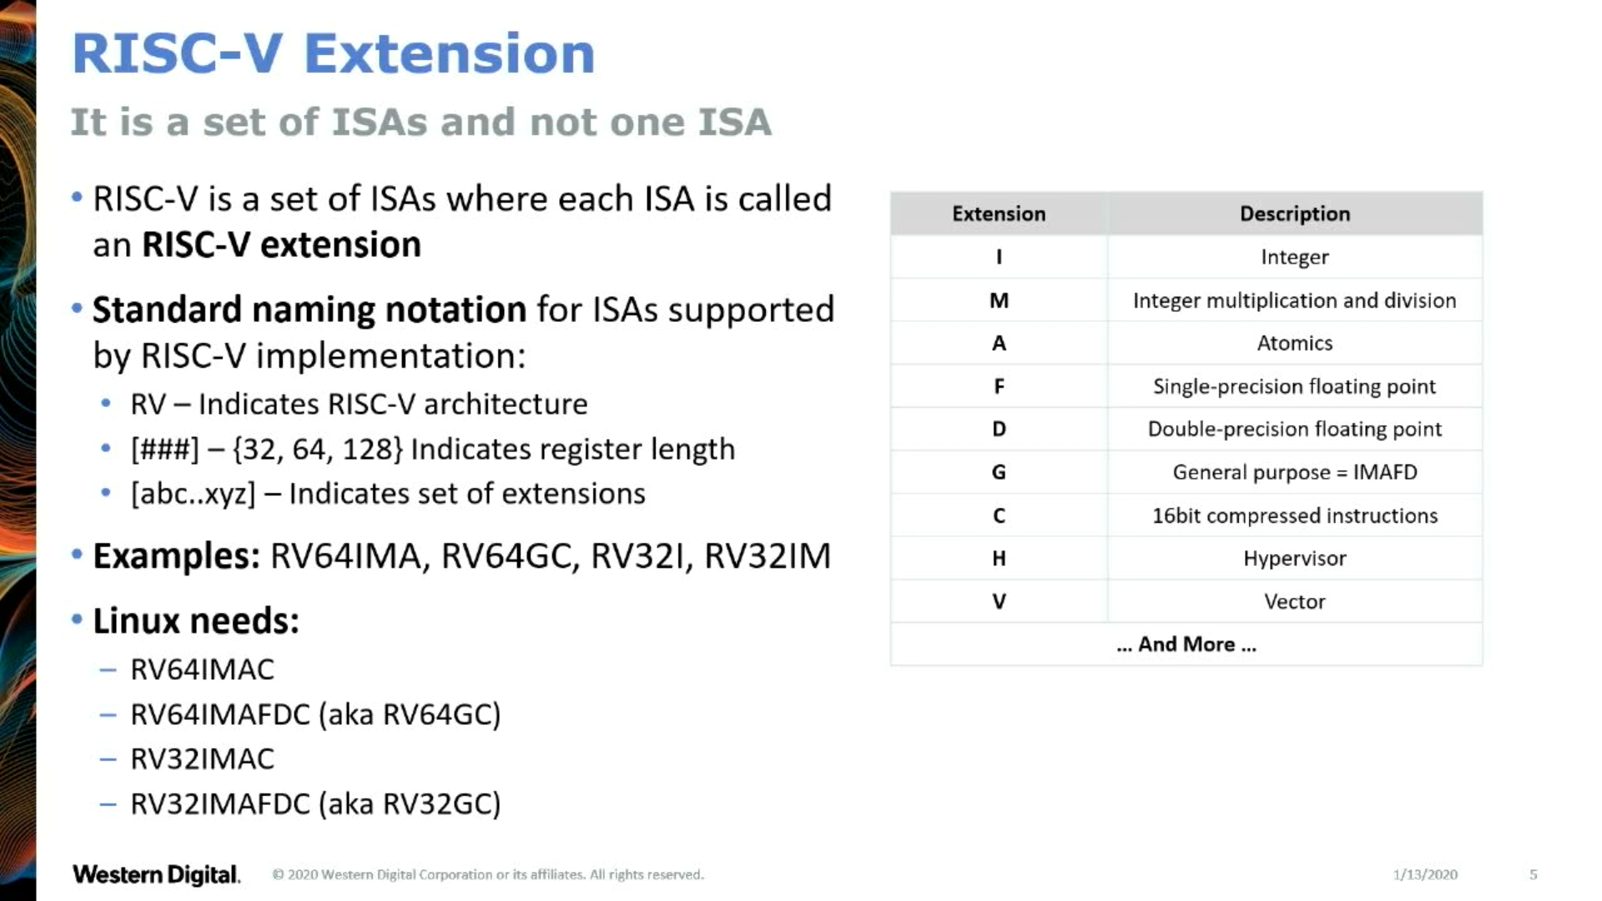
    "Co-developing RISC-V Hypervisor Support" - Anup Patel
      https://youtu.be/4GoikHB5Qcw

Slide 8
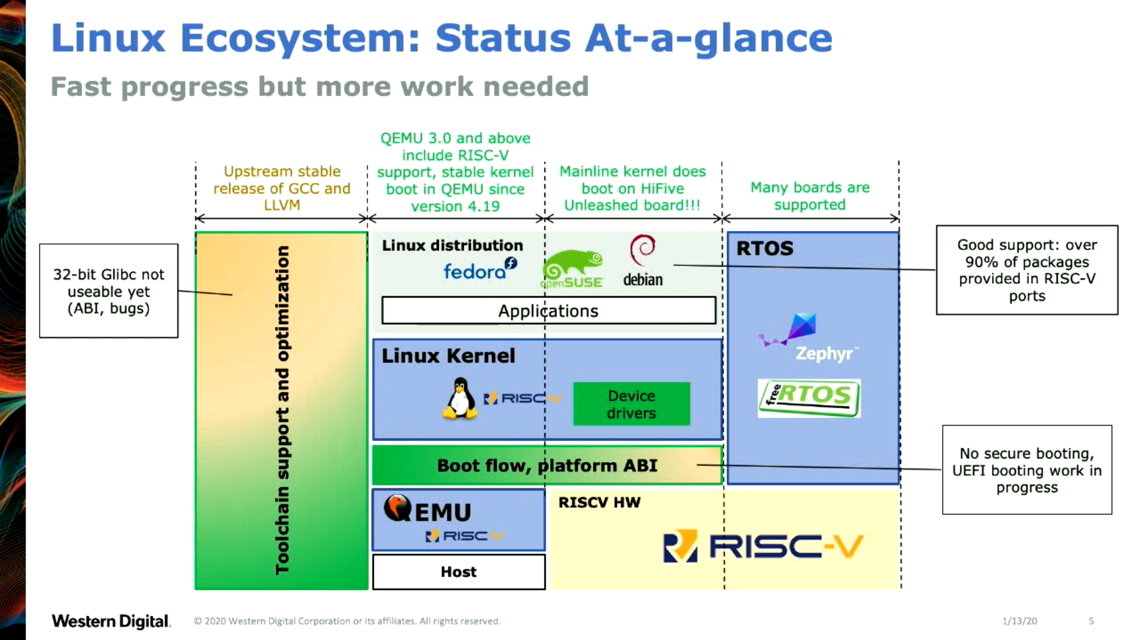
    "RISC-V software ecosystem in 2020" - Atish Patra (LCA 2020)
      https://youtu.be/qwkab2Z44pk

Slide 9
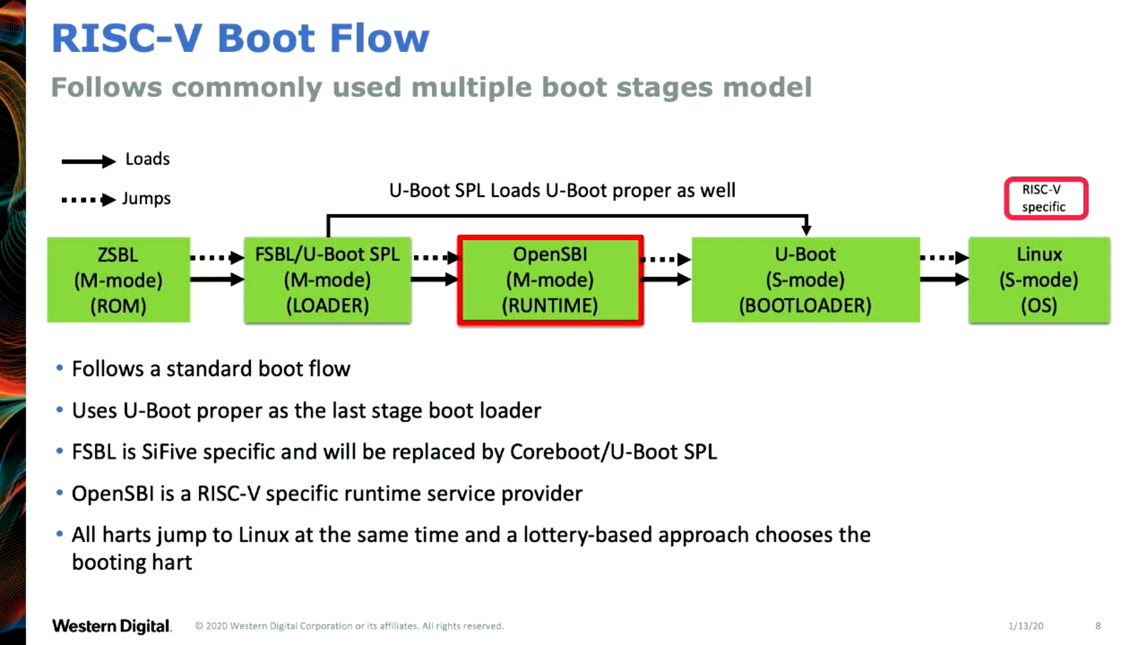
    "RISC-V software ecosystem in 2020" - Atish Patra (LCA 2020)
      https://youtu.be/qwkab2Z44pk

Slide 10
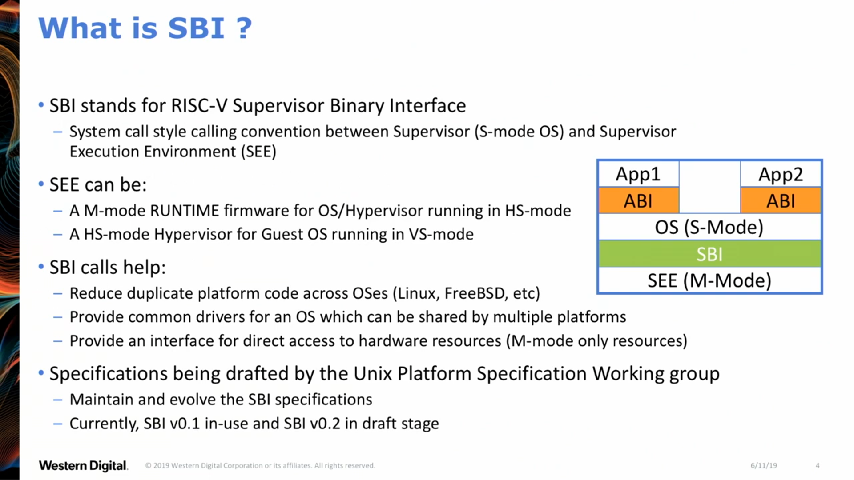
    "OpenSBI Deep Dive" - Anup Patel (RV Workshop 2019)
      https://youtu.be/jstwB-o9ll0

Slide 11
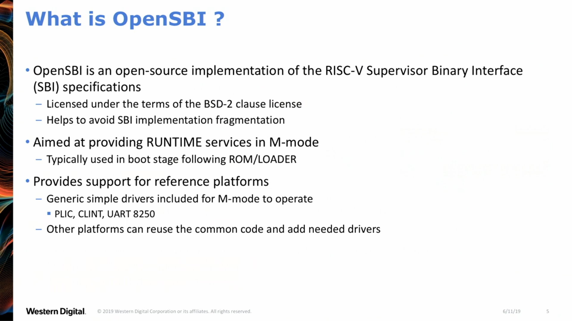
    "OpenSBI Deep Dive" - Anup Patel (RV Workshop 2019)
      https://youtu.be/jstwB-o9ll0

Slide 12
UEFI support
[RFC PATCH 00/11] Add UEFI support for RISC-V
  Atish Patra (June 25, 2019)
  This series adds UEFI support for RISC-V.
    Linux kernel: 5.8-rc2
    U-Boot: master
    OpenSBI: master

Slide 13
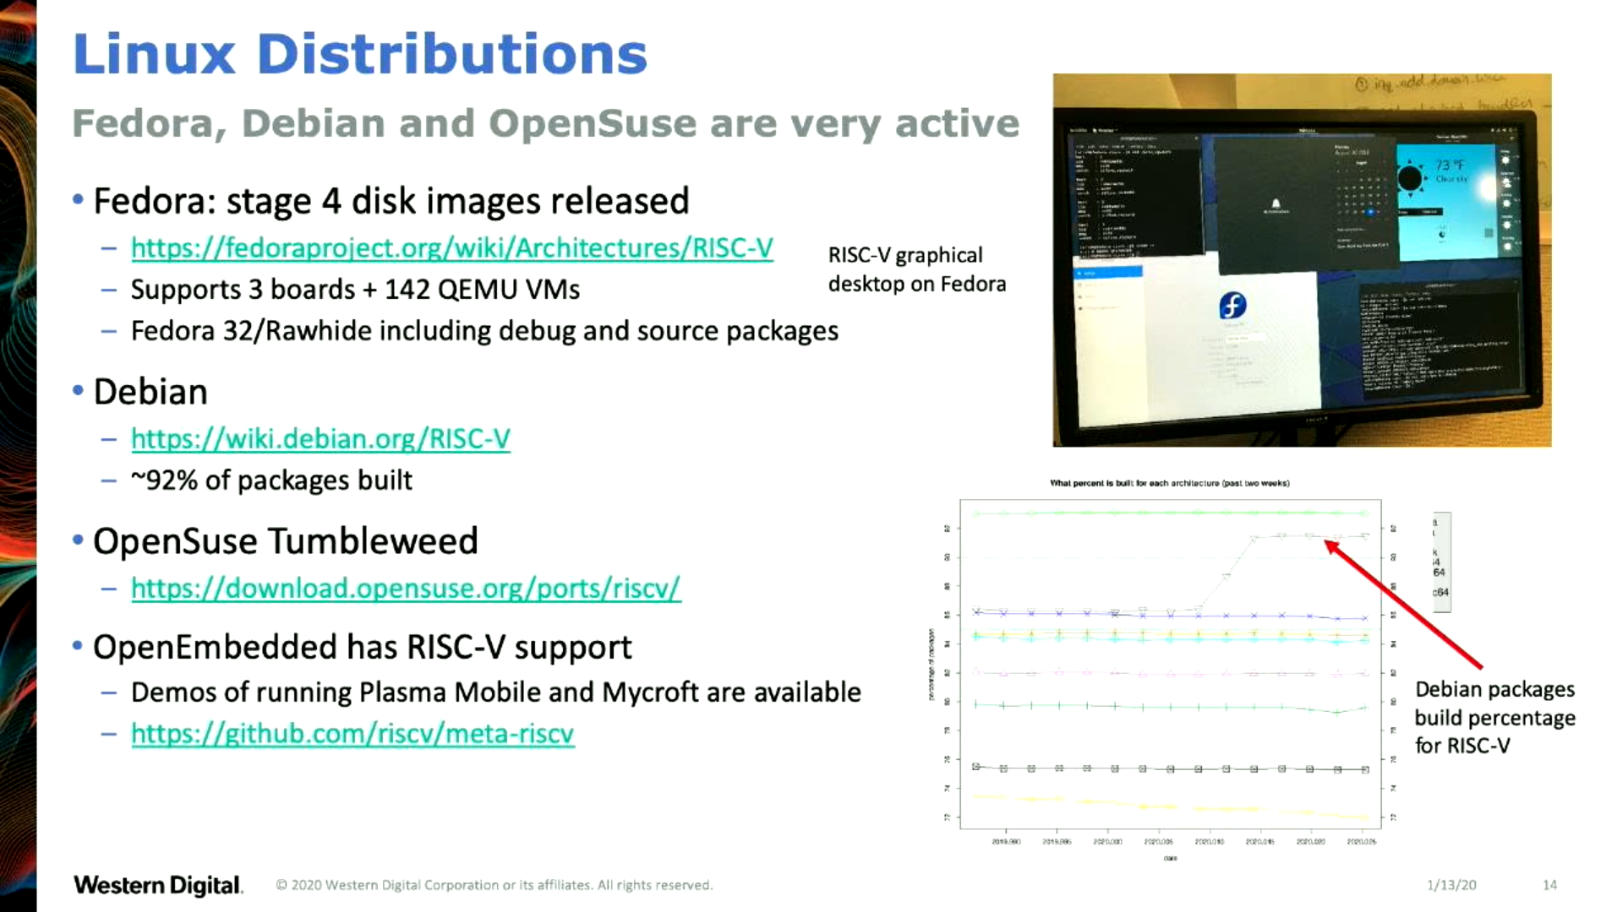
    "OpenSBI Deep Dive" - Anup Patel (RV Workshop 2019)
      https://youtu.be/jstwB-o9ll0

Slide 14
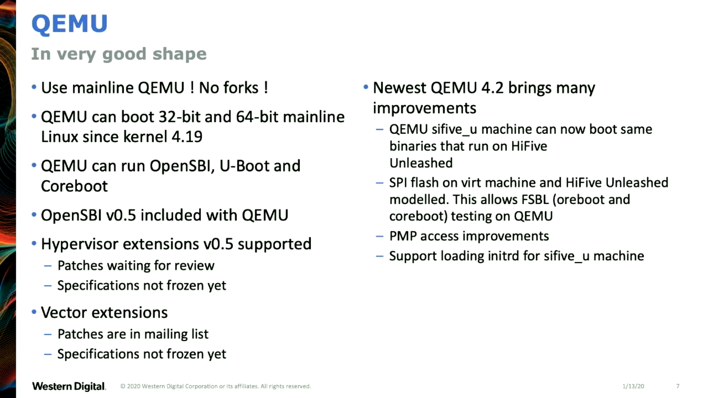
    "OpenSBI Deep Dive" - Anup Patel (RV Workshop 2019)
      https://youtu.be/jstwB-o9ll0

Slide 15

SiFive: Linux on RISC-V
HiFive Unleashed on Crowd Supply

Slide 16

    “Linux on RISC V Fedora” Wei Fu (RV Summit 2019)
      https://www.youtube.com/watch?v=WC6e3g8uWdk

Slide 17


Slide 18
Kendryte K210
  dual core 64-bit RISC-V at 400MHz with 8MB SRAM
  Sipeed MAix BiT for RISC-V is only $13!
  Damien Le Moal at Linux Plumbers 2019
    RISC-V NOMMU and M-mode Linux
  Full support coming in Linux 5.8
  Buildroot with busybox (https://git.io/JJflC)
  need NOMMU/FDPIC support for better userspace
    https://youtu.be/GydyykyNjxs (Maciej W. Rozycki)
    8MB runs out very quick!
  there is a MMU but the wrong spec :(
  u-boot patch series
    [PATCH v14 00/20] riscv: Add Sipeed Maix support
    Sean Anderson (June 24th)

Slide 19
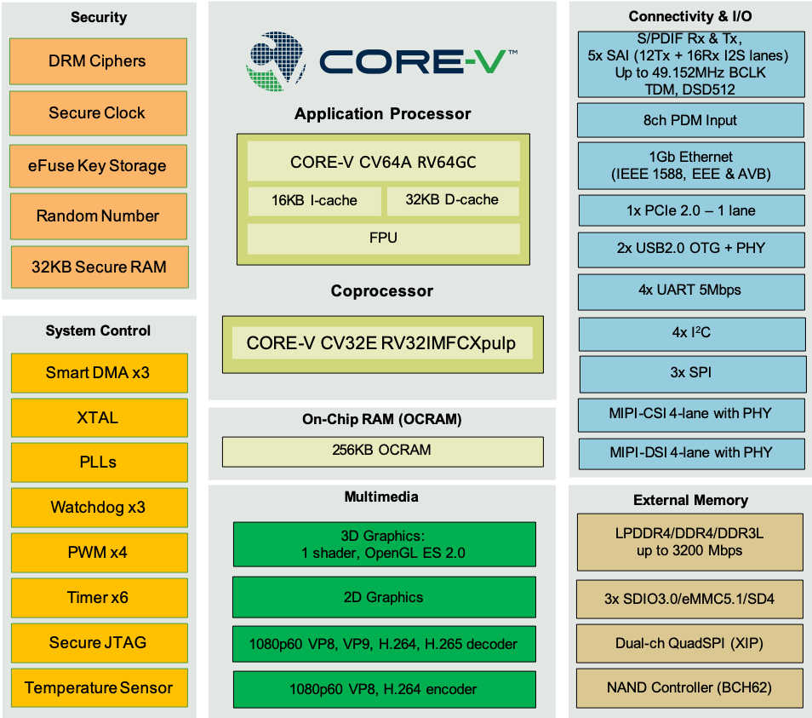
  OpenHW Group Announces CORE-v Chassis SoC
    similar to NXP iMX but with RISC-V cores
    tape-out 2nd half of 2020

Slide 20

Keynote at Hackday Supercon 2019 by
Dr. Megan Wachs of SiFive
“RISC-V and FPGAs: Open Source Hardware Hacking”
  https://www.youtube.com/watch?v=vCG5_nxm2G4

Slide 21

Open Source toolchains for FPGAs
Project Trellis for Lattice ECP5
  “Project Trellis and nextpnr FOSS FPGA flow for the Lattice ECP5” - David Shah (@fpga_dave)
    youtube.com/watch?v=0se7kNes3EU

Slide 22
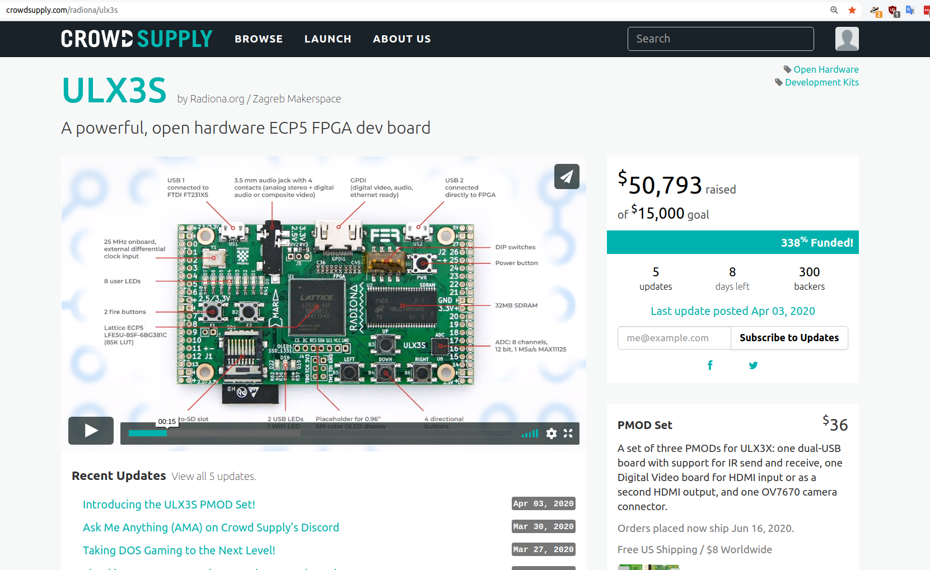
Open Source ECP5 boards
Radiona.org ULX3S
    https://www.crowdsupply.com/radiona/ulx3s

Slide 23

Open Source ECP5 boards
Lattice ECP5 FPGA in Adafruit Feather form factor and 128MB DDR RAM:
  Orange Crab by Greg Davill
    https://github.com/gregdavill/OrangeCrab
    https://groupgets.com/campaigns/710-orangecrab

Slide 24

No hardware? Try Renode!
https://renode.io/

Slide 25
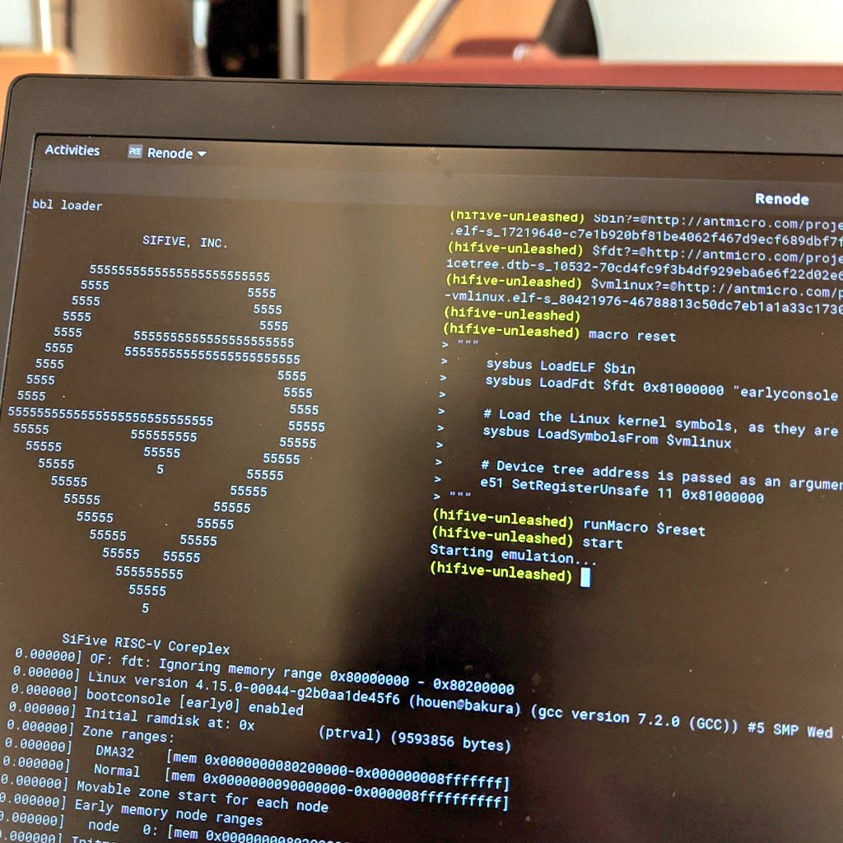

Slide 26
Linux kernel status
https://lore.kernel.org/linux-riscv/
Newly supported:
  eBPF JIT
  kgdb
  kexec/kdump
  generic vDSO support
  Syszcaller
  Build with clang

Slide 27
Linux kernel status
Upcoming:
  UEFI boot
  CLINT driver
  KVM
  RFC: support raw event and DT for perf on RISC-V
  CPUFreq support for FU540 was posted
    (not merged yet)

Slide 28
“What's missing in RISC-V Linux, and how YOU can help!”
Björn Töpel for last week for Munich meetup
https://docs.google.com/presentation/d/1vfrVlWKYWHSw6Q5PDQBn6PC5jwXet4HPxN3f_nxtFm4/edit?usp=sharing

