Slide 1



Drew Fustini
OSH Park
drew@oshpark.com
@oshpark / @pdp7
Slides: https://github.com/pdp7/talks/blob/master/irl-summit-oshw-2018.pdf
Open Source Hardware for Good
IRL Summit at DePaul (2018-02-02)

Slide 2






What is Open Source?
Examples of popular Open Source projects

Slide 3
What is Open Source?
The term "open source" refers to something people can modify and share because its design is publicly accessible
Open Source software is software with source code that anyone can:
inspect, modify, and enhance

Slide 4


What is Free Software?
A program is free software if the users have four essential freedoms:
1) run the program as you wish, for any purpose
2) study how the program works, and change it so it does your computing as you wish
3) redistribute copies so you can help your
neighbor
4) distribute copies of your modified versions

Slide 5

FLOSS is a term to describe software that is Free, Libre, or Open Source Software
In the context of hardware projects, I consider these terms equivalent:
    Free Hardware
    Libre Hardware
    Open Hardware
    Open Source Hardware

Slide 6
Slides: https://github.com/pdp7/talks/blob/master/irl-summit-oshw-2018.pdf
Statement of Principles:
Hardware whose design is made publicly available so that anyone can study, modify, distribute, make, and sell the design or hardware based on that design

Slide 7



Slides: https://github.com/pdp7/talks/blob/master/irl-summit-oshw-2018.pdf
Documentation required for electronics:
Schematics Board Layout
Editable source files for CAD software such as KiCad or EAGLE
Bill of Materials (BoM)
Best practice: all components available from distributors in low quantity

Slide 8

Example: Arduino achieved critical mass by sharing their hardware designs and source code
Arduino: The Documentary describes the team’s motivation

Slide 9

Example: Arduino Uno schematic and PCB layout design files for EAGLE CAD can be downloaded from Arduino.cc

Slide 10
Publish documentation with an
Open Source license:
Creative Commons Share-Alike: CC-BY-SA
    Non-Commercial (NC) clause is NOT acceptable
Copyleft: GPLv2, GPLv3
Permissive: Apache, BSD, MIT
OSHW inspired: CERN OHL, TAPR, SolderPad

Slide 11

CERN Open Hardware Licence
Originally written for CERN designs hosted in the Open Hardware Repository
Can be used by any designer wishing to share design information using a license compliant with the OSHW definition criteria.
CERN OHL version 1.2
Contains the license itself and a guide to its usage

Slide 12
CERN Open Hardware Licence
Myriam Ayass, legal adviser at CERN and author of the CERN OHL:
  OHL is to hardware what GPL is to software
  Similar principles to Free or Open Source software
  Anyone should be able to:
  see the source*, study it, modify it and share it
  *the design documentation in case of hardware

Slide 13

CERN Open Hardware Licence
Video interview with Javier Serrano
physicist and electronics engineer at CERN
co-author of the CERN Open Hardware License
creator of the Open Hardware Repository

Slide 14
Licenses, Copyright and Patents
can get confusing!
Review of Popular OSHW Licenses
Video of Ari Douglas at OHS 2014

Slide 15
What is the spirit of Open Source?
Publish everything that will:
enable collaborative development
Goal is NOT to check a box on a marketing brochure or add keywords to a crowdfunding campaign

Slide 16

US-based 501(c)3 non-profit organization
Hosts the Open Source Hardware definition
“aims to be the voice of the open hardware community, ensuring that technological knowledge is accessible to everyone, and encouraging the collaborative development of technology”

Slide 17
OSHW Best Practices
Quick Reference Guide
OSHW "May and Must" (PDF)
OSHW Checklist (PDF)

Slide 18
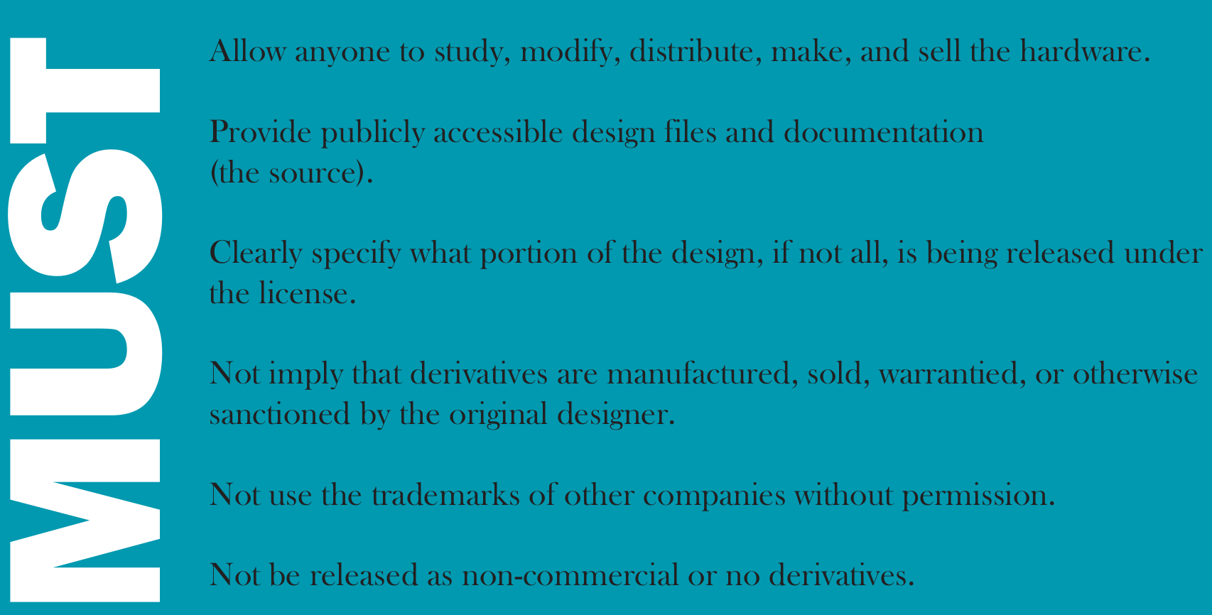

Slide 19
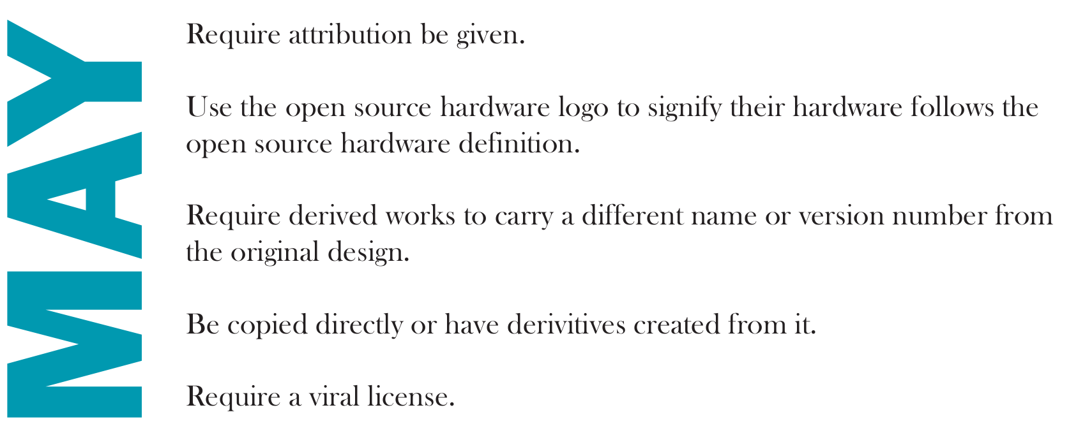

Slide 20


Open Hardware Summit (OHS)
OHS 2017: Denver, Colorado, October 5th
7 prior summits:
  2010, 2011: New York Hall of Science
  2012: Eyebeam (NYC)
  2013: MIT (Boston area)
  2014: Roma, Italia!
  2015: Philadelphia
  2016: Portland, Oregon

Slide 21
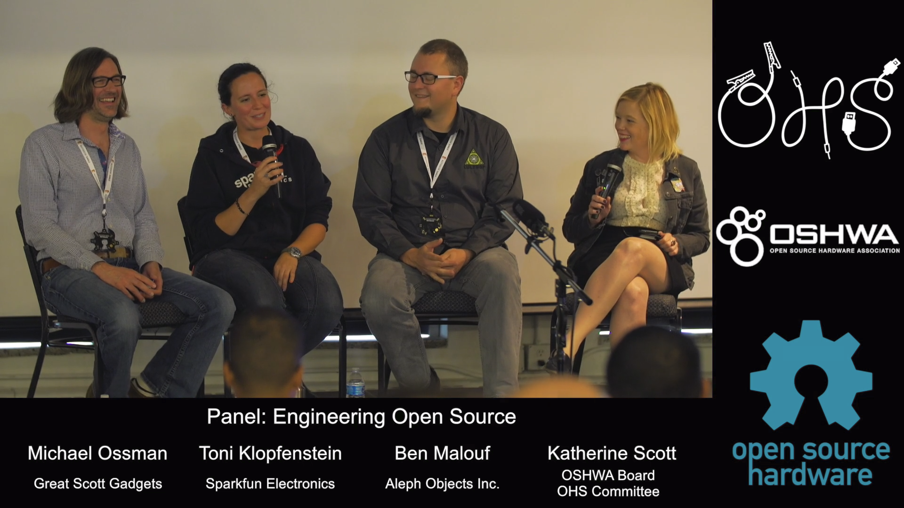
Open Hardware Summit (OHS)
OHS 2017: Engineering Open Source Hardware

Slide 22
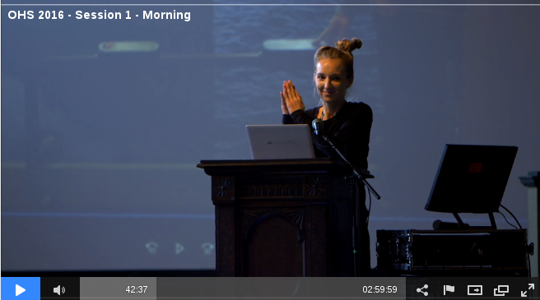
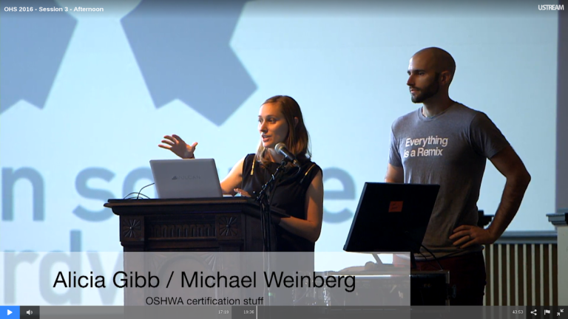
Open Hardware Summit (OHS)
OHS 2016 morning sessions
OHS 2016 afternoon sessions

Slide 23

Open Source Hardware Certification Program
Allows hardware that complies with the community definition of Open Source Hardware to display a certified OSHW logo
Make it easier for users of OSHW to track down documentation and information
More information: certificate.oshwa.org

Slide 24
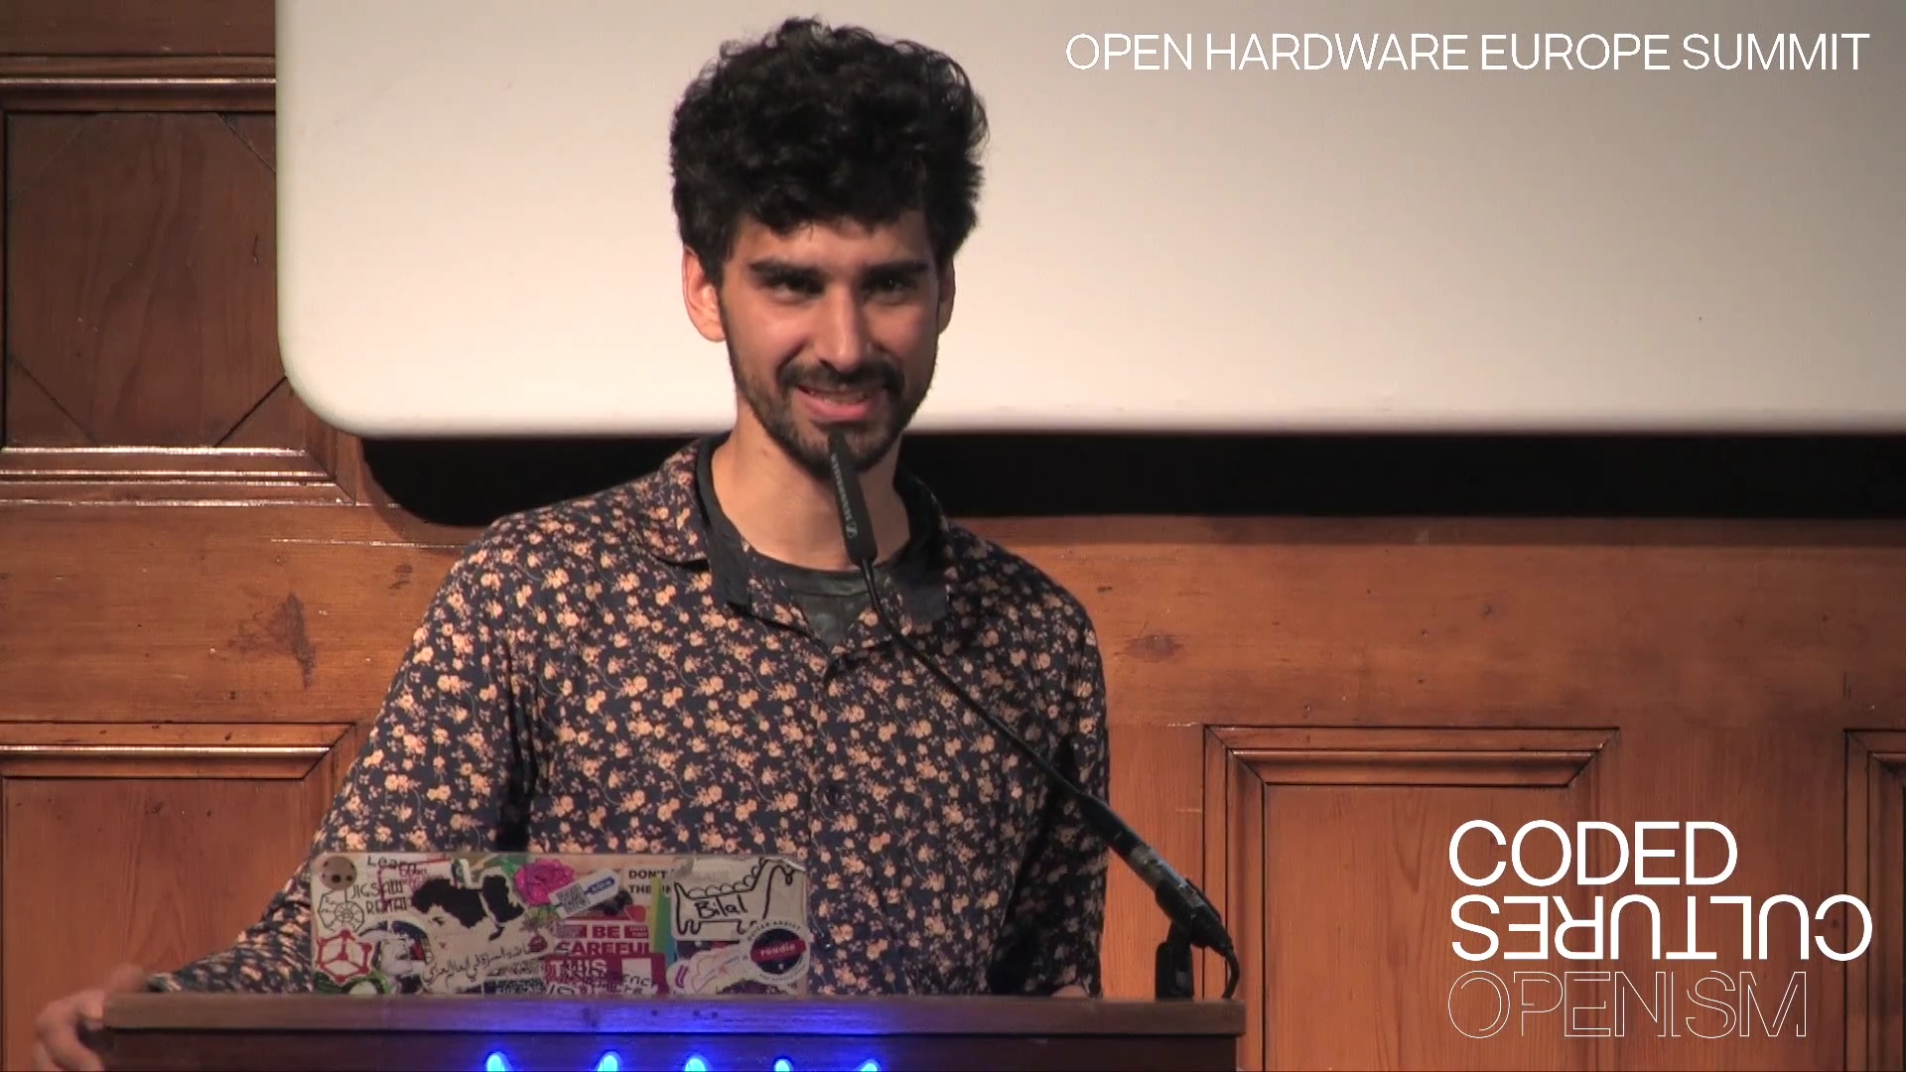
Open Hardware Europe Summit 2016
Video playlist on YouTube
Open Hardware Europe Summit
  “The global open hardware community met in Vienna, Austria to give talks about new aspects, new methods and lessons learned for the open hardware movement.”

Slide 25

Resources
Join OSHWA
Subscribe to the mailing list
Post in the OSHWA Forum
Follow on Twitter:
  @OHSummit
  @oshwassociation
Building Open Source Hardware
by Alicia Gibb (executive director of OSHWA)

Slide 26
Section:
OSHW in Science
Suggestions from the OSHWA mailing list
Slides: https://github.com/pdp7/talks/blob/master/irl-summit-oshw-2018.pdf

Slide 27

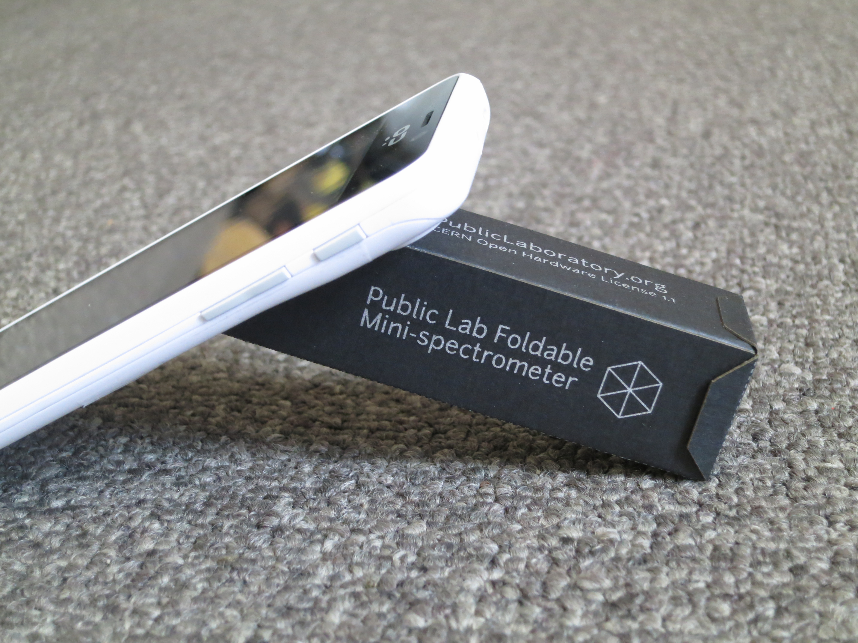
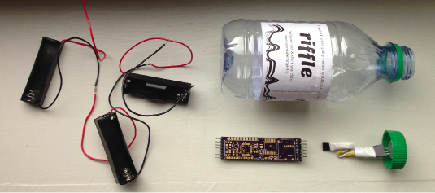
Public Lab
“Using inexpensive DIY techniques, we seek to change how people see the world in environmental, social, and political terms.”
Riffle: Open Source Water Monitoring
Desktop Spectrometry
Balloon Mapping Kit

Slide 28
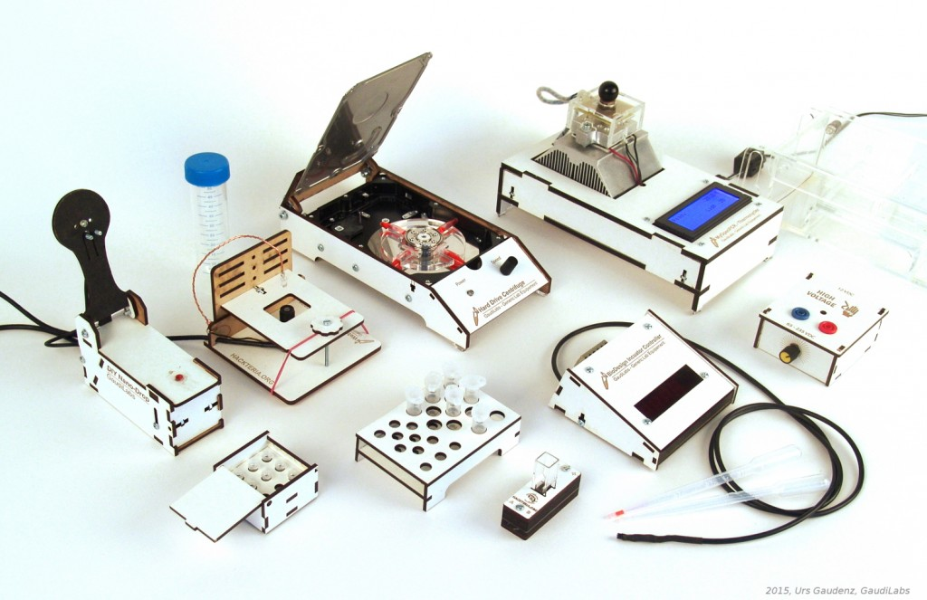
Generic Lab Equipement
GaudiLabs in Switzerland has designed: WebCam Microscope, Hard Drive Centrifuge, Incubator Controller, Gel Box and HV Supply, Turbidity Meter, Microvolume Spectrometer, and Tube Racks

Slide 29
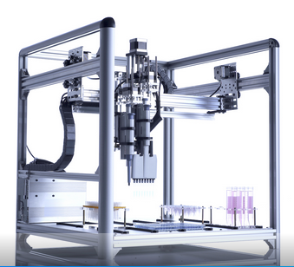
OpenTrons
Robots for Biologists
“We think biologists should have robots to do pipetting for them.”
“They should be able to spend their time designing experiments and analyzing data.”

Slide 30

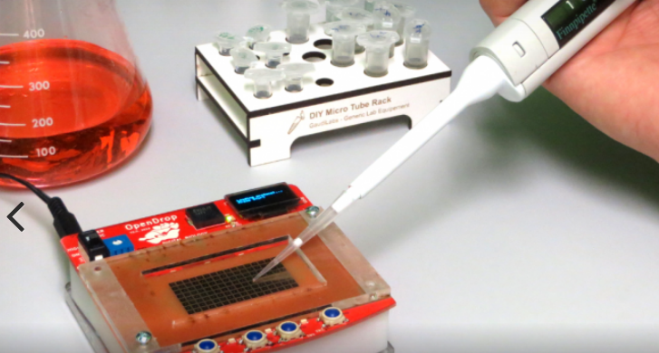
OpenDrop
“Desktop Digital Biology Laboratory”
digital microfludics platform for research
aim of making personal lab-automation accessible to more people

Slide 31
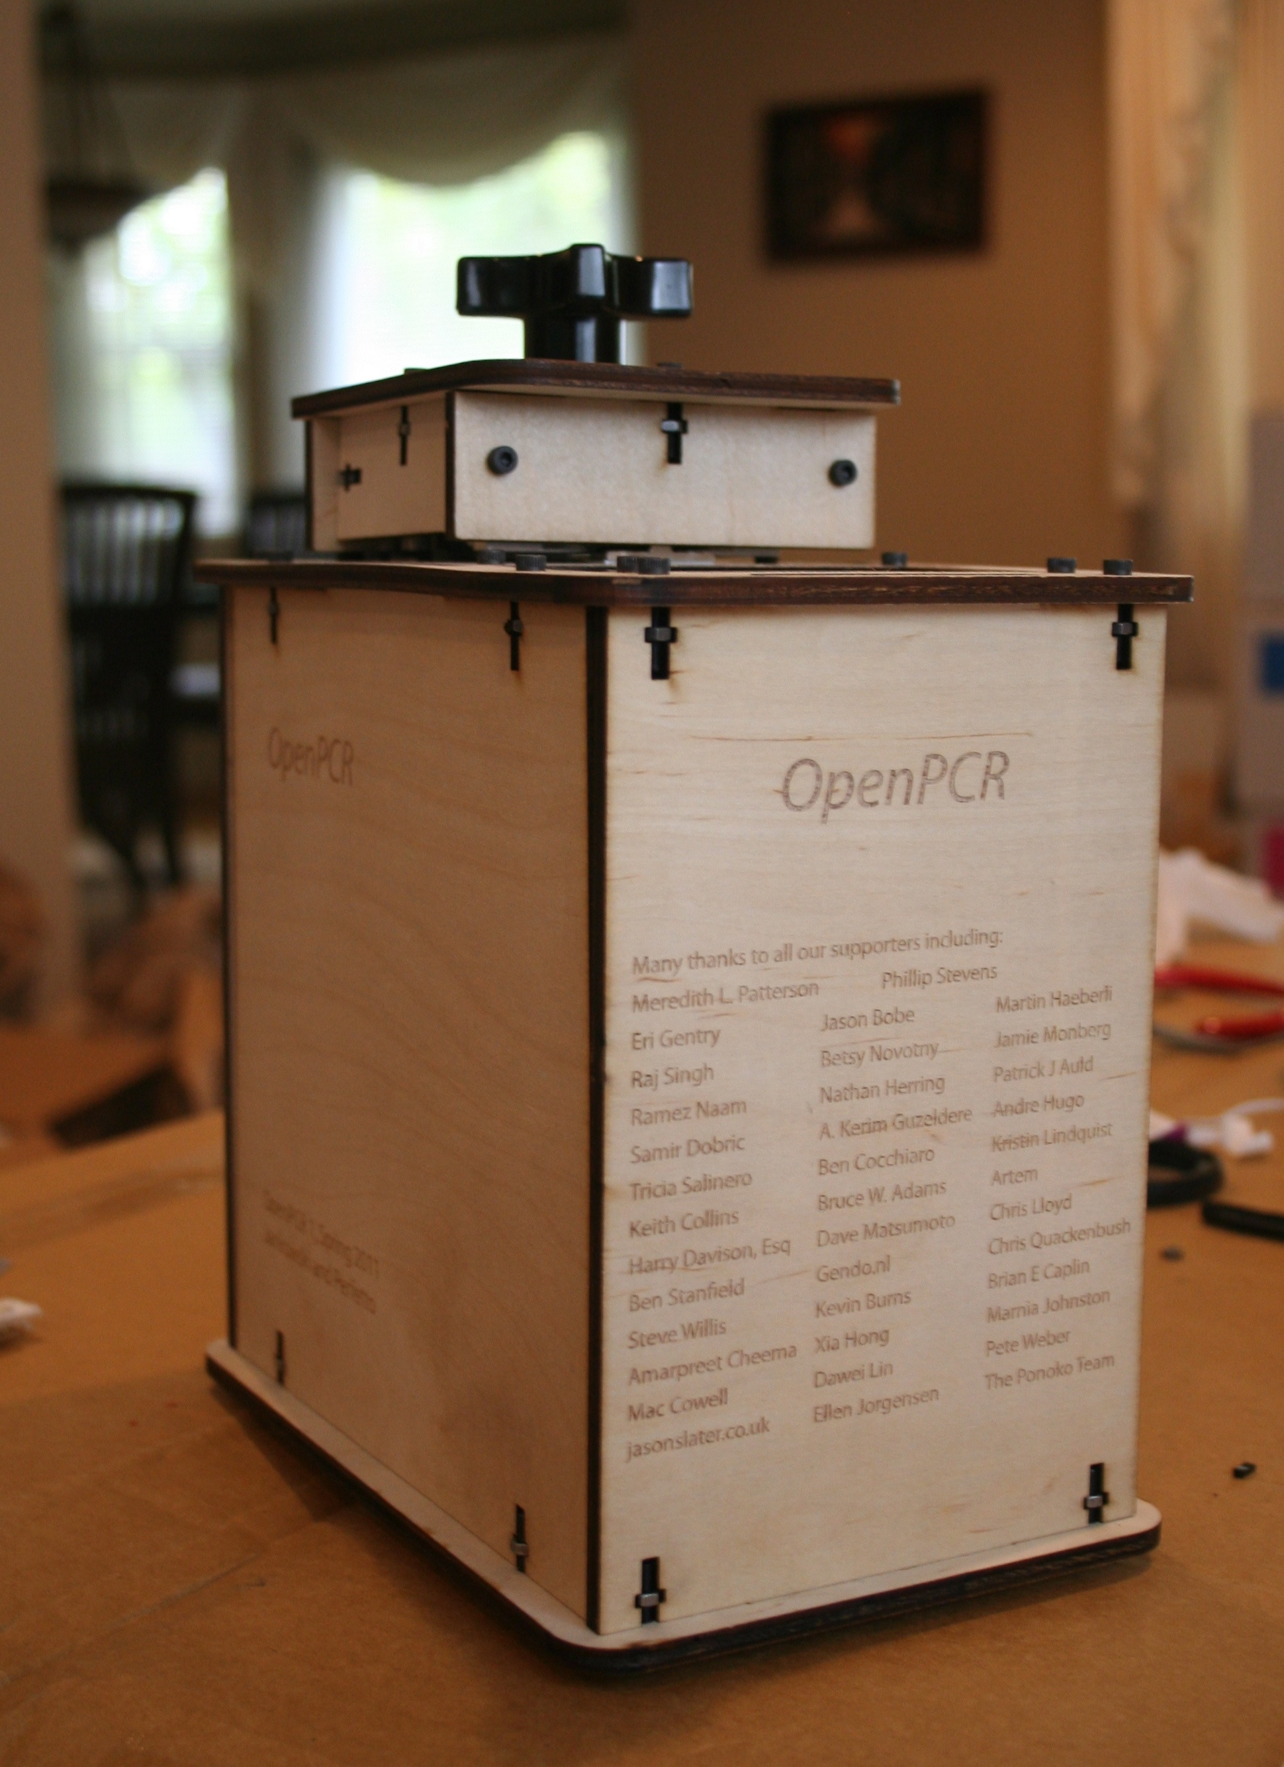
OpenPCR
PCR is a method of copying DNA molecules.
OpenPCR is a project to develop open source hardware, software, and protocols to perform PCR and Real-Time PCR reactions

Slide 32

Open Source Imaging Initiative
“development of medical imaging devices, aiming to make health-care benefits of modern instruments accessible to many more”
“pool the knowledge and experience of many experts in open-source designs for MRI”
Opencore NMR is an open-source toolkit for implementing an NMR spectrometer

Slide 33
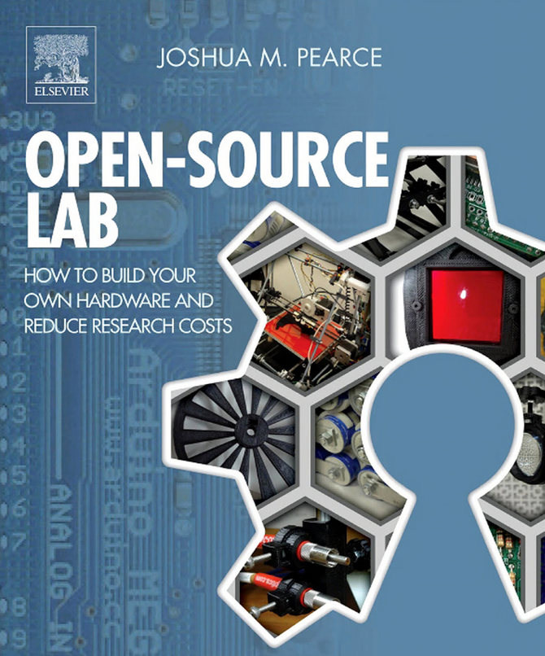
Open-Source Lab
“open-source 3D printing and microcontrollers running on free software enables scientists, engineers, and lab personnel in every discipline to develop powerful research tools at unprecedented low costs”
Author Joshua Pearce runs the MOST research group which is exploring the way solar photovoltaic technology can sustainably power our society

Slide 34

Gathering for Open Science Hardware
“GOSH is a diverse, global community working to enhance the sharing of open, scientific technologies”
Video of GOSH 2016 at CERN
GOSH 2016 in the Journal of Open Hardware
GOSH 2018: Shenzhen, China

Slide 35

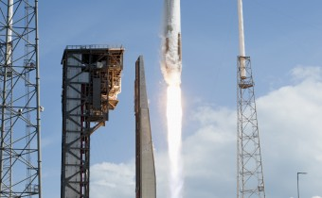
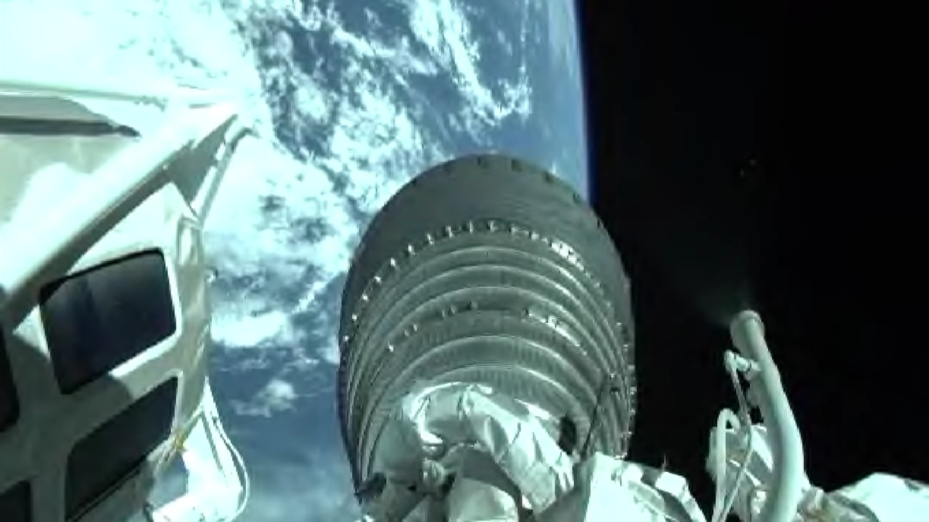

Non-profit for Open Source HW & SW in Space
SatNOGS: global network of satellite ground stations designed as an open source participatory project
UPSat: 1st open source hardware & software satellite
  Launched in 2017
  "Flying The First Open Source Satellite"

Slide 36

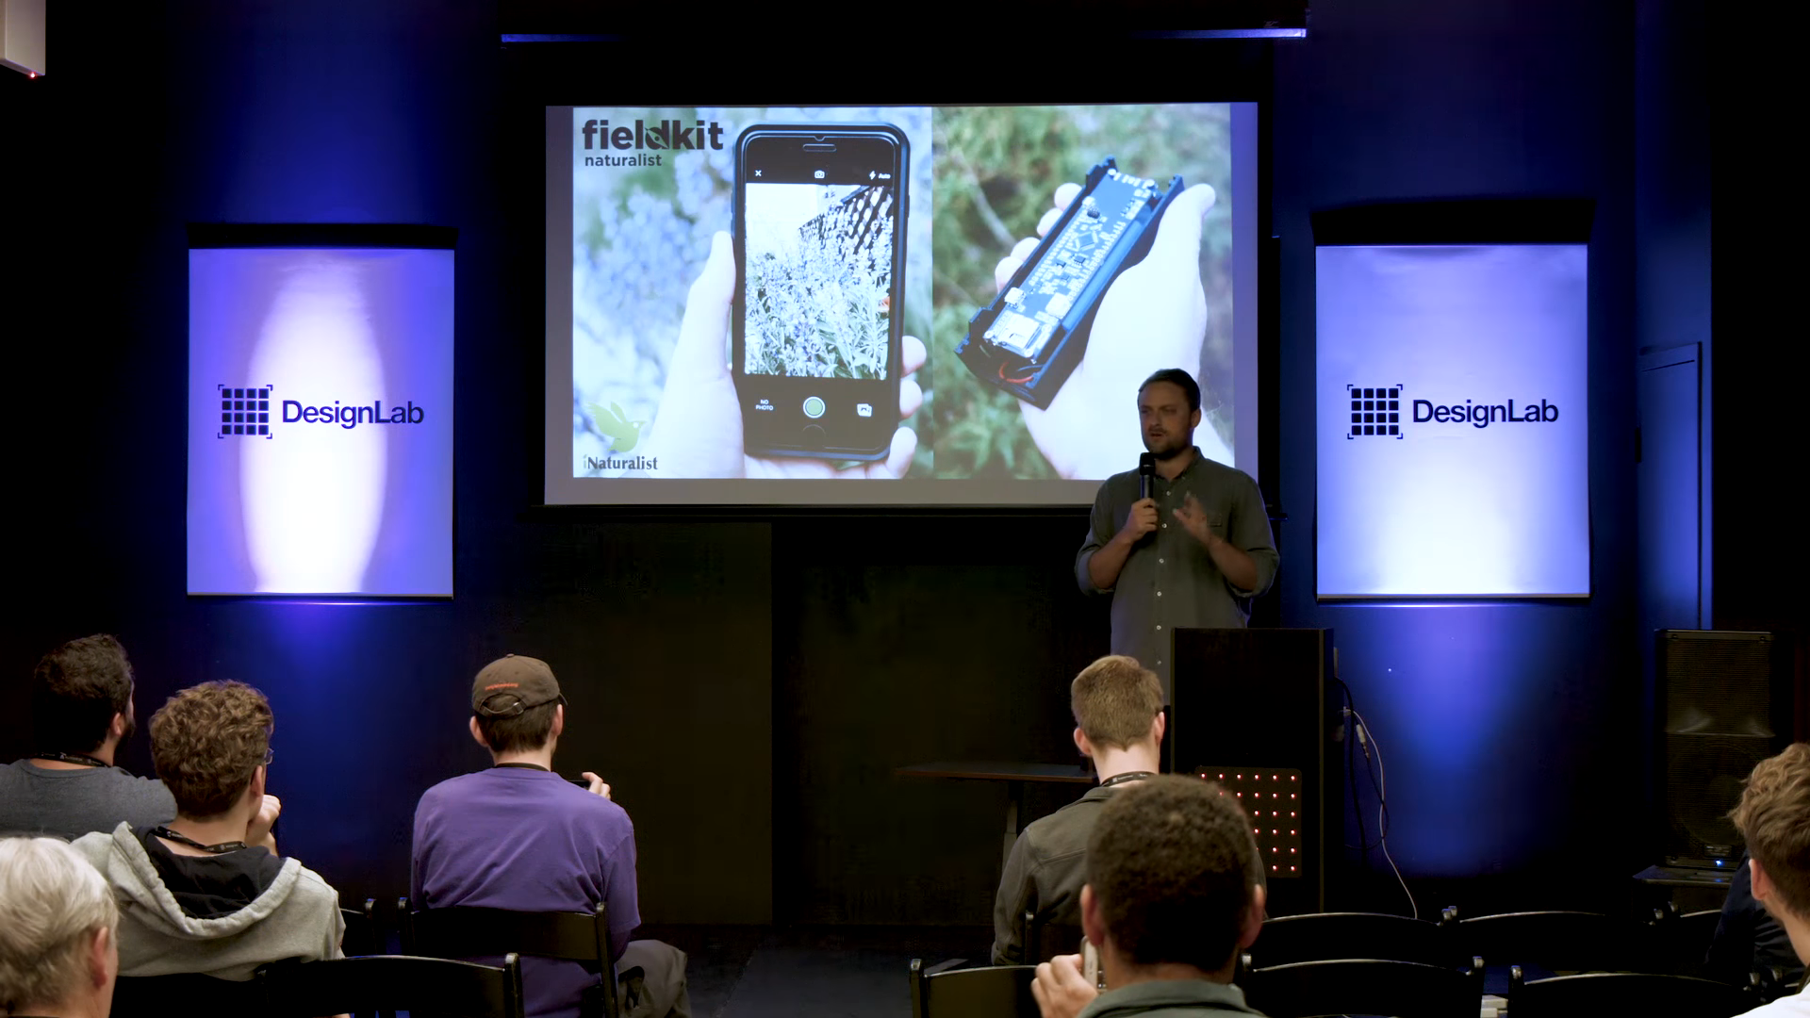
building and deploying hardware to help monitor ecological problems in the wildest places on on Earth
  sensors to monitor ocean fishing practices
  watch the movements of glaciers
  gather real time data about Okavango Delta in Botswana.
Shah Selbe of Conservify at Hackaday Supercon:
Wild Hardware: Adventures with Ecological IoT and National Geographic

Slide 37

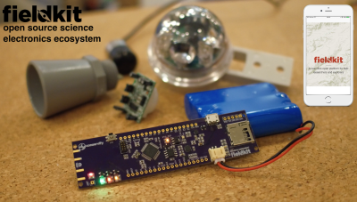
“brought thousands of people along with us into the Okavango Delta on a ‘live data’ expedition”
“tools to collect and share field-based research data and to tell stories through interactive visualizations for conservation, science, exploration and education”

Slide 38

Safecast
international organization devoted to open citizen science for the environment
created after the Fukushima Daiichi nuclear disaster in Japan, because accurate and trustworthy radiation information was not available to the public

Slide 39
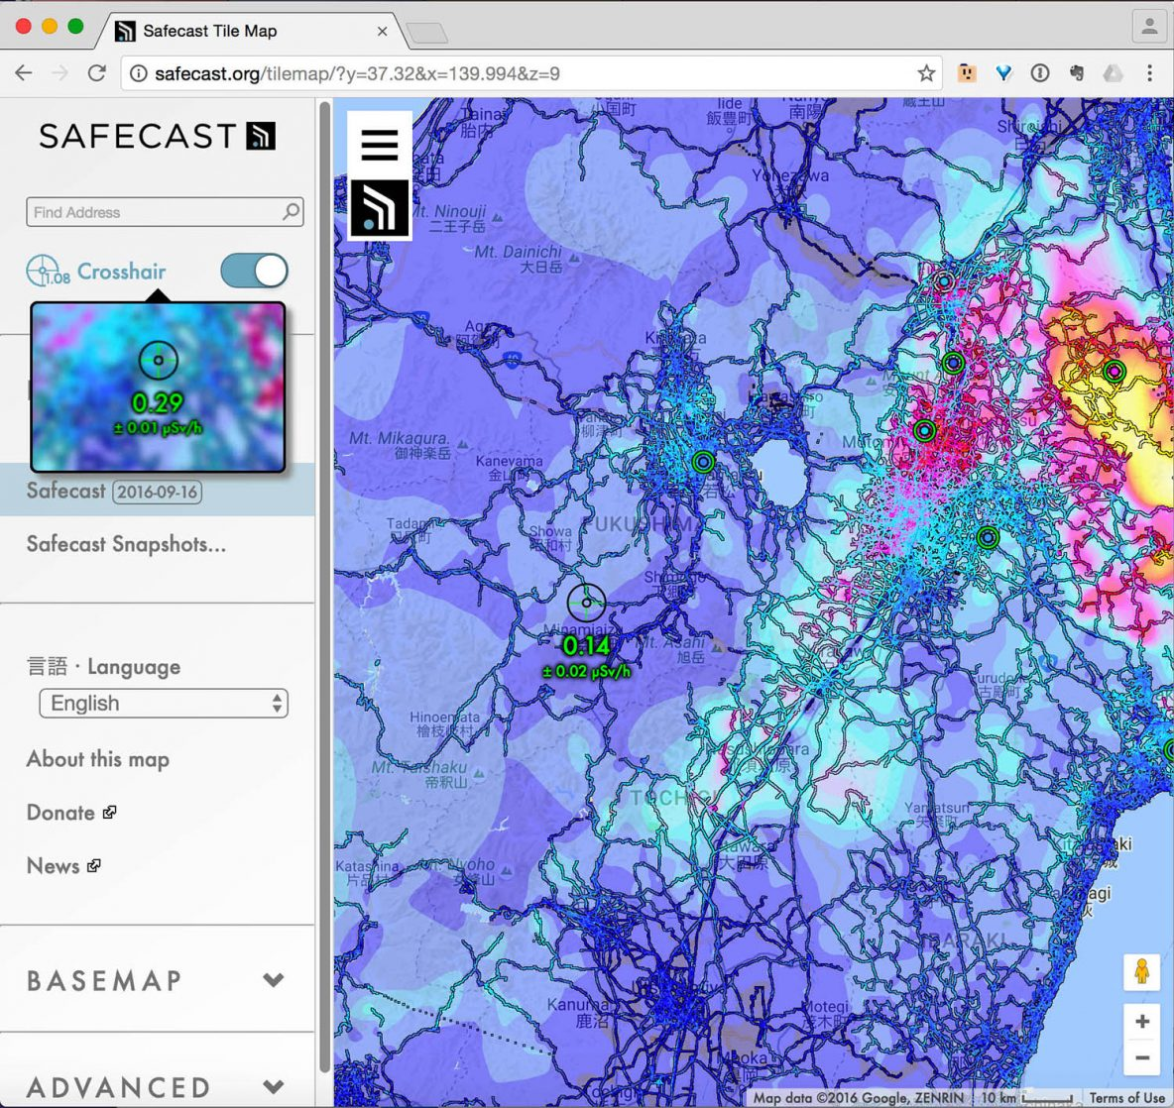
Safecast

Slide 40
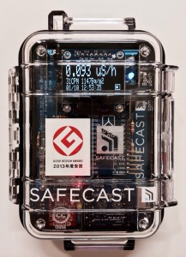
Safecast bGeigie Nano
mobile, GPS enabled, logging, radiation sensor
designed for mounting on the outside of a car window but can be used on bicycles, trains, planes, and other modes of transportation

Slide 41
Section:
OSHW PRODUCTS
Slides:
https://github.com/pdp7/talks/blob/master/penguicon17-oshw-fustini.pdf

Slide 42

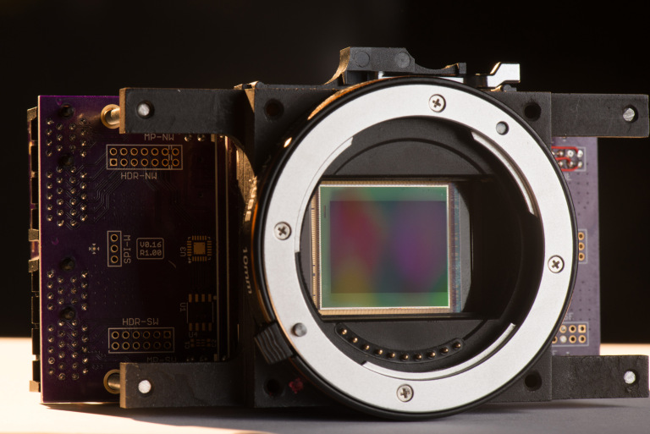
“The goal of the global community-driven apertus° project is to create a variety of powerful, affordable, free (in terms of liberty), sustainable and open digital cinema tools that we as filmmakers love to use”

Slide 43
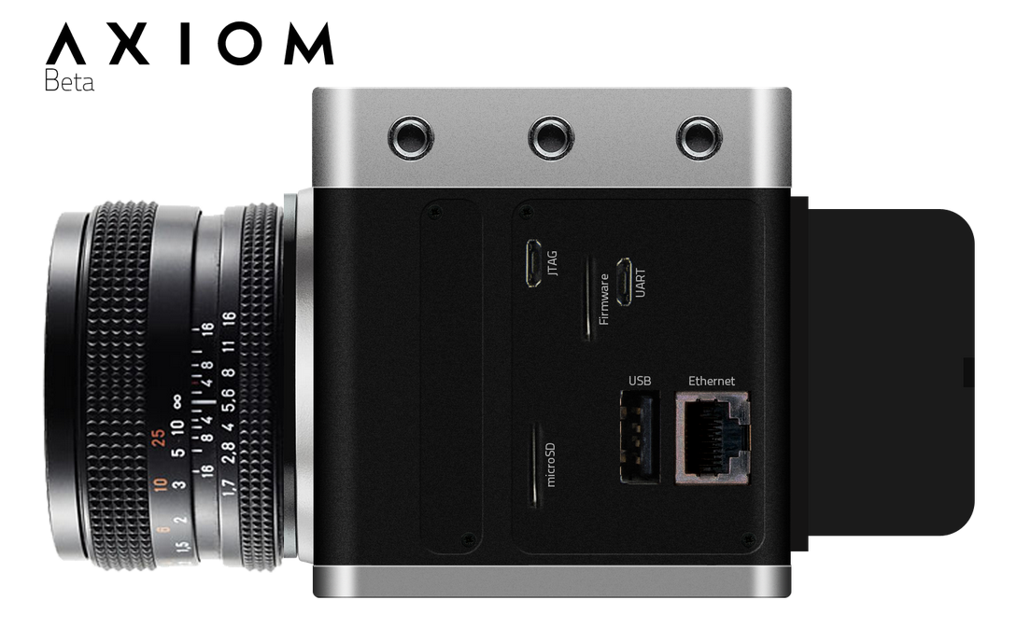
“AXIOM product line is the result of this ongoing endeavor and after successful crowd funding and receiving an EU Innovation grant is well on track to redefine the industry well beyond the DIY garages and hobbyist labs”

Slide 44


Lulzbot 3-D Printers
100% Open Source Hardware & Software
FSF Respects Your Freedom certified!

Slide 45

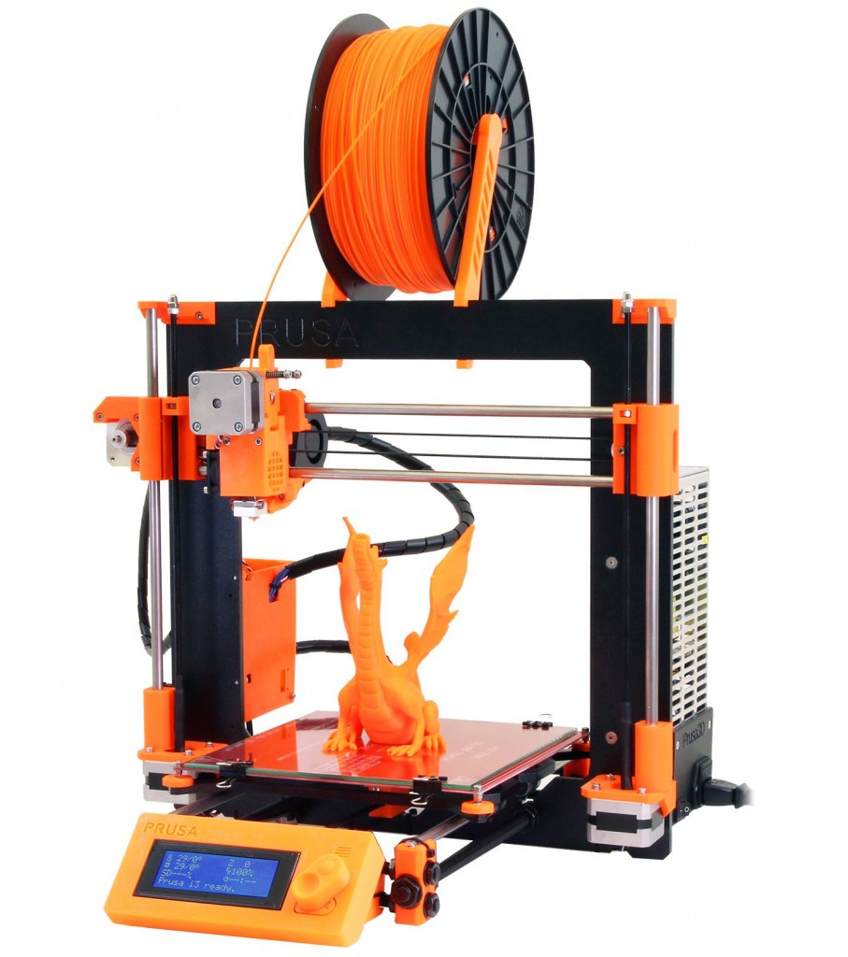
RepRap 3-D Printers
RepRap started as an academic initiative to develop a low-cost 3D printer that can print most of its own components
Giving Manufacturing a New Life
by Adrian Bowyer
Prusa i3 M2 RepRap named Make:'s Best 3D Printer for 2017

Slide 46

Novena laptop
Created by Bunnie Huang & Sean Cross (xobs)
  Chumby, “Hacking the Xbox”, amazing reverse engineers
100% Open Source Hardware laptop
Quad-core 1.2GHz ARM, 4GB RAM, SSD, WiFi
Xilinx FPGA for custom hardware design
Software Defined Radio (SDR) module

Slide 47
Section:
LINUX on OSHW
Slides: https://github.com/pdp7/talks/blob/master/irl-summit-oshw-2018.pdf

Slide 48


Open Source Hardware computing for Makers, Educators & Professionals
Developed by BeagleBoard.org Foundation and BeagleBoard.org Community
Manufacturers: element14, GHI, Seeed

Slide 49

BeagleBoard.org released the first BeagleBoard, an affordable, open hardware ARM computer in 2008

Slide 50


Maker focused, Altoids tin sized BeagleBone introduced in 2011

Slide 51


More affordable, more powerful BeagleBone Black in 2013

Slide 52

Open Source HardwareBeagleBone derivatives

Slide 53


BeagleBone Black Wireless
CadSoft EAGLE design files hosted on GitHub
Bill of Materials: every part available in qty 1
Octavo System-in-Package (SiP) packages several ICs (CPU, RAM, etc) into one large-pitch BGA chip to simplify PCB layout and assembly

Slide 54

BeagleBone Blue: complete Linux robotics controller. 4 layer PCB designed in EAGLE.

Slide 55

BeagleBoard.org PocketBeagle
Michael Welling designed the “PocketBone” using the Octavo SiP and shared on Hackaday.io
In response to online demand, BeagleBoard.org worked with GHI in Michigan to design and manufacture a new product: the PocketBeagle

Slide 56

BeagleBoard.org PocketBeagle
PocketBeagle design makes it feasible for individuals to create their own derivatives
4 layer PCB published for EAGLE and KiCad
Low cost assembly is possible with solder paste stencil and toaster oven

Slide 57

BeagleLogic
Kumar Abhishek created a derivative board intended to be used a logic analyzer
Finalist in the Best Product round of the Hackaday Prize
k

Slide 58
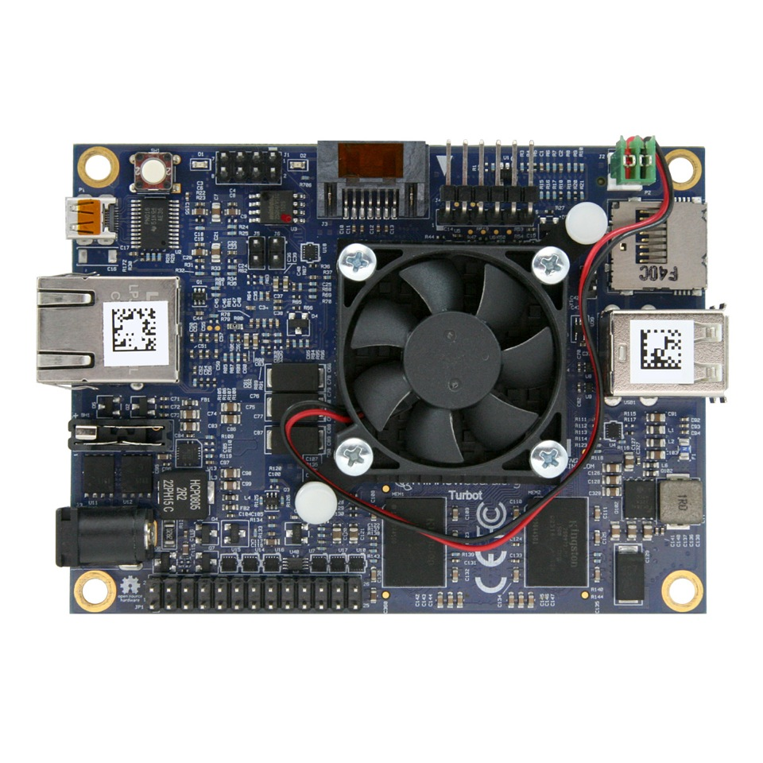

MinnowBoard
64-bit Intel Atom (dual or quad core)
MinnowBoard Turbot
USB 3.0, SATA, PCIe, Gigabit Ethernet, HDMI
Integrated Intel HD Graphics
  Open Source Mainline Linux drivers!

Slide 59

MinnowBoard
Manufactured by ADI
Released under Creative Commons CC-BY-SA
Download design files:
  Schematic
  Board Layout
  Bill of Materials

Slide 60

OLinuXino
Low cost OSHW Linux computers
Designed and manufactured by Olimex in Bulgaria
Great blog post:
Open Source Hardware, why it matters and what is pseudo OSHW

Slide 61

A64-OlinuXino
Allwinner A64: Quad Core 64-bit ARM
Designed with Open Source KiCad
1GB RAM, 4GB eMMC, WiFi+BLE4.0

Slide 62

Slides / Video

Slide 63

KiCad is an Open Source EDA suite including Schematic Capture and PCB Layout
Cross platform: Windows, Mac OS and Linux
CERN has contributed professional CAD features for high-speed digital design
Learn to design your own PCB in KiCad with: Getting to Blinky

Slide 64

TERES I Laptop
“DIY Open Source Hardware Software Hacker's friendly Modular Laptop”
Developing an Open Source Laptop talk by Olimex founder Tsvetan Usunov at Hackaday Belgrade
Design files on GitHub:
“everyone can download &
learn, study, edit, modify”

Slide 65


getchip.com
Next Thing Co. in Oakland
Kickstarter in 2015:
    39,560 backers
    $2,071,927 pledged

Slide 66
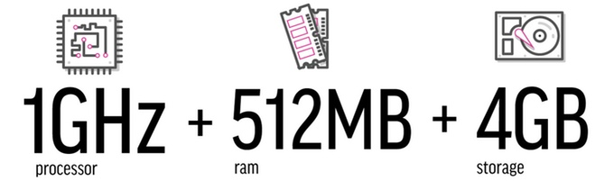
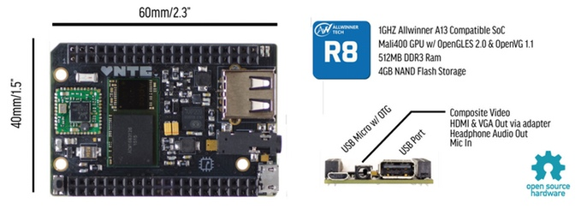
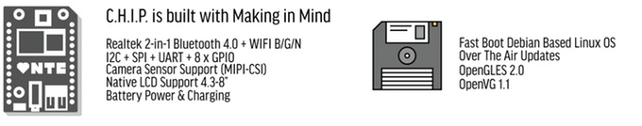



Slide 67

C.H.I.P. is OSHW
GitHub: NextThingCo/CHIP-Hardware
  Schematics
  PCB Layout
  Bill of Materials (BoM)
License:
  Creative Commons Attribution-ShareAlike
  (CC-BY-SA)

Slide 68
Section:
Open Source and Libre Silicon
Source: https://github.com/pdp7/talks/blob/master/penguicon17-oshw-fustini.pdf

Slide 69

What about silicon?
RISC-V: Free and Open RISC Instruction Set Arch
  “new instruction set architecture (ISA) that was originally designed to support computer architecture research and education and is now set to become a standard open architecture for industry”
  Video: Instruction Sets Want To Be Free: A Case for RISC-V
  Video: Krste Asanovic presents at RISC-V and Open Source Silicon Event in Munich on March 23, 2017

Slide 70


What about silicon?
OnChip Open-V
“completely free (as in freedom) and open source 32-bit microcontroller based on the RISC-V architecture”

Slide 71

What about silicon?

Slide 72

What about silicon?
Crowd Supply update: A Taste of Chip Design
Video: YoPuzzle: mRISC V development platform
Video: RISC-V Community needs Peripheral Cores

Slide 73

What about silicon?
SiFive
“founded by the creators of the free and open RISC-V architecture as a reaction to the end of conventional transistor scaling and escalating chip design costs”

Slide 74

What about silicon?
HiFive1: Arduino-Compatible RISC-V Dev Kit

Slide 75
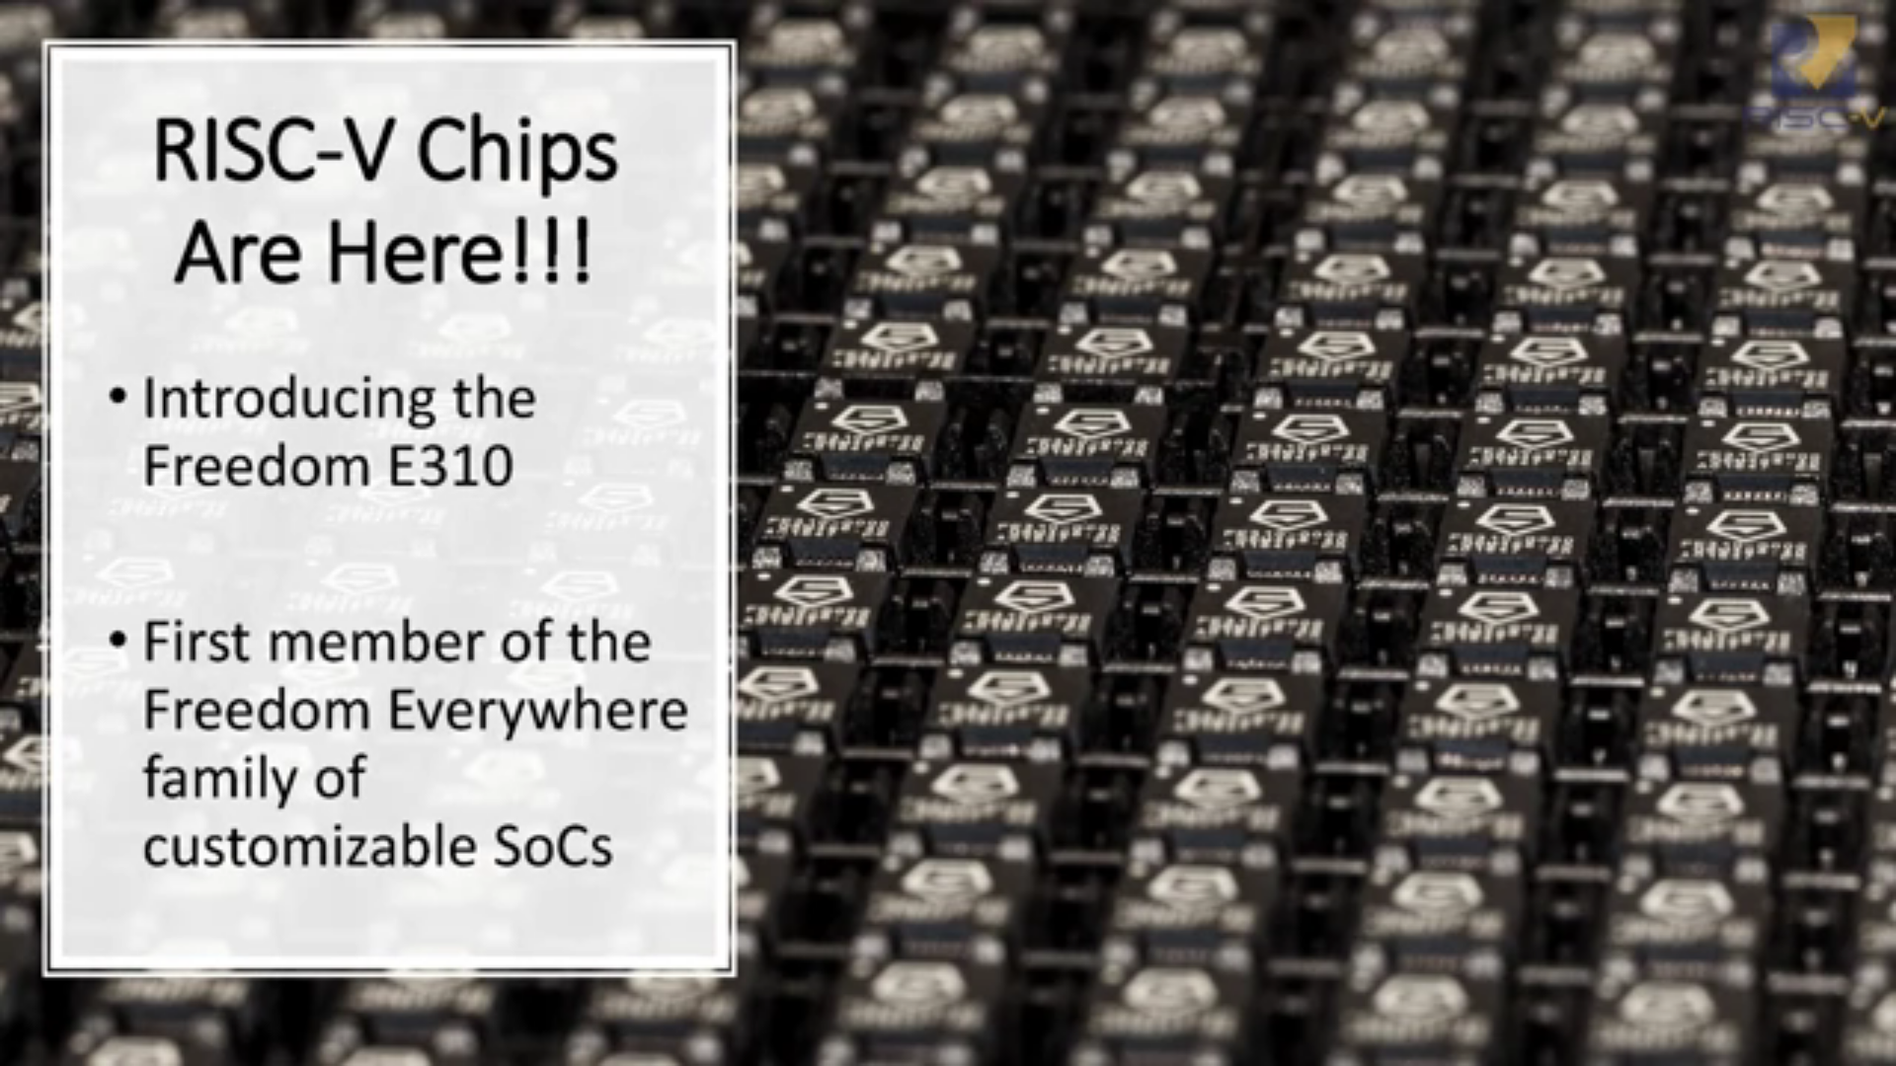
What about silicon?
SiFive FE300 & low cost HiFive Dev Board
  Video of talk by Jack Kang of SiFive (Dec 22, 2016)

Slide 76

What about silicon?
lowRISC:
“creating a fully open-sourced, Linux-capable, RISC-V-based SoC, that can be used either directly or as the basis for a custom design”
Video: Rob Mullins talking about lowRISC
(RISC-V & Open Source Silicon Event in Munich on March 23, 2017)

Slide 77

What about silicon?
FOSSi Foundation
  The Free and Open Source Silicon Foundation
  “non-profit foundation with the mission to promote and assist free and open digital hardware designs”
  “FOSSi Foundation operates as an open, inclusive, vendor-independent group.”

Slide 78

What about silicon?
Open Source Silicon Design Ecosystem
  Talk by FOSSi co-founder Julius Baxter

Slide 79

What about silicon?
LibreCores
  Project of the FOSSi Foundation
  “gateway to free and open source digital designs and other components that you can use and re-use in your digital designs”
  “advances the idea of OpenCores.org”

Slide 80
Thanks
Suggestions from the OSHWA mailing list:
  Abram Connelly
  Andrew Plumb
  Andrew Quitmeyer
  Eleftherios Kosmas
  Marcin Jakubowski

Slide 81
These slides are available at:
github.com/pdp7/talks/blob/master/irl-summit-oshw-2018.pdf
Drew Fustini
drew@oshpark.com
@OSHPark / @pdp7
OSH Park Blog
This work is licensed under a Creative Commons Attribution-ShareAlike 4.0 International License.

