Slide 1




Drew Fustini
OSH Park
drew@oshpark.com
@oshpark / @pdp7
Slides: https://github.com/pdp7/talks/blob/master/nerp-riscv.pdf
RISC-V and
open source chip design
NERP meetup at PS1 hackerspace (2020-01-27)

Slide 2
  Open Source Hardware designer at OSH Park
    PCB manufacturing service in the USA
    drew@oshpark.com / Twitter: @oshpark
  Volunteer Member of Board of Directors of BeagleBoard.org Foundation
      drew@beagleboard.org
  Volunteer Member of the Board of Directors of the Open Source Hardware Association (OSHWA)
      drew@pdp7.com

Slide 3


Slide 4

Section:
RISC-V the instruction set for everything?
Slides: https://github.com/pdp7/talks/blob/master/nerp-riscv.pdf

Slide 5

My column in the latest Hackspace Magazine is an introduction to RISC-V and how it is enabling open source chip design:
  hackspace.raspberrypi.org/issues/27/

Slide 6
When you write a program in the Arduino IDE, it is compiled into instructions for the microcontroller to execute.
How does the compiler know what instructions the chip understands?
  defined by the Instruction Set Architecture
  The ISA is a standard, a set of rules that define the tasks the processor can perform.
  Examples: x86 (Intel/AMD) and ARM
    Both are proprietary and need commercial licensing

Slide 7

RISC-V: Free and Open RISC Instruction Set Arch
  “new instruction set architecture (ISA) that was originally designed to support computer architecture research and education and is now set to become a standard open architecture for industry”

Slide 8
RISC-V: Free and Open RISC Instruction Set Arch
    Instruction Sets Want To Be Free: A Case for RISC-V
      David Patterson, UC Berekely – co-creator of the original RISC!
      https://www.youtube.com/watch?v=mD-njD2QKN0
    RISC-V Summit 2019: State of the Union
      Krste Asanovic, UC Berkeley
      https://www.youtube.com/watch?v=jdkFi9_Hw-c

Slide 9


Slide 10


Slide 11


Slide 12


Slide 13
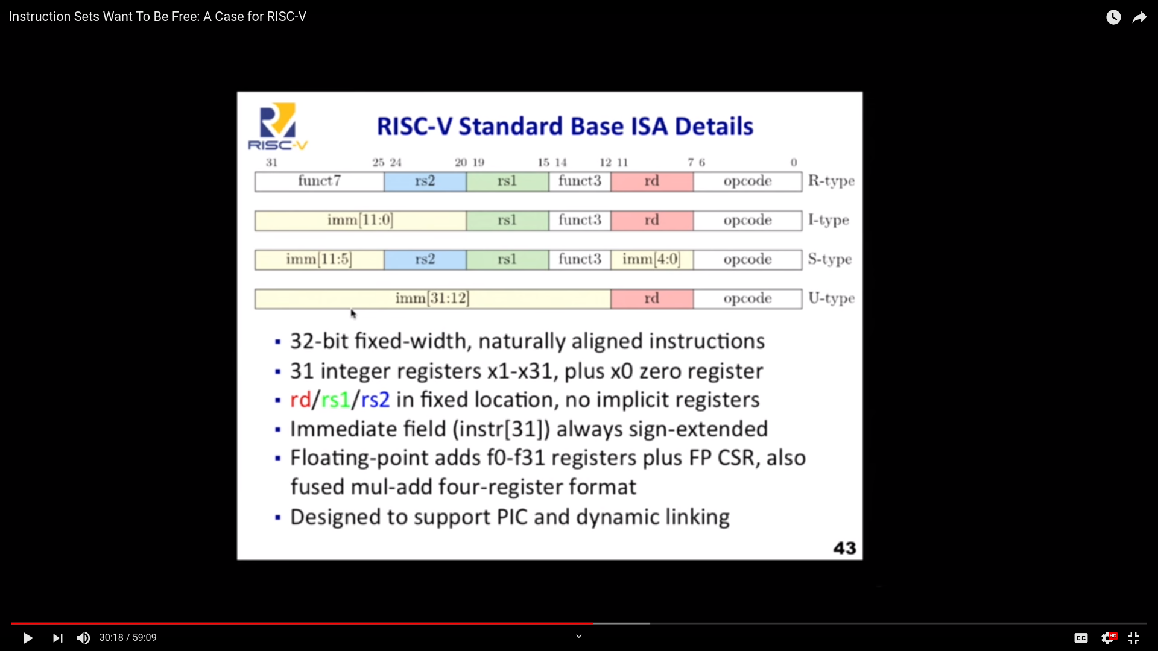

Slide 14
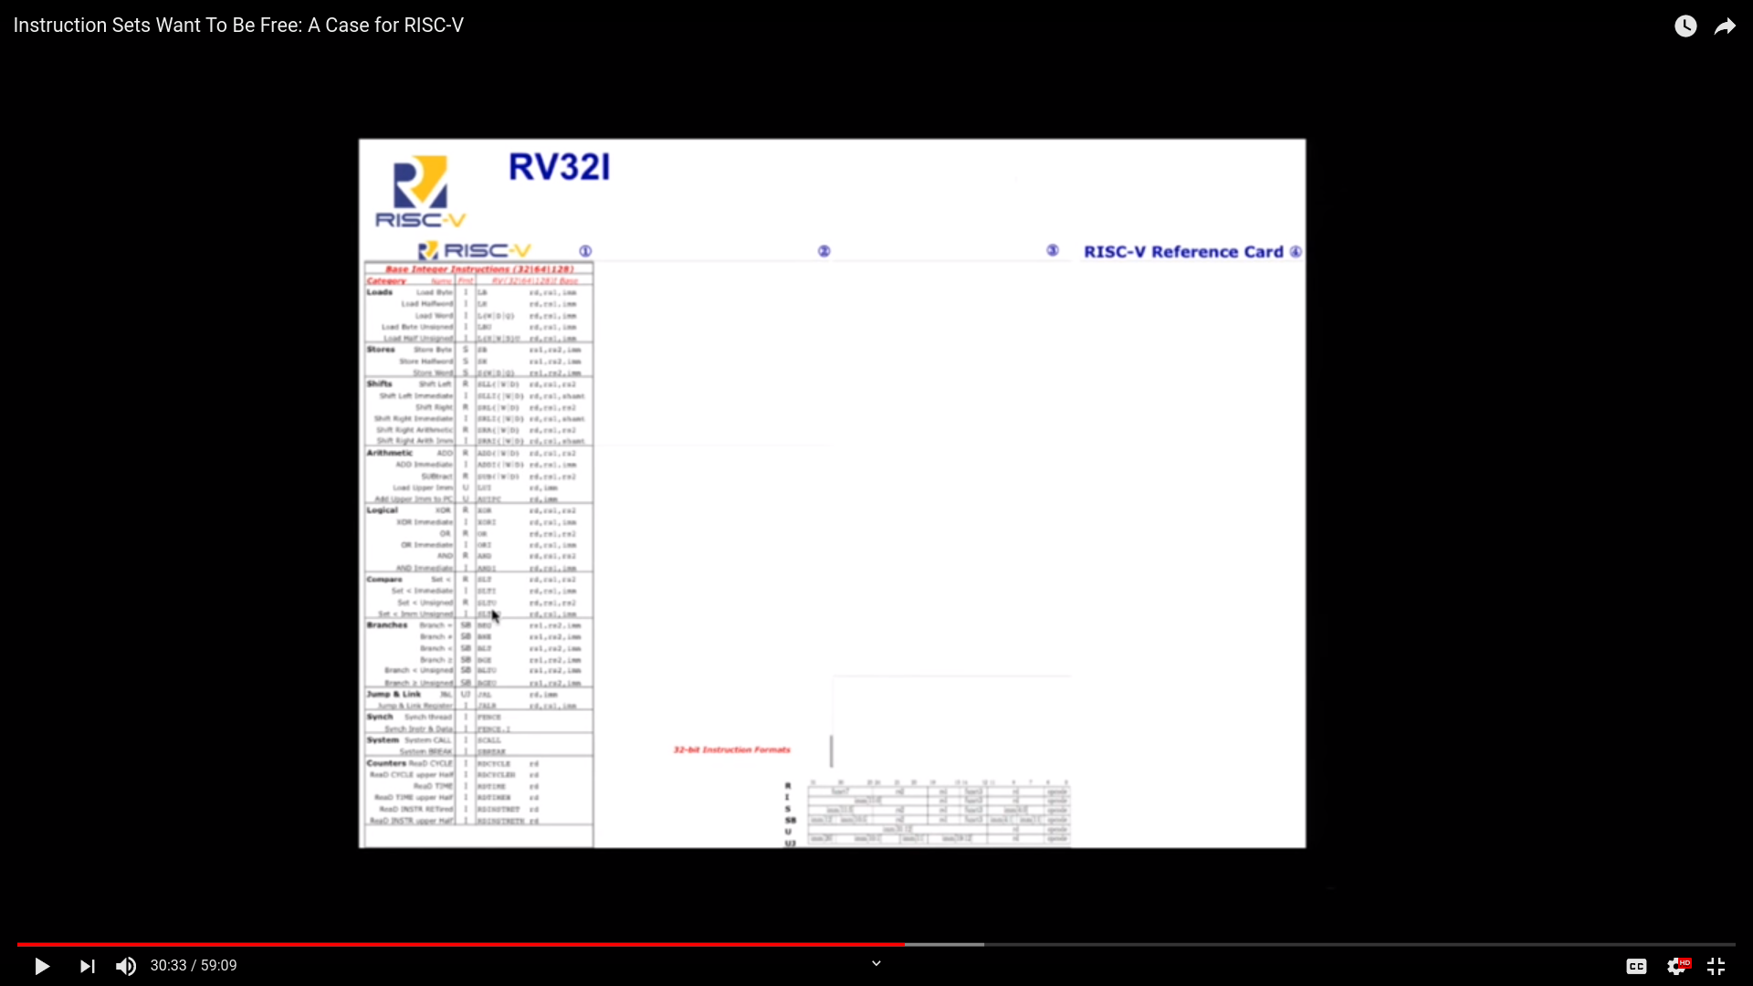

Slide 15
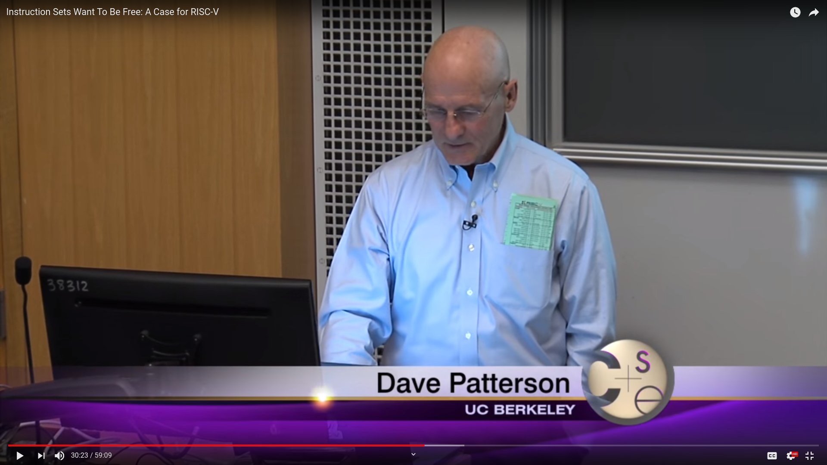

Slide 16
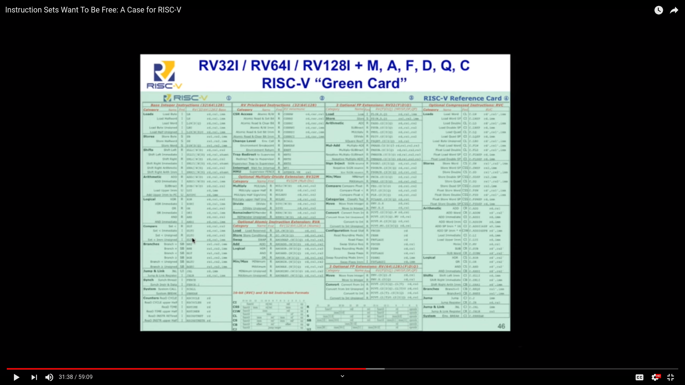

Slide 17
RISC-V and Industry
Created at UC Berkeley but useful beyond academia
Designed to be extensible
  Microcontroller to supercomputer
RISC-V Foundation now controls standard: riscv.org
  Over 400 members: companies, universities and more
  YouTube channel has hundreds of talks!
    https://www.youtube.com/channel/UC5gLmcFuvdGbajs4VL-WU3g
Nvidia and Western Digital are now shipping millions of devices with RISC-V processors
  freedom to leverage open source implementations
    BOOM, Rocket, PULP, SweRV, and many more
  avoiding ARM licensing fees

Slide 18
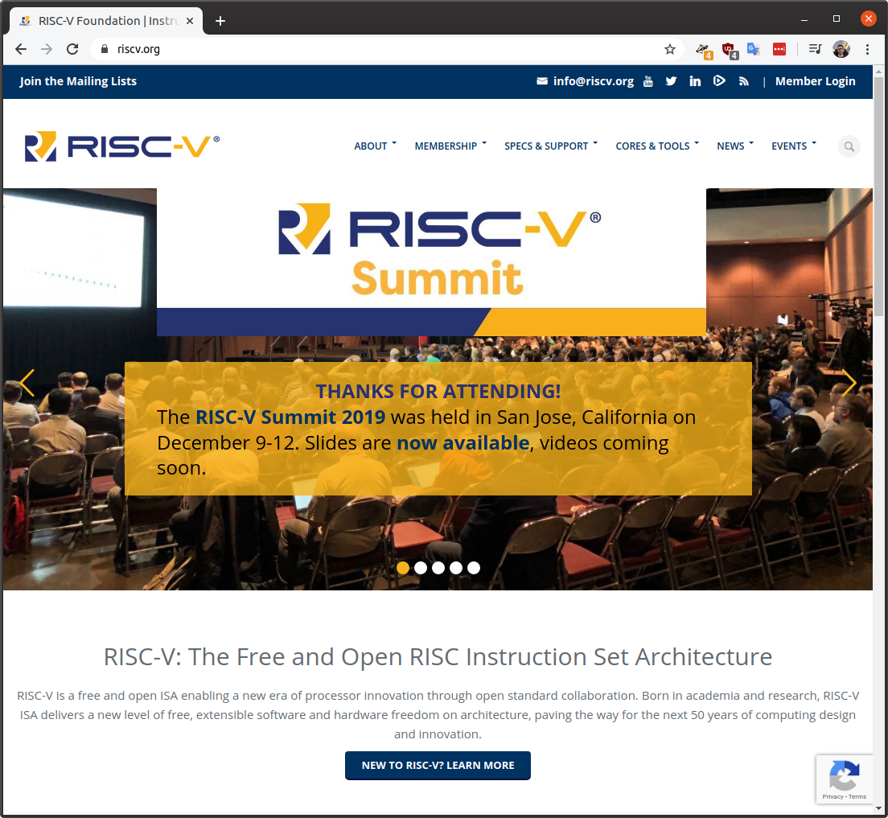

Slide 19
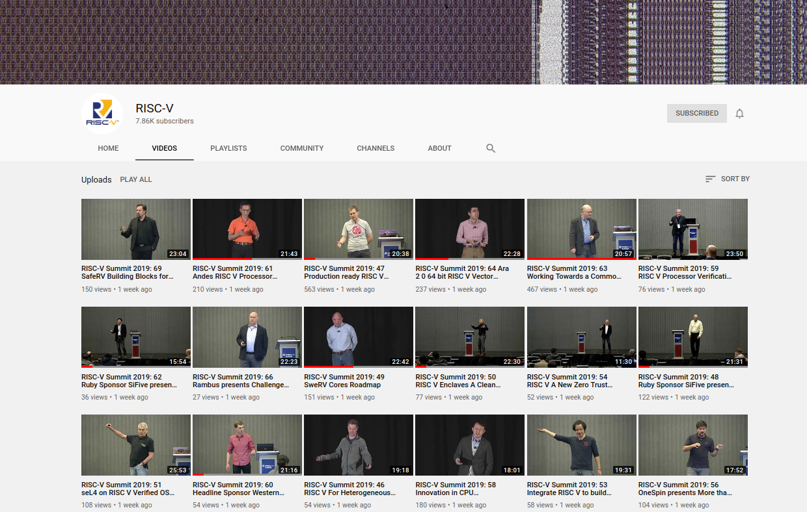

Slide 20
RISC-V and the world
RISC-V Foundation moving from US to Switzerland
Nations such as India have RISC-V initiatives
  Desire for sovereign technology and avoid backdoors from other nations
Strong interest from chipmakers in China
  U.S. companies have been banned from doing business with Huawei… who’s next?
  ARM deemed UK-origin tech so ok to do business with Huawei, but what will brexit-govt bring?

Slide 21


OnChip Open-V
“completely free (as in freedom) and open source 32-bit microcontroller based on the RISC-V architecture”

Slide 22

OnChip Open-V

Slide 23

lowRISC: “creating a fully open-sourced, Linux-capable, RISC-V-based SoC, that can be used either directly or as the basis for a custom design”
Video: Rob Mullins talking about lowRISC
  (RISC-V & Open Source Silicon Event in Munich on March 23, 2017
OpenTitan project with Google:
  Announcing OpenTitan, the First Transparent Silicon Root of Trust

Slide 24

The Future of Operating Systems on RISC-V
  Alex Bradbury gives an overview of the status and development of RISC-V as it relates to modern operating systems, highlighting major research strands, controversies, and opportunities to get involved.
  https://www.youtube.com/watch?v=emnN9p4vhzk

Slide 25

FOSSi Foundation
  The Free and Open Source Silicon Foundation
  “non-profit foundation with the mission to promote and assist free and open digital hardware designs”
  Events: ORConf, Latch-up, Week of OSHW
  Open Source Silicon Design Ecosystem
    Talk by FOSSi co-founder Julius Baxter

Slide 26

LibreCores
  Project of the FOSSi Foundation
  “gateway to free and open source digital designs and other components that you can use and re-use in your digital designs”
  “advances the idea of OpenCores.org”

Slide 27

SiFive
“founded by the creators of the free and open RISC-V architecture as a reaction to the end of conventional transistor scaling and escalating chip design costs”

Slide 28

RISC-V Keynote at Embedded Linux Conf
  March 12th, 2018
  Yunsup Lee, Co-Founder and CTO, SiFive
  Designing the Next Billion Chips: How RISC-V is Revolutionizing Hardware

Slide 29

SiFive FE310 microcontroller
HiFive1: Arduino-Compatible RISC-V Dev Kit

Slide 30

SiFive: Linux on RISC-V
FOSDEM 2018 talk
  YouTube: “Igniting the Open Hardware Ecosystem with RISC-V: SiFive's Freedom U500 is the World's First Linux-capable Open Source SoC Platform”
  Interview with Palmer Dabbelt of SiFive

Slide 31

SiFive: Linux on RISC-V
HiFive Unleashed on Crowd Supply

Slide 32
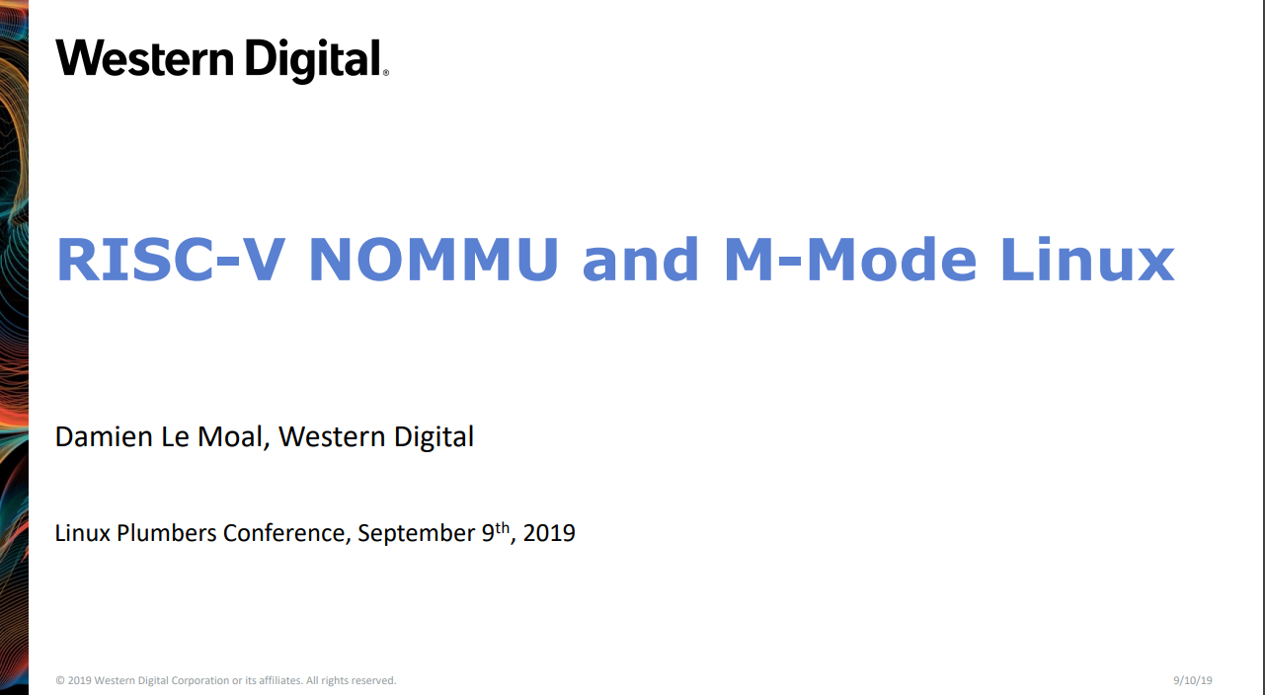

Slide 33


Slide 34
Experiment to get Linux on the low cost Kendryte K210 RISC-V microcontroller
PDF: RISC-V NOMMU and M-mode Linux
https://www.youtube.com/watch?v=ycG592N9EMA&t=10394
jump to 2h 53m
Many RISC-V Improvements Ready For Linux 5.5: M-Mode, SECCOMP, Other Features

Slide 35
Great talk with overview of bootloader,
Linux kernel, distro support
  HOT CHIPS 2019: Linux RISC-V tutorial
  https://youtu.be/nPXdbm9lc3A?t=6139
  1 hour 42 minutes
  “Overview of RISC-V SW Ecosystem”
    Bunnaroath Sou, SiFive

Slide 36
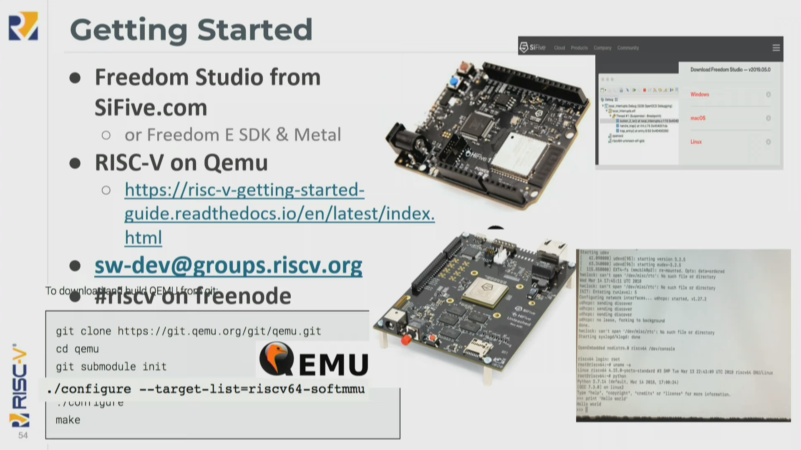

Slide 37
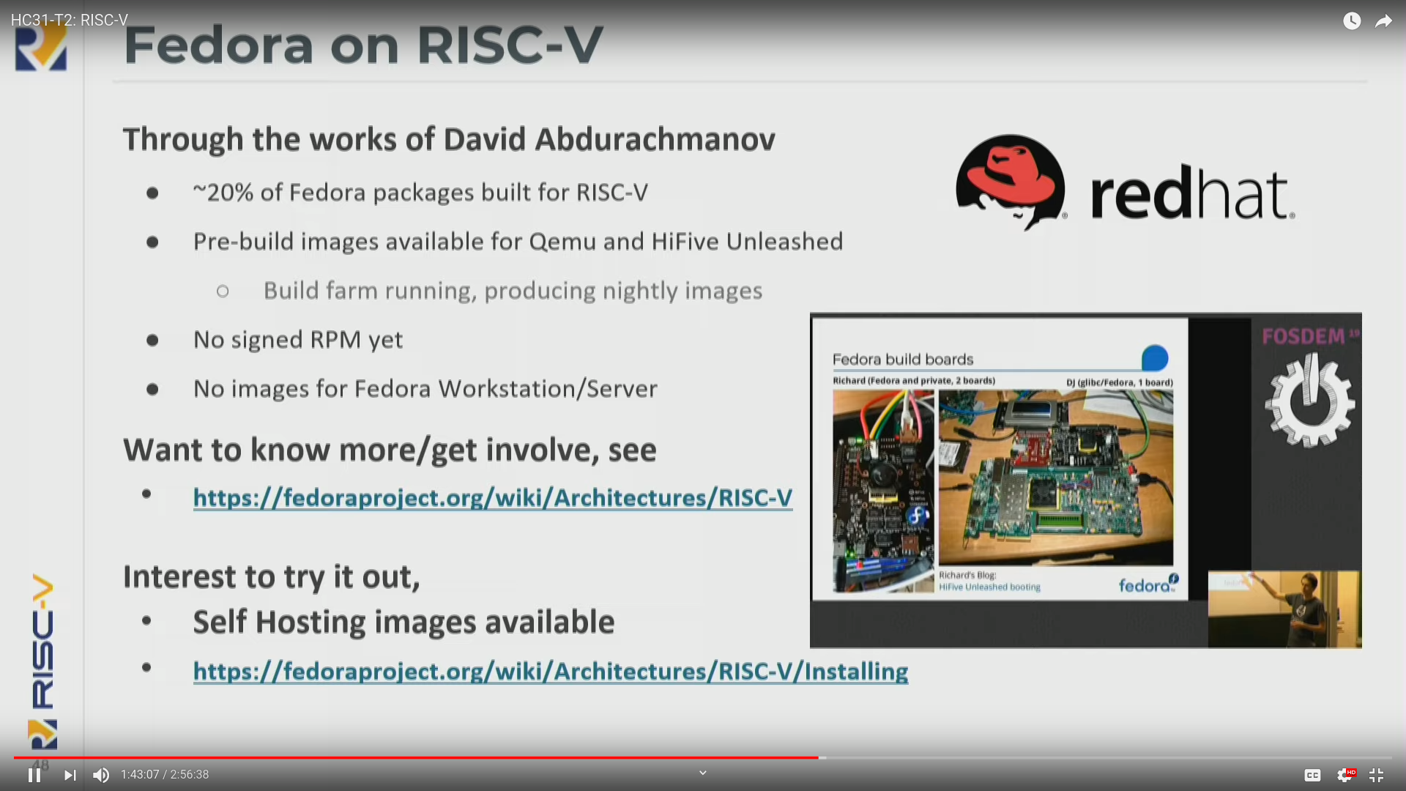

Slide 38
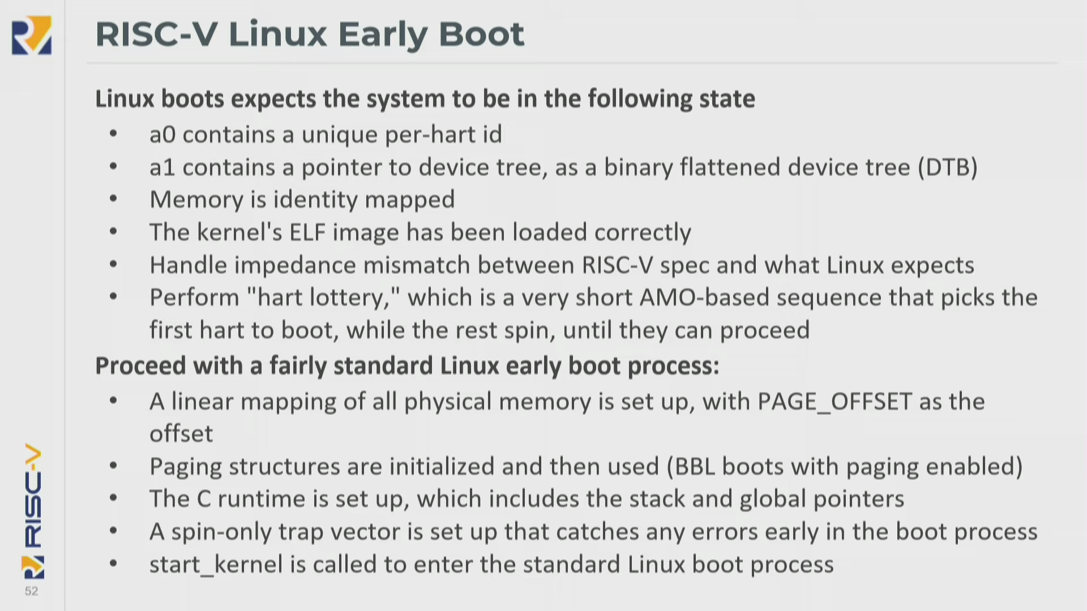

Slide 39
Coming in 2020?
Andes 27-series CPU
  “32-bit A27 and 64-bit AX27 and NX27V cores, which will enter production in Q1 2020.”
  Andes’ RISC-V SoC debuts with AI-ready VPU as Microchip opens access to its PolarFire SoC
Microchip PolarFire SoC FPGA
  Hard RISC-V with FPGA fabric… like the Xilinx Zync for ARM
NXP iMX with RISC-V instead of ARM!
  “OpenHW Group Unveils CORE-V Chassis SoC Project, Building on PULP Project IP”

Slide 40
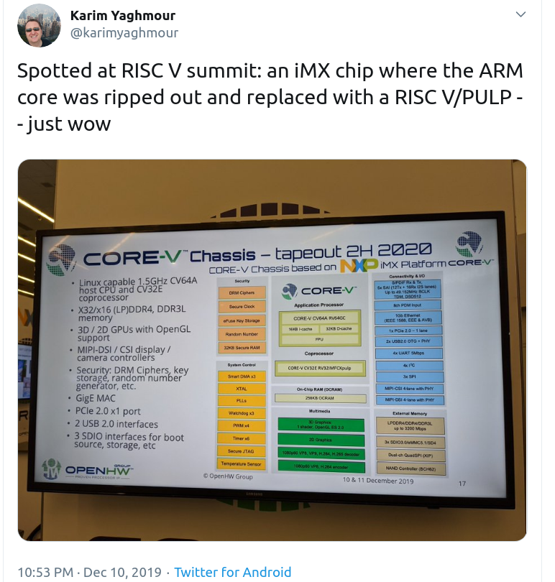

Slide 41

Coming in 2020?

Slide 42
OSHW RISC-V Linux board for less than $100?
Goal: Sub-$100 Open Source Hardware board that can run Linux on RISC-V
Possible by 2021?
Interested in working together?
  drew@oshpark.com / Twitter: @pdp7
  create a mailing list?

Slide 43
Section:
Open Source FPGA tools
Slides: https://github.com/pdp7/talks/blob/master/nerp-riscv.pdf

Slide 44


Open Source and FPGAs
Hackspace Magazine column about how about open source FPGA tools developed by Claire Wolf (oe1cxw), David Shah and others have made FPGAs more accessible than ever before to makers and hackers:
  hackspace.raspberrypi.org/issues/26/

Slide 45

Keynote at Hackday Supercon 2019 by
Dr. Megan Wachs of SiFive
“RISC-V and FPGAs: Open Source Hardware Hacking”
  https://www.youtube.com/watch?v=vCG5_nxm2G4

Slide 46


Slide 47

Open Source and FPGAs
Open Source toolchains for FPGAs!
  Project IceStorm for Lattice iCE40
    “A Free and Open Source Verilog-to-Bitstream Flow for iCE40 FPGAs” by Claire Wolf (oe1cxw) at 32c3

Slide 48

Open Source and FPGAs
Open Source toolchains for FPGAs!
  Project Trellis for Lattice ECP5
  “Project Trellis and nextpnr FOSS FPGA flow for the Lattice ECP5” - David Shah (@fpga_dave)
    youtube.com/watch?v=0se7kNes3EU

Slide 49

Open Source and FPGAs
Open Source toolchains for FPGAs!
  Project X-Ray and SymbiFlow for Xilinix Series 7
  Timothy ‘mithro’ Ansell: “Xilinx Series 7 FPGAs Now Have a Fully Open Source Toolchain!” (almost)
    youtube.com/watch?v=EHePto95qoE

Slide 50

Open Source and FPGAs
Open Source Hardware boards with Lattice ECP5 FPGA with open RISC-V “soft” CPU:
  Orange Crab by Greg Davill
    https://github.com/gregdavill/OrangeCrab

Slide 51


Slide 52

Open Source and FPGAs
Radiona.org ULX3S
    https://www.crowdsupply.com/radiona/ulx3s

Slide 53

Open Source and FPGAs
Open Source Hardware boards with Lattice ECP5 FPGA with open RISC-V “soft” CPU:
  David Shah's Trellis board (Ultimate ECP5 Board)
  https://github.com/daveshah1/TrellisBoard

Slide 54

Hackaday 2019 Supercon badge
RISC-V “soft” core on ECP5 FPGA
Gigantic FPGA In A Game Boy Form Factor

Slide 55


Slide 56

LiteX is a FPGA design/SoC builder that can be used to build cores, create SoCs and full FPGA designs.
LiteX is based on Migen and provides specific building/debugging tools for a higher level of abstraction and compatibily with the LiteX core ecosystem.
Think of Migen as a toolbox to create FPGA designs in Python and LiteX as a SoC builder to create/develop/debug FPGA SoCs in Python
https://github.com/enjoy-digital/litex

Slide 57
Bunnie:
LiteX vs. Vivado: First Impressions
https://www.bunniestudios.com/blog/?p=5018

Slide 58


Slide 59
Linux on LiteX-VexRiscv
Linux with VexRiscv CPU, a 32-bits Linux Capable RISC-V CPU written in Spinal HDL
SoC around the VexRiscv CPU is created using LiteX as the SoC builder and LiteX's cores written in Migen Python DSL (LiteDRAM, LiteEth, LiteSDCard)
github.com/litex-hub/linux-on-litex-vexriscv

Slide 60
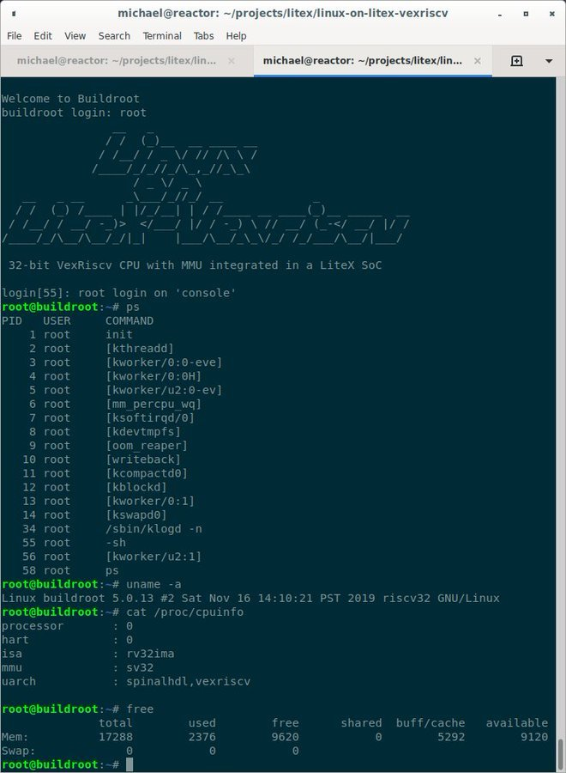
Linux on LiteX-VexRiscv

Slide 61
Section:
Linux on the Hackaday Badge
Slides: https://github.com/pdp7/talks/blob/master/nerp-riscv.pdf

Slide 62
Hackaday 2019 Supercon badge
RISC-V “soft” core on ECP5 FPGA
Gigantic FPGA In A Game Boy Form Factor

Slide 63

“Team Linux on Badge”

Slide 64
“Team Linux on Badge”
Blog post: Hackaday Supercon badge boots Linux using SDRAM cartridge
  https://blog.oshpark.com/2019/12/20/boot-linux-on-this-hackaday-supercon-badge-with-this-sdram-cartridge/
Michael Welling (@QwertyEmedded), Tim Ansell (@mithro), Sean Cross (@xobs), Jacob Creedon (@jacobcreedon)
First attempt: use the built-in 16MB SRAM…
no luck :(
  (though xobs now might have a way to do it)

Slide 65

“Team Linux on Badge”
Second attempt:
  Jacob Creedon designed an a cartridge board that adds 32MB of SDRAM to the Hackaday Supercon badge… before the event!

Slide 66

“Team Linux on Badge”
Second attempt:
  Jacob Creedon designed an a cartridge board that adds 32MB of SDRAM to the Hackaday Supercon badge… before the event!

Slide 67
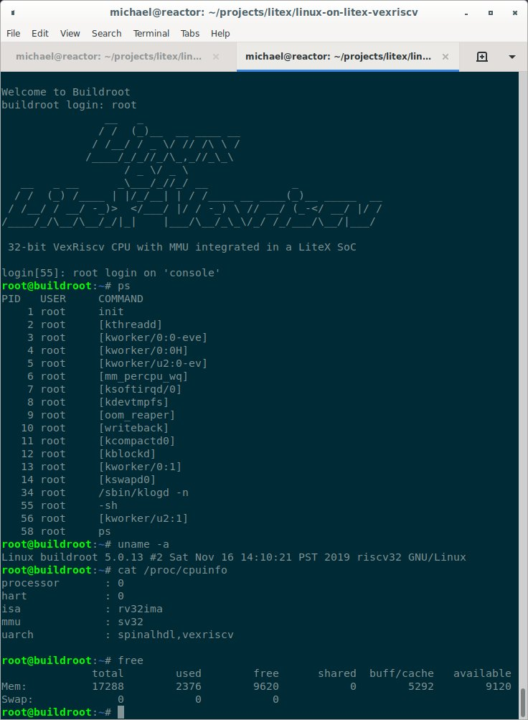

Slide 68
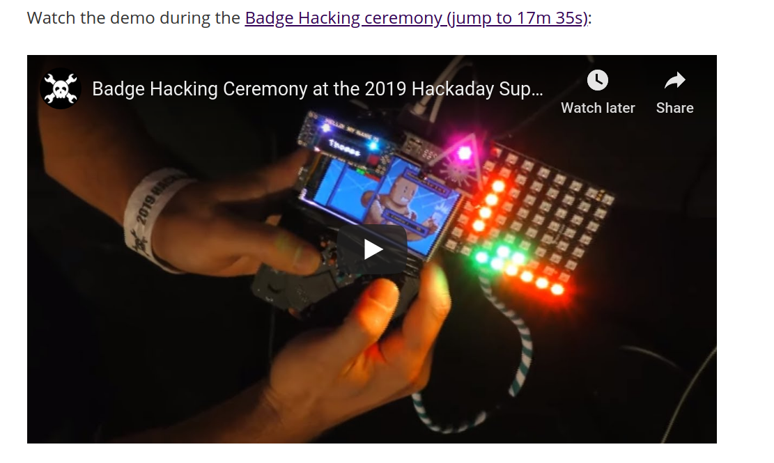
“Team Linux on Badge”
https://youtu.be/3se_L0tRZeg?t=1055

Slide 69
Linux on LiteX-VexRiscv
Linux with VexRiscv CPU, a 32-bits Linux Capable RISC-V CPU written in Spinal HDL
  github.com/litex-hub/linux-on-litex-vexriscv
NOW with upstream support for the Hackaday Supercon badge!
  https://github.com/litex-hub/litex-boards/pull/31

Slide 70


Slide 71
Opened GitHub issue:
  optimize performance on Hackaday Badge #35
    https://github.com/litex-hub/litex-boards/issues/35
Now 10x faster!
  https://asciinema.org/a/Pcm3vd1BEdEKY9srYX6MsNfCE
  Thanks to enjoy-digital

Slide 72


Slide 73
Slides:
github.com/pdp7/talks/blob/master/lug-riscv.pdf
Drew Fustini
drew@oshpark.com
@pdp7 / @oshpark
This work is licensed under a Creative Commons Attribution-ShareAlike 4.0 International License.

Slide 74
bonus section:
Open Source Hardware laptop from Berlin
Slides: https://github.com/pdp7/talks/blob/master/lug-riscv.pdf

Slide 75


