Slide 1



Drew Fustini
OSH Park
drew@oshpark.com
@oshpark / @pdp7
Slides: https://github.com/pdp7/talks/blob/master/oshw-linux-36c3.pdf
Linux on
Open Source Hardware and
Open Source Chip Design
Chaos Communication Congress (36c3)

Slide 2
  Open Source Hardware designer at OSH Park
    PCB manufacturing service in the USA
    drew@oshpark.com / Twitter: @oshpark
  Volunteer Member of Board of Directors of BeagleBoard.org Foundation
      drew@beagleboard.org
  Volunteer Member of the Board of Directors of the Open Source Hardware Association (OSHWA)
      serving as Vice President
      drew@pdp7.com

Slide 3






What is Open Source?
Examples of popular Open Source projects

Slide 4
What is Open Source?
The term "open source" refers to something people can modify and share because its design is publicly accessible
Open Source software is software with source code that anyone can:
inspect, modify, and enhance

Slide 5

FLOSS is a term to describe software that is Free, Libre, or Open Source Software
In the context of hardware projects, I consider these terms equivalent:
    Free Hardware
    Libre Hardware
    Open Hardware
    Open Source Hardware

Slide 6
Slides: https://github.com/pdp7/talks/blob/master/oshw-linux-36c3.pdf
Statement of Principles:
Hardware whose design is made publicly available so that anyone can study, modify, distribute, make, and sell the design or hardware based on that design

Slide 7



Slides: https://github.com/pdp7/talks/blob/master/oshw-linux-36c3.pdf
Documentation required for electronics:
Schematics Board Layout
Editable source files for CAD software such as KiCad or EAGLE
Bill of Materials (BoM)
Not strict requirement, but best practice is for all components available from distributors in low quantity

Slide 8

Example: Arduino achieved critical mass by sharing their hardware designs and source code
Arduino: The Documentary describes the team’s motivation

Slide 9

Example: Arduino Uno schematic and PCB layout design files for EAGLE CAD can be downloaded from Arduino.cc

Slide 10
Publish documentation with an
Open Source license:
Creative Commons Share-Alike: CC-BY-SA
    Non-Commercial (NC) clause is NOT acceptable
Copyleft: GPLv2, GPLv3
Permissive: Apache, BSD, MIT
OSHW inspired: CERN OHL, TAPR, SolderPad

Slide 11

CERN Open Hardware Licence
Originally written for CERN designs hosted in the Open Hardware Repository
Can be used by any designer wishing to share design information using a license compliant with the OSHW definition criteria.
CERN OHL version 1.2
Contains the license itself and a guide to its usage

Slide 12

CERN Open Hardware Licence
Video interview with Javier Serrano
physicist and electronics engineer at CERN
co-author of the CERN Open Hardware License
creator of the Open Hardware Repository

Slide 13
Licenses, Copyright and Patents
can get confusing!
Review of Popular OSHW Licenses
Video of Ari Douglas at OHS 2014

Slide 14
What is the spirit of Open Source?
Publish everything that will:
enable collaborative development
OSHW makes sense when you want to encourage other people to contribute to your project

Slide 15

US-based 501(c)3 non-profit organization
Hosts the Open Source Hardware definition
“aims to be the voice of the open hardware community, ensuring that technological knowledge is accessible to everyone, and encouraging the collaborative development of technology”

Slide 16
OSHW Best Practices
Quick Reference Guide
OSHW "May and Must" (PDF)
OSHW Checklist (PDF)

Slide 17
Open Hardware Summit (OHS)
OHS 2020: March 13 in NYC (USA)
  http://2020.oshwa.org/
8 prior summits:
  2010, 2011: New York Hall of Science
  2012: Eyebeam (NYC)
  2013: MIT (Boston area)
  2014: Roma, Italia!
  2015: Philadelphia, USA
  2016: Portland, Oregon, USA
  2017: Denver, USA
  2018: MIT (Cambridge, MA, USA)

Slide 18

October is Open Hardware Month!
People all over the world celebrated with meet-ups, talks and workshops
Kicked off with events at RAIT in Vienna (Austria) and SparkFun in Colorado (USA), followed by gatherings in Poland, Panama, Thailand, Japan, Ghana and more!
40 events in 14 different countries across 5 continents

Slide 19

Open Hardware Summit (OHS)
The Open Hardware Summit 2018 talks are available as individual videos on YouTube

Slide 20

Open Source Hardware Certification Program
Allows hardware that complies with the community definition of Open Source Hardware to display a certified OSHW logo
Make it easier for users of OSHW to track down documentation and information
More information: certificate.oshwa.org

Slide 21

Resources
Join OSHWA, visit oshwa.org
Subscribe to the mailing list
Post in the OSHWA Forum
Follow on Twitter:
  @OHSummit
  @oshwassociation
Building Open Source Hardware
by Alicia Gibb (executive director of OSHWA)

Slide 22
Section:
LINUX on OSHW
(my two favorite things!)
Slides: https://github.com/pdp7/talks/blob/master/oshw-linux-36c3.pdf

Slide 23

Novena laptop
Created by Bunnie Huang & Sean Cross (xobs)
  Chumby, “Hacking the Xbox”, amazing reverse engineers
100% Open Source Hardware laptop
Quad-core 1.2GHz ARM, 4GB RAM, SSD, WiFi
Xilinx FPGA for custom hardware design
Software Defined Radio (SDR) module

Slide 24
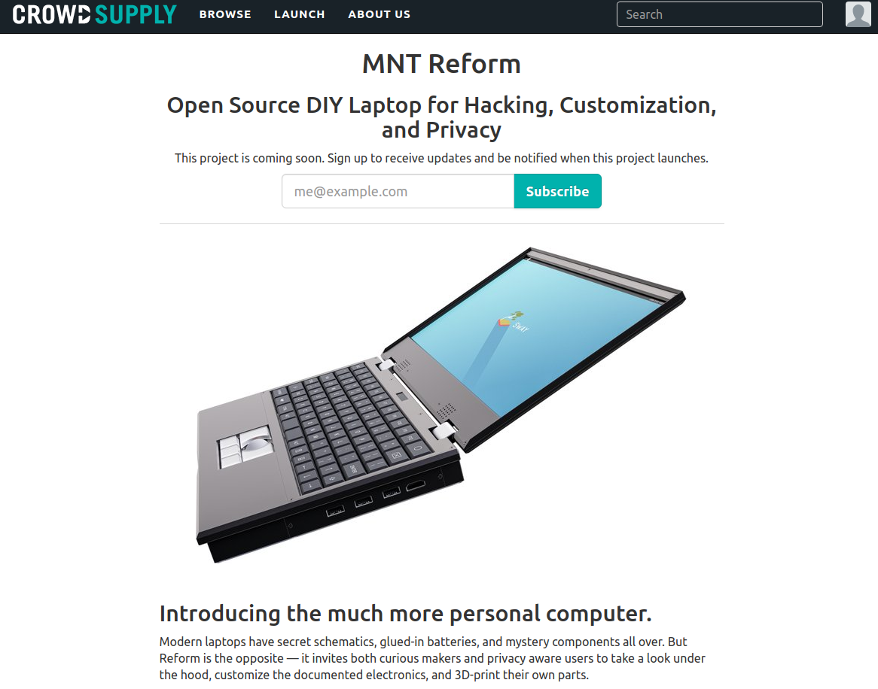

Slide 25


Open Source Hardware computing for Makers, Educators & Professionals
Developed by BeagleBoard.org Foundation and BeagleBoard.org Community
Manufacturers: element14, GHI, Seeed

Slide 26

BeagleBoard.org released the first BeagleBoard, an affordable, open hardware ARM computer in 2008

Slide 27


Maker focused, Altoids tin sized BeagleBone introduced in 2011

Slide 28


More affordable, more powerful BeagleBone Black in 2013

Slide 29

Open Source HardwareBeagleBone derivatives

Slide 30

BeagleBoard.org PocketBeagle
Michael Welling designed the “PocketBone” using the Octavo SiP and shared on Hackaday.io
In response to online demand, BeagleBoard.org worked with GHI in Michigan to design and manufacture a new product: the PocketBeagle

Slide 31

BeagleBoard.org PocketBeagle
PocketBeagle design makes it feasible for individuals to create their own derivatives
4 layer PCB published for EAGLE and KiCad
Low cost assembly is possible with solder paste stencil and toaster oven

Slide 32

BeagleLogic
Kumar Abhishek created a derivative board intended to be used a logic analyzer
Finalist in the Best Product round of the Hackaday Prize
k

Slide 33
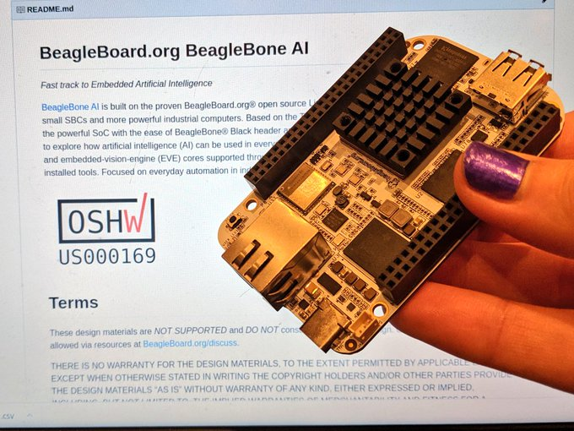
BeagleBone AI design files

Slide 34

OLinuXino
Low cost OSHW Linux computers
Designed and manufactured by Olimex in Bulgaria
Great blog post:
Open Source Hardware, why it matters and what is pseudo OSHW

Slide 35

A64-OlinuXino
Allwinner A64: Quad Core 64-bit ARM
Designed with Open Source KiCad
1GB RAM, 4GB eMMC, WiFi+BLE4.0

Slide 36

Slides / Video

Slide 37

KiCad is an Open Source EDA suite including Schematic Capture and PCB Layout
Cross platform: Windows, Mac OS and Linux
CERN has contributed professional CAD features for high-speed digital design
Learn to design your own PCB in KiCad with: Getting to Blinky

Slide 38

TERES I Laptop
“DIY Open Source Hardware Software Hacker's friendly Modular Laptop”
Developing an Open Source Laptop talk by Olimex founder Tsvetan Usunov at Hackaday Belgrade
Design files on GitHub:
“everyone can download &
learn, study, edit, modify”

Slide 39


getchip.com
Next Thing Co. in Oakland
Kickstarter in 2015
Company ended in 2018

Slide 40

C.H.I.P. is OSHW
GitHub: NextThingCo/CHIP-Hardware
  Schematics
  PCB Layout
  Bill of Materials (BoM)
License:
  Creative Commons Attribution-ShareAlike
  (CC-BY-SA)

Slide 41


Nebula One created by Groguard to be compat
PocketChip with Nebula One running DOOM!

Slide 42

Giant Board by groguard
A single-board computer in the Adafruit Feather form factor
Funded on Crowd Supply

Slide 43


Open Source and FPGAs
Hackspace Magazine column about how about open source FPGA tools developed by Claire Wolf (oe1cxw), David Shah and others have made FPGAs more accessible than ever before to makers and hackers:
  hackspace.raspberrypi.org/issues/26/

Slide 44

Open Source and FPGAs
Open Source toolchains for FPGAs!
  Project IceStorm for Lattice iCE40
    “A Free and Open Source Verilog-to-Bitstream Flow for iCE40 FPGAs” by Claire Wolf (oe1cxw) at 32c3

Slide 45

Open Source and FPGAs
Open Source toolchains for FPGAs!
  Project Trellis for Lattice ECP5
  “Project Trellis and nextpnr FOSS FPGA flow for the Lattice ECP5” - David Shah (@fpga_dave)
    youtube.com/watch?v=0se7kNes3EU

Slide 46

Open Source and FPGAs
Open Source toolchains for FPGAs!
  Project X-Ray and SymbiFlow for Xilinix Series 7
  Timothy ‘mithro’ Ansell: “Xilinx Series 7 FPGAs Now Have a Fully Open Source Toolchain!” (almost)
    youtube.com/watch?v=EHePto95qoE

Slide 47

Open Source and FPGAs
Open Source Hardware boards with Lattice ECP5 FPGA with open RISC-V “soft” CPU:
  Orange Crab by Greg Davill
    https://github.com/gregdavill/OrangeCrab

Slide 48


Slide 49

Open Source and FPGAs
Radiona.org ULX3S
    https://www.crowdsupply.com/radiona/ulx3s

Slide 50

Open Source and FPGAs
Open Source Hardware boards with Lattice ECP5 FPGA with open RISC-V “soft” CPU:
  David Shah's Trellis board (Ultimate ECP5 Board)
  https://github.com/daveshah1/TrellisBoard

Slide 51

Hackaday 2019 Supercon badge
RISC-V “soft” core on ECP5 FPGA
Gigantic FPGA In A Game Boy Form Factor

Slide 52


Slide 53

LiteX is a FPGA design/SoC builder that can be used to build cores, create SoCs and full FPGA designs.
LiteX is based on Migen and provides specific building/debugging tools for a higher level of abstraction and compatibily with the LiteX core ecosystem.
Think of Migen as a toolbox to create FPGA designs in Python and LiteX as a SoC builder to create/develop/debug FPGA SoCs in Python
https://github.com/enjoy-digital/litex

Slide 54
Bunnie:
LiteX vs. Vivado: First Impressions
https://www.bunniestudios.com/blog/?p=5018

Slide 55


Slide 56
Linux on LiteX-VexRiscv
Linux with VexRiscv CPU, a 32-bits Linux Capable RISC-V CPU written in Spinal HDL
SoC around the VexRiscv CPU is created using LiteX as the SoC builder and LiteX's cores written in Migen Python DSL (LiteDRAM, LiteEth, LiteSDCard)
github.com/litex-hub/linux-on-litex-vexriscv

Slide 57
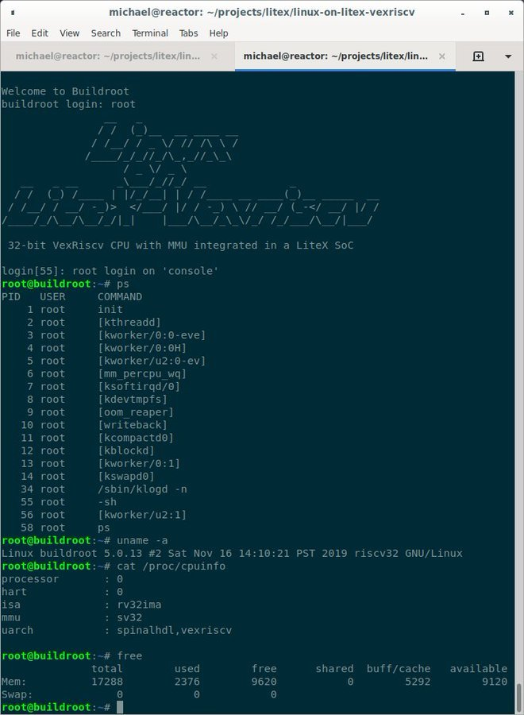
Linux on LiteX-VexRiscv

Slide 58
Section:
Open Source and Chip Design
Slides: https://github.com/pdp7/talks/blob/master/oshw-36c3.pdf

Slide 59

What about open source chips?
RISC-V: Free and Open RISC Instruction Set Arch
  “new instruction set architecture (ISA) that was originally designed to support computer architecture research and education and is now set to become a standard open architecture for industry”
  Video: Instruction Sets Want To Be Free: A Case for RISC-V
  Video: Krste Asanovic presents at RISC-V and Open Source Silicon Event in Munich on March 23, 2017

Slide 60


What about open source chips?
OnChip Open-V
“completely free (as in freedom) and open source 32-bit microcontroller based on the RISC-V architecture”

Slide 61

OnChip Open-V

Slide 62

OnChip Open-V
Crowd Supply update: A Taste of Chip Design
Video: YoPuzzle: mRISC V development platform
Video: RISC-V Community needs Peripheral Cores

Slide 63

Open Source chip design
lowRISC:
“creating a fully open-sourced, Linux-capable, RISC-V-based SoC, that can be used either directly or as the basis for a custom design”
Video: Rob Mullins talking about lowRISC
(RISC-V & Open Source Silicon Event in Munich on March 23, 2017)
Laura James from lowRISC is here!

Slide 64

The Future of Operating Systems on RISC-V
  Alex Bradbury gives an overview of the status and development of RISC-V as it relates to modern operating systems, highlighting major research strands, controversies, and opportunities to get involved.
  https://www.youtube.com/watch?v=emnN9p4vhzk

Slide 65

Open Source chip design
FOSSi Foundation
  The Free and Open Source Silicon Foundation
  “non-profit foundation with the mission to promote and assist free and open digital hardware designs”
  “FOSSi Foundation operates as an open, inclusive, vendor-independent group.”

Slide 66

Open Source chip design
Open Source Silicon Design Ecosystem
  Talk by FOSSi co-founder Julius Baxter

Slide 67

Open Source chip design
LibreCores
  Project of the FOSSi Foundation
  “gateway to free and open source digital designs and other components that you can use and re-use in your digital designs”
  “advances the idea of OpenCores.org”

Slide 68

Latch-Up Conf 2019 videos
Latch-Up 2020 will be
April 11-12 Cambridge MA, USA, at MIT

Slide 69
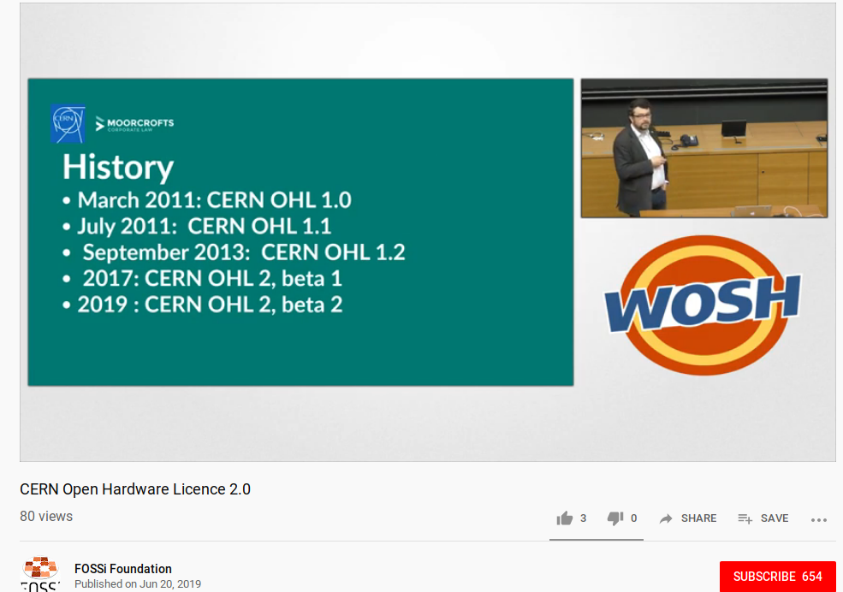
Week of Open Source Hardware

Slide 70

SiFive
“founded by the creators of the free and open RISC-V architecture as a reaction to the end of conventional transistor scaling and escalating chip design costs”

Slide 71

RISC-V ecosystem
RISC-V Keynote at Embedded Linux Conf
  March 12th, 2018
  Yunsup Lee, Co-Founder and CTO, SiFive
  Designing the Next Billion Chips: How RISC-V is Revolutionizing Hardware

Slide 72

SiFive FE310 microcontroller
HiFive1: Arduino-Compatible RISC-V Dev Kit

Slide 73

SiFive FE310 microcontroller
LoFive designed by Michael Welling (QWERTY Embedded Design)
Lower cost eval board for SiFive FE310.
Open Source Hardware design files
Sold as group buy on GroupGets

Slide 74

SiFive: Linux on RISC-V
FOSDEM 2018 talk
  YouTube: “Igniting the Open Hardware Ecosystem with RISC-V: SiFive's Freedom U500 is the World's First Linux-capable Open Source SoC Platform”
  Interview with Palmer Dabbelt of SiFive

Slide 75

SiFive: Linux on RISC-V
HiFive Unleashed on Crowd Supply

Slide 76
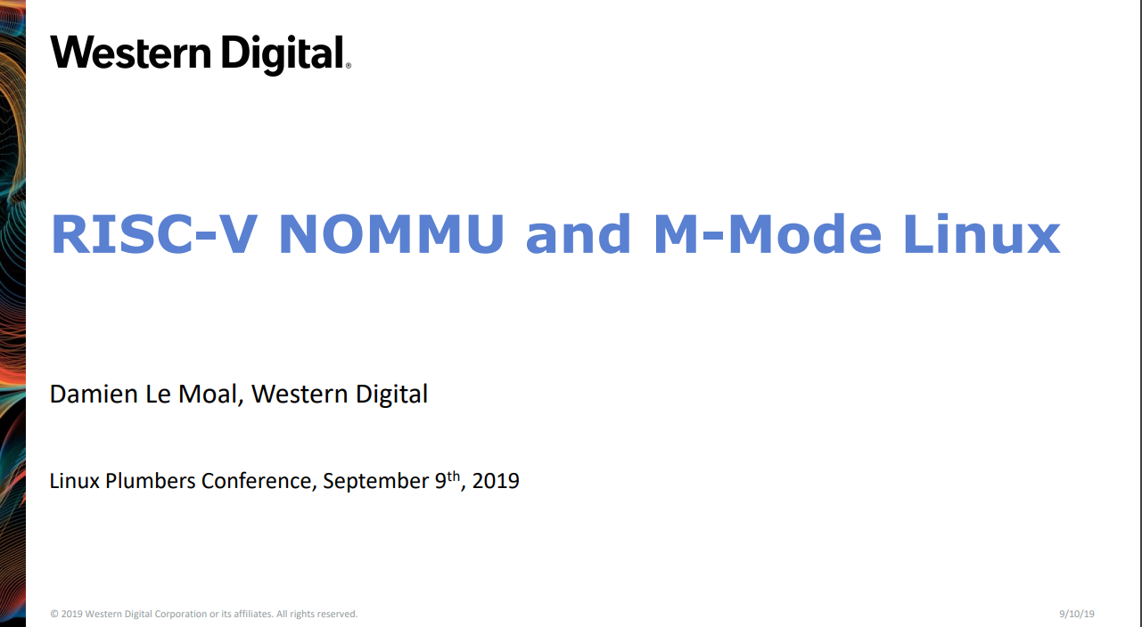

Slide 77
PDF: RISC-V NOMMU and M-mode Linux
https://www.youtube.com/watch?v=ycG592N9EMA&t=10394
jump to 2h 53m
Many RISC-V Improvements Ready For Linux 5.5: M-Mode, SECCOMP, Other Features

Slide 78
HOT CHIPS 2019: Linux RISC-V tutorial
https://youtu.be/nPXdbm9lc3A?t=6139
1 hour 42 minutes
Overview of RISC-V SW Ecosystem Bunnaroath Sou, SiFive

Slide 79
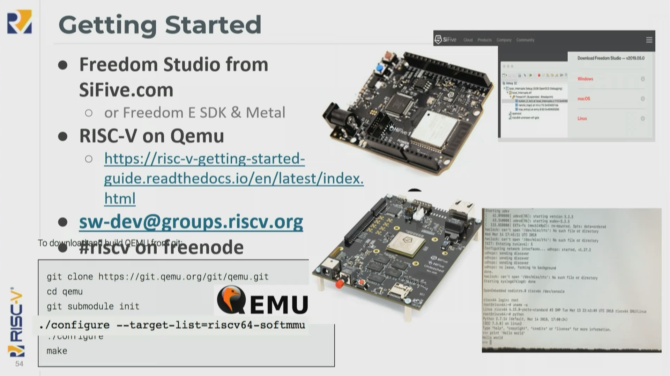

Slide 80
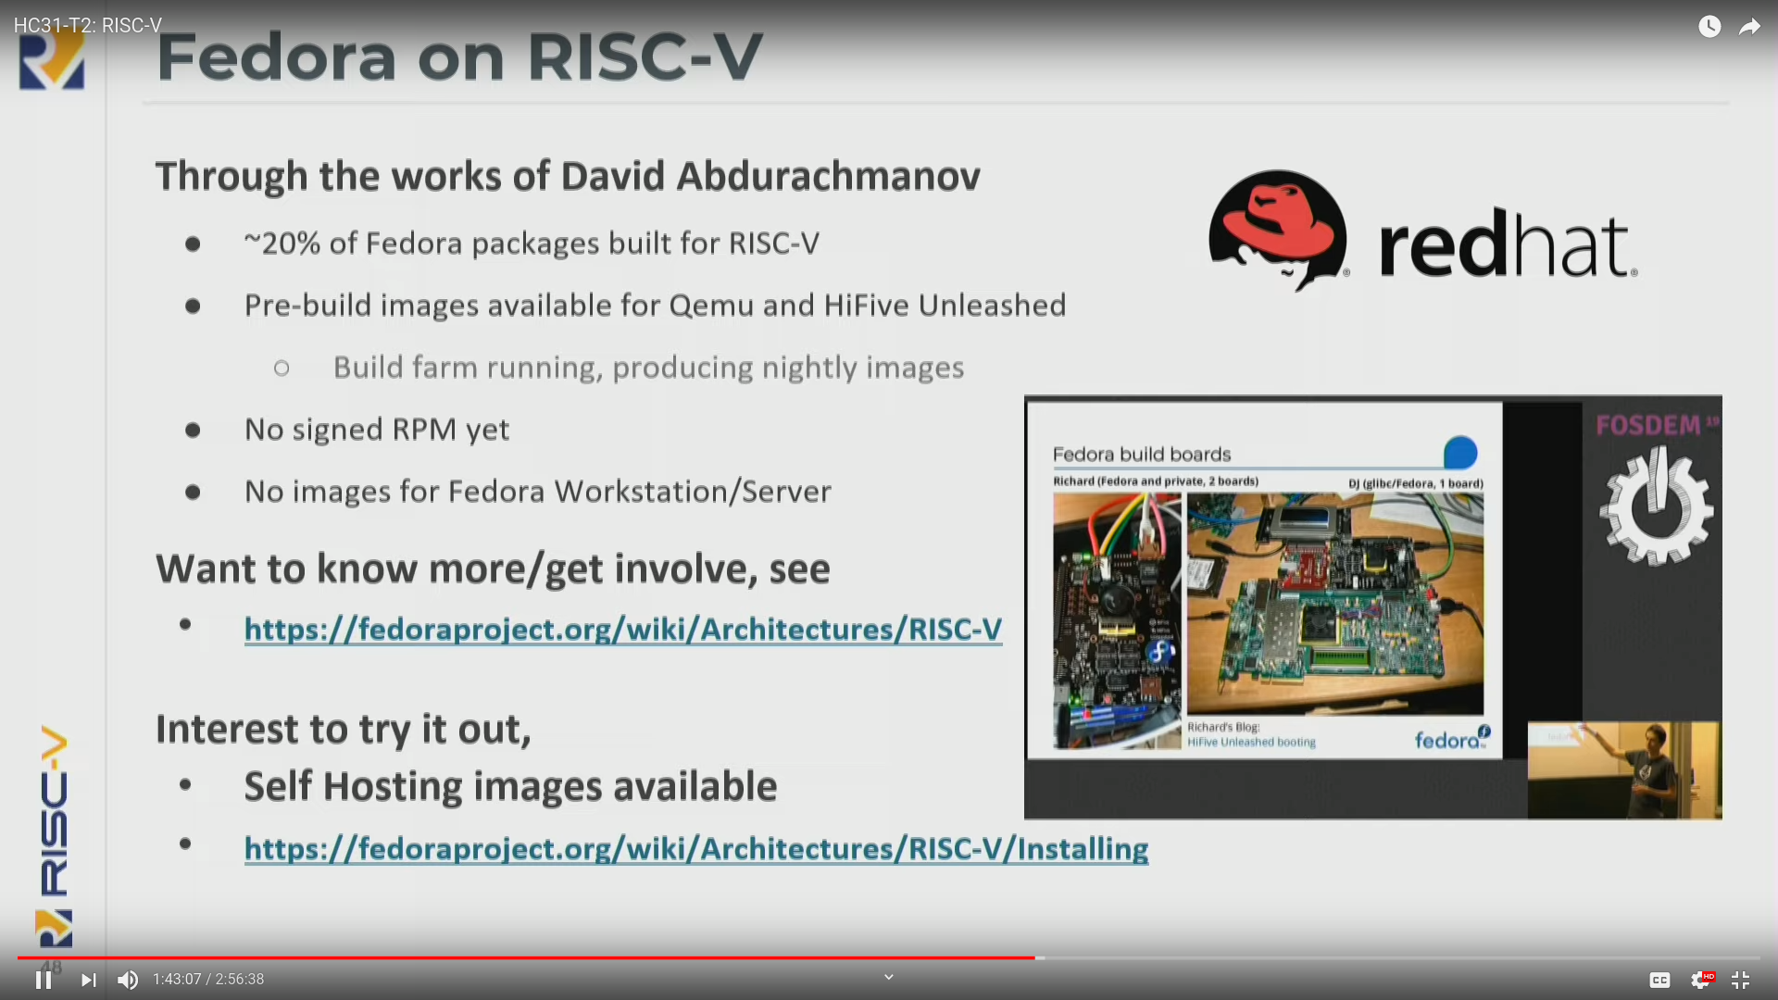

Slide 81
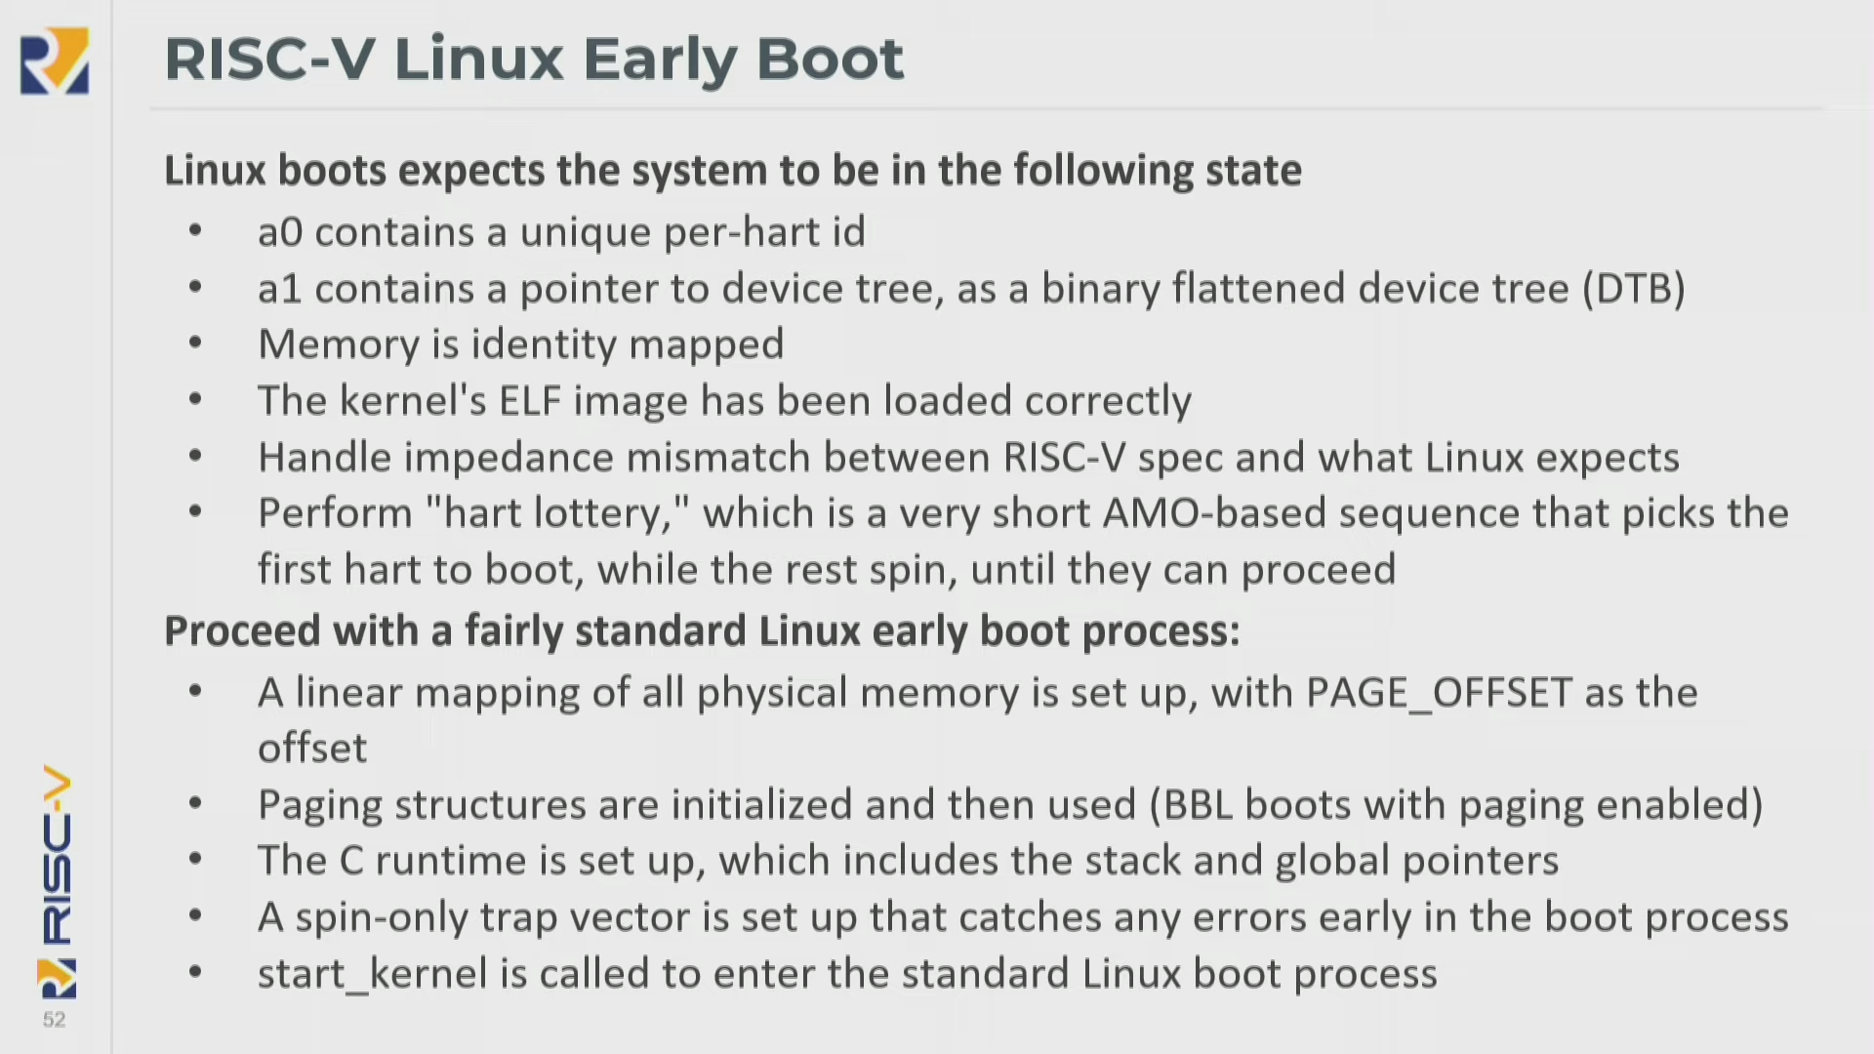

Slide 82
Coming in 2020?
OpenHW Group Unveils CORE-V Chassis SoC Project, Building on PULP Project IP
  https://abopen.com/news/openhw-group-unveils-core-v-chassis-soc-project-building-on-pulp-project-ip/
  “The design in question is based on the NXP i.MX platform, and features a CV64A 64-bit core running at up to 1.5GHz and built on the RV64GC RISC-V core IP from the PULP Platform; this is then partnered with a lower-power VC32E coprocessor, based on the PULP Platform’s RV32IMFCXpulp IP.”

Slide 83
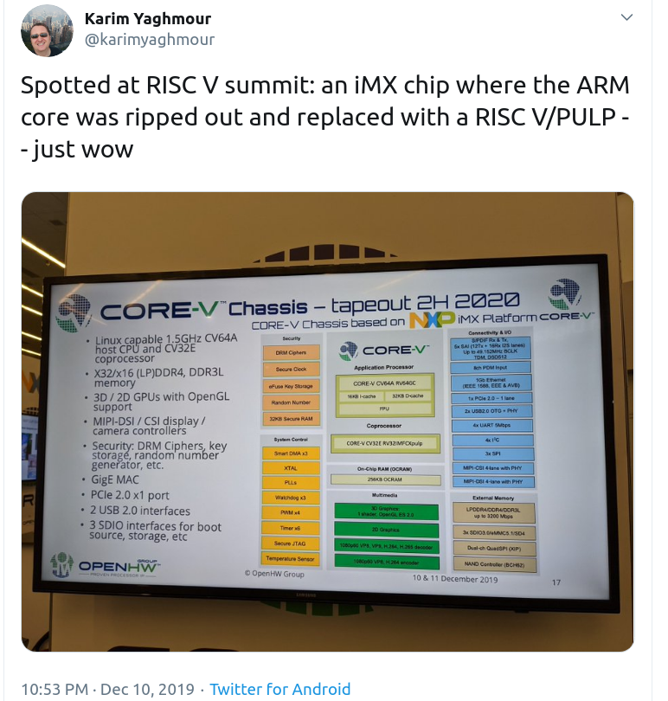

Slide 84

Coming in 2020?

Slide 85
OSHW RISC-V Linux board for less than $100?
Goal: Sub-$100 Open Source Hardware board that can run Linux on RISC-V
Possible by 37c3?
Interested in working together?
  drew@oshpark.com / Twitter: @pdp7
  create a mailing list?

Slide 86
Slides:
github.com/pdp7/talks/blob/master/oshw-linux-36c3.pdf
Drew Fustini
drew@oshpark.com
@pdp7 / @oshpark
This work is licensed under a Creative Commons Attribution-ShareAlike 4.0 International License.

