Slide 1




Drew Fustini
drew@oshpark.com
Twitter: @pdp7
Slides: github.com/pdp7/talks/blob/master/fossn20.pdf
Linux on RISC-V
with open source hardware and open source FPGA tools
FOSS North 2020

Slide 2
  Open Source Hardware designer at OSH Park
    PCB manufacturing service in the USA
    drew@oshpark.com / Twitter: @oshpark
  Volunteer Member of Board of Directors of BeagleBoard.org Foundation
      small open source Linux boards
      drew@beagleboard.org
  Volunteer Member of the Board of Directors of the Open Source Hardware Association (OSHWA)
      Open Source Hardware Certification Program: https://certification.oshwa.org/

Slide 3

Statement of Principles:
Hardware whose design is made publicly available so that anyone can study, modify, distribute, make, and sell the design or hardware based on that design

Slide 4



Documentation required for electronics:
Schematics Board Layout
Editable source files for CAD software such as KiCad or EAGLE
Bill of Materials (BoM)
Not strict requirement, but best practice is for all components available from distributors in low quantity

Slide 5

36c3 talk: Linux on Open Source Hardware with Open Source chip design

Slide 6
Section:
RISC-V the instruction set for everything?
Slides: https://github.com/pdp7/talks/blob/master/fossn20.pdf

Slide 7
When you write a C or C++ program, it is compiled into instructions for the microprocessor (CPU) to execute.
How does the compiler know what instructions the CPU understands?
  defined by the Instruction Set Architecture
  The ISA is a standard, a set of rules that define the tasks the processor can perform.
  Examples: x86 (Intel/AMD) and ARM
    Both are proprietary and need commercial licensing

Slide 8

RISC-V: Free and Open RISC Instruction Set Arch
  “new instruction set architecture (ISA) that was originally designed to support computer architecture research and education and is now set to become a standard open architecture for industry”

Slide 9
RISC-V: Free and Open RISC Instruction Set Arch
    Instruction Sets Want To Be Free: A Case for RISC-V
      David Patterson, UC Berekely – co-creator of the original RISC!
      https://www.youtube.com/watch?v=mD-njD2QKN0
    RISC-V Summit 2019: State of the Union
      Krste Asanovic, UC Berkeley
      https://www.youtube.com/watch?v=jdkFi9_Hw-c

Slide 10
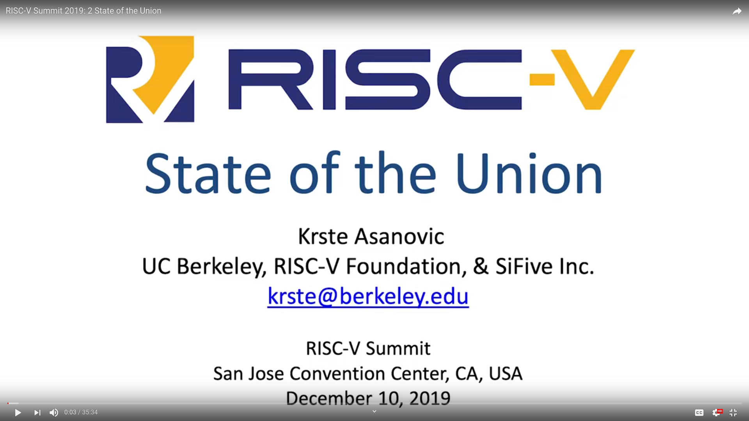

Slide 11


Slide 12


Slide 13


Slide 14
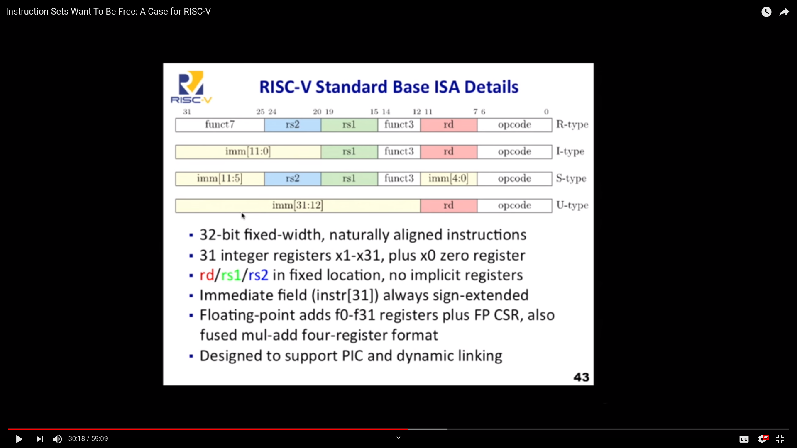

Slide 15
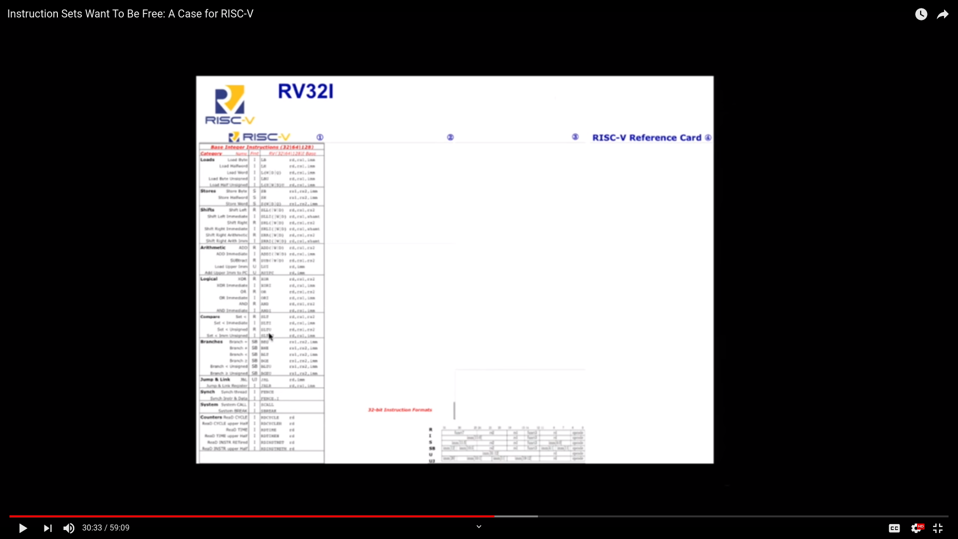

Slide 16
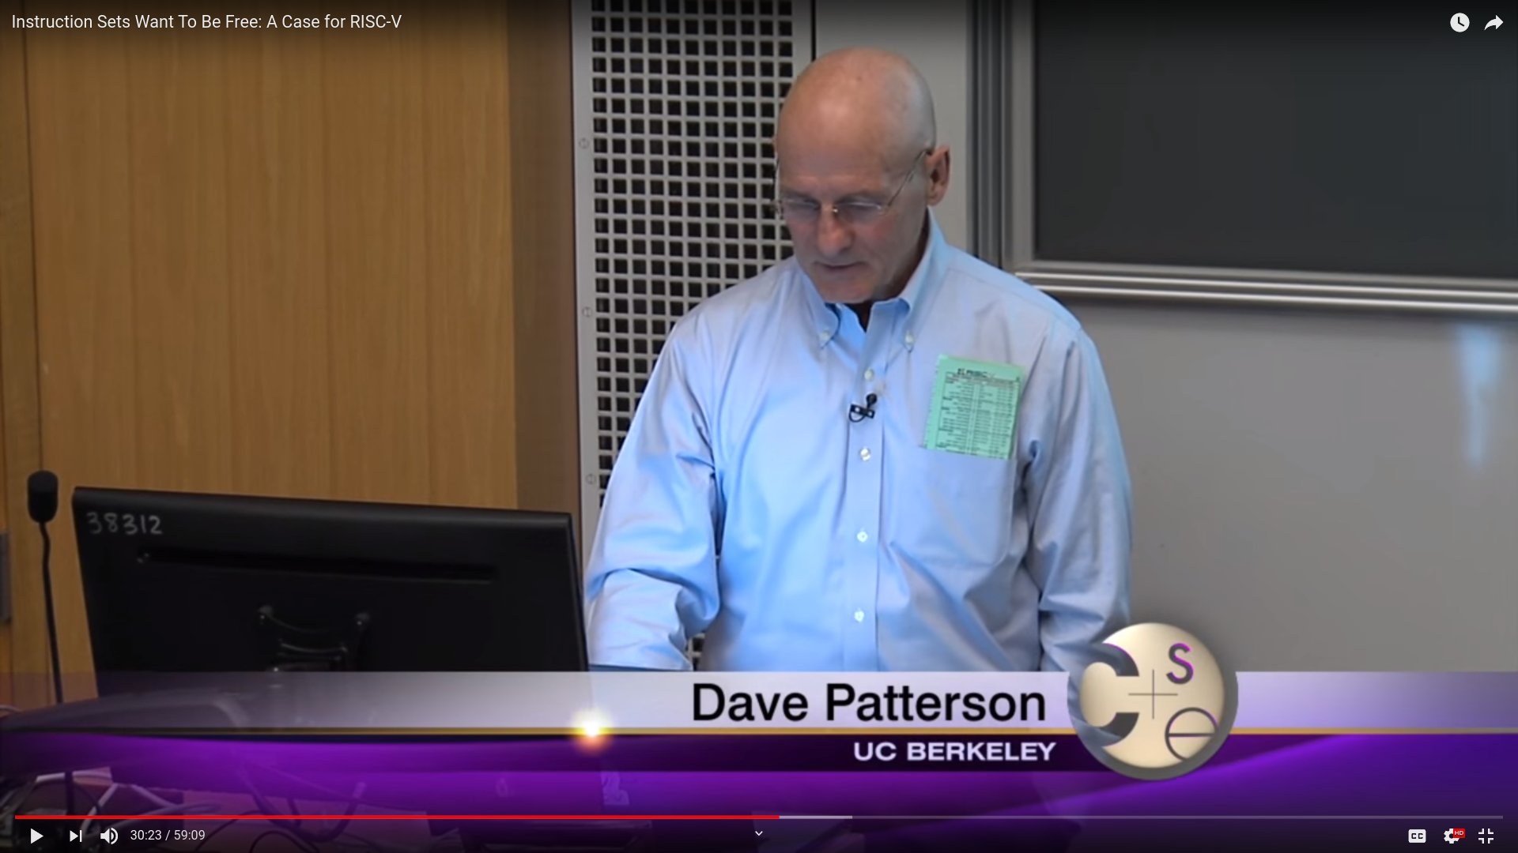

Slide 17
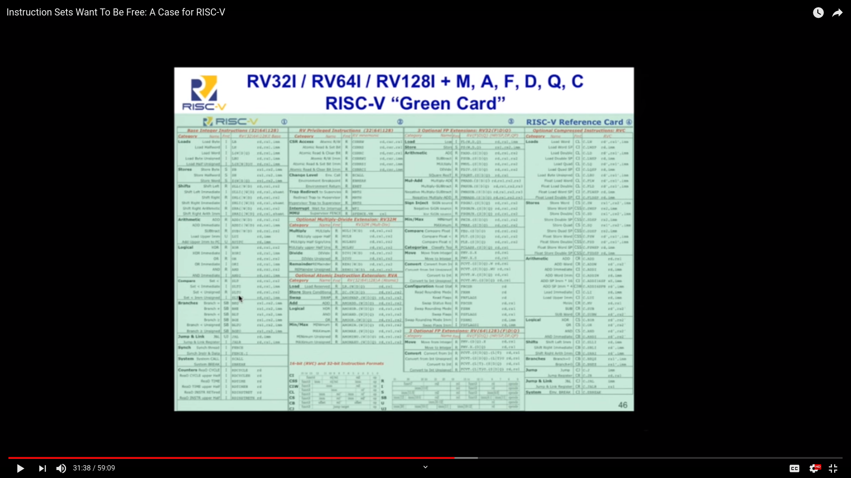

Slide 18
RISC-V and Industry
Designed to be extensible
  Microcontroller to supercomputer
RISC-V Foundation now controls standard: riscv.org
  Over 400 members: companies, universities and more
  YouTube channel has hundreds of talks!
    https://www.youtube.com/channel/UC5gLmcFuvdGbajs4VL-WU3g
Companies like Nvidia and Western Digital will ship millions of devices with RISC-V
Avoid ARM licensing fees
Freedom to leverage open source implementations
    BOOM, Rocket, PULP, SweRV, and many more

Slide 19
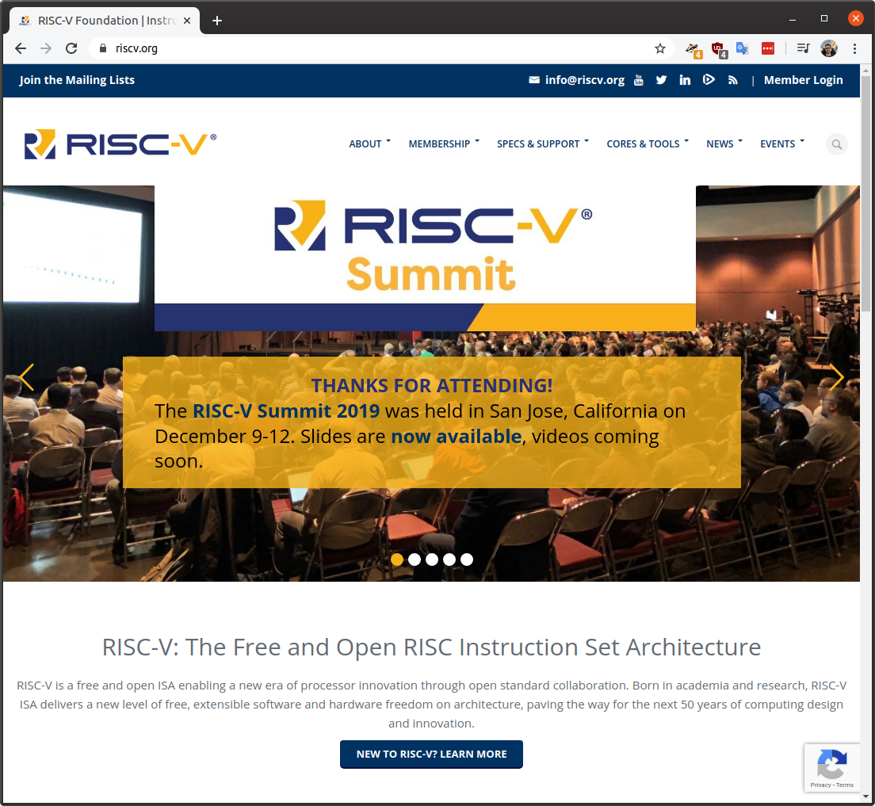

Slide 20
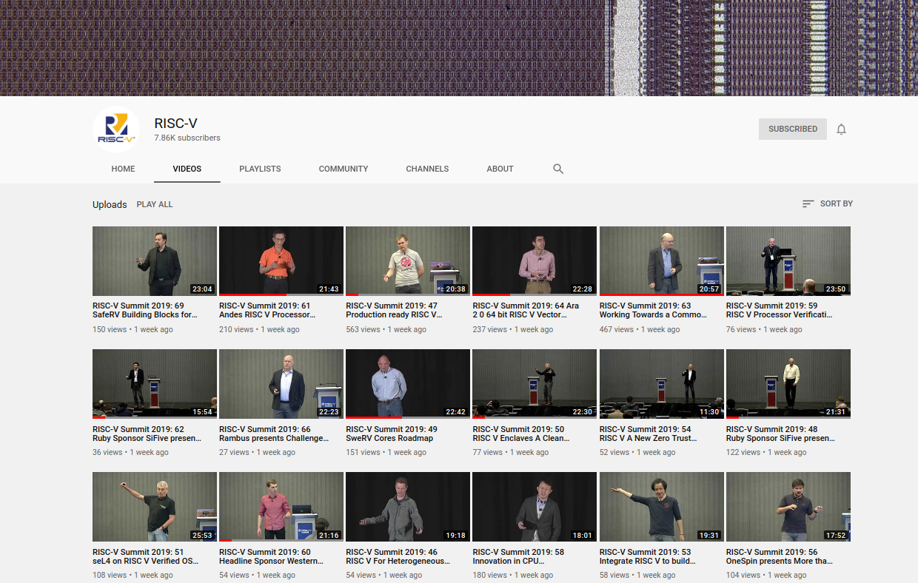

Slide 21
RISC-V and the world
RISC-V Foundation moving from US to Switzerland
Nations such as India have RISC-V initiatives
  Desire for sovereign technology and avoid backdoors from other nations
Strong interest from chipmakers in China
  U.S. companies have been banned from doing business with Huawei… who’s next?
  ARM deemed UK-origin tech so ok to do business with Huawei, but what will brexit-govt bring?

Slide 22

My column in the Hackspace Magazine is an introduction to RISC-V and how it is enabling open source chip design:
  hackspace.raspberrypi.org/issues/27/

Slide 23


OnChip Open-V
“completely free (as in freedom) and open source 32-bit microcontroller based on the RISC-V architecture”

Slide 24

OnChip Open-V

Slide 25

lowRISC is a not-for-profit organisation whose goal is to produce a fully open source System-on-Chip (SoC) in volume
  “We will produce a SoC design to populate a low-cost community development board and to act as an ideal starting point for derivative open-source and commercial designs”
OpenTitan project with Google
  Announcing OpenTitan, the First Transparent Silicon Root of Trust

Slide 26

The Future of Operating Systems on RISC-V
  Alex Bradbury gives an overview of the status and development of RISC-V as it relates to modern operating systems, highlighting major research strands, controversies, and opportunities to get involved.
  https://www.youtube.com/watch?v=emnN9p4vhzk

Slide 27
Tutorial for the v0.7 lowRISC release
    By Jonathan Kimmitt (lead developer), and Alex Bradbury (lead reviewer)
    https://www.cl.cam.ac.uk/~jrrk2/docs/ariane-v0.7/tutorial/
    Digilent Nexys A7-100T: $265
    This tutorial adds further functionality towards the final SoC design:
      Graphical Colour Console with X-windows support incorporating mouse and keyboard events.
      Choice of SD-Card, Quad-SPI or Ethernet TFTP boot-loader with DHCP support.
      Linux 5.3.8 RISCV kernel and updated Debian userland with advanced package tool.
      Choice of RV64-GC Rocket (Chisel) or Ariane (SystemVerilog) CPU

Slide 28

FOSSi Foundation
  The Free and Open Source Silicon Foundation
  “non-profit foundation with the mission to promote and assist free and open digital hardware designs”
  Events: ORConf, Latch-up, Week of OSHW
  Open Source Silicon Design Ecosystem
    Talk by FOSSi co-founder Julius Baxter

Slide 29

LibreCores
  Project of the FOSSi Foundation
  “gateway to free and open source digital designs and other components that you can use and re-use in your digital designs”
  “advances the idea of OpenCores.org”

Slide 30

SiFive
“founded by the creators of the free and open RISC-V architecture as a reaction to the end of conventional transistor scaling and escalating chip design costs”

Slide 31

SiFive FE310 microcontroller
HiFive1: Arduino-Compatible RISC-V Dev Kit

Slide 32
Section:
Linux-capable RISC-V chips
Slides: https://github.com/pdp7/talks/blob/master/fossn20.pdf

Slide 33

SiFive: Linux on RISC-V
FOSDEM 2018 talk
  YouTube: “Igniting the Open Hardware Ecosystem with RISC-V: SiFive's Freedom U500 is the World's First Linux-capable Open Source SoC Platform”
  Interview with Palmer Dabbelt of SiFive

Slide 34

SiFive: Linux on RISC-V
HiFive Unleashed on Crowd Supply

Slide 35

  RISC-V Summit 2019: Linux on RISC V Fedora and Firmware Status Update
    https://www.youtube.com/watch?v=WC6e3g8uWdk
    Wei Fu – Software Engineer, Red Hat

Slide 36


Slide 37


Slide 38
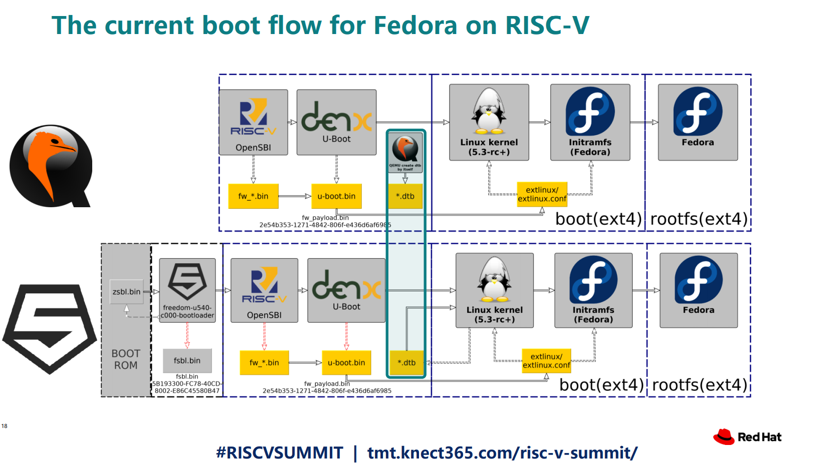

Slide 39


Slide 40
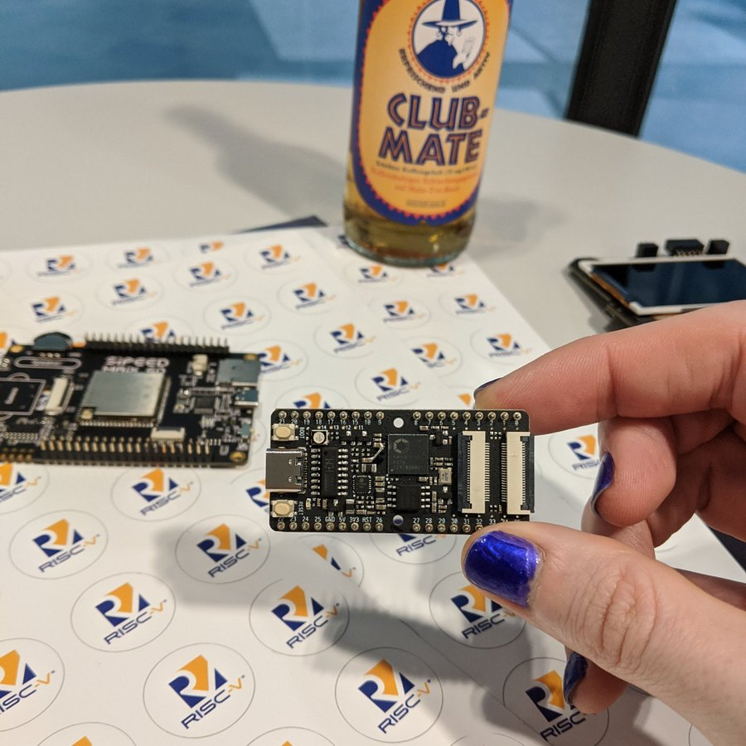

Slide 41


Slide 42
Linux now runs the low cost Kendryte K210 RISC-V processor
  dual core 64-bit RISC-V at 400MHz with 8MB SRAM
  Sipeed MAix BiT for RISC-V is only $13!
  Damien Le Moal at Linux Plumbers Conf: RISC-V NOMMU and M-mode Linux
    youtube.com/watch?v=ycG592N9EMA&t=10394
    jump to 2h 53m
  Many RISC-V Improvements Ready For Linux 5.5: M-Mode, SECCOMP, Other Features
  How to Build & Run Linux on Kendryte K210 RISC-V NOMMU Processor

Slide 43


Slide 44
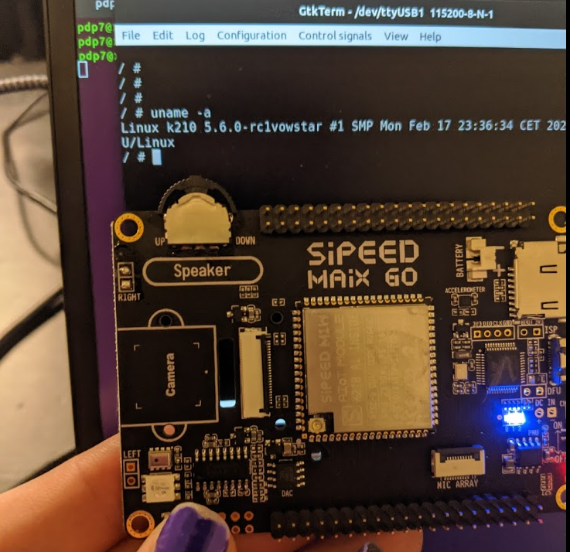

Slide 45
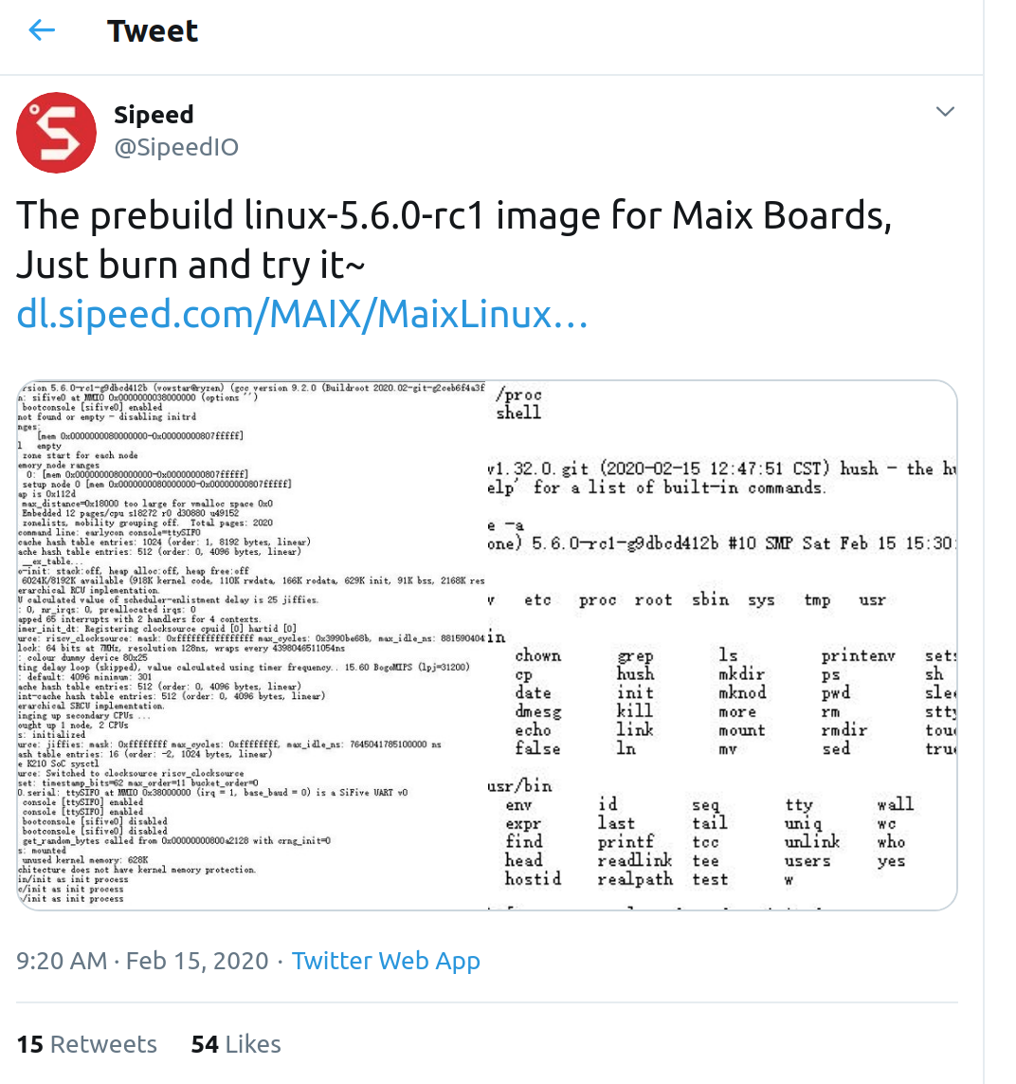
Sipeed now has prebuilt Linux 5.6
  https://twitter.com/SipeedIO/status/1228594799675990016/

Slide 46
Coming in 2020
Microchip PolarFire SoC FPGA
  Hard RISC-V with FPGA fabric… like the Xilinx Zync for ARM
OpenHW Core-V SoC which is similar to NXP iMX with RISC-V instead of ARM!
  “OpenHW Group Unveils CORE-V Chassis SoC Project, Building on PULP Project IP”

Slide 47

Coming in 2020?

Slide 48
OSHW RISC-V Linux board for less than $100?
Goal: Sub-$100 Open Source Hardware board that can run Linux on RISC-V
Possible by FOSS North 2021?
Interested in working together?
  drew@oshpark.com / Twitter: @pdp7
  create a mailing list?

Slide 49
Section:
Open Source FPGA tools
Slides: https://github.com/pdp7/talks/blob/master/fossn20.pdf

Slide 50

Keynote at Hackday Supercon 2019 by
Dr. Megan Wachs of SiFive
“RISC-V and FPGAs: Open Source Hardware Hacking”
  https://www.youtube.com/watch?v=vCG5_nxm2G4

Slide 51


Slide 52

Open Source toolchains for FPGAs
Project IceStorm for Lattice iCE40
    “A Free and Open Source Verilog-to-Bitstream Flow for iCE40 FPGAs” by Claire Wolf (oe1cxw) at 32c3

Slide 53

Open Source toolchains for FPGAs
Project Trellis for Lattice ECP5
  “Project Trellis and nextpnr FOSS FPGA flow for the Lattice ECP5” - David Shah (@fpga_dave)
    youtube.com/watch?v=0se7kNes3EU

Slide 54

Open Source toolchains for FPGAs
Project X-Ray & SymbiFlow for Xilinix Series 7
  Timothy ‘mithro’ Ansell: “Xilinx Series 7 FPGAs Now Have a Fully Open Source Toolchain!” (almost)
    youtube.com/watch?v=EHePto95qoE

Slide 55


Open Source and FPGAs
Hackspace Magazine column about how about open source FPGA tools developed by Claire Wolf (oe1cxw), David Shah and others have made FPGAs more accessible than ever before to makers and hackers:
  hackspace.raspberrypi.org/issues/26/

Slide 56
Section:
Linux on the Hackaday Badge
Slides: https://github.com/pdp7/talks/blob/master/fossn20.pdf

Slide 57

Hackaday 2019 Supercon badge
RISC-V “soft” core on ECP5 FPGA
Gigantic FPGA In A Game Boy Form Factor

Slide 58

“Team Linux on Badge”

Slide 59
“Team Linux on Badge”
Blog post: Hackaday Supercon badge boots Linux using SDRAM cartridge
  https://blog.oshpark.com/2019/12/20/boot-linux-on-this-hackaday-supercon-badge-with-this-sdram-cartridge/
Michael Welling (@QwertyEmedded), Tim Ansell (@mithro), Sean Cross (@xobs), Jacob Creedon (@jacobcreedon)
First attempt: use the built-in 16MB SRAM…
no luck :(
  (though xobs now might have a way to do it)

Slide 60

“Team Linux on Badge”
Second attempt:
  Jacob Creedon designed an a cartridge board that adds 32MB of SDRAM to the Hackaday Supercon badge… before the event!

Slide 61

“Team Linux on Badge”
Second attempt:
  Jacob Creedon designed an a cartridge board that adds 32MB of SDRAM to the Hackaday Supercon badge… before the event!

Slide 62


Slide 63
Designing Hardware in Python?
Yes!
“Using Python for creating hardware to record FOSS conferences!”
Tim “mithro” Ansell
youtube.com/watch?v=MkVX_mh5dOU

Slide 64


Slide 65


Slide 66


Slide 67
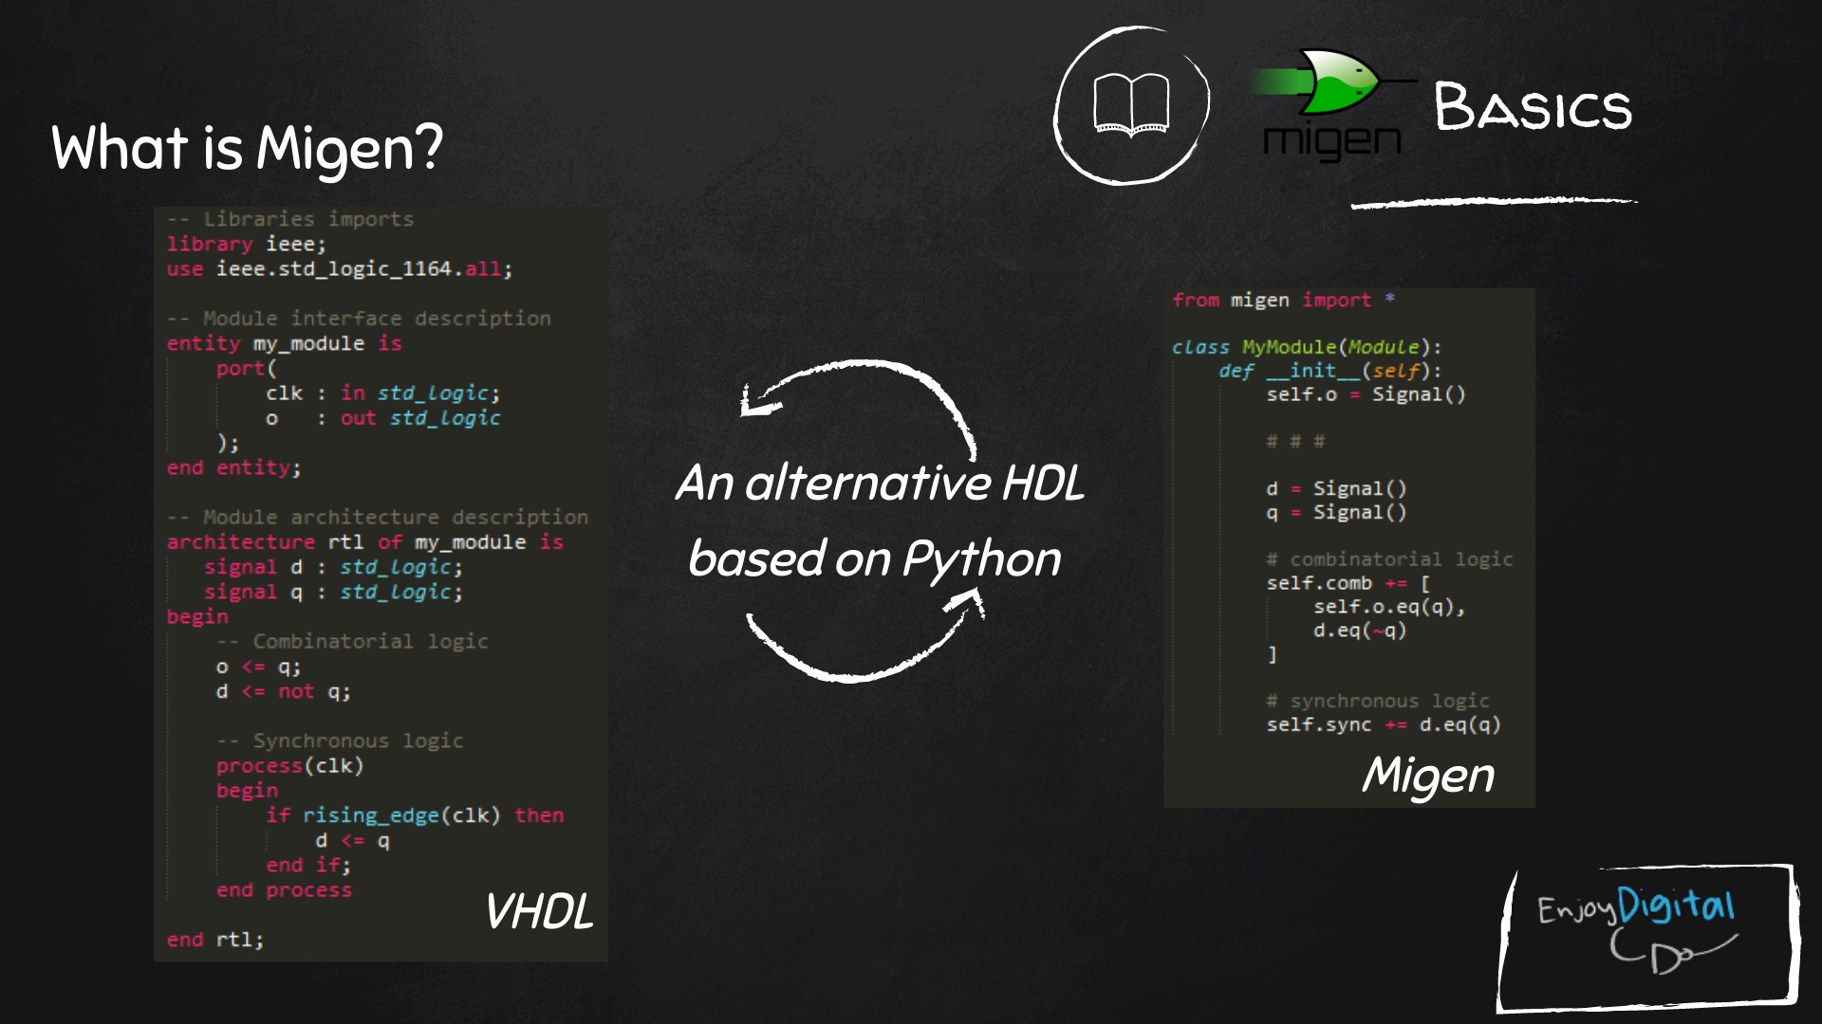
Slides: https://github.com/litex-hub/fpga_101

Slide 68
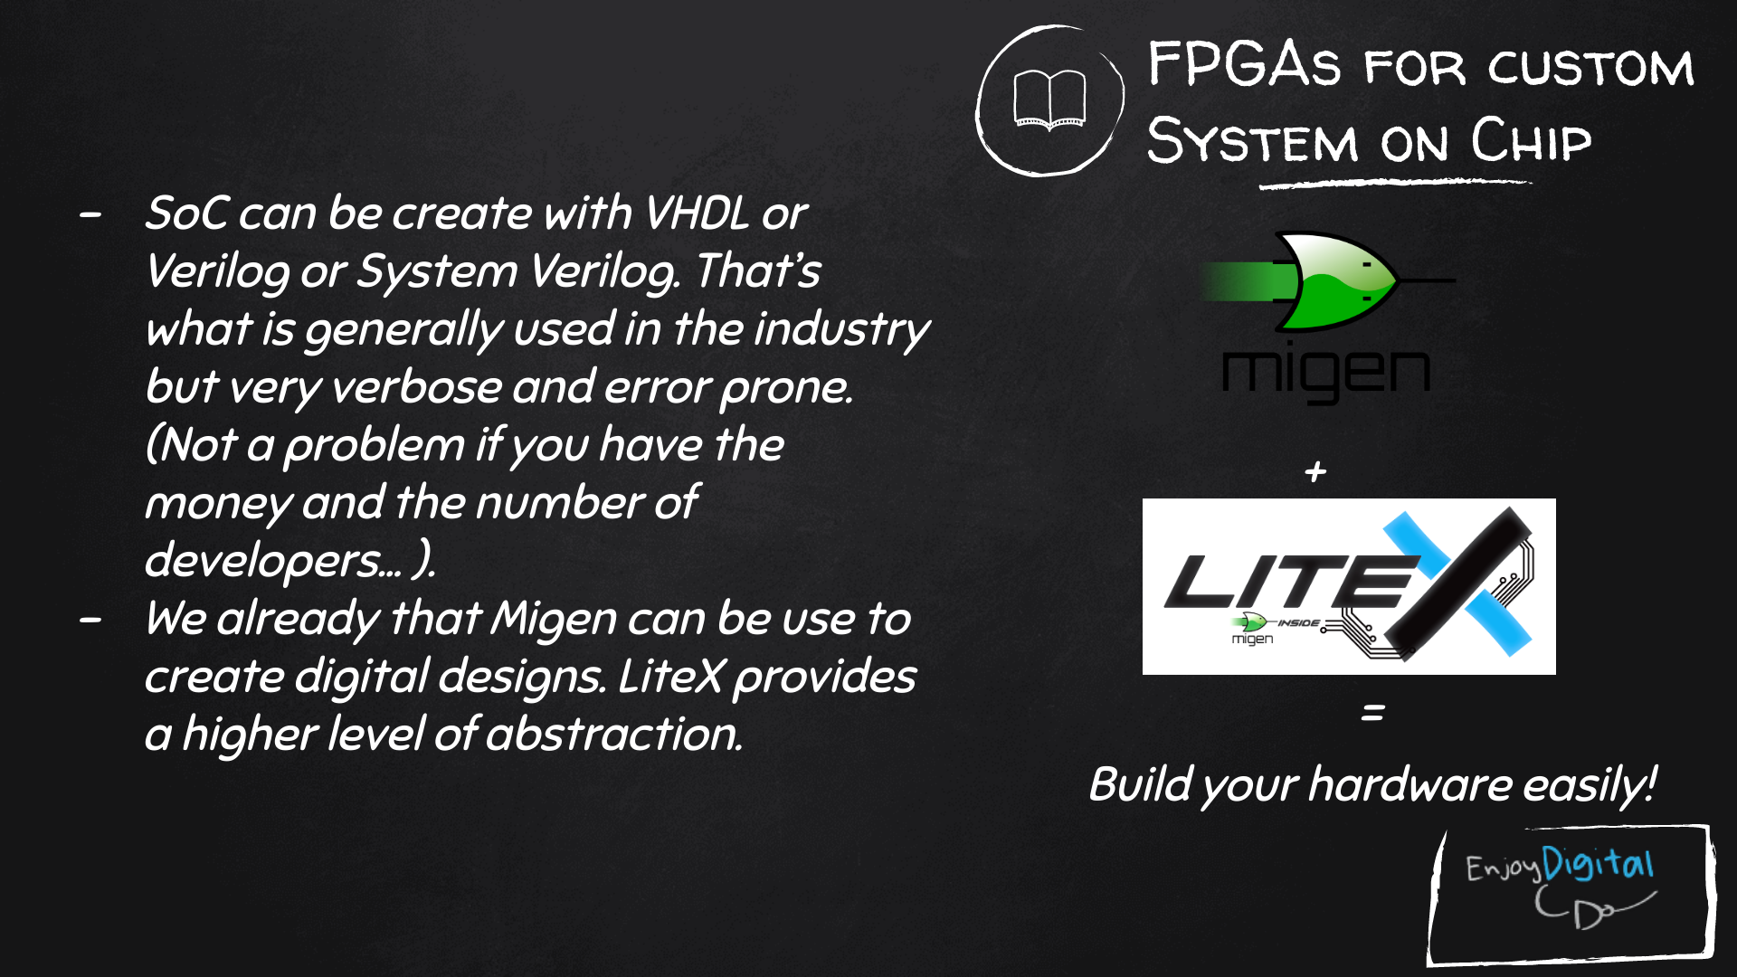
Slides: https://github.com/litex-hub/fpga_101

Slide 69

LiteX used to build cores, create SoCs and full FPGA designs.
LiteX is based on Migen
Migen lets you do FPGA design in Python!
https://github.com/enjoy-digital/litex

Slide 70
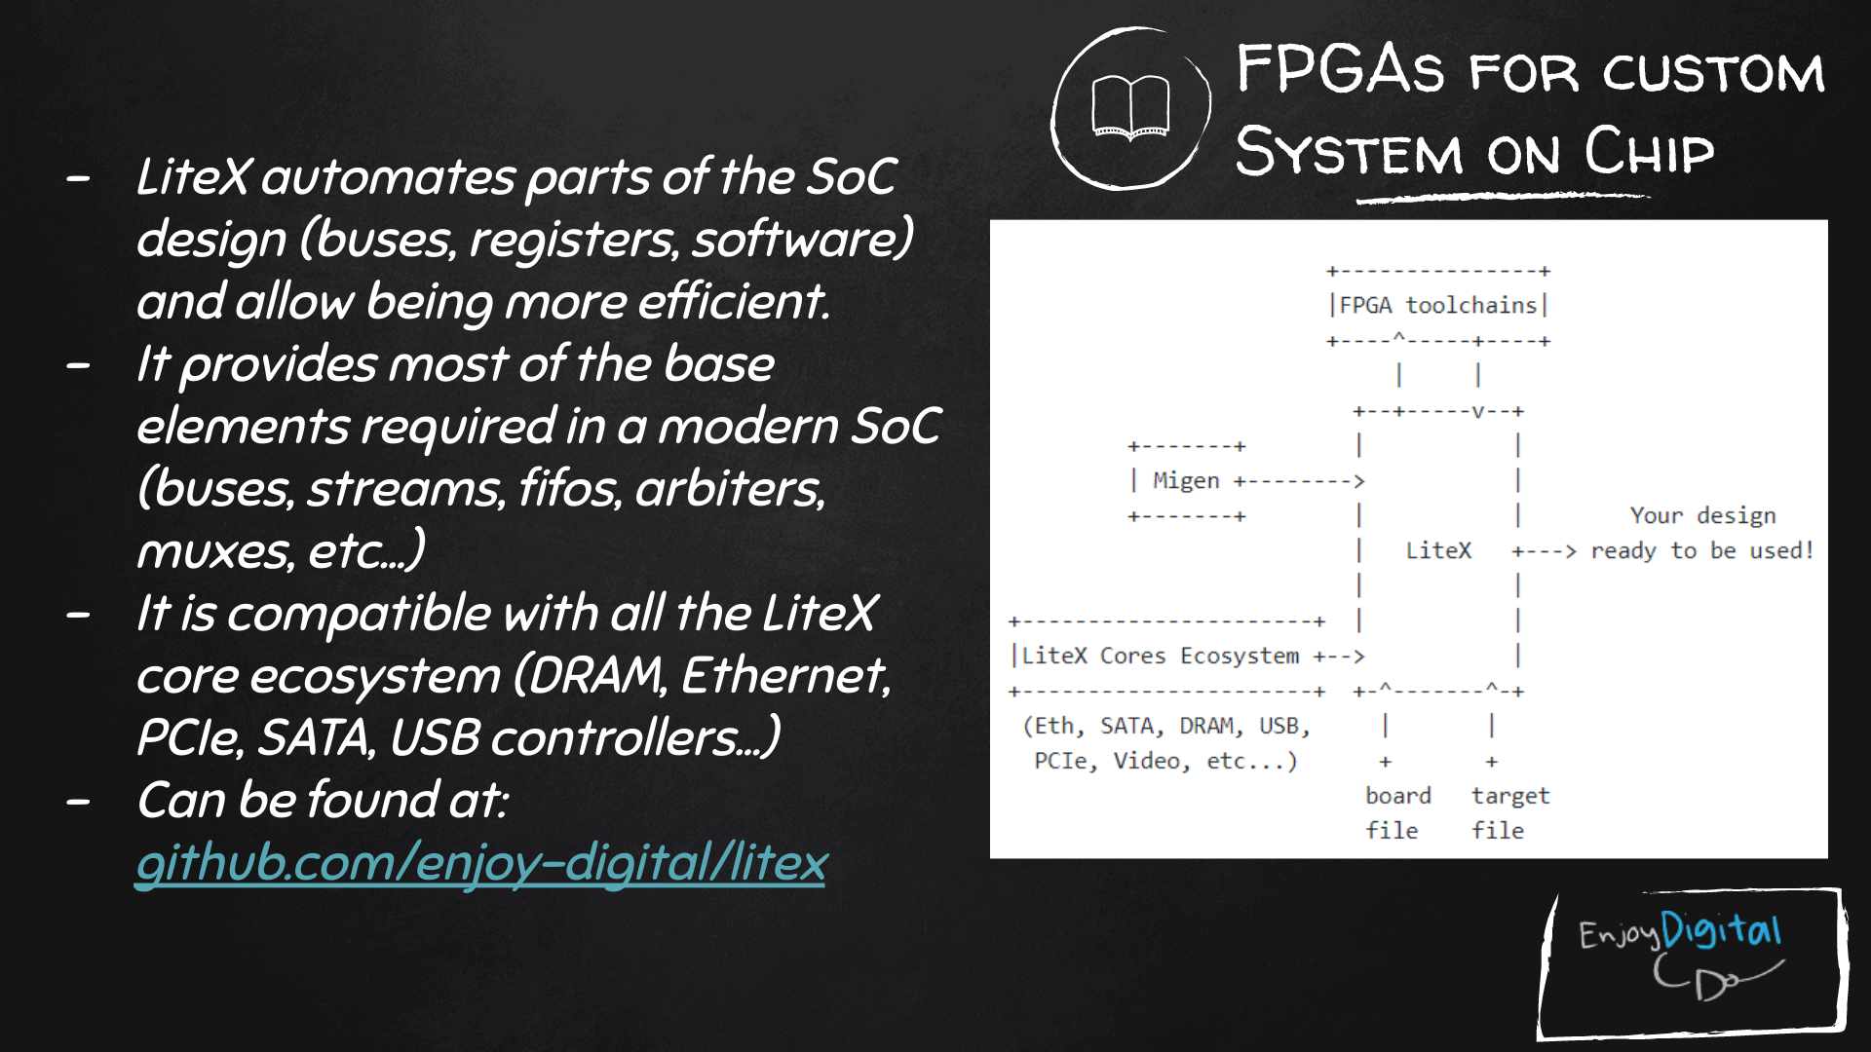
Slides: https://github.com/litex-hub/fpga_101
https://github.com/litex-hub/fpga_101

Slide 71


Slide 72

Linux on LiteX-VexRiscv
VexRiscv: 32-bit Linux Capable RISC-V CPU
SoC built using VexRiscv core and LiteX moduels like LiteDRAM, LiteEth, LiteSDCard, ...
  github.com/litex-hub/linux-on-litex-vexriscv

Slide 73


Slide 74

upstream support for Hackaday Supercon badge:
  https://github.com/litex-hub/litex-boards/pull/31

Slide 75

upstream support for Hackaday Supercon badge:
  https://github.com/litex-hub/litex-boards/pull/31

Slide 76

upstream support for Hackaday Supercon badge:
  https://github.com/litex-hub/litex-boards/pull/31

Slide 77


Slide 78


Slide 79


Slide 80


Slide 81
Opened GitHub issue:
  optimize performance on Hackaday Badge #35
    https://github.com/litex-hub/litex-boards/issues/35
Now 10x faster!
  https://asciinema.org/a/Pcm3vd1BEdEKY9srYX6MsNfCE
  Thanks to enjoy-digital

Slide 82


Slide 83


Slide 84


Slide 85


Slide 86

Greg Davill got the screen working with LiteVideo!
  twitter.com/GregDavill/status/1231082623633543168

Slide 87
Open Source boards with
ECP5 FPGA
(can run Linux)
Slides: https://github.com/pdp7/talks/blob/master/fossn20.pdf

Slide 88

Open Source Hardware board with Lattice ECP5 FPGA with open RISC-V “soft” CPU:
  David Shah's Trellis board (Ultimate ECP5 Board)
  https://github.com/daveshah1/TrellisBoard

Slide 89

Open Source ECP5 boards
Lattice ECP5 FPGA in Adafruit Feather form factor and 128MB DDR RAM:
  Orange Crab by Greg Davill
    https://github.com/gregdavill/OrangeCrab
    https://groupgets.com/campaigns/710-orangecrab

Slide 90


Slide 91

Open Source ECP5 boards
Radiona.org ULX3S
    https://www.crowdsupply.com/radiona/ulx3s

Slide 92

Want to learn FPGAs? Try Fomu!
workshop.fomu.im
crowdsupply.com/sutajio-kosagi/fomu
Fits in USB port
RGB LED
Learn:
  MicroPython
  Verilog
  LiteX

Slide 93

Slides:
github.com/pdp7/talks/blob/master/fossn20.pdf
Contact: @pdp7 || drew@oshpark.com
36c3 talk

