Slide 1


Introduction to
Open Source Hardware
Presented at Heart of Illinois Open Tech Summit on March 23, 2017
Drew Fustini
OSH Park
drew@oshpark.com
@oshpark / @pdp7

Slide 2

Design is made
publicly available
so that anyone can
study,
modify,
distribute,
make
or sell
designs or
hardware based on that design

Slide 3



Documentation required for electronics:
Schematics Board Layout
Editable source files for CAD software (KiCad, EAGLE, Altium, etc)
Bill of Materials (BOM)
Best practice: all components available in low quantity distribution

Slide 4

Example: Arduino
Achieved critical mass by sharing design files
Arduino: The Documentary describes the motivation

Slide 5

Example: Arduino
EAGLE design files for Arduino Uno

Slide 6
Publish documentation with an
Open Source license:
Creative Commons Share-Alike: CC-BY-SA
    Non-Commercial (NC) clause is NOT acceptable
Copyleft: GPLv2, GPLv3
Permissive: Apache, BSD, MIT
OSHW inspired: CERN OHL, TAPR, SolderPad

Slide 7

CERN Open Hardware Licence
Originally written for CERN designs hosted in the Open Hardware Repository
Can used by any designer wishing to share design information using a license compliant with the OSHW definition criteria.
CERN OHL version 1.2
Contains the license itself and a guide to its usage

Slide 8
CERN Open Hardware Licence
Myriam Ayass, legal adviser at CERN and author of the CERN OHL:
  OHL is to hardware what GPL is to software
  Similar principles to Free or Open Source software
  Anyone should be able to:
  see the source*, study it, modify it and share it
  *the design documentation in case of hardware

Slide 9

CERN Open Hardware Licence
Video interview with Javier Serrano
physicist and electronics engineer at CERN
co-author of the CERN Open Hardware License
creator of the Open Hardware Repository

Slide 10
Licenses, Copyright and Patents
can get confusing!
Review of Popular OSHW Licenses
Video of Ari Douglas at OHS 2014

Slide 11
What is the spirit of Open Source?
Publish everything that will:
enable collaborative development
The goal is NOT to just check a box on a marketing flyer or add keywords to a Kickstarter campaign

Slide 12

US-based 501(c)3 non-profit organization
Hosts the Open Source Hardware definition
The Open Source Hardware Association (OSHWA) “aims to be the voice of the open hardware community, ensuring that technological knowledge is accessible to everyone, and encouraging the collaborative development of technology”

Slide 13
Best Practices
Quick Reference Guide
May and Must attributes (PDF)

Slide 14


Open Hardware Summit (OHS)
OHS 2017: Denver, Colorado, October 5th
7 prior summits:
  2010, 2011: New York Hall of Science
  2012: Eyebeam (NYC)
  2013: MIT (Boston area)
  2014: Roma, Italia!
  2015: Philadelphia
  2016: Portland, Oregon

Slide 15
Open Hardware Summit (OHS)
OHS 2017: Denver, Colorado, October 5th
Speaker Submissions are open!
Ada Lovelace Fellowship aims to increase diversity by offering a $500 travel stipend each for 10 people

Slide 16
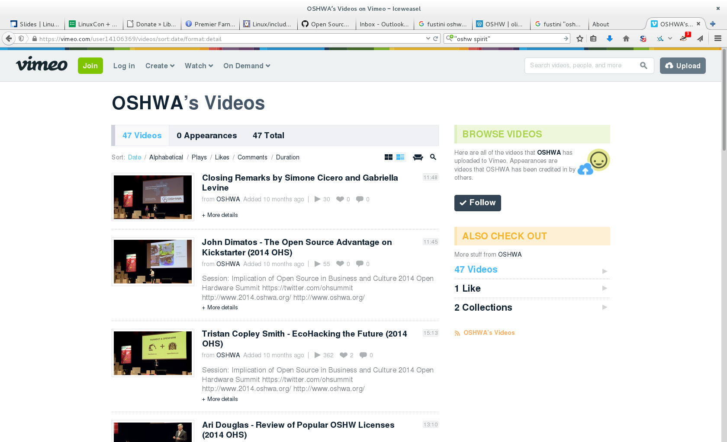
2014 videos:
Open Hardware Summit (OHS)

Slide 17
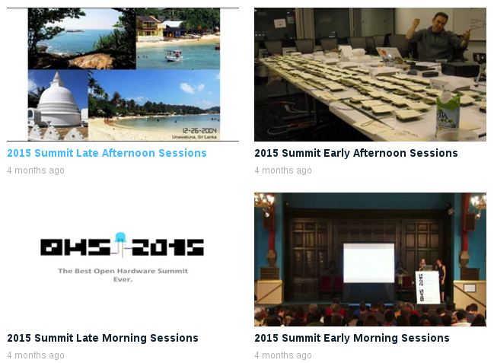
Open Hardware Summit (OHS)
2015 videos:

Slide 18
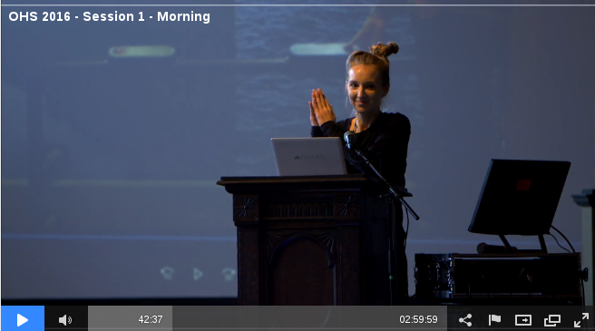
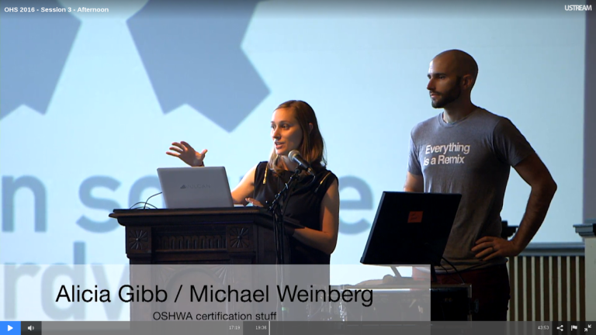
Open Hardware Summit (OHS)
OHS 2016 morning sessions
OHS 2016 afternoon sessions

Slide 19

Open Source Hardware Certification Program
Announced by OSHWA at Open Hardware Summit in Portland back in October 2016
Blog post:Announcing the OSHWA Open Source Hardware Certification Program

Slide 20
Open Source Hardware Certification Program
Allows hardware that complies with the community definition of Open Source Hardware to display a certified OSHW logo
Make it easier for users of OSHW to track down documentation and information
More information: certificate.oshwa.org

Slide 21
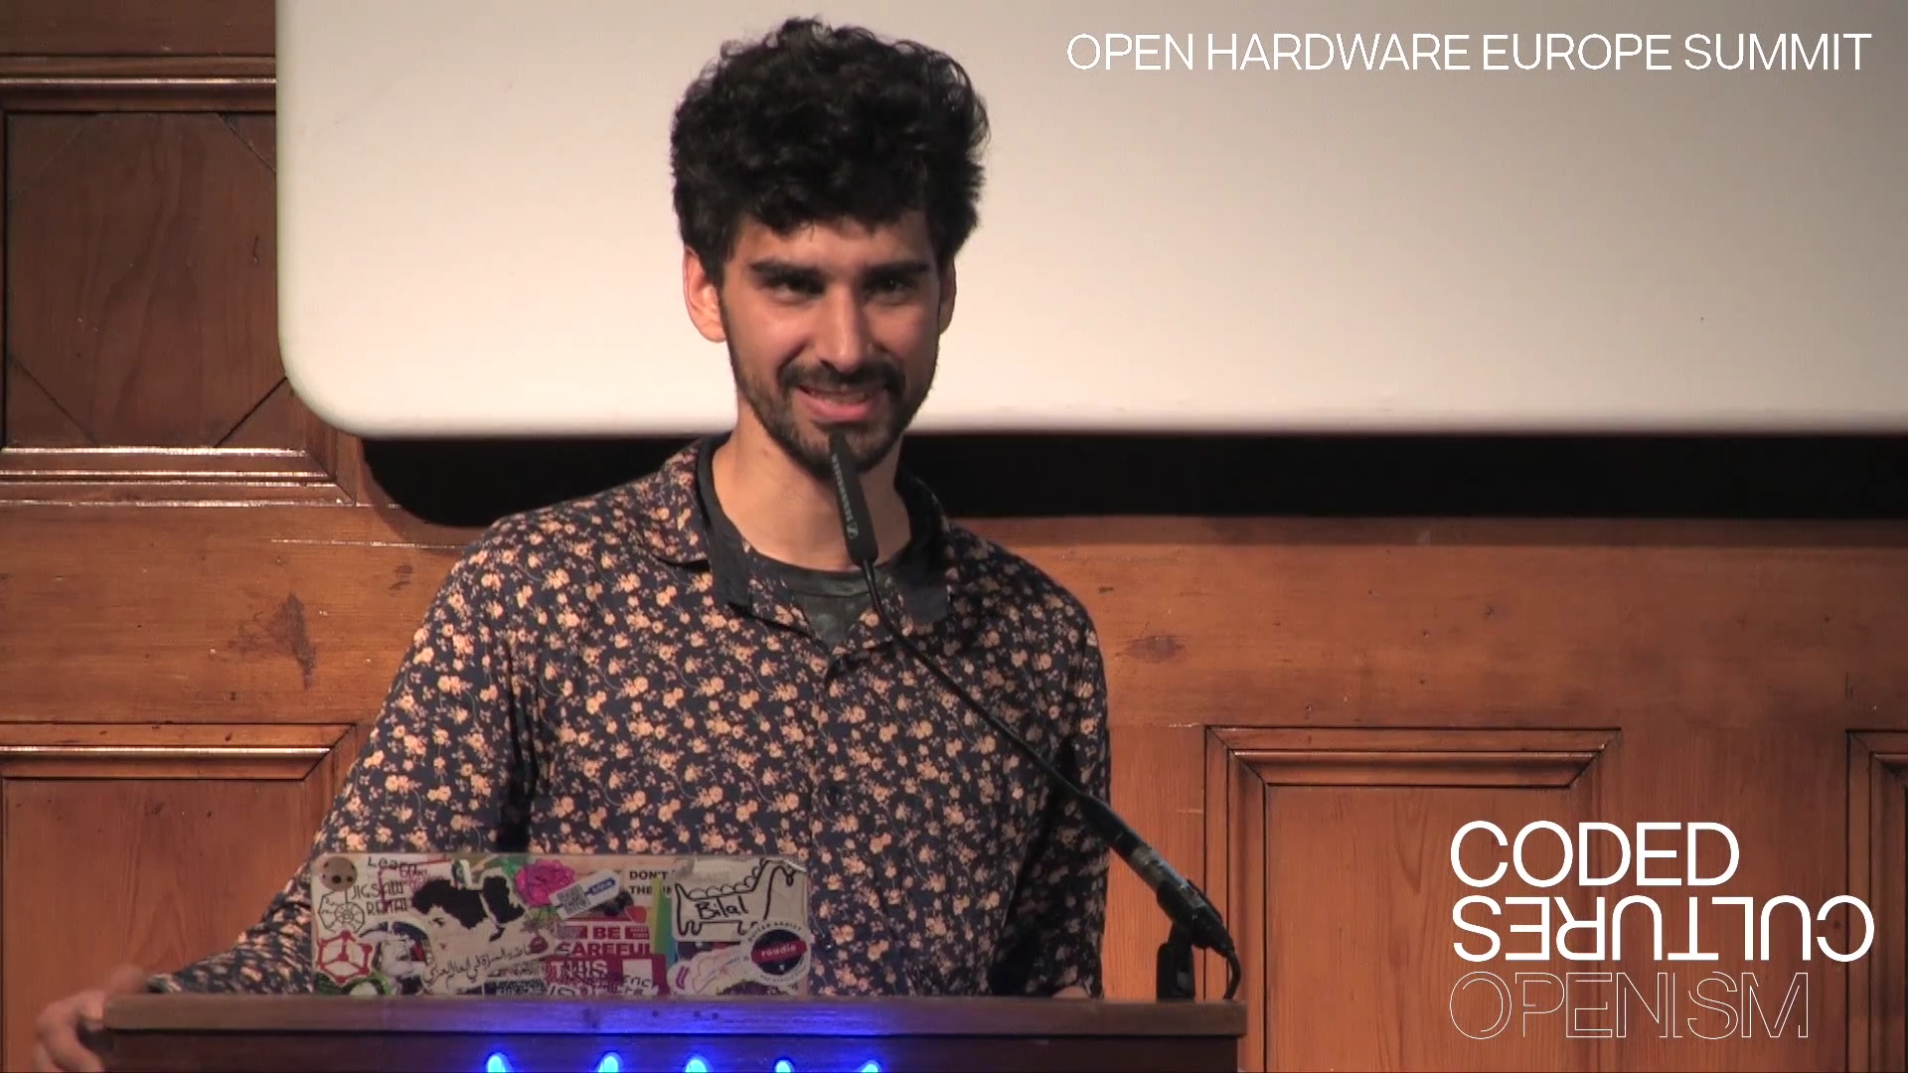
Open Hardware Europe Summit 2016
Video playlist on YouTube
Open Hardware Europe Summit & The DIY 2.0 revolution
  “The global open hardware community met in Vienna, Austria to give talks about new aspects, new methods and lessons learned for the open hardware movement.”

Slide 22

Resources
Join OSHWA
Subscribe to the mailing list
Post in the OSHWA Forum
Follow on Twitter:
  @OHSummit
  @oshwassociation
Building Open Source Hardware
by Alicia Gibb (executive director of OSHWA)

Slide 23
Section:
OSHW PRODUCTS

Slide 24

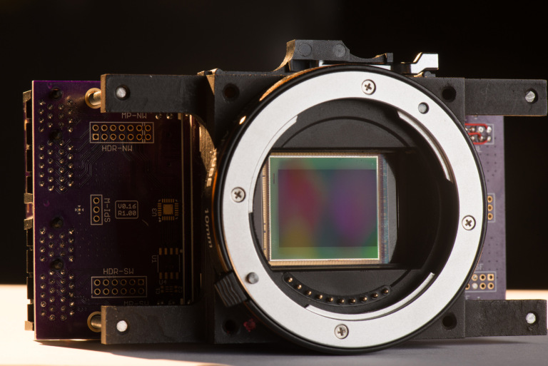
“The goal of the global community-driven apertus° project is to create a variety of powerful, affordable, free (in terms of liberty), sustainable and open digital cinema tools that we as filmmakers love to use”

Slide 25
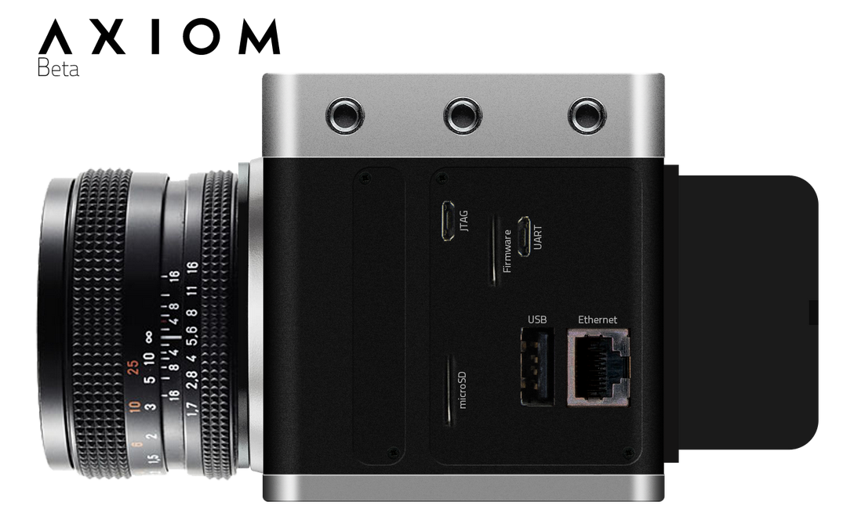
“The AXIOM product line is the result of this ongoing endeavor and after successful crowd funding and receiving an EU Innovation grant is well on track to redefine the industry well beyond the DIY garages and hobbyist labs the project started in”

Slide 26


Lulzbot 3-D Printers
100% Open Source
Hardware & Software
FSF Respects Your Freedom certified

Slide 27

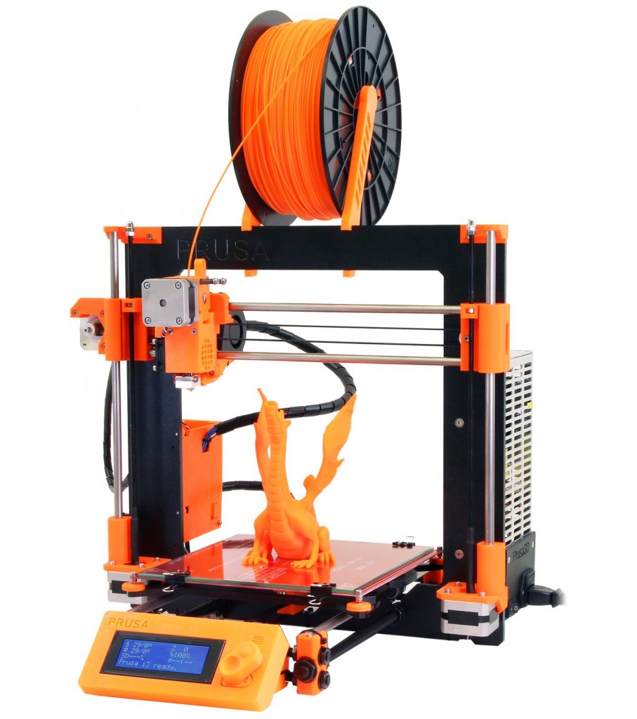

RepRap 3-D Printers
RepRap project started as an academic initiative to develop a low-cost 3D printer that can print most of its own components
Giving Manufacturing a New Life
by Adrian Bowyer
Prusa i3 M2 RepRap designed and manufactured by Josef Prusa in Czech Republic

Slide 28

Novena laptop
Created by Bunnie & xobs
  Chumby! Hacking the X-Box! Amazing reverse engineers
  The Exploration and Exploitation of an SD Memory Card
100% Open Source Hardware laptop
Quad-core 1.2GHz Freescale ARM CPU
FPGA! 4GB RAM, WiFi, 2x Ethernet, SSD

Slide 29
Section:
LINUX on OSHW

Slide 30


ARM Linux on Open Source Hardware
Developed by BeagleBoard.org Foundation and BeagleBoard.org Community
Manufacturers: element14, GHI, Seeed

Slide 31

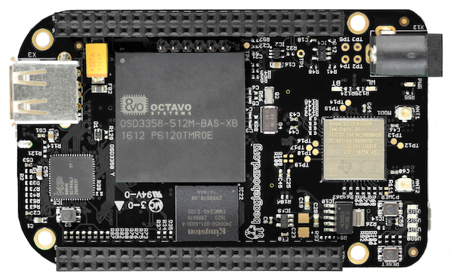
BeagleBone Black Wireless
1 GHz ARM processor, 512 MB RAM
2x 32-bit PRU microcontroller for hard real-time
4GB eMMC with Debian GNU/Linux installed
WiFi 802.11 b/g/n, Bluetooth 4.1 with BLE
HDMI / USB / 65 GPIO pins / 8 PWM outputs
7 analog inputs / 4x UART / 2x I²C / 2x SPI

Slide 32

BeagleBone Black Wireless
CadSoft EAGLE design files hosted on GitHub
Bill of Materials: every part available in qty 1
Octavo System-in-Package (SiP) large pitch BGA simplifies PCB layout and assembly

Slide 33


MinnowBoard
64-bit Intel Atom “Bay Trail”
MinnowBoard Turbot
  $135: E3826 (dual-core, 1.46 GHz)
USB 3.0, SATA, PCIe, Gigabit Ethernet, HDMI
Integrated Intel HD Graphics
  Open Source Mainline Linux drivers!

Slide 34
MinnowBoard
Manufactured by ADI
Released under Creative Commons CC-BY-SA
Download:
  [x] Schematic (Orcad DSN & PDF)
  [x] Board Layout (Allegro BRD & Gerbers)
  [x] Bill of Materials

Slide 35

OLinuXino
Low cost OSHW Linux computers
Designed and manufactured by Olimex in Bulgaria
Blog post:
“Open Source Hardware, why it matters and what is pseudo OSHW”

Slide 36

A64-OlinuXino
Allwinner A64: Quad Core 64-bit ARM
Designed with Open Source KiCad
1GB RAM, 4GB eMMC, WiFi+BLE4.0

Slide 37

http://www.slideshare.net/olimexbulgaria/designing-with-kicad-of-64bit-arm-board

Slide 38


getchip.com
Next Thing Co. in Oakland
Kickstarter in 2015:
    39,560 backers
    $2,071,927 pledged

Slide 39

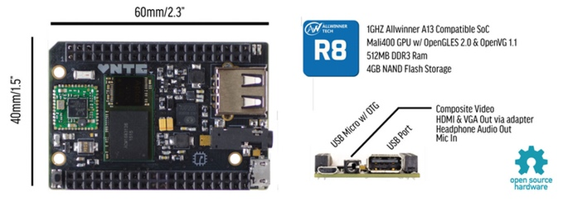
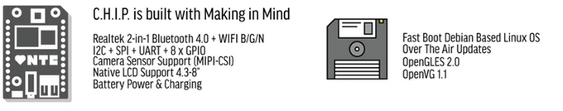



Slide 40

C.H.I.P. is OSHW
GitHub: NextThingCo/CHIP-Hardware
  Schematics
  PCB Layout
  Bill of Materials (BoM)
License:
  Creative Commons Attribution-ShareAlike
  (CC-BY-SA)

Slide 41
Section:
OSHW in Science
Suggestions from the OSHWA mailing list

Slide 42

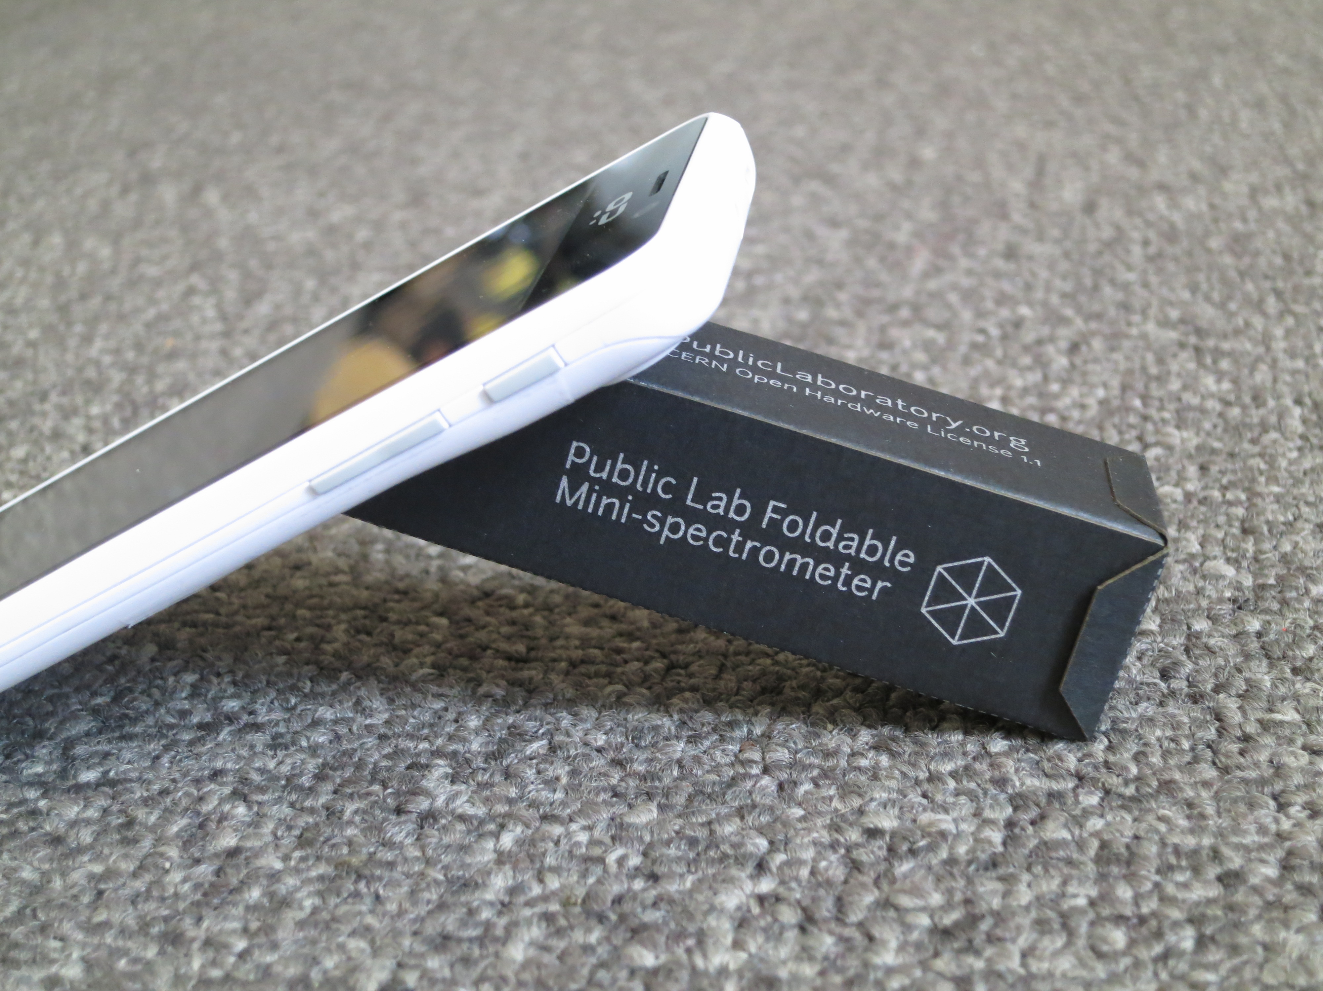
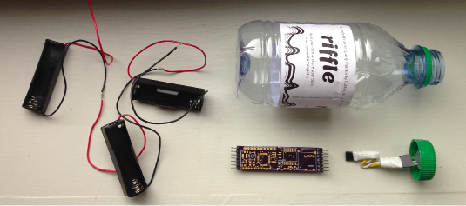
Public Lab
“Using inexpensive DIY techniques, we seek to change how people see the world in environmental, social, and political terms.”
Office in Portland!
Riffle: Open Source Water Monitoring
Desktop Spectrometry
Balloon Mapping Kit

Slide 43
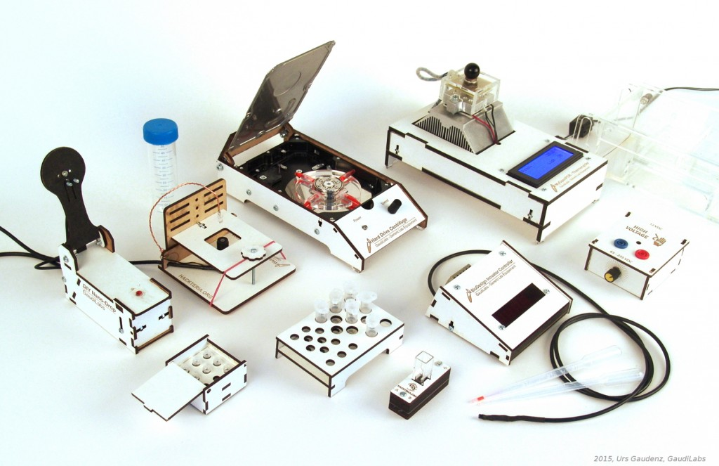
Generic Lab Equipement
GaudiLabs in Lucern, Switzerland
  part of the hackteria.org open source biology art network

Slide 44
Generic Lab Equipement
WebCam Microscope
Hard Drive Centrifuge
Incubator Controller
Gel Box and High Voltage Supply
Turbidity Meter Kit
DIY Microvolume Spectrometer
My Open PCR
Tube Racks

Slide 45

GOSH 2017
Gathering for Open Science Hardware
Santigo, Chile. March 22-25, 2017.
“growing number of people around world are developing and using Open Science Hardware, and we want to help build self-organising community to drive change in open science”

Slide 46
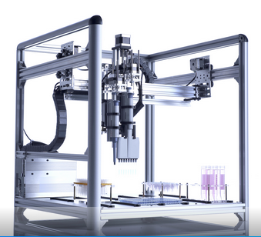
OpenTrons
Robots for Biologists
“We think biologists should have robots to do pipetting for them.”
“They should be able to spend their time designing experiments and analyzing data.”

Slide 47

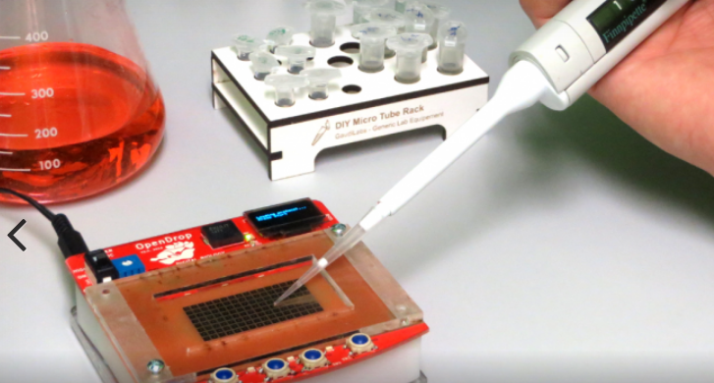
OpenDrop
“Desktop Digital Biology Laboratory”
digital microfludics platform for research
part of a bigger ecosystem around digital biology with the aim of making personal lab-automation accessible to more people

Slide 48
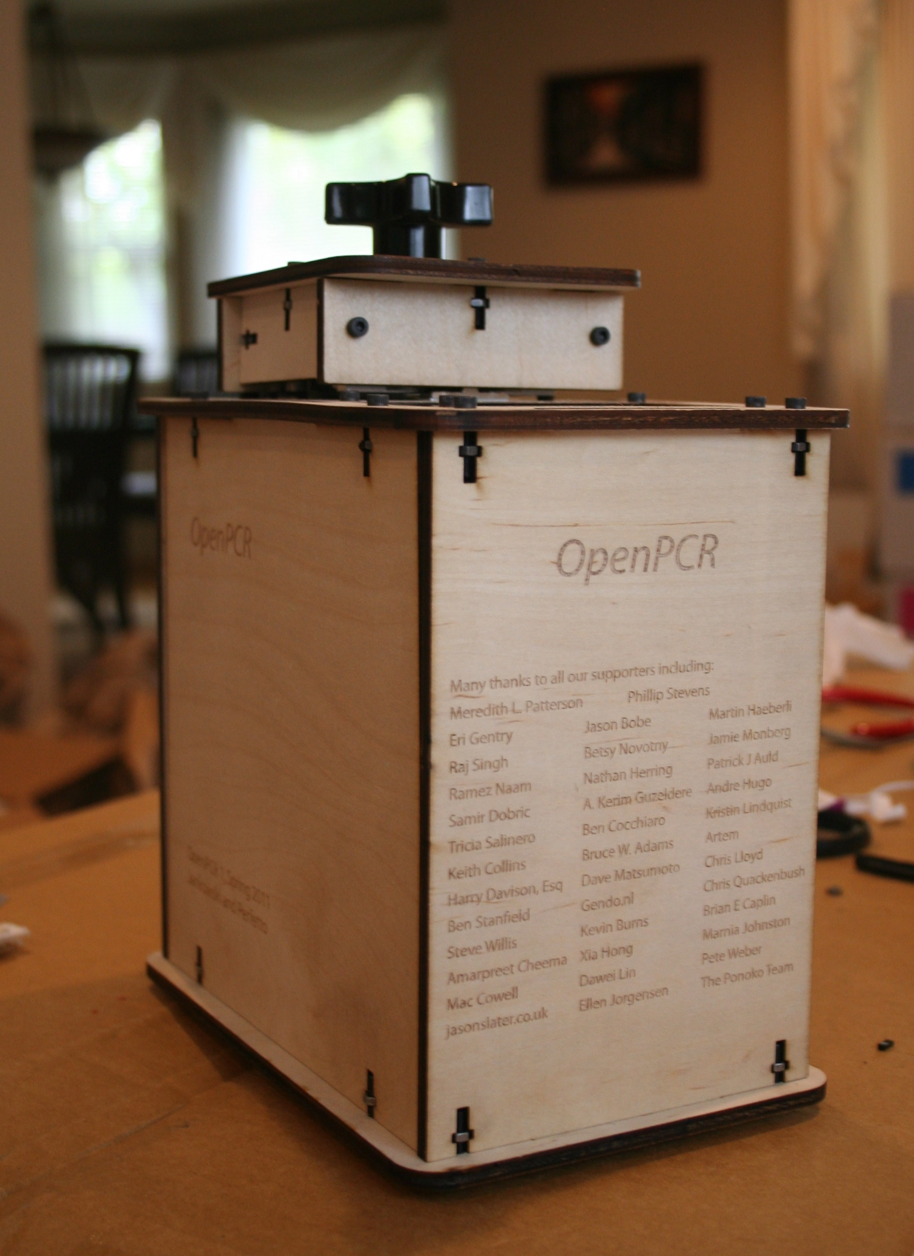
OpenPCR
PCR is a method of copying DNA molecules.
OpenPCR is a project to develop open source hardware, software, and protocols to perform PCR and Real-Time PCR reactions
community dedicated to openness in science and applying the fundamental technologies of PCR to global problems

Slide 49

Open Source Imaging (MRI)
Open Source Magnetic Resonance Imaging
Opencore NMR is an open-source toolkit for implementing an NMR spectrometer
LukasW log: “COSI Magnet: Single ring results look fantastic! Less than 2% difference to simulation”

Slide 50
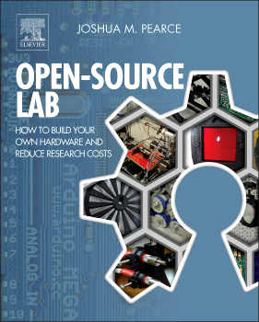
MOST research group
Joshua Pearce Research Group at Michigan Tech in Open Sustainability Technology (MOST) focuses on open and applied sustainability
Exploring the way solar photovoltaic technology can sustainably power our society

Slide 51

Libre Space Foundation
Non-profit for Open Source HW & SW in Space
UPSat: first open hardware satellite bound to be launched to the International Space Station in late December
SatNOGS: open source hardware satellite ground-station network

Slide 52
Section:
Open Source Silicon

Slide 53

What about silicon?
RISC-V: Free & Open RISC Instruction Set Arch
  “new instruction set architecture (ISA) that was originally designed to support computer architecture research and education and is now set to become a standard open architecture for industry”
  Video: Instruction Sets Want To Be Free: A Case for RISC-V

Slide 54


What about silicon?
OnChip Open-V
“completely free (as in freedom) and open source 32-bit microcontroller based on the RISC-V architecture”

Slide 55

What about silicon?
SiFive
“founded by the creators of the free and open RISC-V architecture as a reaction to the end of conventional transistor scaling and escalating chip design costs”

Slide 56

What about silicon?
HiFive1: Arduino-Compatible RISC-V Dev Kit

Slide 57

What about silicon?
LowRISC
“creating a fully open-sourced, Linux-capable, RISC-V-based SoC, that can be used either directly or as the basis for a custom design. We aim to complete our SoC design this year”

Slide 58

What about silicon?
FOSSi Foundation
  The Free and Open Source Silicon Foundation
  “non-profit foundation with the mission to promote and assist free and open digital hardware designs and their related ecosystems. FOSSi Foundation operates as an open, inclusive, vendor-independent group.”

Slide 59
Thanks
Suggestions from the OSHWA mailing list:
  Abram Connelly
  Andrew Plumb
  Andrew Quitmeyer
  Eleftherios Kosmas
  Marcin Jakubowski

Slide 60
Contact info
email: Drew Fustini <drew@oshpark.com>
SMS: +1-773-710-7131
twitter: @OSHPark / @pdp7
OSH Park Blog

