Slide 1




Drew Fustini
drew@oshpark.com
Twitter: @pdp7
Slides: https://github.com/pdp7/talks/blob/master/berlin-elinux.pdf
How to run Linux on RISC-V
with open hardware and open source FPGA tools
Berlin Embedded Linux meetup (2020-02-12)

Slide 2
Section:
RISC-V the instruction set for everything?

Slide 3

RISC-V: Free and Open RISC Instruction Set Arch
  “new instruction set architecture (ISA) that was originally designed to support computer architecture research and education and is now set to become a standard open architecture for industry”

Slide 4
RISC-V: Free and Open RISC Instruction Set Arch
    Instruction Sets Want To Be Free: A Case for RISC-V
      David Patterson, UC Berekely – co-creator of the original RISC!
      https://www.youtube.com/watch?v=mD-njD2QKN0
    RISC-V Summit 2019: State of the Union
      Krste Asanovic, UC Berkeley
      https://www.youtube.com/watch?v=jdkFi9_Hw-c

Slide 5


Slide 6


Slide 7


Slide 8


Slide 9
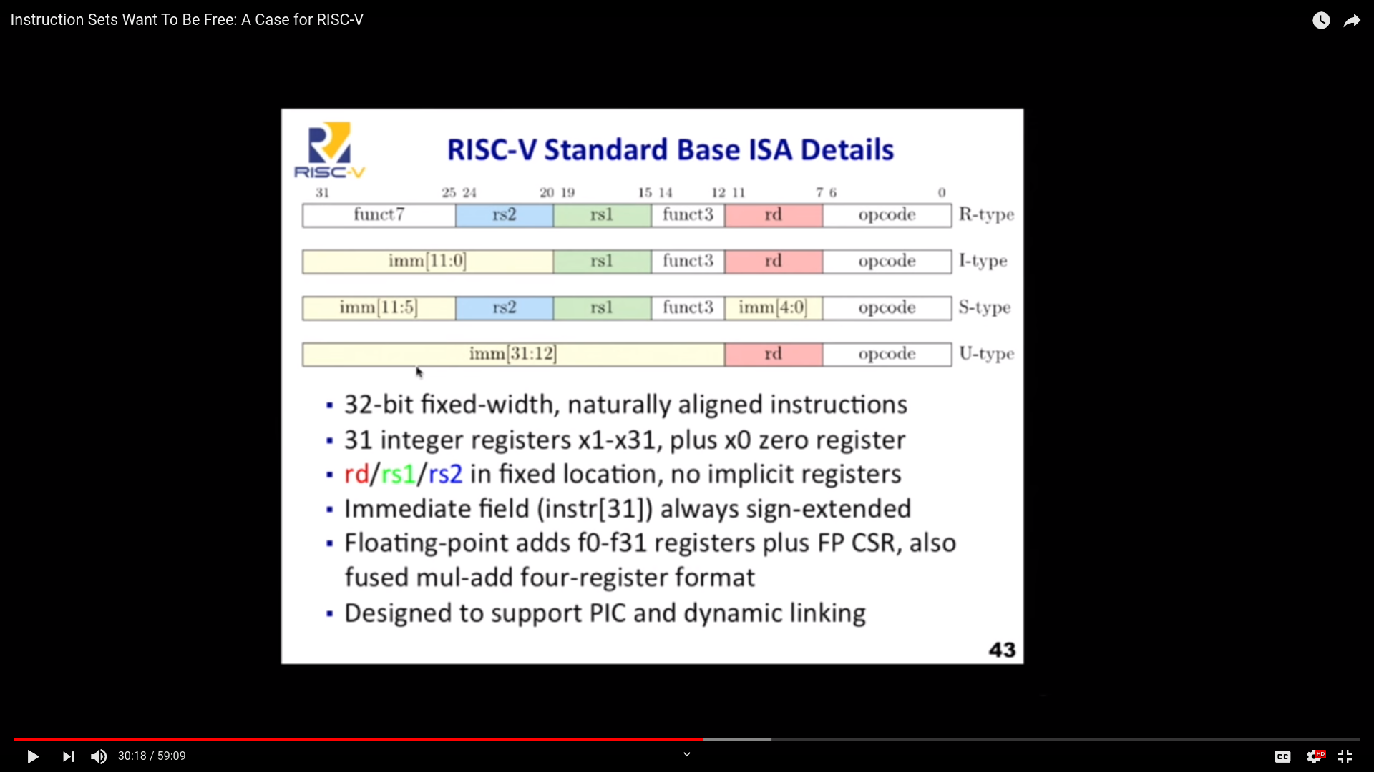

Slide 10
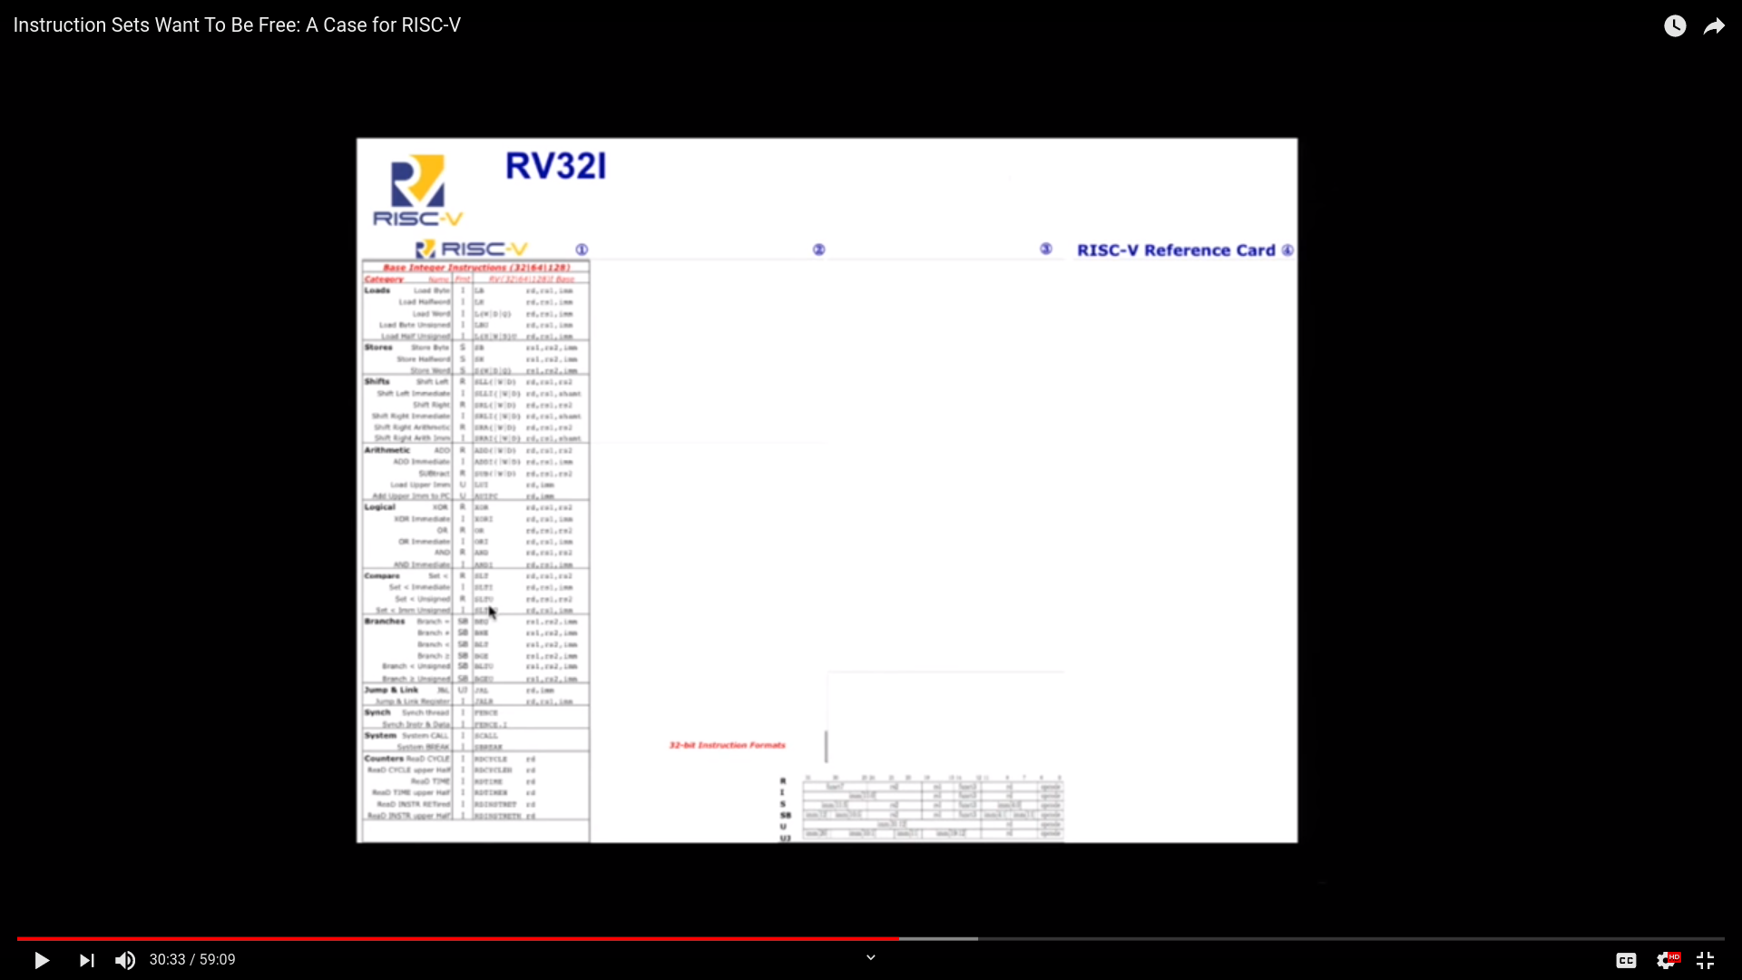

Slide 11
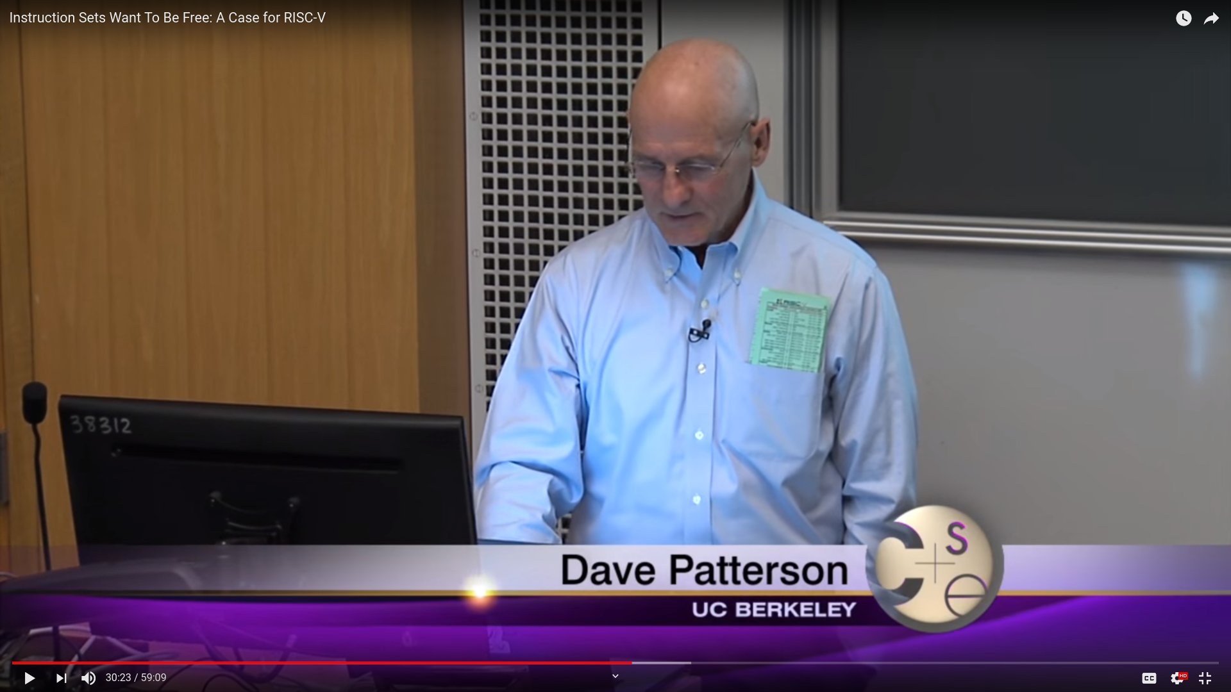

Slide 12
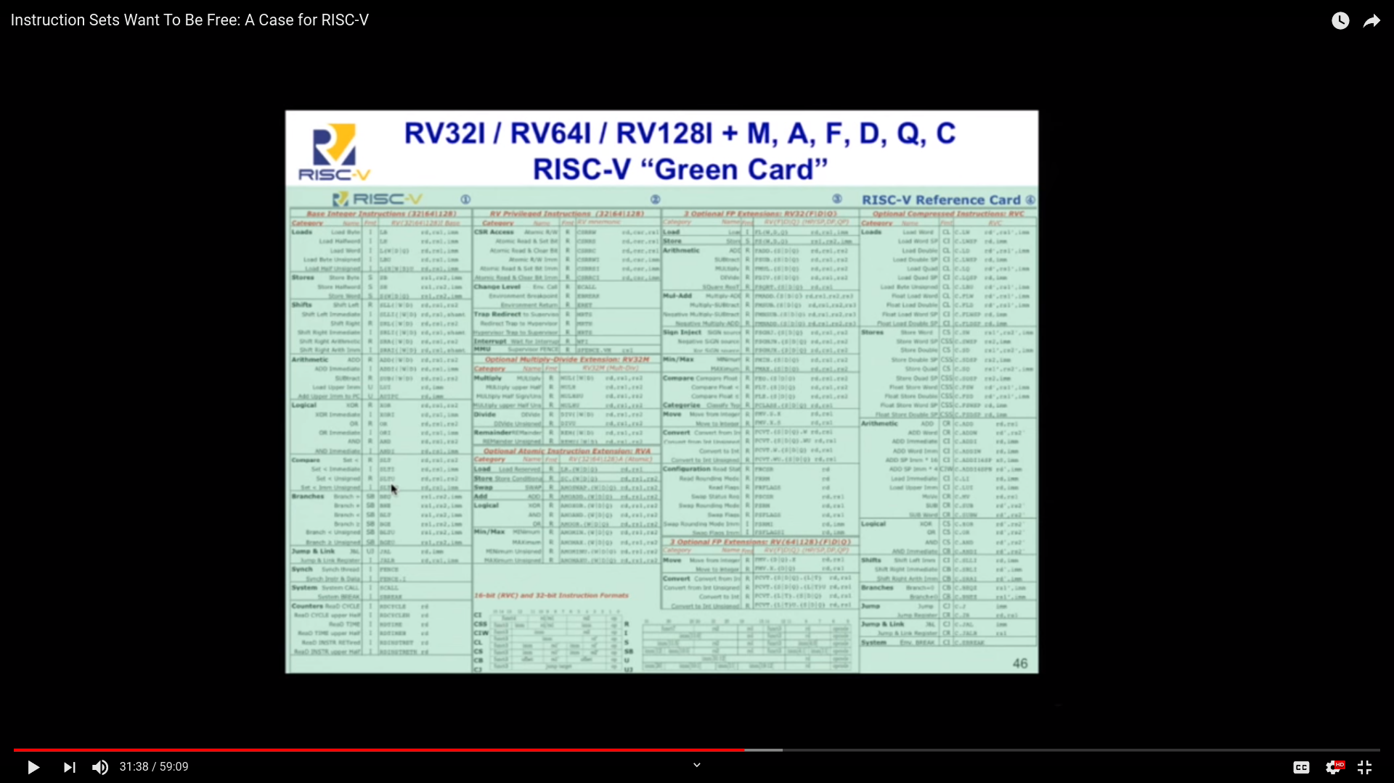

Slide 13
RISC-V and Industry
Designed to be extensible
  Microcontroller to supercomputer
RISC-V Foundation now controls standard: riscv.org
  Over 400 members: companies, universities and more
  YouTube channel has hundreds of talks!
    https://www.youtube.com/channel/UC5gLmcFuvdGbajs4VL-WU3g
Companies like Nvidia and Western Digital will ship millions of devices with RISC-V
Avoid ARM licensing fees
Freedom to leverage open source implementations
    BOOM, Rocket, PULP, SweRV, and many more

Slide 14
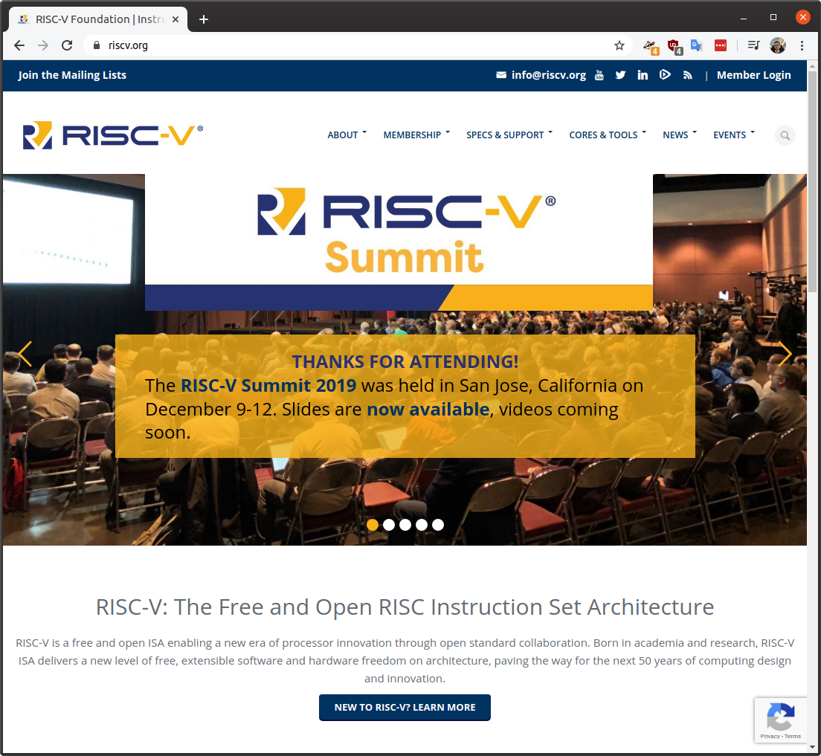

Slide 15
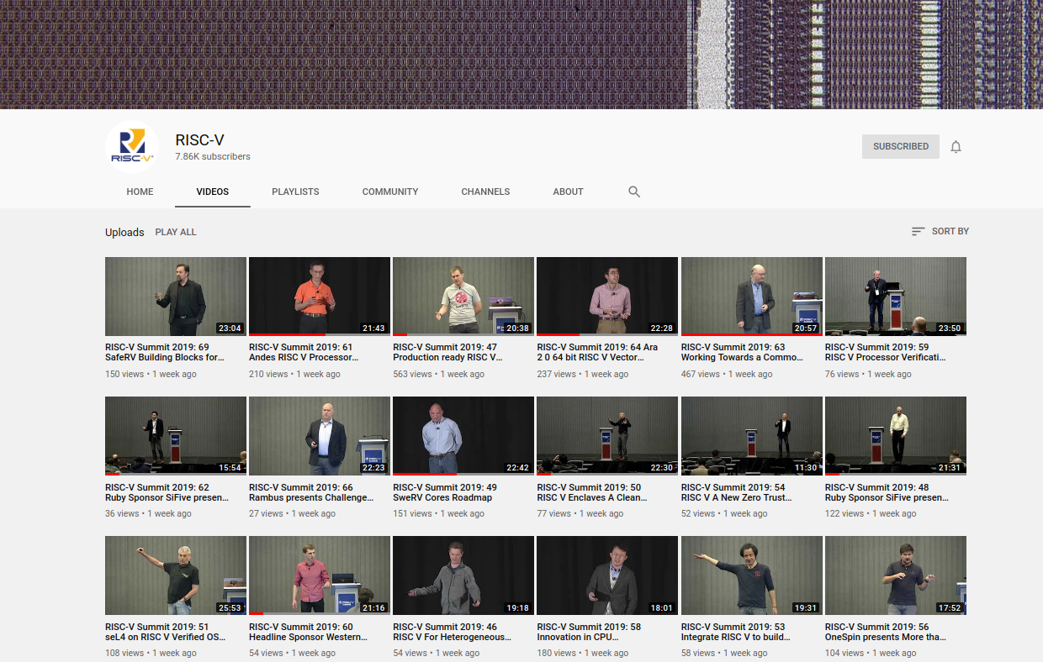

Slide 16
RISC-V and the world
RISC-V Foundation moving from US to Switzerland
Nations such as India have RISC-V initiatives
  Desire for sovereign technology and avoid backdoors from other nations
Strong interest from chipmakers in China
  U.S. companies have been banned from doing business with Huawei… who’s next?
  ARM deemed UK-origin tech so ok to do business with Huawei, but what will brexit-govt bring?

Slide 17

lowRISC is a not-for-profit organisation whose goal is to produce a fully open source System-on-Chip (SoC) in volume
  “We will produce a SoC design to populate a low-cost community development board and to act as an ideal starting point for derivative open-source and commercial designs”
OpenTitan project with Google
  Announcing OpenTitan, the First Transparent Silicon Root of Trust

Slide 18
Tutorial for the v0.7 lowRISC release
    By Jonathan Kimmitt (lead developer), and Alex Bradbury (lead reviewer)
    https://www.cl.cam.ac.uk/~jrrk2/docs/ariane-v0.7/tutorial/
    Digilent Nexys A7-100T: $265
    This tutorial adds further functionality towards the final SoC design:
      Graphical Colour Console with X-windows support incorporating mouse and keyboard events.
      Choice of SD-Card, Quad-SPI or Ethernet TFTP boot-loader with DHCP support.
      Linux 5.3.8 RISCV kernel and updated Debian userland with advanced package tool.
      Choice of RV64-GC Rocket (Chisel) or Ariane (SystemVerilog) CPU

Slide 19

FOSSi Foundation
  The Free and Open Source Silicon Foundation
  “non-profit foundation with the mission to promote and assist free and open digital hardware designs”
  Events: ORConf, Latch-up, Week of OSHW
  Open Source Silicon Design Ecosystem
    Talk by FOSSi co-founder Julius Baxter

Slide 20

LibreCores
  Project of the FOSSi Foundation
  “gateway to free and open source digital designs and other components that you can use and re-use in your digital designs”
  “advances the idea of OpenCores.org”

Slide 21

SiFive
“founded by the creators of the free and open RISC-V architecture as a reaction to the end of conventional transistor scaling and escalating chip design costs”

Slide 22

SiFive: Linux on RISC-V
HiFive Unleashed on Crowd Supply

Slide 23

  RISC-V Summit 2019: Linux on RISC V Fedora and Firmware Status Update
    https://www.youtube.com/watch?v=WC6e3g8uWdk
    Wei Fu – Software Engineer, Red Hat

Slide 24


Slide 25


Slide 26
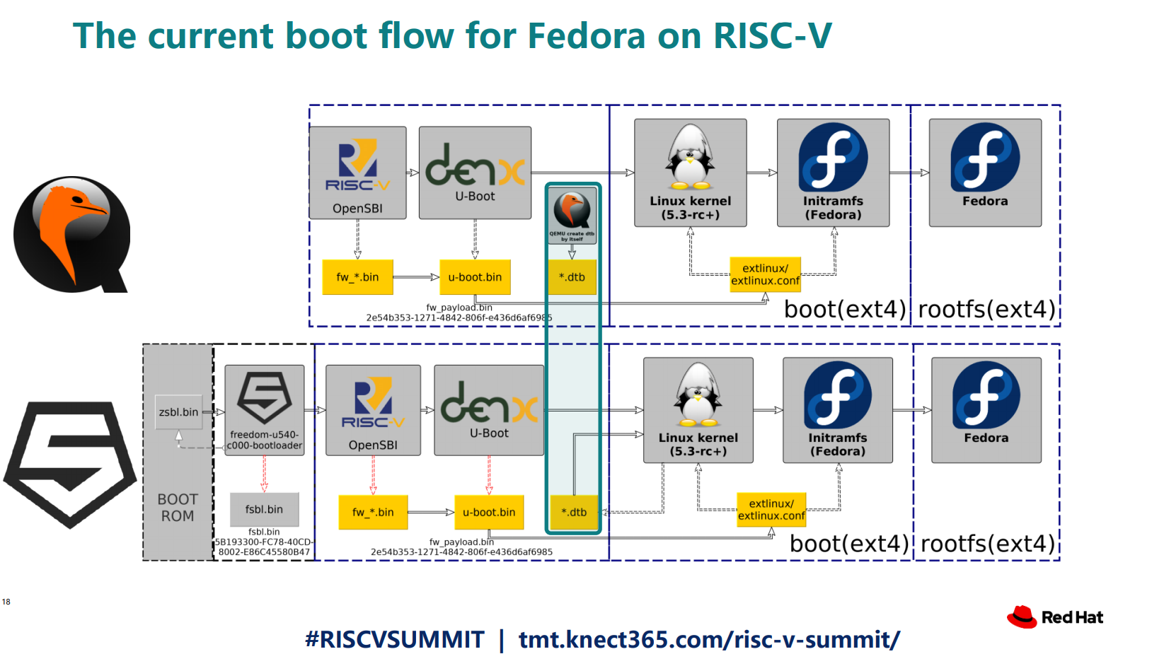

Slide 27


Slide 28
Experiment to get Linux on the low cost Kendryte K210 RISC-V microcontroller
  dual core 64-bit RISC-V at 400MHz with 8MB SRAM
  Sipeed MAix BiT for RISC-V $13
  PDF: RISC-V NOMMU and M-mode Linux
  youtube.com/watch?v=ycG592N9EMA&t=10394
  jump to 2h 53m
Many RISC-V Improvements Ready For Linux 5.5: M-Mode, SECCOMP, Other Features

Slide 29
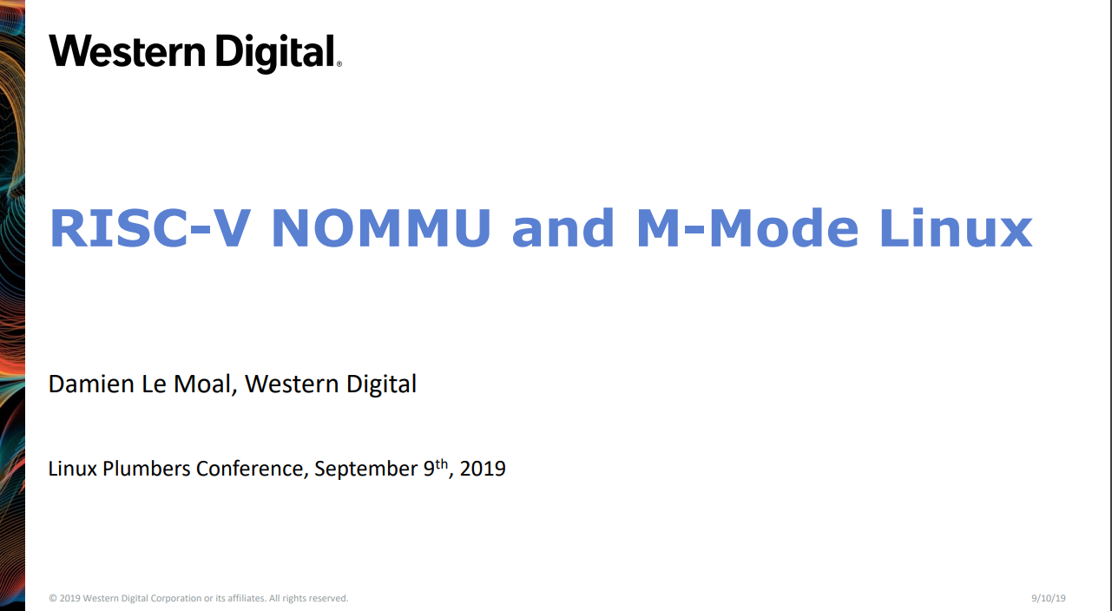

Slide 30


Slide 31
Coming in 2020?
Andes 27-series CPU
  “32-bit A27 and 64-bit AX27 and NX27V cores, which will enter production in Q1 2020.”
  Andes’ RISC-V SoC debuts with AI-ready VPU as Microchip opens access to its PolarFire SoC
Microchip PolarFire SoC FPGA
  Hard RISC-V with FPGA fabric… like the Xilinx Zync for ARM
NXP iMX with RISC-V instead of ARM!
  “OpenHW Group Unveils CORE-V Chassis SoC Project, Building on PULP Project IP”

Slide 32
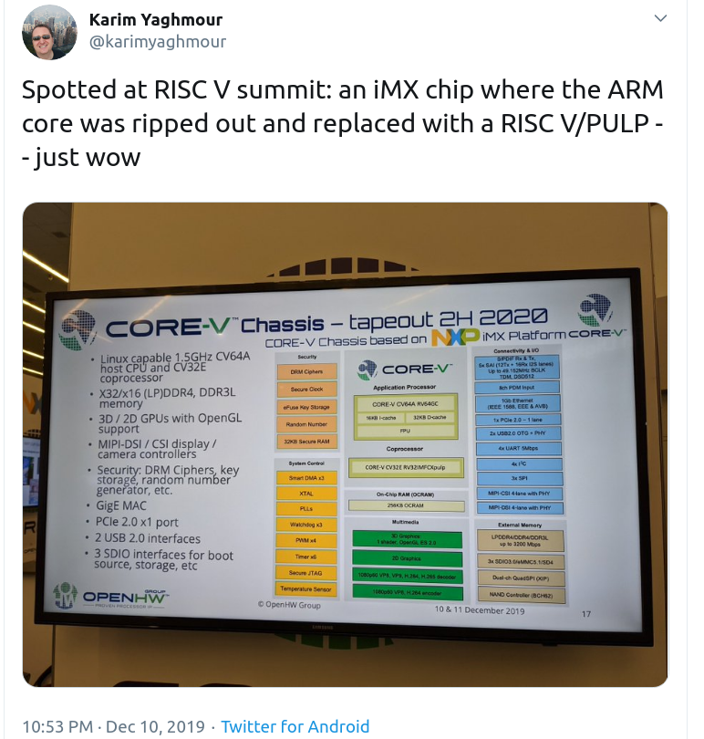

Slide 33

Coming in 2020?

Slide 34
Section:
Open Source FPGA tools

Slide 35

Open Source and FPGAs
Open Source toolchains for FPGAs!
  Project IceStorm for Lattice iCE40
    “A Free and Open Source Verilog-to-Bitstream Flow for iCE40 FPGAs” by Claire Wolf (oe1cxw) at 32c3

Slide 36

Open Source and FPGAs
Open Source toolchains for FPGAs!
  Project Trellis for Lattice ECP5
  “Project Trellis and nextpnr FOSS FPGA flow for the Lattice ECP5” - David Shah (@fpga_dave)
    youtube.com/watch?v=0se7kNes3EU

Slide 37

Open Source and FPGAs
Open Source toolchains for FPGAs!
  Project X-Ray and SymbiFlow for Xilinix Series 7
  Timothy ‘mithro’ Ansell: “Xilinx Series 7 FPGAs Now Have a Fully Open Source Toolchain!” (almost)
    youtube.com/watch?v=EHePto95qoE

Slide 38

Open Source and FPGAs
Open Source Hardware boards with Lattice ECP5 FPGA with open RISC-V “soft” CPU:
  Orange Crab by Greg Davill
    https://github.com/gregdavill/OrangeCrab

Slide 39


Slide 40

Open Source and FPGAs
Radiona.org ULX3S
    https://www.crowdsupply.com/radiona/ulx3s

Slide 41

Open Source and FPGAs
Open Source Hardware boards with Lattice ECP5 FPGA with open RISC-V “soft” CPU:
  David Shah's Trellis board (Ultimate ECP5 Board)
  https://github.com/daveshah1/TrellisBoard

Slide 42


Slide 43
Section:
Linux on the Hackaday Badge

Slide 44

Hackaday 2019 Supercon badge
RISC-V “soft” core on ECP5 FPGA
Gigantic FPGA In A Game Boy Form Factor

Slide 45

“Team Linux on Badge”

Slide 46
“Team Linux on Badge”
Blog post: Hackaday Supercon badge boots Linux using SDRAM cartridge
  https://blog.oshpark.com/2019/12/20/boot-linux-on-this-hackaday-supercon-badge-with-this-sdram-cartridge/
Michael Welling (@QwertyEmedded), Tim Ansell (@mithro), Sean Cross (@xobs), Jacob Creedon (@jacobcreedon)
First attempt: use the built-in 16MB SRAM…
no luck :(
  (though xobs now might have a way to do it)

Slide 47

“Team Linux on Badge”
Second attempt:
  Jacob Creedon designed an a cartridge board that adds 32MB of SDRAM to the Hackaday Supercon badge… before the event!

Slide 48

“Team Linux on Badge”
Second attempt:
  Jacob Creedon designed an a cartridge board that adds 32MB of SDRAM to the Hackaday Supercon badge… before the event!

Slide 49

LiteX used to build cores, create SoCs and full FPGA designs.
LiteX is based on Migen
Migen lets you do FPGA design in Python!
https://github.com/enjoy-digital/litex

Slide 50


Slide 51

Linux on LiteX-VexRiscv
VexRiscv: 32-bit Linux Capable RISC-V CPU
SoC built using VexRiscv core and LiteX moduels like LiteDRAM, LiteEth, LiteSDCard, ...
  github.com/litex-hub/linux-on-litex-vexriscv

Slide 52


Slide 53

upstream support for Hackaday Supercon badge:
  https://github.com/litex-hub/litex-boards/pull/31

Slide 54

upstream support for Hackaday Supercon badge:
  https://github.com/litex-hub/litex-boards/pull/31

Slide 55

upstream support for Hackaday Supercon badge:
  https://github.com/litex-hub/litex-boards/pull/31

Slide 56


Slide 57


Slide 58


Slide 59


Slide 60
Opened GitHub issue:
  optimize performance on Hackaday Badge #35
    https://github.com/litex-hub/litex-boards/issues/35
Now 10x faster!
  https://asciinema.org/a/Pcm3vd1BEdEKY9srYX6MsNfCE
  Thanks to enjoy-digital

Slide 61


Slide 62


Slide 63


Slide 64


