Slide 1
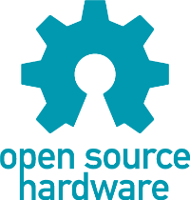
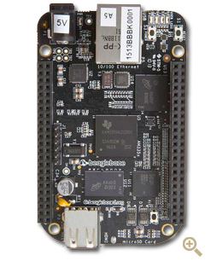
BeagleBone Black: $45 tiny
Open Source Hardware
Linux ARM Computer
Drew Fustini
Software Developer
element14 Community
element14.com/beagleboneblack
afustini@element14.com

Slide 2



BeagleBoard.org Family
Manufactured by CircutiCo in Texas
Developed by BeagleBoard.org community
  Federal non-profit org with board members:
    Gerald Coley, TI, HW & owner of (real) Beagle
    Jason Kridner, TI, SW & Community
    Clint Cooley, CircuitCo, President
Mascot is Boris the Beagle! :)

Slide 3
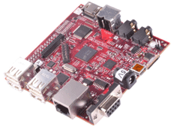
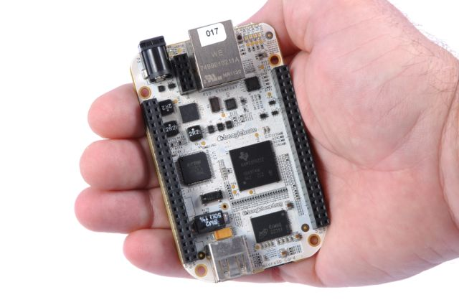
Previous Beagles
BeagleBoard:
  2008
  first affordable ($150) ARM single board computer (SBC)
  Open Source Hardware!
BeagleBone:
  2011
  $89
  256MB RAM
  720MHz, ARM Cortex A8
  fits in an Altoids-tin!

Slide 4

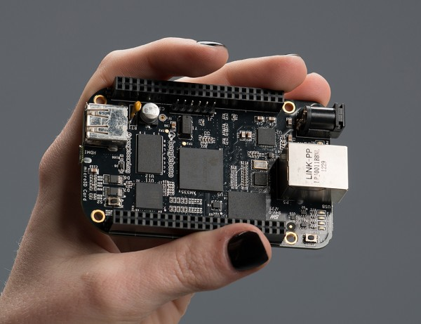
BeagleBone Black:
$45 ARM Computer
50% price of original BeagleBone (aka “White”)
Faster 1GHz ARM Cortex A8
  TI Sitara AM335x
512MB RAM
  double the White
Adds built-in HDMI
  microHDMI port
Adds 2GB Flash built-in
  No SD card needed to boot

Slide 5
100% Open Source Hardware
Schematics: YES!
Board Layout (PCB): YES!
Bill of Materials (BOM): YES!
  All components chosen are available in single quantity
Design files! http://circuitco.com/support/index.php?title=BeagleBoneBlack#Hardware_Files
Full system technical reference manual! http://elinux.org/Beagleboard:BeagleBoneBlack#Hardware_Files

Slide 6
Linux Distros
Linux ships on-board 2GB flash (eMMC)
  Angstrom distribution w/ 3.8 Kernel & Device Tree
  Transition to Debian in progress :)
    beta image now available!
ARMv7 instruction set:
  This is the current standard for Linux on ARM
  Run Android, Ubuntu, Debian, Fedora, and more without repackaging (e.g. Raspbian)
Install distro of your choice on eMMC or just run off microSD card (like the Pi does)

Slide 7
Extensive I/O capabilities
Standard computer peripherals: USB 2.0 host & device, micro HDMI, microSD, serial
Lots of GPIO pins (General Purpose Input/Oupt)! 2 x 48 pin headers provide:
  65 digital I/O
  8 PWM / 4 timers / 7 analog inputs
  4 UART / 2 i2c / 2 SPI
Daughterboards called Capes (like Arduino Shields) provide lots of options:
  touchscreen LCD, sensors, motor control, 3D printing & CNC (LinuxCNC), wireless comm

Slide 8
Physical Computing = Awesome!
You can interface LEDs, buttons & sensors using any programming language
  all the pins can be controlled via /sys
  if your fav language runs on ARM Linux and has file I/O library you are in luck!
Recommended ways to start:
  JavaScript library called Bonescript
    http://beagleboard.org/support/bonescript
  Python library called PyBBIO
    http://learn.adafruit.com/category/beaglebone

Slide 9

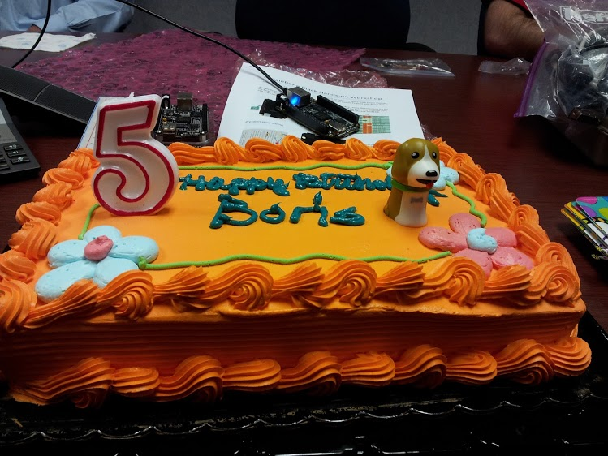
Tidbit: 5 years old last July!

Slide 10
Let's get I N T E R A C T I V E!
LOTS OF COOL STUFF HAPPENS... hopefully
http://beagleboard.org/Support/BoneScript/demo_blinkled/
http://beagleboard.org/Support/BoneScript/demo_blinkled_external/
http://learn.adafruit.com/blinking-an-led-with-beaglebone-black
http://learn.adafruit.com/connecting-a-push-button-to-beaglebone-black

Slide 11
Resources
BeagleBone Black - GPIO Programming on ARM Embedded Linux (video): http://derekmolloy.ie/beaglebone/beaglebone-gpio-programming-on-arm-embedded-linux/
BeagleBoard.org Blog (weekly project spotlight): http://beagleboard.org/blog
Adafruit Learning System: http://learn.adafruit.com/category/beaglebone
BoneScript workshop: http://beagleboard.org/makerfairedetroit2013
Beagle Community Mailing List: http://beagleboard.org/Community/Forums
Robert C Nelson (Community member), maintains kernels & root filesystems for Debian and Ubuntu on BeagleBone and BeagleBone Black http://eewiki.net/display/linuxonarm/BeagleBone+Black
Wiki: http://elinux.org/Beagleboard:BeagleBoneBlack

