Slide 1
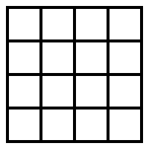



a)
J correlation matrix
B (magnetic field)
N
lattice size
a
lattice constant
b)
$$T≪T_{c}$$
$$T=T_{c}$$
$$T≫T_{c}$$

Slide 2
Figure 2: Magnetization

Slide 3
Figure 3:

