Slide 1
CRE Analyzer Agent
AI-Powered Commercial Real Estate Intelligence
Team: AI-lluminati

Slide 2
Problem
The "Analyst's Bottleneck“ : Commercial lending is high-stakes, but the process is notoriously slow and manual.
The Pain Points:
Limited Throughput: Bankers cannot screen deals fast enough, missing opportunities.
Inconsistent Quality: Manual data gathering leads to human error and varied underwriting standards.
Slow Customer Response: In a competitive market, a slow "maybe" means losing the deal to a faster competitor.
Notes:
Speaker Note: "Currently, highly paid bankers spend hours acting as 'human search engines' just to gather basic facts for a loan request. It’s unscalable, expensive, and hurts competitiveness. We are solving the 'Analyst's Bottleneck'."

Slide 3
Solution
Agentic AI for valuation and stress testing
Real-time scenario simulation
LLM-generated investment-grade explanations
Notes:
Speaker Note: "Our agent doesn't just summarize text; it actively plans. It goes out to public data sources, performs the necessary financial calculations, and synthesizes varied information into an investment-committee-ready format."

Slide 4
Clean Agent Architecture
Input Layer
Agent & Analytics Layer
Platform Layer
Web UI
(Deal Inputs & Scenarios)
Financial Engine
• NOI
• DSCR
• Stress Tests
GCP Cloud Run
• Containerized API
• Autoscale
LLM Agent
• Reasoning
• Memo Generation
• Risk Narrative
Observability
• Logs
• Metrics
Notes:
Speaker Note: "The output isn't just a data dump. It's a structured narrative. The agent assesses the risk, runs the basic financial scenarios, and presents a holistic view of the opportunity."

Slide 5
Key Analytics
NOI and Cap Rate valuation
DSCR and cash flow analysis
Rate and income stress scenarios

Slide 6
DSCR Stress Scenario
Property’s Debt Service Coverage Ratio (DSCR) responds to rising interest rates, holding operating assumptions constant.

Slide 7
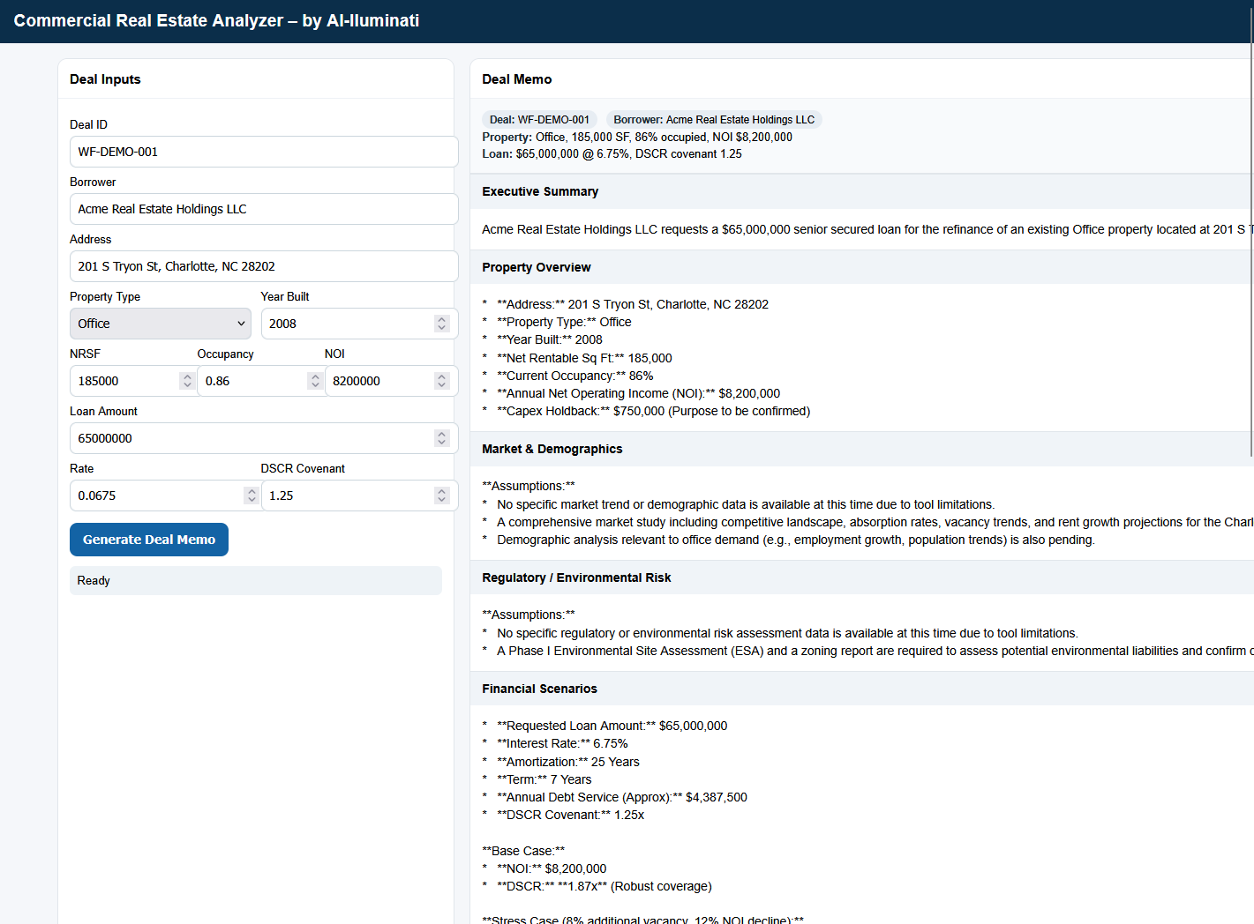
Live Demo Interface
https://ai-lluminati-1027827275262.us-central1.run.app/
Notes:
Speaker Note (Gesturing to the slide): "This is our live prototype. On the left, the banker enters minimal deal inputs—like this Office property in Charlotte with an $8.2M NOI and a requested $65M loan. They hit 'Generate', and the agent takes over. Minutes later, the right side populates with the structured Deal Memo sections you see here."

Slide 8
Future State – Multi-Agent Architecture
Risk Agent
Market Agent
Policy / Credit Agent
Narrative Agent
Agent Orchestrator
• Task routing
• Shared context
• Consensus output

Slide 9
Thank You
Team AI-lluminati
Git- https://github.com/pdppan

