Slide 1
Clustering and randomness
This will be the subject of your next exercise involving real location data of objects

Slide 2
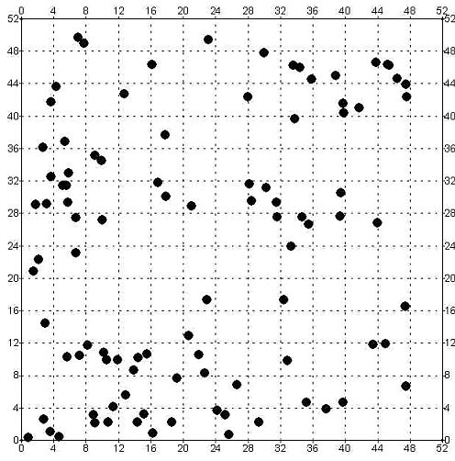

How to Interrogate this kind of Data?
There are regions of over density and understanding
Code to Count in boundaries!
There is information in the Voids

Slide 3
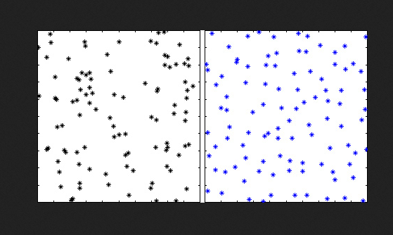
Which side is randomly generated?
People Perceive Patterns easily in randomly generated data – need to test for this

Slide 4
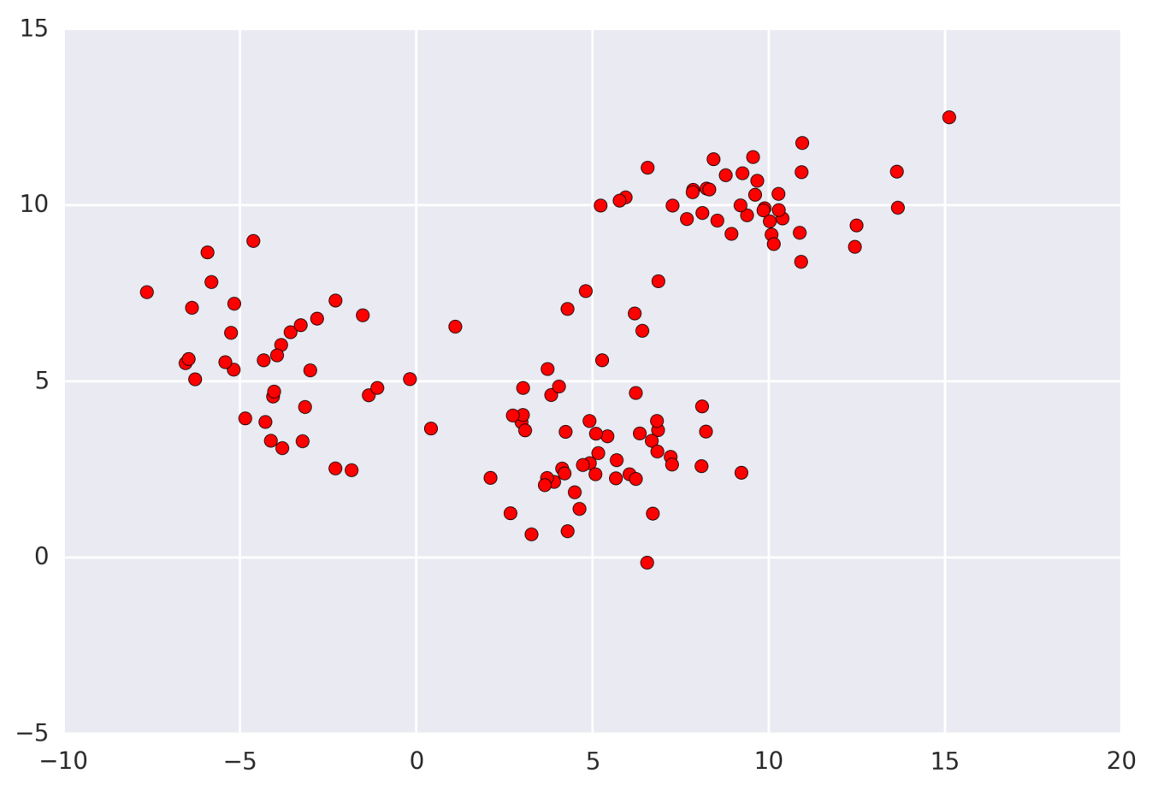
Clustering
Event density that occurs on different spatial scales.
Is there a characteristic scale?

Slide 5
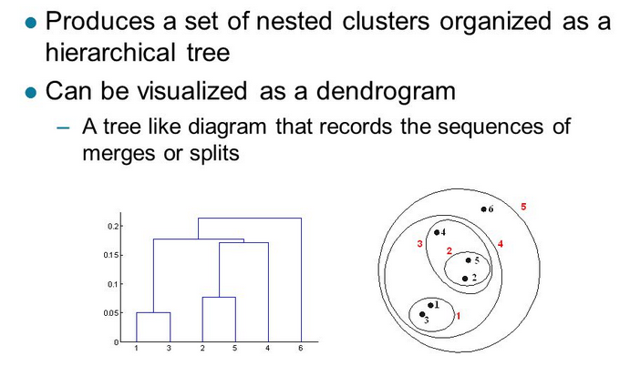
Often times clustering is hierarchical

Slide 6
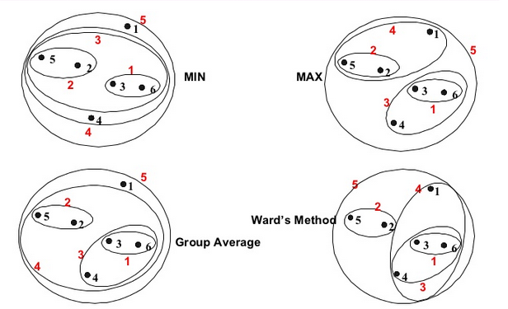
Algorithm dependent

Slide 7
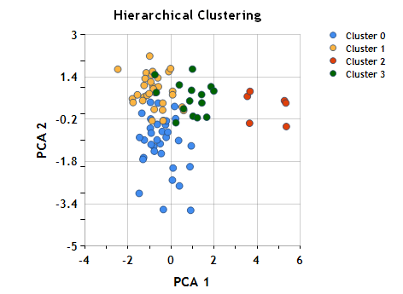
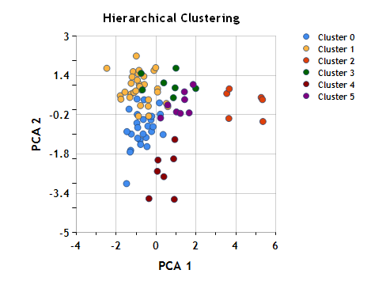
Hierarchical clustering and sub clusters

Slide 8
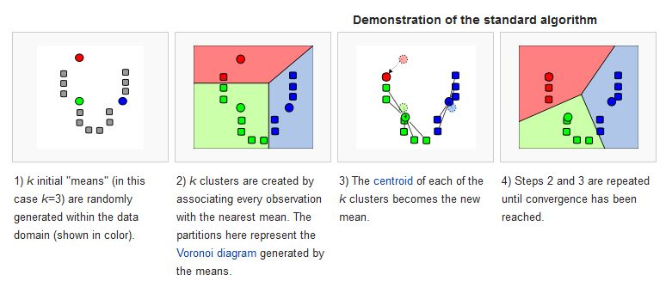
K-Means clustering (data mining)
Code Example
Game of Life Example

Slide 9
Keep track of the filaments with your eye

Slide 10
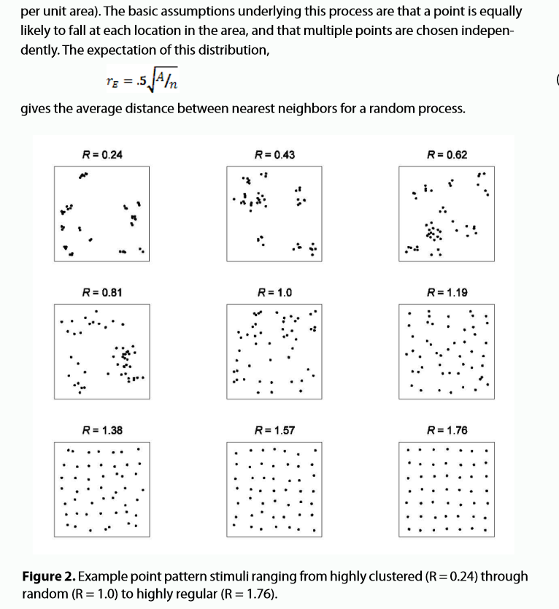

Slide 11
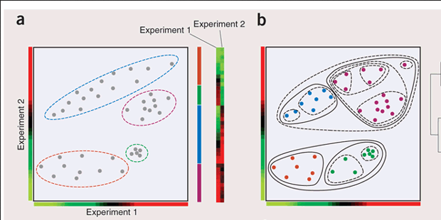
Sub-clustering – sub structure – expectation shapes …

Slide 12
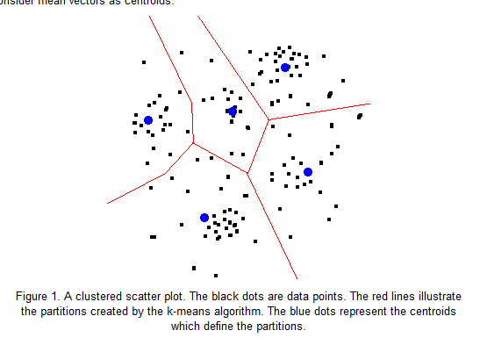
Centroid Approach
How do you find the centroid?

Slide 13
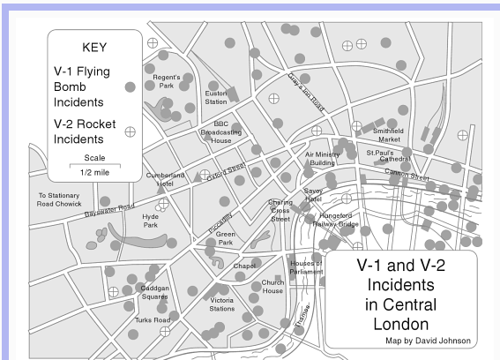
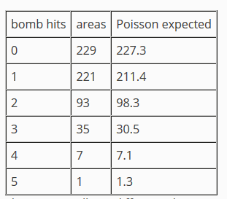
Grids and Poisson
Bombs Per Grid

Slide 14
Some Links
http://www.seas.upenn.edu/~ese502/NOTEBOOK/Part_I/3_Testing_Spatial_Randomness.pdf
http://www.colorado.edu/geography/class_homepages/geog_4023_s11/Lecture12_PointPat1.pdf
https://web.stanford.edu/class/cs345a/slides/12-clustering.pdf

