Slide 1

Homework 2 Responses and Issues
This was a good exercise in real data mining – while your were given a structured journey you can clearly see how you can interrogate data in open ended ways – a future exercise will involve you finding weather data across the country and find evidence for climate change in that data using any exploratory analysis that you like. This is a potentially publishable result.

Slide 2
The raw data is messy – can be handled with JSON tools but this is not necessary; You just want to sort, by any means necessary, this data to pull out the elevation number

Slide 3
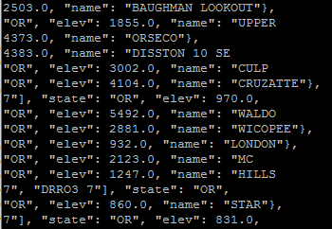
Unix Shell
The number of fields per line is not constant
Care about elevation which is always in field 12 or greater
awk ‘{print $12 FS $13 FS $14 FS $15 FS $ 16 FS }’ data.txt > new.txt
Now I have an easier file to work with; can test for presence of a number

Slide 4
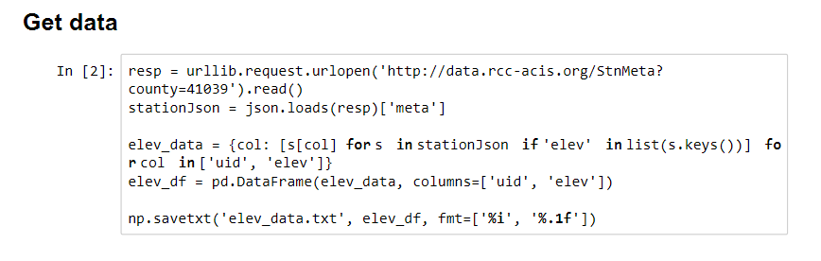
Using JSON Tools

Slide 5
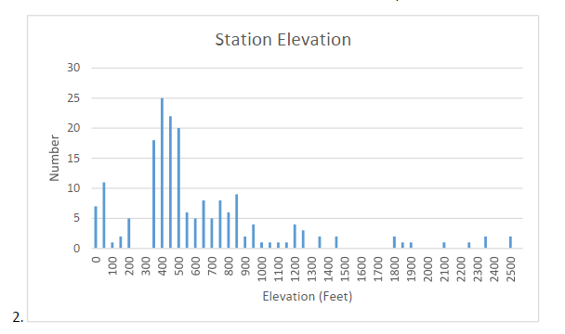
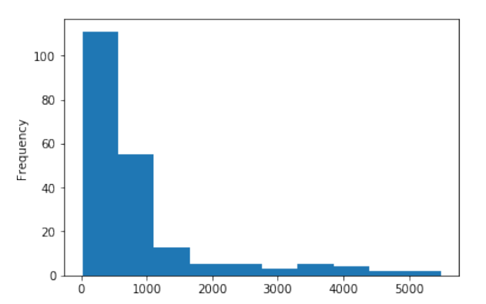
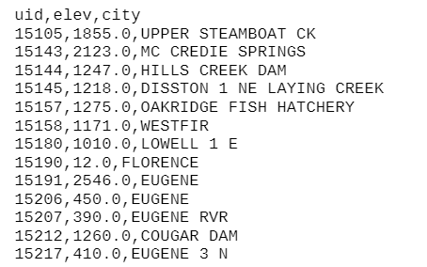
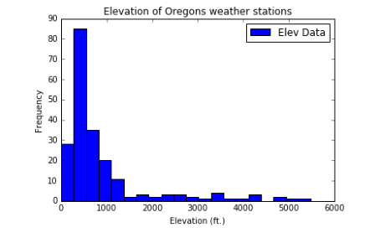

Slide 6
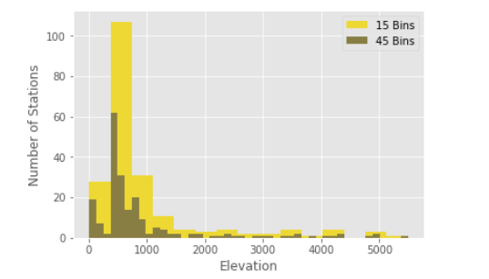
See Learning Occurs

Slide 7
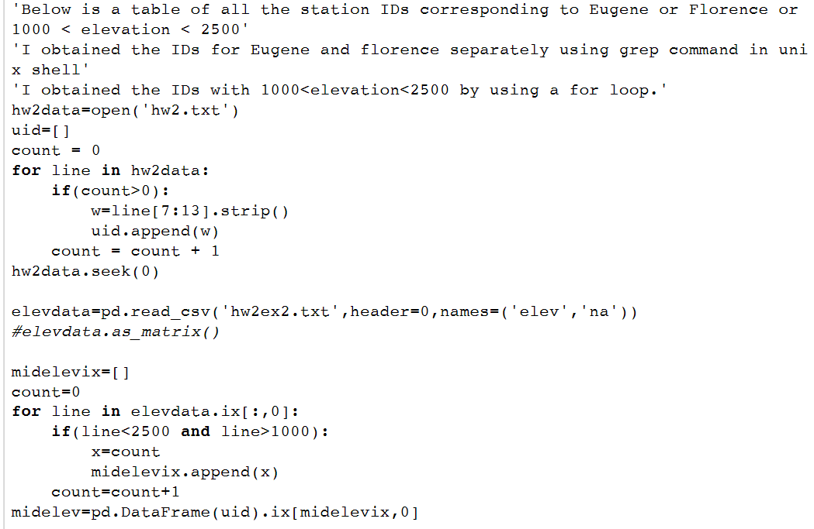
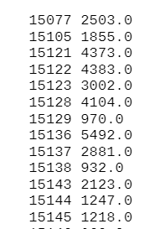

Slide 8


Interrogating the data – verification is important

Slide 9

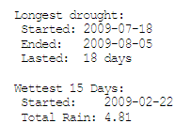
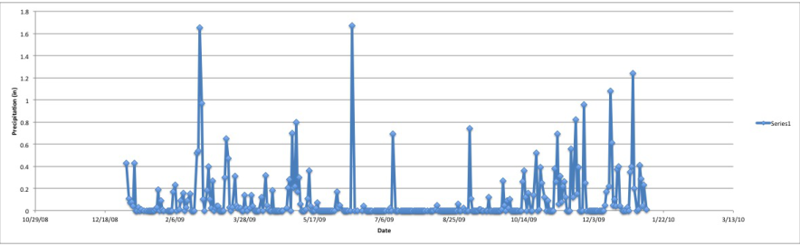
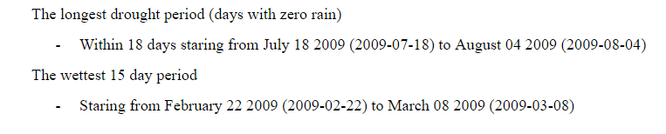
Do this visually!

Slide 10
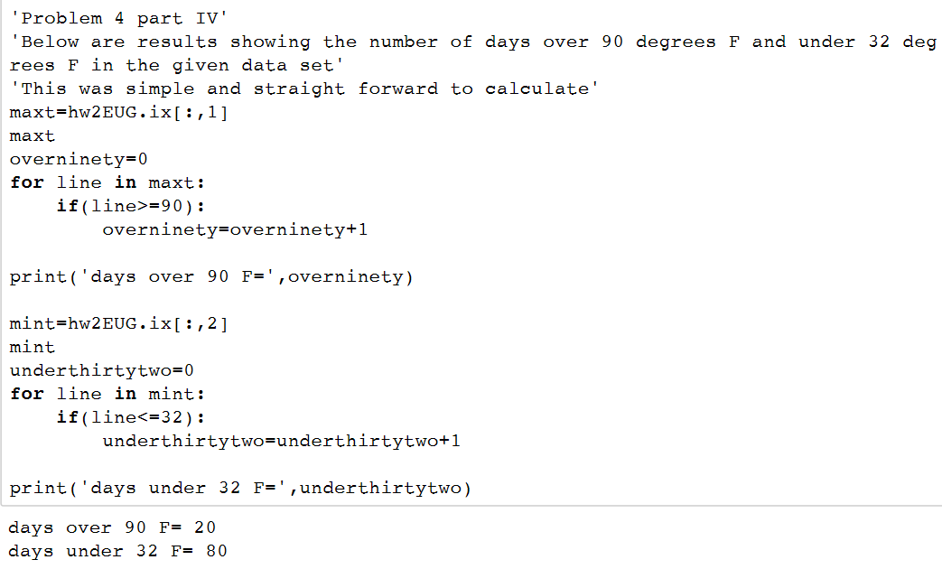


Slide 11
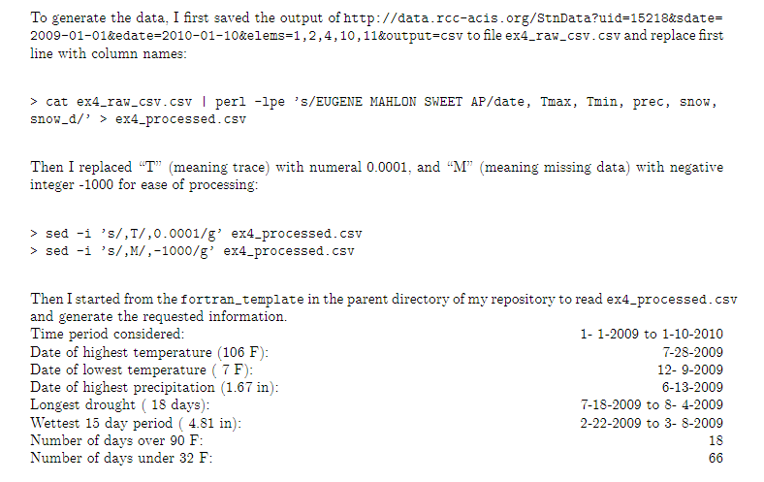
Interrogated with Fortran

Slide 12
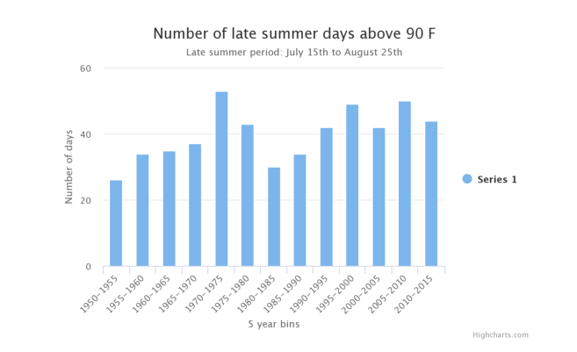
Is the one peak statistically significant?
Is increase since 1990 significant?
Without the peak average bin count = 36 +/- 6 Peak bin = 52 +/- 7.2
Sigma = (52-36)/sqrt(6*6 +7.2*7.2) = 16/9 = NO

Slide 13
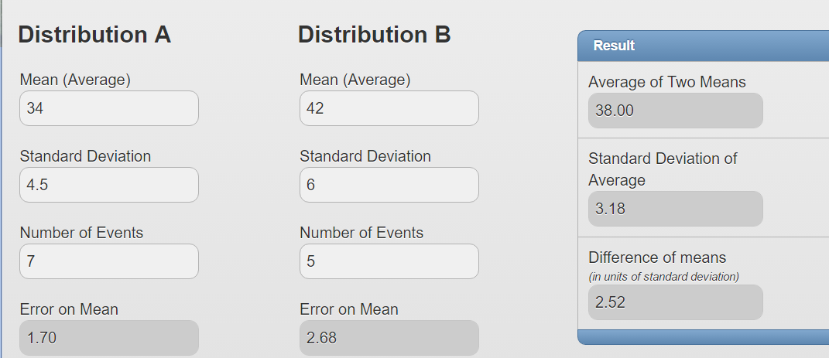
USE the Z-test
http://www.stat.yale.edu/Courses/1997-98/101/meancomp.htm

Slide 14
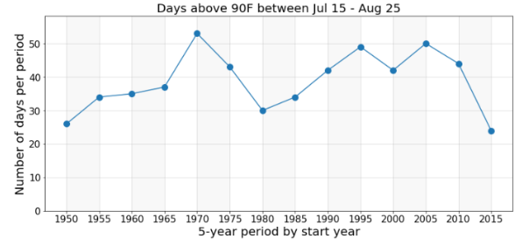
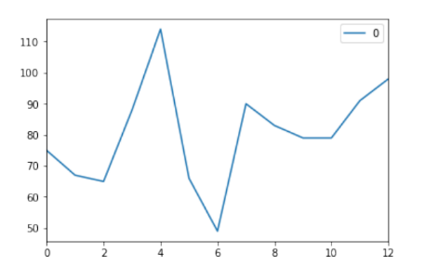
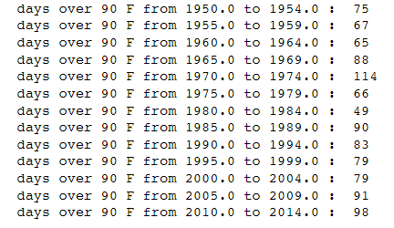
Maybe it’s a sine wave?
Reality check

Slide 15

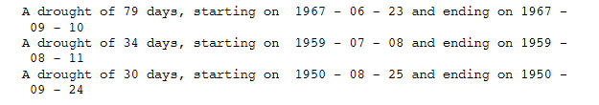
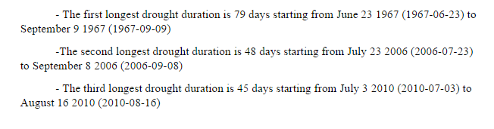
Droughts – much variance

Slide 16
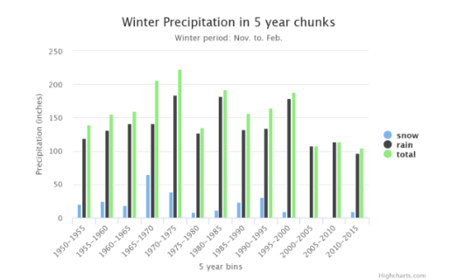
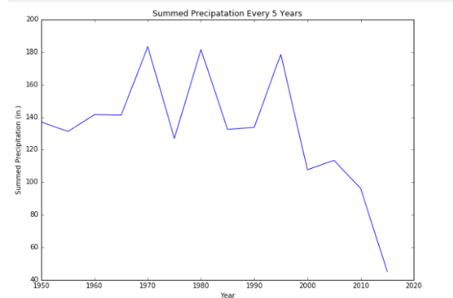
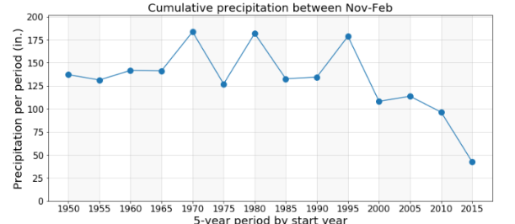
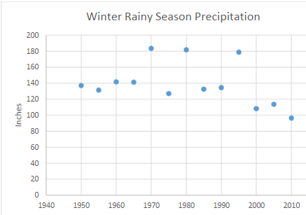
Cyclical or Systematic?
Z-test = 4.61 sigma!

Slide 17


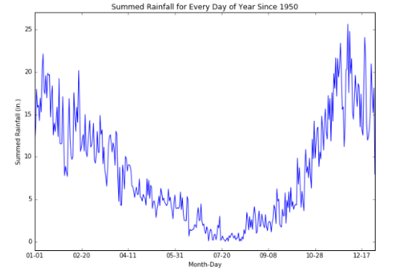

When to get married outside?

Slide 18
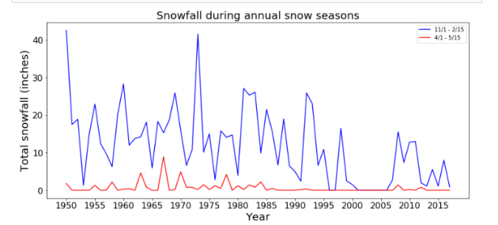
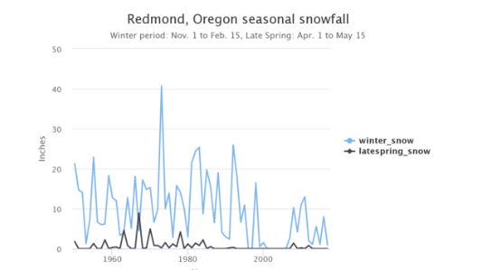
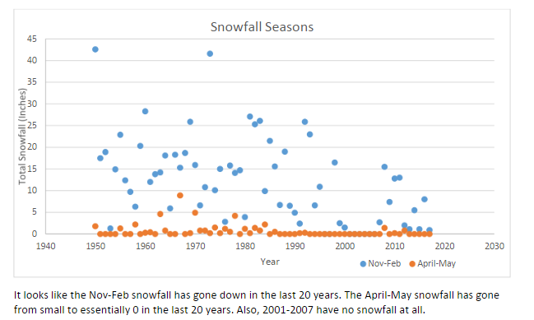
Science

Slide 19
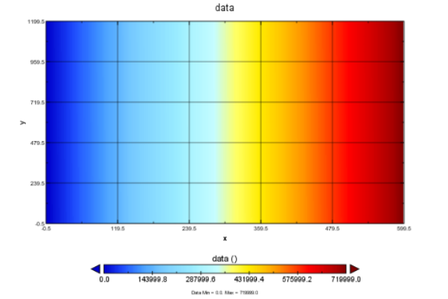
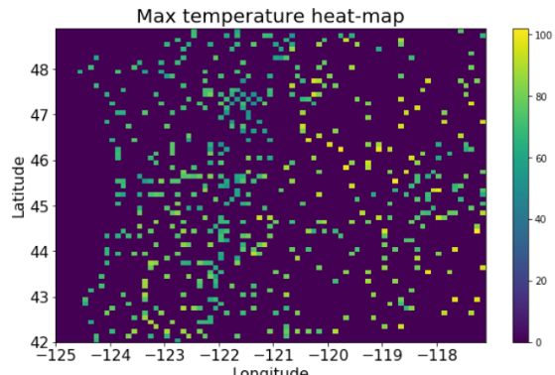
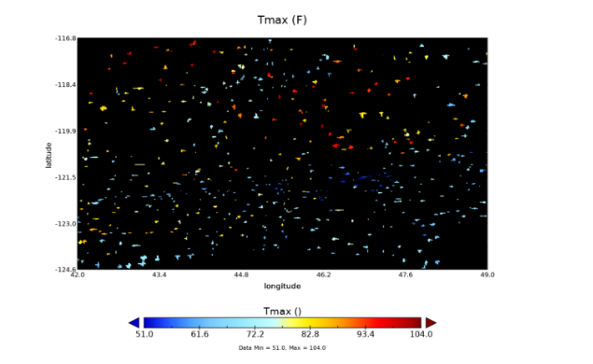
Panoply

