Slide 1

Homework 4a: Trend Forecasting and Future Uncertainties

Slide 2
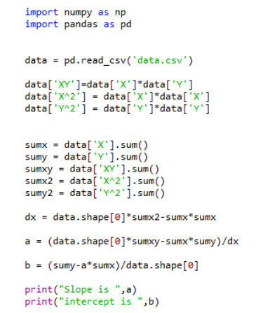
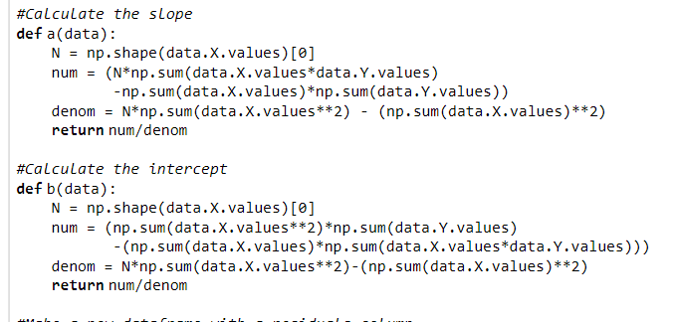
Least Squares Code

Slide 3
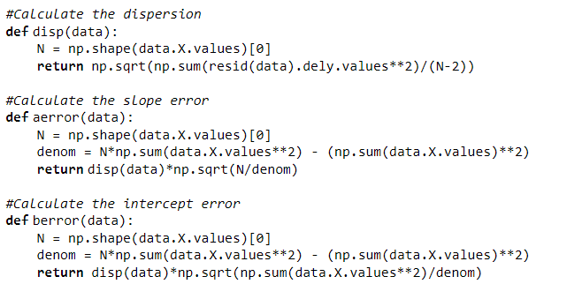

Slide 4

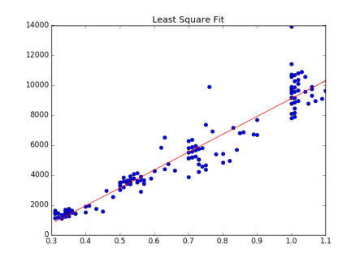
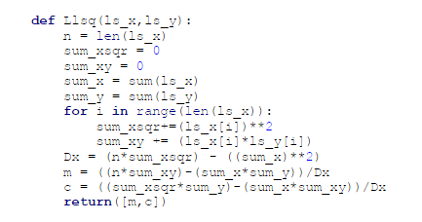
Not what as asked for – e.g. using libraries to do this task
Write your own CODE!

Slide 5
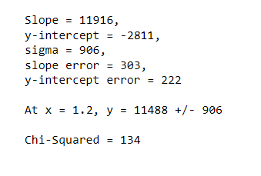
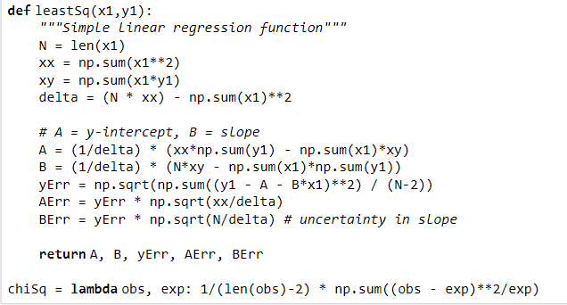

Errors in slope
Using just slope and intercept errors – the smaller values indicates that your scatter is too large – so deviant points exist

Slide 6
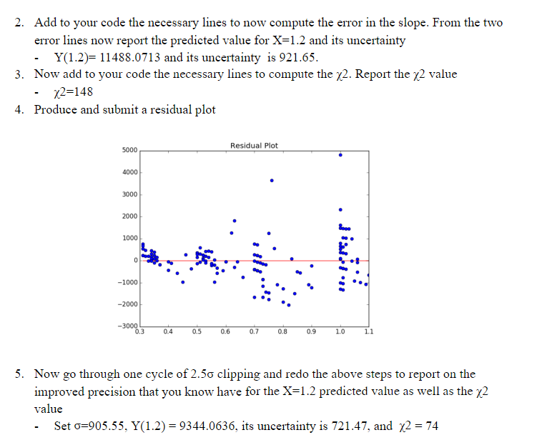

Make the Y-axis in units of Sigma!

Slide 7
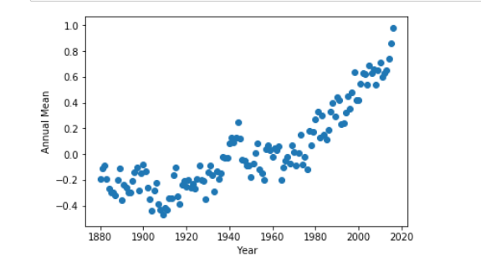
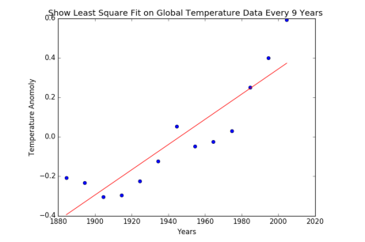
Data Scientist Hat on
So how do you weight data like this or should one consider all of the data equal?

Slide 8
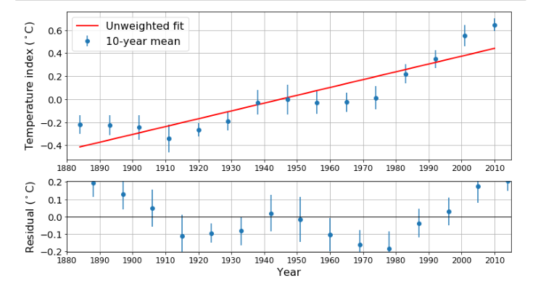
Residuals show systematic behavior

Slide 9
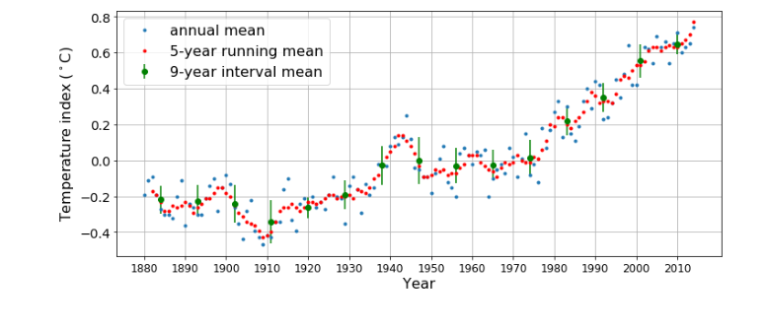
Table of Weights per averaged bin:
.084 .086 .105
.092 .113 .088
.113 .138 .084
.128 .102 .099
.060 .089 .058
There is a factor of 2 variation here so weighting by inverse square might matter
This output was not included in your reports so I have no idea of the weights you actually used

Slide 10
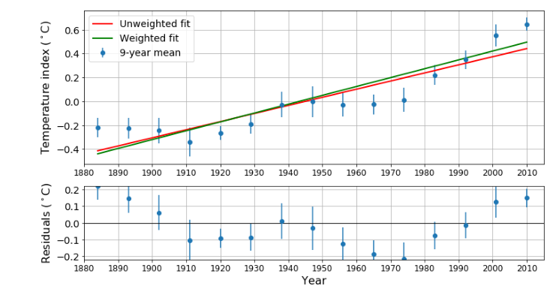
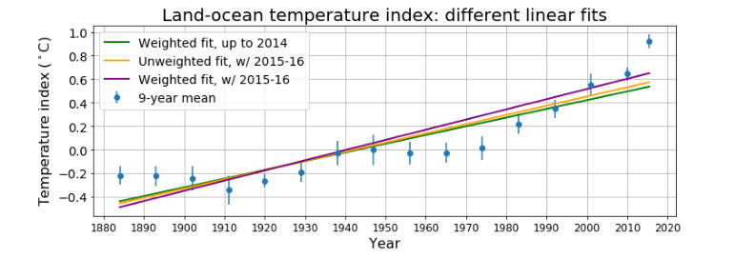
What is the policy implication here?

Slide 11
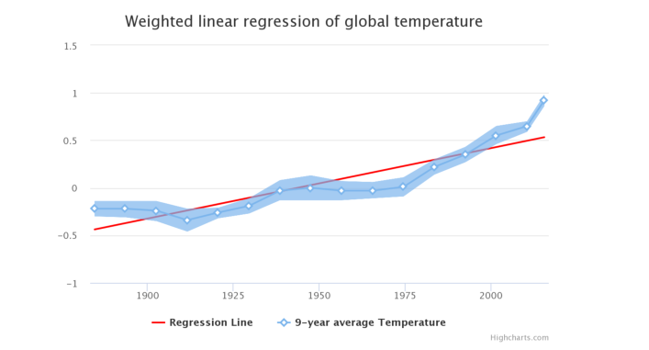

Slide 12
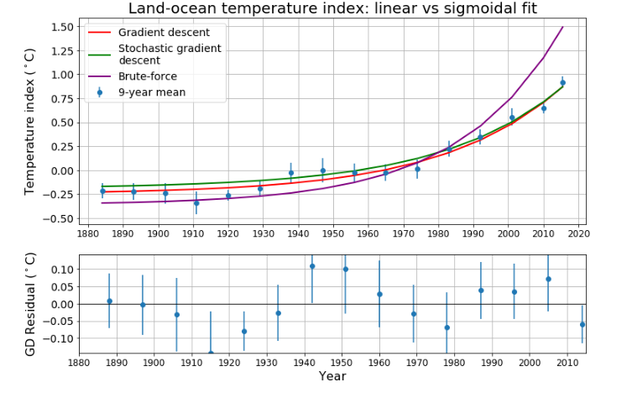
Non Linear attempts

Slide 13
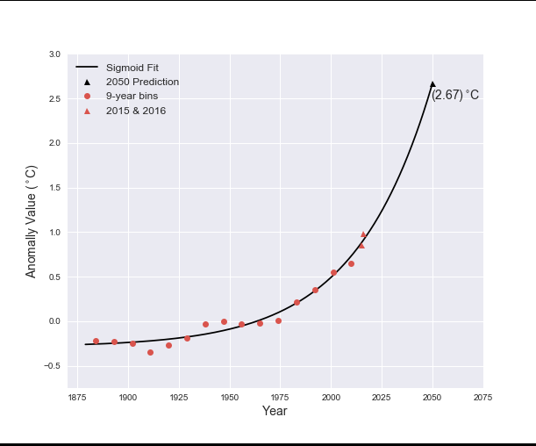
A policy result

