Slide 1
Weighted Least Squares Fit
Not all data points are every equally valid.

Slide 2
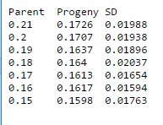
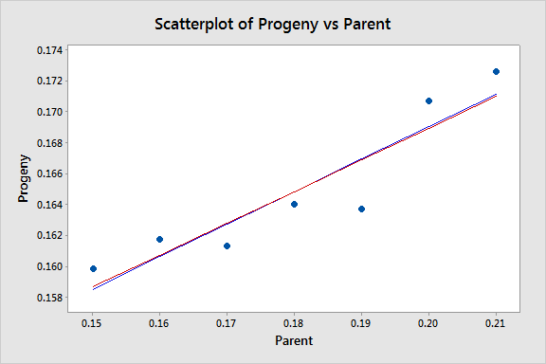
Weighting Methods – there are many, plus you can make up your own scheme – who says you can’t?
A standard way is to weight by the inverse square of the noise. Will not make much of a difference here because the noise around the average value of Y does not very much; we assume there is no noise in X

Slide 3
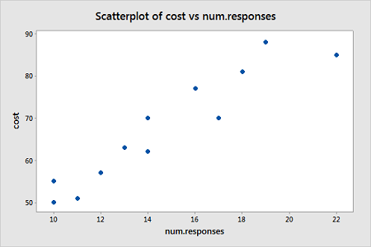
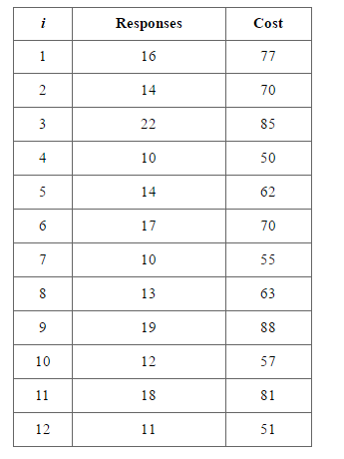
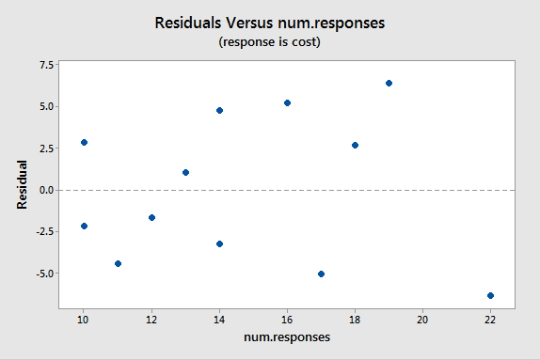
What do you notice here?
And always make a residual plot to see if the residuals correlate with anything

Slide 4
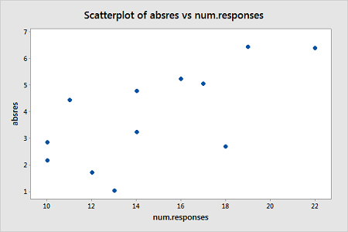
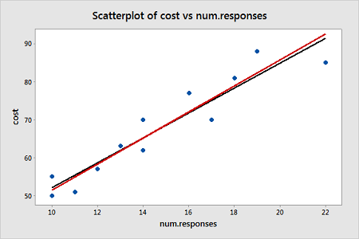
Weight by 1/Y^2

Slide 5
Guide to weighting
In general, there is a lot of statistical wordy crap out there that is not very helpful
A simple test to do with all data is to bin your data values in x over some constant bin range and compute the standard deviation per bin. If those values do not very much from bin to bin, then you probably can not weight the data. If those values do show variability then the overall scatter around your fitted line may well be driven by other things and therefore you should consider weighting (you can also make a residual plot and inspect for this kind of covariance)

Slide 6
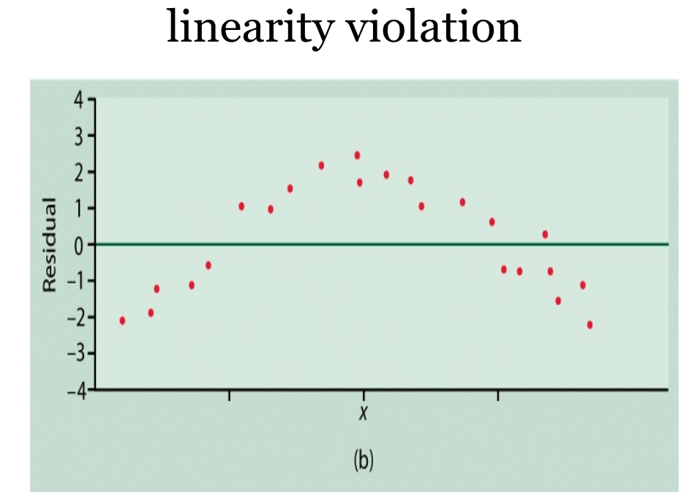
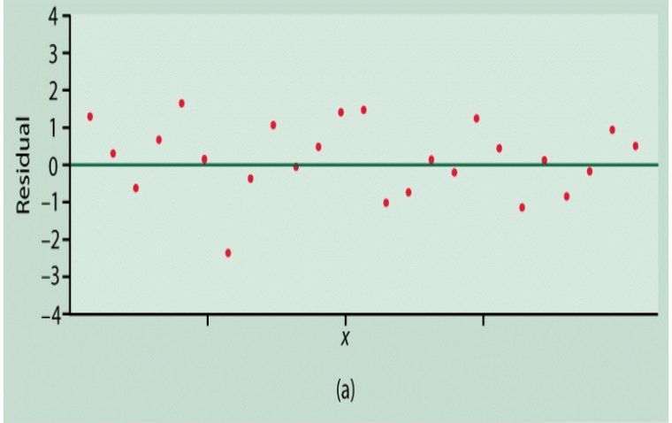
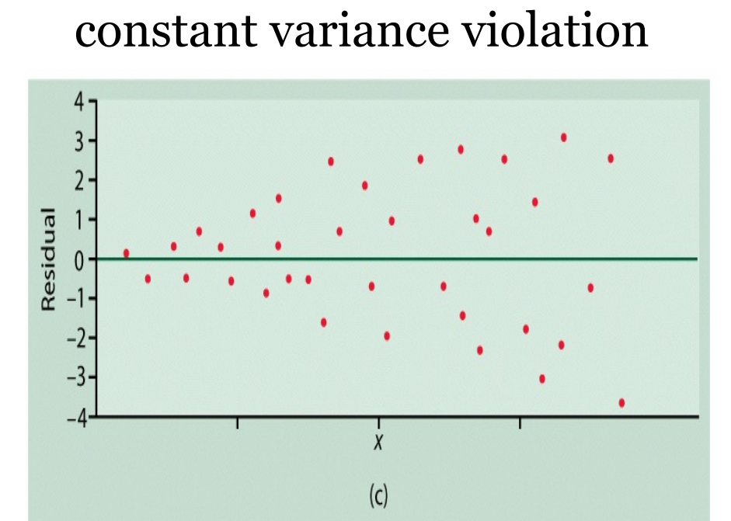
Residual Plots can tell you a great deal

Slide 7
More
Note that sigma clipping is a first order weighting
If you have reason to believe that your X-data has problems then you can weight by 1/X or 1/X^2. This is often true when X is a time variable – indeed I will give you global temperature data that I want you to weight in time
If your data point represents an average of multiple data sets then always weight by the inverse square of the noise

Slide 8
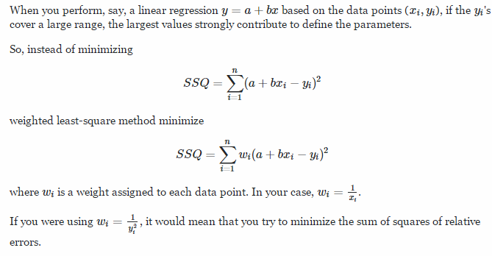
Ask Google how you do this?
This is normal regression – what values of a and b produce the lowest number?
This uses weights of some form

