Slide 1
1. Introduction
Topics in Data Science 2 (TDS2)

Slide 2
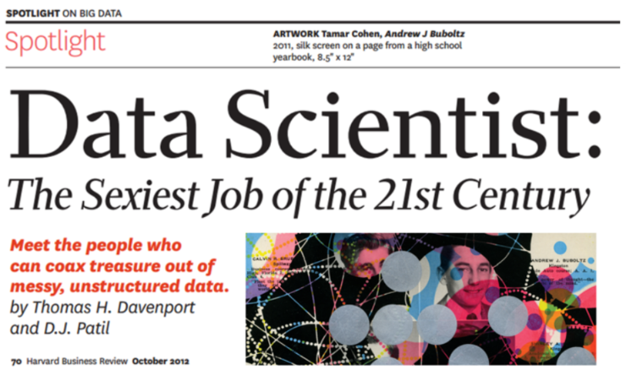
This course introduces data science tools, as well as advanced methodologies in an applied manner

Slide 3
Learning objectives for this course
The foundations, frameworks and applications of the emerging field of data science
Design, implement, and evaluate the core algorithms underlying an end-to-end data science workflow, including data import, analysis, and presentation of information
Leverage the Python application programming interface (API) ecosystem and data infrastructure that supports data acquisition, storage, retrieval and analysis
The application of a data-based analytical approach to identify and solve problems
Implementation and execution skills for data-driven business analytics

Slide 4
Course Schedule
Introduction, Jupyter Notebooks, Version Control (today)
Descriptive Analytics
Machine Learning Introduction
Feature Engineering
Deep Learning on Tabular Data
Deep Learning for Computer Vision
Deep Learning for Image Segmentation, Geocoding & Capstone Project
Data to Production
Deep Learning for Natural Language Processing
NLP with Huggingface
Guest lecture
Group Work on Capstone Project
Final presentations (End of semester)
Oct – Dec
Jan & Feb

Slide 5
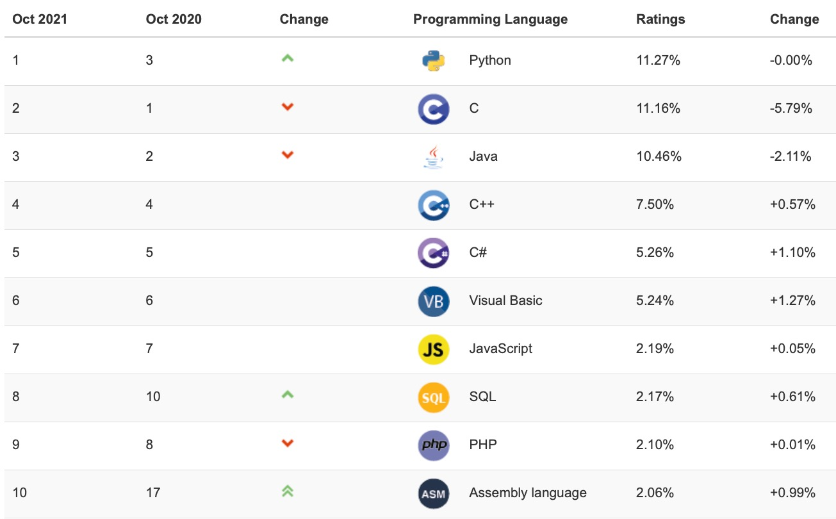
Why Python?

Slide 6
The course relates to several other courses of the D3 teaching program
Spreadsheet Modelling
Managerial Problem Solving
Business Intelligence
Enterprise AI
Topics in Data Science 2
Tools
Programming & System Design
Programmieren für WiWis
Advanced Web Engineering
Mobile & Ubiquitous Business
E-Business Strategies
Digital Business
E-Business
IT-Management
Enterprise Information System
Data Driven Decisions in Practice
Applications
Vorstände berich-ten aus der Praxis
Smart Cities & Spatial Analytics
Strategic Mgmt of Glob Supply Chains
Adv. Operations & Logistics Mgmt
Global Logistics & Supply Chain Mgmt
Logistics
Planen und Entscheiden
Simulation
for Decision Making
Managerial Analytics & Decision Making
Decision Support Systems
Theory & methods
Optimization
Datenmanagement und -analyse
Primer in Data Science
Analytical Information Systems
Data Science in Economics and Business
Data Analytics
Bachelor
Master

Slide 7
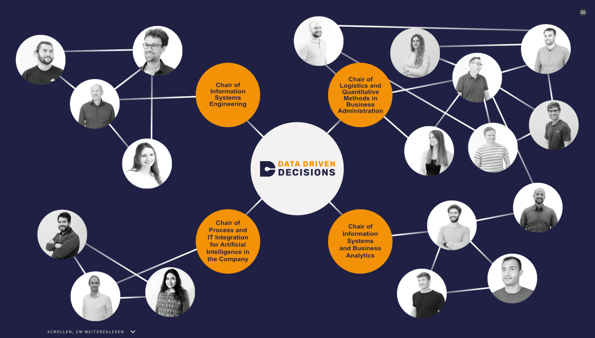
D3 Group

Slide 8


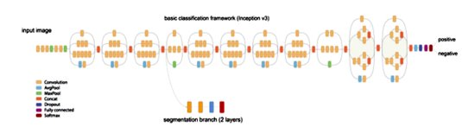

Our research: Deep Learning to Segment Photovoltaic Arrays
Deep Solar
Objectives
Detect solar PV systems based on areal images
Geocode the PV systems and estimate their size​
Results
First exhaustive data set containing the geolocation of PV systems for large regions of Germany
The data set serves as the basis for further analyses about the adoption of PV systems
In a follow-up project we plan to combine the PV data set with 3D city models​

Slide 9
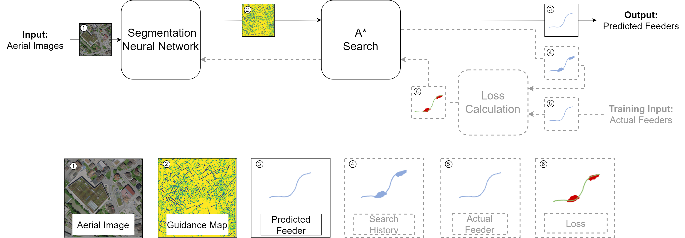
Our research: FEEDAIR --- Planning Electricity Networks using Aerial Images & Deep Learning

Slide 10
Ways to work with us
Hiwi jobs (Bachelor‘s and Master‘s level)
Women are particularly encouraged to apply (see also Women@WIWI program)
Seminar thesis
Bachelor seminar
Master seminar
Project seminar
Bachelor‘s thesis
Master‘s thesis
Scholarships available
Doctorate
Applications are accepted on an on-going basis

Slide 11
Course Organization
Lecture
Mondays 14:00 – 16:00
Theoretical foundations
Implementation examples using Python
Exercise
Directly after lecture: 16:00 – 18:00
Weekly assignments to be solved on your own
Published After Lecture
1.5 weeks later
Complete 4 out of 5 assignments to be eligible for final project
Bonus (0,3 bonus for the exam)
Complete 5 out of 5 assignments
Participate in the WueCampus forum (or Discord) within the first 4 weeks of the course
Final project
Work on a real-world problem set
Groups of 3 students

