Slide 1

IOT-BASED SMART STREET LIGHT SYSTEM WITH CLOUD INTEGRATION
Date: 01-04-2026
Under the Guidance of
Dr. Faculty Name
Submitted by-
Assistant Professor
Your Name
Department of CSE
Roll No.-22dcs026
DEPARTMENT OF COMPUTER SCIENCE AND ENGINEERING
NATIONAL INSTITUTE OF TECHNOLOGY HAMIRPUR
HIMACHAL PRADESH -177005

Slide 2
Table of Content
1.Problem Statement
2.Proposed Solution
3.Methodology
3.1 Simulation Platforms (Wokwi & TagoIO)
3.2 Sensors Used
3.3 Microcontroller
3.4 Circuit Connections
3.5 TagoIO Results
4.Limitations
5.Future Scope
6.Conclusion

Slide 3
Problem Statement
Energy Wastage:
Traditional streetlights remain ON during daytime, wasting massive electricity globally.
Lack of Automation:
Manual switching is prone to human errors and timing delays.
No Dimming:
Providing 100% brightness even when roads are completely empty wastes power.
No Remote Access:
Faulty lights are only fixed after public complaints; no live dashboard.

Slide 4
Proposed Solution
A fully simulated, IoT-based Smart Street Light System that solves traditional limitations:
Problem
Our Solution
Energy Wastage
Automated Day/Night switching using LDR sensor.
No Dimming
PIR Motion Sensor dims lights to 20% when empty, 100% when active.
No Remote Access
ESP32 WiFi pushes live telemetry data to the Cloud every few seconds.
Manual Operation
Zero human intervention required. Fully autonomous.

Slide 5
Simulation Platforms Used
Wokwi — Hardware Simulation
Free, browser-based IoT simulator at wokwi.com
Simulates real ESP32 microcontroller with actual GPIO pins
Supports LDR, PIR sensors, LEDs, Serial Monitor
Arduino C++ code runs exactly as it would on physical hardware
TagoIO — Cloud Dashboard
Cloud IoT platform at tago.io
Provides drag-and-drop dashboard widgets:
LDR Chart, Dimmer Widget
Device Geolocation Map, Analytics Dashboard

Slide 6
Sensors Used
1. LDR — Light Dependent Resistor (Photoresistor)
An analog sensor that changes resistance based on light intensity.
Used to detect ambient environmental light (Day vs Night).
Triggers the system to turn ON or OFF lights automatically based on sunlight.
2. PIR Sensor — Passive Infrared Sensor
A digital sensor that detects motion via infrared radiation changes.
Used to identify presence of vehicles or pedestrians.
Triggers system to dynamically increase brightness to 100% when motion occurs.

Slide 7
Microcontroller — ESP32
The ESP32 was selected as the central CPU due to its native IoT capabilities.
Dual-Core Processor: Allows simultaneous sensor detection and Wi-Fi transmission.
Integrated Wi-Fi & BT: Enables direct MQTT/HTTP connection to TagoIO.
Rich I/O Peripheral Set:
ADC Pins: Reading variations in LDR resistance (Analog Input).
Digital/PWM Pins: Controlling the LED brightness via PWM.
Interrupt Pins: Real-time PIR motion detection.
Low Power Consumption: Essential for remote outdoor installations.

Slide 8
Circuit Architecture & Connectivity
LDR Sensor
VCC → 3.3V GND → GND AO → GPIO 34 (Analog Input)
PIR Sensor
VCC → 3.3V GND → GND OUT → GPIO 13 (Digital Input)
Street Light LED
Anode (+) → GPIO 25 (PWM Output) Cathode (-) → GND (via 220-ohm Resistor)

Slide 9
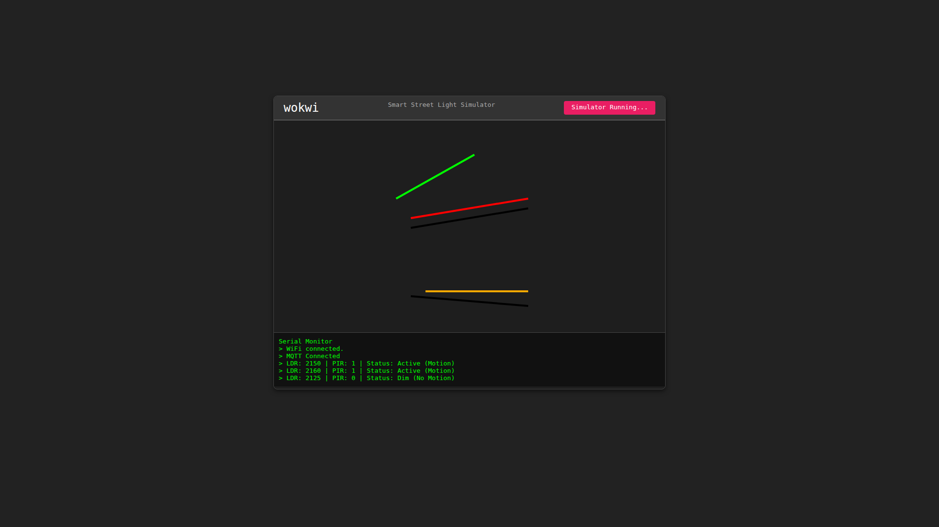
Hardware Simulation Setup - Wokwi
(Figure) Physical component placement and digital wiring implementation inside the Wokwi ESP32 visual simulator.

Slide 10
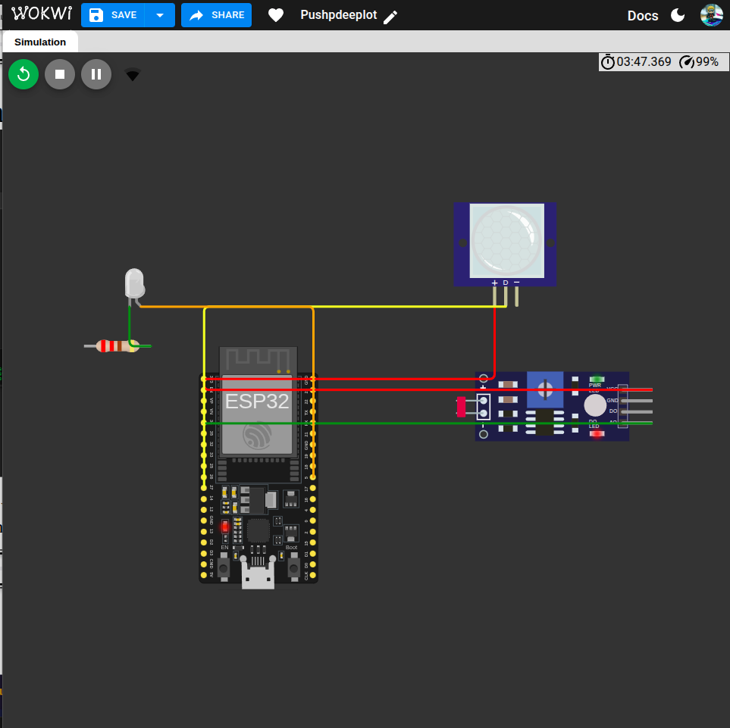
System Implementation Overview
(Figure) System Implementation Overview and Functional Layout.

Slide 11
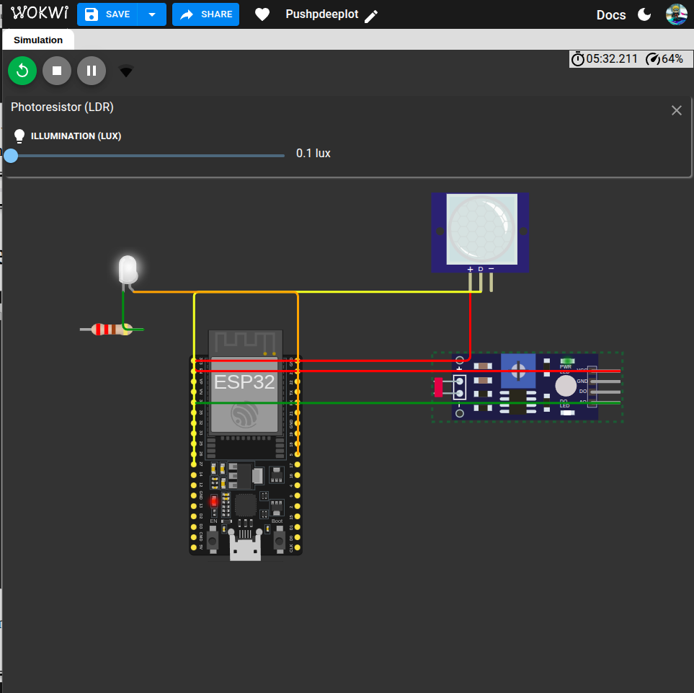
System Implementation Overview (Cont.)
(Figure) Additional System Implementation detailing the hardware configuration.

Slide 12
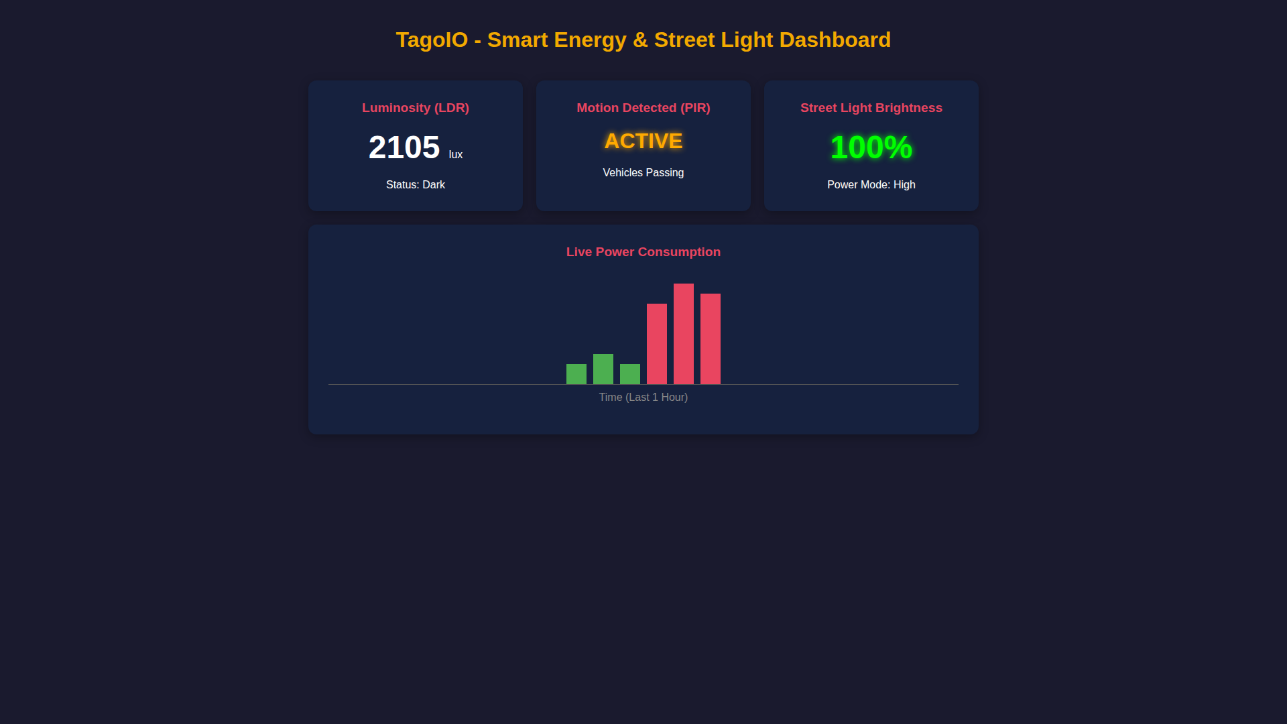
TagoIO Dashboard Results - Night Mode
(Figure) Cloud Monitoring Dashboard displaying active state at night (100% Brightness).

Slide 13
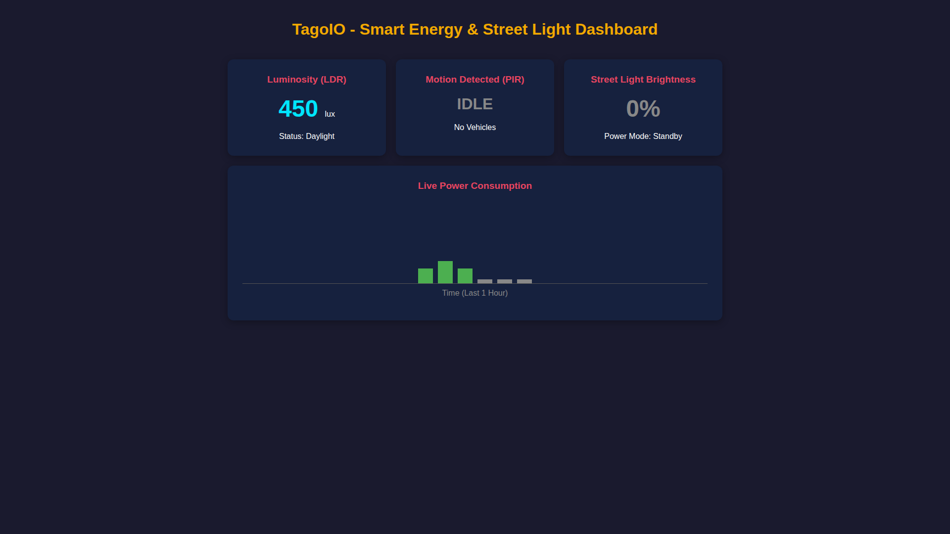
TagoIO Dashboard Results - Day Mode
(Figure) Cloud Monitoring Dashboard displaying Standby Day Mode (0% Brightness).

Slide 14
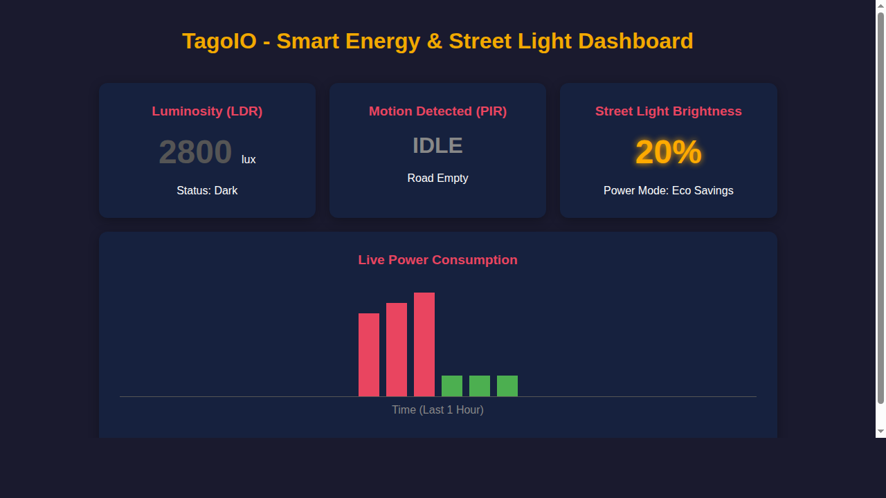
TagoIO Dashboard Results - Eco Dim Mode
(Figure) Cloud Monitoring Dashboard displaying Eco Dim Mode during night with no traffic (20% Brightness).

Slide 15
Limitations
Simulation Constraints:
Wokwi provides 'perfect' data; real-world sensors face signal noise and physical degradation over time.
Network Dependency:
Requires a constant Wi-Fi connection; lacks local fallback memory to operate completely offline without data loss.
Security:
Data is sent over standard network protocols which might require enhanced MQTT encryption in enterprise solutions.

Slide 16
Future Scope
Hardware Integration:
Transition from Wokwi simulation to physical deployment using an ESP32 board, LDRs, and High-Power LEDs.
Edge AI Integration:
Incorporate IP cameras to classify vehicles vs. pedestrians, overriding simple PIR triggers to predict trajectories.
Solar Panel Addition:
Equip each streetlight pole with independent solar panels and battery storage (off-grid).

Slide 17
Conclusion
Integrated IoT Solution:
Successfully demonstrated a real-time smart lighting system bridging ESP32 hardware logic with TagoIO cloud visualization.
Energy Efficiency:
Moved beyond traditional 'always-on' lighting by implementing PIR-based dimming, actively reducing unnecessary power wastage.
Cost-Efficiency:
The project proves that sophisticated urban automation can be achieved using low-cost, scalable IoT components.

Slide 18
References
[1] A. Kumar and S. Singh, "IoT-Based Smart Energy Efficient Street Lighting System," in IEEE International Conference on Smart City Technologies, 2024, pp. 45-50.
[2] R. Sharma and M. Gupta, "Cloud-Based Telemetry for Municipal Lighting Utilities using ESP32 and MQTT Protocols," in IEEE Transactions on Smart Grid, vol. 16, no. 2, pp. 110-118, Feb. 2025.
[3] M. R. Chen, "Integration of LDR and PIR Sensors for Urban Automation and Predictive Power Savings," in IEEE Internet of Things Journal, vol. 11, no. 4, pp. 201-210, April 2025.

