Slide 1
KALPA HEALTH · BOARD BRIEF
H1 growth missed plan,
and two cities declined in Q2
Investigate why booked tests grew 5.01% in H1 2026 versus an 18% plan. Next: validate the Chennai and Jaipur patient decline.

Slide 2
THE BOARD DECISION
Focus on patient recovery; validate causes before scaling spend
GROWTH
CITIES
MEASUREMENT
+5.01%
−7.6% · −10.7%
The count gap is partial
H1 booked tests rose from 435,008 to 456,788, versus an 18% plan.
Adjusted Q2 bookings fell in Chennai and Jaipur; four Legacy cities grew 2.1%.
Comparable counts still show declines in both cities; the four-city peer group grew.
Proceed with a targeted 30-day review; scale only after city drivers and pilot economics are clear.
02

Slide 3
BOARD RESPONSE
Turn evidence into a focused 30-day city plan
01
02
03
04
05
Start with the city scorecard
Track patients, visits and tests
Prioritize Chennai, Bengaluru and Jaipur
Diagnose acquisition and retention gaps
Build costed city pilots with clear measures
30-day plan. Validate patient decline, locate drop-off, return with costed pilots and owners; no broad spend yet.
03

Slide 4
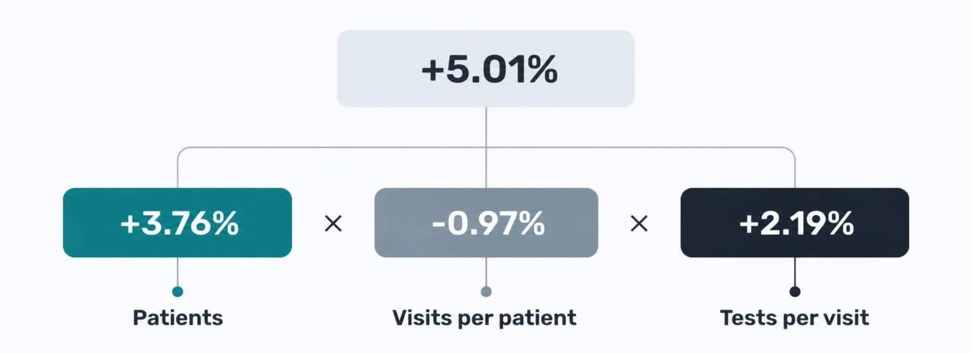
H1 GROWTH DECOMPOSITION
Patient gains led; lower visit frequency partly offset growth
The factors combine multiplicatively; do not multiply the percentage changes directly.
04

Slide 5
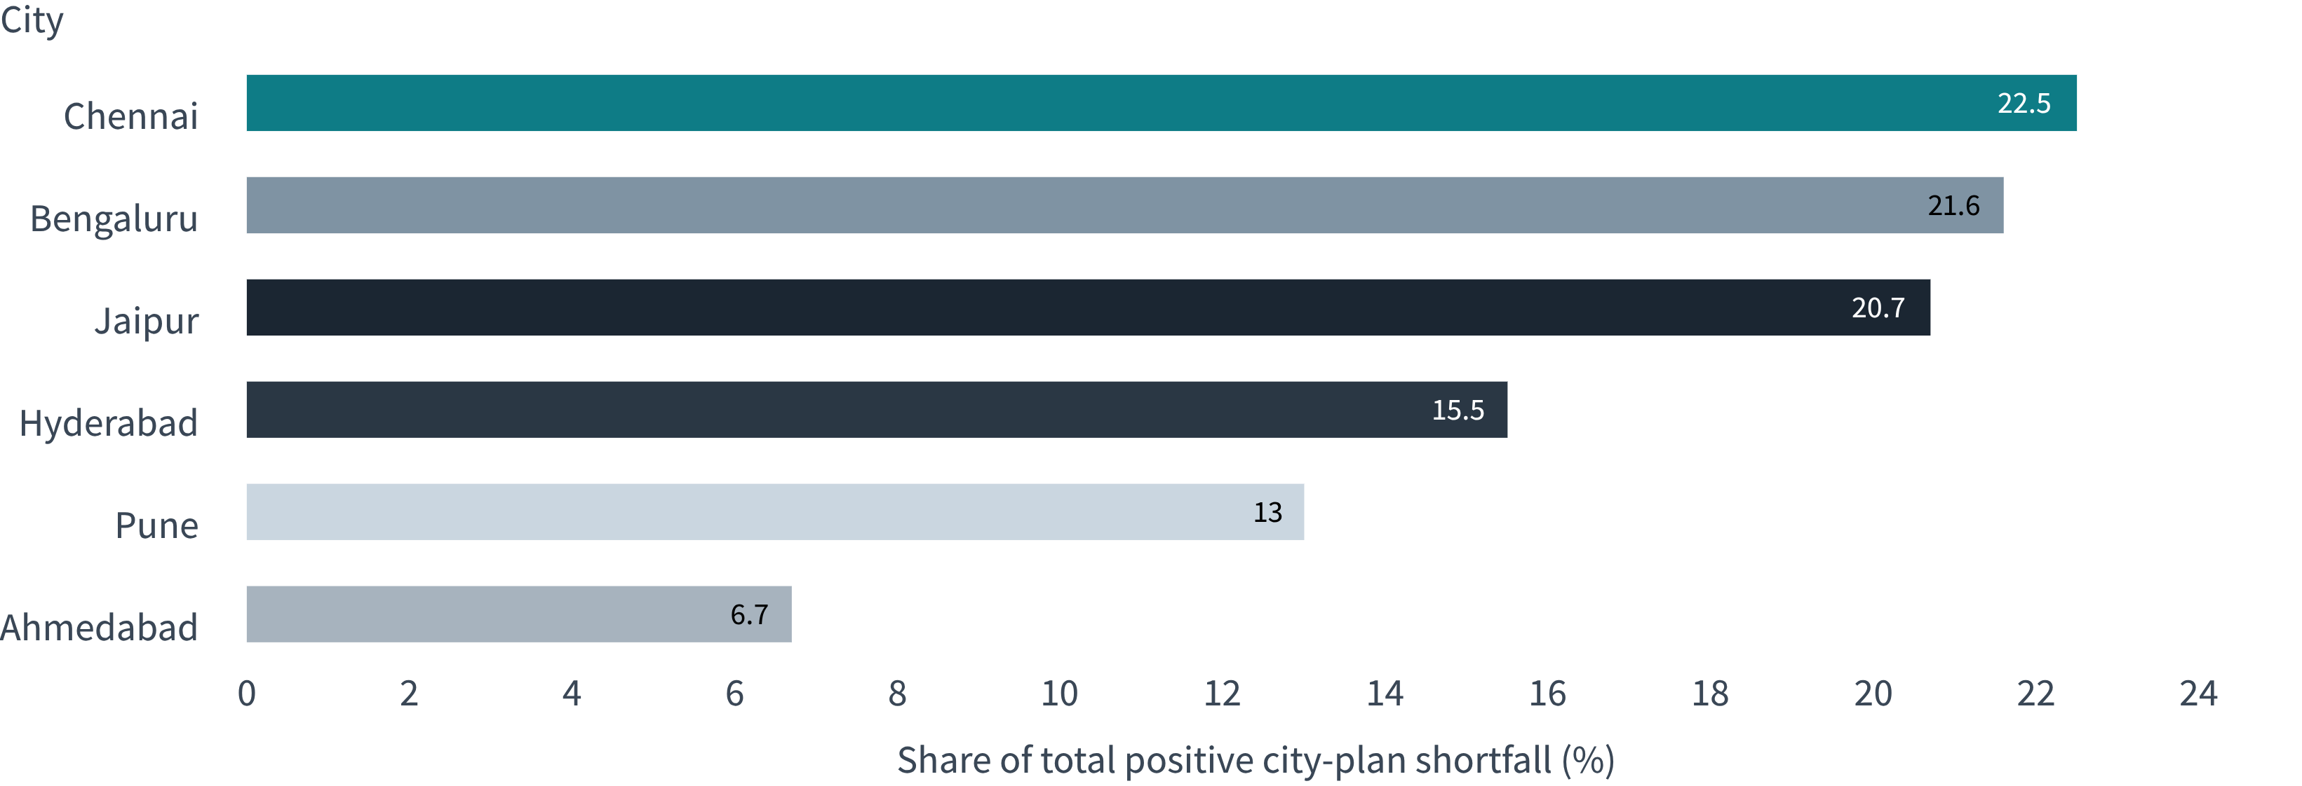
PLAN SHORTFALL · H1 2026
Start city diagnosis where the plan gap is largest
Chennai, Bengaluru, and Jaipur contribute 64.8% combined. All six cities were below their H1 2026 plans.
05

Slide 6
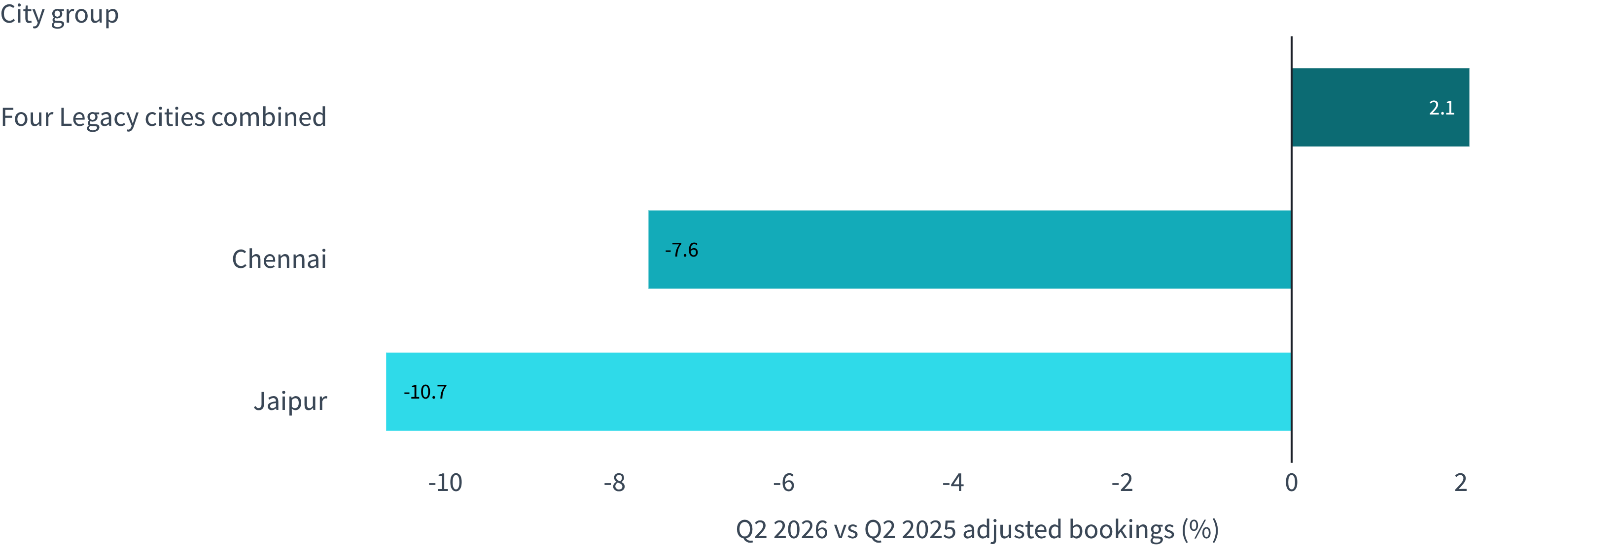
CITY COMPARISON · ADJUSTED BOOKINGS
Chennai and Jaipur fell while Legacy peers grew
Q2 2025 → Q2 2026. Chennai: 17,444 → 16,116; Jaipur: 9,136 → 8,161.
06

Slide 7
COUNT RECONCILIATION
Reconciliation changes the size of the dip, not direction
City | Q2 2025 baseline | Reported Q2 2026 | Count variance | Comparable Q2 2026 | Raw → adjusted change
Chennai | 17,444 | 17,086 | 970 | 16,116 | −2.1% → −7.6%
Jaipur | 9,136 | 8,655 | 494 | 8,161 | −5.3% → −10.7%
Reconciled counts remain below Q2 2025: Chennai −7.6%, Jaipur −10.7%; Legacy peers +2.1%.
07

Slide 8
PATIENT VOLUME IS THE LEAD SIGNAL
Patient losses lead; local causes still need diagnosis
ACTIVITY SPLIT
Chennai
Jaipur’s decline was visible before the April 2026 system move. The transition cannot be the sole explanation.
Patients −8.3%
Visits per patient +0.8%
Tests per visit +2.8%
Management read-through: patient counts fell while per-patient activity was flat or higher. Start with acquisition and retention diagnostics, not a blanket repeat-frequency fix.
Jaipur
Patients −10.7%
Visits per patient about 0.0%
Tests per visit +2.4%
08

Slide 9
RECOMMENDED BOARD ACTION
Start with a 30-day review,
then develop costed city pilots
01
02
03
04
Approve a 30-day patient review in Chennai and Jaipur.
Reconcile city dashboards to one agreed visit definition.
Separate new-patient loss from repeat-patient drop-off.
Return with costed city pilots after confirming local drivers.
The analysis locates the signal, not its cause. Jaipur declined before Nova. Costs are unestimated; avoid broad spend until pilots are defined.

